Slide 1

Ghislain Fourny
Big Data For Engineers Exercises
0. Introduction (Azure, Jupyter, Moodle)
0
Notes:
<Foliennummer>

Slide 2
Exercise Format
Week Nr. X
Lecture on X on Tuesday
Exercises on Wednesday & Friday
Introduce exercise sheet for X-1
Get started with new technology
Discuss tips for exercises
Discuss solution of exercise sheet for X-2
At home
Solve the rest of exercises for X-1
Read up on topics for X
Notes:
<Foliennummer>

Slide 3
Graded exercises
Up to 0.25 improvement of the exam grade
Roughly 2 bonus questions à 0.01 per week
Answer them on moodle
Published at the same time as exercise sheets
Deadline on Tuesday night one week later
Notes:
<Foliennummer>

Slide 4
Plan for this week:
Get Started with Azure, Jupyter, and Moodle
Moodle (for graded exercises):
https://moodle-app2.let.ethz.ch/enrol/index.php?id=12414
Online class room on Azure (with cloud credit):
Enroll under https://aka.ms/JoinEdu, enter the code from moodle
Access the course under https://aka.ms/startedu
Microsoft’s notebook server:
https://notebooks.azure.com/
Try to do it alone, come to the exercise for help
There will be one slot on Friday (check web site)
Notes:
<Foliennummer>

Slide 5
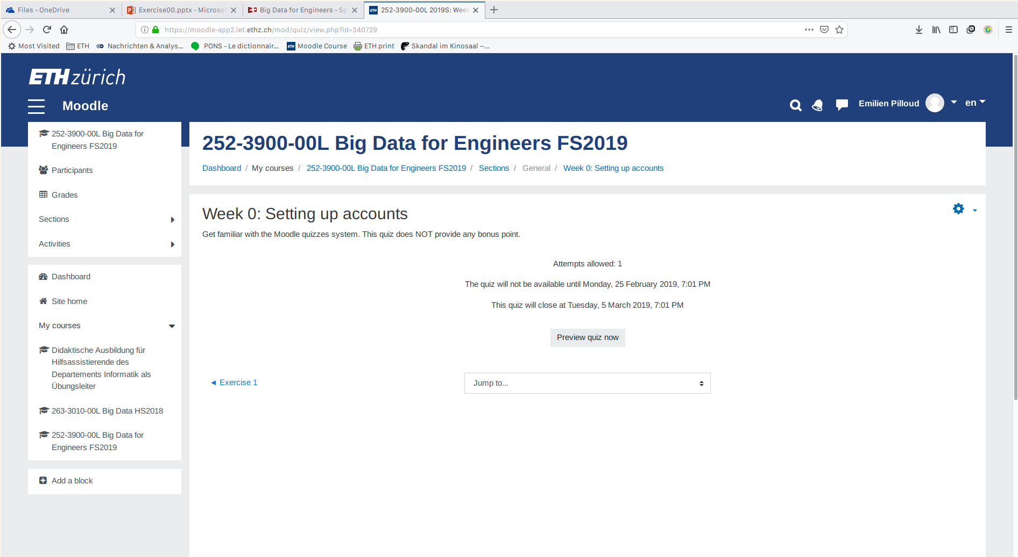
Online class room on Azure
Take the first test to get familiar with moodle.

Slide 6
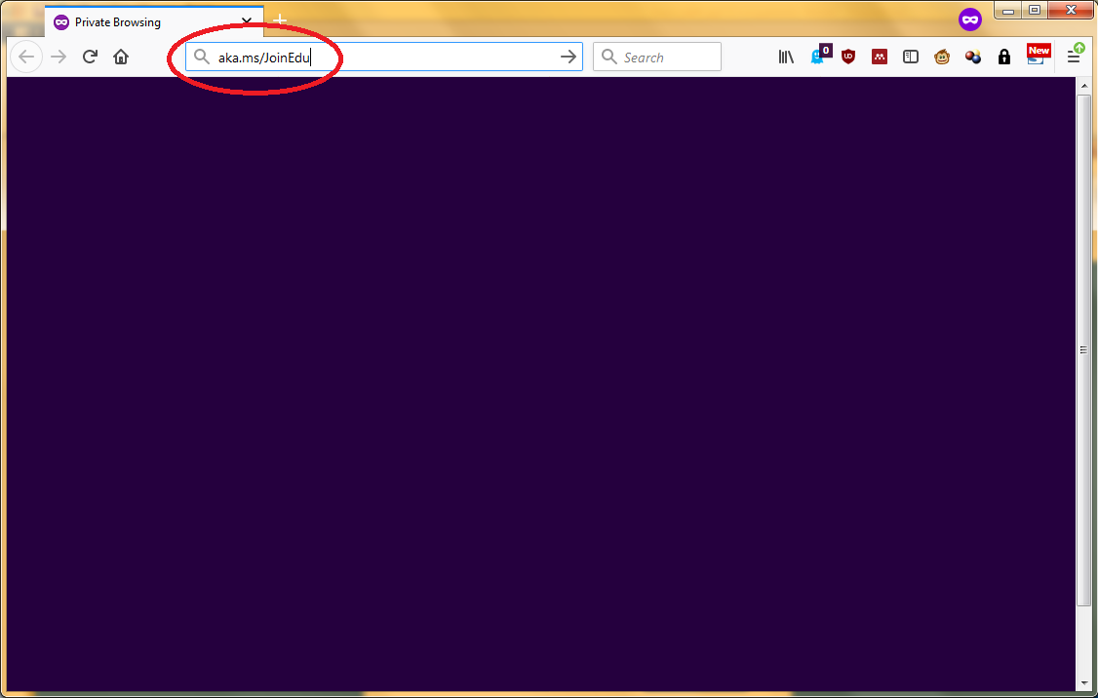
Online class room on Azure

Slide 7
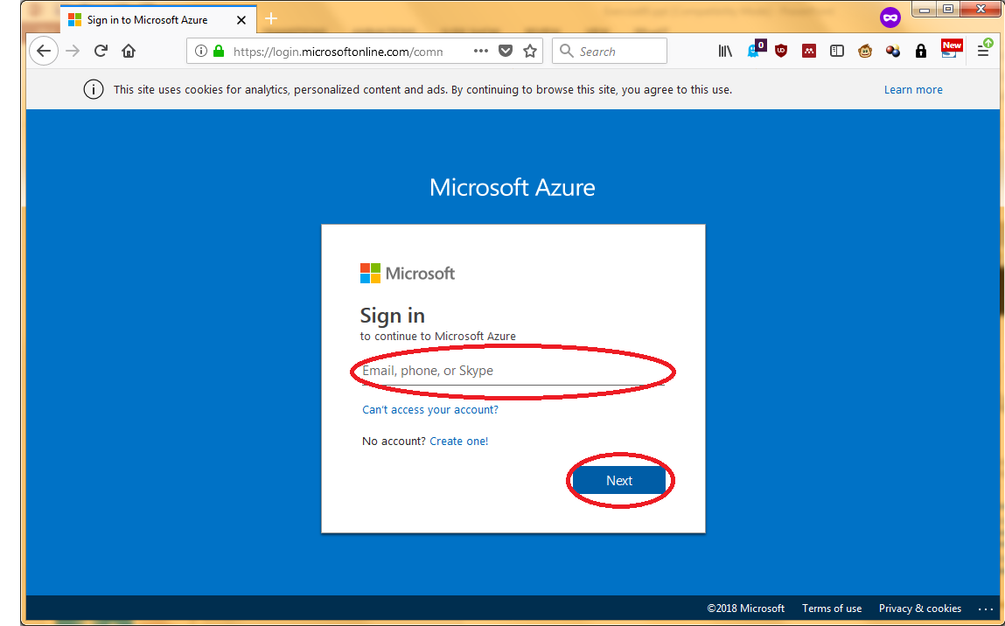
Online class room on Azure
Use any Microsoft account you may already have.
Create an account if you do not have one.
ETH e-mail addresses do not seem to work.
Use any other address or create one.

Slide 8
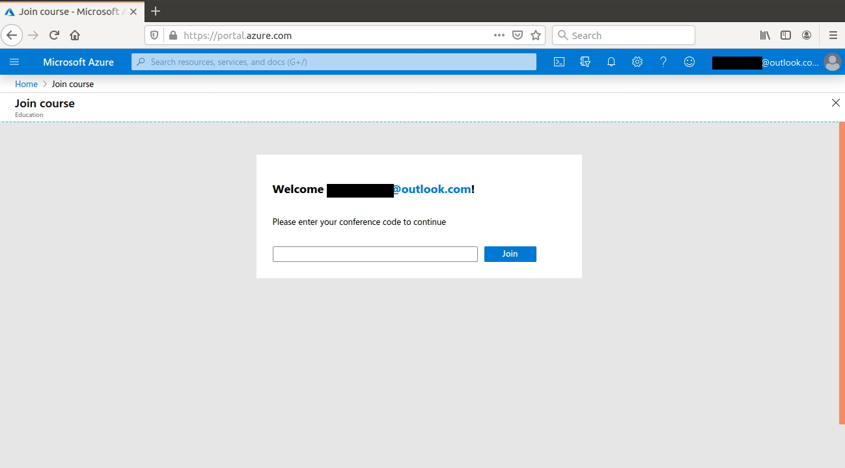
Online class room on Azure
Find the code on moodle

Slide 9
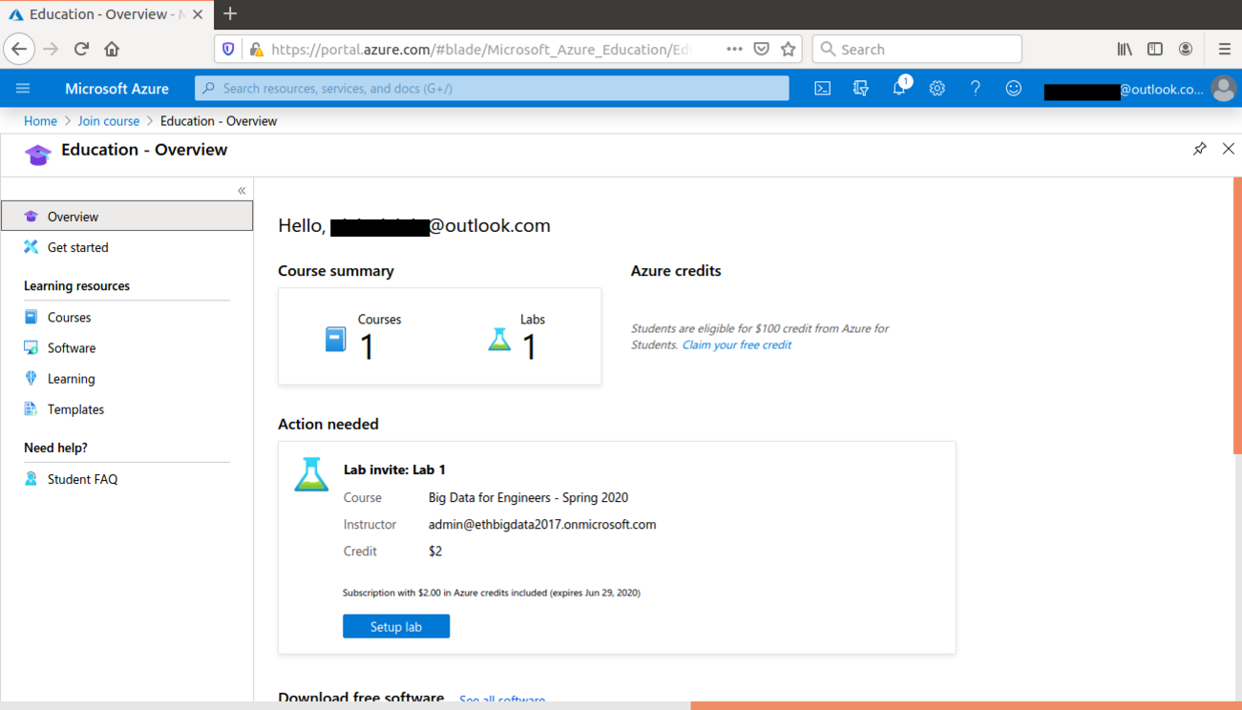
Online class room on Azure

Slide 10
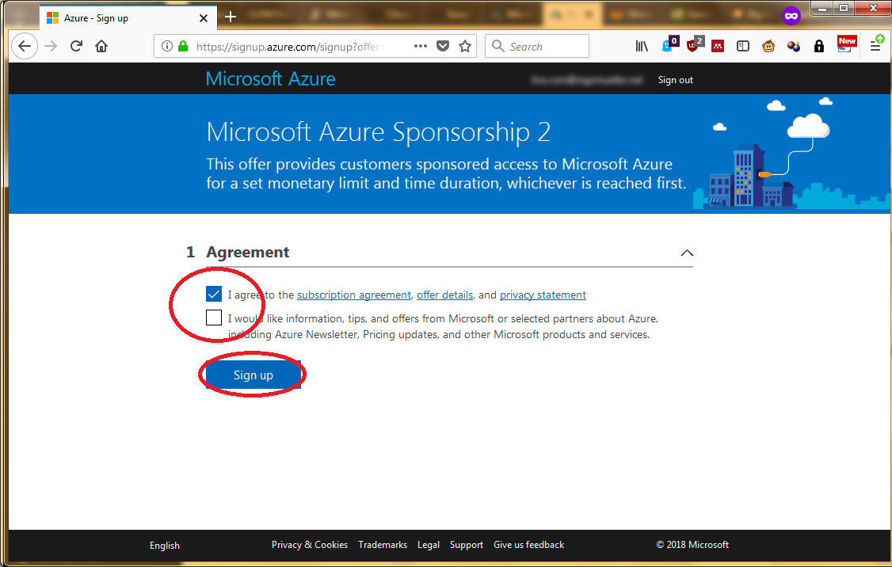
Online class room on Azure

Slide 11
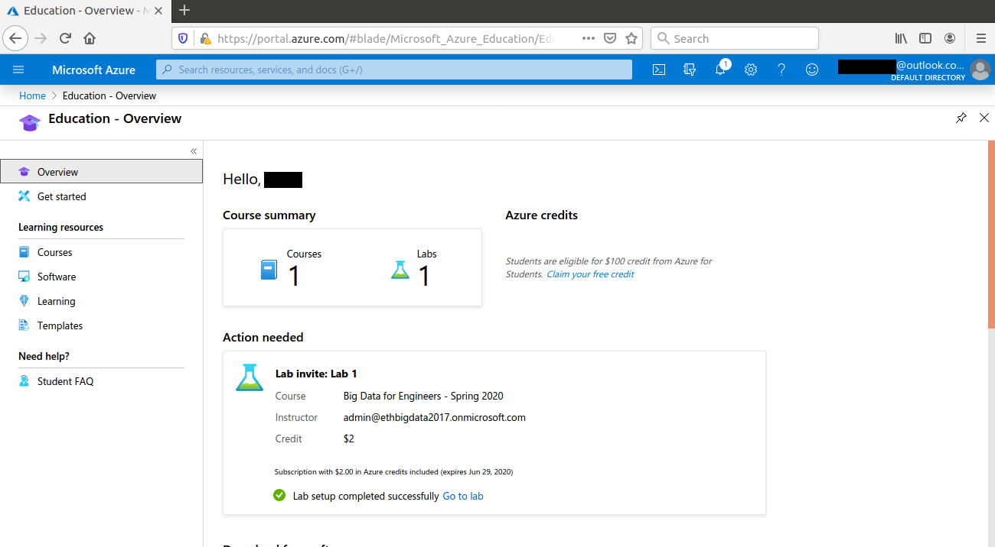
Online class room on Azure

Slide 12
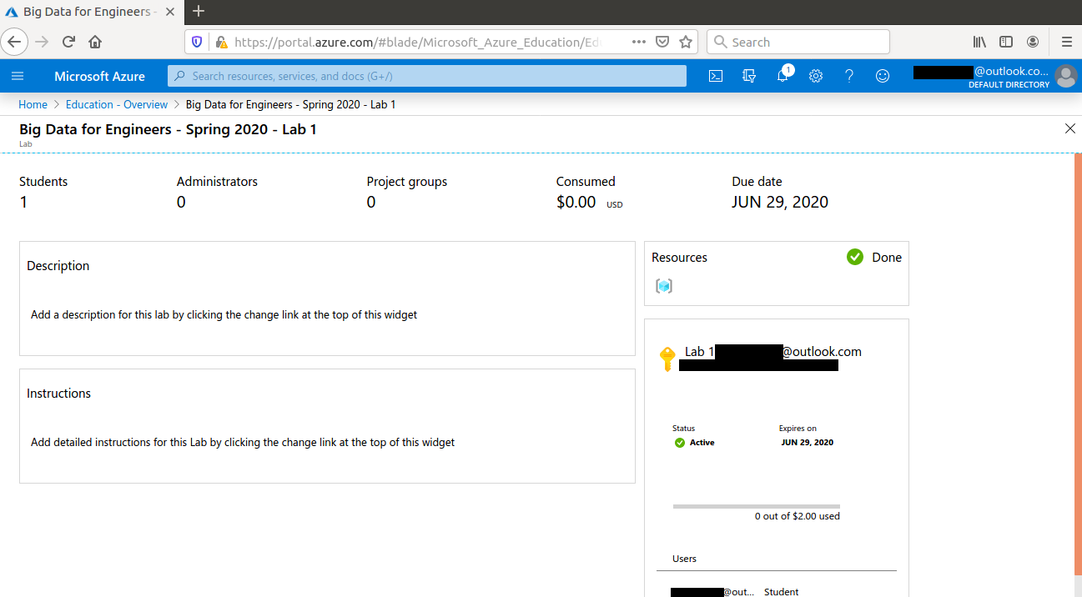
Online class room on Azure

Slide 13
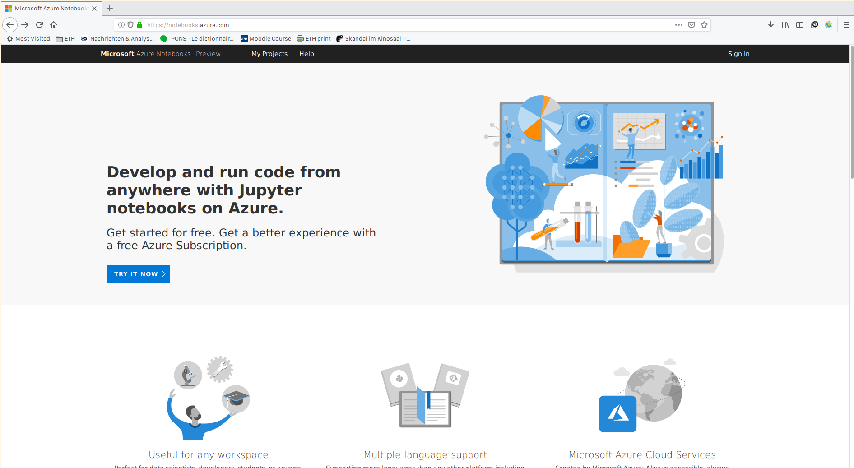
Jupyter notebooks
Open in a new tab

Slide 14
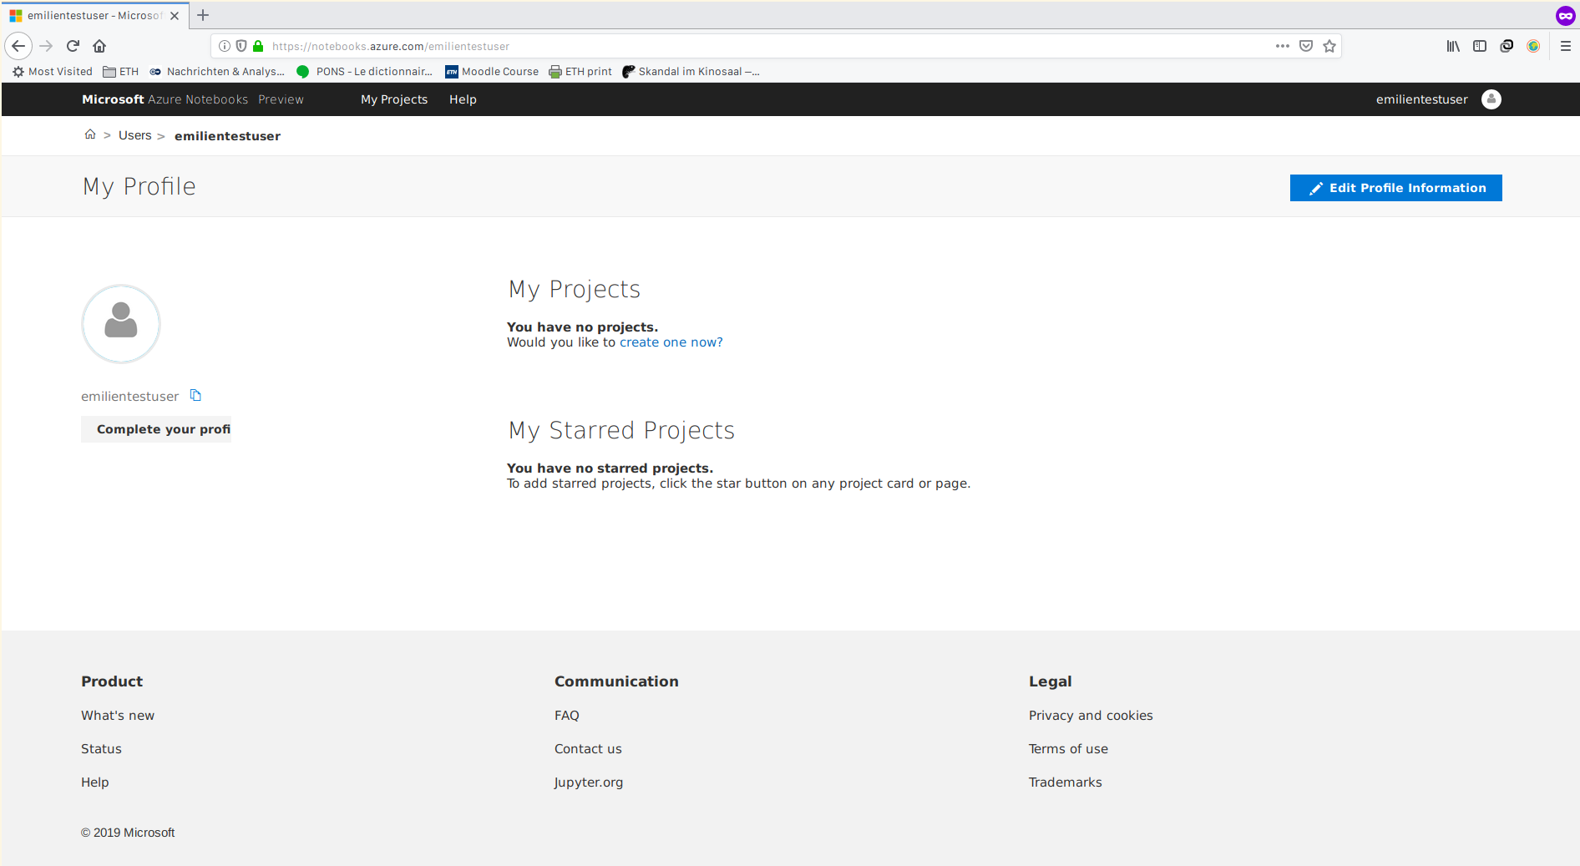
Jupyter notebooks

Slide 15
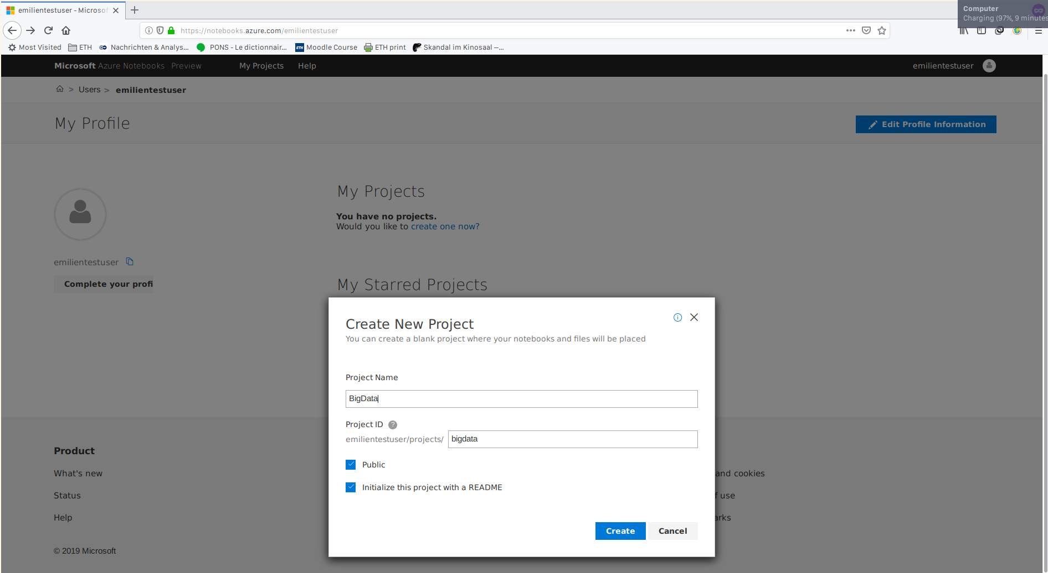

Slide 16
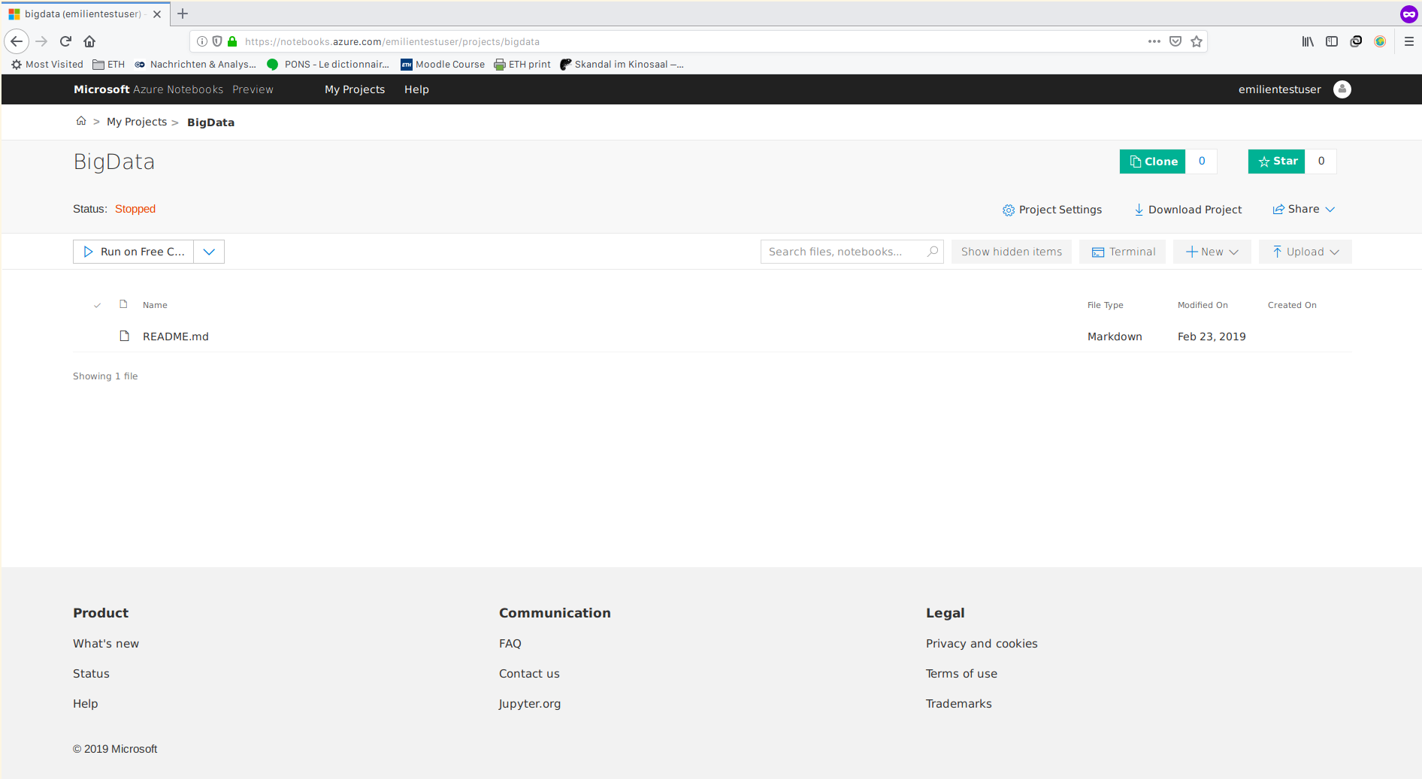
Jupyter notebooks

Slide 17
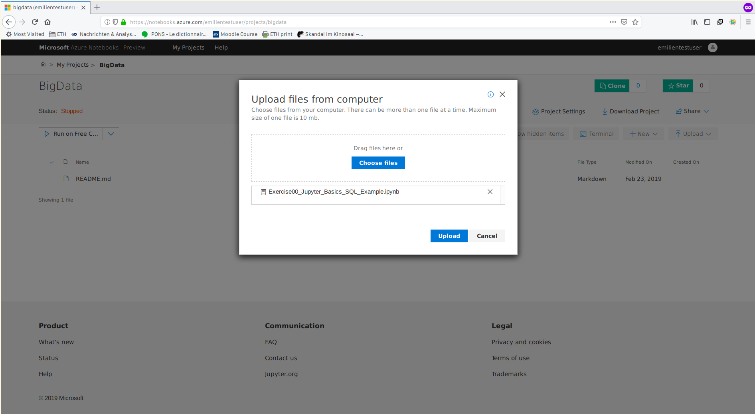
Jupyter notebooks

Slide 18
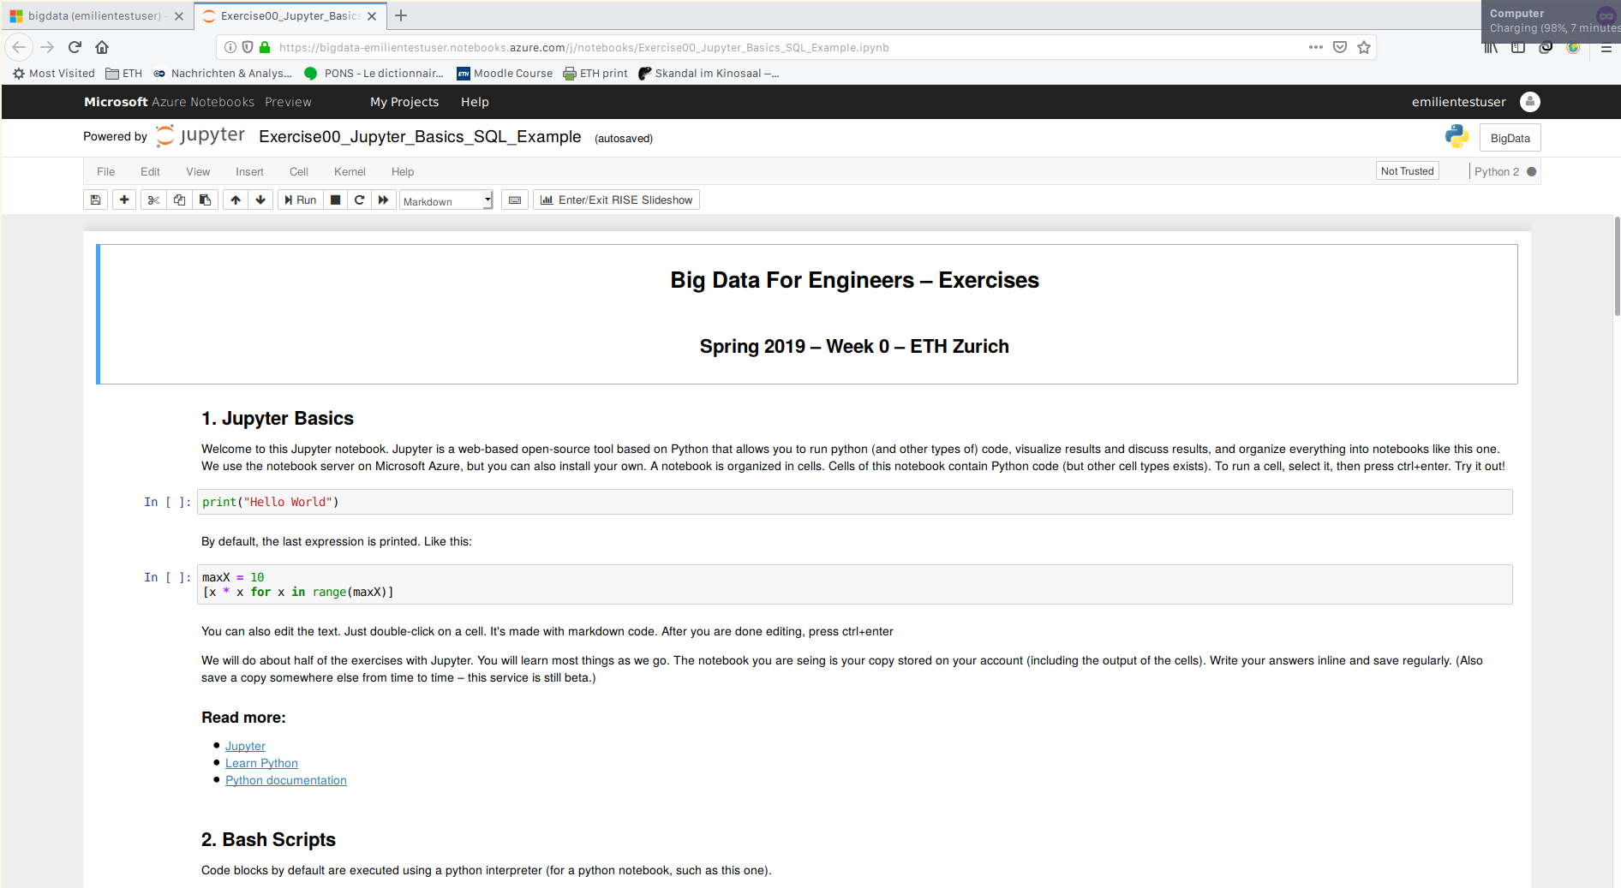
Jupyter notebooks
If you see „Not Trusted“ here, click on it and change it to trusted

Slide 19
Jupyter
Execute cells with ctrl+enter (shift+enter also works)
Service is in beta phase
Might be buggy
In cases of problems → kernel and clear output, or close and reopen notebook
Notes:
<Foliennummer>

