Slide 1

Debug & Profile Scripts On CKB
Introduction to ckb-debugger
9/1/2021

Slide 2
Before We Start: Terminology
Smart Contract: Also known as script on CKB
RISC-V Binary: Executable binary in ELF format which contains RISC-V instructions
syscall: System Call. Interact with CKB. Adopted from Operation System
ckb-debugger: debug and profile scripts on off-chain contract development
mocked transaction file: Json format file dumped from CKB, provided to ckb-debugger as input

Slide 3
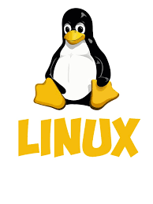
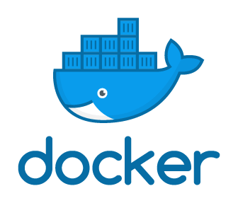
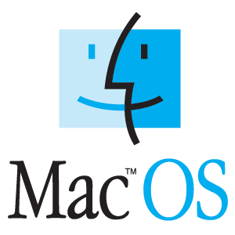

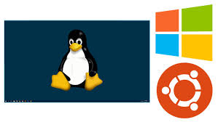
Before We Start: Environment

Slide 4
Playground
We have a playground on github. Prepapre with:
git clone https://github.com/XuJiandong/ckb-debugger-playground.git
git submodule update --init --recursive
make all-via-docker
cd deps/ckb-system-scripts
make install-tools
make all-via-docker
Download ckb-debugger
Install ckb-transaction-dumper (optional)

Slide 5
Run Scripts off-chain
❯ make run
ckb-debugger --tx-file sample-data/data1.json --cell-index 0 --cell-type input --script-group-type lock
Run result: Ok(0)
Total cycles consumed: 1707569
Transfer cycles: 12680, running cycles: 1694889
--tx-file: mocked transaction file
--cell-index: 0,1, 2...
--cell-type: input/output
--script-group-type: lock/type

Slide 6
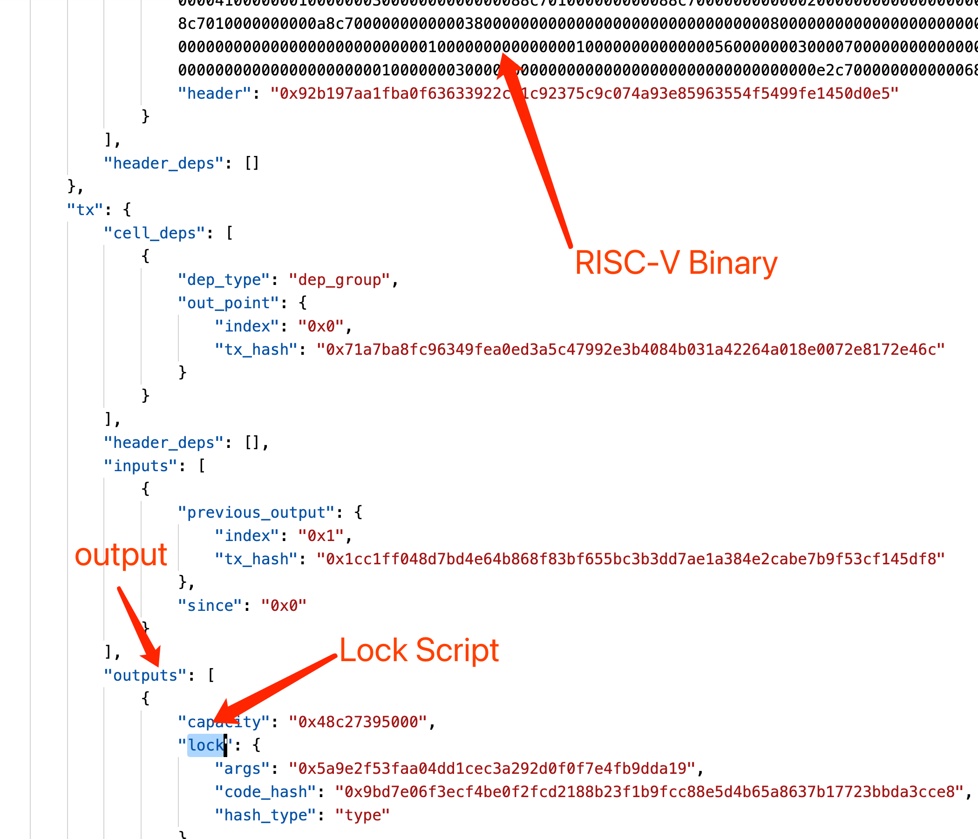
Mocked Transaction File Format
This is a very simple transaction with 1 input and 2 outputs using secp256k1 signature

Slide 7
Debug Scripts (GDB Remote Debug)
GDB process
(in docker container)
CKB-Debugger process
GDB Remote Seriel Protocol
listening on 127.0.0.1:9999
It's not very easy to build gdb in gcc toolchain So we use gdb in docker instead.

Slide 8
Debug Information
When build scripts:
$(OBJCOPY) --only-keep-debug
Strip everything but the debug information. It will be provided to GDB process.
riscv64-unknown-linux-gnu-gdb -ex "target remote host.docker.internal:${PORT}" build/secp256k1_blake160_sighash_all.debug
shold be paired
ckb-debugger --listen 127.0.0.1:${PORT} --tx-file sample-data/data1.json --cell-index 0 --cell-type input --script-group-type lock \
--replace-binary deps/ckb-system-scripts/specs/cells/secp256k1_blake160_sighash_all
use --replace-binary to replace RISC-V binary by another one

Slide 9
More information on --replace-binary
By default, ckb-debugger only loads and runs the code (RISCV-Binary) listed in mocked transaction file.
The option --replace-binary gives ckb-debugger a chance to “replace” these code.
We can modify source code, re-build it and use “--replace-binary” to run new code again.
--simple-binary is an aliace of --replace-binary

Slide 10
Debug Scripts with Simple Commands
❯ make run-debugger
ckb-debugger --listen 127.0.0.1:9999 --tx-file sample-data/data1.json --cell-index 0 --cell-type input --script-group-type lock \
--replace-binary deps/ckb-system-scripts/specs/cells/secp256k1_blake160_sighash_all
❯ make run-docker
docker run --rm -it -v `pwd`:/code nervos/ckb-riscv-gnu-toolchain@sha256:aae8a3f79705f67d505d1f1d5ddc694a4fd537ed1c7e9622420a470d59ba2ec3 bash
root@2401d04549b4:/# cd code
root@2401d04549b4:/code# make run-gdb
cd deps/ckb-system-scripts && riscv64-unknown-linux-gnu-gdb -ex "target remote host.docker.internal:9999" build/secp256k1_blake160_sighash_all.debug

Slide 11
Use GDB
(gdb) b 259
Breakpoint 2 at 0x1067e: file c/secp256k1_blake160_sighash_all.c, line 259.
(gdb) p/x *args_bytes_seg.ptr@8
$3 = {0x32, 0xd6, 0x76, 0xb7, 0x36, 0xd5, 0x19, 0xf8}
(gdb) p/x *temp@8
$5 = {0x32, 0xd6, 0x76, 0xb7, 0x36, 0xd5, 0x19, 0xf8}
(gdb)
Some commands are not supported, like “run”, however.

Slide 12
Run Scripts Without Syscalls
Sometime, we just want to run RISC-V binary directly without syscalls. e.g.: 3rd-party libraries
Use command line option: --simple-binary <simple-binary>
❯ make run-simple-binary
ckb-debugger --simple-binary build/fib
Run result: 0
Total cycles consumed: 1847

Slide 13
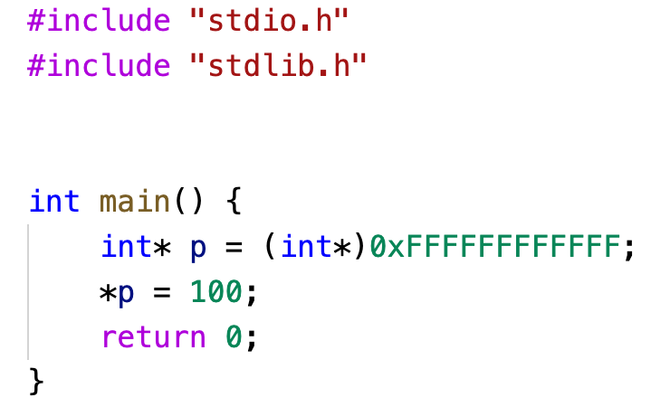
Print Backtrace When CKB-VM panic
❯ make run-simple-binary-panic
ckb-debugger --pprof=/dev/null --simple-binary build/panic
Backtrace:
??:??
/code/c/panic.c:main
/code/c/panic.c:7
Machine returned error code: OutOfBound
Performance Profiling (--pprof) and Dumping backtrace share same internal implementation.

Slide 14
Performance Profiling
Another important feature
It can enabled by --pprof=<output file for inferno-flamegraph>
❯ make run-simple-binary-pprof
ckb-debugger --simple-binary build/fib --pprof=build/fib.pprof
Run result: 0
Total cycles consumed: 1847
cat build/fib.pprof | inferno-flamegraph > build/fib.svg

Slide 15
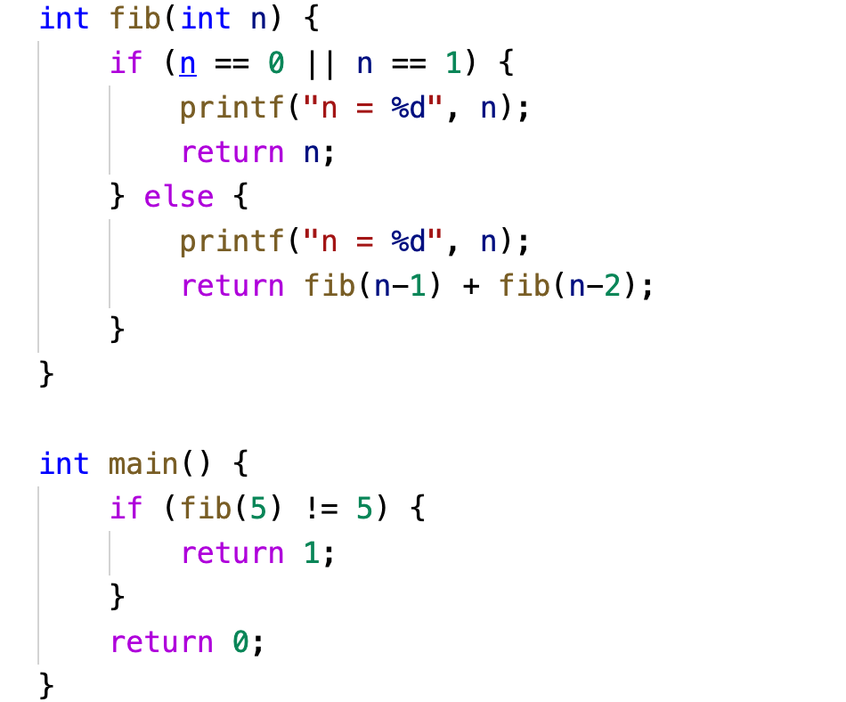
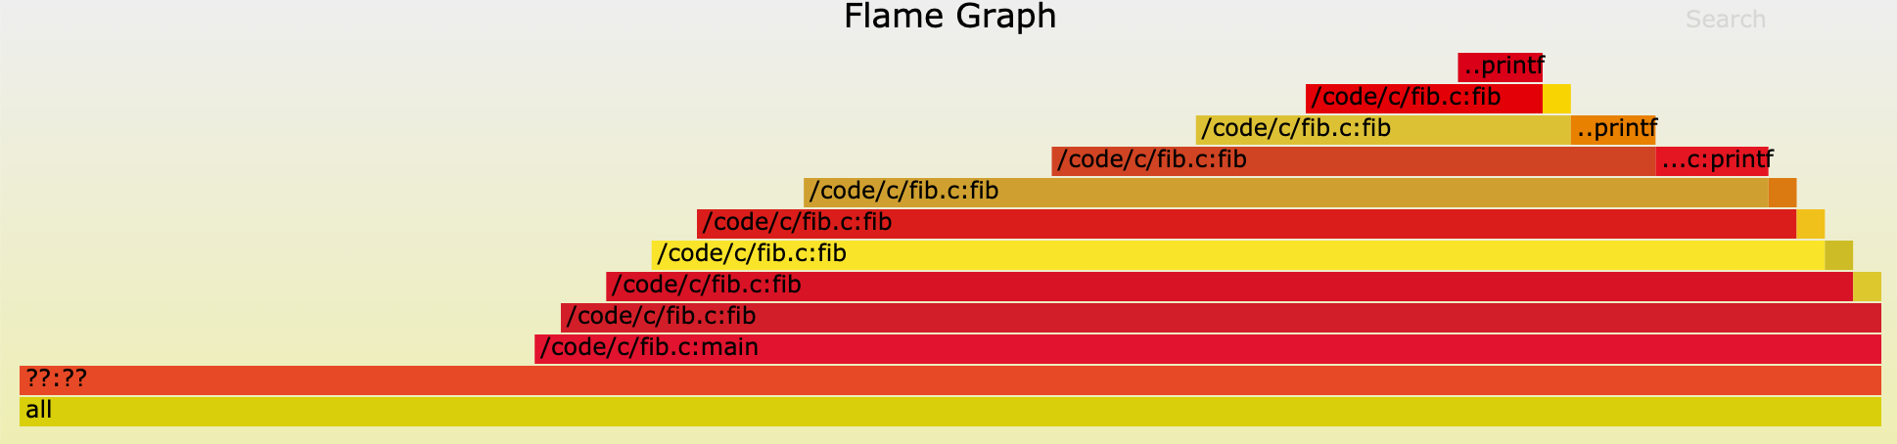
Flamegraph
We use inferno-flamegraph

Slide 16
Tips About Performance Profiling
Must compiled with “-g” (debug information)
--replace-binary or --simple-binary must be used
❯ make run-simple-binary-pprof
ckb-debugger --simple-binary build/fib --pprof=build/fib.pprof
Run result: 0
Total cycles consumed: 1847
cat build/fib.pprof | inferno-flamegraph > build/fib.svg

Slide 17
Limitation/Future Enhancedments
Limitation: Difficult to generate altered mocked transaction files by any tool.
Build a tool to generate/modify mocked transaction files
Add dynamic tracing framework like DTrace

Slide 18
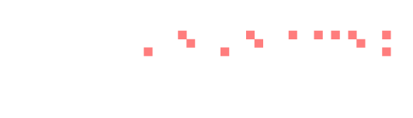
THANKS

