Slide 1

Debug & Profile Scripts On CKB
Introduction to ckb-debugger
9/1/2021

Slide 2
Before We Start: Terminology
Smart Contract: Also known as script on CKB
RISC-V Binary: Executable binary in ELF format which contains RISC-V instructions
syscall: System Call. Interact with CKB. Adopted from Operation System
ckb-debugger: debug and profile scripts on off-chain contract development
mocked transaction file: Json format file dumped from CKB, provided to ckb-debugger as input

Slide 3
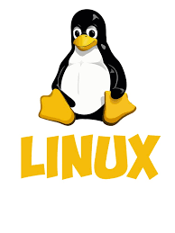
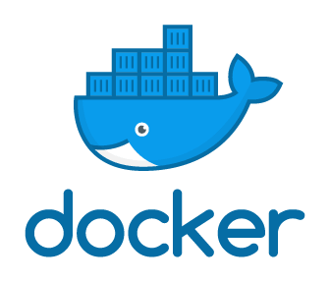
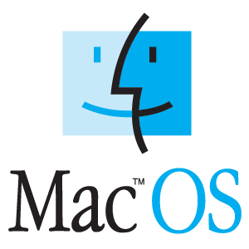

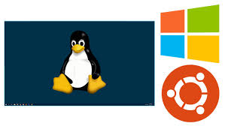
Before We Start: Environment

Slide 4
Playground
We have a playground on github. Prepapre with:
git clone https://github.com/XuJiandong/ckb-debugger-playground.git
git submodule update --init --recursive
make all-via-docker
cd deps/ckb-system-scripts
make install-tools
make all-via-docker
Download ckb-debugger
Install ckb-transaction-dumper (optional)

Slide 5
Run Scripts off-chain
❯ make run
ckb-debugger --tx-file sample-data/data1.json --cell-index 0 --cell-type input --script-group-type lock
Run result: Ok(0)
Total cycles consumed: 1707569
Transfer cycles: 12680, running cycles: 1694889
--tx-file: mocked transaction file
--cell-index: 0,1, 2...
--cell-type: input/output
--script-group-type: lock/type

Slide 6
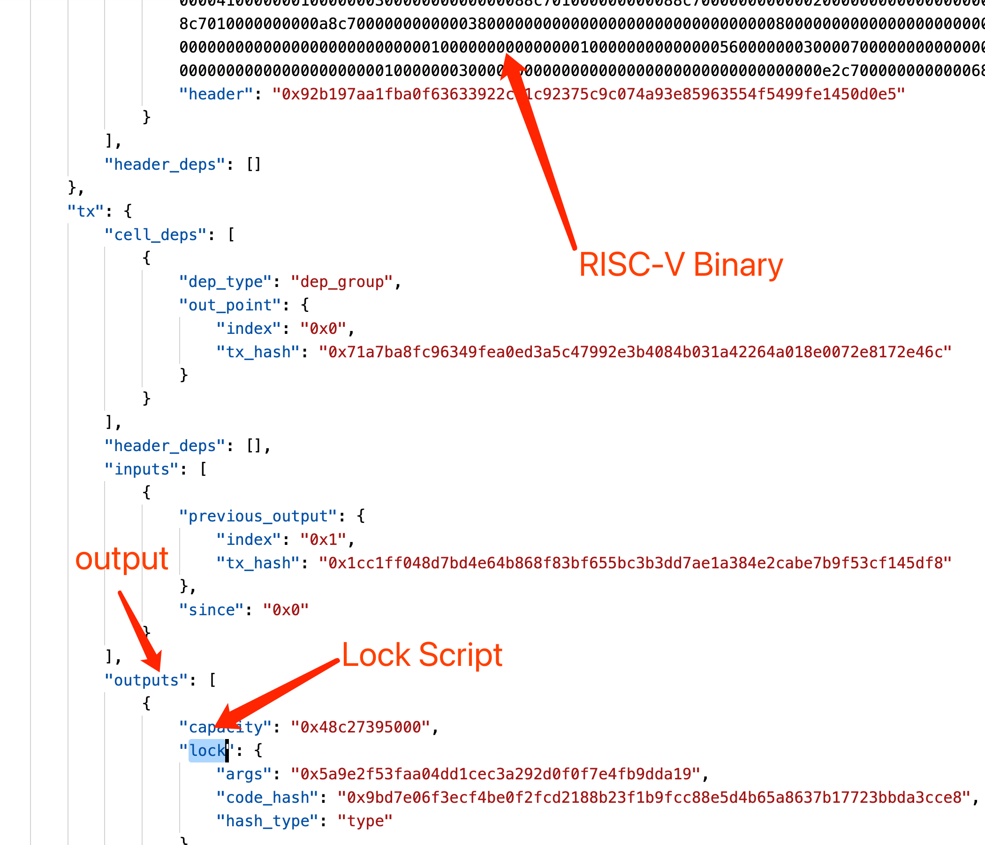
Mocked Transaction File Format
This is a very simple transaction with 1 input and 2 outputs using secp256k1 signature

Slide 7
Debug Scripts (GDB Remote Debug)
GDB process
(in docker container)
CKB-Debugger process
GDB Remote Seriel Protocol
listening on 127.0.0.1:9999
It's not very easy to build gdb in gcc toolchain So we use gdb in docker instead.

Slide 8
Debug Information
When build scripts:
$(OBJCOPY) --only-keep-debug
Strip everything but the debug information. It will be provided to GDB process.
When invoke gdb:
riscv64-unknown-linux-gnu-gdb -ex "target remote host.docker.internal:${PORT}" build/secp256k1_blake160_sighash_all.debug
shold be paired
When run scripts:
ckb-debugger --mode gdb --gdb-listen 127.0.0.1:${PORT} --tx-file sample-data/data1.json --cell-index 0 --cell-type input --script-group-type lock \
--bin deps/ckb-system-scripts/specs/cells/secp256k1_blake160_sighash_all
use --bin to replace RISC-V binary by another one

Slide 9
Debug Scripts with Simple Commands
❯ make run-debugger
ckb-debugger --mode gdb --gdb-listen 127.0.0.1:9999 --tx-file sample-data/data1.json --cell-index 0 --cell-type input --script-group-type lock \
--bin deps/ckb-system-scripts/specs/cells/secp256k1_blake160_sighash_all
Use GNU toolchain for RISC-V in docker
❯ make run-docker
docker run --rm -it -v `pwd`:/code nervos/ckb-riscv-gnu-toolchain@sha256:aae8a3f79705f67d505d1f1d5ddc694a4fd537ed1c7e9622420a470d59ba2ec3 bash
root@60820a2c702e:/# cd code
root@60820a2c702e:/code# make run-gdb
cd deps/ckb-system-scripts && riscv64-unknown-linux-gnu-gdb -ex "target remote host.docker.internal:9999" build/secp256k1_blake160_sighash_all.debug

Slide 10
Use GDB
(gdb) b 259
Breakpoint 2 at 0x1067e: file c/secp256k1_blake160_sighash_all.c, line 259.
(gdb) p/x *args_bytes_seg.ptr@8
$3 = {0x32, 0xd6, 0x76, 0xb7, 0x36, 0xd5, 0x19, 0xf8}
(gdb) p/x *temp@8
$5 = {0x32, 0xd6, 0x76, 0xb7, 0x36, 0xd5, 0x19, 0xf8}
(gdb)
Some commands are not supported, like “run”, however.

Slide 11
More information on --bin
By default, ckb-debugger only loads and runs the code (RISCV-Binary) listed in mocked transaction file.
The option --bin gives ckb-debugger a chance to “replace” these code.
We can modify source code, re-build it and use “--bin” to run new code again.

Slide 12
--mode
full
Default mode. Don't need to specify. It can detect error and report backtrace.
gdb
Run it in gdb mode: listening on tcp port and wait for remote gdb to be attached.
fast
Run it without detecting any error. It's very fast but can't capture any error.

Slide 13
Run Scripts Without Syscalls
Sometime, we just want to run RISC-V binary directly without syscalls. e.g.: 3rd-party libraries
Use command line option: --bin <simple-binary>
❯ make run-simple-binary
ckb-debugger --bin build/fib
Run result: 0
Total cycles consumed: 4499
Transfer cycles: 2652, running cycles: 1847

Slide 14
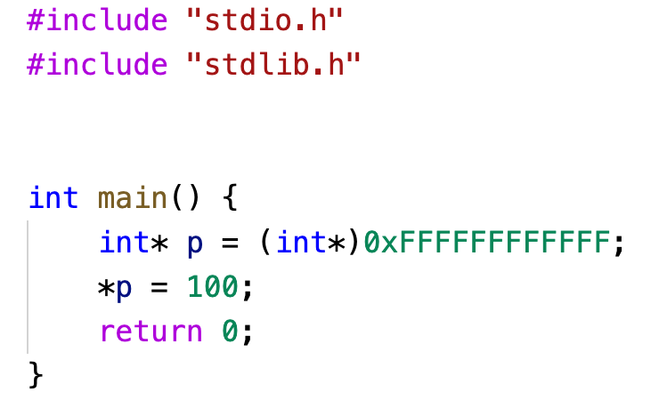
Print Backtrace When CKB-VM panic
❯ make run-simple-binary-panic
ckb-debugger --bin build/panic
Trace:
??:??:??
/code/deps/ckb-c-stdlib/libc/entry.h:9:_start
/code/c/panic.c:7:main
Error:
OutOfBound

Slide 15
Detect Heap/Stack Overlapping
CKB-VM Memory Layout
Text/Data/Bss... | Heap | Not Used | Stack
??
4M
increased by _sbrk
overlaping is bad
changed by register “sp”

Slide 16
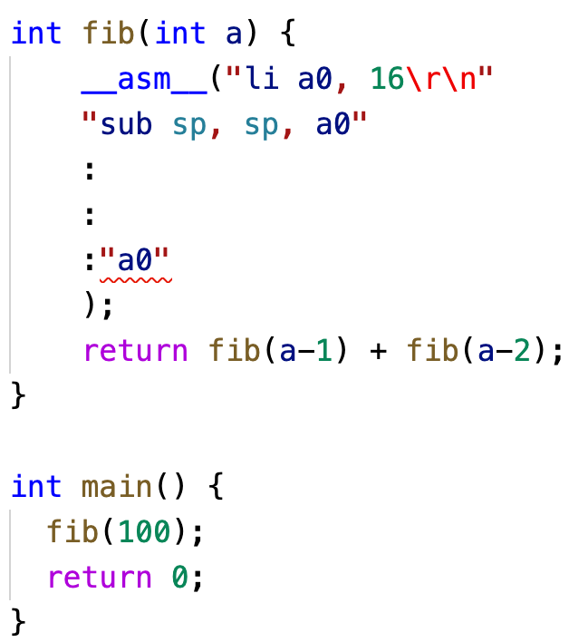
Detect Heap/Stack Overlapping
❯ make run-simple-binary-overlapping
ckb-debugger --bin build/overlapping
thread 'main' panicked at 'Heap and stack overlapping sp=76688 heap=76704'

Slide 17
Performance Profiling
Another important feature
It can enabled by --pprof=<output file for inferno-flamegraph>
❯ make run-simple-binary-pprof
ckb-debugger --bin build/fib --pprof=build/fib.pprof
Run result: 0
Total cycles consumed: 4499
Transfer cycles: 2652, running cycles: 1847
cat build/fib.pprof | inferno-flamegraph > build/fib.svg

Slide 18
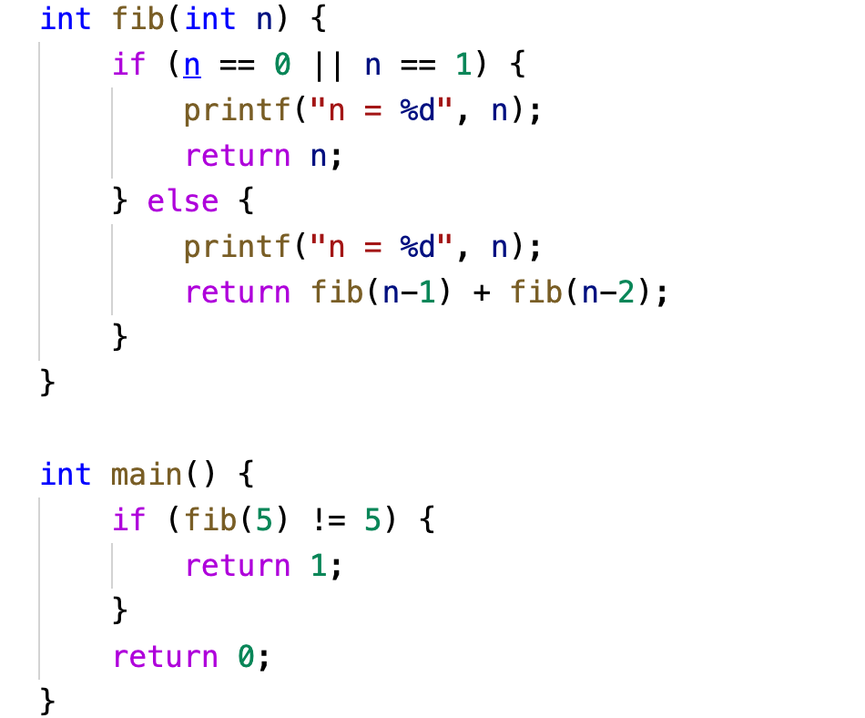
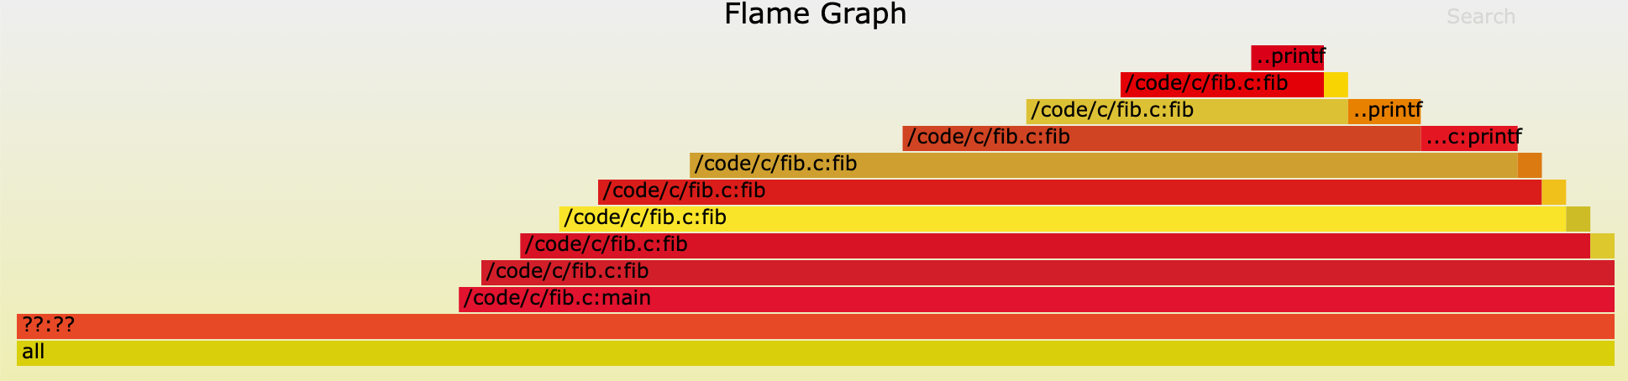
Flamegraph
We use inferno-flamegraph

Slide 19
Tips About Performance Profiling
Must compiled with “-g” (debug information)
--bin must be used
❯ make run-simple-binary-pprof
ckb-debugger --bin build/fib --pprof=build/fib.pprof
Run result: 0
Total cycles consumed: 4499
Transfer cycles: 2652, running cycles: 1847
cat build/fib.pprof | inferno-flamegraph > build/fib.svg

Slide 20
Limitation/Future Enhancedments
Limitation: Difficult to generate altered mocked transaction files by any tool.
Build a tool to generate/modify mocked transaction files
Add dynamic tracing framework like DTrace

Slide 21
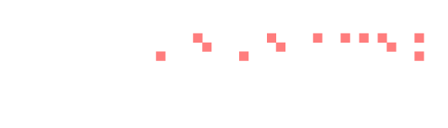
THANKS

