Slide 1
What factors affect IMDB ratings above 7?
Part 1
Part 2
Part 3
Dataset
Exploratory Analysis
Model Fitting
What data we used
and what the variables mean
What patterns we saw
before modelling
How we chose the final model
and the main results
Group 8: Zhiyao Wang, Zhenzi Wang, Rui Xu, Lixing Liu, Ziyang Wang

Slide 2
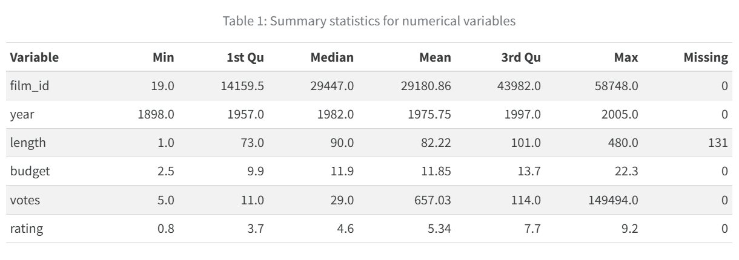
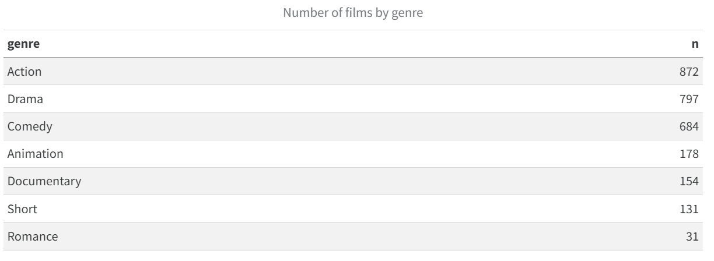
Part 1
Dataset
2,847 films in the original dataset
7 main variables were used in this study
IMDB rating was changed into a binary outcome: rating > 7
Only film length has missing values (131 cases)
Action, Drama, and Comedy are the largest genre groups in the dataset, while Romance has the fewest films. This shows that the dataset is dominated by a few major genres, and some smaller genres may be less stable in later analysis.
Notes:
[Sources] User-provided report screenshot: /mnt/data/7af7215a-24c7-4193-8d51-0e9a68f30592.png

Slide 3
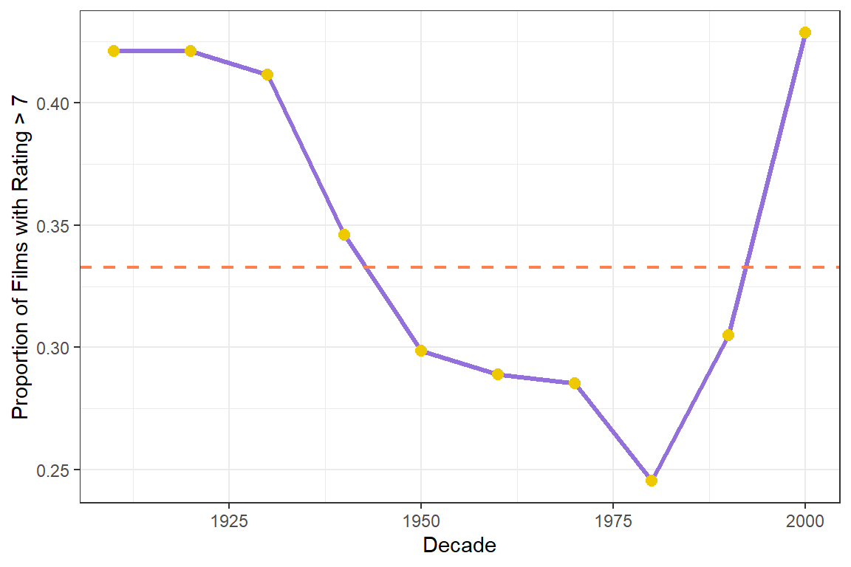
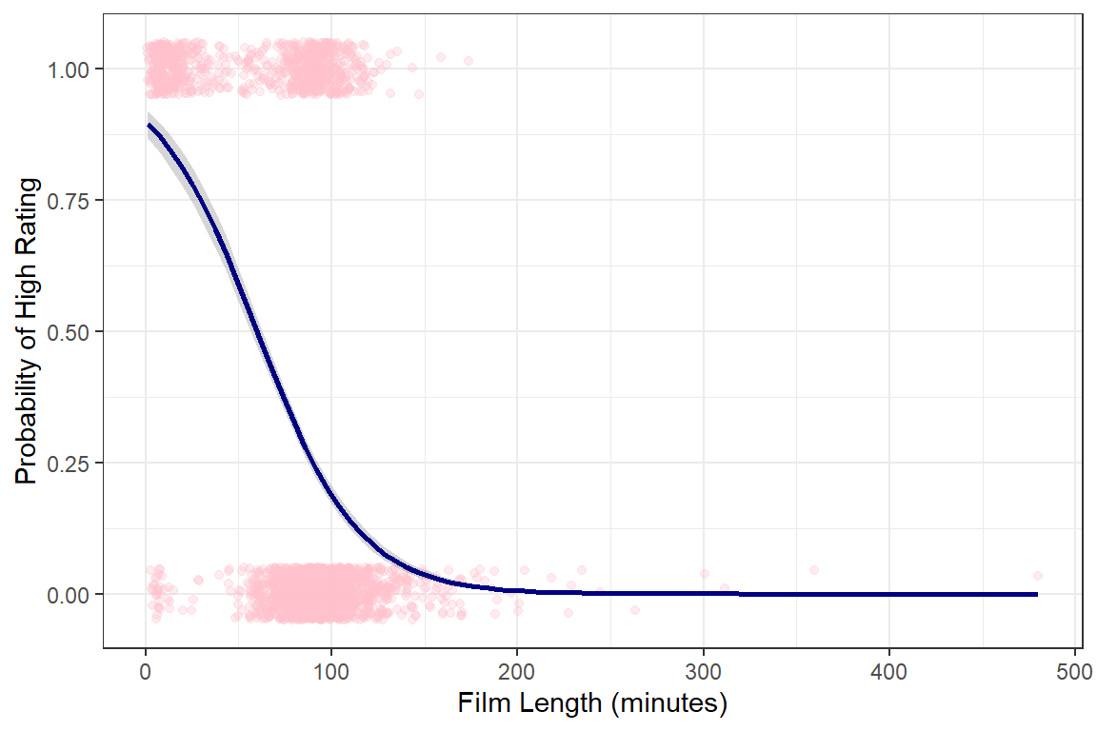
Part 2
Exploratory Analysis
figure 1 the relationship between release year and the proportion of successful films
figure 2 the relationship between flim length and the proportion of successful films
The red line shows the average success rate. Success rate was above average before 1930 and around 2000, but below average from 1950 to 1990. One possible reason for the decline is that audience expectations increased with social development.
There is a clear downward trend. This means that shorter films are more likely to succeed than longer films. One possible reason is that shorter films are easier for audiences to understand and enjoy.
Notes:
[Sources] User-provided report screenshots: /mnt/data/963a97dc-e5a8-4e16-aad8-3d235634196f.png, /mnt/data/9076f0e5-25cd-49ce-b80c-e1522464ac3f.png

Slide 4
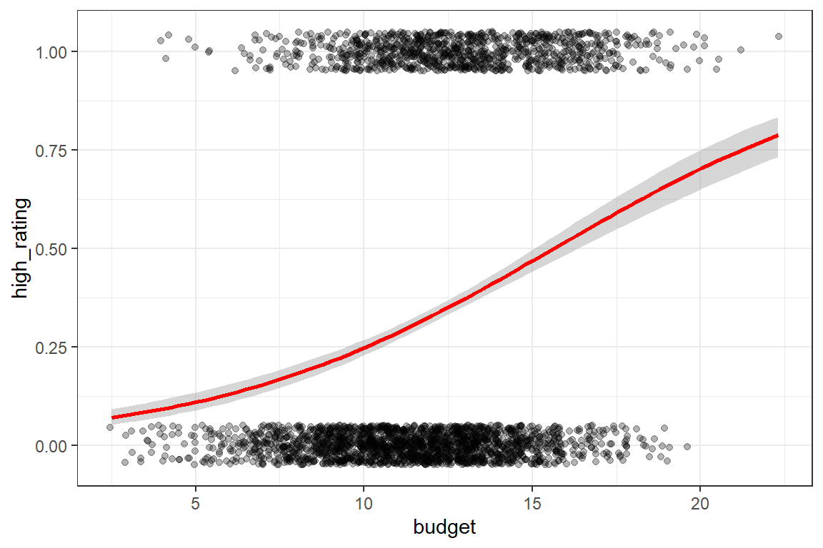
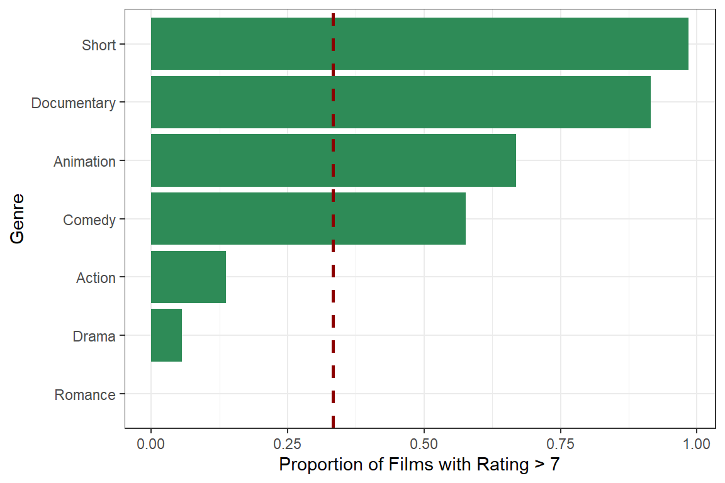
Part 2
Exploratory Analysis
figure 3 the relationship between budget and the proportion of successful films
figure 4 the relationship between genre and the proportion of successful films
A clear upward trend can be seen in the figure 3. This means that as budget increases, the proportion of successful films also increases. In other words, films with higher budgets are more likely to be successful. One possible reason is that higher-budget films may have better production quality, stronger promotion, and wider audience attention.
The figure suggests that genre may affect film success. One possible reason is that audiences have different interests for different types of films, so some genres may be more likely to receive higher ratings than others.
Notes:
[Sources] User-provided report screenshots: /mnt/data/963a97dc-e5a8-4e16-aad8-3d235634196f.png, /mnt/data/9076f0e5-25cd-49ce-b80c-e1522464ac3f.png

Slide 5
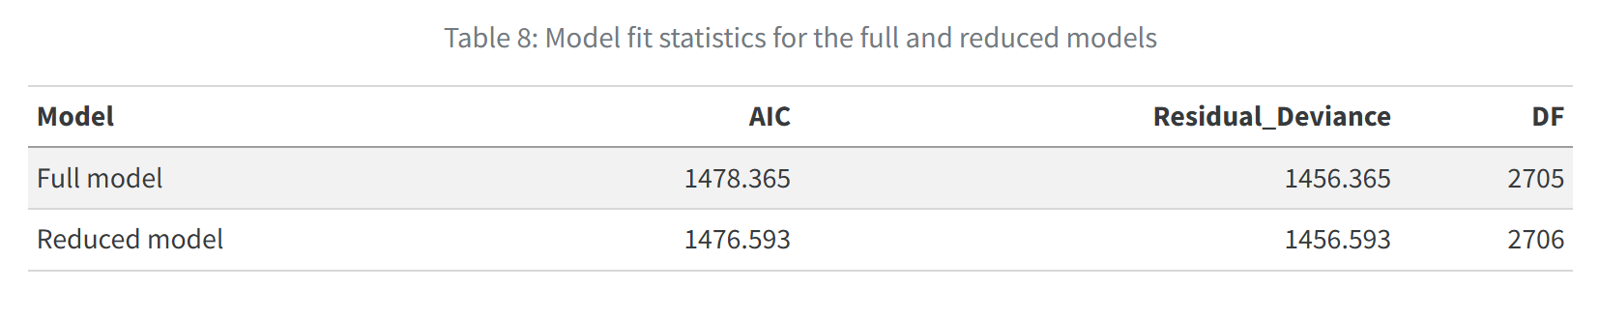
Part 3
Model Fitting
Full model
Reduced model
high_rating ~ year + length + budget + votes + genre
high_rating ~ year + length + budget + genre
Variable
p value
Decision
year
0.001
keep
Main modelling result
Votes was not statistically significant.
Year, length, budget, and several genre effects stayed significant.
The model identifies key drivers influencing a high IMDB rating.
length
<0.001
keep
budget
<0.001
keep
votes
0.612
remove
Final model : high_rating ~ year + length + budget + genre
The reduced model achieved a lower AIC with minimal changes on deviance, providing a better balance between model fit and simplicity while retaining full explanatory power.
Note: 'high_rating' is binary; a Logit link function is used to model the probability of success.

Slide 6
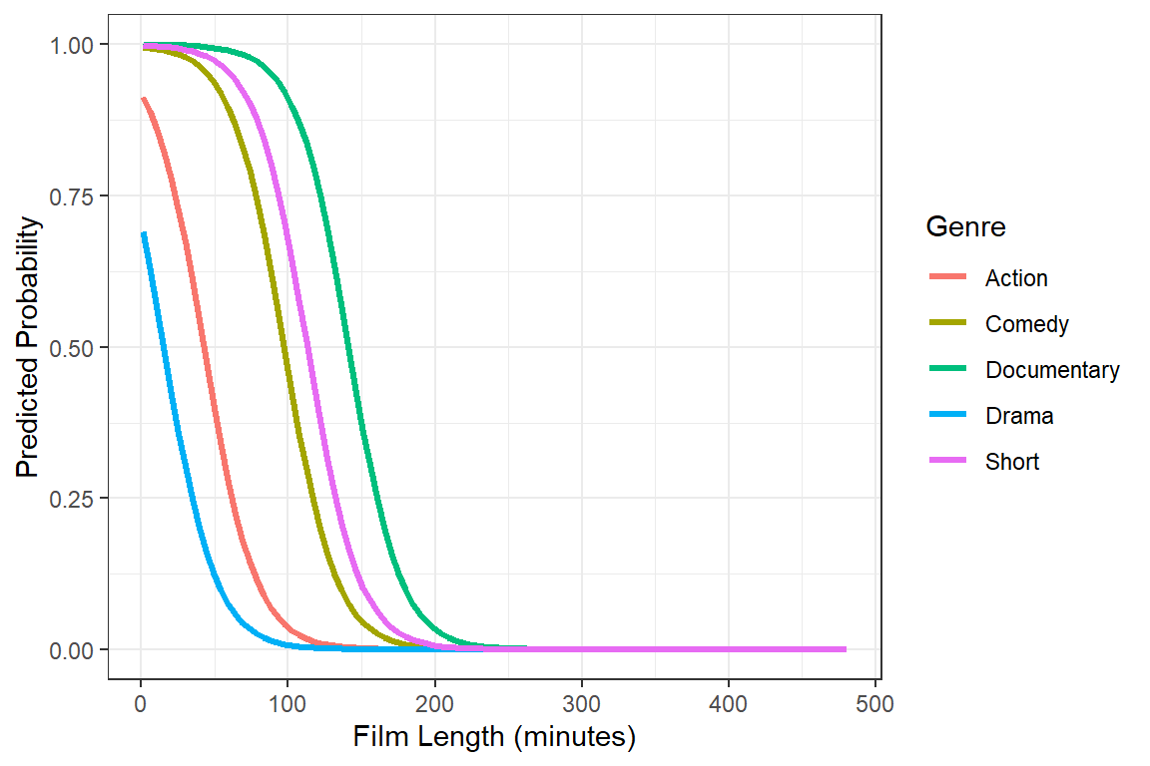
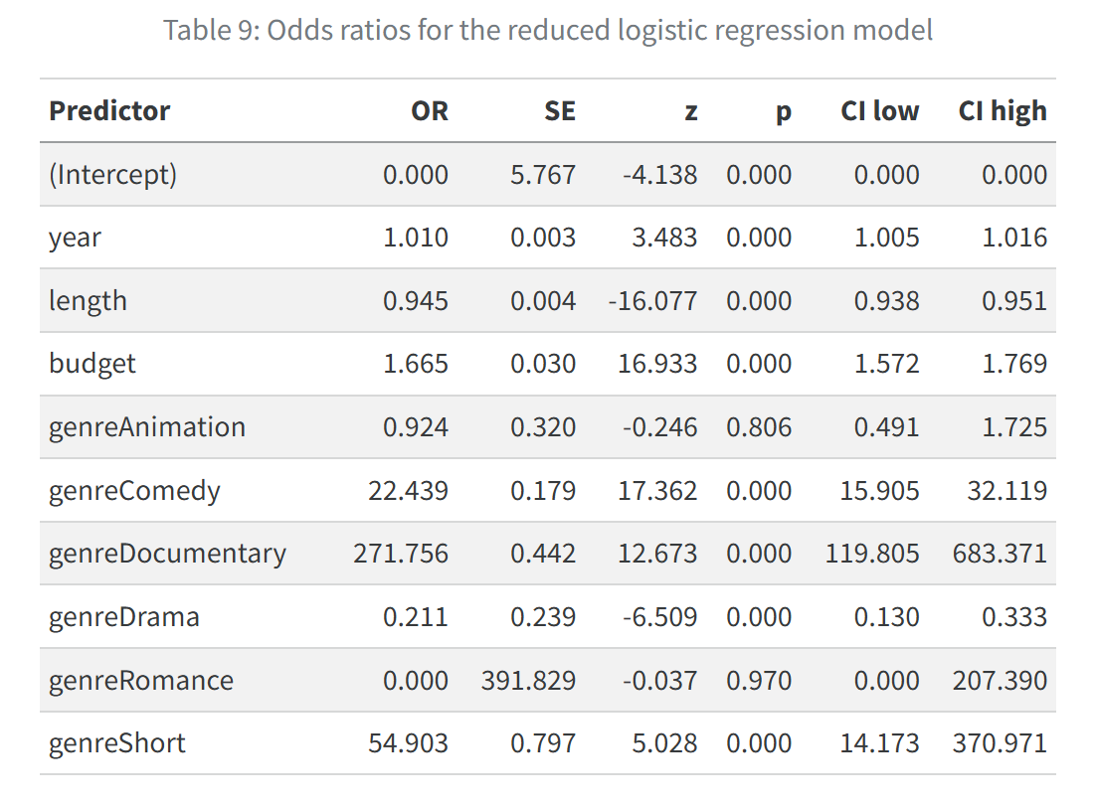
Part 3
Final Model: Main Findings
Easy reading of the final model
As year increases, the odds go up slightly (OR 1.010).
As film length increases, the odds go down (OR 0.945).
Higher budget raises the odds (OR 1.665).
Documentary, Short, and Comedy have much higher odds than Action.
Drama has lower odds than Action.
What we learn
As film length increases, the predicted probability of a high rating becomes lower.
Documentary films keep the highest predicted probability across most film lengths.
Drama films have the lowest predicted probability.
The figure shows the joint effect of film length and genre, while other variables are held constant.

Slide 7
Model Limitation
Limited variables
The dataset does not include factors such as director, cast, awards, or marketing.
Missing values
Missing film length values were removed, which reduced the sample size and may cause bias.
Small genre groups
Some genres have few films, so their coefficient estimates may be less stable.

Slide 8
Future work & Conclusion
1. Expand variables: Add factors like director, cast, and awards to the model.
2. Handle missing data: Use imputation methods instead of removing incomplete records.
3. Explore interactions: Investigate interaction effects between variables like budget and release periods.
Future work
Key message
Longer films were less likely to receive high ratings, while newer films, higher-budget films, and some genres showed higher probabilities of receiving ratings above 7.
Data Source: A comprehensive subset of the IMDB database

Slide 9


