Slide 1
2021/03/04

Slide 2
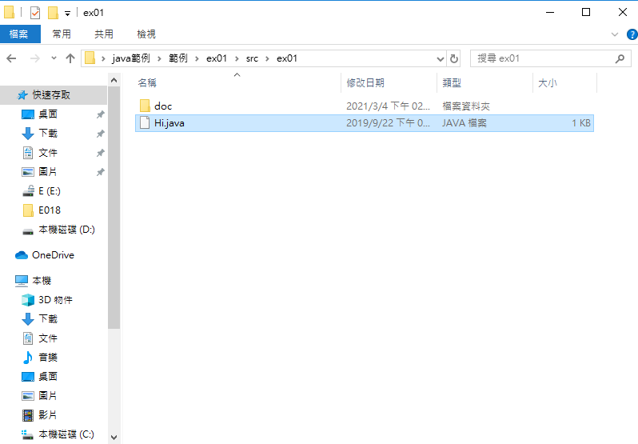

Slide 3
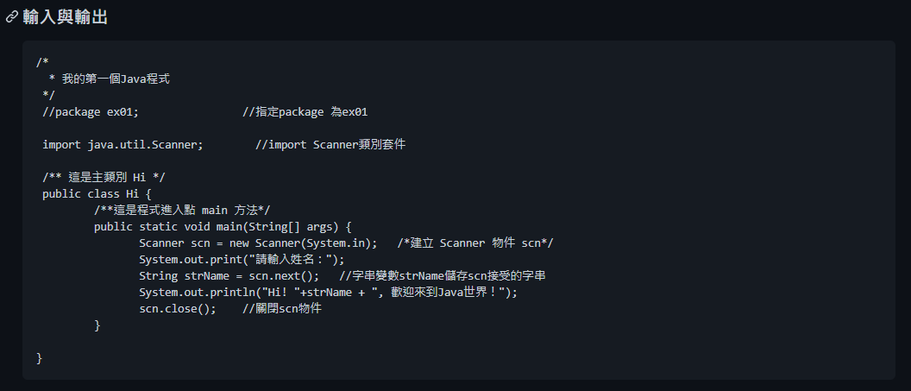

Slide 4


Slide 5
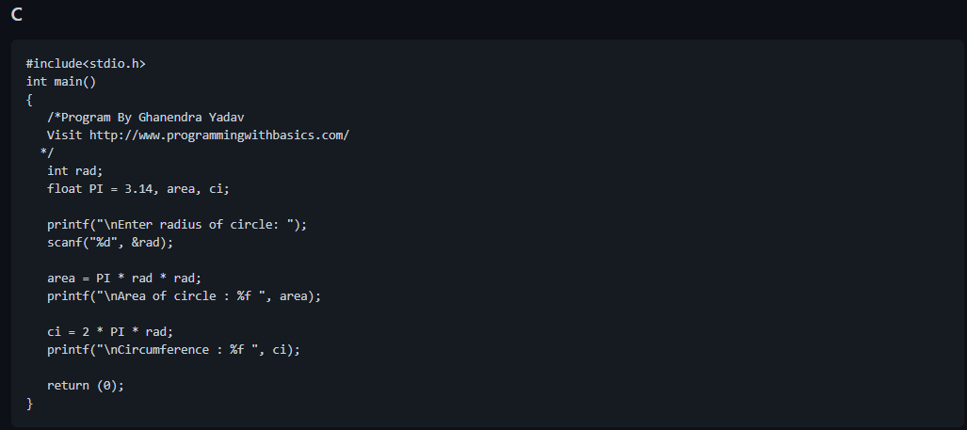

Slide 6
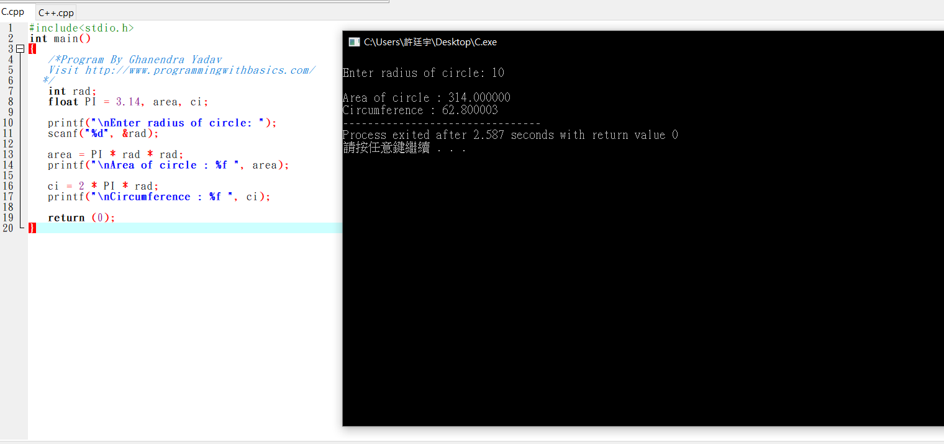

Slide 7
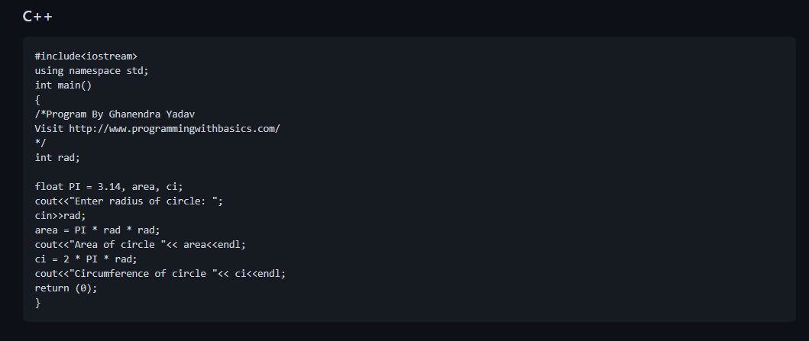

Slide 8
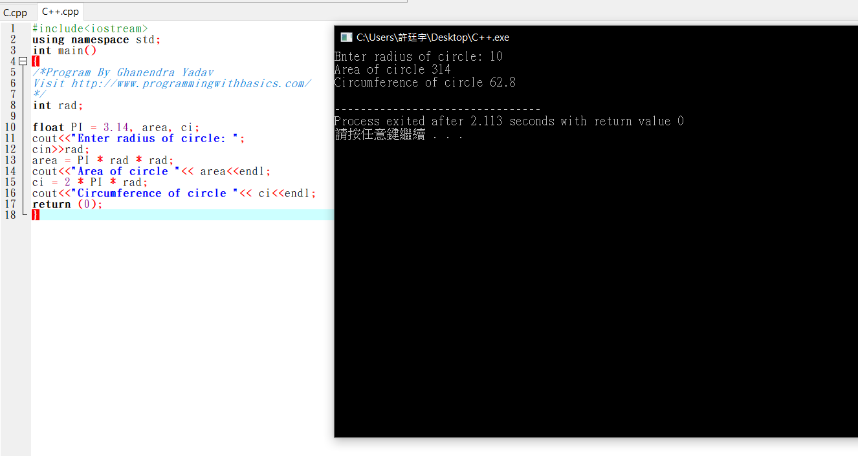

Slide 9
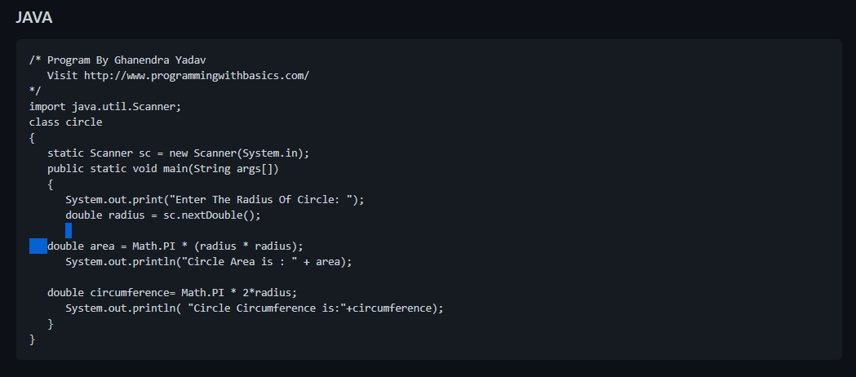

Slide 10
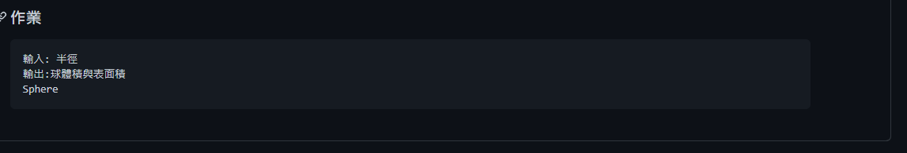

Slide 11
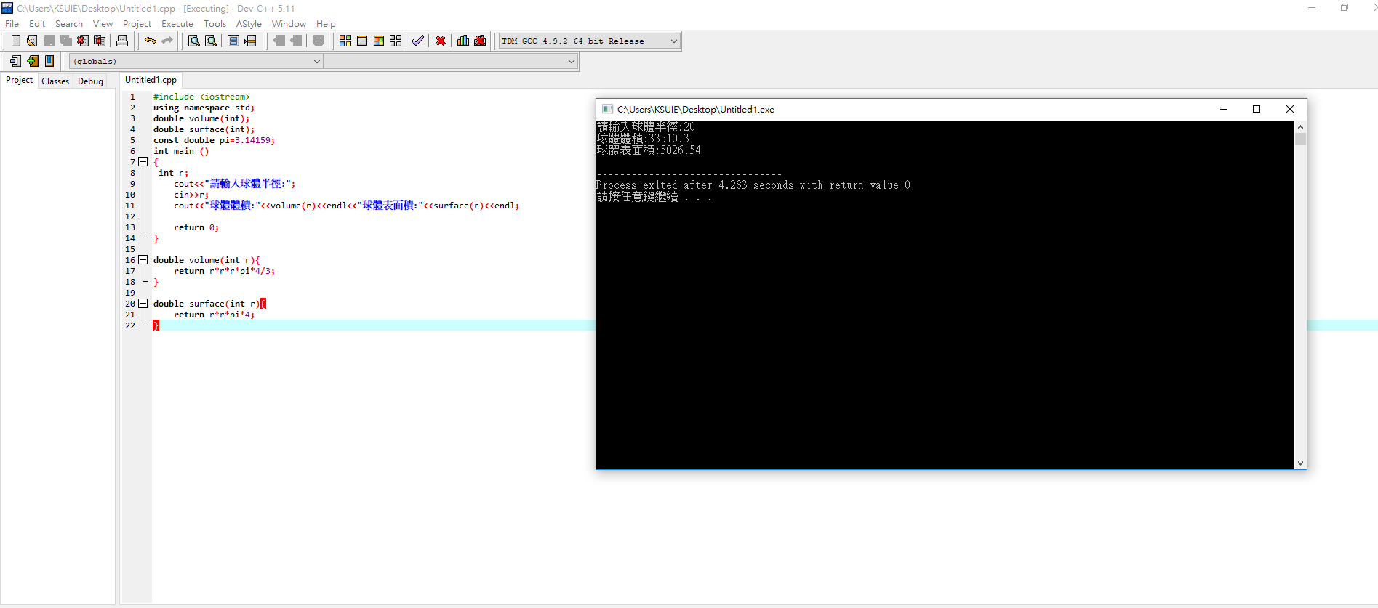

Slide 12
#include <iostream>
using namespace std;
double volume(int);
double surface(int);
const double pi=3.14159;
int main ()
{
int r;
cout<<"請輸入球體半徑:";
cin>>r;
cout<<"球體體積:"<<volume(r)<<endl<<"球體表面積:"<<surface(r)<<endl;
return 0;
}
double volume(int r){
return r*r*r*pi*4/3;
}
double surface(int r){
return r*r*pi*4;
}

