Slide 1
《算法分析与设计》
Analysis and Design of Computer Algorithms
中南大学计算机学院
School of Computer Science and Engineering
Central South University
主讲：李敏
联系方式：limin@mail.csu.edu.cn
15257578@qq.com
课程学习交流群： 709290112

Slide 2
课程目标与要求：
算法分析的基本技巧
掌握计算机问题求解的经典算法
计算思维
算法设计与运用能力
理论联系实际，学以致用

Slide 3
学习内容提要：
算法概念、表示
算法时间复杂度分析
五种经典的算法技术
具体问题设计符合时间复杂度要求的算法
NP难理论
Central South University

Slide 4
考核方式：
考核方式 |  | 考核内容 | 成绩比例
过程考核 | 平时表现 | 考勤、课堂提问、课堂讨论、课堂测试、课后作业等 | 20%
 | 课程实验 | 上机检查+实验报告 | 20%
期末考核 | 笔试 | 全部知识点 | 60%

Slide 5
算法（Algorithms）
什么是算法?
  算法是一系列解决问题的清晰指令，也就是说，对于符合一定规范的输入，能够在有限时间内获得所要求的输出。
问题
算法
“computer”
输出
输入
Central South University
Notes:
指令：人或物能够理解和执行所给出的命令

Slide 6
算法的几个要点
算法的每一个步骤都必须清晰、明确。
算法所处理的输入的值域必须仔细定义。
同样的一个算法可以用几种不同的形式来描述。
可能存在几种解决相同问题的算法。
针对同一个问题的算法可能会基于完全不同的解题思路，而且解题的速度也会有明显区别。
Central South University
Notes:
© School of Computer Science and Technology, SWUST

Slide 7
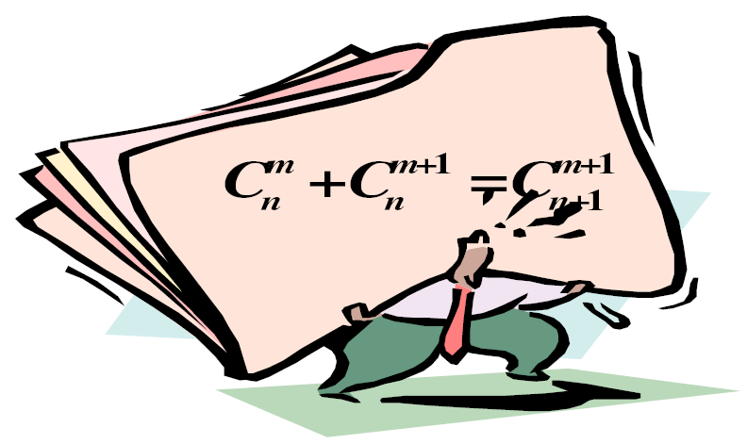
算法问题求解基础
理解问题
算法是问题的程序化解决方案。
决定：计算方法；
精确和近似的解法；
数据结构；
算法设计技术；
设计算法
正确性证明
分析算法
根据算法写代码
Central South University
Notes:
© School of Computer Science and Technology, SWUST

Slide 8
算法问题求解基础
理解问题
  设计算法前做的第一件事情
  仔细阅读问题的描述
  提出疑问
  手工处理一些实例
  考虑特殊情况
  确定输入
  抽象出问题，用数学表达式描述
Central South University
Notes:
© School of Computer Science and Technology, SWUST

Slide 9
算法问题求解基础
了解计算设备的性能
  确定计算方法
  RAM结构下的顺序算法
  并行算法
选择精确解和近似解
  某些重要的问题无法求得精确解
  某些问题利用精确解速度慢，无法接受
Central South University
Notes:
© School of Computer Science and Technology, SWUST

Slide 10
算法问题求解基础
确定适当的数据结构
  算法 + 数据结构 = 程序
算法设计技术
  使用算法解题的一般性方法，用于解决计算领域的多种问题。
详细表述算法的方法
  自然语言
  伪代码
  流程图
Central South University
Notes:
© School of Computer Science and Technology, SWUST

Slide 11
算法问题求解基础
证明算法的正确性
  证明对于每一个合法的输入，该算法都会在有限的时间内输出一个满足要求的结果。
  一般方法：数学归纳法
  证明算法的正确性与不正确哪一个更容易？
分析算法
  算法有两种效率：时间效率和空间效率
  算法的另外两个特性：简单性和一般性
Central South University
Notes:
© School of Computer Science and Technology, SWUST

Slide 12
分析框架——输入规模度量
输入规模度量
  算法的时间效率和空间效率都用输入规模的函数进行度量。
  对于所有的算法，对于规模更大的输入都需要运行更长的时间。
  经常使用一个输入规模n为参数的函数来研究算法的效率。
  选择输入规模的合适量度，要受到所讨论算法的操作细节影响。
Central South University

Slide 13
分析框架——运行时间的度量单位
  用标准的时间单位，秒、分钟？
  考虑所有的操作？
  用算法的基本操作（算法中最重要的操作）的执行次数来度量算法的时间效率。
  基本操作通常是算法最内层循环中最费时的操作。
  算法运行时间的估计：
T(n) ≈ c_{op}C(n)
n是该算法的输入规模
c_{op}是特定计算机上一个算法基本操作的执行时间
C(n)是该算法需要执行的基本操作的次数
Central South University

Slide 14

分析框架——增长次数
  小规模输入在运行时间上的差别不足以将高效的算法和低效的算法区分开来。
Example: Given a problem with input n, there exist two algorithms A, B solving it.
For Algorithm A, basic operations: n.
For Algorithm B, basic operations:
Compare the efficiency of the two algorithms:
When n is very small, the differences between them is not so large.
As n→∞, the differences between them is very large.
Central South University

Slide 15
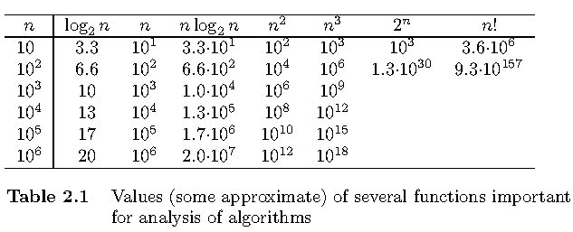
Orders of Growth - well known functions
Exponential-growth functions
一个需要指数级操作次数的算法只能用来解决规模非常小的问题
Central South University

Slide 16
分析框架——增长次数
Asymptotic Analysis
Asymptotic analysis: analyze the efficiency of algorithm when input size n→∞.
一个算法的时间复杂度(Time Complexity)T(n)是该算法的时间耗费，是该算法所求解问题规模n的函数。当问题的规模n趋向无穷大时，时间复杂度T(n)的数量级(阶)称为算法的复杂性的渐近性态（渐进时间复杂度）。
Central South University

Slide 17
渐进符号
算法效率的主要指标是基本操作次数的增长次数。
为了对这些增长次数进行比较和归类，计算机科学家们使用了3种符号：
  O（读“O”）：上界
  Ω（读”omega”）：下界
  Θ（读”theta”）：近似
Central South University

Slide 18
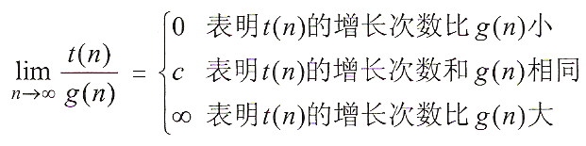
利用极限比较增长次数
前两种情况意味着t(n) =O(g(n))
后两种情况意味着t(n) =Ω(g(n))
第二种情况意味着t(n) =Θ(g(n))
Central South University

Slide 19
分析框架——算法的最优、最差和平均效率
算法的最优、最差和平均效率
  最差效率是指在输入规模为n时，算法在最坏情况下的效率。
  最优效率是指在输入规模为n是，算法在最优情况下的效率。
  平均效率是指在“典型”或“随机”输入的情况下，算法具有的行为（效率）。
  摊销效率是指对于同样的数据结构执行多次操作，然后分摊到每一次上。
Central South University

Slide 20
分析非递归算法效率的通用方案
决定用那些参数作为输入规模的度量。
找出算法的基本操作。
检查基本操作的执行次数是否只依赖输入规模。
建立一个算法基本操作执行次数的求和表达式。
利用求和运算的标准公式和法则来建立一个操作次数的闭合公式，或者至少确定它的增长次数。
Central South University

Slide 21
Example:元素唯一性问题
Algorithm UniqueElements (A[0..n-1])
//验证给定数组的元素是否全部唯一
//输入：实数数组A[0..n-1]
//输出：如果唯一，返回True，否则False
for i ← 0 to n - 2 do
for j ← i + 1 to n – 1 do
if A[i] = A[j] return false
return true
T(n) = Θ (n²)
Central South University

Slide 22
分析递归算法效率的通用方案
决定用哪个参数作为输入规模的度量
找出算法的基本操作
检查对相同规模的输入，基本操作的执行次数是否相同，如果不同，必须对最差、平均及最优效率单独研究
建立一个递推关系式及相应的初始条件
求解这个递归关系式，或者至少确定解的增长次数

Slide 23
Solving recurrences
A few tricks analyzing recurrence relation:
  Guessing: Substitution (代入法）
  Recursion tree（递归树）
  Master method（主定理/公式法）
  母函数法
  差分方程法

Slide 24
递归算法的数学分析
例：对于任意非负整数n，计算F(n)=n!的值。
n(n-1)! , n>1
F(n)=
1 , n=1
1 ,n=0
算法 F(n)
//递归计算n!
//输入：非负整数n
//输出：n!的值
if n=0 retuen 1
else return F(n-1)*n
M(n-1)+1 , n≥1
M(n)=
0 , n=0
M(n)=M(n-1)+1
=[M(n-2)+1]+1=M(n-2)+2
=[M(n-3)+1]+2=M(n-3)+3
……
=[M(n-n)+1]+n-1=n

Slide 25
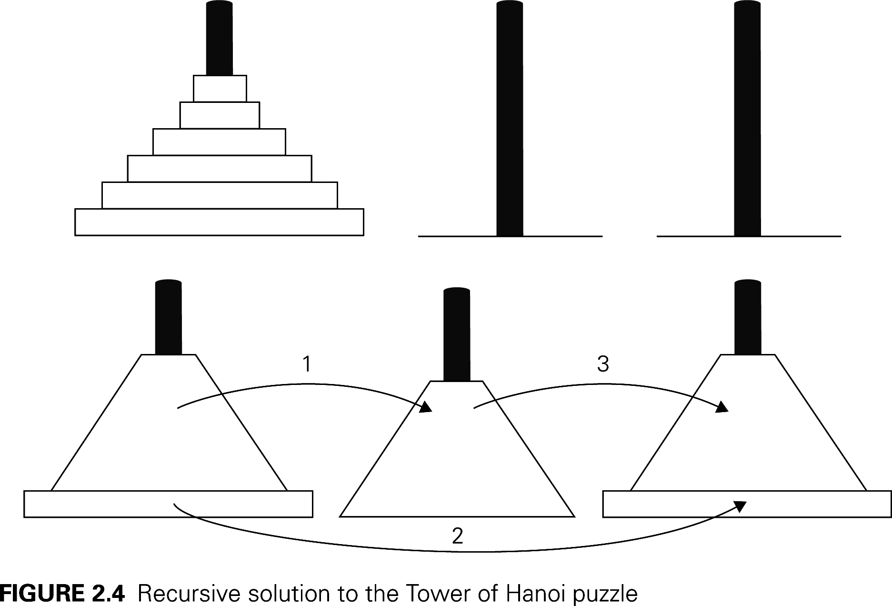
The Towers of Hanoi Puzzle
2M(n-1)+1 , n>1
M(n)=
1 , n=1
M(n)=2^{n}-1
我们应该谨慎使用递归算法，因为他们的简洁可能会掩盖他们的低效率。
© School of Computer Science and Technology, CSU

Slide 26

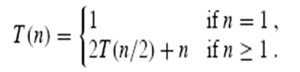

Recurrence(递归）
A recurrence is a function is defined in terms of
  one or more base cases, and
  itself, with smaller arguments(参数）.
Examples:

Slide 27
Recurrence(递归）
A recurrence is a function is defined in terms of
  one or more base cases, and
  itself, with smaller arguments(参数）.
Examples:

Slide 28

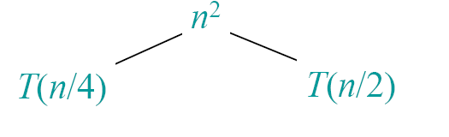
Recursion tree(递归树）

Slide 29
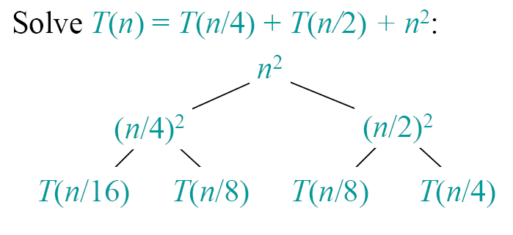
Example of recursion tree

Slide 30
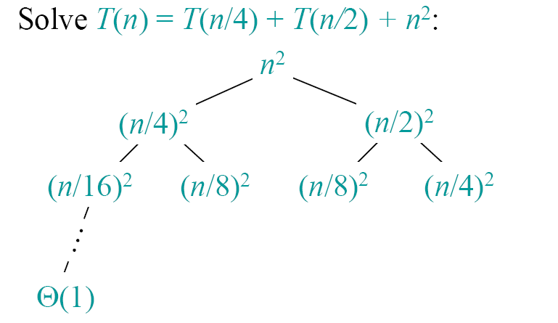
Example of recursion tree

Slide 31
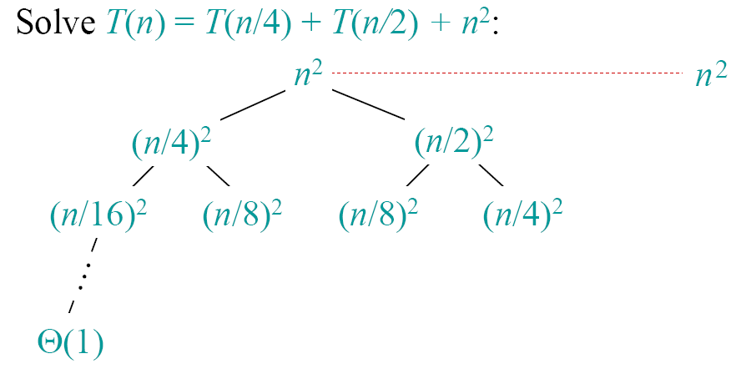
Example of recursion tree

Slide 32
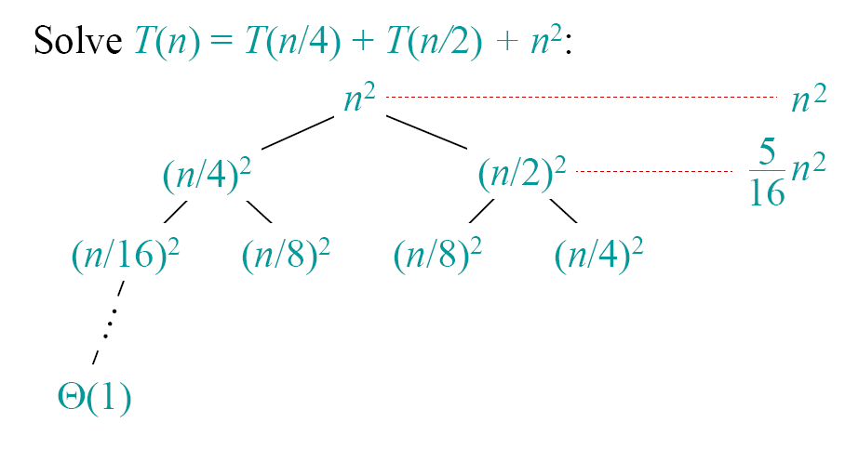
Example of recursion tree

Slide 33
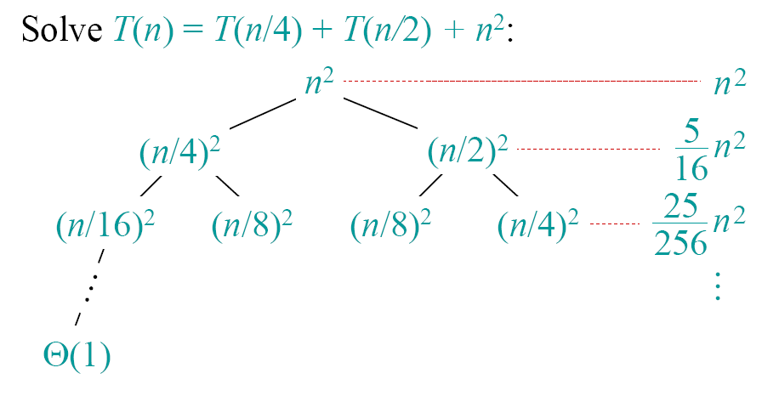
Example of recursion tree

Slide 34
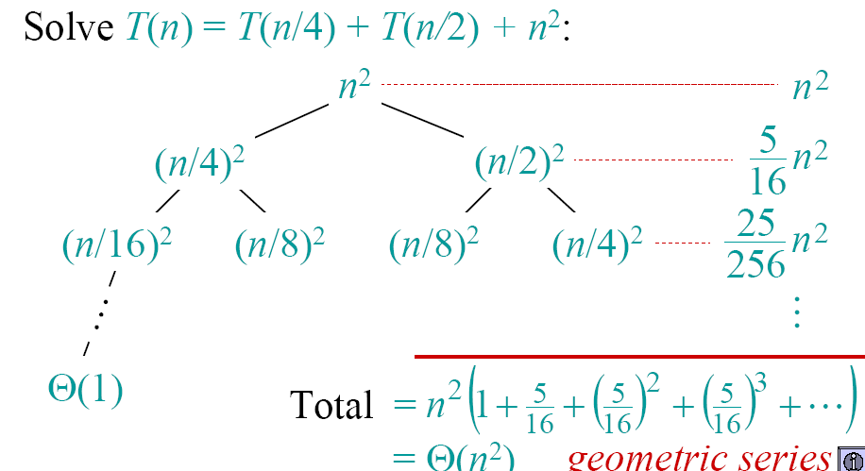
Example of recursion tree

Slide 35
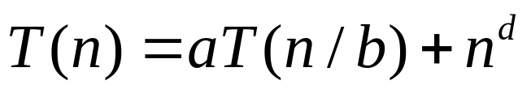
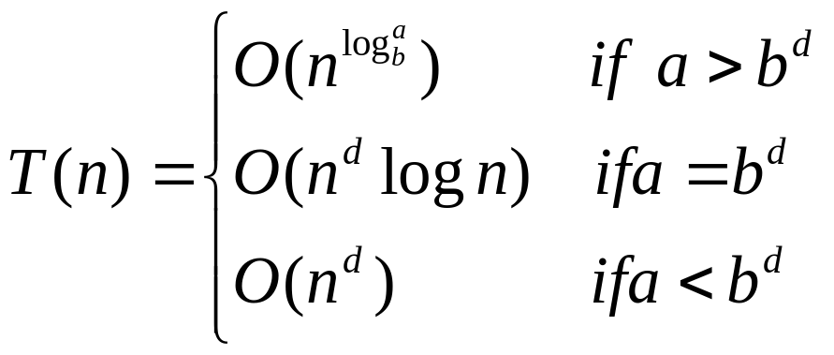
  When f(n)=n^{d}
  For

Slide 36
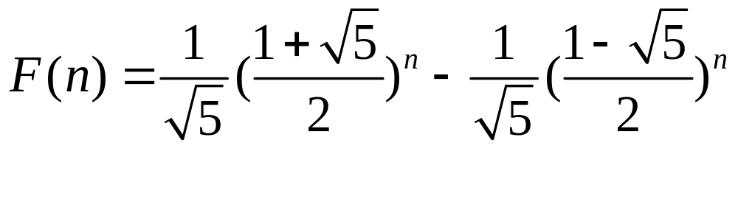
Review
Analyzing recurrence relation:
Characteristic equation
F(n) - F(n-1) - F(n-2) = 0
r² -r -1 = 0

Slide 37
分治法的一般方法
原始问题(N个输入)
原始问题的解
子问题1
子问题2
…
子问题k
相同的
类型
合并最小问题的解
子问题1
子问题2
…
子问题k
不用再分就可求解
Notes:
分治法的几个步骤：
1、将原始问题划分为k个相同类型的子问题。（问题：为什么？）
2、子问题不可解还可继续划分。（问题：分到什么时候结束？）
3、求解每个子问题。
4、将每个最小子问题的解合并成原问题的解。
分治法适用条件：
1、原始可分解，且分解出来的子问题和原始问题就有相同的类型。
2、分解出来的子问题到很小时可以很容易（在很短的时间和空间内能求解）求解。
3、子问题的解能合并。

Slide 38
General Divide and Conquer recurrence
The Master Theorem
T(n) = aT(n/b) + f (n), where f (n) = Θ(n^{d})
the time spent on solving a subproblem of size n/b.
the time spent on dividing the problem
into smaller ones and combining their solutions.
Notes:
This is the same slide from chapter 2 (analysis of recursive algorithms)
It is a good idea to remind students at this point and do some examples especially
if you went over this quickly and did not do examples the previous time.
Here are examples from before:
T(n) = T(n/2) + 1
T(n) = 2T(n/2) + n
T(n) = 3 T(n/2) + n
=> this last example is important to mention at some point:
Θ(n^{log}₂³)
NB: cannot “eliminate” or simplify this constant

Slide 39
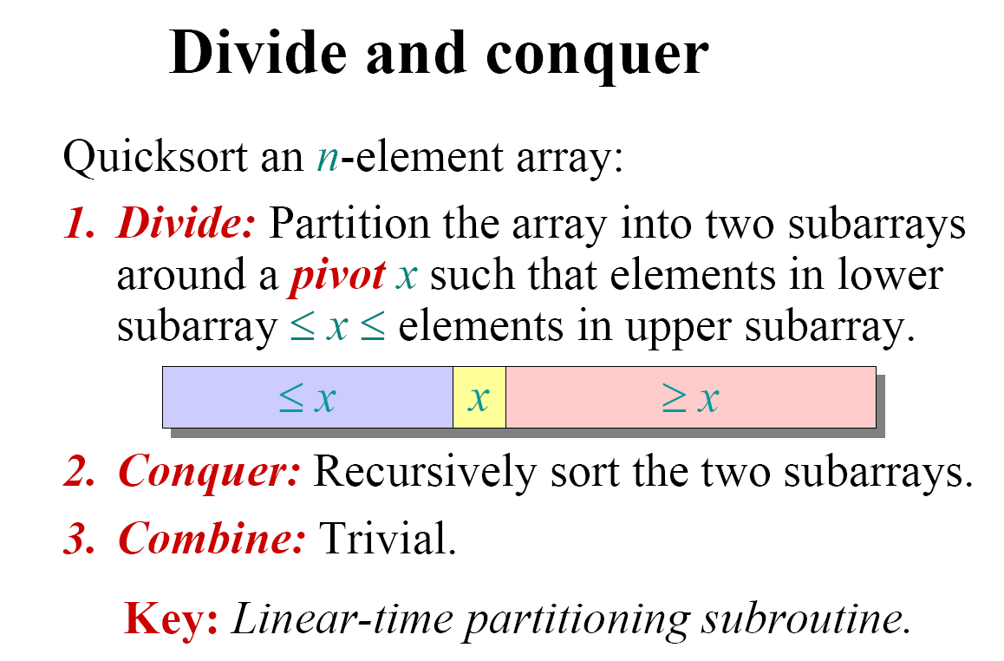
Quicksort
Quicksort(A, p, q)
{
if (p < q)
{
r = Partition(A, p, q);
Quicksort(A, p, r-1);
Quicksort(A, r+1, q);
}
}

Slide 40
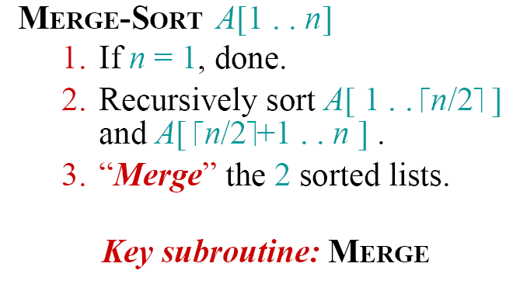
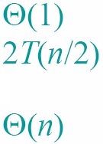
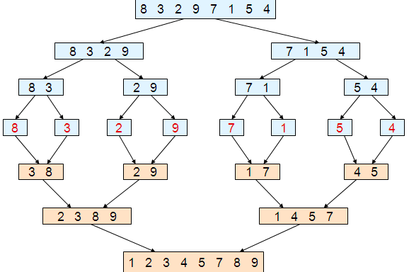
Merge sort：
Merge (B1,B2)
i₁= 1, i₂=1, i=1
While i₁≤ |B1| and i₂≤ |B2| do
if B1[i₁] ≤ B2[i₂]
then A[i]=B1[i₁]; i₁++
else A[i]=B2[i₂]; i₂++;
i=i+1;
if i₁> |B1| then
for k= i₂ to |B2| do
A[i++]=B2[k];
else for k= i₁ to |B1| do
A[i++]=B1[k];
Notes:
Merge sort :是最经典的算法，由计算机先驱之一John Von Neumann在1945年发明的。

Slide 41


Chess-Board Coverage
Given a chess-board with 2^{k}×2^{k} grids, there is one specail grid that is different from others.
Question: use the following 4 types L-bone cards to cover all grids except the special grid, requiring that any two L-bone cards could not have overlapping.

Slide 42
Strassen’s Matrix Multiplication
Two n×n matrices, where n is a power of two (What about the situations where n is not a power of two?)
    C₀₀ C₀₁ A₀₀ A₀₁ B₀₀ B₀₁
    = *
    C₁₀ C₁₁ A₁₀ A₁₁ B₁₀ B₁₁
    A₀₀ * B₀₀ + A₀₁ * B₁₀ A₀₀ * B₀₁ + A₀₁ * B₁₁
    =
    A₁₀ * b₀₀ + A₁₁ * B₁₀ A₁₀ * B₀₁ + A₁₁ * B₁₁

Slide 43
Strassen’s Matrix Multiplication
    C₀₀ C₀₁ A₀₀ A₀₁ B₀₀ B₀₁
    = *
    C₁₀ C₁₁ A₁₀ A₁₁ B₁₀ B₁₁
    M₁ + M₄ - M₅ + M₇ M₃ + M₅
    =
    M₂ + M₄ M₁ + M₃ - M₂ + M₆
M₁ = (A₀₀ + A₁₁) * (B₀₀ + B₁₁)
M₂ = (A₁₀ + A₁₁) * B₀₀
M₃ = A₀₀ * (B₀₁ - B₁₁)
M₄ = A₁₁ * (B₁₀ - B₀₀)
M₅ = (A₀₀ + A₀₁) * B₁₁
M₆ = (A₁₀ - A₀₀) * (B₀₀ + B₀₁)
M₇ = (A₀₁ - A₁₁) * (B₁₀ + B₁₁)

Slide 44
Review
Analyzing recurrence relation:
Recursion tree
Master method
How to choose methods?
Characteristic equation
T(n) = aT(n/b) + f (n)
(1) As long as f(n) exists, Recursion tree can be used.
(2) For master method, b must larger than 1.
if b>1, T(n) is polynomial.
if b=1, T(n) is always exponential. M(n) = 2M(n – 1) + 1
(3) T(n) = a₁T(n-c₁) + a₂T(n-c₂)+…+a_{i}T(n-c_{i})
b=1 and no f(n)

Slide 45
Chess-Board Coverage
Given a chess-board with 2^{k}×2^{k} grids, there is one specail grid that is different from others.
Question: use the following 4 types L-bone cards to cover all grids except the special grid, requiring that any two L-bone cards could not have overlapping.

Slide 46
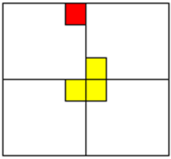
(a) (b)
Chess-Board Coverage
Strategy:
If k>0, divide the 2^{k}×2^{k} chess-board into 4 smaller chess-board of size 2^{k-1}×2^{k-1} .
2^{k-1}×2^{k-1}
2^{k-1}×2^{k-1}
2^{k-1}×2^{k-1}
2^{k-1}×2^{k-1}

Slide 47
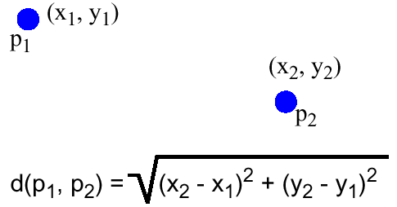
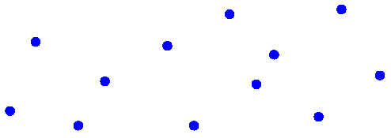
Closest pair of points
Problem definition:
Given a set S of n points in the plane (n is power of 2), c1=(x1, y1), c2=(x2, y2), …, cn=(xn, yn), where the points are ordered in ascending order of their x coordinates, find a pair points with closed instance.
Enumeration: O(n²）
Our objective: O(nlogn）

Slide 48
Tournament scheduling
Problem:
n=2^{k} players take part in Tennis Tournament.
Design a tournament scheduling satisfying the following properties:
each player must have one game with other n-1 players.
each player only has one game per day.
the tournament takes n-1 days.

Slide 49
Tournament scheduling
1 | 2 | 3 | 4 | 5 | 6 | 7 | 8
2 | 1 | 4 | 3 | 6 | 5 | 8 | 7
3 | 4 | 1 | 2 | 7 | 8 | 5 | 6
4 | 3 | 2 | 1 | 8 | 7 | 6 | 5
5 | 6 | 7 | 8 | 1 | 2 | 3 | 4
6 | 5 | 8 | 7 | 2 | 1 | 4 | 3
7 | 8 | 5 | 6 | 3 | 4 | 1 | 2
8 | 7 | 6 | 5 | 4 | 3 | 2 | 1

Slide 50
Decrease and Conquer (减治法)
Basic idea for decrease and conquer
Fake-coin problem
Find the k-th smallest element
Insertion Sort
DFS&BFS
Topological sorting
Notes:
Decrease and Conquer

Slide 51
5.1 减治法的设计思想
规模为n的原问题的解与较小规模（通常是n/2）的子问题的解之间具有关系：
（1）原问题的解只存在于其中一个较小规模的子问题中；
（2）原问题的解与其中一个较小规模的解之间存在某种对应关系。
由于原问题的解与较小规模的子问题的解之间存在这种关系，所以，只需求解其中一个较小规模的子问题就可以得到原问题的解。
Central South University

Slide 52
A Typical Decrease by One Technique
a problem of size n
subproblem
of size n-1
a solution to the
subproblem
  e.g., n! =(n-1)!*n
a solution to
the original problem
Central South University

Slide 53
减治法有三种变种
  减去一个常量
  例如减一法
  计算a^{n}的值: a^{n}= a^{n-1} * a
  减去一个常数因子
  例如减半思想
  计算a^{n}的值
  减去的规模是可变的
  算法在每次迭代时 规模减小的模式不同。
  例如：计算最大公约数的欧几里得算法
  gcd(m,n)=gcd(n,m mod n)
⎧
a
n
=
1
⎪
a
n
=
⎨
(
a
n
2
)
2
n
>
1
且是偶数
⎪
(
a
(
n
−
1
)
2
)
2
×
>
⎩
a
n
1
且是奇数
Central South University

Slide 54
Find the k-th smallest element
Problem:
Given n elements saved in a[](all elements are different), an integer k, 1≤k ≤ n, find the k-th smallest element in a[] in O(n) time.
If a[] is sorted, a[k-1] is the k-th element.
Central South University

Slide 55
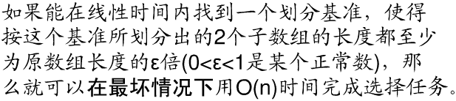
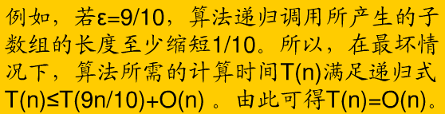
Find kth smallest element based on Quicksort
Worst case complexity: O(n²)
Our objective: the worst case running time is still O(n).
Central South University

Slide 56

Find kth smallest element
Strategy:
(1) Divide the elements in a[] into groups.
(2) Sort each group with any arbitrary sorting algorithm.
(3) For each group, find the median element. Then, there are totally median elements.
(4) Denote the set of median elements found by M, |M|= . Recursively find the median elements of M, denoted by x.
(5) Partition with pivot x.
Central South University

Slide 57
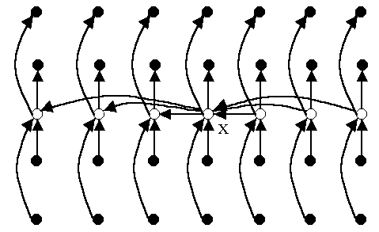
Find kth smallest element
How to get the recursive relation?
How many elements are less than pivot x?
(1) In each group , there are two elements less than the median of this group;
(2) How many are less than x?
There are at least 3 n/10 elements that are less than pivot x.
Central South University

Slide 58
Find kth smallest element
Select(a[],k) //T(n)
1. if size of a[] is less than 10, sort [] using any sorting algorithm;
2. Divide a[] into M=⎣n/5⎦ groups, each of which has size 5;
3. Find the median of each group and denote the set of medians by M;
4．x←Select(M,⎡|M|/2⎤); //T(n/5)
5．Compare the elements of a[] with x;
Let S1 be the set of elements less than x, and
let S2 be the set of elements larger than x;
6．if k ≤ |S1| then Select(S1,k) //T(|S1|)
7．else Select(S2,k-|S1|); //T(|S2|)
Central South University

Slide 59
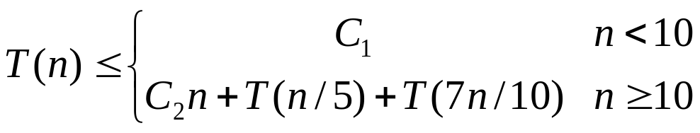
Find kth smallest element
T(n)=O(n)
Group size 5 and 10 is the critical point for recursion.
n/5+7n/10=9n/10=εn，0<ε<1
Besides 5 and 10, there are many other options.
Central South University

Slide 60
Graph Traversal
Graph traversal algorithms:
  Depth-first search
  Breadth-first search
Central South University
Notes:
Decrease and Conquer

Slide 61
Depth-First Search: The Code
DFS(G)
{
for each vertex u
{
u.color = WHITE;
}
time = 0;
for each vertex u
{
if (u.color == WHITE)
DFS_Visit(u);
}
}
DFS_Visit(u)
{
u.color = gray;
time = time+1;
u. d = time;
for each v ∈ u.Adj[]
{
if (v.color = = WHITE)
DFS_Visit(v);
}
u.color = black;
time = time+1;
u.f = time;
}

Slide 62
Depth-first search: Notes
DFS can be implemented with graphs represented as:
  Adjacency matrices: Θ(|V |²)
  Adjacency linked lists: Θ(|V |+|E| )
Applications:
  checking connectivity
  finding connected components
  Test if a graph has cycle.
  Others…..
Notes:
Decrease and Conquer

Slide 63
Breadth-first search (BFS)
The idea
  Traverse “wider” whenever possible.
  Discover all vertices at distance k from s (on level k) before discovering any vertices at distance k +1 (at level k+1)
Instead of a stack, breadth-first uses a queue.
Notes:
Decrease and Conquer

Slide 64
Breadth-First Search
BFS(G, s) {
initialize vertices;
Q = {s}; // Q is a queue ; initialize to s
while (Q not empty) {
u = RemoveTop(Q);
for each v ∈ u.adj {
if (v.color == WHITE)
v.color = GREY;
v.d = u.d + 1;
v.p = u;
Enqueue(Q, v);
}
u.color = BLACK;
}
}
What does v.d represent?
What does v.p represent?

Slide 65
Breadth-first search: Notes
BFS has same efficiency as DFS and can be implemented with graphs represented as:
  Adjacency matrices: Θ(|V |²)
  Adjacency linked lists: Θ(|V |+|E| )
Applications:
  checking connectivity
  finding connected components
  finding paths between two vertices with the smallest number of edges
Notes:
Decrease and Conquer
Use a tree.

Slide 66
Topological Sorting
Problem: Given a Directed Acyclic Graph(DAG) G = (V, E), find a linear ordering of all its vertices such that if G contains an edge <u, v>, then u appears before v in the ordering.
Example: Give an order of the courses so that the prerequisites are met.
Question: Is the problem solvable if the digraph contains a cycle?
C4
C1
C3
C2
C5
Notes:
Decrease and Conquer

Slide 67

变治法(Transform and Conquer)
减治是基于变换的思想。
分两个阶段工作，即“变”阶段和“治”阶段.
变治法的三种类型：
  1)实例化简(instance simplification)
  2)改变表现(representation change)
  3)问题化简(problem reduction)
Central South University

Slide 68
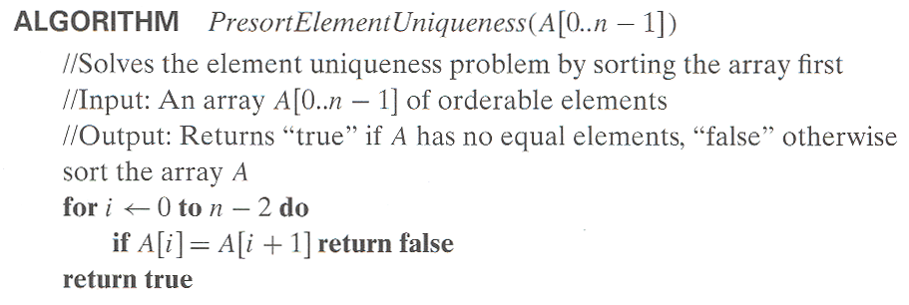
预排序(Presorting)
如果列表是有序的话，许多关于列表的问题更容易解决。
例1：检查数组中元素的唯一性
T(n)=T_{sort}(n)+T_{scan}(n)
T_{sort}(n)=Θ(nlogn)
T_{scan}(n)=Θ(n)
T(n)= Θ(nlogn)
Central South University

Slide 69
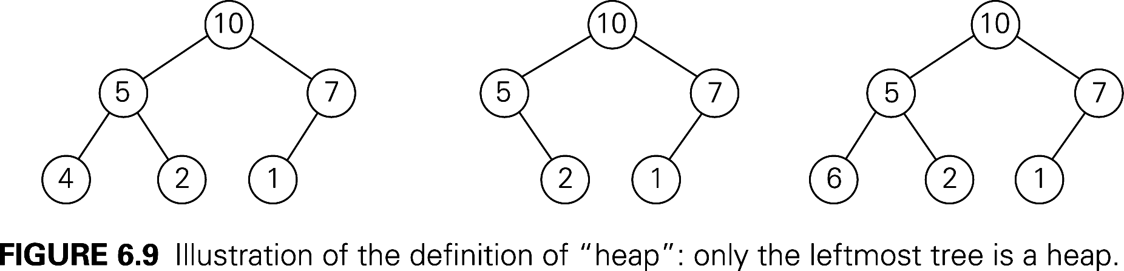
堆(Heap)
堆：一棵二叉树，且满足以下条件：
  是一棵完全二叉树
  每个节点的键大于或等于子女节点的键
All its levels are full except possibly the last level, where only some rightmost leaves may be missing.
…
Central South University

Slide 70
Properties of Heaps (1)
9
Heap and its array representation.
  think heap as a binary tree.
  it is easier and more efficient to implement a heap using an array.
    Store the BFS traversal of the heap’s elements in position 1 through n, leaving H[0] unused.
Relationships between indexes of parents and children.
5
3
1
4
2
1 2 3 4 5 6
9 5 3 1 4 2
PARENT(i) LEFT(i) RIGHT(i)
return ⎣i/2⎦
return 2i
return 2i+1
Central South University

Slide 71
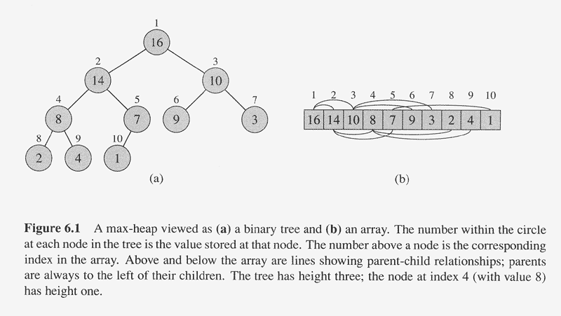
Central South University

Slide 72
Bottom-up Heap construction
Build an essentially complete binary tree by inserting n
keys in the given order.
Heapify a series of trees
1. Starting with the last (rightmost) parental node A(n/2), heapify/fix the subtree rooted at it:
if the parental dominance condition does not hold for the key at this node then
    exchange its key K with the key of its larger child;
    Heapify/fix the subtree rooted at it ;
    (now in the child’s position)
2. Stops after this is done for the tree’s root (A(1)).
Central South University

Slide 73
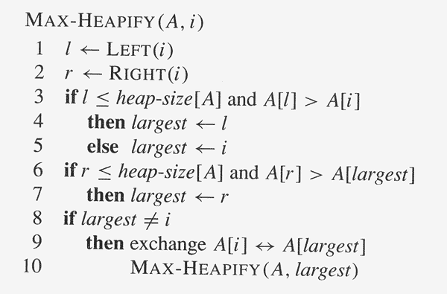
ALGORITHM HeapBottomUp(A[1..n])
for i ← ⎣n/2⎦ downto 1 do
MAX-HEAPIFY(A, i)
Central South University

Slide 74
Example: 4 1 3 2 16 9 10 14 8 7
→ 16 14 10 8 7 9 3 2 4 1
在最坏的情况下，自底向上构建堆的算法的效率？
Central South University

Slide 75
Worst-Case Efficiency
Worst case:
a full tree; each key on a certain level will travel to the leaf.
  Fix a subtree rooted at height j: 2j comparisons
  Fix a subtree rooted at level i : 2(h-i) comparisons
    A node’s level + its height = h, the tree’s height.
  Total for heap construction phase:
h-1
Σ
2(h-i) 2^{i} = 2 ( n – lg (n + 1)) = Θ(n)
i=0
# nodes at level i
Central South University

Slide 76
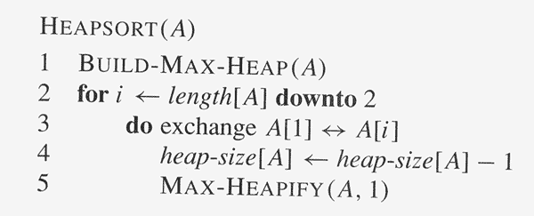
Heap sort
Central South University

Slide 77
Analysis of Heapsort
Recall algorithm:
    Bottom-up heap construction
    Root deletion
    3. Repeat 2 until heap contains just one node.
Θ(n)
Θ(log n)
n – 1 times
Total: Θ(n) + Θ( n log n) = Θ(n log n)
Note: this is the worst case. Average case also Θ(n log n).
Central South University

Slide 78
动态规划的思想及特性
可以使用动态规划的问题特点
  一个大问题可以划分为若干个子问题
  子问题：性质一样但是规模变小的问题
  最优子结构
  在计算时子问题有交叠。(交叠子结构)
记忆化思想
  对较小的子问题进行一次求解，并把结果记录下来，然后利用较小问题的解，求解出较大问题的解，直到求解出最大问题的解。[同一件事情不做第二次]

Slide 79
最优性原理(Principle of Optimality)
  最优性原理：无论过程的初始状态和初始决策是什么，其余的决策都必须相对于初始决策所产生的状态构成一个最优决策序列。
  不管前面的策略如何，此后的决策必须基于当前状态（由上一次决策产生）的最优决策。
  最优子结构性质：原问题的最优解包含了其子问题的最优解，即最优化原理成立。
  一般来说，如果所求解问题对于最优性原理成立，则说明用动态规划方法有可能解决该问题。而解决问题的关键在于获取各阶段问的递推关系式。

Slide 80
Dynamic programming vs. divide-and-conquer
Divide-and-conquer algorithms split a problem into separate subproblems, solve the subproblems, and combine the results for a solution to the original problem.
Divide-and-conquer algorithms can be thought of as top-down algorithms
In contrast, a dynamic programming algorithm proceeds by solving small problems, then combining them to find the solution to larger problems
Dynamic programming can be thought of as bottom-up
Store and not store solutions to subproblems

Slide 81
Examples of Dynamic Programming Algorithms
  Computing binomial coefficients
  multistage graph problem
  Longest path in DAG
  Edit distance
  Knapsack
  Chain matrix multiplication
  all-pairs shortest paths
  Traveling salesman

Slide 82
Dynamic programming solution:
Record the values of the binomial coefficients in a table of n+1 rows and k+1 columns, numbered from 0 to n and 0 to k respectively.
0 1 2 3 … k-1 k
0 1
1 1 1
2 1 1
3 1 1
…
k 1 1
…
n-1 1
n 1

Slide 83
Dynamic programming solution:
Record the values of the binomial coefficients in a table of n+1 rows and k+1 columns, numbered from 0 to n and 0 to k respectively.
0 1 2 3 … k-1 k
0 1
1 1 1
2 1 2 1
3 1 1
…
k 1 1
…
n-1 1
n 1

Slide 84
Dynamic programming solution:
Record the values of the binomial coefficients in a table of n+1 rows and k+1 columns, numbered from 0 to n and 0 to k respectively.
0 1 2 3 … k-1 k
0 1
1 1 1
2 1 2 1
3 1 3 3 1
…
k 1 1
…
n-1 1
n 1

Slide 85
Dynamic programming solution:
Record the values of the binomial coefficients in a table of n+1 rows and k+1 columns, numbered from 0 to n and 0 to k respectively.
0 1 2 3 … k-1 k
0 1
1 1 1
2 1 2 1
3 1 3 3 1
…
k 1 1
…
n-1 1 C(n-1,k-1) C(n-1,k)
n 1

Slide 86
Dynamic programming solution:
Record the values of the binomial coefficients in a table of n+1 rows and k+1 columns, numbered from 0 to n and 0 to k respectively.
0 1 2 3 … k-1 k
0 1
1 1 1
2 1 2 1
3 1 3 3 1
…
k 1 1
…
n-1 1 C(n-1,k-1) C(n-1,k)
n 1 C(n,k)

Slide 87
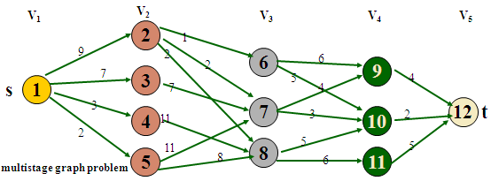
例2：多段图(multistage graph problem)
多段图G＝(V，E)是—个有向图。它具有如下特性：
  图中的结点被划分成k≥ 2个不相交的集合V_{i} ,1≤i≤k,其中V₁和V_{k}分别只有一个结点s(源点)和t(汇点)。
  图中所有的边<u,v>均具有如下性质：若u∈V_{i} ，则v ∈ V_{i+1} ,1≤i≤k,且每条边<u,v>均附有成本c(u，v)。
  从s到t的一条路径成本是这条路径上边的成本和。
  多段图问题是求由s到t的最小成本路径。

Slide 88
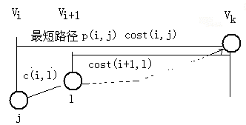
2）写出动态规划方程
设P(i，j)是一条从V_{i}中的结点j到汇点t的最小成本路径，
COST(i，j)是这条路的成本。
则从V_{i}中节点j到t的最小代价为：
cost(i,j)=min{cost(i+1,l)+c (j,l) }, l∈V_{i+1} ， j∈V_{i}
cost(i+1，l)是从V_{i+1}中节点l 到t的最小代价，

Slide 89
向后递推规划方法
s
V_{i-1}
v_{i}
t
c[i-1,l]
……….
l
j
……….
Cost[i-1,l]
Cost[i,j]
Cost[k,n]
Cost[1,s]=0已知 可求得Cost[2,j]
对于任意的cost[i,j]，有
cost[i,j]=min{cost[i-1,l]+c[l,j] } j∈V_{i} ，l ∈V_{i-1}
最后求出s,…..v_{i}，…，v_{k-1}，t。

Slide 90
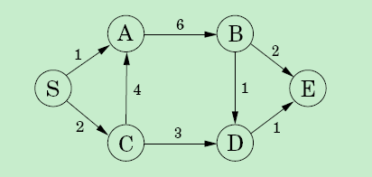
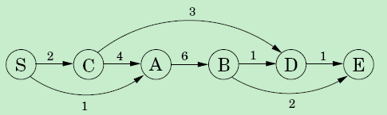
例3： Longest path in DAG
  Problem:
  Given a weighted directed acyclic graph G=(V, E), a vertex v, where each edge is assigned an integer weight, find a longest path in graph G.

Slide 91
Longest path in DAG
dilg(v): the longest path ending with v.
dilg(D), dilg(B), dilg(C)
dilg(D)=max{dilg(B)+1, dilg(C)+3}
For any vertex v,
dilg(v)=max_{(u,v)∈E}{dilg(u)+w(u, v)}

Slide 92


例4： Edit Distance
The distance between strings: alignment
Alignment: a way of writing the strings one above the other.
The “－”indicates a “gap”;
any number of these gap can be placed in either string.
The cost of an alignment is the number of columns in which the letters differ.

Slide 93


Edit Distance
Subproblem E(7, 5)
subproblem E(i, j):
express E(i, j) in terms of smaller subproblems
What do we know about the best alignment between x[1..i], y[1..j]?
rightmost column

Slide 94
Edit Distance
Subproblem E[i,j] rightmost column
E(i, j) E(i-1, j)
E(i, j) E(i, j-1)
E(i, j) E(i-1, j-1)
Relationship
Relationship
Relationship
E(i,j)=1+E(i-1,j)
E(i,j)=1+E(i,j-1)
E(i,j)=1/0+E(i-1,j-1)
If x[i]=x[j] then diff(i, j)=0, otherwise diff(i, j)=1.
E(0, j)=j；E(i, 0)=i.

Slide 95
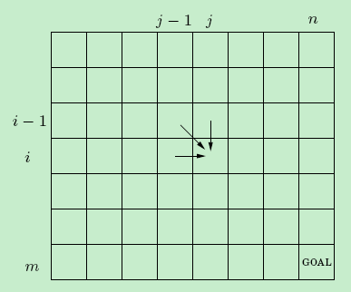
Edit Distance
The answers to all the subproblems E(i, j) form a two-dimensional table.

Slide 96

Subproblems choosing
The finding of subproblems is an important step in Dynamic programming.
Commonly used methods:
The input is x1, x2, …, xn.
a subproblem is x1, x2, …, xi.
How many subproblems for this case?
O(n)

Slide 97
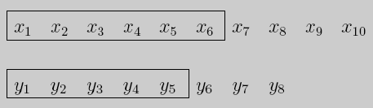
Subproblems choosing
2. The input is x1, x2, …, xn, and y1, y2,…, ym.
a subproblem is x1, x2, …, xi and y1,…, yj.
How many subproblems for this case?
O(mn)

Slide 98

Subproblems choosing
3. The input is x1, x2, …, xn.
a subproblem is xi, xi+1, …, xj.
How many subproblems for this case?
O(n²)

Slide 99
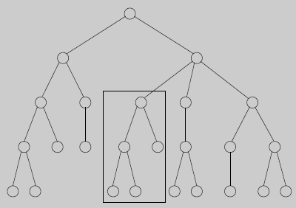
Subproblems choosing
3. The input is a rooted tree.
a subproblem is a rooted subtree.
If the tree has n nodes?
How many subproblems are there?

Slide 100

例5： Knapsack
During a robbery, a burglar finds much more loot than he had expected and has to decide what to take.

Slide 101
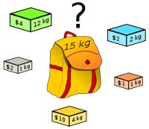
Knapsack
His bag (or .knapsack.) will hold a total weight of at most W pounds.
There are n items to pick from, of weight w1, …,wn and
value v1,…,vn.
What's the most valuable combination of items he can fit into his bag?

Slide 102

Knapsack
Knapsack with repetition
K(w) k(w-wi)
K(w)=k(w-wi)+vi
don't know which i
try all possibilities
K(w)
K(w-w1)
K(w-w2)
…
K(w-wn)
K(0)=0

Slide 103
Knapsack
Knapsack without repetition
What are the subproblems?
K(w, j) = maximum value achievable using a knapsack of capacity w and items 1, …,j.
K(W, n) is the answer.
How to get subproblem K(w, j) in terms of smaller subproblems?
K(w,j)=max{K(w-wj, j-1)+vj, K(w,j-1)} w ≥ wj
K(w,j)=K(w,j-1)
w < wj
K(0,j)=0, K(w, 0)=0.

Slide 104
Knapsack
 | 0 | … | w-w_{j} | … | w | … | W
0 | 0 | … | 0 | … | 0 | …. | 0
： | ： | …
j-1 | 0 | … | K[w-wj, j-1] |  | K[w,j-1]
j | 0 | … |  |  | K[w, j]
n | 0 | … |  |  |  |  | goal

Slide 105
例6： Chain matrix multiplication
Multiply four matrices:A×B×C×D
A: 50×20 B: 20×1 C: 1×10 D: 10×100
Matrix multiplication:
not commutative: A×B ≠B×A
Associative: A×(B×C)=(A×B)×C
Multiply an m×n matrix by an n×p matrix
mnp multiplications

Slide 106
Chain matrix multiplication
Matrix multiplication Binary tree
for a tree to be optimal, its subtrees must also be optimal.
What are the subproblems corresponding to the subtrees?
A_{i}×A_{i+1}×…×A_{j}
C(i, j)=minimum cost of mulitiplying A_{i}×A_{i+1}×…×A_{j} . 1≤i≤j≤n

Slide 107
Chain matrix multiplication
C(i, j)=minimum cost of mulitiplying A_{i}×A_{i+1}×…×A_{j}. 1≤i≤j≤n
How to get subproblem C(i, j) in terms of smaller subproblems?
for a k between i and j,
A_{i}×…×A_{k} and A_{k+1}×…×A_{j}
C(i, k)
C(k+1, j)
C(i, j) C(i, k) C(k+1, j)
j≥i
C(i, i)=0.
j=i

Slide 108
例7： All pairs shortest path
For a fixed starting point s, the shortest path from s to other vertices can be found in O(|V||E|) by Bellman-Ford algorithm.
Find shortest path for all pair vertices in given graph.
Straight strategy: run Bellman-Ford algorithm |V| times.
Running time: O(|V|²|E|)
Our objective: O(|V|³)

Slide 109
All pairs shortest path
D^{(k)} : allow 1, 2, …, k to be intermediate vertices.
How to get subproblem d_{ij}^{(k)} in terms of smaller subproblems?
d_{ik}^{(k-1)}
k
i
d_{kj}^{(k-1)}
d_{ij}^{(k-1)}
j
d_{ij}^{(k)} = min{d_{ij}^{(k-1)} , d_{ik}^{(k-1)} + d_{kj}^{(k-1)}} for k ≥ 1,
d_{ij}⁽⁰⁾ ⁼ w_{ij}

Slide 110
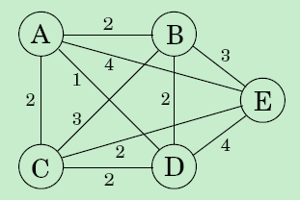
例8： Traveling Salesman
Problem(TSP):
Given a weighted complete graph G=(V, E), where each edge has a weight, find a simple cycle passing through each vertex exactly once and the total weight is minimized.
Brute force: O(n!)

Slide 111


Traveling Salesman
For a subset S {1,2,…,n} such that 1∈S and j∈S.
let C(S, j) be the length of the shortest path visiting each node in S exactly once, starting at 1 and
ending at j.
How to express C(S, j) in terms of smaller subproblems?
C({1},1)=0;

Slide 112
回溯法(Backtracking)
回溯法是从初始状态出发，按照深度优先搜索的方式，根据产生子结点的条件约束，搜索问题的解。当发现当前结点不满足求解条件时，就回溯，尝试其他的路径。回溯法是一种“能进则进，进不了则换，换不了则退”的搜索方法。
回溯法指导思想——走不通，就掉头。

Slide 113
回溯法
回溯法在问题的解空间树中，按深度优先策略，从根结点出发搜索解空间树。
算法搜索至解空间树的任意一点时，先判断该结点是否包含问题的解。
如果肯定不包含，则跳过对该结点为根的子树的搜索，逐层向其祖先结点回溯；
否则，进入该子树，继续按深度优先策略搜索。
直到根结点的所有子树都已被搜索。

Slide 114
回溯法
求问题所有解：要回溯到根，且根结点的所有子树都已被搜索遍才结束。
求任一解：只要搜索到问题的一个解就可结束。
回溯算法设计过程
step1 确定问题的解空间；
step2 确定结点的扩展规则；
step3 搜索解空间。

Slide 115
Example: 0/1 knapsack problem with n=3, W=[16,15,15], P=[45,25,25],M=30.
At first, A is a “live node”, and also an “extension node”, then move deeper to B, B to D, D is a “dead node”( why?)
A
1
0
B
C
1
0
0
1
D
E
F
G
1
0
1
0
1
0
1
0
H
I
J
K
M
L
N
O

Slide 116
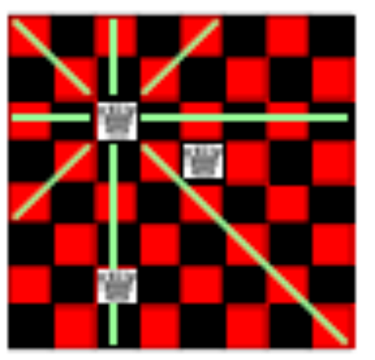
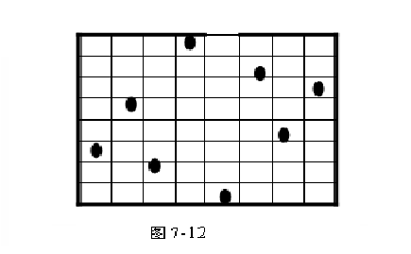
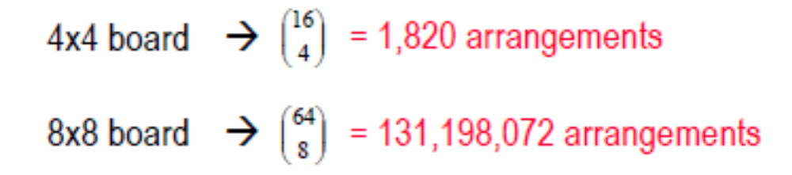
n-queen problem
  n皇后问题:要在n*n的国际象棋棋盘中放n个皇后，使任意两个皇后都不能互相吃掉。规则：皇后能吃掉同一行、同一列、同一对角线的任意棋子。求所有的解。
How to solve it?
systematically generate every possible arrangement
test each one to see if it is a valid solution

Slide 117
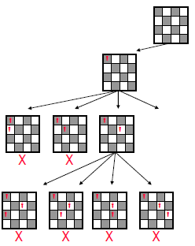
c递归回溯算法
int a[100], n;
main(){
input(n);
backtrack(1);
}
backtrack(int k){
if (k>n) 找到一个解输出结果;
else
for (int i = 1;i <=n; i++)
{
a[k] = i;
if (check2(a,k) = 1) backtrack(k+1);
}
}

Slide 118
d非递归回溯算法
backdate (int n)
{ int k;
a[1]=0; k=1;
while( k>0 ){
a[k]=a[k]+1;
while ((a[k]<=n) and (check(a,k)=0)) //搜索第k个皇后位置
a[k]=a[k]+1;
if（ a[k]<=n）
if (k=n) output(n); //找到一组解
else {k=k+1; //继续为第k+1个皇后找到位置
a[k]=0;} //注意下一个皇后一定要从头开始搜索
else k=k-1; //回溯
}
}

Slide 119
Subset sum problem
Problem:
Given a set W of n different integers and positive integer M, W={w_{i}| w_{i} >0，i=1，2，…，n}, find all subset S such that the sum of all integers in S equals to M.

Slide 120
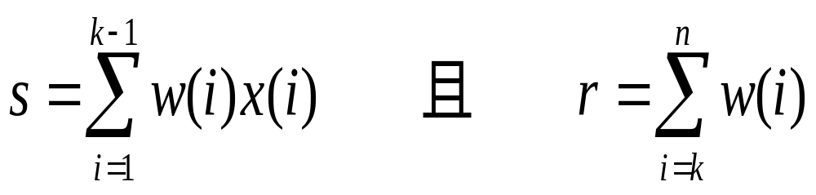
设s<M，s+r≥M和s+W(K) ≤M。
如果在这个假设下测试问题的解，那么(x₁，x₂，…， x _{k-1}，1)很可能是问题的解，所以进入测试的第一件事就应该是检测(x₁，x₂，…， x_{k-1}，1)是否为问题的解，如果是，则输出并回溯；
如果不是，则测试以(x₁，x₂，…， x _{k-1}，1)为根的左子树
以及以(x₁，x₂，…， x _{k-1}，0)为根的右子树。

Slide 121
例n＝6，M＝30和W(1：6)＝(5，10，12，13，15，18)。S=0,r=73 ,k=1
0,1,73
X(1)=1
X(1)=0
5,2,68
0,2,68
X(2)=1
15,3,58
5, 3,58
10,3,58
0,3,58
X(3)=0
15,4,46
17,4,46
10,4,46
12,4,46
0,4,46
X(4)=0
15,5,33
17, 5,33
10,5,33
12,5,33
…….
X(5)=1
(1,0,1,1)
12,6,18
(1,1,0,0,1)
(0,0,1,0,0,1)

Slide 122
分支限界法的基本思想
分支限界法与回溯法的不同
（1）求解目标：回溯法的求解目标是找出解空间树中满足约束条件的所有解，而分支限界法的求解目标则是找出满足约束条件的一个解，或是在满足约束条件的解中找出在某种意义下的最优解。
（2）搜索方式的不同：回溯法以深度优先的方式搜索解空间树(纵)，而分支限界法则以广度优先或以最小耗费优先的方式搜索解空间树(横)。

Slide 123
分支限界法的基本思想
以广度优先或以最小耗费（最大效益）优先的方式搜索问题的解空间树。
在分支限界法中，每一个活结点只有一次机会成为扩展结点。活结点一旦成为扩展结点，就一次性产生其所有孩子结点。在这些孩子结点中，导致不可行解或导致非最优解的孩子结点被舍弃，其余孩子结点被加入活结点表中。
此后，从活结点表中取下一结点成为当前扩展结点，并重复上述结点扩展过程。这个过程一直持续到找到所需的解或活结点表为空时为止。

Slide 124
分支限界法的基本思想
分支限界法的一般解题步骤：
（1）定义问题的解空间。
（2）确定问题的解空间组织结构。
（3）搜索解空间。搜索前要定义判断标准（约束函数或限界函数），如果选用优先队列式分支限界法，则必须确定优先级。

Slide 125
分支限界法的基本思想
常见的两种分支限界法
（1）队列式(FIFO)分支限界法
按照队列先进先出（FIFO）原则选取下一个节点为扩展节点。
（2）优先队列式分支限界法
按照优先队列中规定的优先级选取优先级最高的节点成为当
前扩展节点。

Slide 126
分支限界法的基本思想
结点x的最小耗费函数c(x):以x为根的子树所包含的回答结点中,路权最小者。若x是回答结点, 则c(x)即为该点的目标函数值; 若x是根结点, 则c(x)即为最优解值。c(x)为单增函数，不能即时求得, 取能即时计算的下界函数代替。
目标函数限界U的调整:初始U可取∞，随回答结点值的求出逐步更新
为U=c(x*), x*为已知回答结点中值最小者。

Slide 127
Item weight value value/weight
1 4 40 10
2 7 42 6
3 5 25 5
4 3 12 4
W=10
w=0,v=0
Ub=100
With 1
W/o 1
w=4,v=40
Ub=76
w=0,v=0
Ub=60
w=11
w=4,v=40
Ub=70
w=9,v=65
Ub=69
w=4,v=40
Ub=64
w=12
w=9,v=65
Value=65

Slide 128
Example: 0/1 knapsack problem with n=3,
W=[16,15,15], P=[45,25,25],M=30.
A
1
0
B
C
1
0
0
1
D
E
F
G
1
0
1
0
1
0
1
0
H
I
J
K
L
M
N
O
队列式分支限界法(处理法则:先进先出)：{}—>{A}—>{B,C}—>{C,D,E}(D是不可行解，舍弃)—>{C,E}—>{E,F,G}—>{F,G,J,K}(J是不可行解，舍弃)—>{F,G,K}—>{G,K,L,M}—>{K,L,M,N,O}—>{}
优先队列式分支限界法(处理法则:价值大者优先)：{}—>{A}—> {B,C}—>{C，D，E}—>{C，E}—>{C，J，K}—>{C}—>{F，G}—>{G，L，M}— >{G，M}—>{G}—>{N，O}—>{O}—>{}

Slide 129
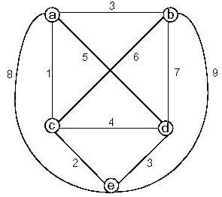
例3.旅行售货员问题
0
a
Ib=14
2
3
4
1
a,b
Ib=14
a,c
a,d
Ib=16
a,e
Ib=19
5
6
7
a,b,c
Ib=16
a,b,e
Ib=19
a,b,d
Ib=16
b is not before c
8
9
10
11
a,b,c,d,e,a
l=24
a,b,c,e,d,a
l=19
a,b,d,c,e,a
I=24
a,b,d,e,c,a
I=16

Slide 130
分支限界法适用的问题：
（1） 0-1背包问题；
（2）单源最短路径问题
（3）旅行售货员问题
（4）装载问题；
（5）布线问题
（6）最大团问题；
（7）电路板排列问题
（8）批处理作业调度问题
。。。。。。

