Slide 1

Conceptual Architecture of Apollo System
Group ArchiTiger
url:https://www.youtube.com/watch?v=evYjKNFLBBI&ab_channel=PipiGiao

Slide 2
Group Members Intro
Leader:
Poppy Li 20181706 (Evolution, Use Case#2, Naming Conventions)
Presenter:
Xuan Xiong 20147035 (Abstract, Introduction, Subsystem Breakdown, Subsystem Interactions)
Yuen Zhou 20186821 (Use Case#1, Responsibilities among participates)
Other Group members:
Yingjie Gong 20144264 (Control & Data Flow, Conclusion)
Wang Zhimu 20190758 (Lessons Learned)
Baisheng Zhang 20094496 (Concurrency, Lessons Learned)

Slide 3

A brief Introduction to Apollo
Apollo System released by Baidu provides users Autonomous Driving solutions, it is an open-source platform which is available for all developers in Autonomous Driving field. Our presentation about the architecture will focus on its open software platform.

Slide 4
Architecture Style
- Publish-Subscribe Style with some layered style

Slide 5
System Breakdown
Key components:
Perception Sys: Improves the accuracy of detection and recognition
Prediction Sys: Predicts traffic conditions
Planning Sys: Provides the Autonomous Driving plans
Control Sys: Control the car
Guardian: Intervene once the Monitor detects failure
CANBus: Passing commands
HD-Map: High Definition Map
Localization Sys: Provides GPS localization
Monitor: The surveillance of the system
HMI: Human Machine Interface

Slide 6
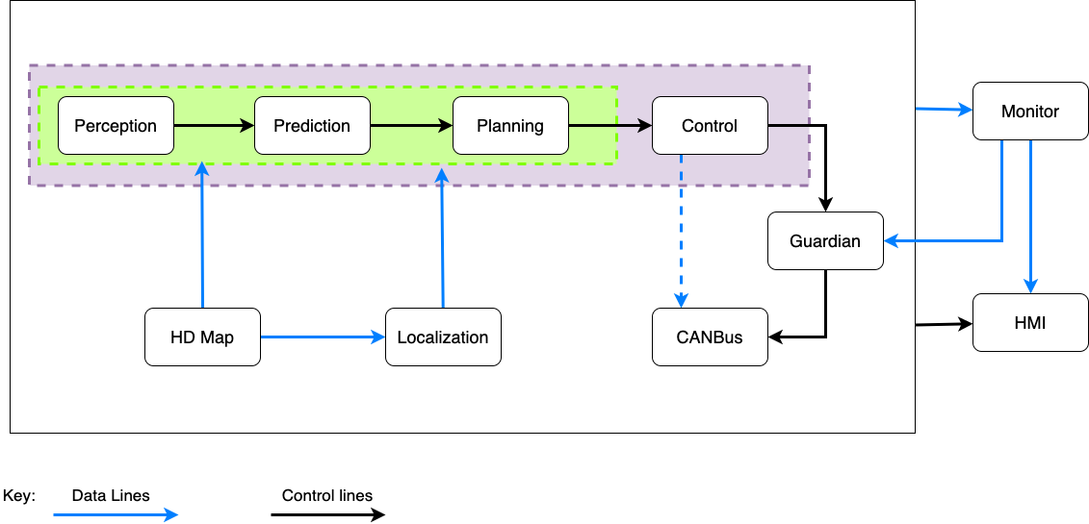
Control & Data Flow

Slide 7
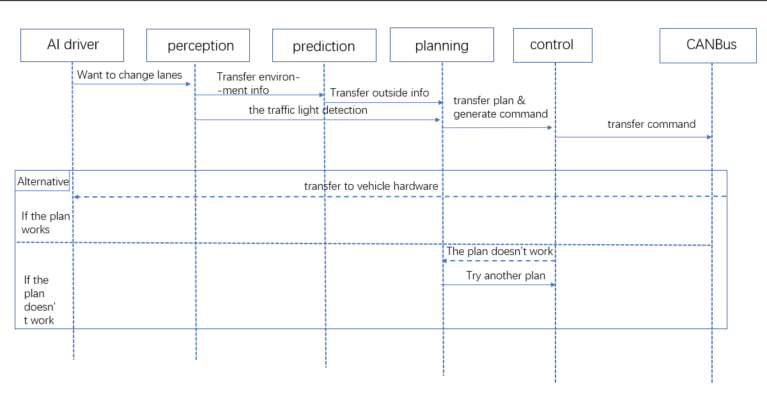
Use Case& Functionality

Slide 8
Concurrency
Orchestration mode
The scheduler can know in advance which tasks should be executed at this time, and will consider the priority.
Classic mode
All processors share the task queue and execute tasks in a first-in, first-out manner. This strategy allows for better prioritization of tasks. Apollo also allows grouping of thread pools, which can divide processors into multiple groups, but tasks cannot be transferred between different thread pools.

Slide 9
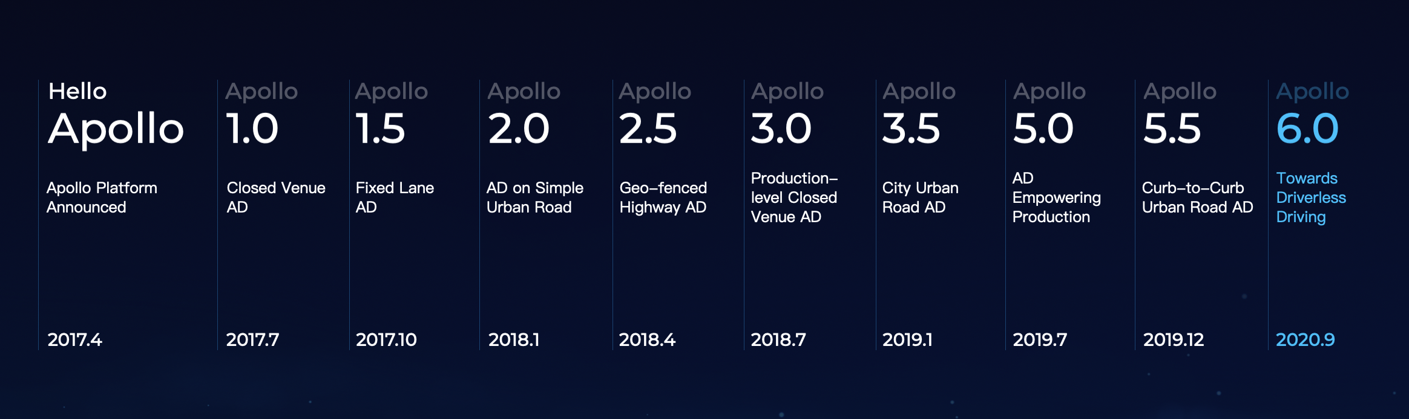
Evolution of Apollo

Slide 10
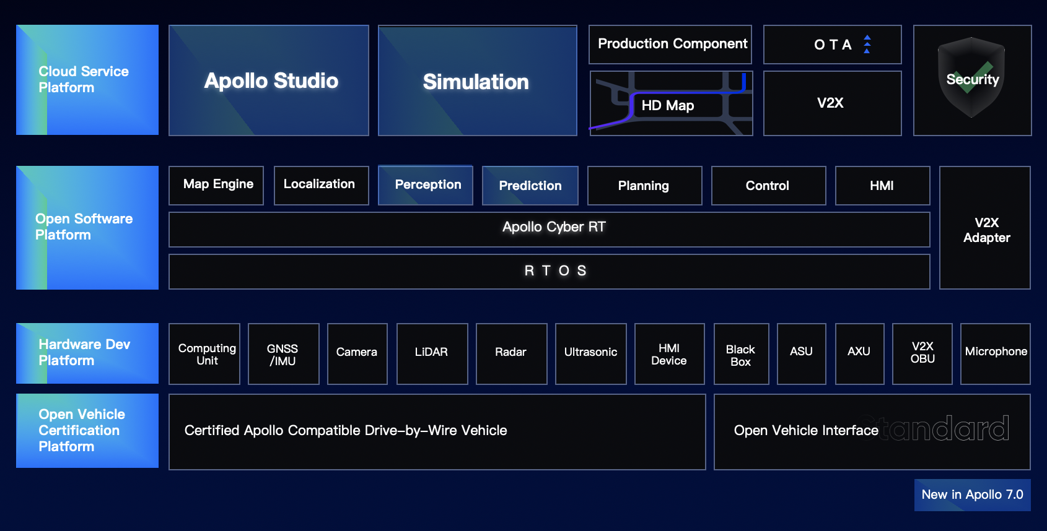
Apollo v7

Slide 11
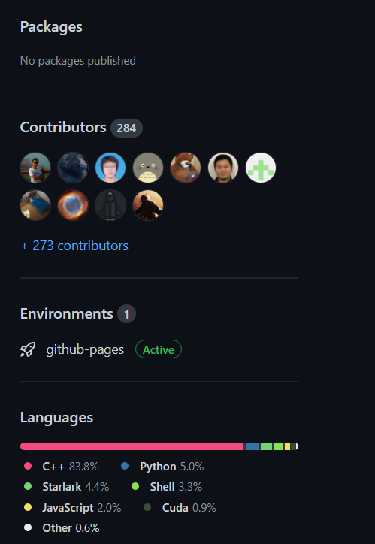
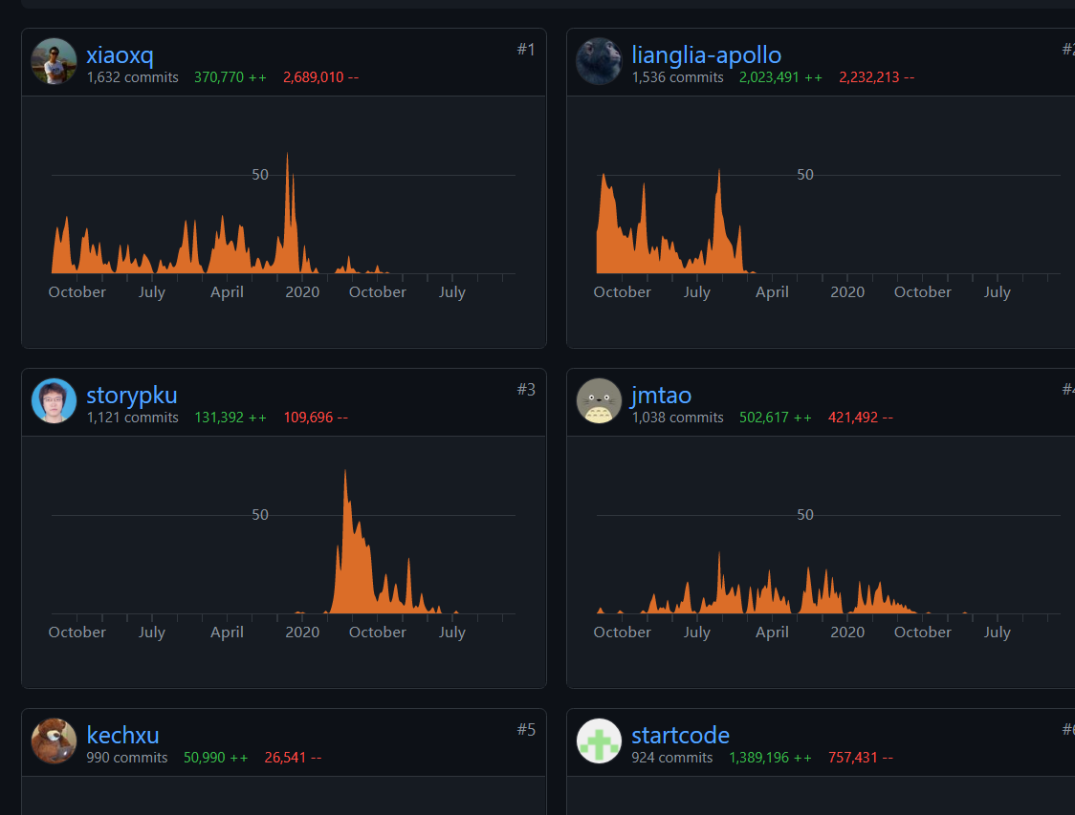

Slide 12
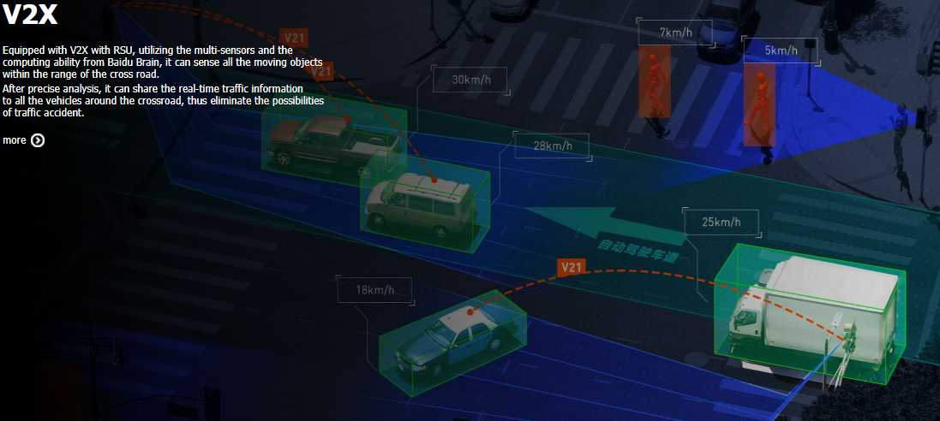
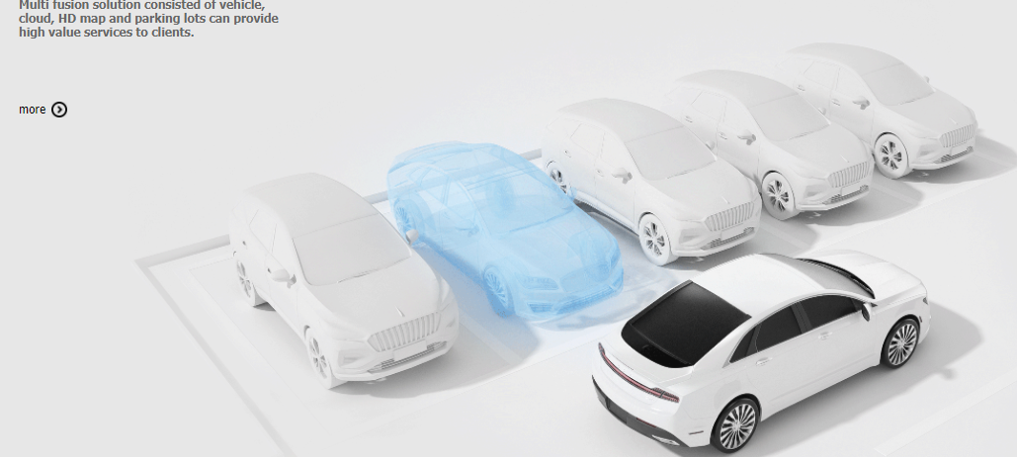
Scenarios and risks

Slide 13
Conclusion

Slide 14

Thank You!

