Slide 1


Scientific Machine Learning
Lecture 11: PINN for high-dimensional PDE problems
孟旭辉
数学与统计学院数学与应用学科交叉创新研究院
办公室：东32楼111室
Email：xuhui_meng@hust.edu.cn
https://github.com/XuhuiM/SciML-Course

Slide 2

Monte Carlo physics-informed neural networks for multiscale heat conduction via phonon Boltzmann transport equation
Lin et al., JCP, 2025

Slide 3
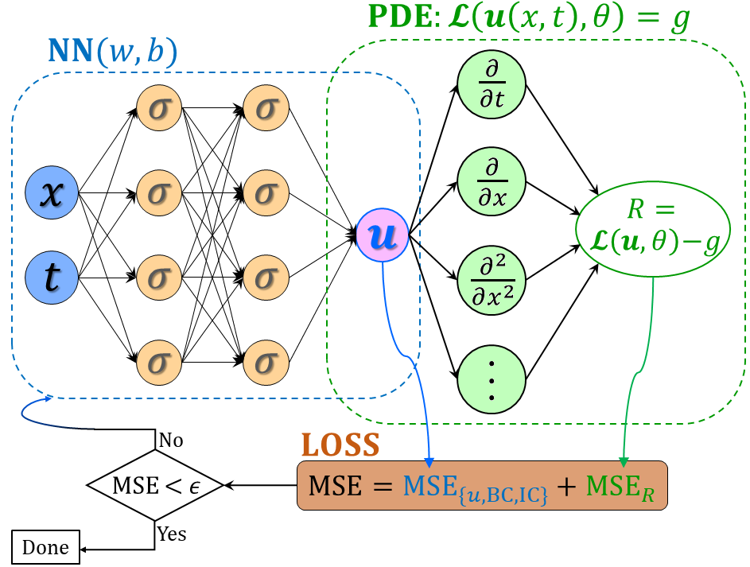


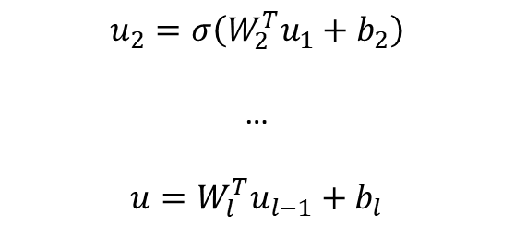

From DNNs to PINNs
$$u_{1}=σ(W_{1}^{T}X+b_{1})$$
(1)
$$u_{2}=σ\left(W_{2}^{T}u_{1}+b_{2}\right)$$
…
$$u=W_{l}^{T}u_{l−1}+b_{l}$$
(2) PDE part: Chain rule
$$∂_{t}u, ∂_{x}u, …$$
Loss function:
Forward problem:
$$L={\min_{θ}⁡(R^{2}+|u_{bc}^{∗}−u_{bc}|}^{2}+{\left|u_{ic}^{∗}−u_{ic}\right|}^{2})$$
Inverse problem:
$$L={\min_{θ,λ}⁡(R^{2}+|u_{bc}^{∗}−u_{bc}|}^{2}+{\left|u_{ic}^{∗}−u_{ic}\right|}^{2}+{\left|u^{∗}−u\right|}^{2})$$
Unified framework for forward and inverse PDE problems
No mesh for computations of derivatives
Raissi, et al, JCP, 2019
Meng, et al, CMAME, 2020

Slide 4
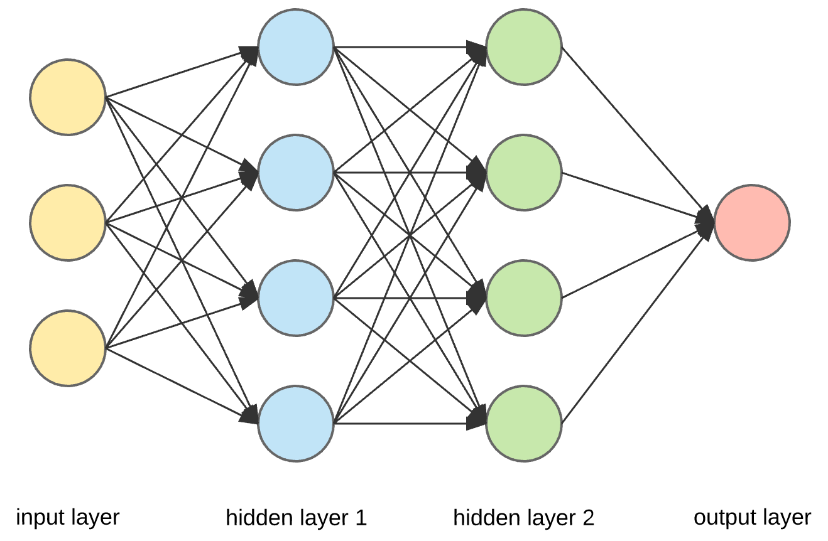


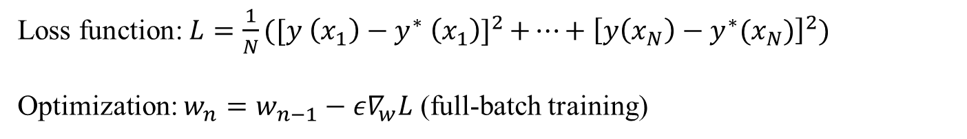









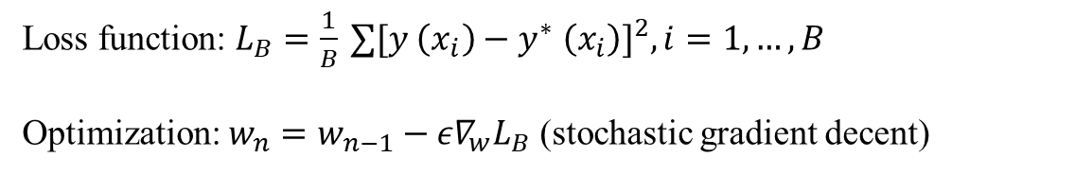
Mini-batch training – stochastic gradient descent
$$σ$$
$$σ$$
$$y_{1}=σ(W_{1}^{T}x+b_{1})$$
$$σ$$
$$σ$$
$$y_{2}=σ\left(W_{2}^{T}y_{1}+b_{2}\right)$$
…
$$y=W_{l}^{T}y_{l−1}+b_{l}$$
$$y$$
$$σ$$
$$σ$$
$$σ$$
$$σ$$
Loss function: $L=\frac{1}{N}{⁡([y \left(x_{1}\right)−y^{∗} \left(x_{1}\right)]}^{2}+…+{\left[y\left(x_{N}\right)−y^{∗}(x_{N})\right]}^{2})$
Optimization: $w_{n}=w_{n−1}−{ε∇}_{w}L$ (full-batch training)
Mini-batch training
Loss function: $L_{B}=\frac{1}{B}{⁡∑[y \left(x_{i}\right)−y^{∗} \left(x_{i}\right)]}^{2},i=1,…,B$
Optimization: $w_{n}=w_{n−1}−{ε∇}_{w}L_{B}$ (stochastic gradient decent)

Slide 5
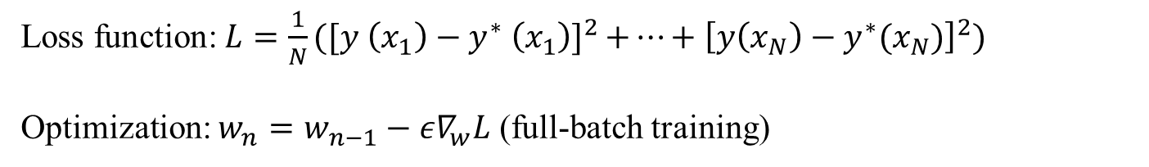


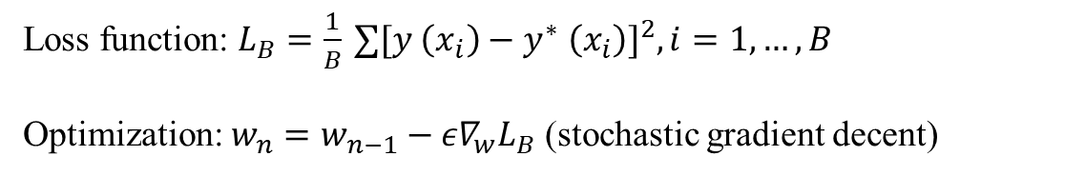
Stochastic gradient descent
Full-batch training
Loss function: $L=\frac{1}{N}{⁡([y \left(x_{1}\right)−y^{∗} \left(x_{1}\right)]}^{2}+…+{\left[y\left(x_{N}\right)−y^{∗}(x_{N})\right]}^{2})$
Optimization: $w_{n}=w_{n−1}−{ε∇}_{w}L$ (full-batch training)
$$∇_{w}L=\frac{1}{N}\sum_{i=1,…,N}{{∇_{w}l}_{i}, { l}_{i}={\left(y\left(x_{i}\right)−y^{∗}\left(x_{i}\right)\right)}^{2}}$$
Mini-batch training
Loss function: $L_{B}=\frac{1}{B}{⁡∑[y \left(x_{i}\right)−y^{∗} \left(x_{i}\right)]}^{2},i=1,…,B$
Optimization: $w_{n}=w_{n−1}−{ε∇}_{w}L_{B}$ (stochastic gradient decent)
$$∇_{w}L_{B}=\frac{1}{B}\sum_{i=1,…,B}{{∇_{w}l}_{i}, { l}_{i}={\left(y\left(x_{i}\right)−y^{∗}\left(x_{i}\right)\right)}^{2}}$$

Slide 6
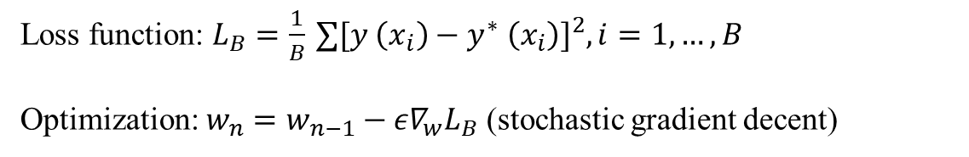



SGD-unbiased estimator of gradient
Mini-batch training
Loss function: $L_{B}=\frac{1}{B}{⁡∑[y \left(x_{i}\right)−y^{∗} \left(x_{i}\right)]}^{2},i=1,…,B$
Optimization: $w_{n}=w_{n−1}−{ε∇}_{w}L_{B}$ (stochastic gradient decent)
$$∇_{w}L_{B}=\frac{1}{B}\sum_{i=1,…,B}{{∇_{w}l}_{i}, { l}_{i}={\left(y\left(x_{i}\right)−y^{∗}\left(x_{i}\right)\right)}^{2}}$$
Special case: $B=1$
$${E[∇}_{w}L_{B}]=\sum_{i=1,…,N}{\frac{1}{N}∇_{w}l_{i}=\frac{1}{N}\sum_{i=1,…,N}{∇_{w}l_{i}}}$$
gradient of full-batch training

Slide 7



SGD-unbiased estimator of gradient
Mini-batch training
Loss function: $L_{B}=\frac{1}{B}{⁡∑[y \left(x_{i}\right)−y^{∗} \left(x_{i}\right)]}^{2},i=1,…,B$
Optimization: $w_{n}=w_{n−1}−{ε∇}_{w}L_{B}$ (stochastic gradient decent)
$$∇_{w}L_{B}=\frac{1}{B}\sum_{i=1,…,B}{{∇_{w}l}_{i}, { l}_{i}={\left(y\left(x_{i}\right)−y^{∗}\left(x_{i}\right)\right)}^{2}}$$
General case: $B>1$
$${E[∇}_{w}L_{B}]=\frac{1}{N}\sum_{i=1,…,N}{∇_{w}l_{i}}$$
gradient of full-batch training

Slide 8



SGD-unbiased estimator of gradient
Remarks:
SGD with fixed learning rate/step size cannot converge to global/local minimizers
$${E[∇}_{w}L_{B}]=\frac{1}{N}\sum_{i=1,…,N}{∇_{w}l_{i}}$$
$$∇_{w}L=\frac{1}{N}\sum_{i=1,…,N}{∇_{w}l_{i}}=0$$
$$∇_{w}L_{B}≠0, if B≠N$$
$$\frac{1}{N}∇_{w}L≈\frac{1}{B}∇_{w}L_{B}+η, E\left(η\right)=0$$
Pros: computationally more efficient; avoid local minimal…
As for convergence: decrease learning rata/step size $ε$ to 0

Slide 9
SGD
Remarks:
More theoretical analyses on the convergence of SGD
Guillaume Garrigos, et al., Handbook of Convergence Theorems for (Stochastic) Gradient Methods, 2023
…

Slide 10

Outline
Deep neural networks (DNNs): Universal Approximation Theorem
Monte Carlo PINNs for solving phonon Boltzmann equation
Numerical experiments
Summary

Slide 11
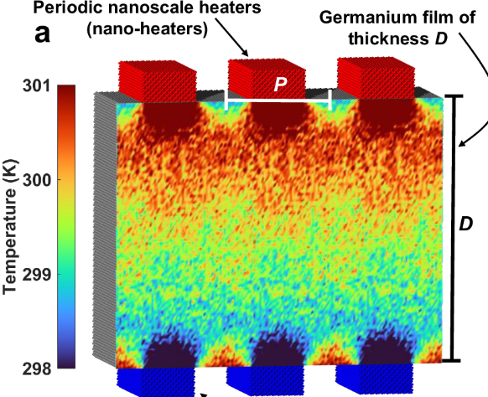
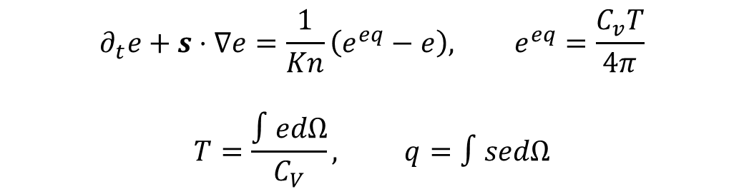
Phonon Boltzmann transport equation
$$∂_{t}e+s⋅∇e=\frac{1}{Kn}\left(e^{eq}−e\right), e^{eq}=\frac{C_{v}T}{4π}$$
$$T=\frac{∫edΩ}{C_{V}}, q=∫sedΩ$$
Deterministic method
Stochastic method
DVM
Curse of dimensionality
DSMC
Free of ray effect
Lin, et al. JCP, 2025

Slide 12
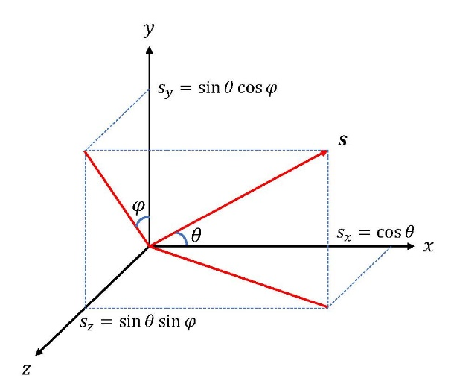
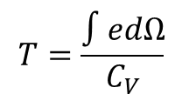
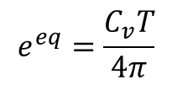

Monte Carlo PINNs for phonon BTE
${\left(t,x,s\right)}_{i}, i=1,…,N$
Popular sampling approach in PINNs: Randomly select B points at each step
$$e^{eq}=\frac{C_{v}T}{4π}$$
s
$$T=\frac{∫edΩ}{C_{V}}$$
x
Lin, et al. JCP, 2025

Slide 13
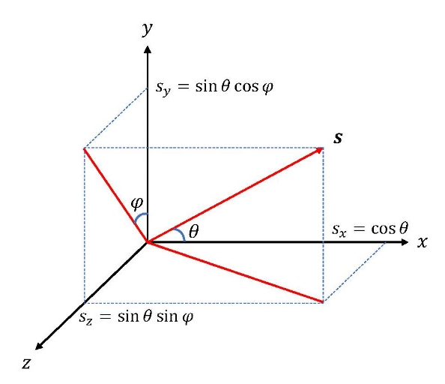
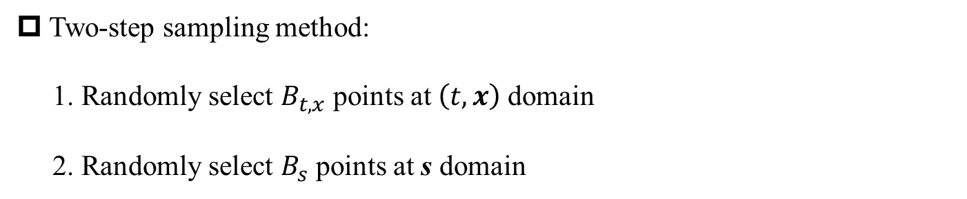
Two-step sampling method in MC-PINNs
Two-step sampling method:
1. Randomly select $B_{t,x}$ points at $\left(t,x\right)$domain
2. Randomly select $B_{s}$ points at s domain
$$e^{eq}=\frac{C_{v}T}{4π}$$
s
$$T=\frac{∫edΩ}{C_{V}}$$
x
Lin, et al. JCP, 2025

Slide 14
Gradients unbiasedness and convergence
mini-batch
Garrigos, et al., arxiv, 2023
Lin, et al. JCP, 2025

Slide 15
Outline
Deep neural networks (DNNs): Universal Approximation Theorem
Monte Carlo PINNs for solving phonon Boltzmann equation
Numerical experiments: Forward problems
Summary

Slide 16

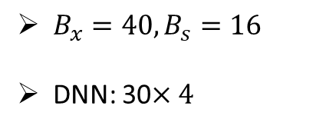
MC-PINNs for 1D steady multiscale heat conduction
$B_{x}=40, B_{s}=16$
DNN: 30$×4$
$$Kn=1 x=0, 0.5$$
Lin, et al. JCP, 2025

Slide 17
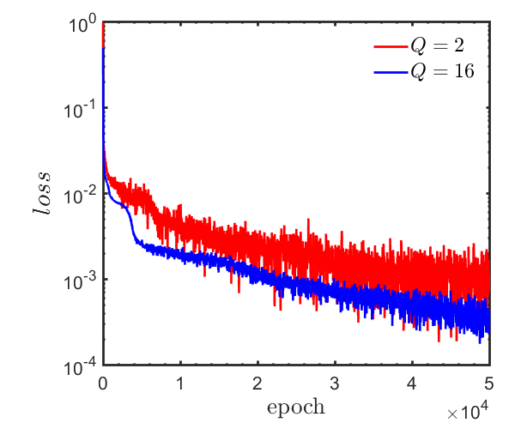
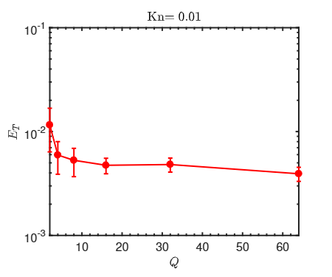
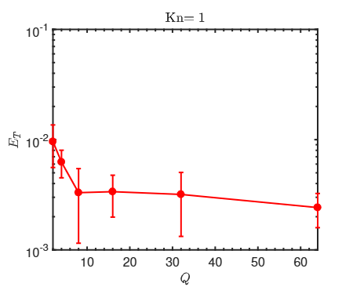
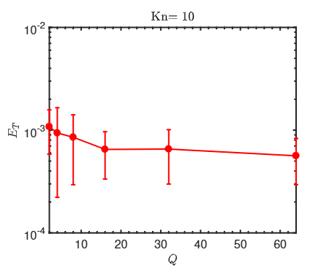
MC-PINNs: Effect of training points in angular space
Lin, et al. JCP, 2025

Slide 18
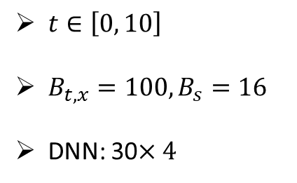



MC-PINNs for 1D unsteady multiscale heat conduction
$t∈\left[0, 10\right]$
$B_{t,x}=100, B_{s}=16$
DNN: 30$×4$
$$t=0.2$$
$$t=5$$
$$t=10$$
Lin, et al. JCP, 2025

Slide 19
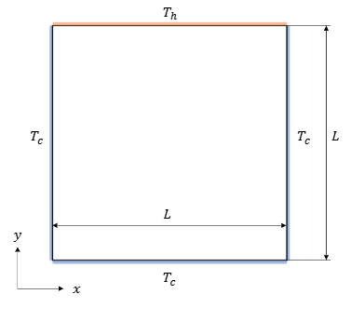
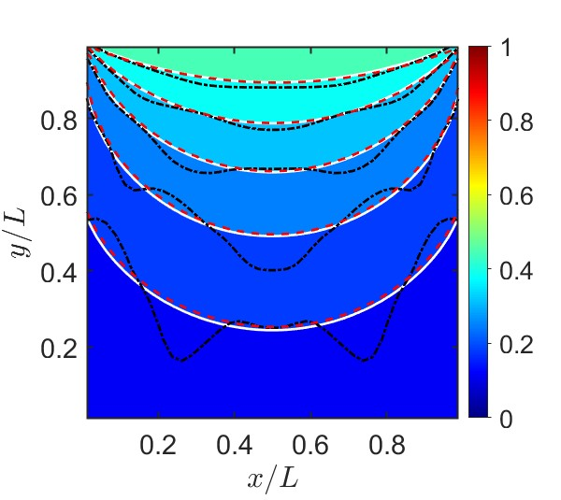
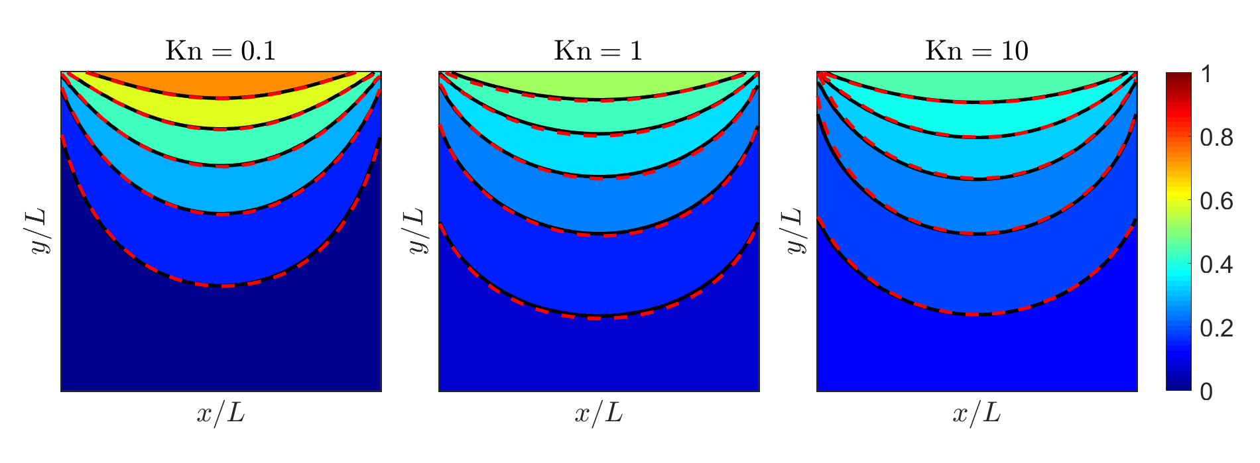
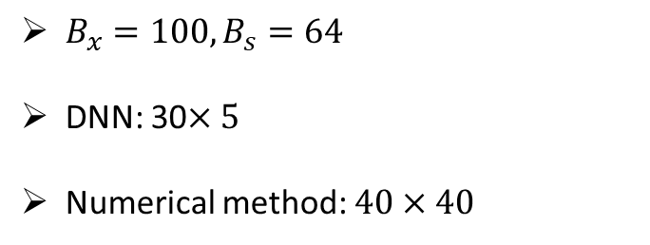
MC-PINNs for 2D multiscale heat conduction
$B_{x}=100, B_{s}=64$
DNN: 30$×5$
Numerical method: $40×40$
Lin, et al. JCP, 2025

Slide 20
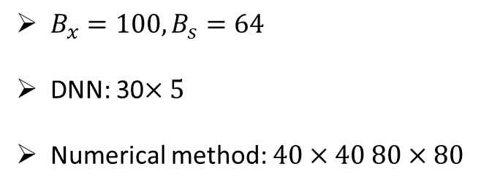
MC-PINNs for 3D multiscale heat conduction
$B_{x}=100, B_{s}=64$
DNN: 30$×5$
Numerical method: $40×40 80×80$
Lin, et al. JCP, 2025

Slide 21
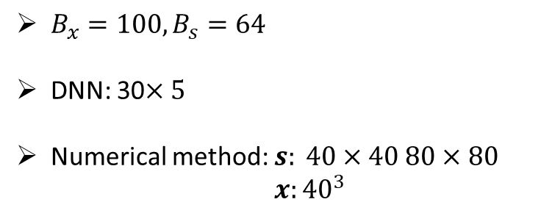
MC-PINNs for 3D multiscale heat conduction
$B_{x}=100, B_{s}=64$
DNN: 30$×5$
Numerical method: $s: 40×40 80×80$ $x:{40}^{3}$
Lin, et al. JCP, 2025

Slide 22
From DNNs to PINNs
$$u_{1}=σ(W_{1}^{T}X+b_{1})$$
(1)
$$u_{2}=σ\left(W_{2}^{T}u_{1}+b_{2}\right)$$
…
$$u=W_{l}^{T}u_{l−1}+b_{l}$$
(2) PDE part: Chain rule
$$∂_{t}u, ∂_{x}u, …$$
Physics-informed neural networks (PINNs)
Loss function:
$$L={\min_{θ}⁡(R^{2}+|u_{bc}^{∗}−u_{bc}|}^{2}+{\left|u_{ic}^{∗}−u_{ic}\right|}^{2})$$
Raissi, et al, JCP, 2019
Meng, et al, CMAME, 2020

Slide 23
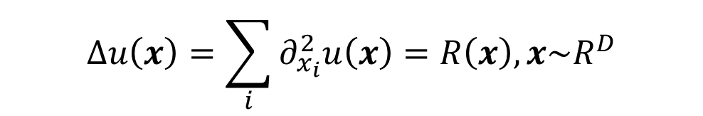
High-dimensional Poisson equation
$$Δu\left(x\right)=\sum_{i}{∂_{x_{i}}^{2}u\left(x\right)=R\left(x\right), x\sim R^{D}}$$
Memory usage:
The size of first layer ~ D
The number of second-order derivatives ~ D

Slide 24
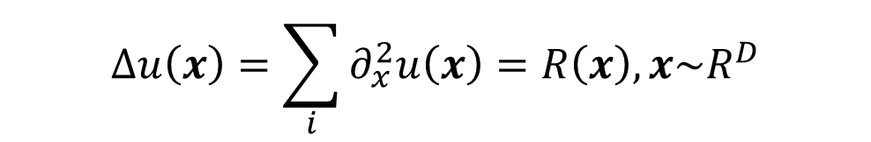
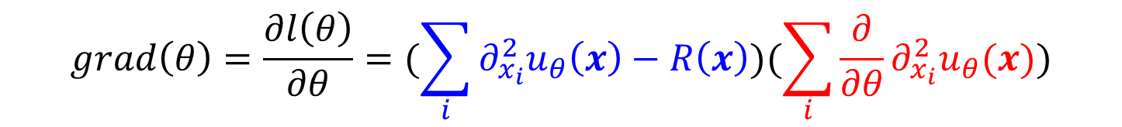
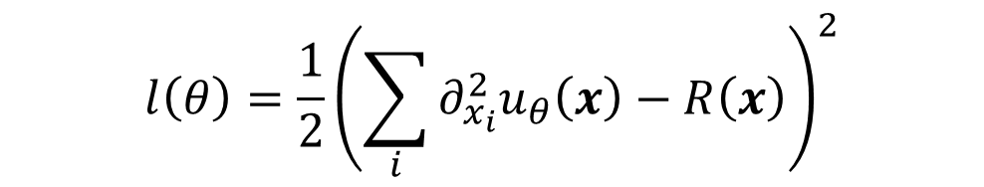
High-dimensional Poisson equation - Gradient descent
$$Δu\left(x\right)=\sum_{i}{∂_{x}^{2}u\left(x\right)=R\left(x\right), x\sim R^{D}}$$
$$l\left(θ\right)={\frac{1}{2}\left(\sum_{i}{∂_{x_{i}}^{2}u_{θ}\left(x\right)−R\left(x\right)}\right)}^{2}$$
$$grad\left(θ\right)=\frac{∂l\left(θ\right)}{∂θ}=(\sum_{i}{∂_{x_{i}}^{2}u_{θ}\left(x\right)−R\left(x\right)})(\sum_{i}{\frac{∂}{∂θ}∂_{x_{i}}^{2}u_{θ}(x)})$$

Slide 25
Tackling the curse of dimensionality with physics-informed neural networks
Neural Networks. (2024)
Zheyuan Hu, Khemraj Shukla, etc

Slide 26
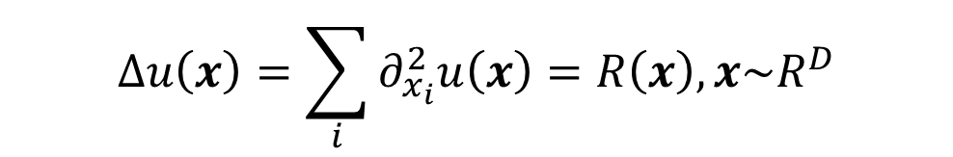
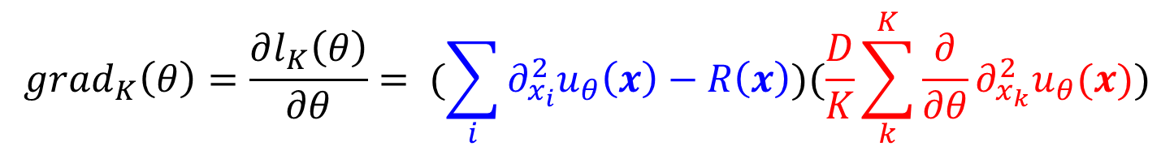
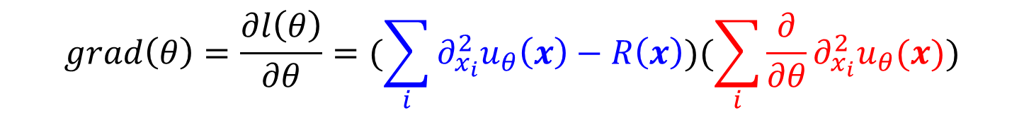
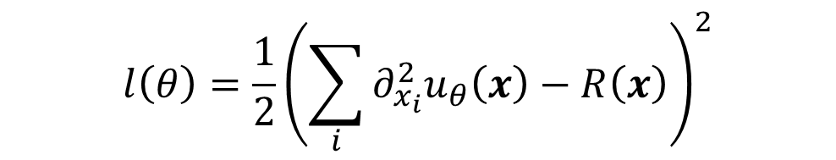
From SGD to stochastic dimension gradient descent (SDGD)
$$Δu\left(x\right)=\sum_{i}{∂_{x_{i}}^{2}u\left(x\right)=R\left(x\right), x\sim R^{D}}$$
$$l\left(θ\right)={\frac{1}{2}\left(\sum_{i}{∂_{x_{i}}^{2}u_{θ}\left(x\right)−R\left(x\right)}\right)}^{2}$$
$$grad\left(θ\right)=\frac{∂l\left(θ\right)}{∂θ}=(\sum_{i}{∂_{x_{i}}^{2}u_{θ}\left(x\right)−R\left(x\right)})(\sum_{i}{\frac{∂}{∂θ}∂_{x_{i}}^{2}u_{θ}(x)})$$
$$grad_{K}\left(θ\right)=\frac{∂l_{K}\left(θ\right)}{∂θ}= (\sum_{i}{∂_{x_{i}}^{2}u_{θ}\left(x\right)−R\left(x\right)})(\frac{D}{K}\sum_{k}^{K}{\frac{∂}{∂θ}∂_{x_{k}}^{2}u_{θ}(x}))$$
Hu, et al., Neural Networks. (2024)

Slide 27

From SGD to SDGD
$$Δu\left(x\right)=\sum_{i}{∂_{x_{i}}^{2}u\left(x\right)=R\left(x\right), x\sim R^{D}}$$
$$l\left(θ\right)={\frac{1}{2}\left(\sum_{i}{∂_{x_{i}}^{2}u_{θ}\left(x\right)−R\left(x\right)}\right)}^{2}$$
$$grad\left(θ\right)=\frac{∂l\left(θ\right)}{∂θ}=(\sum_{i}{∂_{x_{i}}^{2}u_{θ}\left(x\right)−R\left(x\right)})(\sum_{i}{\frac{∂}{∂θ}∂_{x_{i}}^{2}u_{θ}(x)})$$
$$grad_{K}\left(θ\right)=\frac{∂l_{K}\left(θ\right)}{∂θ}= (\sum_{i}{∂_{x_{i}}^{2}u_{θ}\left(x\right)−R\left(x\right)})(\frac{D}{K}\sum_{k}^{K}{\frac{∂}{∂θ}∂_{x_{k}}^{2}u_{θ}(x}))$$
Hu, et al., Neural Networks. (2024)

Slide 28
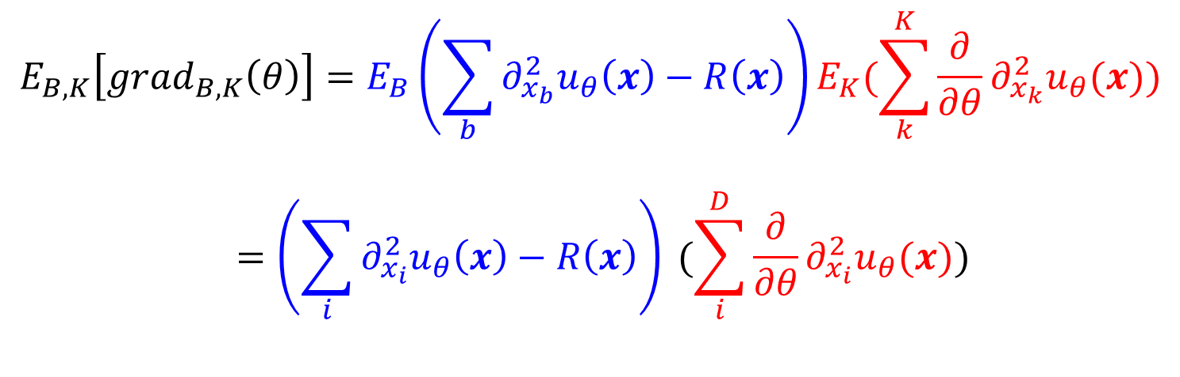
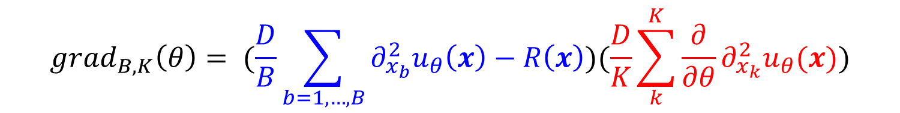

Further speed-up of SDGD
$$grad_{K}\left(θ\right)=\frac{∂l_{K}\left(θ\right)}{∂θ}= (\sum_{i}{∂_{x_{i}}^{2}u_{θ}\left(x\right)−R\left(x\right)})(\frac{D}{K}\sum_{k}^{K}{\frac{∂}{∂θ}∂_{x_{k}}^{2}u_{θ}(x}))$$
$$grad_{B,K}\left(θ\right)= (\frac{D}{B}\sum_{b=1,…,B}{∂_{x_{b}}^{2}u_{θ}\left(x\right)−R\left(x\right)})(\frac{D}{K}\sum_{k}^{K}{\frac{∂}{∂θ}∂_{x_{k}}^{2}u_{θ}(x}))$$
$$E_{B,K}\left[grad_{B,K}\left(θ\right)\right]=E_{B}\left(\sum_{b}{∂_{x_{b}}^{2}u_{θ}\left(x\right)−R\left(x\right)}\right)E_{K}(\sum_{k}^{K}{\frac{∂}{∂θ}∂_{x_{k}}^{2}u_{θ}(x}))$$
$$=\left(\sum_{i}{∂_{x_{i}}^{2}u_{θ}\left(x\right)−R\left(x\right)}\right) (\sum_{i}^{D}{\frac{∂}{∂θ}∂_{x_{i}}^{2}u_{θ}(x}))$$
Hu, et al., Neural Networks. (2024)

Slide 29
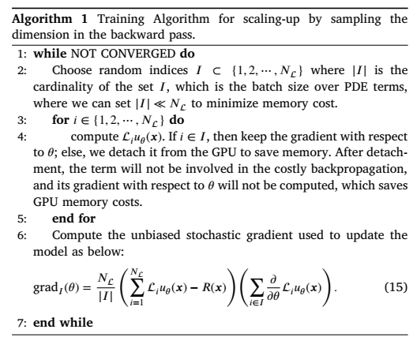
SDGD-1
Hu, et al., Neural Networks. (2024)

Slide 30
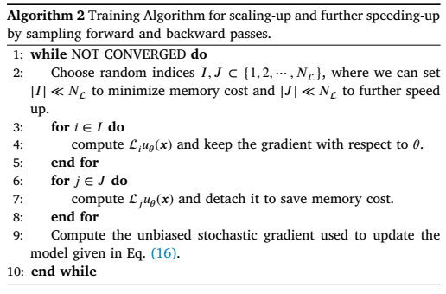
SDGD-2
Hu, et al., Neural Networks. (2024)

Slide 31
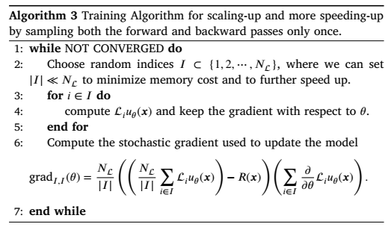
SDGD-3
Hu, et al., Neural Networks. (2024)

Slide 32
Numerical examples
Hu, et al., Neural Networks. (2024)

Slide 33
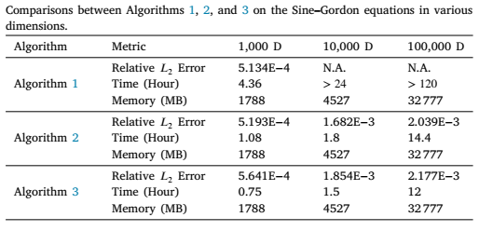
Numerical examples
Hu, et al., Neural Networks. (2024)

Slide 34
Numerical examples
Hu, et al., Neural Networks. (2024)

Slide 35
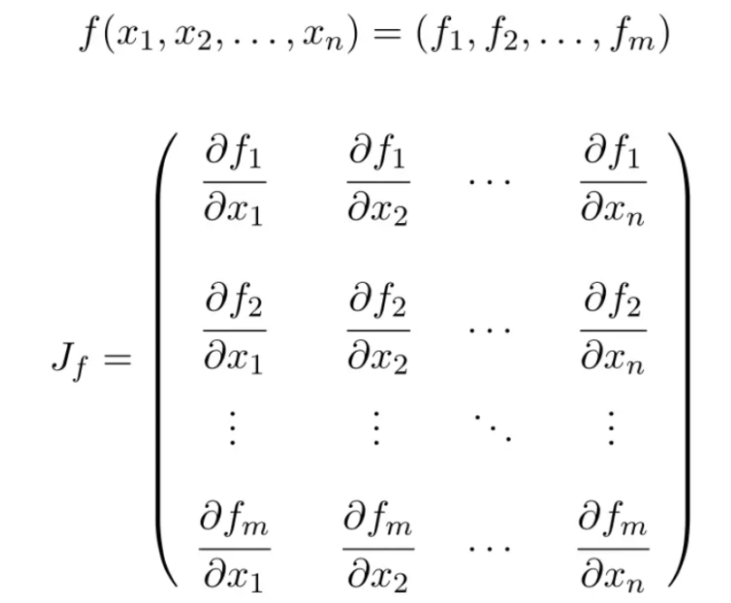
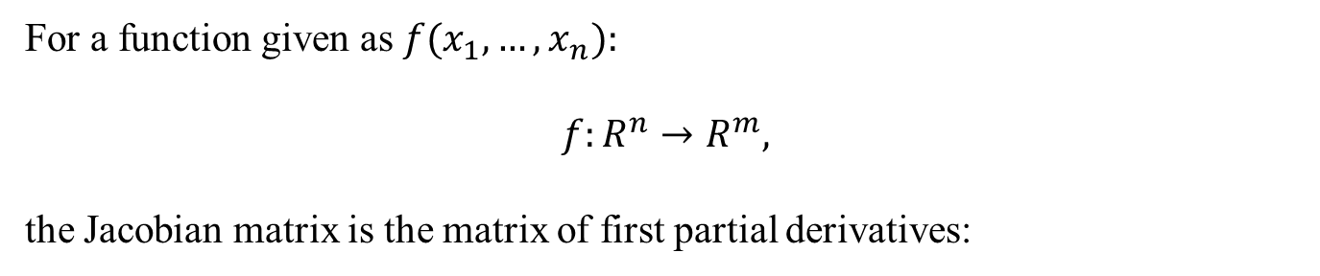
Jacobian & Hessian Matrix
For a function given as $f(x_{1},…,x_{n}):$
$$f:R^{n}→R^{m},$$
the Jacobian matrix is the matrix of first partial derivatives:

Slide 36
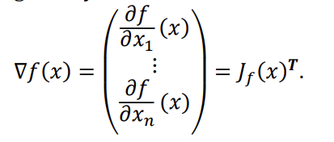
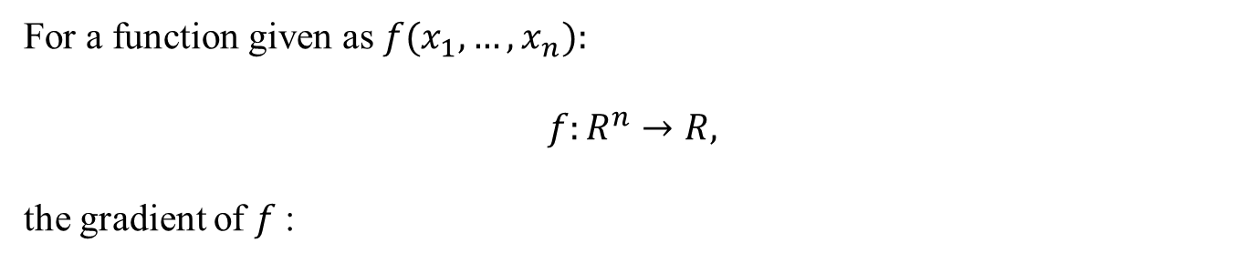
Jacobian & Hessian Matrix
For a function given as $f(x_{1},…,x_{n}):$
$$f:R^{n}→R,$$
the gradient of $f$:

Slide 37
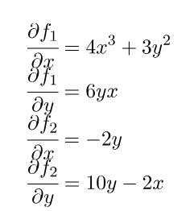
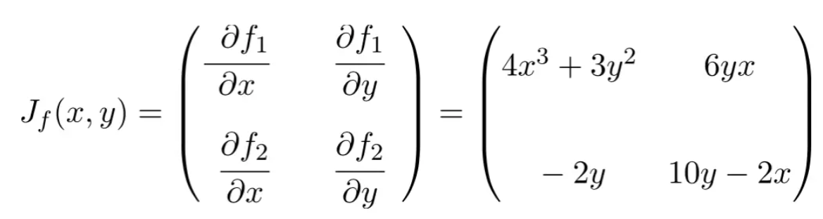
Example for Jacobian matrix
$$f\left(x,y\right)=(x^{4}+3y^{2}x, 5y^{2}−2xy+1)$$

Slide 38
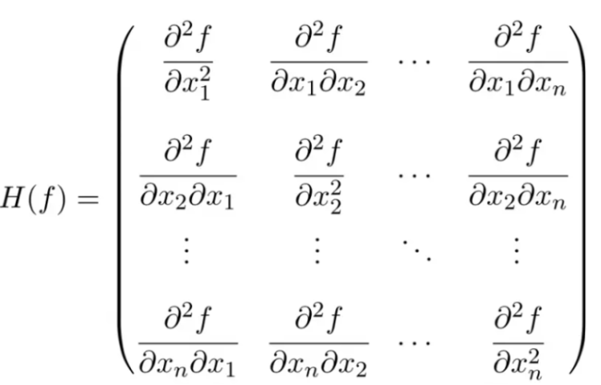

Hessian Matrix
For a function $f:R^{n}→R,$ that is twice differentiable, the Hessian matrix is the matrix of second derivatives:

Slide 39
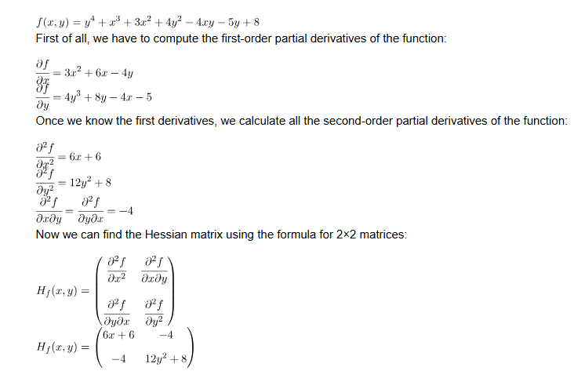
Example of Hessian matrix

Slide 40



Hutchinson trace estimation
$$Tr\left(A\right)=E_{v\sim p(v)}[v^{T}Av]$$
$$v∈R^{d},E_{v\sim p\left(v\right)}\left[vv^{T}\right]=I$$
Rademacher distribution:
For each dimension of $v$, it has a 50% chance to get 1 and 50% chance to get -1
$$Tr\left(A\right)≈\frac{1}{V}\sum_{i=1,…,V}{v_{i}^{T}Av_{i}}$$

Slide 41


Hutchinson trace estimation
$$Δu\left(x\right)=\sum_{i}{∂_{x_{i}}^{2}u\left(x\right)=R\left(x\right), x\sim R^{D}}$$
$Δu\left(x\right)=Tr\left(H\right)≈\frac{1}{V}\sum_{i=1,…,V}{v_{i}^{T}Hv_{i}}$
Hessian-vector-product (HVP) in Jax/Pytorch

Slide 42


Randomized smoothing PINNs
$$Δu\left(x\right)=\sum_{i}{∂_{x_{i}}^{2}u\left(x\right)=R\left(x\right), x\sim R^{D}}$$
$$u\left(x\right)≈u\left(x;θ\right)=E_{δ\sim N(0,σ^{2}I)}[f\left(x+δ;θ\right)]$$
Hu, et al., 2023

Slide 43

Randomized smoothing PINNs
$$Δu\left(x\right)=\sum_{i}{∂_{x_{i}}^{2}u\left(x\right)=R\left(x\right), x\sim R^{D}}$$
$$u\left(x\right)≈u\left(x;θ\right)=E_{δ\sim N(0,σ^{2}I)}[f\left(x+δ;θ\right)]$$
Hu, et al., 2023

Slide 44

Randomized smoothing PINNs
$$Δu\left(x\right)=\sum_{i}{∂_{x_{i}}^{2}u\left(x\right)=R\left(x\right), x\sim R^{D}}$$
$$u\left(x\right)≈u\left(x;θ\right)=E_{δ\sim N(0,σ^{2}I)}[f\left(x+δ;θ\right)]$$
Hu, et al., 2023

Slide 45

Thank you for your attention!

