Slide 1


Scientific Machine Learning
Lecture 13: Parallel Computing
孟旭辉
数学与统计学院数学与应用学科交叉创新研究院
办公室：东32楼111室
Email：xuhui_meng@hust.edu.cn
https://github.com/XuhuiM/SciML-Course

Slide 2

Outline
Parallel computing
Numerical experiments
Summary

Slide 3


Horovod: Distributed training framework
Xuhui Meng, Khemraj Shukla
Division of Applied Mathematics, Brown University
September 27th , 2019

Slide 4
Outline
What’s Horovod?
How to use?
Examples for function approximation/PINN
Data parallelism
Ensemble training
Data parallelism
Ensemble training

Slide 5
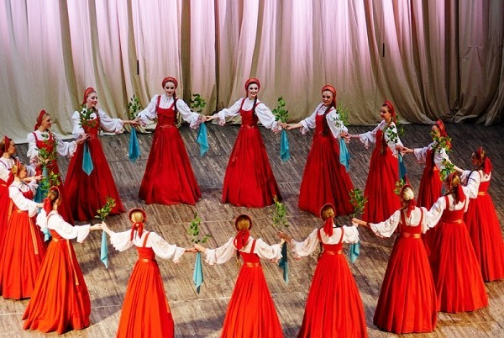
What’s Horovod?

Slide 6
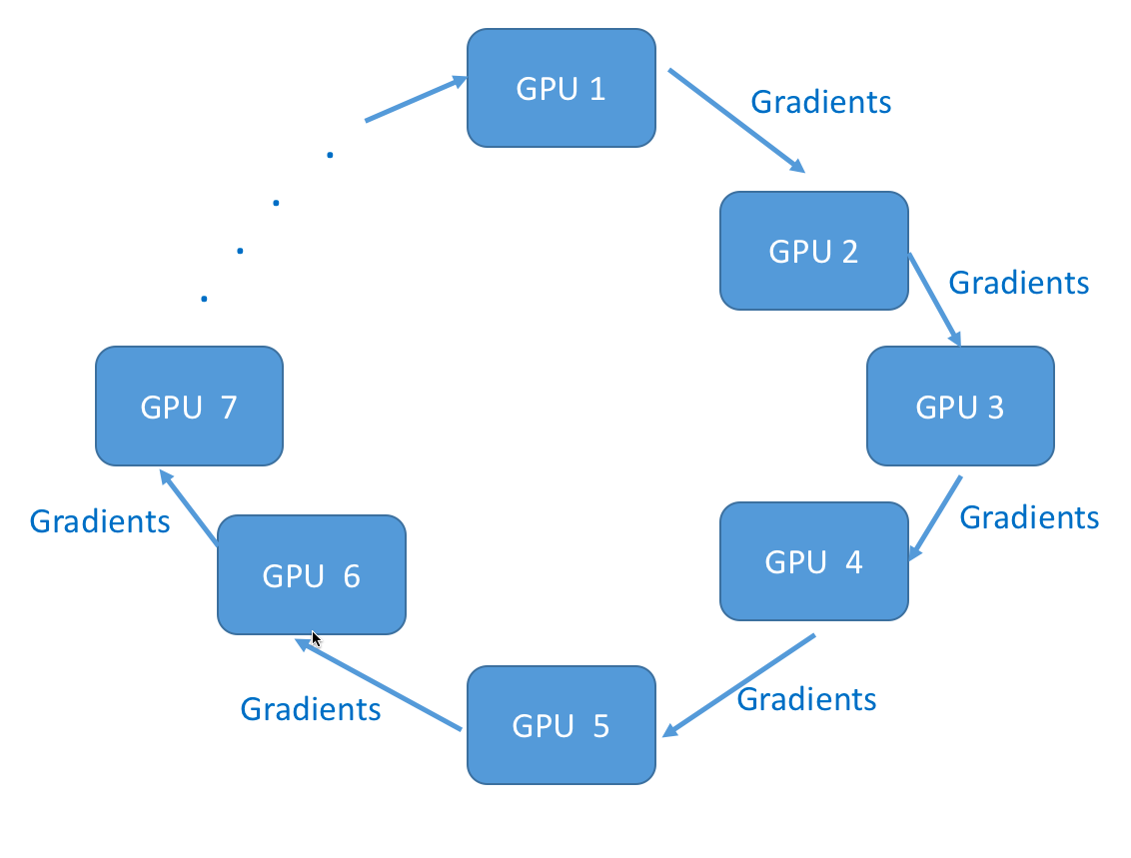

What’s Horovod?

Slide 7
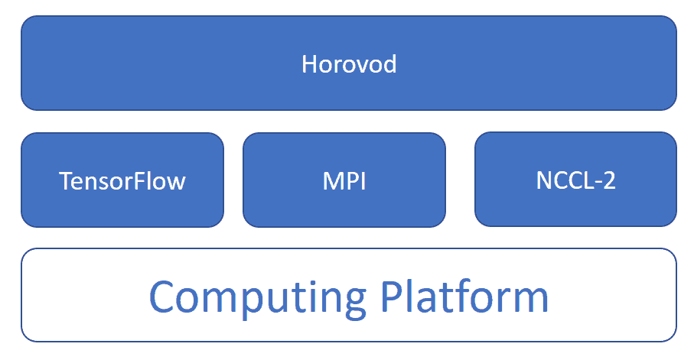
What’s Horovod?

Slide 8
Data parallelism & Ensemble training
Data parallelism
Dataset
GPU 1
GPU 2
……
GPU (n-1)
GPU n
DNN
DNN
……
DNN
DNN
Ensemble training
DNNs
DNN 1
DNN 2
……
DNN (n-1)
DNN n
GPU 1
GPU 2
……
GPU (n-1)
GPU n

Slide 9
Outline
What’s Horovod?
How to use?
Examples for function approximation/PINN
Data parallelism
Ensemble training
Data parallelism
Ensemble training

Slide 10
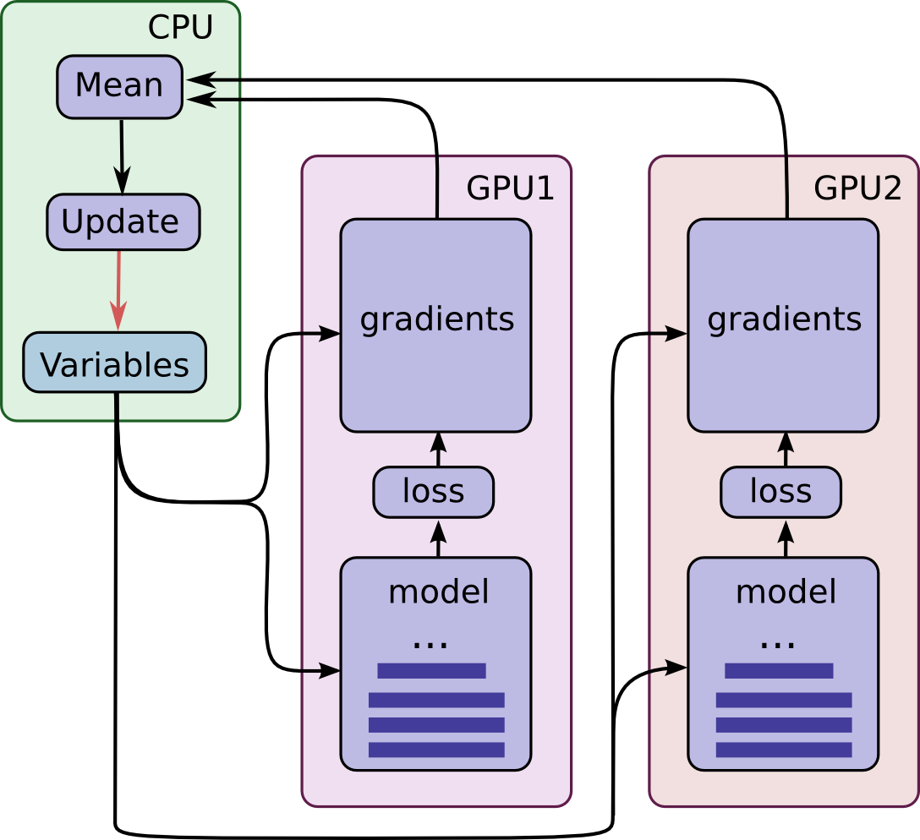
How to use Horovod – Data parallelism
1. Run multiple copies of the training
scripts, and each copy:
Reads a chunk of data
Train the model
Compute the gradients
2. Average the gradients from all the
copies
3. Update the model
4. Repeat 1-3
Same initializations!

Slide 11
Show me the code: Data parallelism
import tensorflow as tf
import horovod.tensorflow as hvd
hvd.init() #initialize the environment
#pin one GPU to each tensorflow process
config = tf.ConfigProto()
config.gpu_options.visible_device_list
= str(hvd.local_rank())
if hvd.rank() == 0: #read data
read_chunk_0
else:
read_chunk_n…
# Build model...
loss = ...
opt = tf.train.AdamOptimizer(learning_rate * hvd.size())
# Add Horovod Distributed Optimizer
opt = hvd.DistributedOptimizer(opt)
train = opt.minimize(loss)
init = tf.global_variables_initializer()
sess.run(init)
#broadcast the initialization to all processes
bcast = hvd.broadcast_global_variables(0)
sess.run(bcast)
while train_step < step_max:
sess.run([train, loss], feed_dict=…)
horovodrun/mpirun –np NP –H localhost:NP
python *.py
mpirun –np NP –H
server 1:np…server n: np …
python *.py

Slide 12
Show me the code: Data parallelism
import tensorflow as tf
import horovod.tensorflow as hvd
hvd.init()
config = tf.ConfigProto()
config.gpu_options.visible_device_list
= str(hvd.local_rank())
if hvd.rank() == 0:
read_chunk_0
else:
read_chunk_n…
loss = ...
opt = tf.train.AdamOptimizer(learning_rate * hvd.size())
opt = hvd.DistributedOptimizer(opt)
train = opt.minimize(loss)
init = tf.global_variables_initializer()
sess.run(init)
bcast = hvd.broadcast_global_variables(0)
sess.run(bcast)
while train_step < step_max:
sess.run([train, loss], feed_dict=…)
1
2
7
3
4
5
6

Slide 13
How to use Horovod – Ensemble training
1. Run multiple copies of the training
scripts, and each copy:
Reads a chunk of data
Train the model
Compute the gradients
2. Update the model using its
own gradient
3. Repeat 1-2

Slide 14
Show me the code: Ensemble training
import tensorflow as tf
import horovod.tensorflow as hvd
hvd.init() #initialize the environment
#pin one GPU to each tensorflow process
config = tf.ConfigProto()
config.gpu_options.visible_device_list
= str(hvd.local_rank())
if hvd.rank() == 0: #read data
read_chunk_0
else:
read_chunk_n…
# Build model...
loss = ...
opt = tf.train.AdamOptimizer(learning_rate)
# Add Horovod Distributed Optimizer
#opt = hvd.DistributedOptimizer(opt)
train = opt.minimize(loss)
init = tf.global_variables_initializer()
sess.run(init)
#broadcast the initialization to all processes
bcast = hvd.broadcast_global_variables(0)
sess.run(bcast)
while train_step < step_max:
sess.run([train, loss], feed_dict=…)

Slide 15
Show me the code: Ensemble training
import tensorflow as tf
import horovod.tensorflow as hvd
hvd.init()
config = tf.ConfigProto()
config.gpu_options.visible_device_list
= str(hvd.local_rank())
if hvd.rank() == 0:
read_chunk_0
else:
read_chunk_n…
loss = ...
opt = tf.train.AdamOptimizer(learning_rate)
#opt = hvd.DistributedOptimizer(opt)
train = opt.minimize(loss)
init = tf.global_variables_initializer()
sess.run(init)
bcast = hvd.broadcast_global_variables(0)
sess.run(bcast)
while train_step < step_max:
sess.run([train, loss], feed_dict=…)
1
2
5
3
4

Slide 16
Outline
What’s Horovod?
How to use?
Examples for function approximation/PINN
Data parallelism
Ensemble training
Data parallelism
Ensemble training

Slide 17
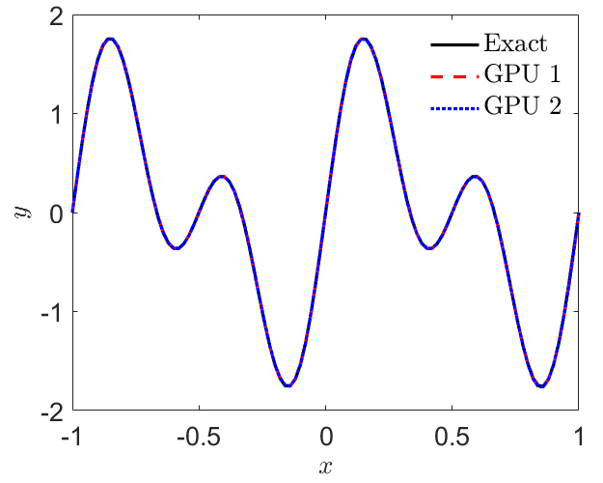
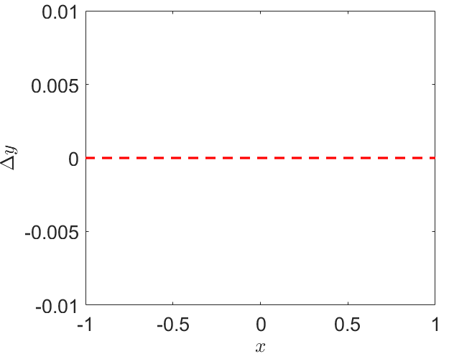
Example 1: Function approximation (Data parallelism)
GPU 1
GPU 2
GPU 1
GPU 2
y_pred (GPU 1) – y_pred (GPU 2)

Slide 18
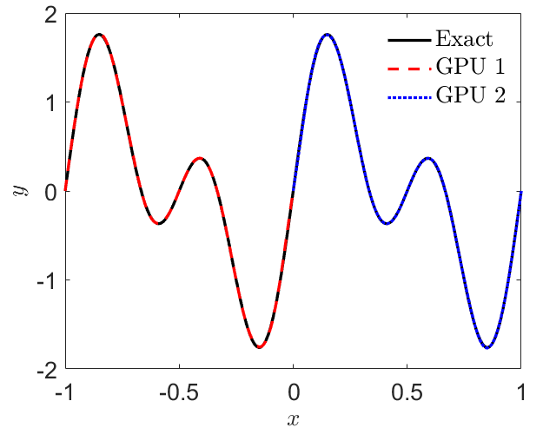
Example 2: Function approximation (Ensemble training)
GPU 1
GPU 2
GPU 1
GPU 2
GPU 1
GPU 2

Slide 19
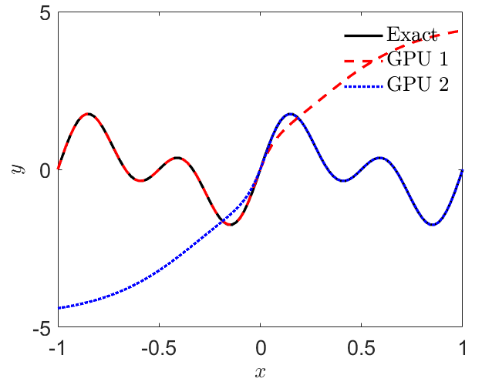
Example 2: Function approximation (Ensemble training)
GPU 1
GPU 2
GPU 1
GPU 2
GPU 1
GPU 2

Slide 20
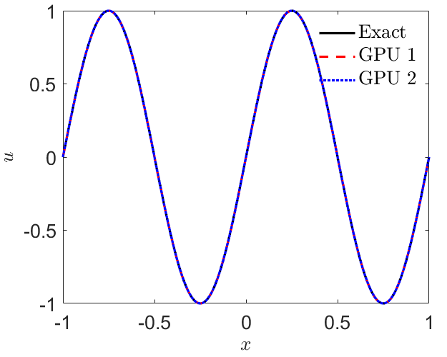

Example 3: PINNs (Data parallelism)
GPU 1
GPU 1
GPU 2
GPU 2
u_pred (GPU 1) – u_pred (GPU 2)
GPU 1
GPU 2

Slide 21
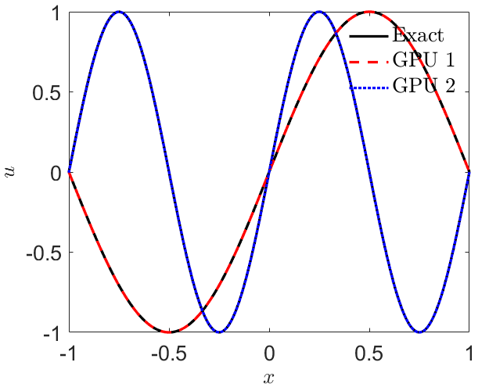
Example 4: PINNs (Ensemble training)
GPU 1
GPU 2
GPU 1
GPU 2
GPU 1
GPU 2
GPU 1
GPU 2

Slide 22
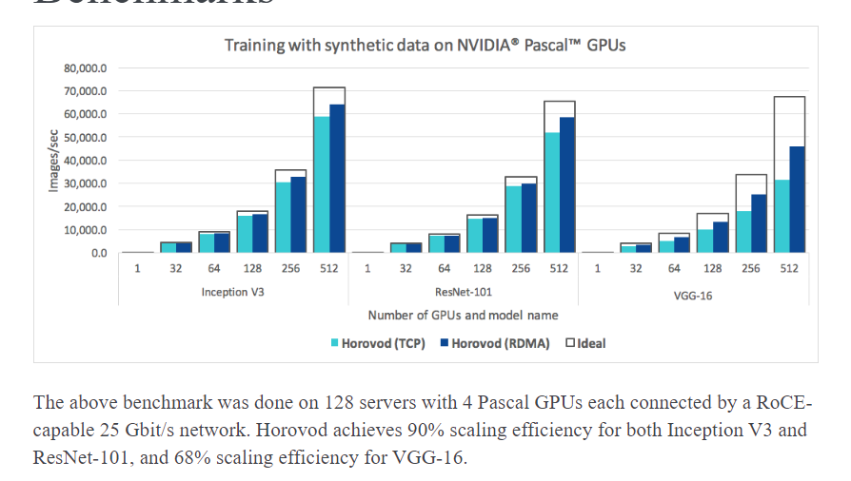
Scaling efficiency

Slide 23
Installation & Code
Installation
https://github.com/horovod/horovod
Code download
https://github.com/XuhuiM/Distributed-training-Horovod.git

Slide 24
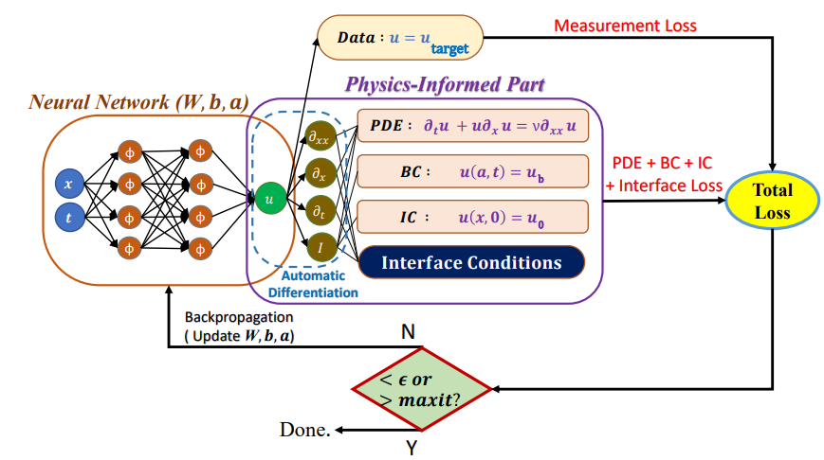
Nonoverlapping Domain Decomposition
Notes:
PINNs can be scaled up by using ideas from Domain Decomposition in the solution of PDEs, e.g. FEM etc. We have already seen a variational example in Lecture 9 but here we
Consisder the classical PINN form.

Slide 25
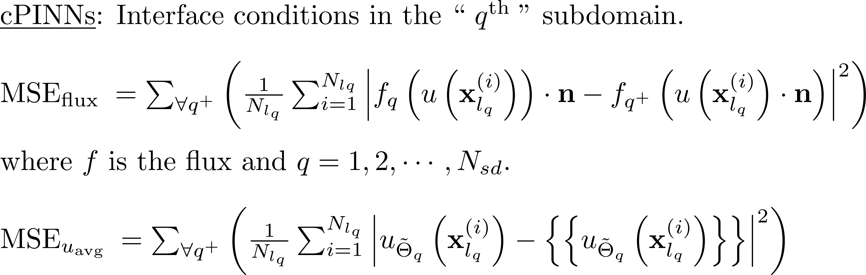
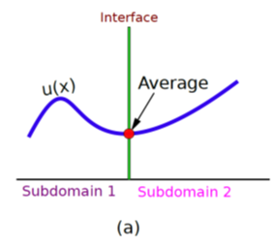
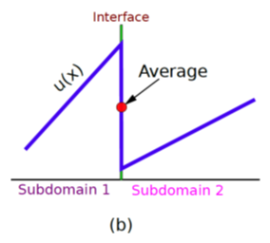
Conservative PINNs (cPINNs)
Jagtap AD, Kharazmi E, Karniadakis GE. Conservative physics-informed neural networks on discrete domains for conservation laws: Applications to forward and inverse problems. Computer Methods in Applied Mechanics and Engineering. 2020 Jun 15;365:113028
Notes:
For conservation laws, we can get inspiration from finite volumes using fluxes at the interfaces and hence derive proper interface conditions that will be added as extra loss terms in the total
Loss function. In addition, we penalize the solution at the interface. Mimicking DG methods.

Slide 26
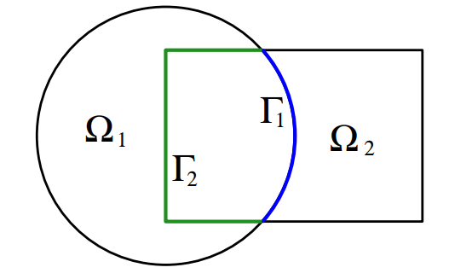
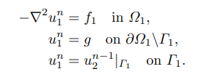

Overlapping Domain Decomposition
Cai, Overlapping Domain Decomposition Method
Notes:
PINNs can be scaled up by using ideas from Domain Decomposition in the solution of PDEs, e.g. FEM etc. We have already seen a variational example in Lecture 9 but here we
Consisder the classical PINN form.

Slide 27
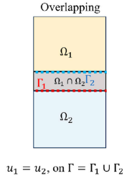
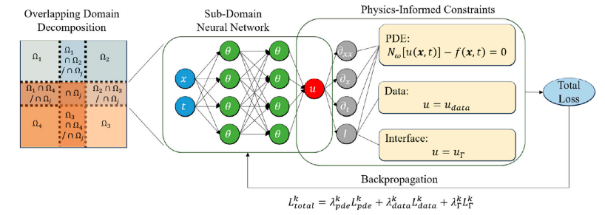
Overlapping Domain Decomposition
Ye, et al, 2025
Notes:
PINNs can be scaled up by using ideas from Domain Decomposition in the solution of PDEs, e.g. FEM etc. We have already seen a variational example in Lecture 9 but here we
Consisder the classical PINN form.

Slide 28
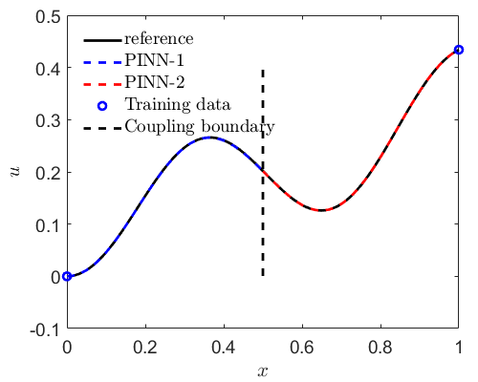
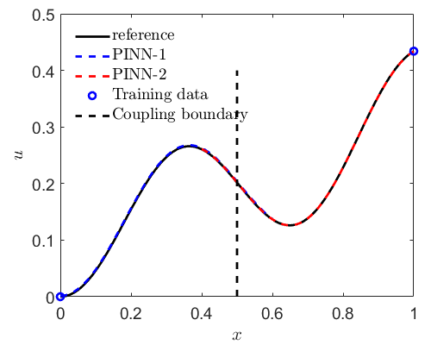
Example: Forward problem
$$\frac{du}{dx}=\sin\left(3x\right)+1.5u\left(1−u\right), x∈[0,1]$$
Ye, et al, 2025
Notes:
PINNs can be scaled up by using ideas from Domain Decomposition in the solution of PDEs, e.g. FEM etc. We have already seen a variational example in Lecture 9 but here we
Consisder the classical PINN form.

Slide 29
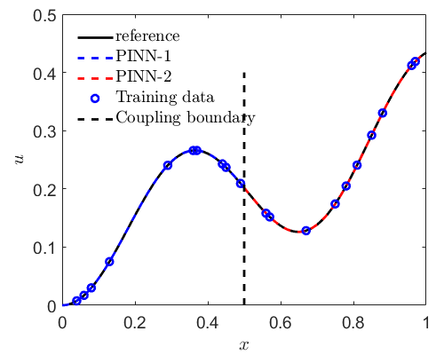
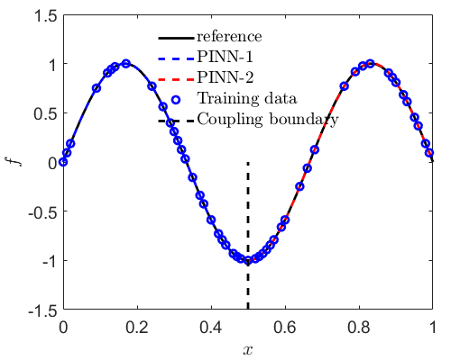
Example: Inverse problem
$$\frac{du}{dx}=\sin\left(3x\right)+au\left(1−u\right), x∈[0,1]$$
Ye, et al, 2025
Notes:
PINNs can be scaled up by using ideas from Domain Decomposition in the solution of PDEs, e.g. FEM etc. We have already seen a variational example in Lecture 9 but here we
Consisder the classical PINN form.

Slide 30
Thank you!

