Slide 1


Scientific Machine Learning
Lecture 10: Learning differential equations from data
孟旭辉
数学与统计学院数学与应用学科交叉创新研究院
办公室：东32楼111室
Email：xuhui_meng@hust.edu.cn
https://github.com/XuhuiM/SciML-Course

Slide 2
Contents
Sparse identification of non-linear dynamics (SINDy)
PDE-Net
Residual network for learning equations from data
…

Slide 3
Contents
Sparse identification of non-linear dynamics (SINDy)
PDE-Net
Residual network for learning equations from data
…

Slide 4
Machine learning for discovering equations from data
Brunton et al. Sci. Adv. 2017

Slide 5
Machine learning for discovering equations from data
Brunton et al. Sci. Adv. 2017

Slide 6
Machine learning for discovering equations from data
Brunton et al. Sci. Adv. 2017

Slide 7
Correcting model misspecification in physics-informed neural networks
Zou, et al., JCP, 2024

Slide 8
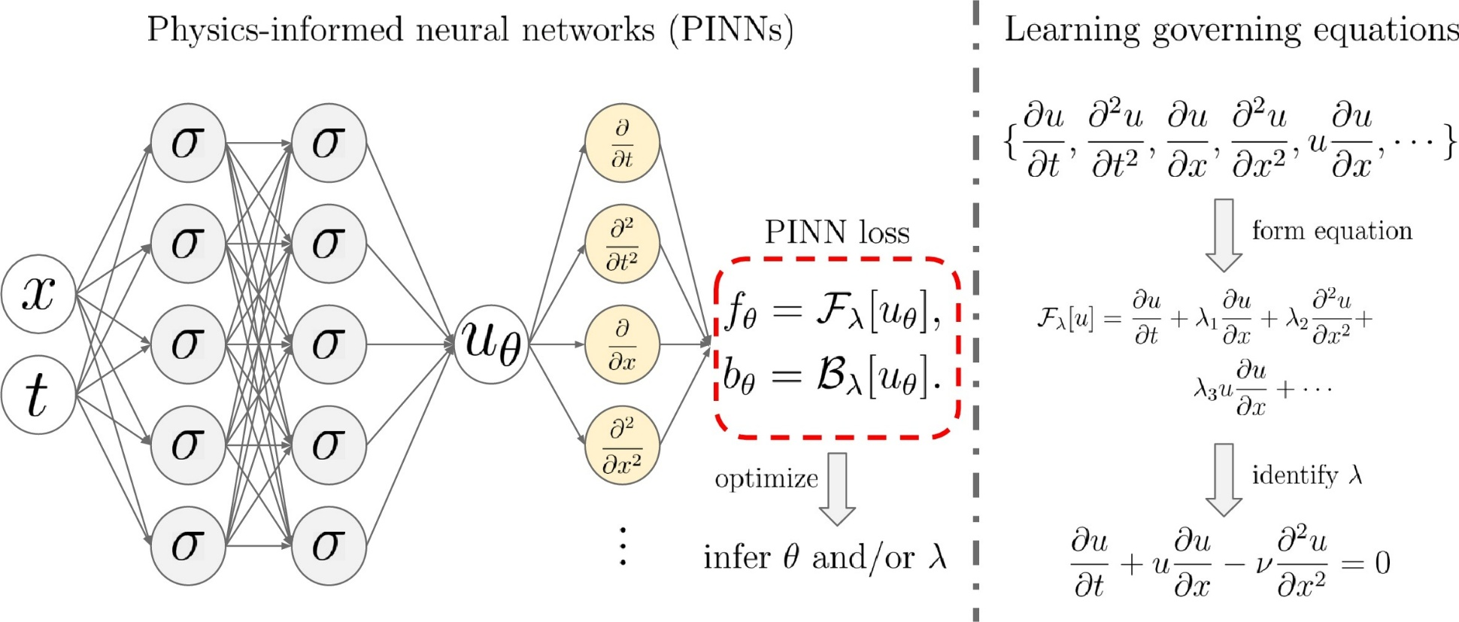
PINN for inverse problems
Loss function:
$$L={\min_{θ,λ}⁡(f_{θ}^{2}+|u_{bc}^{∗}−u_{bc}|}^{2}+{\left|u_{ic}^{∗}−u_{ic}\right|}^{2}+{\left|u^{∗}−u\right|}^{2})$$
Zou, et al, JCP, 2024

Slide 9
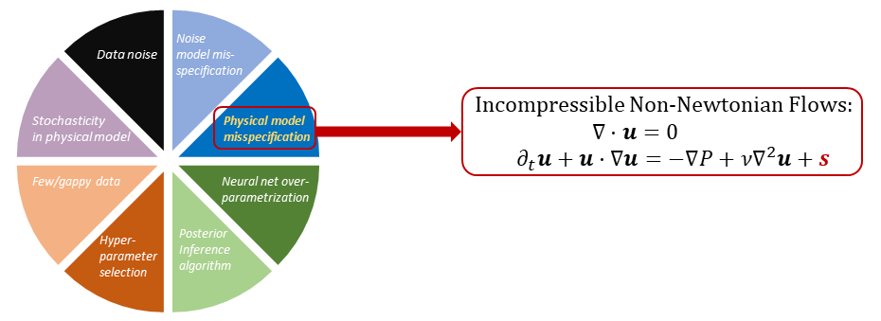
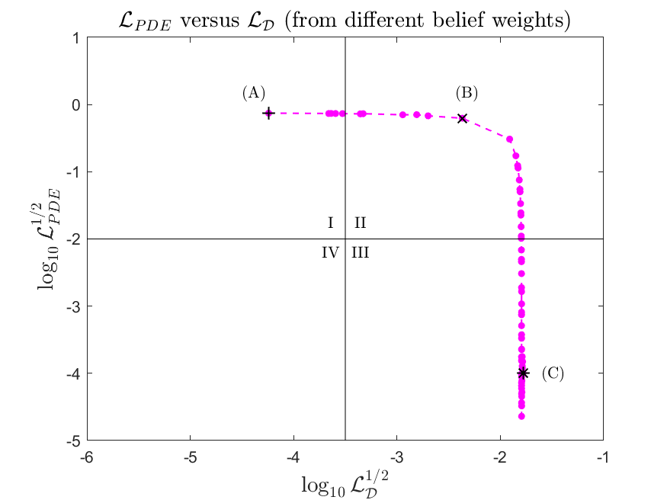
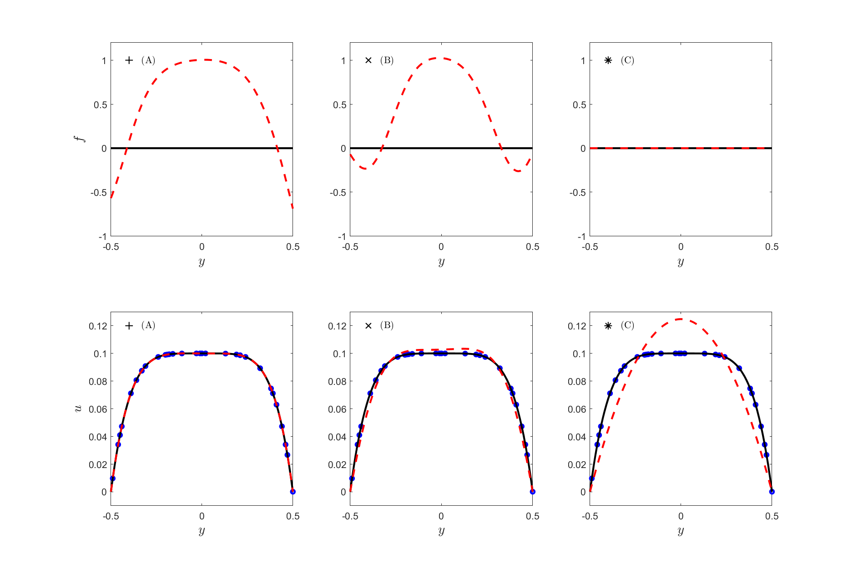
PINNs with misspecified model
Zou, et al., JCP, 2024

Slide 10
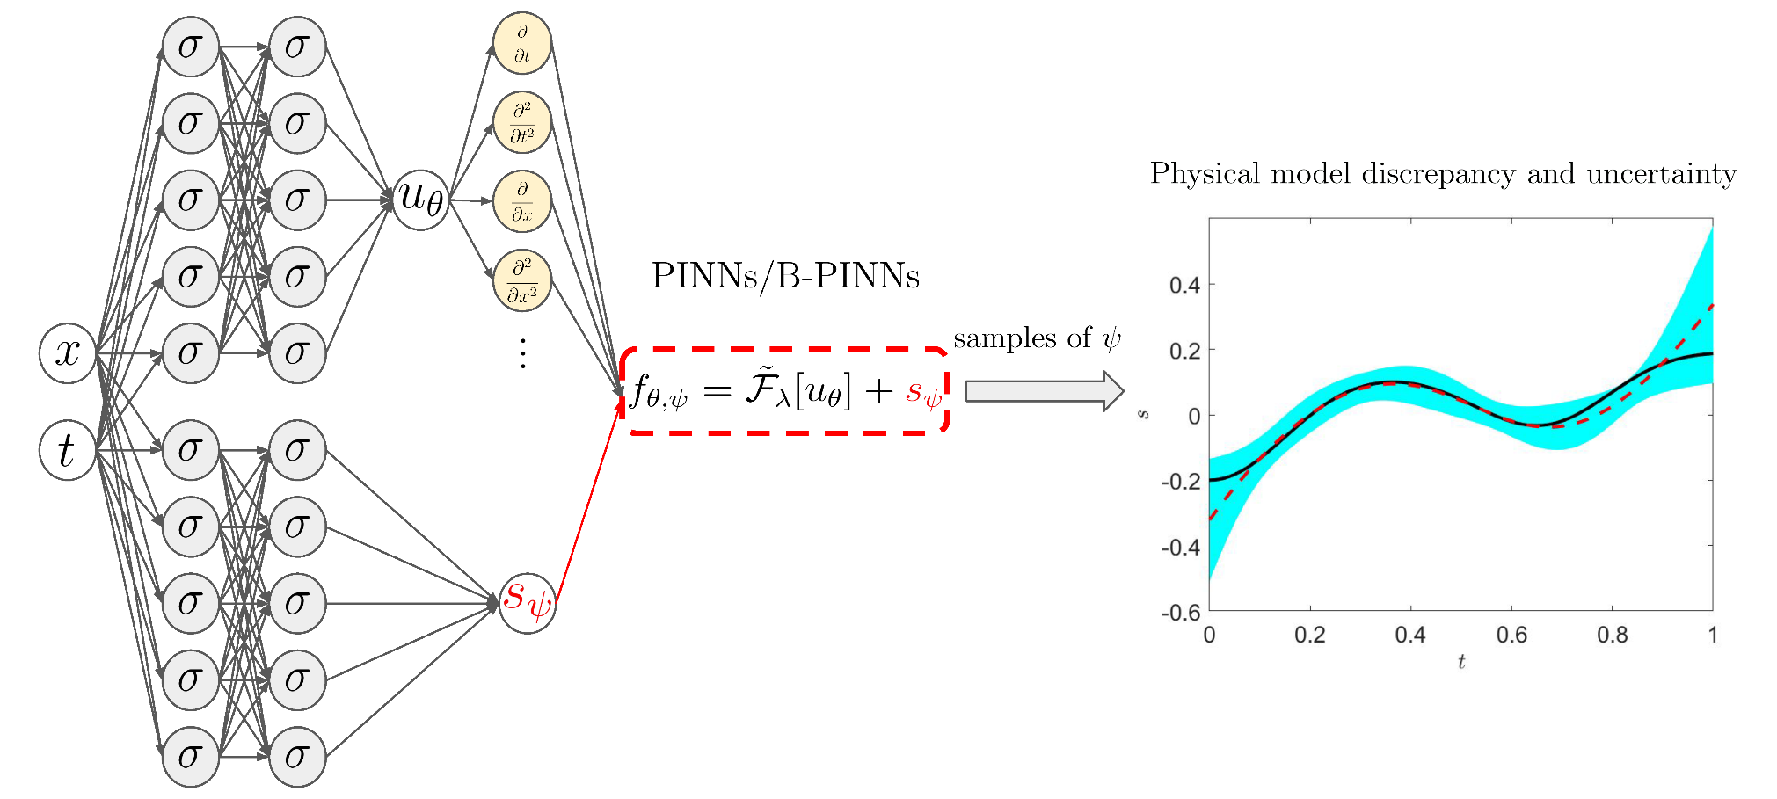
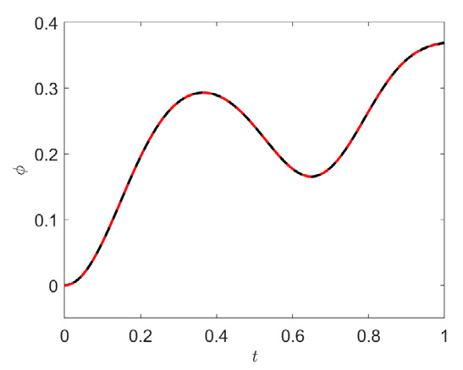
Correcting model misspecification in PINNs
Zou, et al., JCP, 2024

Slide 11

Outline
Model misspecification in PINNs
Correcting model misspecification in PINNs
Numerical examples
Summary

Slide 12
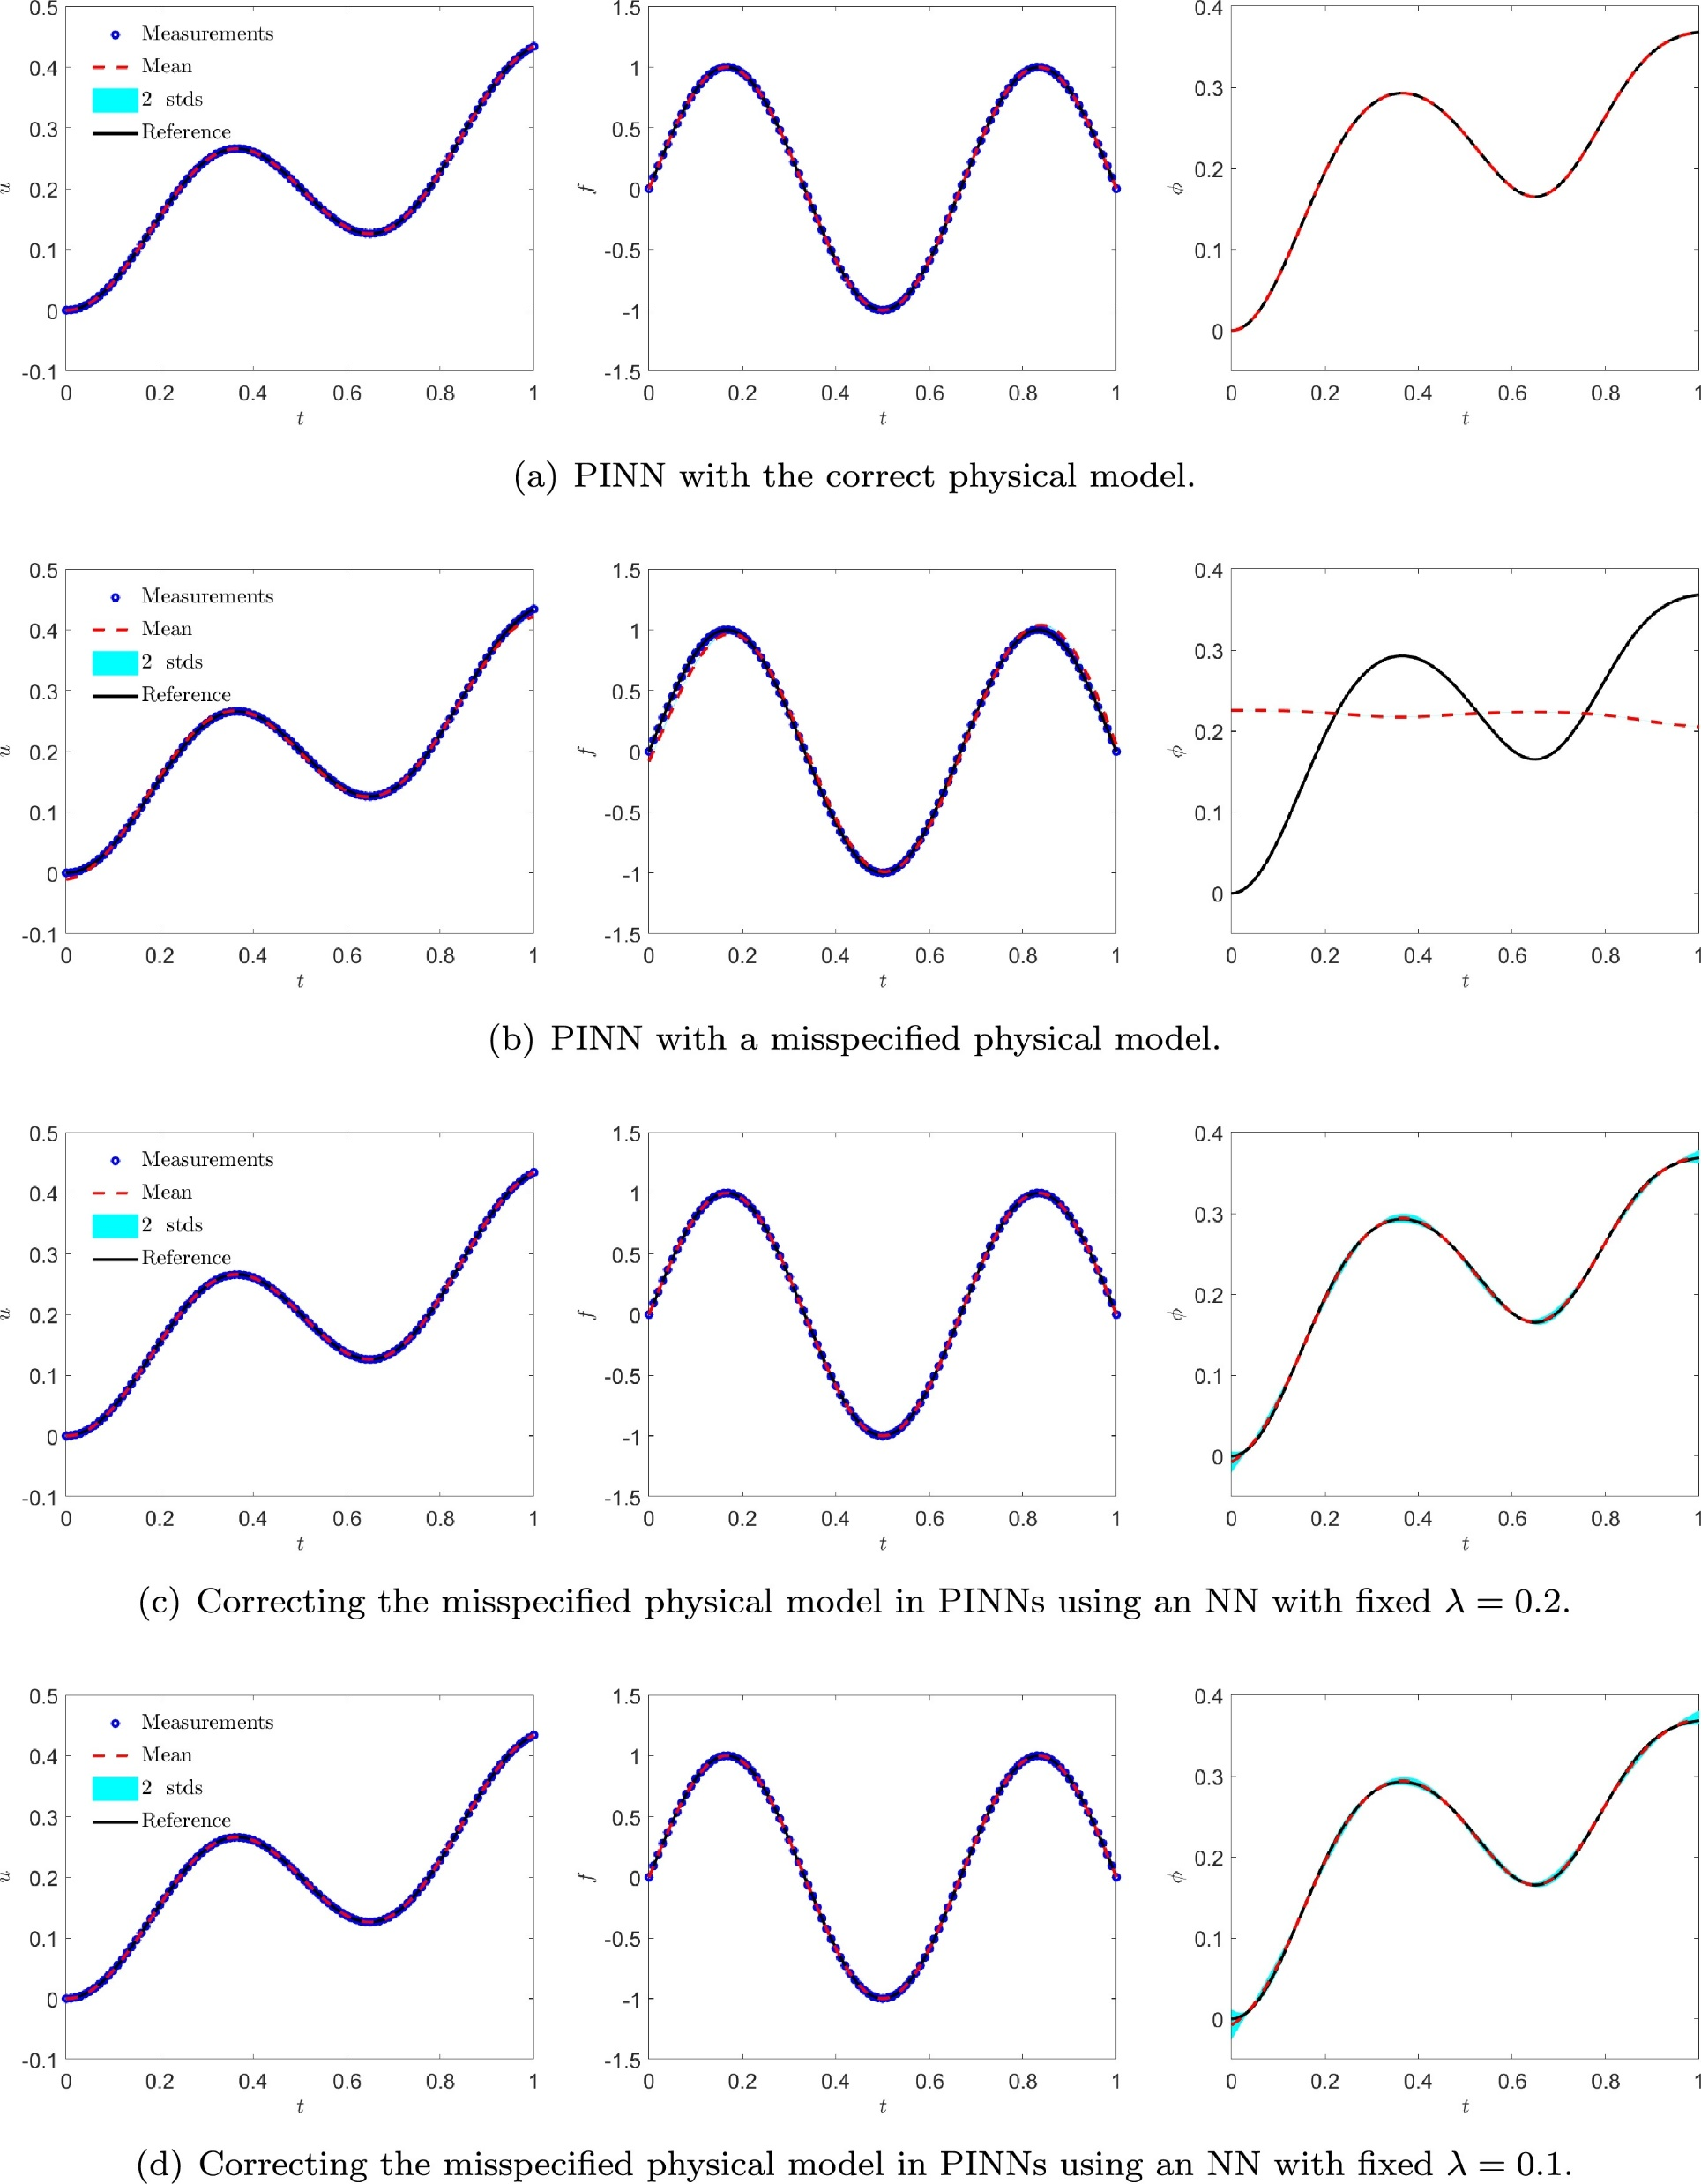


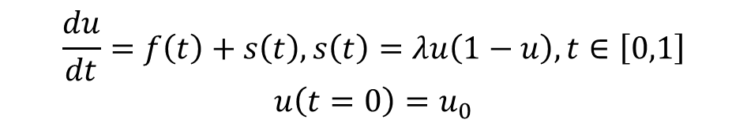
Example I: ODE example
$$\frac{du}{dt}=f\left(t\right)+s\left(t\right), s\left(t\right)=λu\left(1−u\right), t∈\left[0,1\right]$$
$$u\left(t=0\right)=u_{0}$$
Case A: $s=λu(1−u)$
Case B: $s=λcos⁡(u)$

Slide 13


Correcting model misspecification in PINNs
Case C: $φ=0.2\cos\left(u\right)+s_{ψ}(t)$
Case D: $φ=0.1\cos\left(u\right)+s_{ψ}(t)$

Slide 14
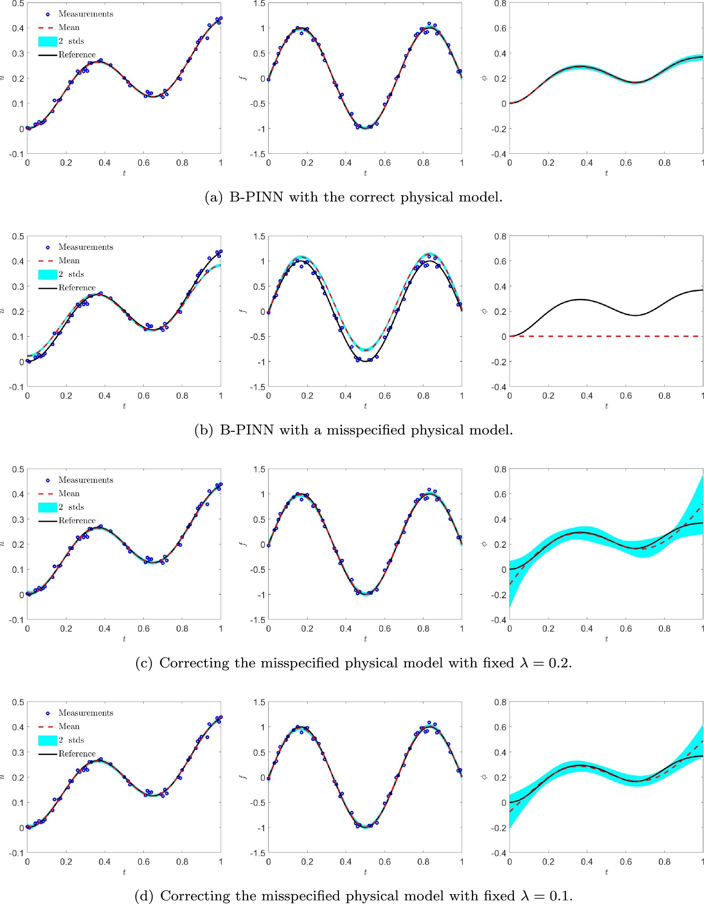

Bayesian PINNs for uncertainty quantification
$$\frac{du}{dt}=f\left(t\right)+s\left(t\right), s\left(t\right)=λu\left(1−u\right), t∈\left[0,1\right]$$
$$u\left(t=0\right)=u_{0}$$
Case A: $s=λu(1−u)$
$$u,f,s_{ψ}←BNN$$
Case B: $s=λcos⁡(u)$

Slide 15

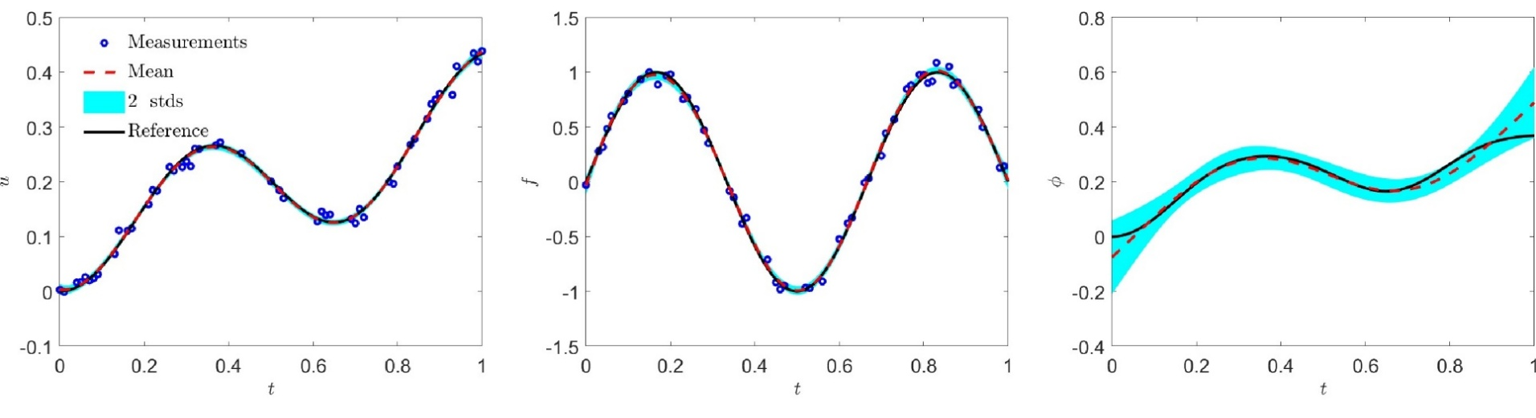


Bayesian PINNs for uncertainty quantification
Case C: $φ=0.2\cos\left(u\right)+s_{ψ}(t)$
$$u,f,s_{ψ}←BNN$$
Case D: $φ=0.1\cos\left(u\right)+s_{ψ}(t)$
Zou, et al., JCP, 2024

Slide 16
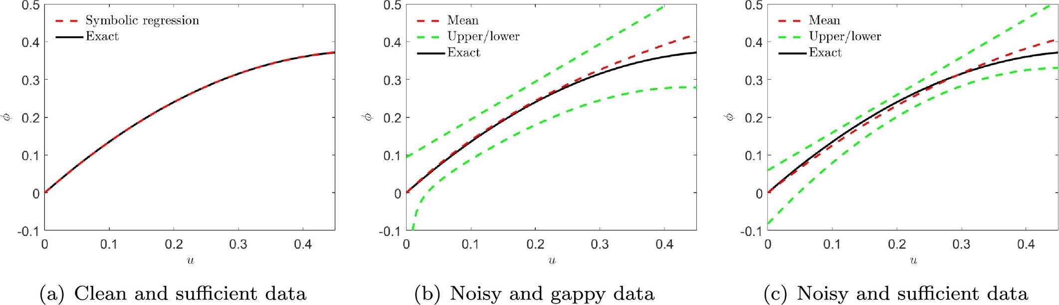
Symbolic regression for discovering equation
$$φ=0.1\cos\left(u\right)+s_{ψ}(t)$$
Zou, et al., JCP, 2024

Slide 17
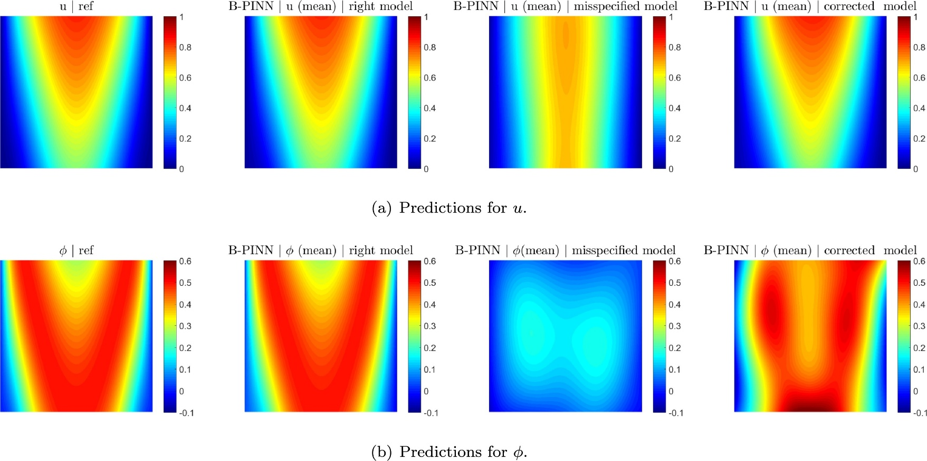
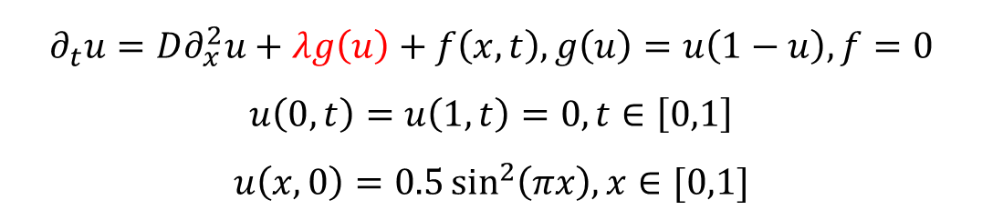
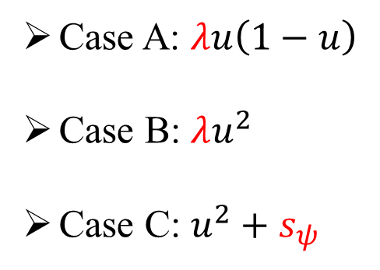
Example II: reaction-diffusion equation
Case A: $λu\left(1−u\right)$
Case B: $λu^{2}$
Case C: $u^{2}+s_{ψ}$
$$∂_{t}u=D∂_{x}^{2}u+λg\left(u\right)+f\left(x,t\right), g\left(u\right)=u\left(1−u\right),f=0$$
$$u\left(0,t\right)=u\left(1,t\right)=0, t∈\left[0,1\right]$$
$$u\left(x,0\right)=0.5\sin^{2}\left(πx\right),x∈[0,1]$$
Zou, et al., JCP, 2024

Slide 18
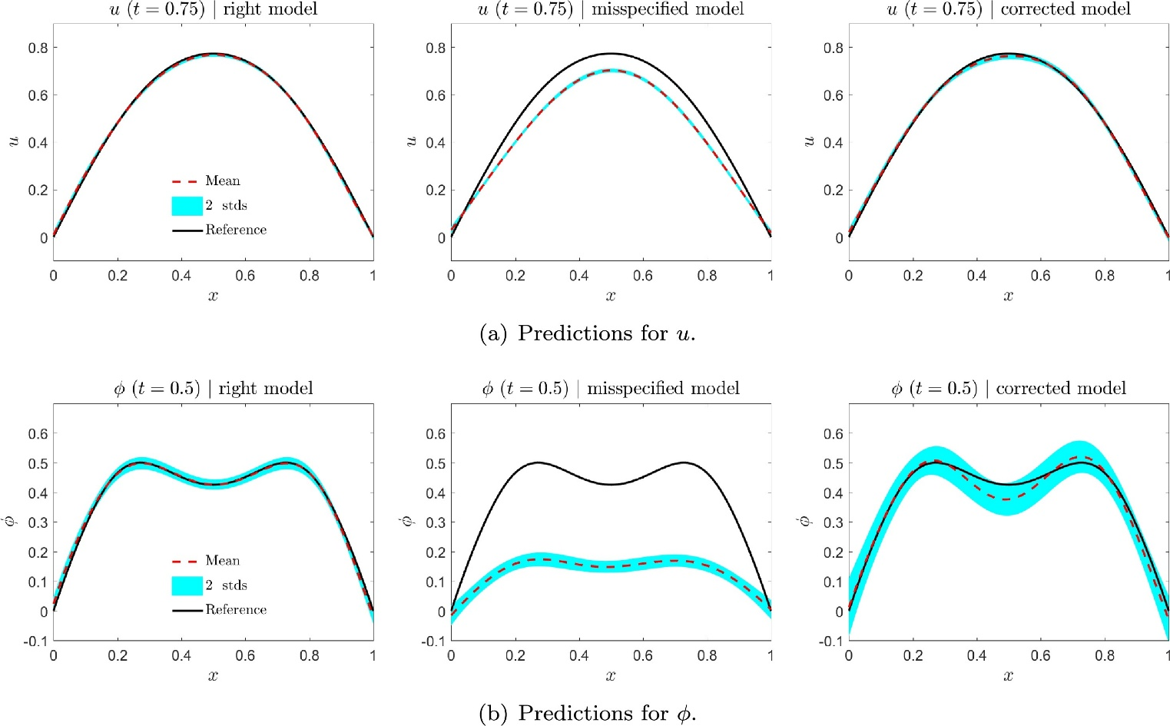
Example II: reaction-diffusion equation
Case A: $λu\left(1−u\right)$
Case B: $λu^{2}$
Case C: $u^{2}+s_{ψ}$
$$∂_{t}u=D∂_{x}^{2}u+λg\left(u\right)+f\left(x,t\right), g\left(u\right)=u\left(1−u\right),f=0$$
$$u\left(0,t\right)=u\left(1,t\right)=0, t∈\left[0,1\right]$$
$$u\left(x,0\right)=0.5\sin^{2}\left(πx\right),x∈[0,1]$$

Slide 19

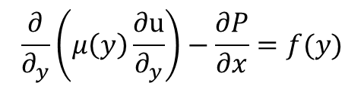

Example III: Non-Newtonian flow-Channel flow
$$n=0.25,c=−1,H=1, μ_{0}=0.5$$
Correct the model misspecification using a DNN
$$μ_{1}=0.1$$
Use a DNN to approximate $μ(y)$
$$\frac{∂}{∂_{y}}\left(μ\left(y\right)\frac{∂u}{∂_{y}}\right)−\frac{∂P}{∂x}=f(y)$$
Zou, et al., JCP, 2024

Slide 20
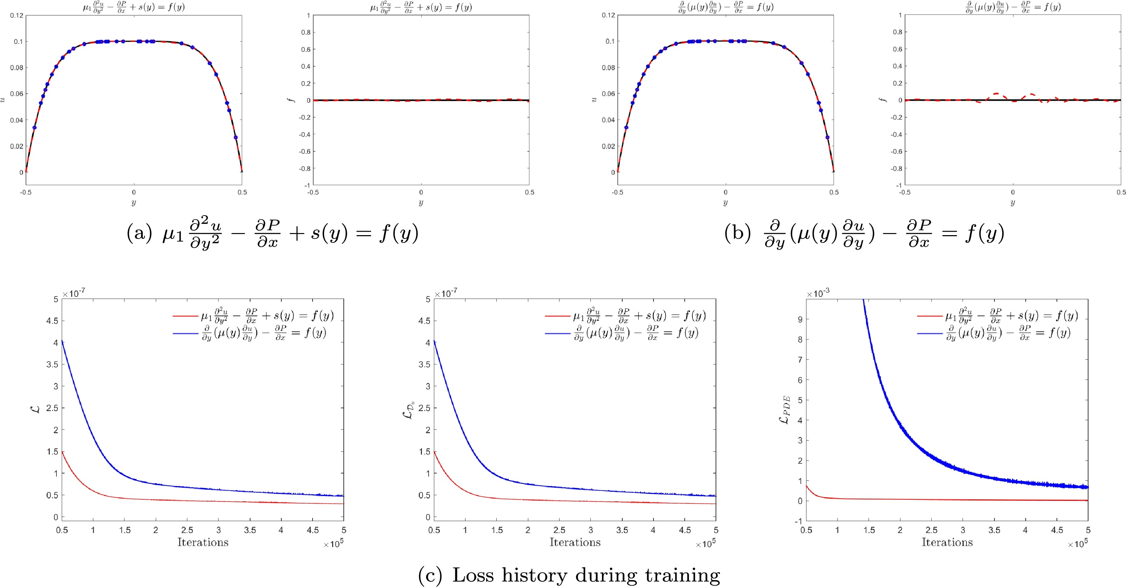
PINN with clean data
Zou, et al., JCP, 2024

Slide 21


PINN with clean data
Zou, et al., JCP, 2024

Slide 22
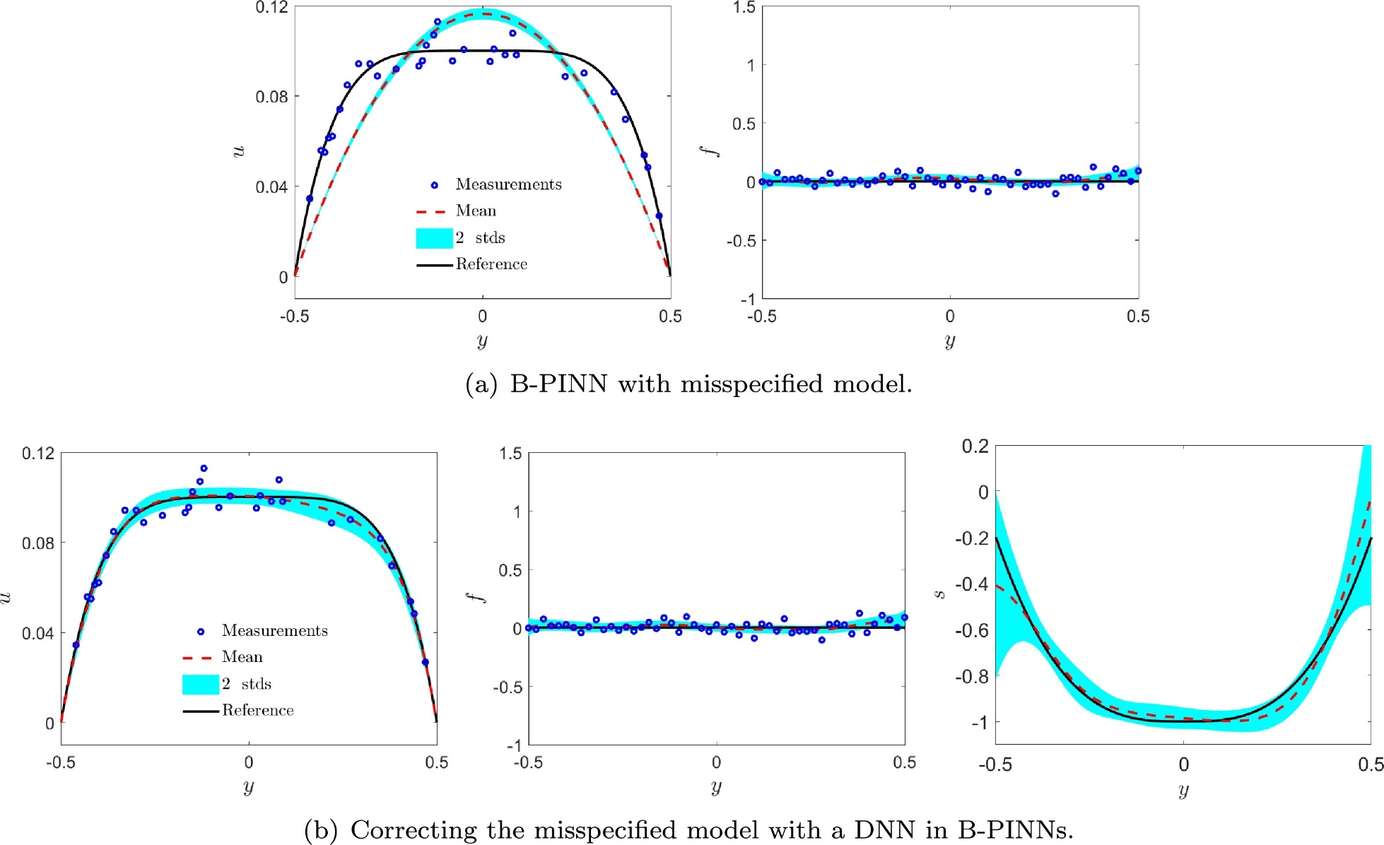
BPINN with noisy data
Zou, et al., JCP, 2024

Slide 23
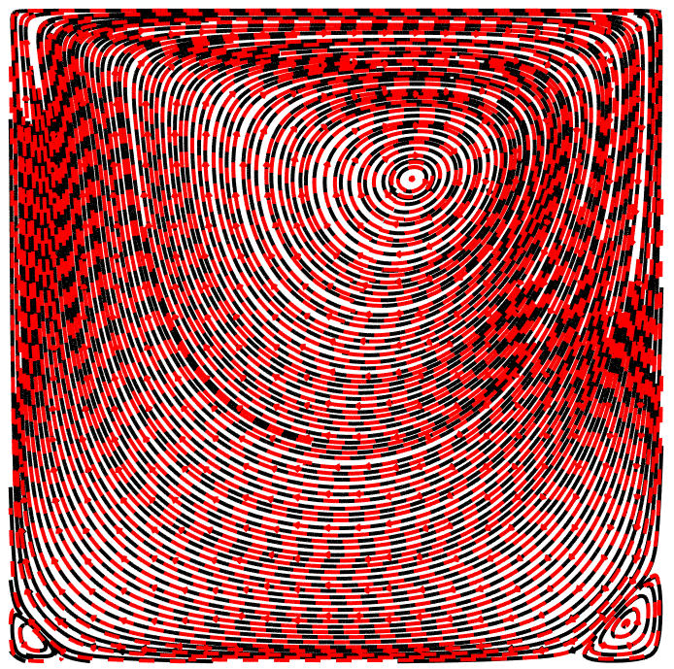

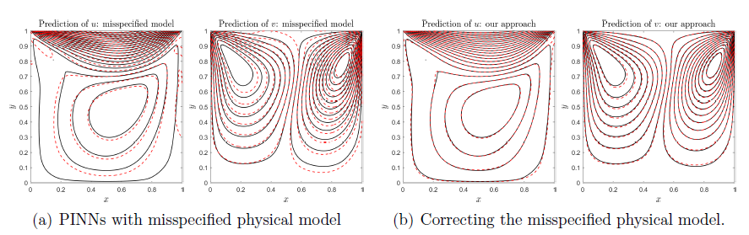
Model misspecification in PINNs: Non-Newtonian flow
NS + constant viscosity
NS + constant viscosity + s
Zou, et al., JCP, 2024

Slide 24
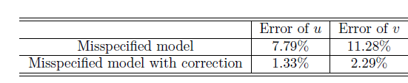
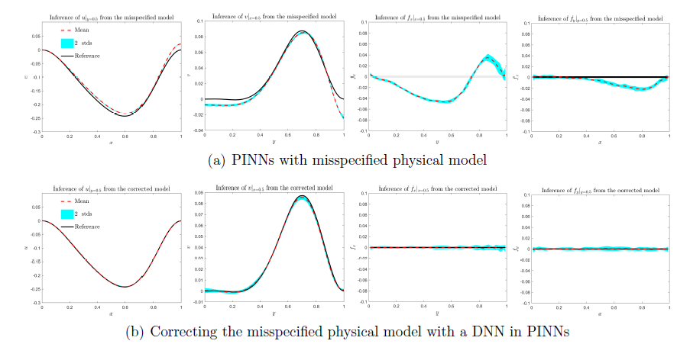
Model misspecification in PINNs: Non-Newtonian flow
Zou, et al., JCP, 2024

Slide 25
Residual-net
Qin et al. JCP 2019

Slide 26
Residual-net
Qin et al. JCP 2019

Slide 27
Residual-net
Qin et al. JCP 2019

Slide 28
Residual-net
Qin et al. JCP 2019

Slide 29
Residual-net
Qin et al. JCP 2019

Slide 30
Residual-net
Qin et al. JCP 2019

Slide 31
Residual-net
Qin et al. JCP 2019

Slide 32

Residual-net
$$Δ=0.1$$
Qin et al. JCP 2019

Slide 33
Residual-net
Qin et al. JCP 2019

Slide 34
Residual-net
Qin et al. JCP 2019

Slide 35
Residual-net
Qin et al. JCP 2019

Slide 36
Residual-net
Qin et al. JCP 2019

Slide 37
Residual-net
Qin et al. JCP 2019

Slide 38
Residual-net
Qin et al. JCP 2019

Slide 39
Residual-net
Qin et al. JCP 2019

Slide 40
Residual-net
Qin et al. JCP 2019

Slide 41
Residual-net
Qin et al. JCP 2019

Slide 42
Residual-net
Qin et al. JCP 2019

Slide 43
PDE-net
Long et al. ICML 2018

Slide 44
PDE-net
Long et al. ICML 2018

Slide 45
PDE-net
Long et al. ICML 2018

Slide 46
PDE-net
Long et al. ICML 2018

Slide 47
PDE-net
Long et al. ICML 2018

Slide 48
PDE-net: Convection-diffusion equation
Long et al. ICML 2018

Slide 49
PDE-net: Convection-diffusion equation
Long et al. ICML 2018

Slide 50
PDE-net: Convection-diffusion equation
Long et al. ICML 2018

Slide 51
PDE-net: Diffusion-reaction system
Long et al. ICML 2018

Slide 52
PDE-net: Diffusion-reaction system
Long et al. ICML 2018

Slide 53
PDE-net: Diffusion-reaction system
Long et al. ICML 2018

Slide 54
PDE-net: Diffusion-reaction system
Long et al. ICML 2018

Slide 55

Thank you for your attention!

