Slide 1


Scientific Machine Learning
Lecture 12: Learning numerical schemes for PDEs via deep learning
孟旭辉
数学与统计学院数学与应用学科交叉创新研究院
办公室：东32楼111室
Email：xuhui_meng@hust.edu.cn
https://github.com/XuhuiM/SciML-Course

Slide 2
PINN variants
An Alphabet of PINNs aper in Nature Physics Reviews, June 2021)
vPINNs/hp-vPINNs: variational PINNs (Lecture 9)
gPINNs: gradient-enhanced PINNs
cPINNs: conservative PINNs
xPINNs: eXtended PINNs
fPINNs: fractional PINNs
sPINNs: stochastic PINNs
BPINNs: Bayesian PINNs …

Slide 3
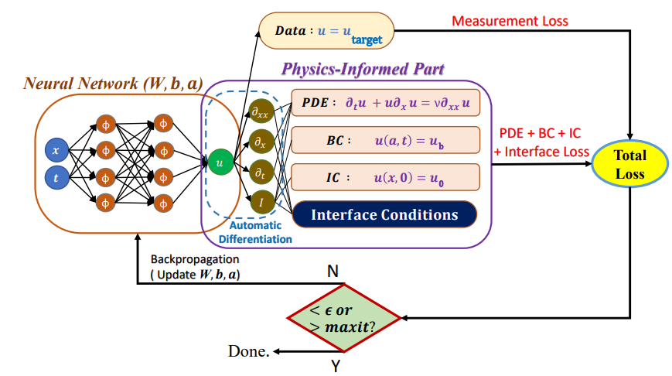
PINNs with Domain Decomposition
Notes:
PINNs can be scaled up by using ideas from Domain Decomposition in the solution of PDEs, e.g. FEM etc. We have already seen a variational example in Lecture 9 but here we
Consisder the classical PINN form.

Slide 4
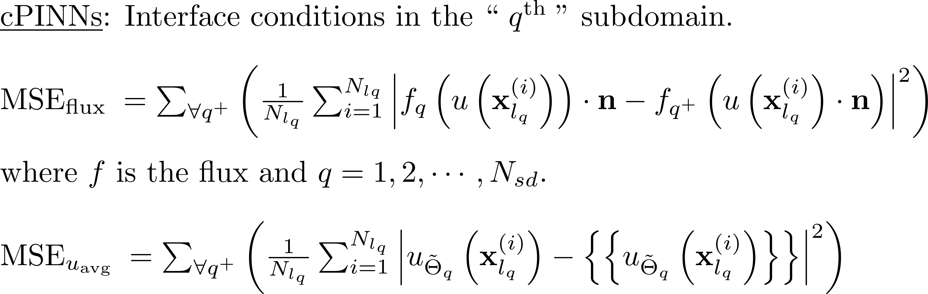
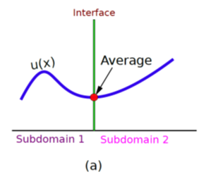
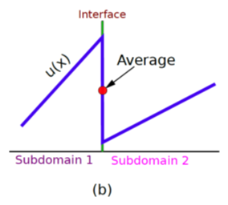
Conservative PINNs (cPINNs)
Jagtap AD, Kharazmi E, Karniadakis GE. Conservative physics-informed neural networks on discrete domains for conservation laws: Applications to forward and inverse problems. Computer Methods in Applied Mechanics and Engineering. 2020 Jun 15;365:113028
Notes:
For conservation laws, we can get inspiration from finite volumes using fluxes at the interfaces and hence derive proper interface conditions that will be added as extra loss terms in the total
Loss function. In addition, we penalize the solution at the interface. Mimicking DG methods.

Slide 5
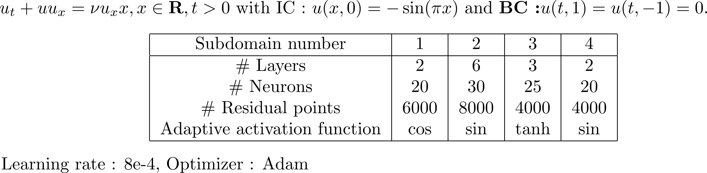
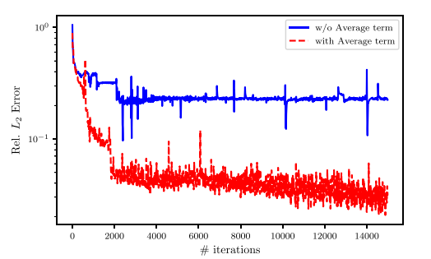
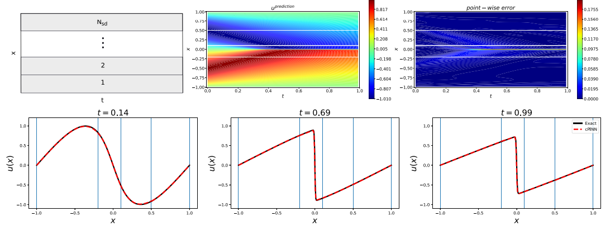
cPINNs: Burgers equation
Notes:
Let us consider again the Burgers equation – here we split the domain in space only in 4 elements. Note that we can assign different NN in every domain of different size and even different AF and this gives
Us great flexibility.

Slide 6
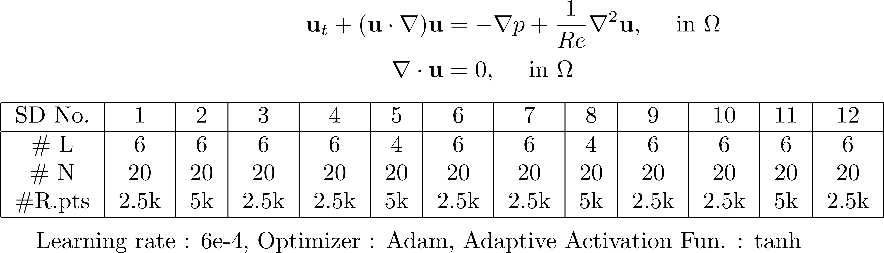
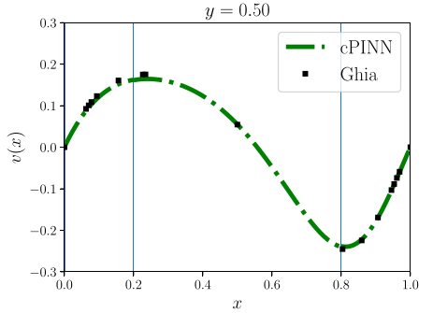
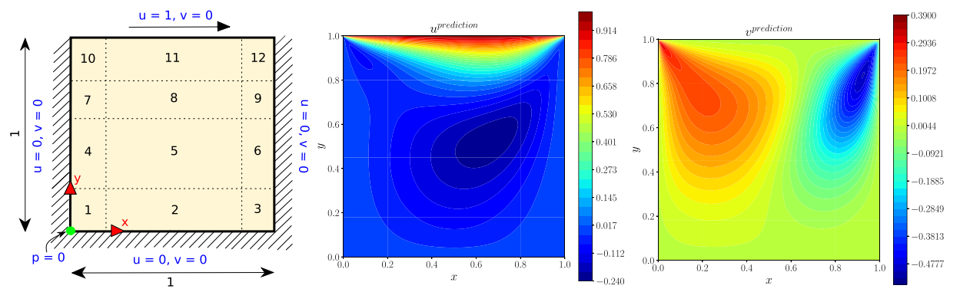
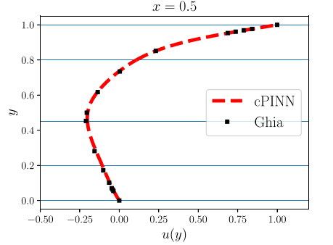
cPINN Results: 2D Incompressible Navier Stokes Equation
Notes:
Applying this to the standard cavity benchmark at Re=100, we can introduce 12 domains here with different architectures; the results are compared with benchmark solutions.

Slide 7
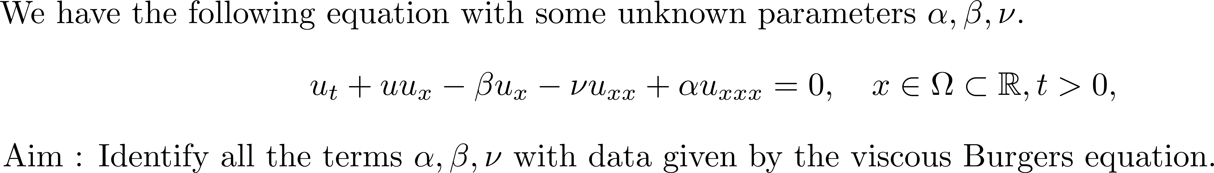
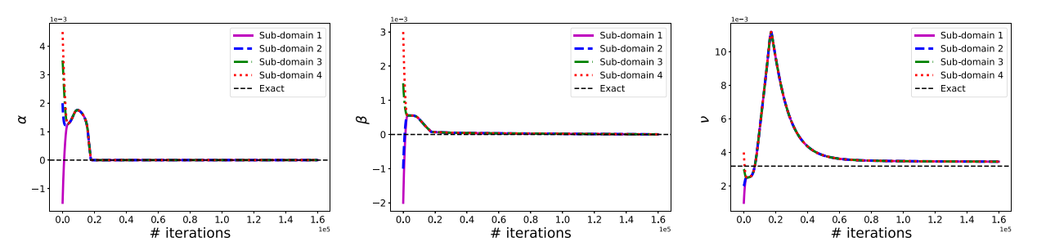
cPINN Results: Inverse 2D Burgers Equation
Notes:
We can also tackle the inverse Burgers to identify three parameters, shown here, and convergence seems ti be uniform across all domains.

Slide 8
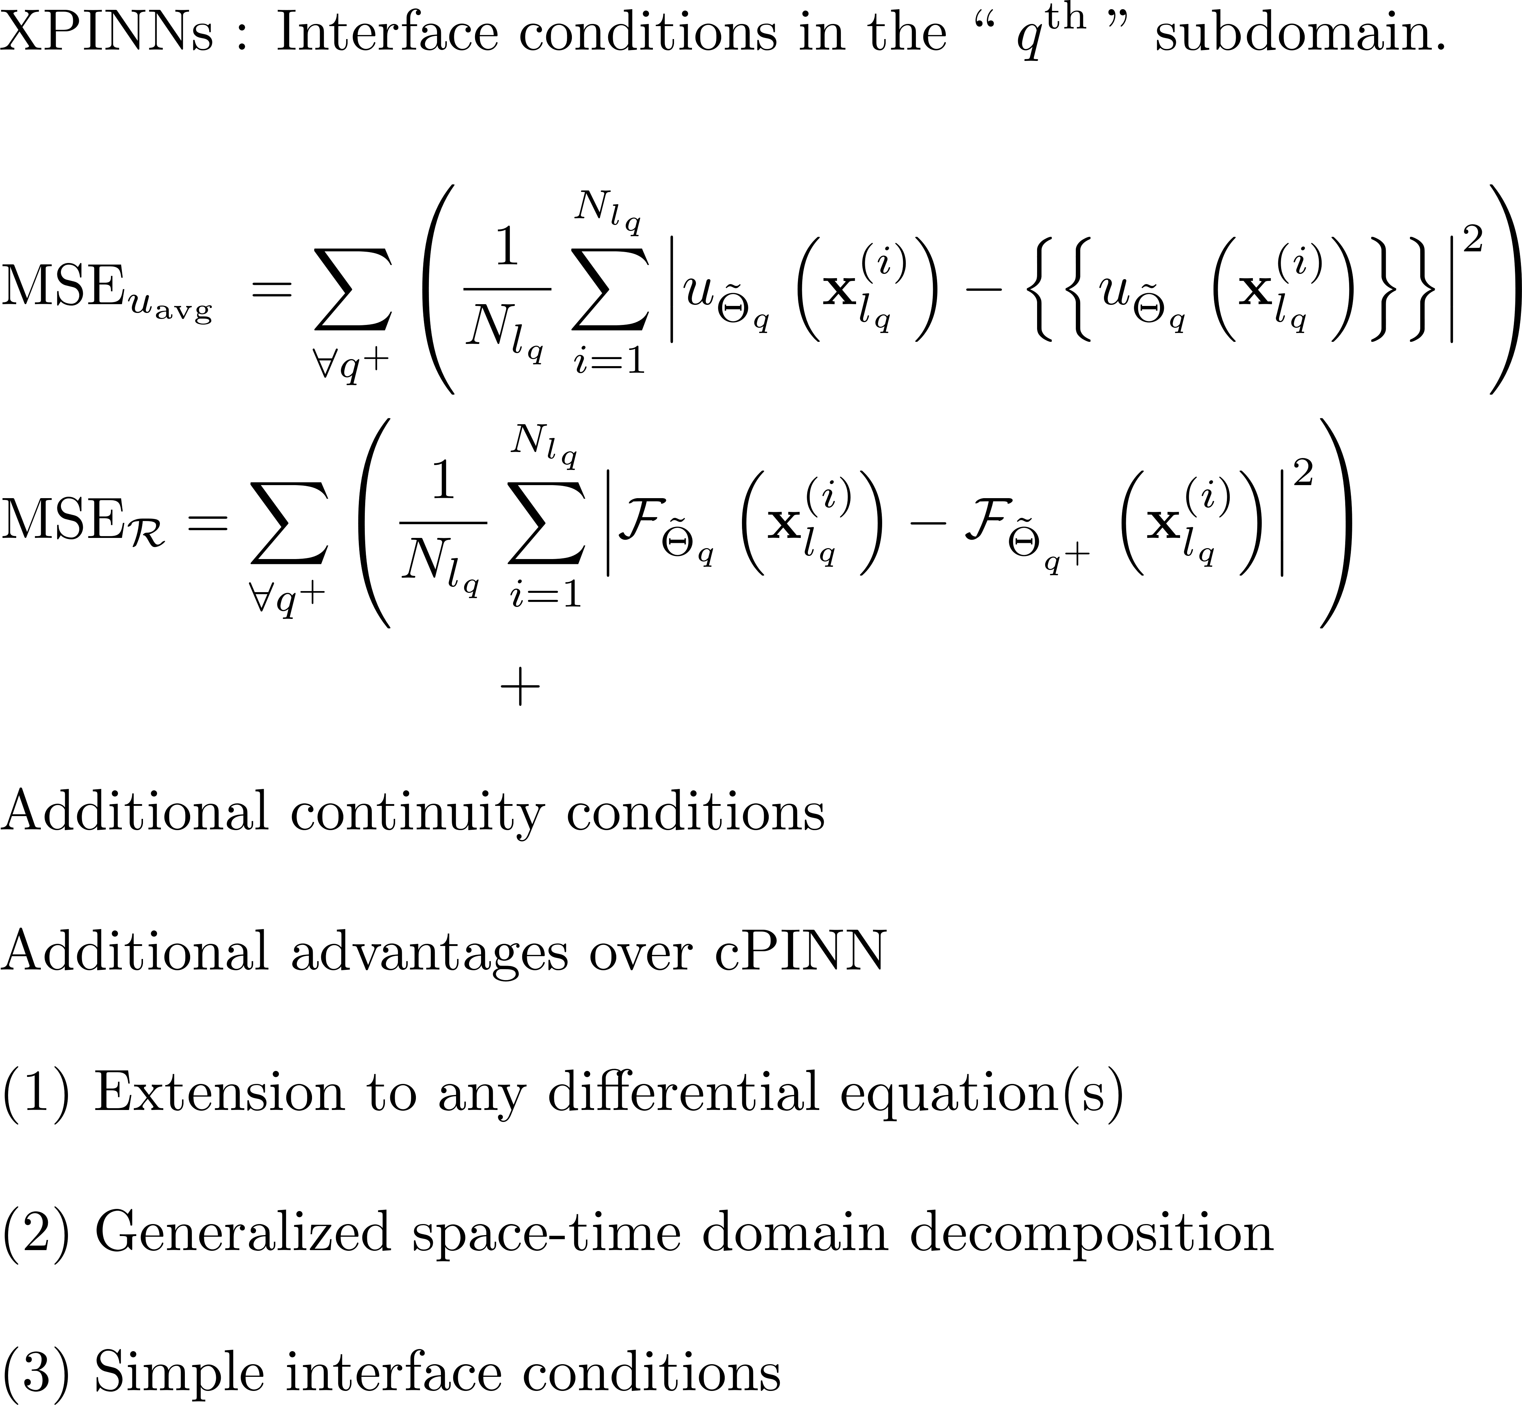
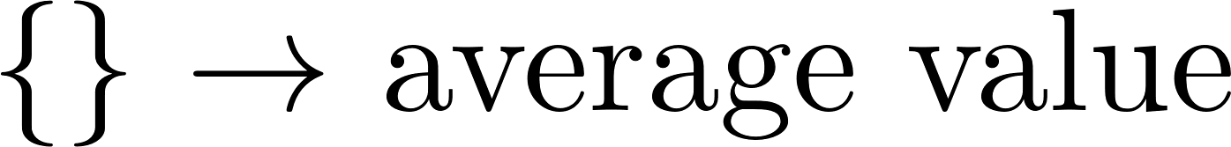
Extended PINNs (XPINNs)
Notes:
The XPINN is a generalization of CPINN as it can be applied to arbitrary PDEs. Here we can penalize the residual at the interface since we know its continuous and equals to zero.
We also impose the average velocity at the interface. This algorithm works but theoretically to prove convergence, we also need to impose the gradient at the interface that
Will make the algorithm more complicated. An alternative is to use the gPINN approach.

Slide 9
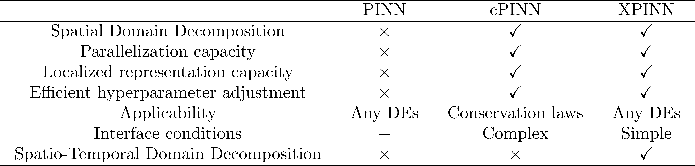
Comparison of PINN, cPINN and XPINN frameworks
Jagtap AD, Karniadakis GE. Extended physics-informed neural networks (xPINNs): A generalized space-time domain decomposition based deep learning framework for nonlinear partial differential equations. Communications in Computational Physics. 2020 Nov 1;28(5):2002-41.
Notes:
Here we summarize three versions of PINNs……

Slide 10
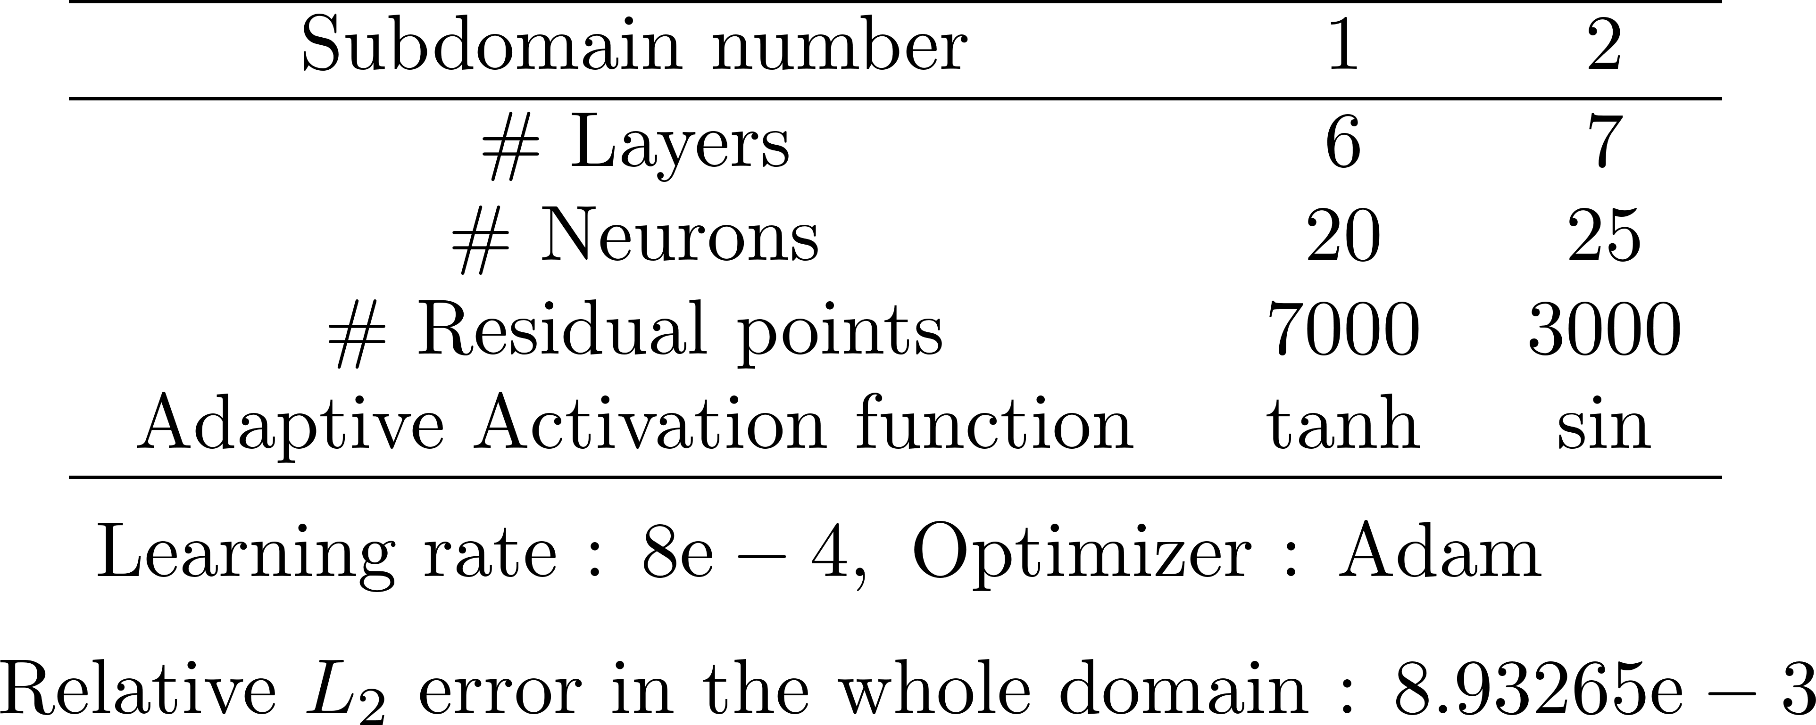
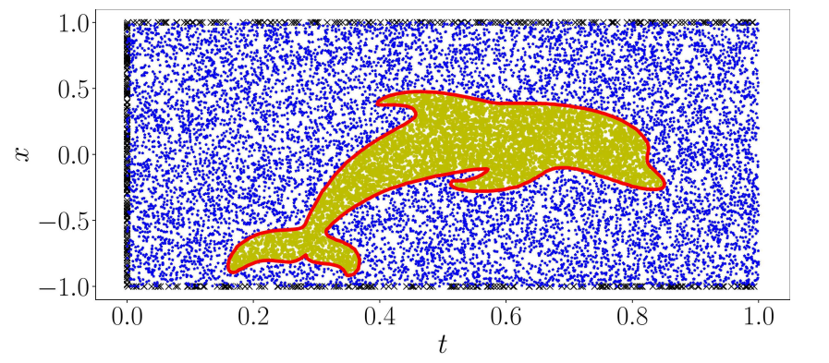
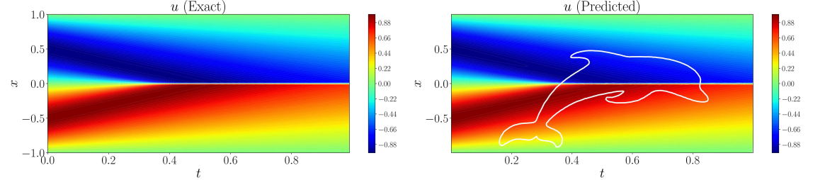
XPINN Results: Burgers Equation
Notes:
XPINN can provide decomposition in both space and time and hence we can achive parallelism in time that iis typically very hard to do in scientific computing. Note also that the
Domains can be of arbitrary shape unlike the convebtional methods.

Slide 11
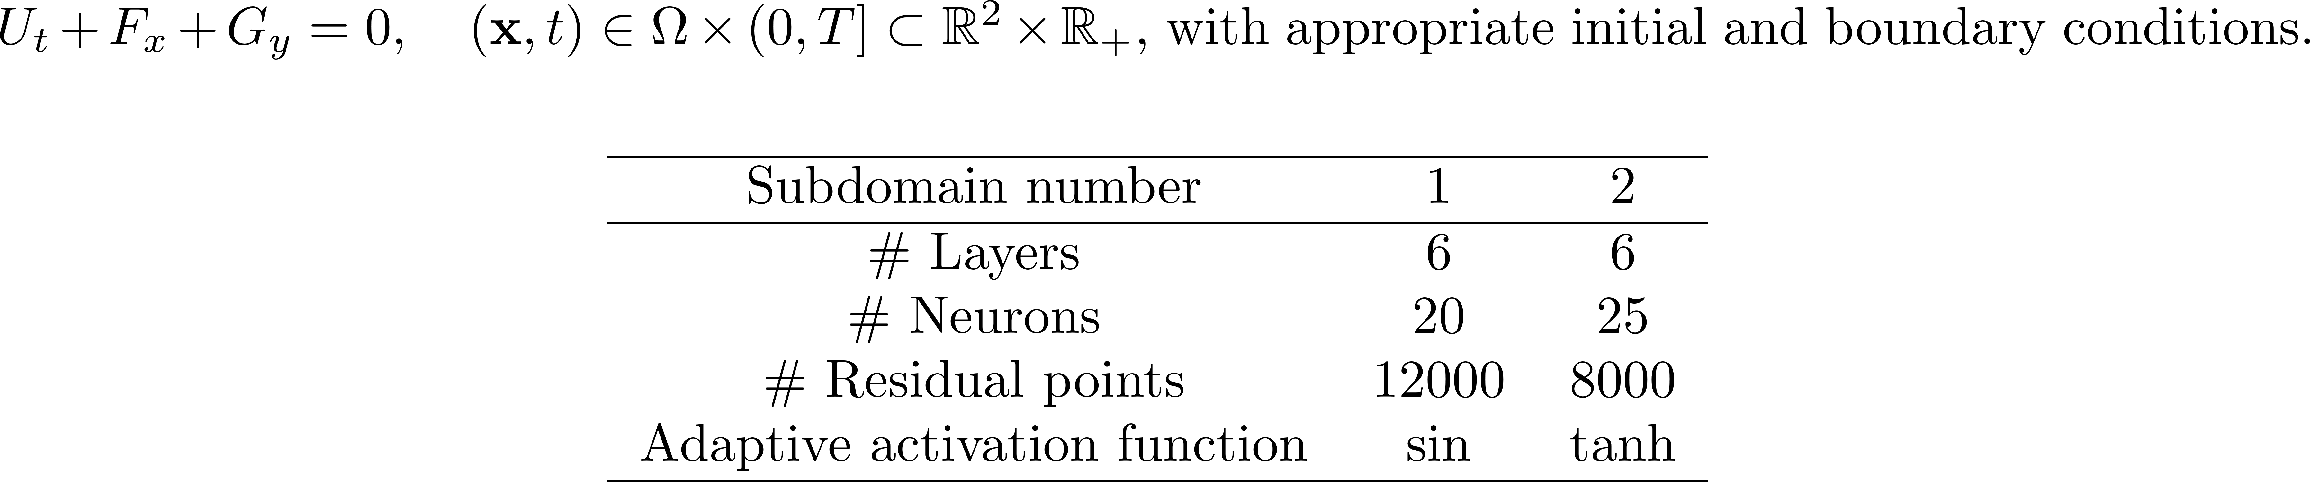
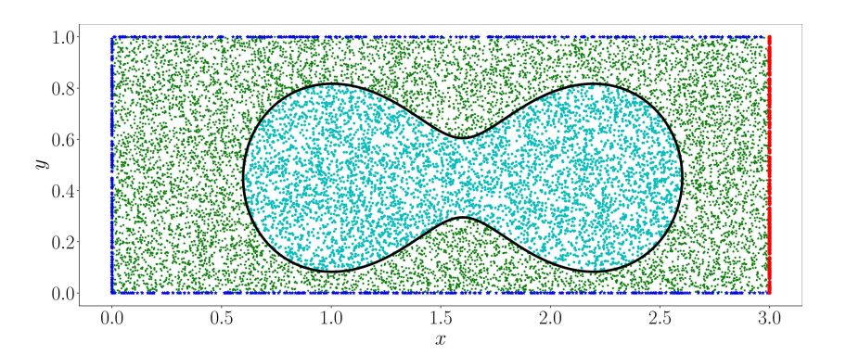
XPINN Results: 2D Compressible Euler Equations
Notes:
Another example of arbitrary decomposition is the peanut domain for the 2D steady Euler equations. Note again that we use different NNs and different AF in each domain.

Slide 12
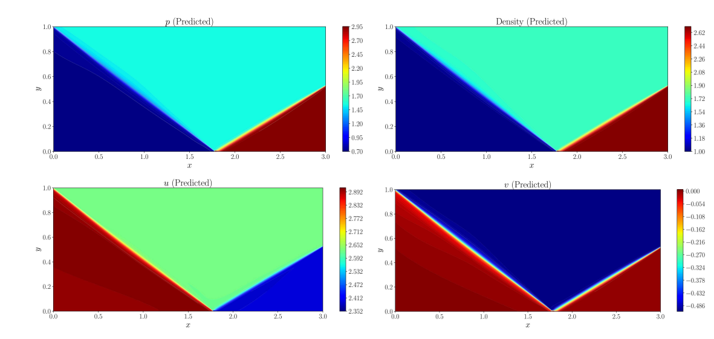
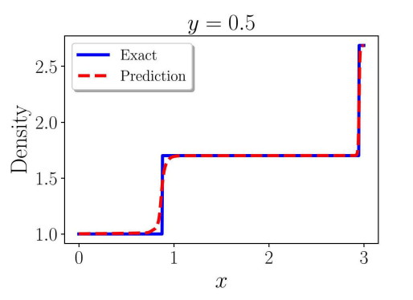
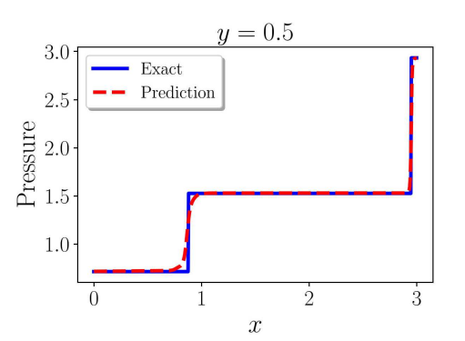
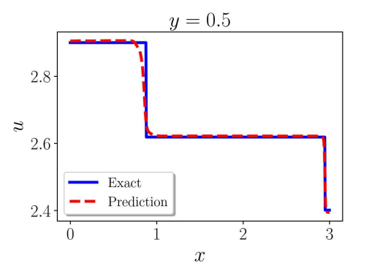
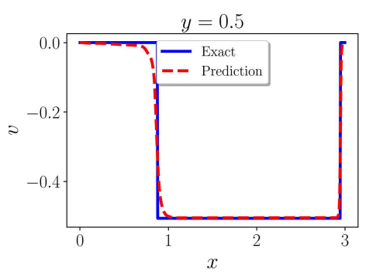
XPINN Results: 2D Compressible Euler Equations
Notes:
Despite the arbitrary decomposition, the solution is seamless across the interfaces.

Slide 13
Contents
Brief review on FDM/FVM
Learning numerical schemes from data
Applications to PDEs
…

Slide 14
Contents
Brief review on FDM/FVM
Learning numerical schemes from data
Applications to PDEs
…

Slide 15
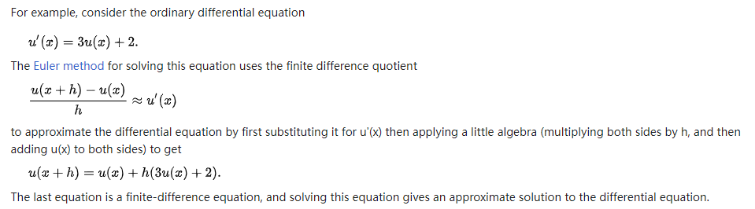
Finite Difference Method (FDM)
From Wiki

Slide 16
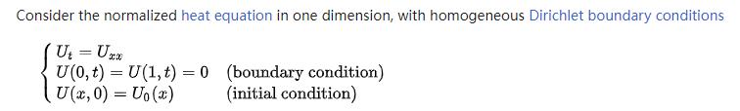
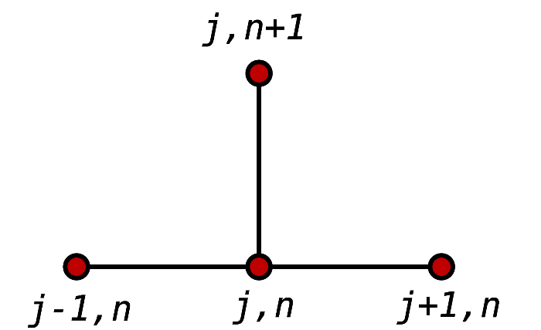
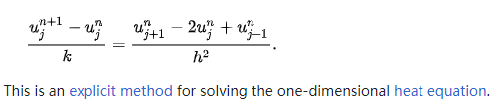
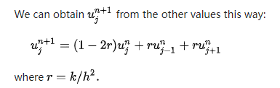
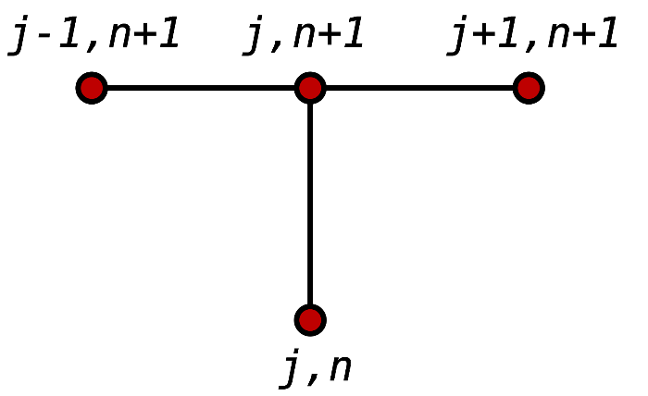
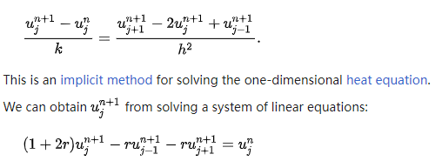
Finite Difference Method (FDM)
From Wiki

Slide 17
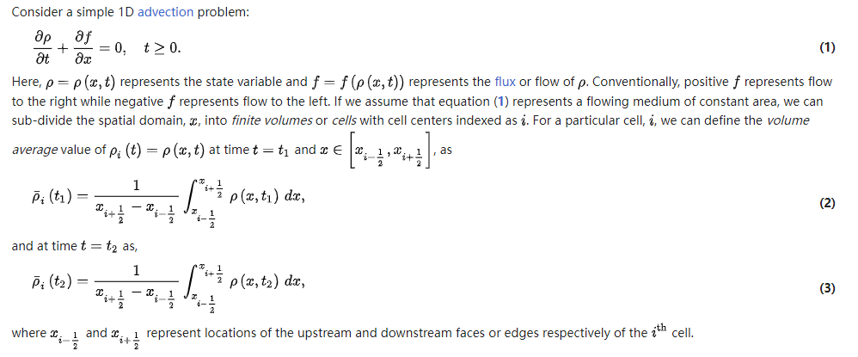

Finite Volume Method (FVM)
From Wiki

Slide 18
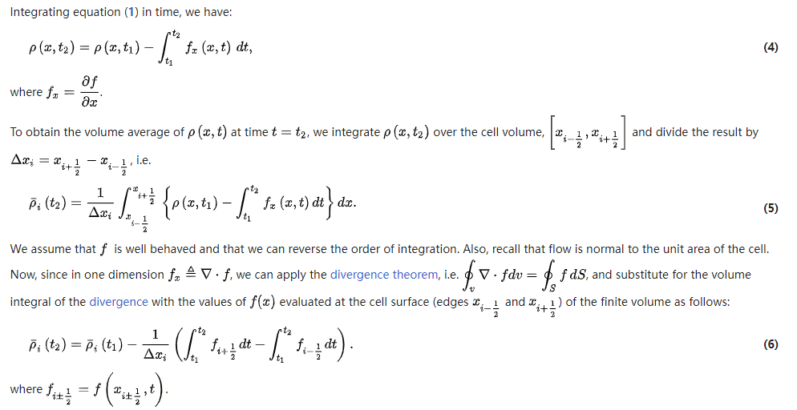
Finite Volume Method (FVM)
From Wiki

Slide 19
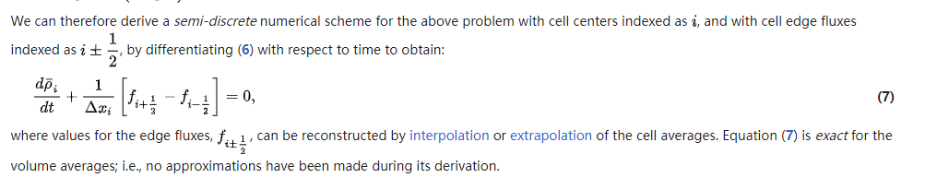
Finite Volume Method (FVM)
From Wiki

Slide 20
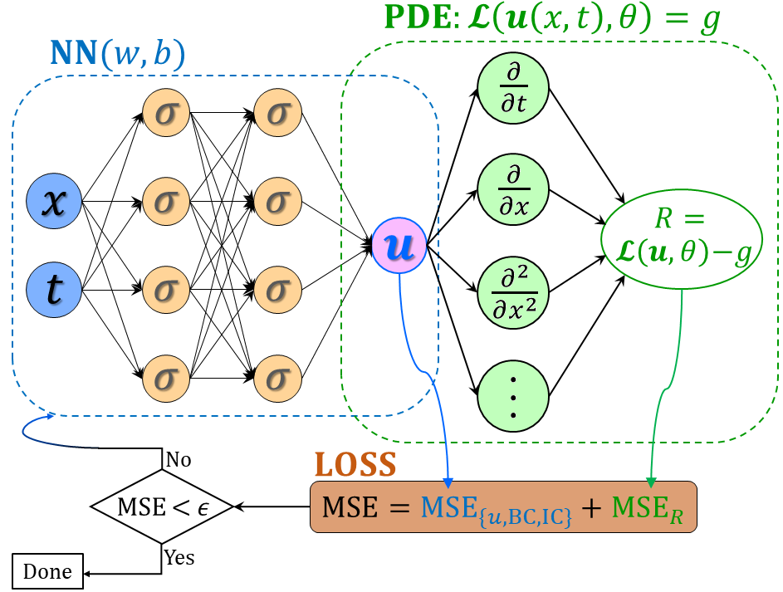


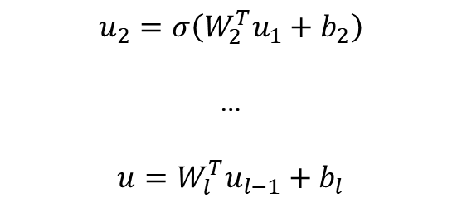

From DNNs to PINNs
$$u_{1}=σ(W_{1}^{T}X+b_{1})$$
(1)
$$u_{2}=σ\left(W_{2}^{T}u_{1}+b_{2}\right)$$
…
$$u=W_{l}^{T}u_{l−1}+b_{l}$$
(2) PDE part: Chain rule
$$∂_{t}u, ∂_{x}u, …$$
Physics-informed neural networks (PINNs)
Loss function:
Forward problem:
$$L={\min_{θ}⁡(R^{2}+|u_{bc}^{∗}−u_{bc}|}^{2}+{\left|u_{ic}^{∗}−u_{ic}\right|}^{2})$$
Inverse problem:
$$L={\min_{θ,λ}⁡(R^{2}+|u_{bc}^{∗}−u_{bc}|}^{2}+{\left|u_{ic}^{∗}−u_{ic}\right|}^{2}+{\left|u^{∗}−u\right|}^{2})$$
Raissi, et al, JCP, 2019
Meng, et al, CMAME, 2020

Slide 21
FDM-based PINNs
$$u_{1}=σ(W_{1}^{T}X+b_{1})$$
(1)
$$u_{2}=σ\left(W_{2}^{T}u_{1}+b_{2}\right)$$
…
$$u=W_{l}^{T}u_{l−1}+b_{l}$$
(2) PDE part: finite difference
$$∂_{t}u, ∂_{x}u, …$$
Physics-informed neural networks (PINNs)
Lim, et al, 2022

Slide 22
FDM-based PINNs
$$u_{1}=σ(W_{1}^{T}X+b_{1})$$
(1)
$$u_{2}=σ\left(W_{2}^{T}u_{1}+b_{2}\right)$$
…
$$u=W_{l}^{T}u_{l−1}+b_{l}$$
(2) PDE part: finite difference
$$∂_{t}u, ∂_{x}u, …$$
Physics-informed neural networks (PINNs)
Loss function:
Forward problem:
$$L={\min_{θ}⁡(R^{2}+|u_{bc}^{∗}−u_{bc}|}^{2}+{\left|u_{ic}^{∗}−u_{ic}\right|}^{2})$$
Inverse problem:
$$L={\min_{θ,λ}⁡(R^{2}+|u_{bc}^{∗}−u_{bc}|}^{2}+{\left|u_{ic}^{∗}−u_{ic}\right|}^{2}+{\left|u^{∗}−u\right|}^{2})$$
Raissi, et al, JCP, 2019
Meng, et al, CMAME, 2020

Slide 23
Contents
Brief review on FDM/FVM
Learning numerical schemes from data
Applications to PDEs
…

Slide 24


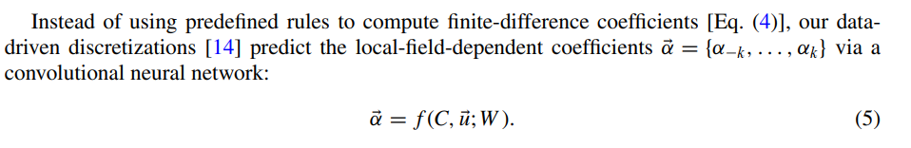
Learning numerical schemes from data
Zhuang, et al, PRF, 2021

Slide 25
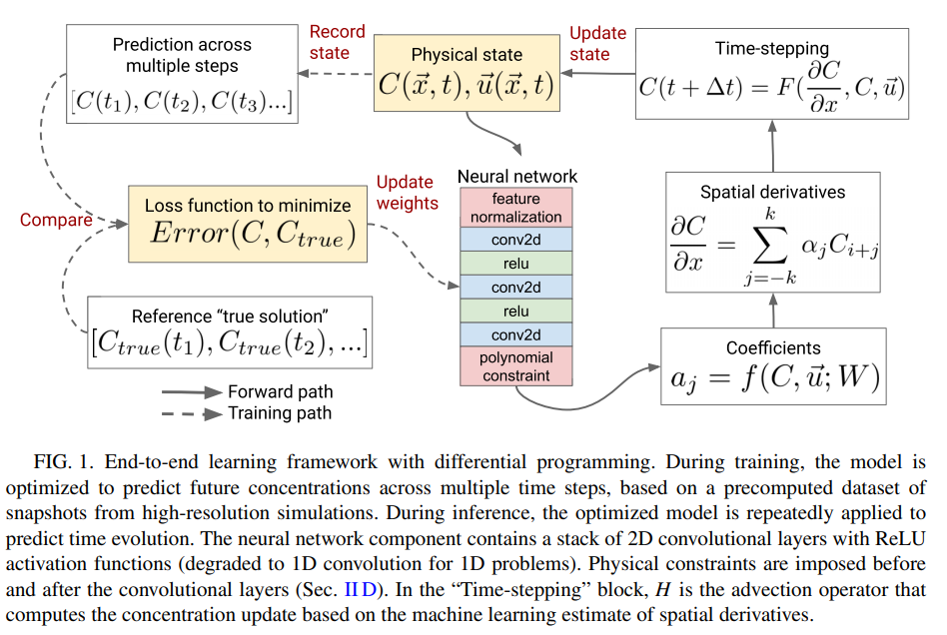
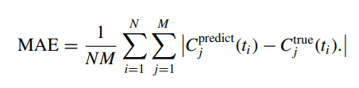
Learning numerical schemes from data
Zhuang, et al, PRF, 2021

Slide 26
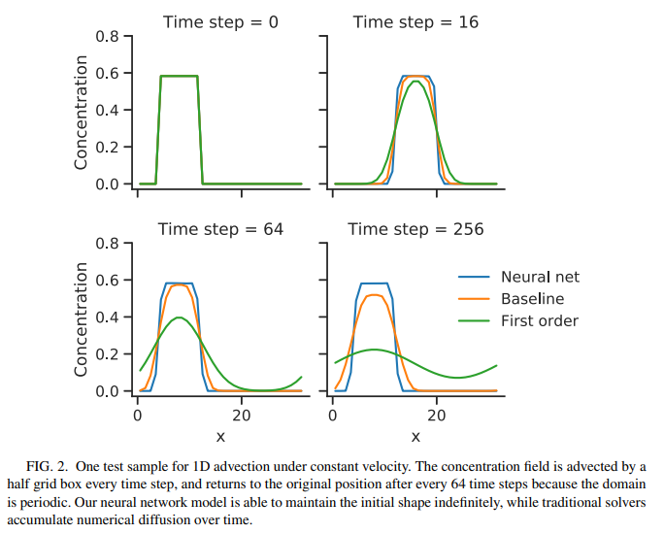
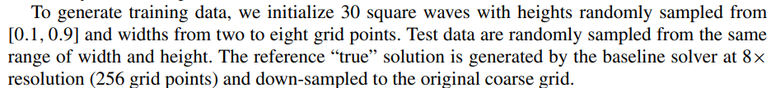
Example: 1D advection equation
$α:$ 4 convolutional layers with 32 filters per layer
Zhuang, et al, PRF, 2021

Slide 27
Example: 1D advection equation
Zhuang, et al, PRF, 2021

Slide 28
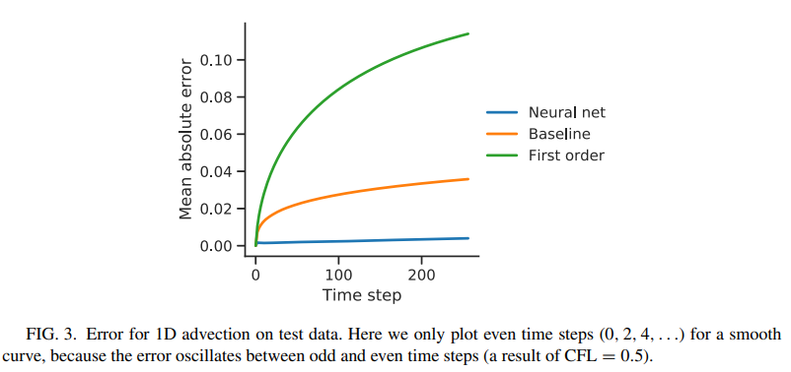
Example: 1D advection equation
Zhuang, et al, PRF, 2021

Slide 29
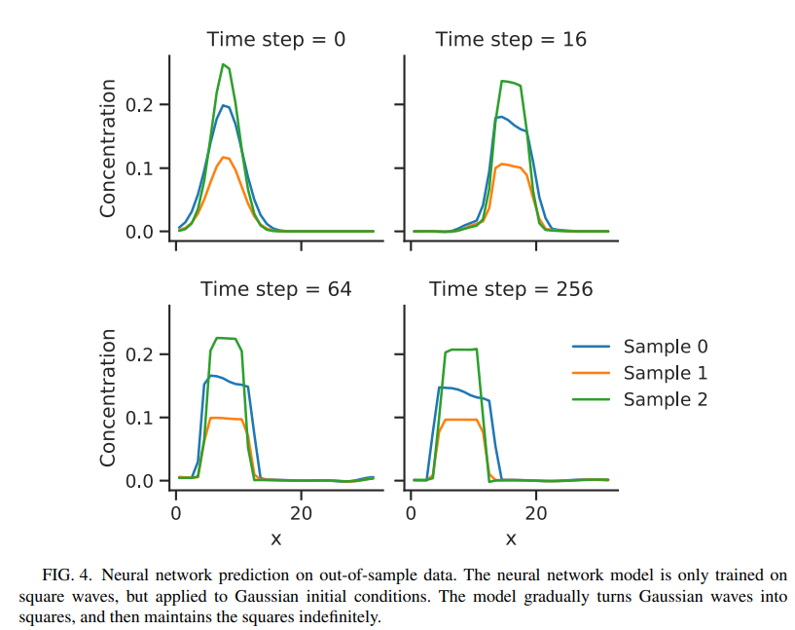
Example: 1D advection equation
Zhuang, et al, PRF, 2021

Slide 30
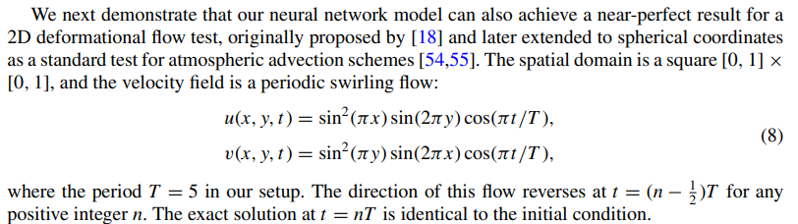
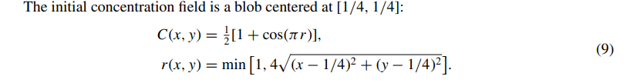
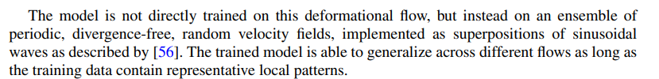
Example: 2D deformational flow
Zhuang, et al, PRF, 2021

Slide 31
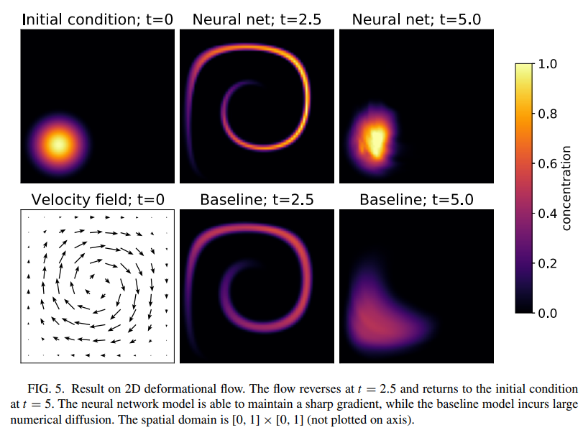
Example: 2D deformational flow
Zhuang, et al, PRF, 2021

Slide 32
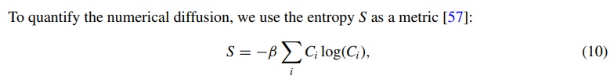

Example: 2D advection equation
Zhuang, et al, PRF, 2021

Slide 33


Example: 2D Turbulence
Zhuang, et al, PRF, 2021

Slide 34

Example: 2D Turbulence
Zhuang, et al, PRF, 2021

Slide 35

Example: 2D Turbulence
Zhuang, et al, PRF, 2021

Slide 36

Example: 2D Turbulence
Zhuang, et al, PRF, 2021

Slide 37



Example: Turbulence (FVM)
Kochkov, et al, PNAS, 2021

Slide 38


Example: Turbulence (FVM)
Kochkov, et al, PNAS, 2021

Slide 39

Example: Turbulence (FVM)
Kochkov, et al, PNAS, 2021

Slide 40

Example: Turbulence (FVM)
Kochkov, et al, PNAS, 2021

Slide 41

Example: Turbulence (FVM)
Kochkov, et al, PNAS, 2021

Slide 42

Thank you for your attention!

