Slide 1


Scientific Machine Learning
Lecture 15: Learning solution operators using neural networks
孟旭辉
数学与统计学院数学与应用学科交叉创新研究院
办公室：东32楼111室
Email：xuhui_meng@hust.edu.cn
https://github.com/XuhuiM/SciML-Course

Slide 2
Contents
Neural Operator
DeepONet: Deep operator networks
FNO: Fourier Neural Operator
…

Slide 3
Contents
Neural Operator
DeepONet: Deep operator networks
FNO: Fourier Neural Operator
…

Slide 4
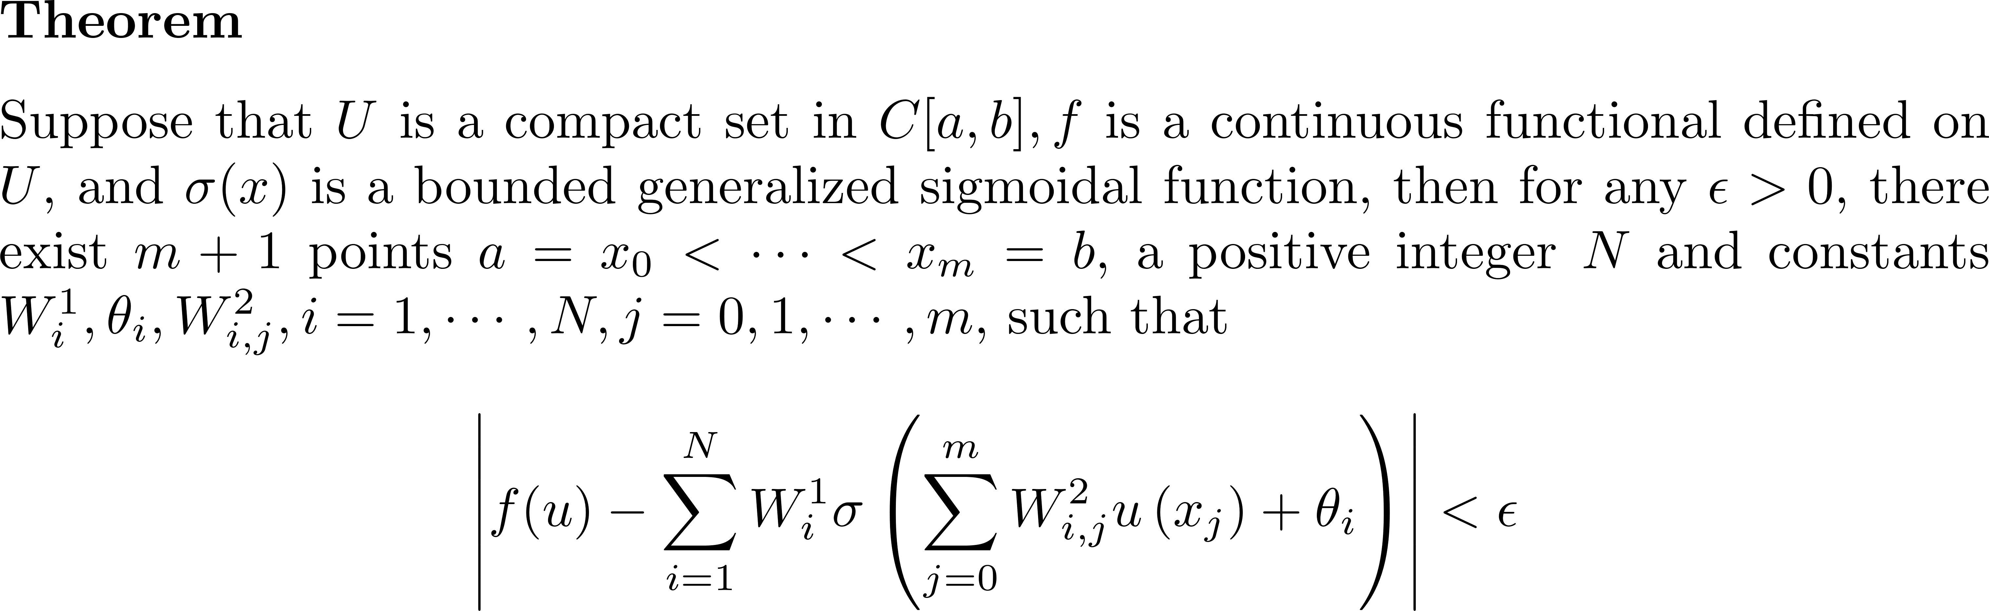
Universal approximation theorem for functionals: 1D case
Chen, et al., 1993

Slide 5
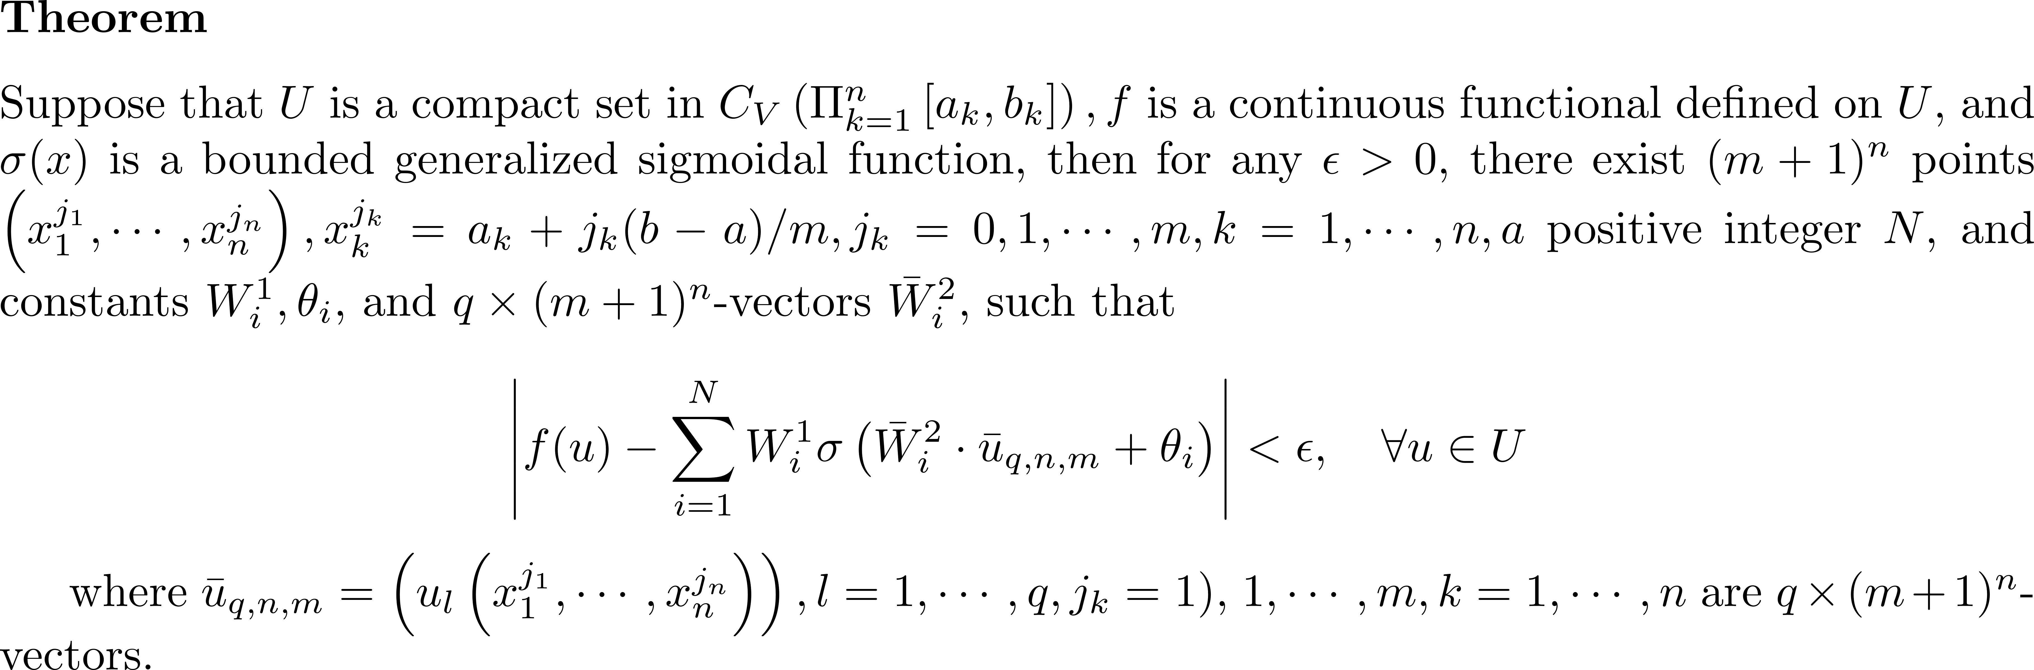
Universal approximation theorem for functionals: nD case
Chen, et al., 1993

Slide 6
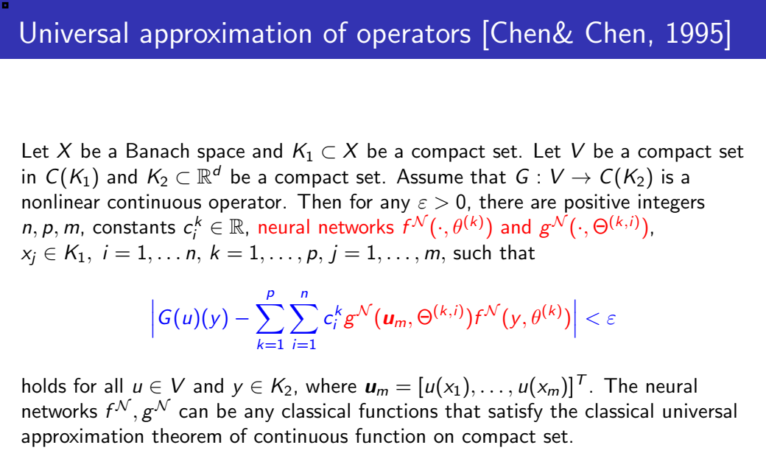
Deep Operator Networks (DeepONet)
Chen, et al., 1995

Slide 7
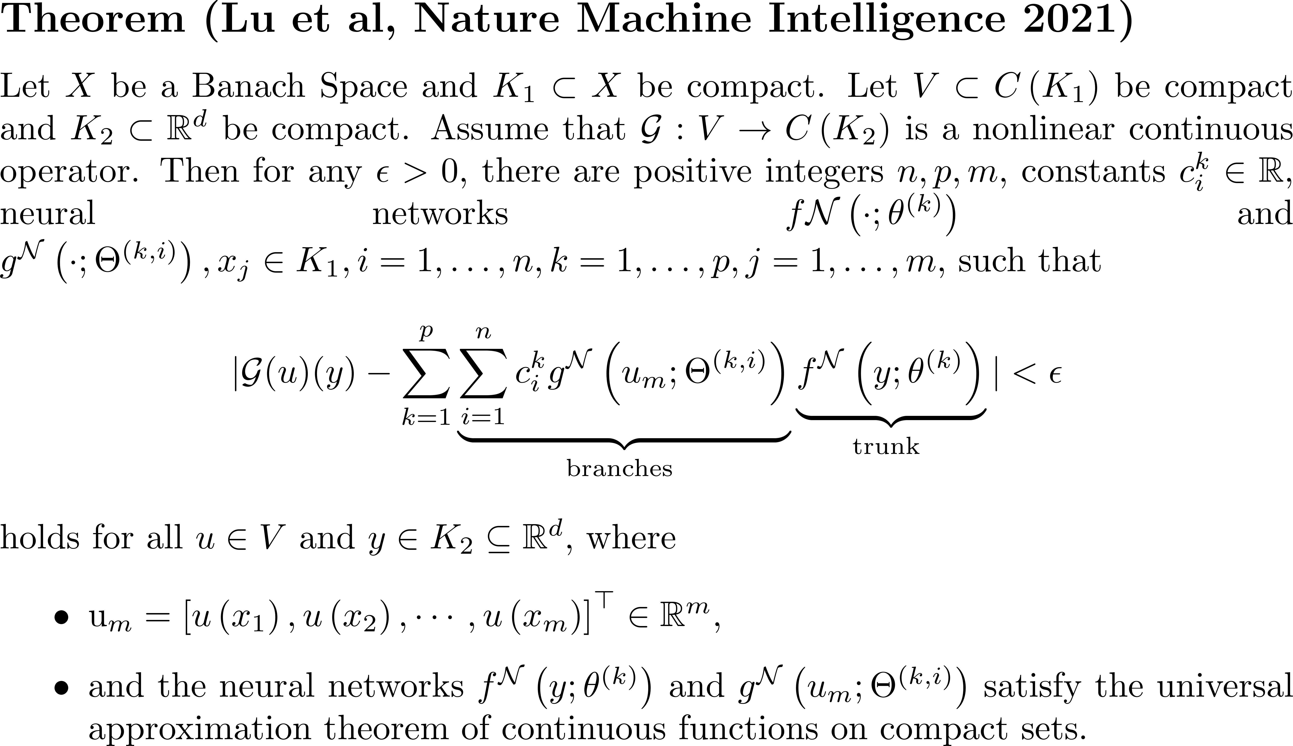
Deep Operator Networks (DeepONet)
Lu, et al., 2021

Slide 8
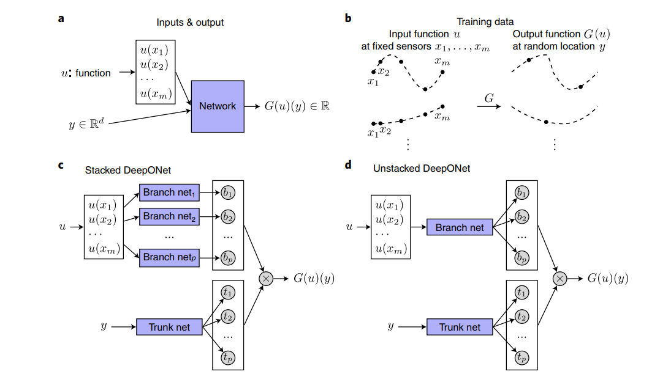
Deep Operator Networks (DeepONet)
Lu, et al., 2021

Slide 9
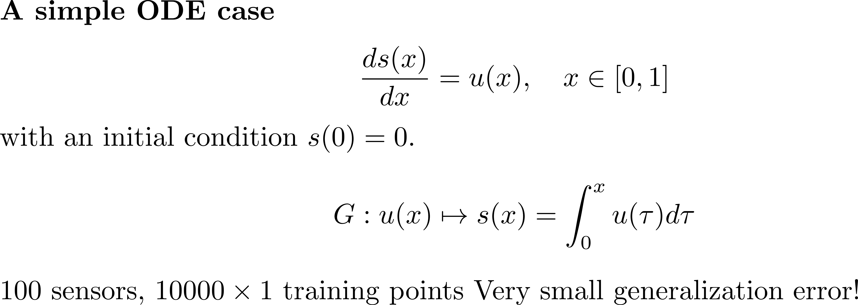
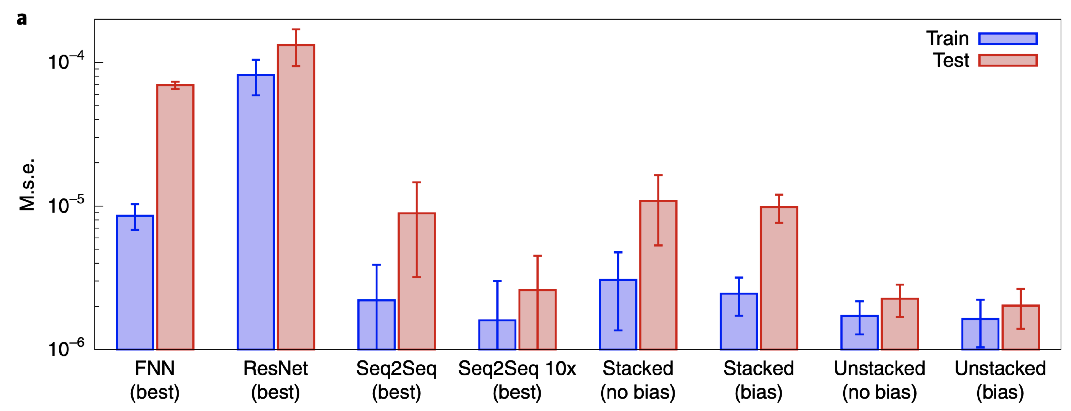
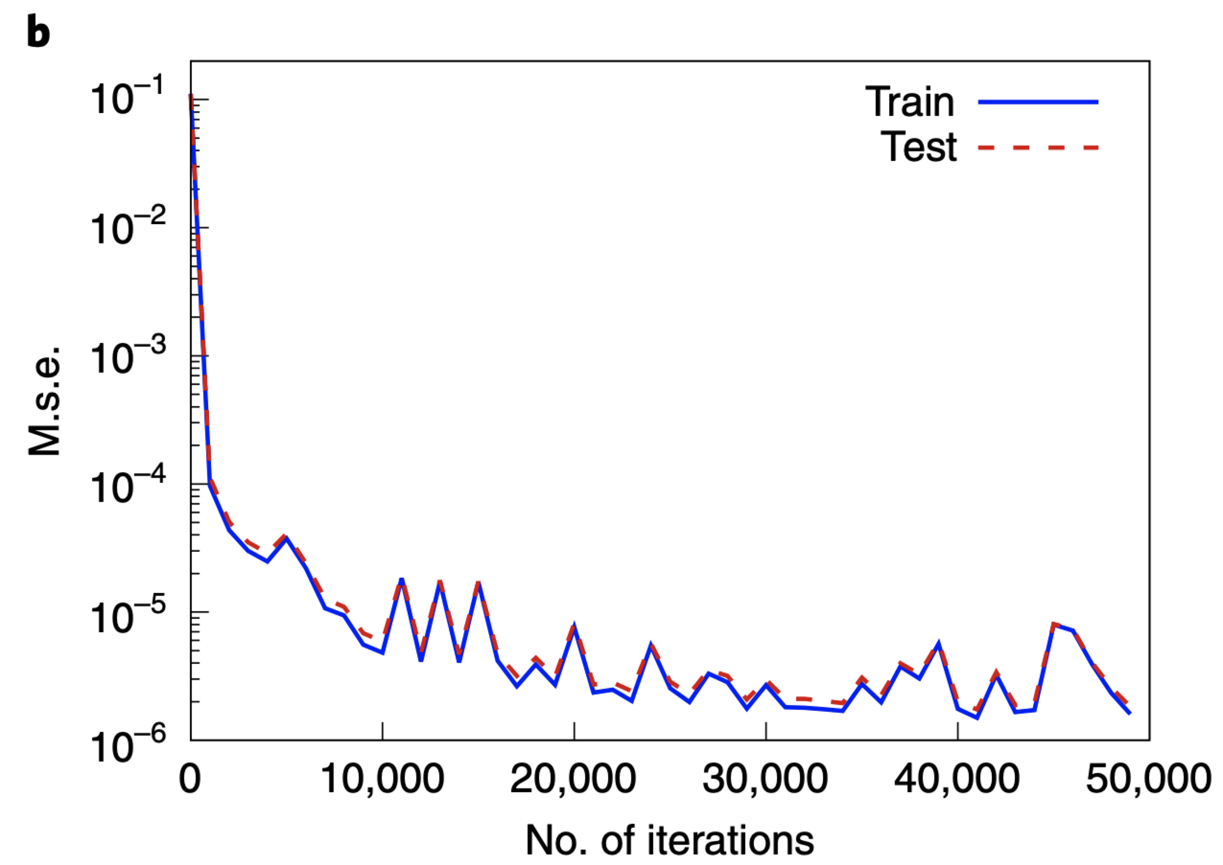
DeepONet: numerical example
Lu, et al., 2021

Slide 10
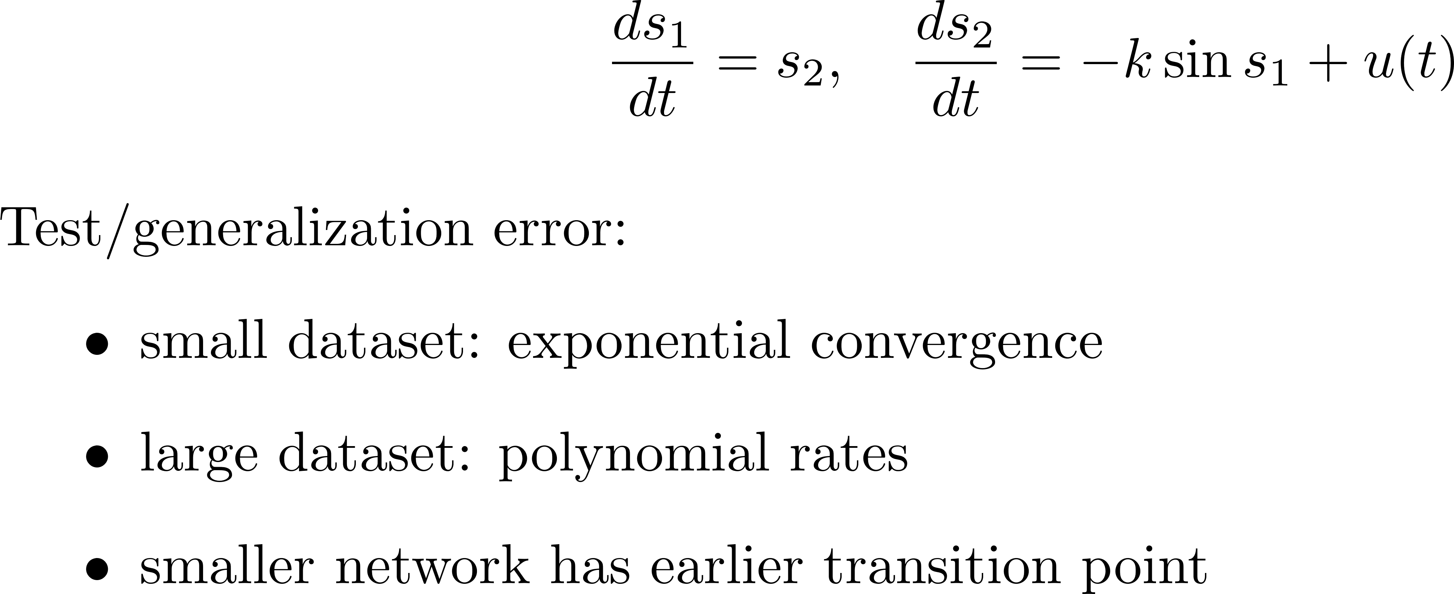
DeepONet: numerical example
Lu, et al., 2021

Slide 11
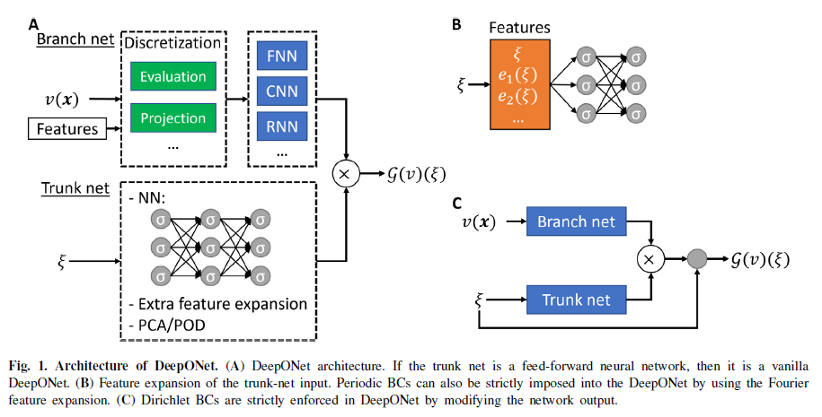
Extensions of DeepONet
Lu&Meng&Cai, et al., CMAME, 2022

Slide 12
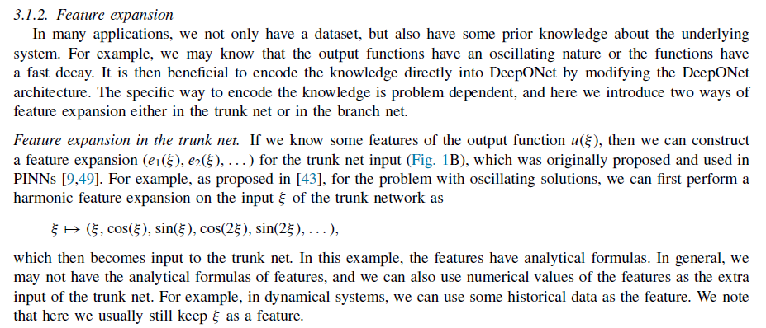
Extensions of DeepONet
Lu&Meng&Cai, et al., CMAME, 2022

Slide 13
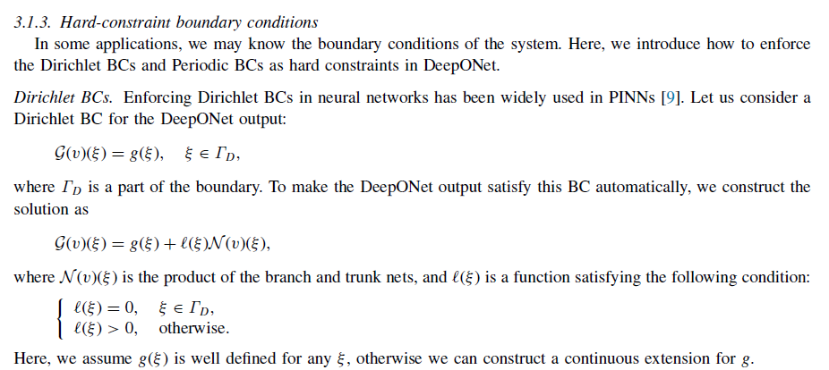
Extensions of DeepONet
Lu&Meng&Cai, et al., CMAME, 2022

Slide 14
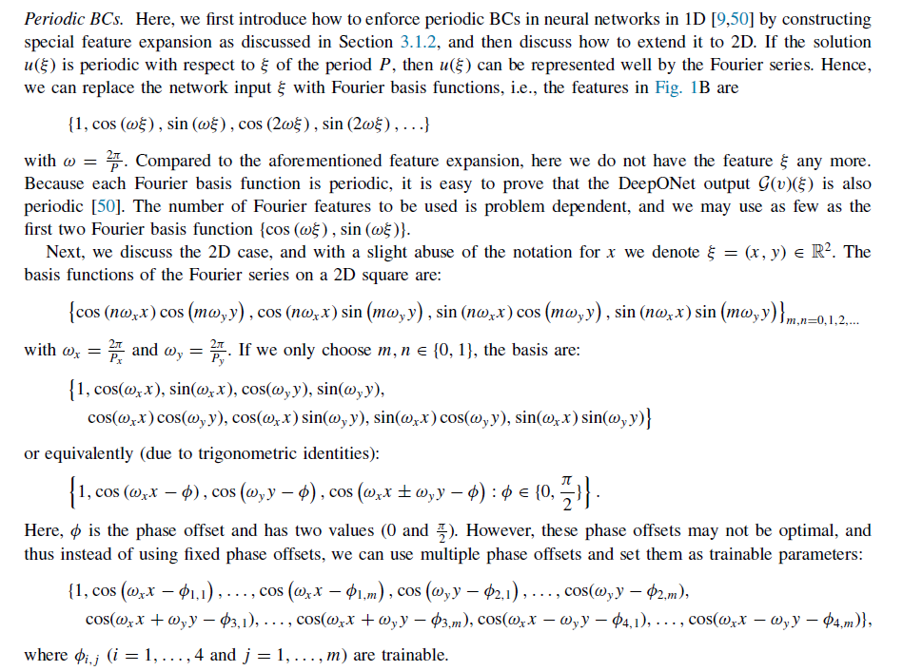
Extensions of DeepONet
Lu&Meng&Cai, et al., CMAME, 2022

Slide 15
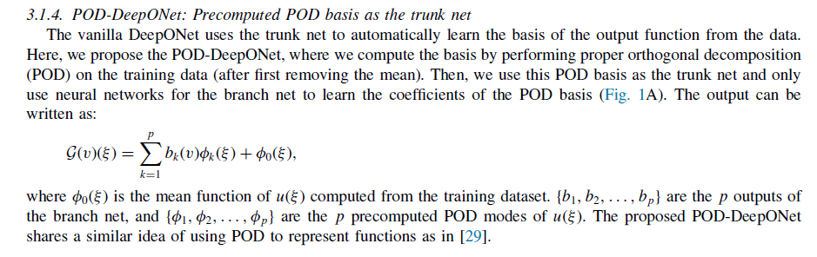
Extensions of DeepONet
Lu&Meng&Cai, et al., CMAME, 2022

Slide 16
Contents
Neural Operator
DeepONet: Deep operator networks
FNO: Fourier Neural Operator
…

Slide 17
Fourier Neural Operator
Z. Li, et al., ICLR, 2020

Slide 18
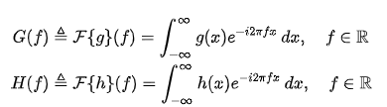

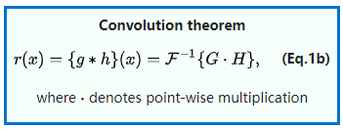
Convolution Theorem
From Wiki

Slide 19
Fourier Neural Operator
$$u\left(x\right)=∫G_{a}\left(x−y\right)f\left(y\right)dy$$
$$u\left(x\right)=∫G_{a}\left(x−y\right)f\left(y\right)dy=F^{−1}(G\left(\hat{f}\right)⋅f(\hat{f}))$$
Z. Li, et al., ICLR, 2021

Slide 20
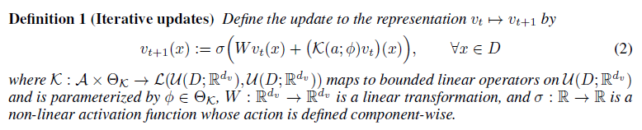

Fourier Neural Operator
$$v\left(x\right)→u(x)$$
Z. Li, et al., ICLR, 2021

Slide 21
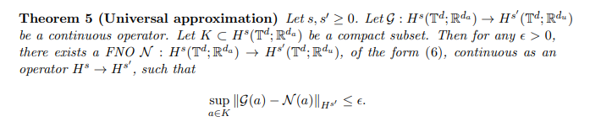
FNO: Universal Approximation
Kovichki, et al., JML, 2021

Slide 22
FNO: Universal Approximation
Kovichki, et al., JML, 2021

Slide 23
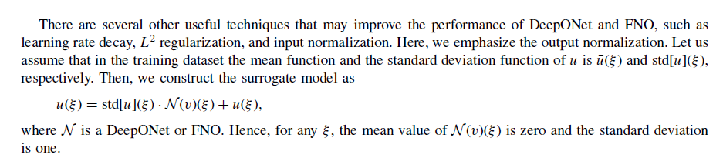
Normalization of training data

Slide 24

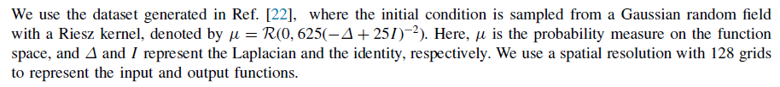
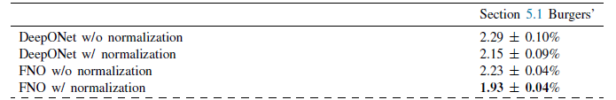
DeepONet vs FNO: Burgers equation
Lu&Meng&Cai, et al., CMAME, 2022

Slide 25
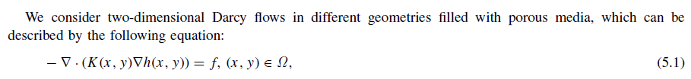
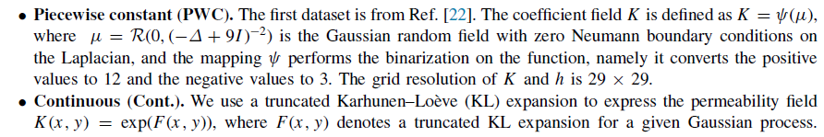
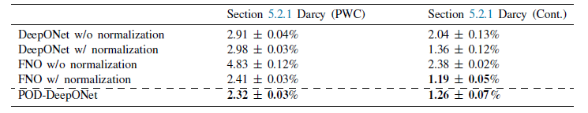
DeepONet vs FNO: Darcy Problem
$$G:K\left(x,y\right)→h(x,y)$$
Lu&Meng&Cai, et al., CMAME, 2022

Slide 26
DeepONet vs FNO: Darcy Problem
$$G:K\left(x,y\right)→h(x,y)$$
Lu&Meng&Cai, et al., CMAME, 2022

Slide 27
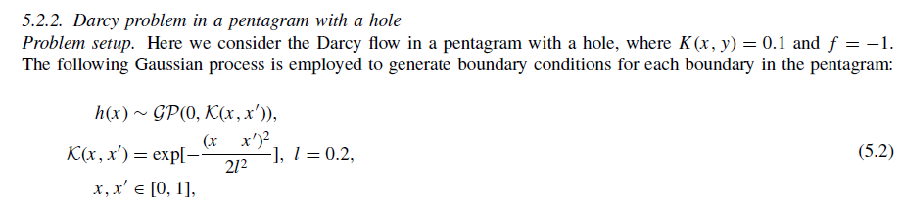
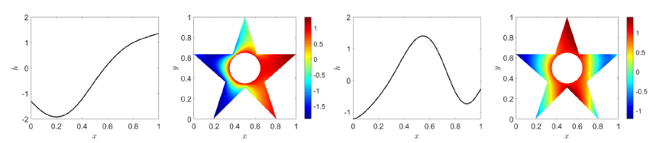
DeepONet vs FNO: Darcy Problem
Lu&Meng&Cai, et al., CMAME, 2022

Slide 28
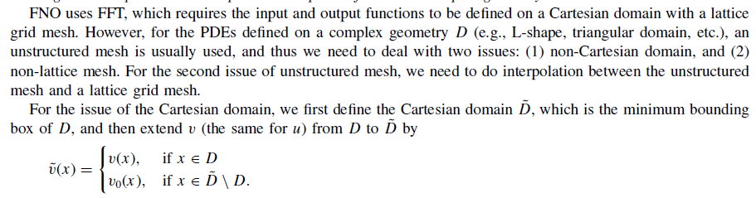
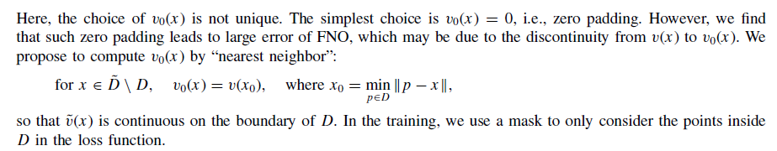
DeepONet vs FNO: Darcy Problem
Lu&Meng&Cai, et al., CMAME, 2022

Slide 29
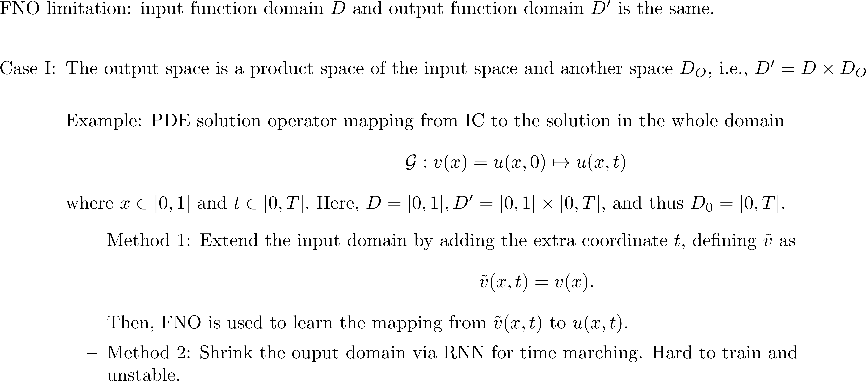
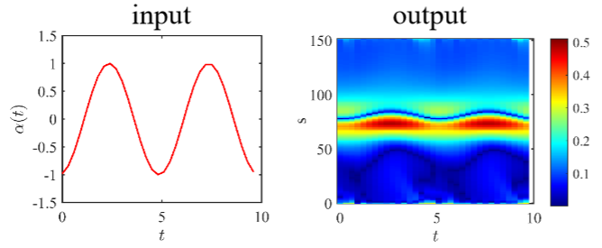
dFNO+: Inputs/outputs defined on different domains
Lu&Meng&Cai, et al., CMAME, 2022

Slide 30
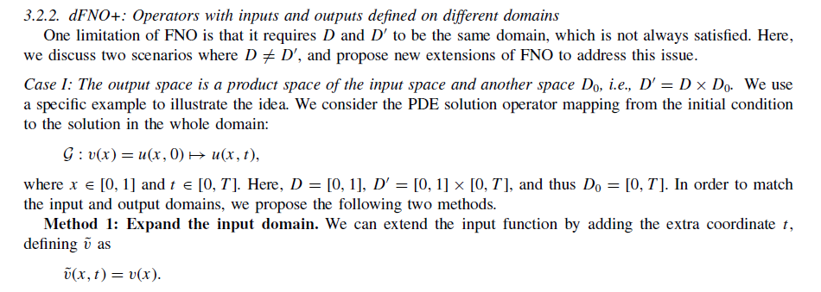
DeepONet vs FNO: Darcy Problem
Lu&Meng&Cai, et al., CMAME, 2022

Slide 31
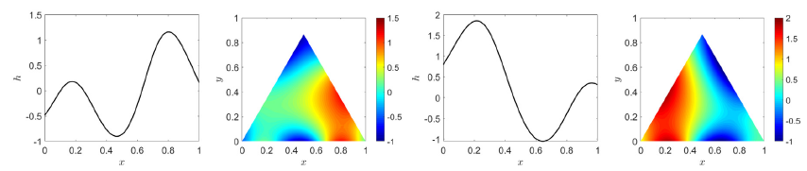
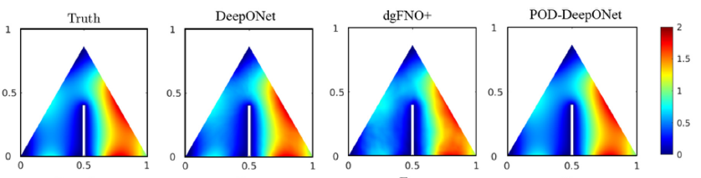
DeepONet vs FNO: Darcy Problem
Lu&Meng&Cai, et al., CMAME, 2022

Slide 32
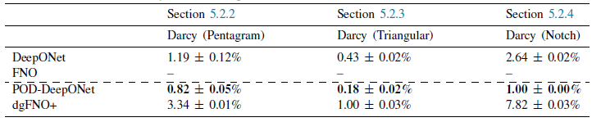
DeepONet vs FNO: Darcy Problem
Lu&Meng&Cai, et al., CMAME, 2022

Slide 33
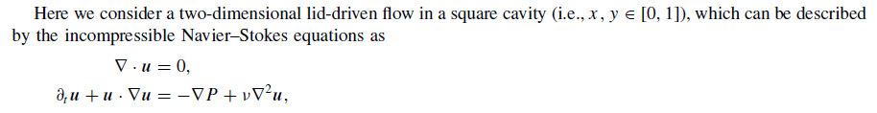


DeepONet vs FNO: Navier-Stokes equations
Lu&Meng&Cai, et al., CMAME, 2022

Slide 34
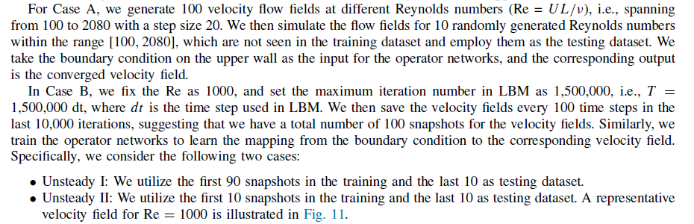
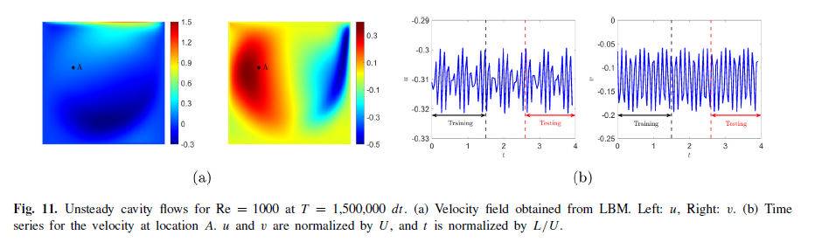
DeepONet vs FNO: Navier-Stokes equation
Lu&Meng&Cai, et al., CMAME, 2022

Slide 35
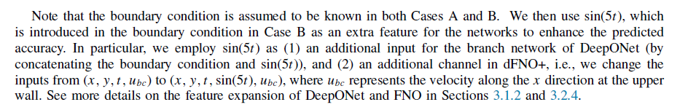
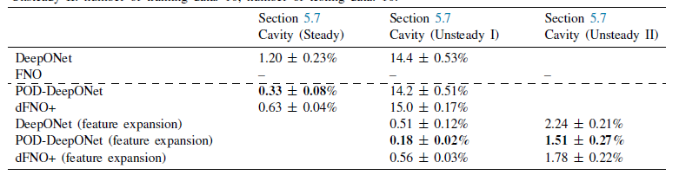
DeepONet vs FNO: Navier-Stokes equations
Lu&Meng&Cai, et al., CMAME, 2022

Slide 36

Thank you for your attention!

