Slide 1

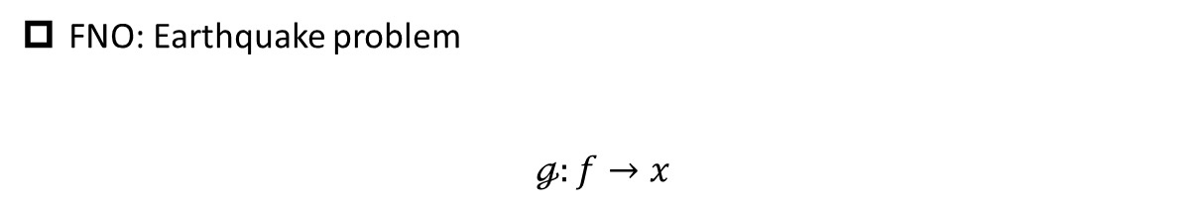
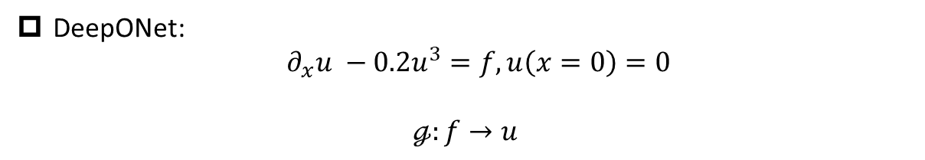
Demo codes for DeepONet/FNO
DeepONet:
$∂_{x}u −0.2u^{3}=f, u\left(x=0\right)=0$
$$ℊ:f→u$$
FNO: Earthquake problem
$$ℊ:f→x$$

Slide 2
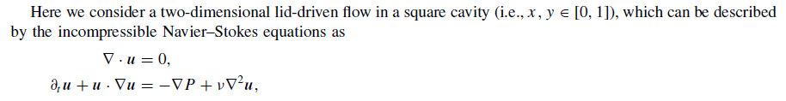

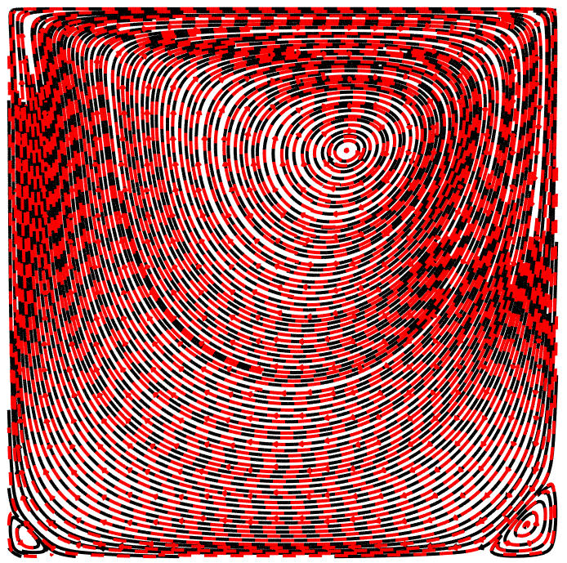
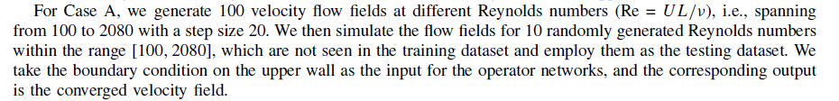
Neural Operator for Cavity flow
Training data in github is normalized using u/U, v/U
Re = 100
Lu&Meng&Cai, et al., CMAME, 2022

