Slide 1
Chapter 1
Introductory concept of Cloud Computing

Slide 2
Learning Objectives
Defining cloud computing
Learning about cloud types
The characteristics of Cloud Computing
Comparing the benefits and disadvantages of cloud systems

Slide 3
Defining cloud computing
Cloud computing is a model for enabling convenient, on-demand network access to a shared pool of configurable computing resources (e.g., networks, servers, storage, applications, and services) that can be rapidly provisioned and released with minimal management effort or service provider interaction.
This cloud model promotes availability and is composed of five essential characteristics, three service models, and four deployment models.

Slide 4
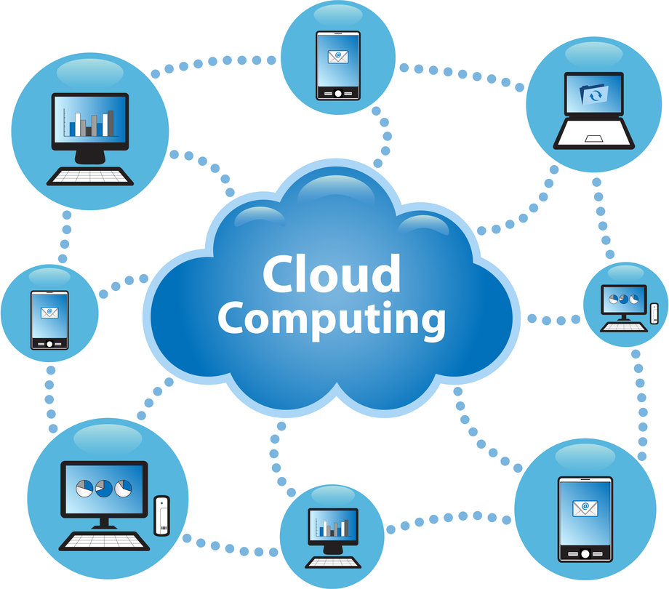

Slide 5
Defining cloud computing
Cloud computing takes the technology, services, and applications that are similar to those on the Internet and turns them into a self-service utility.
The use of the word “cloud” makes reference to the two essential concepts:
Abstraction
Virtualization
Notes:
Abstraction: Cloud computing abstracts the details of system implementation from users and developers. Applications run on physical systems that aren't specified, data is stored in locations that are unknown, administration of systems is outsourced to others, and access by users is ubiquitous.
Virtualization: Cloud computing virtualizes systems by pooling and sharing resources. Systems and storage can be provisioned as needed from a centralized infrastructure, costs are assessed on a metered basis, multi-tenancy is enabled, and resources are scalable with agility.

Slide 6
Examples
Google: In the last decade, Google has built a worldwide network of datacenters to service its search engine
Azure Platform: By contrast, Microsoft is creating the Azure Platform
Amazon Web Services: One of the most successful cloud-based businesses is Amazon Web Services, which is an Infrastructure as a Service offering that lets you rent virtual computers on Amazon's own infrastructure.

Slide 7
Cloud Types
Deployment models: This refers to the location and management of the cloud's infrastructure.
Service models: This consists of the particular types of services that you can access on a cloud computing platform

Slide 8
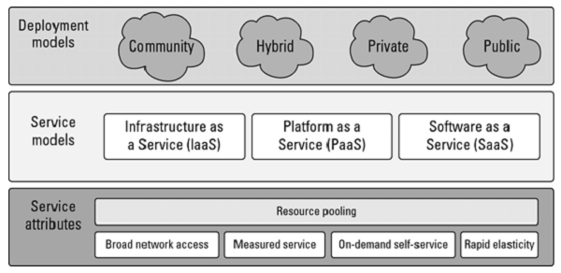
The NIST model

Slide 9
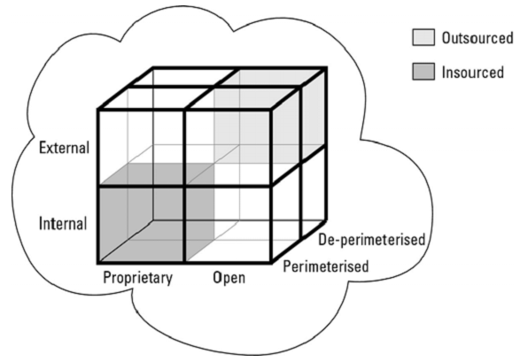
The Cloud Cube Model

Slide 10
The four dimensions of the Cloud Cube Model
Physical location of the data: Internal (I) / External (E) determines your organization's boundaries.
Ownership: Proprietary (P) / Open (O) is a measure of not only the technology ownership, but of interoperability, ease of data transfer, and degree of vendor application lock-in.
Security boundary: Perimeterised (Per) / De-perimiterised (D-p) is a measure of whether the operation is inside or outside the security boundary or network firewall.
Sourcing: Insourced or Outsourced means whether the service is provided by the customer or the service provider.

Slide 11
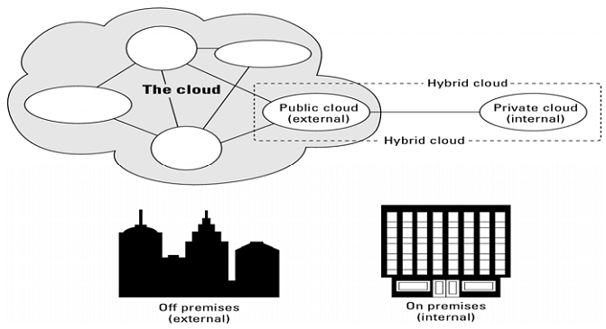
Deployment models

Slide 12
Deployment models
Public cloud: The public cloud infrastructure is available for public use alternatively for a large industry group and is owned by an organization selling cloud services.
Private cloud: The private cloud infrastructure is operated for the exclusive use of an organization. The cloud may be managed by that organization or a third party. Private clouds may be either on- or off-premises.

Slide 13
Deployment models
Hybrid cloud: A hybrid cloud combines multiple clouds (private, community of public) where those clouds retain their unique identities, but are bound together as a unit. A hybrid cloud may offer standardized or proprietary access to data and applications, as well as application portability.
Community cloud: A community cloud is one where the cloud has been organized to serve a common function or purpose.

Slide 14
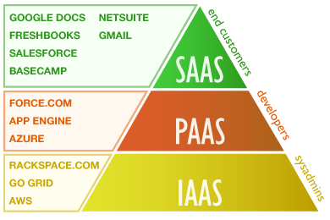
Service models

Slide 15
Service models
Infrastructure as a Service: IaaS provides virtual machines, virtual storage, virtual infrastructure, and other hardware assets as resources that clients can provision.
Platform as a Service: PaaS provides virtual machines, operating systems, applications, services, development frameworks, transactions, and control structures.
Software as a Service: SaaS is a complete operating environment with applications, management, and the user interface.

Slide 16
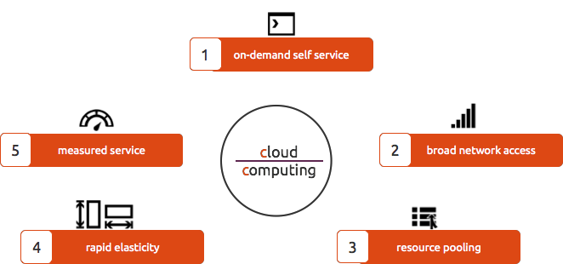
The characteristics of Cloud Computing
Notes:
On demand self services: computer services such as email, applications, network or server service can be provided without requiring human interaction with each service provider. Cloud service providers providing on demand self services include Amazon Web Services (AWS), Microsoft, Google, IBM and Salesforce.com. New York Times and NASDAQ are examples of companies using AWS (NIST). Gartner describes this characteristic as service based
Broad network access: Cloud Capabilities are available over the network and accessed through standard mechanisms that promote use by heterogeneous thin or thick client platforms such as mobile phones, laptops and PDAs.
Resource pooling: The provider’s computing resources are pooled together to serve multiple consumers using multiple-tenant model, with different physical and virtual resources dynamically assigned and reassigned according to consumer demand. The resources include among others storage, processing, memory, network bandwidth, virtual machines and email services. The pooling together of the resource builds economies of scale (Gartner).
Rapid elasticity: Cloud services can be rapidly and elastically provisioned, in some cases automatically, to quickly scale out and rapidly released to quickly scale in. To the consumer, the capabilities available for provisioning often appear to be unlimited and can be purchased in any quantity at any time.
Measured service: Cloud computing resource usage can be measured, controlled, and reported providing transparency for both the provider and consumer of the utilized service. Cloud computing services use a metering capability which enables to control and optimize resource use. This implies that just like air time, electricity or municipality water IT services are charged per usage metrics – pay per use. The more you utilize the higher the bill. Just as utility companies sell power to subscribers, and telephone companies sell voice and data services, IT services such as network security management, data center hosting or even departmental billing can now be easily delivered as a contractual service.
Multi Tenacity: is the 6th characteristics of cloud computing advocated by the Cloud Security Alliance. It refers to the need for policy-driven enforcement, segmentation, isolation, governance, service levels, and chargeback/billing models for different consumer constituencies. Consumers might utilize a public cloud provider’s service offerings or actually be from the same organization, such as different business units rather than distinct organizational entities, but would still share infrastructure.

Slide 17
The benefits of cloud systems
Lower costs
Ease of utilization
Quality of Service
Reliability
Outsourced IT management
Simplified maintenance and upgrade
Low Barrier to Entry
Notes:
• Lower costs: Because cloud networks operate at higher efficiencies and with greater utilization, significant cost reductions are often encountered.
• Ease of utilization: Depending upon the type of service being offered, you may find that you do not require hardware or software licenses to implement your service.
• Quality of Service: The Quality of Service (QoS) is something that you can obtain under contract from your vendor.
• Reliability: The scale of cloud computing networks and their ability to provide load balancing and failover makes them highly reliable, often much more reliable than what you can achieve in a single organization.
• Outsourced IT management: A cloud computing deployment lets someone else manage your computing infrastructure while you manage your business. In most instances, you achieve considerable reductions in IT staffing costs.
• Simplified maintenance and upgrade: Because the system is centralized, you can easily apply patches and upgrades. This means your users always have access to the latest software versions.
• Low Barrier to Entry: In particular, upfront capital expenditures are dramatically reduced. In cloud computing, anyone can be a giant at any time.

Slide 18
Disadvantages of cloud systems
Technical Issues
Security in the Cloud
Prone to attack
Possible downtime
Cost
Inflexibility
Lack of support
Notes:
Technical Issues: Though it is true that information and data on the Cloud can be accessed any time and from anywhere, there are moments when the system can have some serious malfunction. Businesses should be aware of the fact that this technology is always prone to outages and other technical issues.
Security in the Cloud: The other major issue of Cloud is represented by security. Before adopting this technology, beneficiaries should know that they will be surrendering all their company’s sensitive information to a third-party cloud service provider.
Prone to attack: Storing information in the cloud could make the companies vulnerable to external hack attacks and threats, therefore there is always the lurking possibility of stealth of sensitive data.
Possible downtime: Cloud computing makes the small business dependent on the reliability of their Internet connection.
Cost: At first glance, a cloud computing application may appear to be a lot cheaper than a particular software solution installed and run in-house.
Inflexibility: Choosing a Cloud computing vendor often means locking the business into using their proprietary applications or formats. For instance, it is not possible to insert a document created in another application into a Google Docs spreadsheet.
Lack of support: Anita Campbell(OPEN Forum) writes, "Customer service for Web apps leaves a lot to be desired - all too many cloud-based applications make it difficult to get customer service promptly – or at all. Sending an email and hoping for a response within 48 hours is not an acceptable way for most of us to run a business".

Slide 19
Architectural Standards:
Platform virtualization of resources
Service-oriented architecture
Web-application frameworks
Deployment of open-source software
Standardized Web services
Autonomic systems
Grid computing

Slide 20
Summary
Definition of cloud computing
Is cloud computing new?
Manifestations of cloud computing
Cloud deployment models
What should cloud computing be?
Comparing the benefits and disadvantages of cloud systems

Slide 21
Summary
We conclude that while Cloud computing technology can prove to be a great asset to companies, it could also cause harm if not understood and used properly.
We consider Cloud computing to be an opportunity for small businesses to balance the efforts implied by IT management of course limited by the disadvantages of Cloud, some of them presented in this paper.

