Slide 1
Chapter 2
Assessing the Value Proposition

Slide 2
Learning Objectives
Discovering the attributes that make cloud computing unique
Applying cloud computing when it is the best option
Measuring the costs associated with cloud computing systems
Learning about Service Level Agreements and Licensing

Slide 3
Measuring the Cloud's Value
Cloud computing presents new opportunities to users and developers because:
It is based on the paradigm of a shared multitenant utility
The ability to access pooled resources on a pay-as-you-go
Allows new types of access and business models for user applications

Slide 4
A cloud is defined as the combination of the infrastructure of a datacenter with the ability to provision hardware and software
A service that concentrates on hardware follows the Infrastructure as a Service (IaaS) model
When you add a software stack, such as an operating system and applications to the service, the model shifts to the Software as a Service (SaaS) model
When the service requires the client to use a complete hardware/software/application stack. It called the Platform as a Service (PaaS) model

Slide 5
The unique characteristics
Scalability: You have access to unlimited computer resources as needed.
Elasticity: You have the ability to right-size resources as required.
Low barrier to entry: You can gain access to systems for a small investment.
Utility: A pay-as-you-go model matches resources to need on an ongoing basis.

Slide 6
The reasons become a cloud computing provider:
Profit: The economies of scale can make this a profitable business.
Optimization: The infrastructure already exists and isn't fully utilized. This was certainly the case for Amazon Web Services.
Strategic: A cloud computing platform extends the company's products and defends their franchise.

Slide 7
The reasons become a cloud computing provider:
Extension: A branded cloud computing platform can extend customer relationships by offering additional service options.
Presence: Establish a presence in a market before a large competitor can emerge.
Platform: A cloud computing provider can become a hub master at the center of many ISV's (Independent Software Vendor) offerings.

Slide 8
Early adopters and new applications
Messaging and team collaboration applications
Cross enterprise integration projects
Infrastructure consolidation, server, and desktop virtualization efforts
Web 2.0 and social strategy companies
Web content delivery services

Slide 9
Early adopters and new applications
Data analytics and computation
Mobility applications for the enterprise
CRM applications
Experimental deployments, test bed labs, and development efforts
Backup and archival storage

Slide 10
10 Laws of Cloudonomics
Utility services cost less even though they cost more
On-demand trumps forecasting
The peak of the sum is never greater than the sum of the peaks
Aggregate demand is smoother than individual
Average unit costs are reduced by distributing fixed costs over more units of output

Slide 11
10 Laws of Cloudonomics
Superiority in numbers is the most important factor in the result of a combat (Clausewitz)
Space-time is a continuum (Einstein/Minkowski)
Dispersion is the inverse square of latency
Don't put all your eggs in one basket
An object at rest tends to stay at rest (Newton)

Slide 12
10 Laws of Behavioral Cloudonomics
People are risk averse and loss averse
People have a flat-rate bias
People have the need to control their environment and remain anonymous
People fear change
People value what they own more than what they are given

Slide 13
10 Laws of Behavioral Cloudonomics
People favor the status quo and invest accordingly
People discount future risk and favor instant gratification
People favor things that are free
People have the need for status
People are incapacitated by choice

Slide 14


Measuring cloud computing costs
The cost of a cloud computing deployment is roughly estimated to be
To compare your cost benefit with a private cloud

Slide 15

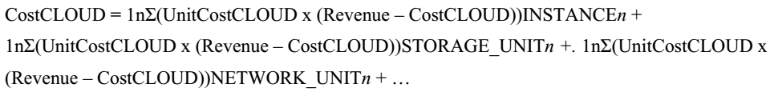
Measuring cloud computing costs
The CostDATACENTER consists of the summation of the cost of each of the individual systems with all the associated resources, as follows:
The CostCLOUD is better represented by the equation:

Slide 16
Avoiding Capital Expenditures
A major part of cloud computing's value proposition and its appeal is its ability to convert capital expenses (CapEx) to operating expenses (OpEx) through a usage pricing scheme that is elastic and can be right-sized.
The conversion of real assets to virtual ones provides a measure of protection against too much or too little infrastructure.

Slide 17
Avoiding Capital Expenditures
A company wishing to grow would normally be faced with the following options:
Buy the new equipment, and deploy it in-house
Lease the equipment for a set period of time
Outsource the operation to a managed-services organization

Slide 18
Avoiding Capital Expenditures
Capital expenditures must create the infrastructure necessary to capture the transactions that the business needs. However, if demand is variable, then it is an open question as to how much infrastructure is needed to support demand.
Cloud computing is also a good option when the cost of infrastructure and management is high.
This is often the case with legacy applications and systems where maintaining the system capabilities is a significant cost.

Slide 19
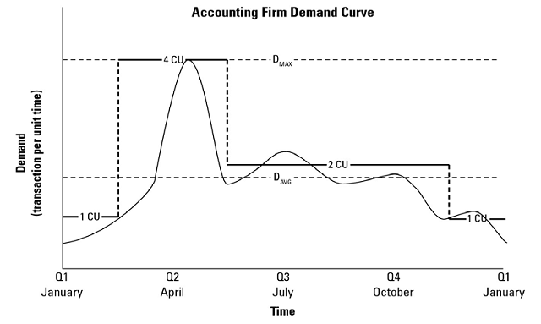
Right-sizing demand to infrastructure

Slide 20
Service Level Agreements
A Service Level Agreement (SLA) is the contract for performance negotiated between you and a service provider.
In the early days of cloud computing, all SLAs were negotiated between a client and the provider.
Today with the advent of large utility-like cloud computing providers, most SLAs are standardized until a client becomes a large consumer of services

Slide 21
SLAs usually specify these parameters:
Availability of the service (uptime)
Response times or latency
Reliability of the service components
Responsibilities of each party
Warranties

Slide 22
Defining Licensing Models
When you purchase shrink-wrapped software, you are using that software based on a licensing agreement called a EULA or End User License Agreement.
The EULA may specify that the software meets the following criteria:
It is yours to own.
It can be installed on a single or multiple machines.
It allows for one or more connections.
It has whatever limit the ISV has placed on its software.

Slide 23
Summary
A cloud's unique features are scalability, elasticity, low barrier to entry, and a utility delivery of services.
Cloud computing shifts capital expenditures into operating expenditures.
Cloud computing changes the nature of the service provider and its relationship to its client. You see this expressed in the Service Level Agreements (SLAs)and software licensing that are part of this new developing industry

