Slide 1
Chapter 6
CAPACITY PLANNING

Slide 2
Learning Objectives
Learning about capacity planning for the cloud
Capturing baselines and metrics
Determining resources and their ceilings
Scaling your systems appropriately

Slide 3
Capacity Planning
Capacity planning for cloud computing sounds like an oxymoron. Why bother doing capacity planning for a resource that is both ubiquitous and limitless? The reality of cloud computing is rather different than the ideal might suggest; cloud computing is neither ubiquitous, nor is it limitless. Often, performance can be highly variable, and you pay for what you use. That said, capacity planning for a cloud computing system offers you many enhanced capabilities and some new challenges over a purely physical system.
A capacity planner seeks to meet the future demands on a system by providing the additional capacity to fulfill those demands. Many people equate capacity planning with system optimization (or performance tuning, if you like), but they are not the same. System optimization aims to get more production from the system components you have. Capacity planning measures the maximum amount of work that can be done using the current technology and then adds resources to do more work as needed. If system optimization occurs during capacity planning, that is all to the good; but capacity planning efforts focus on meeting demand. If that means the capacity planner must accept the inherent inefficiencies in any system.

Slide 4
Capacity Planning
Capacity planning is an iterative process with the following steps:
Determine the characteristics of the present system.
Measure the workload for the different resources in the system: CPU, RAM, disk, network, and so forth.
Load the system until it is overloaded, determine when it breaks, and specify what is required to maintain acceptable performance. Knowing when systems fail under load and what factor(s) is responsible for the failure is the critical step in capacity planning.
Predict the future based on historical trends and other factors.
Deploy or tear down resources to meet your predictions.
Iterate Steps 1 through 5 repeatedly.

Slide 5
DEFINING BASELINE & METRICS
The first item of business is to determine the current system capacity or workload as a measurable quantity over time. Because many developers create cloud-based applications and Web sites based on a LAMP solution stack.
LAMP stands for:
Linux, the operating system
Apache HTTP Server
MySQL
PHP
These four technologies are open source products, although the distributions used may vary from cloud to cloud and from machine instance to machine instance. On Amazon Web Services, machine instances are offered for both Red Hat Linux and for Ubuntu. LAMP stacks based on Red Hat Linux are more common than the other distributions, but SUSE Linux and Debian GNU/Linux are also common. Variants of LAMP are available that use other operating systems such as the Macintosh, OpenBSD, Solaris (SAMP), and Windows (WAMP).

Slide 6
BASELINE MEASUREMENTS
Let's assume that a capacity planner is working with a system that has a Web site based on APACHE, and let's assume the site is processing database transactions using MySQL. There are two important overall workload metrics in this LAMP system:
Page views or hits on the Web site, as measured in hits per second
Transactions completed on the database server, as measured by transactions per second or perhaps by queries per second

Slide 7
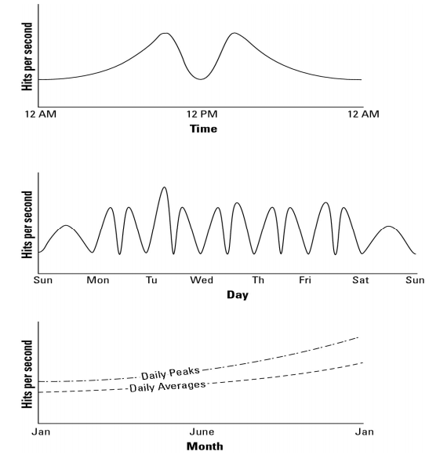
A Web servers' workload measured on a day, a week, and over the course of a year

Slide 8
BASELINE MEASUREMENTS
A number of important characteristics are determined by these baseline studies:
WT, the total workload for the system per unit time To obtain WT, you need to integrate the area under the curve for the time period of interest
WAVG, the average workload over multiple units of time To obtain WAVG, you need to sum various WTs and divide by the number of unit times involved. You may also want to draw a curve that represents the mean work done.
WMAX, the highest amount of work recorded by the system This is the highest recorded system utilization. In the middle graph of Figure 6.1, it would be the maximum number recorded on Tuesday morning.
WTOT, the total amount of work done by the system, which is determined by the sum of WT (ΣWT)
A similar set of graphs would be collected to characterize the database servers, with the workload for those servers measured in transactions per second. As part of the capacity planning exercise, the workload for the Web servers would be correlated with the workload of the database servers to determine patterns of usage.

Slide 9
SYSTEM METRICS
Capacity planning must measure system-level statistics, determining what each system is capable of, and how resources of a system affect system-level performance.
In some instances, the capacity planner may have some influence on system architecture, and the impact of system architecture on application- and system-level statistics may be examined and altered. Because this is a rare case, let's focus on the next step, which defines system performance.

Slide 10
SYSTEM METRICS
A machine instance (physical or virtual) is primarily defined by four essential resources:
CPU
Memory (RAM)
Disk
Network connectivity
Each of these resources can be measured by tools that are operating-system-specific, but for which tools that are their counterparts exist for all operating systems. Indeed, many of these tools were written specifically to build the operating systems themselves, but that's another story. In Linux/UNIX, you might use the sar command to display the level of CPU activity. sar is installed in Linux as part of the sysstat package. In Windows, a similar measurement may be made using the Task Manager, the data from which can be dumped to a performance log and/or graphed.

Slide 11
SYSTEM METRICS LAMP Performance Monitoring Tools
Alertra:
http://www.alertra.com
Web site monitoring service
Cacti:
http://www.cacti.net
Open source RRDTool graphing module
Collectd:
http://www.collectd.org
System statistics collection daemon
Dstat:
http://dag.wieers.com/home-made/dstat/
System statistics utility; replaces vmstat, iostat, netstat and ifstat

Slide 12
SYSTEM METRICS LAMP Performance Monitoring Tools
Zabbix
http://www.zabbix.com
Performance monitor
SiteUpTime
http://siteuptime.com
Web site monitoring service
GraphClick
http://www.arizona-software.ch/graphclick/
A digitizer that can create a graph from an image
RRDTool
http://www.RRDTool.org/
Graphing and performance metrics storage utility

Slide 13
LOAD TESTING
Examining your server under load for system metrics isn't going to give you enough information to do meaningful capacity planning. You need to know what happens to a system when the load increases. Load testing seeks to answer the following questions:
What is the maximum load that my current system can support ?
Which resource(s) represents the bottleneck in the current system that limits the system's performance? This parameter is referred to as the resource ceiling. Depending upon a server's configuration, any resource can have a bottleneck removed, and the resource ceiling then passes onto another resource
Can I alter the configuration of my server in order to increase capacity?
How does this server's performance relate to your other servers that might have different characteristics?

Slide 14
LOAD TESTING
Two examples of applications that can replay requests to Web servers are HTTPerf and Siege, but both of these tools run the requests from a single client, which can be a resource limitation of its own. You can run Autobench to run HTTPerf from multiple clients against your Web server, which is a better test.
Some load generation tools:
HP LodeRunner
IBM Rational Performance Tester
JMeter
OpenSTA
Micro Focus

Slide 15
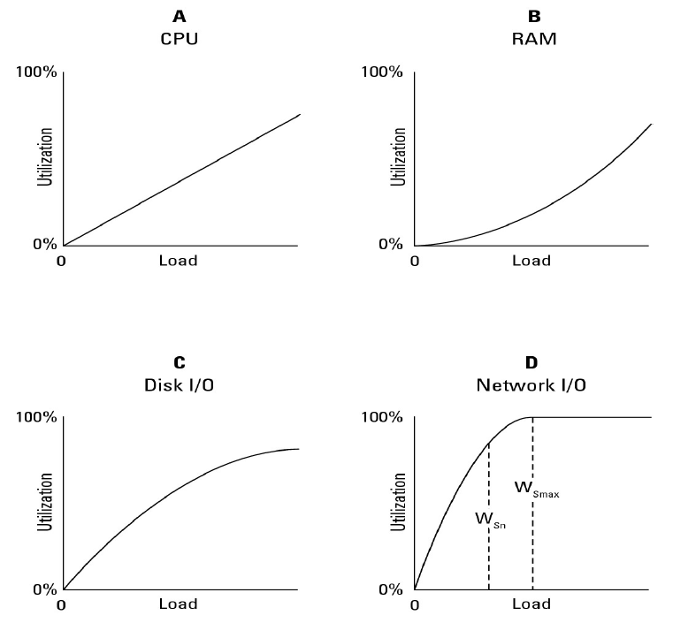
Resource ceilings
Resource utilization curves for a particular server

Slide 16
Resource ceilings
WT = Σ (WSnP WSnV)
WSnP represents the workload of your physical server(s) and WSnV is the workload of the virtual servers (cloud-based server instances) of your infrastructure

Slide 17
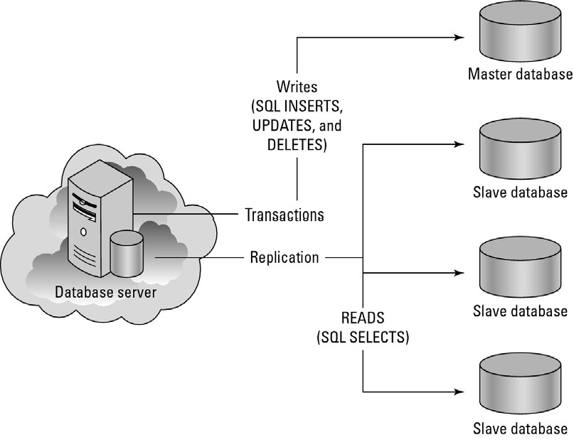
Resource ceilings
Resource contention in a database server

Slide 18


Resource ceilings
A performance analysis tool that lets you save its state is the Microsoft
Management Console (MMC)
In the Amazon Web Service, the statistics monitoring tool is called
Amazon CloudWatch

Slide 19
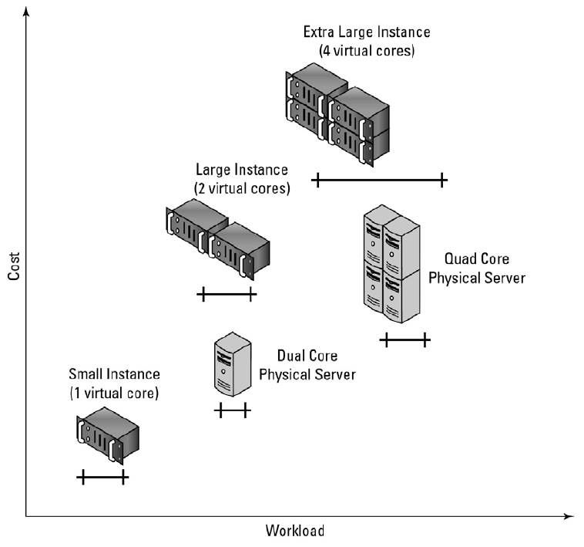
Server and instance types
Relative costs and efficiencies of different physical and virtual servers

Slide 20
An Amazon Machine Instance
• Small Instance (Default): 1.7GB memory, 1 EC2 Compute Unit (1 virtual core with 1 EC2 Compute Unit), 160GB instance storage (150GB plus 10GB root partition), 32-bit platform, I/O Performance: Moderate, and API name: m1.small
• Large Instance : 7.5GB memory, 4 EC2 Compute Unit (2 virtual core with 2 EC2 Compute Unit), 850GB instance, 64-bit platform, I/O Performance: High , and API name: m1.large
• Extra Large Instance: 15GB of memory, 8 EC2 Compute Units (4 virtual cores with 2 EC2 Compute Units each), 1,690GB of instance storage, 64-bit platform, I/O Performance: High, and API name: m1.xlarge

Slide 21
Network Capacity
If any cloud-computing system resource is difficult to plan for, it is network capacity. There are three aspects to assessing network capacity:
• Network traffic to and from the network interface at the server, be it a physical or virtual interface or server
• Network traffic from the cloud to the network interface
• Network traffic from the cloud through your ISP to your local network interface (your computer)

Slide 22
Measure network traffic at a server's network interface
• Wireshark (http://www.wireshark.org/), formerly called Ethereal
• Kismet (http://www kismetwireless.net/), a WiFi sniffer
• TCPdump (http://www.tcpdump.org/)
• Dsniff (http://www monkey.org/~dugsong/dsniff/)
• Ntop (http://www ntop.org/)
• EtherApe (http://etherape.sourceforge net/)

Slide 23
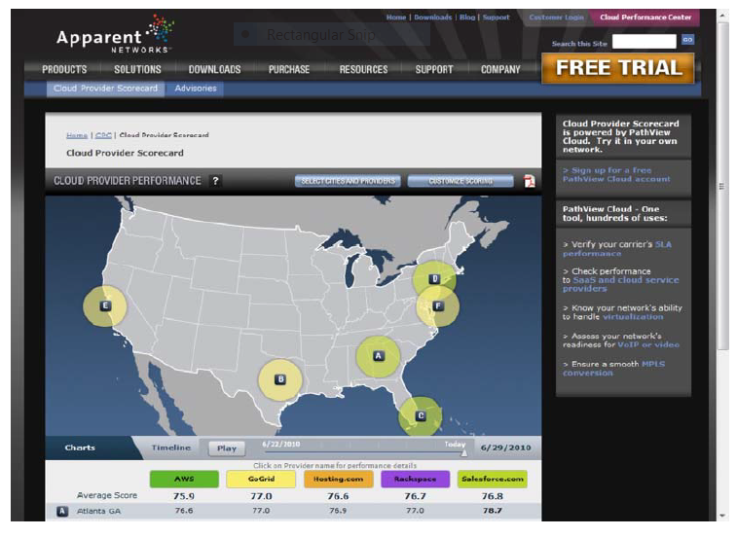
Network Capacity
Apparent Networks' Cloud Performance Center provides data on WAN throughput and uptime at Internet network hubs.

Slide 24
Network Capacity
Google is running a demonstration project called Google Fibre for Communities (http://www.google.com/appserve/fiberrfi/public/overview) that will deliver 1 gigabit-per-second fiber to the home. The few lucky municipalities chosen (with 50,000 to 500,000 residents) for thedemonstration project will get advanced broadband applications, many of which will be cloud-based
You are not in Kansas anymore. To petition Google for a Fiber for Communities network, Topeka,Kansas,became Google for a day, and Google returned the favor.

Slide 25
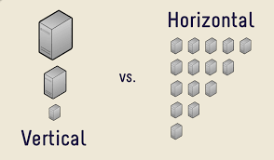
Scaling

Slide 26
Vertical scaling
Vertical scaling can essentially resize your server with no change to your code. It is the ability to increase the capacity of existing hardware or software by adding resources. Vertical scaling is limited by the fact that you can only get as big as the size of the server.

Slide 27
Horizontal scaling
Horizontal scaling affords the ability to scale wider to deal with traffic. It is the ability to connect multiple hardware or software entities, such as servers, so that they work as a single logical unit. This kind of scale cannot be implemented at a moment’s notice

