Slide 1
Chapter 7
Exploring Platform as a Service

Slide 2
Learning Objectives
Understanding the PaaS service model
Learning about PaaS development
Viewing examples of PaaS sites and tools
Discovering common PaaS-built application features

Slide 3
The Platform as a Service model provides the tools within an environment needed to create applications that can run in
Applications developed in PaaS systems can be composite business applications, data portals, or mashups with data derived from multiple sources.
PaaS environments can offer integrated lifecycle management or anchored lifecycle applications a Software as a Service model. An integrated system provides a broad range of tools for customization, whereas an anchored system is based on already established software.
Application frameworks are a particularly powerful tool for creating cloud computing applications.

Slide 4
Defining Services
The Platform as a Service model is the most interesting of all the hosted services in cloud computing
IaaS offers a service that is akin to installing an application on a computer
In SaaS model, the software is pretty well mapped out for you. You can do some modest customization, some branding perhaps, but the software's capabilities and design has largely been worked out.
With Platform as a Service systems, you are given a toolkit to work with, a virtual machine to run your software on, and it is up to you to design the software and its user-facing interface in a way that is appropriate to your needs.

Slide 5
Defining Services
PaaS models span a broad range of services, including these, among others:
Application development: A PaaS platform either provides the means to use programs you create in a supported language or offers a visual development environment that writes the code for you.
Collaboration: Many PaaS systems are set up to allow multiple individuals to work on the same projects.
Data management: Tools are provided for accessing and using data in a data store.

Slide 6
Defining Services
PaaS models span a broad range of services, including these, among others:
Instrumentation, performance, and testing: Tools are available for measuring your applications and optimizing their performance.
Storage: Data can be stored in either the PaaS vendor's service or accessed from a third-party storage service.
Transaction management: Many PaaS systems provide services such as transaction managers or brokerage service for maintaining transaction integrity.

Slide 7
Defining Services
A good PaaS system has certain desirable characteristics that are important in developing robust, scalable, and hopefully portable applications. On this list would be the following attributes:
Separate of data management from the user interface
Reliance on cloud computing standards
An integrated development environment (IDE)
Lifecycle management tools
Multi-tenant architecture support, security, and scalability
Performance monitoring, testing, and optimization tools

Slide 8
Salesforce.com versus Force.com
SaaS versus PaaS
Salesforce.com is a Web application suite that is an SaaS
Force.com is Salesforce.com's PaaS platform for building your own services
Salesforce.com was formed by several Oracle employees in 1999 to create a hosted Customer Relationship Management (CRM) system.
The Salesforce.com team created hosted software based on a cloud computing model: pay as you go, simple to use, and multifunctional.

Slide 9
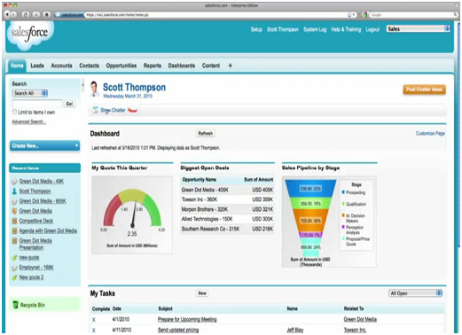

Slide 10
The applications In Salesforce
Accounts and Contact
Analytics and Forecasting
Approvals and Workflow
Chatter (Instant Messaging/Collaboration)
Content Library
E-mail and Productivity
Jigsaw Business Data
Marketing and Leads
Opportunities and Quotes
Partner Relationship
Sales
Service and Support

Slide 11
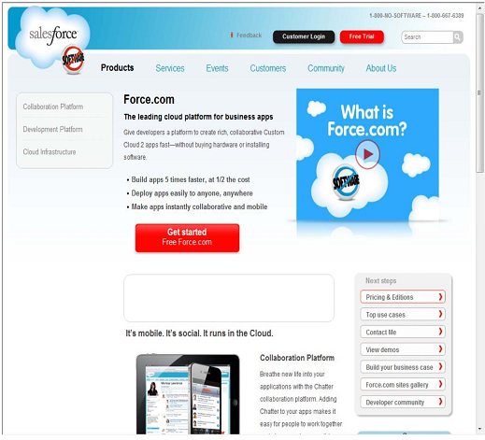

Slide 12
Force.com
Force.com uses a Java-based programming language called Apex for its application building, and it has an interface builder called Visualforce that allows a developer to create interfaces using HTML, Flex, and AJAX.
Visualforce uses an XML-type language in its visual interface builder.
Using the Force.com platform, more than 1,000 applications have been created and are offered for sale on Salesforce.com's AppExchange, which has greatly enhanced its PaaS offerings.
Force.com has been a major hit and has served as the model from many of the PaaS systems of today.

Slide 13
Application development
A PaaS provides the tools needed to construct different types of applications that can work together in the same environment. These are among the common application types:
Composite business applications
Data portals
Mashups of multiple data sources

Slide 14
Application development
All PaaS application development must take into account lifecycle management. As an application ages, it must be upgraded, migrated, grown, and eventually phased out or ported.
Many PaaS vendors offer systems that are integrated lifecycle development platforms. That is, the vendor provides a full software development stack for the programmer to use, and it isn't expected that the developer will need to go outside of the service to create his application.

Slide 15
Application development
An integrated lifecycle platform includes the following:
The virtual machine and operating system (often offered by an IaaS)
Data design and storage
A development environment with defined Application Programming Interfaces
Middleware
Testing and optimization tools
Additional tools and services

Slide 16
Using PaaS Application Frameworks
Application frameworks provide a means for creating SaaS hosted applications using a unified development environment or an integrated development environment(IDE)
PaaS IDEs run the gamut from a tool that requires a dedicated programming staff to create and run to point-and-click graphical interfaces that any knowledgeable computer user can navigate and create something useful with.

Slide 17
Common characteristics of developer-oriented services
They separate data-handling from presentation (user interface).
They offer tools for establishing business objects or entities and the relationships between them.
They support the incorporation of business rules, logic, and actions.
They provide tools for creating data entry controls (forms), views, and reports.
They provide instrumentation, tools for measuring application performance.
They support packaging and deployment of applications.

Slide 18
Drupal
The Drupal core by itself contains a number of modules that provide for the following:
Auto-updates
Blogs, forums, polls, and RSS feeds
Multiple site management
OpenID authentication
Performance optimization through caching and throttling
Search
User interface creation tools
User-level access controls and profiles
Themes
Traffic management
Workflow control with events and triggers

Slide 19
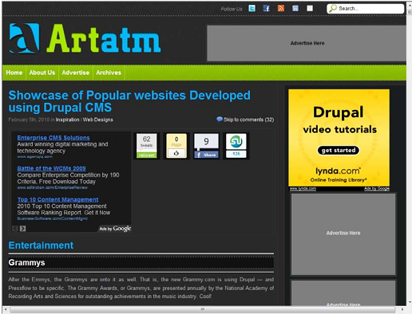

Slide 20
Eccentex AppBase 3.0
AppBase includes a set of different tools for building these applications, including the following:
Business Objects Build
Presentation Builder
Business Process Designer
Dashboard Designer
Report Builder
Security Roles Management

Slide 21
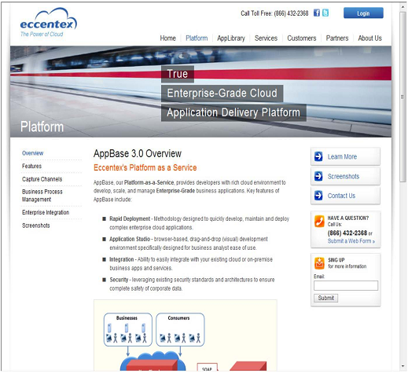

Slide 22
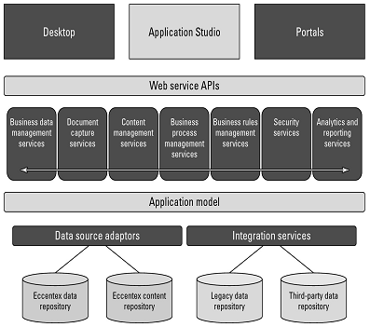
AppBase's architecture

Slide 23
LongJump
LongJump (http://www.longjump.com/) is a Sunnyvale, California, company hosting service created in 2003 with a PaaS application development suite.
Its development environment is based on Java and uses REST/SOAP APIs.
LongJump creates browser-based Web applications that are database-enabled
LongJumpcomes with an ObjectModel Viewer, forms, reports, layout tools, dashboards, and site management tools
LongJump extends Java and uses a Model-View-Controller architecture (MVC) for its framework in the Developer Suite

Slide 24
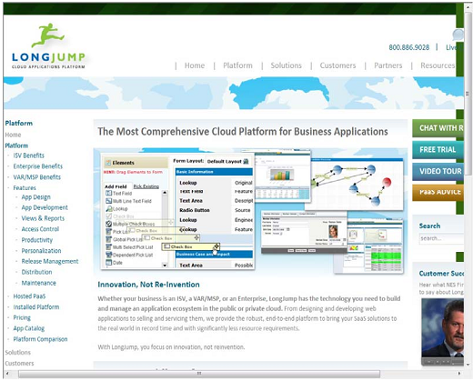

Slide 25
Squarespace
Squarespace presents itself, among other things, as:
A blogging tool
A social media integration tool
A photo gallery
A form builder and data collector
An item list manager
A traffic and site management and analysis tool

Slide 26
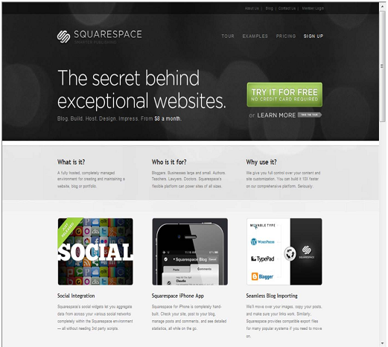

Slide 27
WaveMaker
WaveMaker is a framework that creates applications that can interoperate with other Java frameworks and LDAP systems, including the following:
Dojo Toolkit 1.0 (http://dojotoolkit.org/), a JavaScript library or toolbox
LDAP directories
Microsoft Active Directory
POJO (Plain Old Java Object)
Spring Framework (http://www.springsource.org/), an open-source application framework for Java that now also includes ACEGI

Slide 28
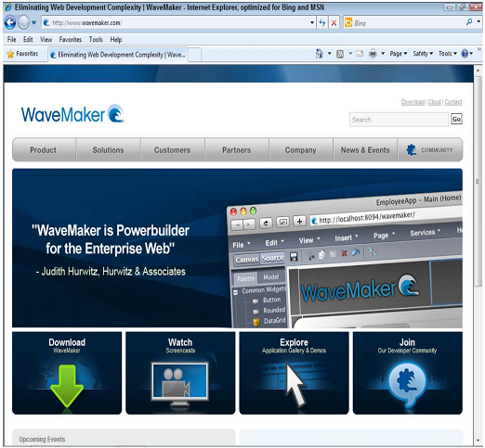

Slide 29
Wolf Frameworks
Wolf Frameworks is based on the three core Windows SOA standard technologies of cloud computing:
AJAX, asynchronous Java
XML
.NET Framework
Wolf Frameworks uses a C# engine and supportsboth Microsoft SQL Server and MySQL database. Applications that you build inWolf are 100-percent browser-based and support mashable and multisource overlaid content.

Slide 30
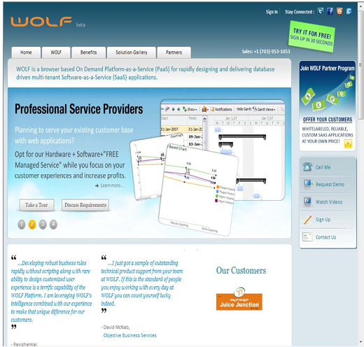

Slide 31
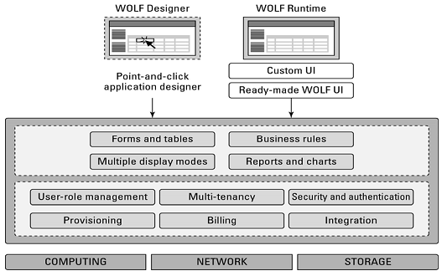
The Wolf platform architecture

Slide 32
Summary
In this chapter, you learned about one of the coreservice models in cloud computing: Platform as a Service. With PaaS, the goal is to create hosted scalable applications that are used in a Software as a Service model. For this reason, some vendors start out offering SaaS systems and then broaden them to make them more customizable and programmable as PaaS systems.
Applications built using PaaS tools need to be standards-based. They often are constructed using similar sets of tools: data object and relationship builders; process and business logic systems; forms, views, and reporting tools; and more.
You learned about a number of tools in this chapter, including Drupal, Eccentex AppBase, Force.com, LongJump, Squarespace, Wolf, and some others.

