Slide 1
Chapter 8
Using Google Web Services

Slide 2
Learning Objectives
Learning about Google's range of cloud-based services
Understanding Google's search model
Using Google's services in your own applications
Discovering the Google App Engine PaaS cloud service

Slide 3
Google is the prototypical cloud computing services company, and it supports some of the largest Web sites and services in the world.
At the center of Google's core business is the company's search technology. Google uses automated technology to index the Web. It makes its search service available to users as a standard search engine and to developers as a collection of special search tools limited to various areas of content.
The application of Google's searches to content aggregation has led to enormous societal changes and to a growing trend of disintermediation.

Slide 4
The most important commercial part of Google's activities is its targeting advertising business: AdWords and AdSense.
Google has developed a range of services including Google Analytics that supports its targeted advertising business
Google applications are cloud-based applications. The range of application types offered by Google spans a variety of types: productivity applications, mobile applications, media delivery, social interactions, and many more.
Google has begun to commercialize some of these applications as cloud-based enterprise application suites that are being widely adopted.

Slide 5
Exploring Google Applications
Google's cloud computing services falls under two umbrellas:
The first and best-known offerings are an extensive set of very popular applications that Google offers to the general public. These applications include Google Docs, Google Health, Picasa, Google Mail, Google Earth, and many more
The second of Google's cloud offerings is its Platform as a Service developer tools. In April 2008, Google introduced a development platform for hosted Web applications using Google's infrastructure called the Google App Engine (GAE).

Slide 6
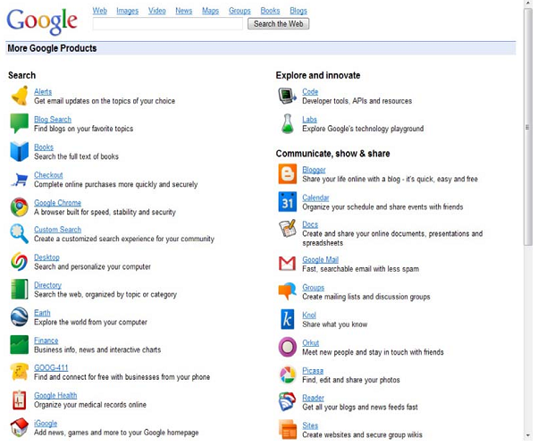
Google Products

Slide 7
Surveying the Google Application Portfolio
It is fair to say that nearly all the products in Google's application and service portfolio are cloud computing services in that they all rely on systems staged worldwide on Google's one million plus servers in nearly 30 datacenters.
Roughly 17 of the 48services listed leverage Google's search engine in some specific way. Some of these search-related sites search through selected content such as Books, Images, Scholar, Trends, and more.
Other sites such as Blog Search, Finance, News, and some others take the search results and format them into an Aggregation page.

Slide 8
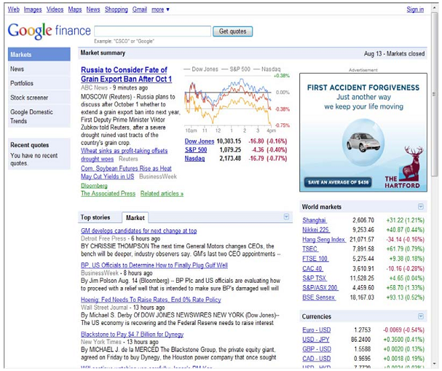
Google's Finance

Slide 9
Indexed search
Google's search technology is based on automated page indexing and information retrieval by Web crawlers, also called spiders or robots.
Content on pages is scanned up to a certain number of words and placed into an index. Google also caches copies of certain Web pages and stores copies of documents it finds such as DOC or PDF files in its cache.

Slide 10
Indexed search
Google uses a patented algorithm to determine the importance of a particular page based on the number of quality links to that page from other sites, along with other factors such as the use of keywords, how long the site has been available, and traffic to the site or page. That factor is called the PageRank, and the algorithm used to determine PageRank is a trade secret
Google is always tweaking the algorithm to prevent Search Engine Optimization (SEO) strategies from gaming the system. Based on this algorithm, Google returns what is called a Search Engine Results Page (SERP) for a query that is parsed for its keywords.

Slide 11
The dark Web
Online content that isn't indexed by search engines belongs to what has come to be called the “Deep Web”—that is, content on the World Wide Web that is hidden. Any site that suppresses Web crawlers from indexing it is part of the Deep Web. You need go no further than the world's number two Web site, Facebook, for a prominent example of a site that isn't indexed in
Entire networks exist that aren't searchable, particularly peer-to-peer networks. Ian Clarke's Freenet, which is a P2P network, supports both “darknet” and “opennet” connections. search engines.

Slide 12
The Deep Web includes:
Database generated Web pages or dynamic content
Pages without links
Private or limited access Web pages and sites
Information contained in sources available through executable code such as JavaScript
Documents and files that aren't in a form that can be searched, which includes not only media files, but information in non-standard file formats

Slide 13
Aggregation & disintermediation
Aggregation pages are a great user service, but they are very controversial—as are a number of Google's search applications and services. It has long been argued that Google's display of information from various sites violates copyright laws and damages content providers
Disintermediation is the removal of intermediaries such as a distributor, agent, broker, or some similar functionary from a supply chain. This connects producers directly with consumers, which in many cases is a very good thing.

Slide 14
Productivity applications and services
These products store your information online in a form that Google can use to build a profile of your activities, and it is unclear how the company uses the information it stores.
Google states that your information is never viewed individually by humans, and the company lists its policies in the Privacy Center
Google has been vigilant in protecting its privacy reputation, but the collection of such a large amount of personal data must give any thoughtful person reason for pause.

Slide 15
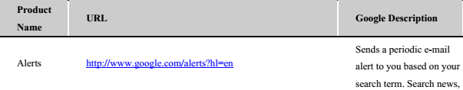
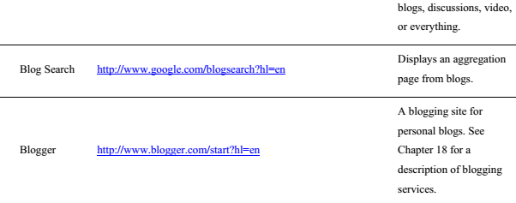
Google Products

Slide 16
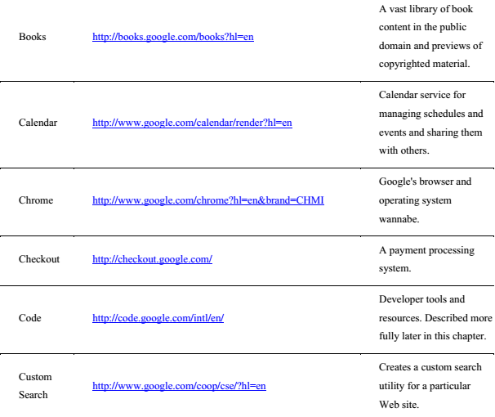
Google Products

Slide 17
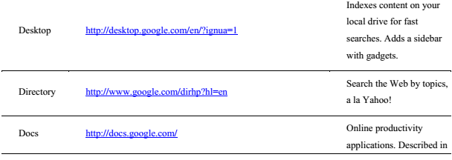
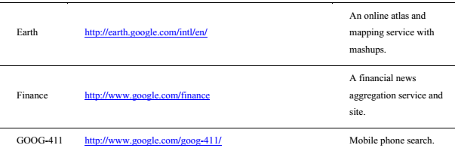
Google Products

Slide 18
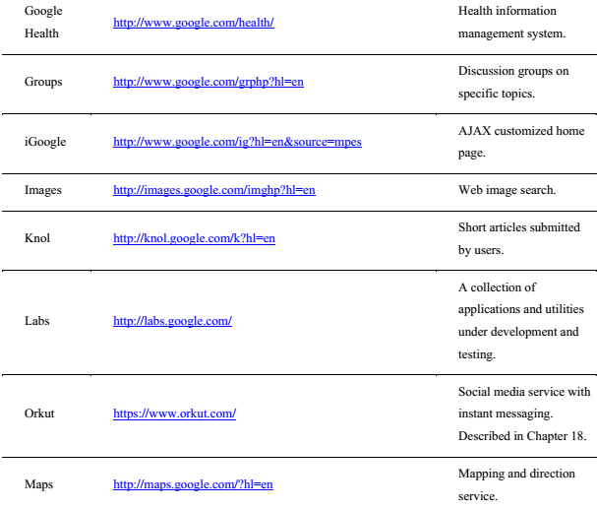
Google Products

Slide 19
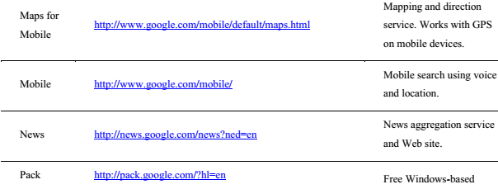
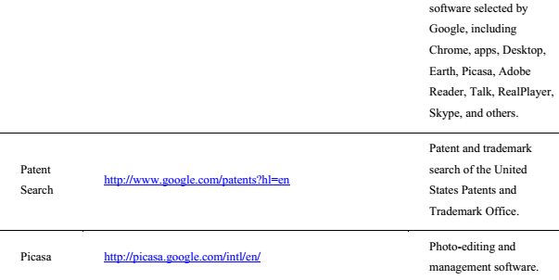
Google Products

Slide 20
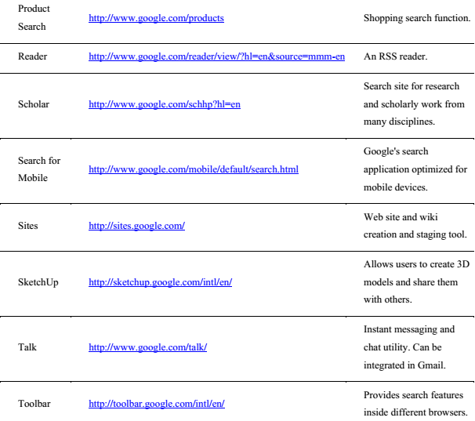
Google Products

Slide 21
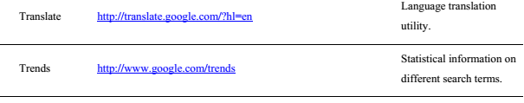
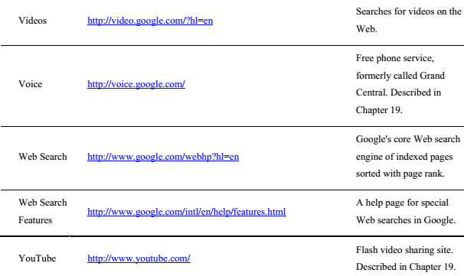
Google Products

Slide 22
Enterprise offerings
The following are among Google's products aimed at the enterprise market:
Google Commerce Search
Google Site Search
Google Search Appliance
Google Mini

Slide 23
AdWords
AdWords (http://www.google.com/AdWords) is a targeted ad service based on matching advertisers and their keywords to users and their search profiles. This service transformed Google from a competent search engine into an industry giant and is responsible for the majority of Google's revenue stream.
AdWords' two largest competitors are Microsoft adcenter (http://adcenter microsoft.com/) and Yahoo! Search Marketing (http://searchmarketing.yahoo.com/).

Slide 24
AdWords
Ads are displayed as text, banners, or media and can be tailored based on geographical location, frequency, IP addresses, and other factors.
AdWords ads can appear not only on Google.com, but on AOL search, Ask.com, and Netscape, along with other partners.
Other partners belonging to the Google Display Network can also display AdSense ads. In all these cases, the AdWords system determines which ads to match to the user searches.

Slide 25
Google Analytics
Google Analytics (GA; http://google.com/analytics) is a statistical tool that measures the number and types of visitors to a Web site and how the Web site is used. It is offered as a free service and has been adopted by many Web sites.
Google Analytics was in use on 54 percent of the top 10,000 and 100,000, and 35 percent of the top one million of the world's Web sites
Google Analytics is the most widely used Web traffic analysis tool on the Internet.

Slide 26
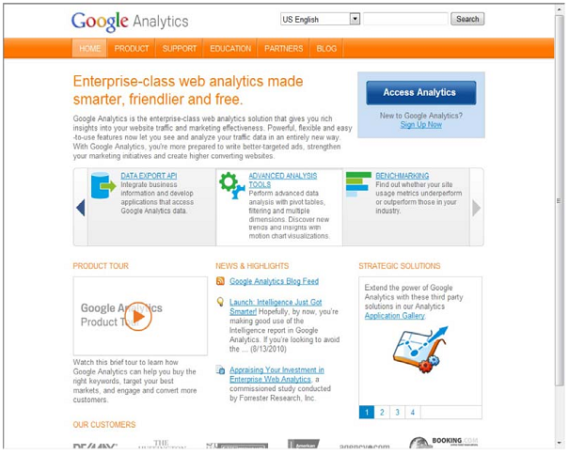
Google Analytics

Slide 27
Google Translate
Google Translate was introduced in 2007 and replaced the SYSTRAN system that many other computer services utilize. The translation method uses a statistical approach that was first developed by Franz-Joseph Och in 2003. Och now heads the Translate effort at Google.
Translate uses what is referred to as a corpus linguistics approach to translation. You start off building a translation system for a language pair by collecting a database of words and then matching that database to two bilingual text corpuses.

Slide 28
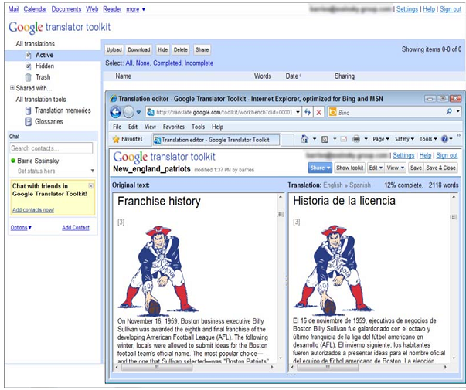
Google Translate

Slide 29
Exploring the Google Toolkit
Google has an extensive program that supports developers who want to leverage Google's cloud-based applications and services. These APIs reach into every corner of Google's business.
Google's Code Home page for developers may be found at http://code.google.com
You can access developer tools, information on how to use its various APIs to include Google services in your own work, and technical resources.

Slide 30
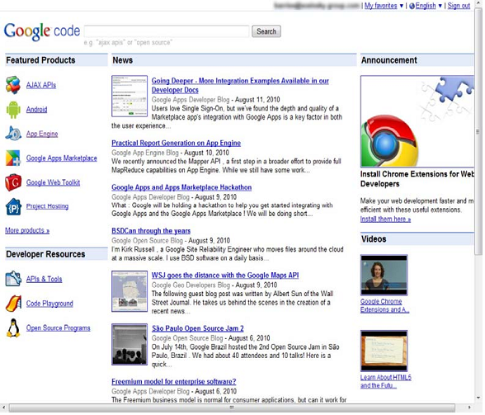
Exploring the Google Toolkit

Slide 31
Exploring the Google Toolkit
Google has a number of areas in which it offers development services, including the following:
AJAX APIs(http://code.google.com/intl/en/apis/ajax/)
Android(http://developer.android.com/index html)
Google App Engine(http://appengine.google.com/)
Google Apps Marketplace(http://code.google.com/intl/en/googleapps/marketplace/)
Google Gears(http://gears.google.com/)
Google Web Toolkit(GWT; http://code.google.com/webtoolkit)
Project Hosting(http://code.google.com/intl/en/projecthosting/)

Slide 32
The Google APIs
Most Google services are exposed by an API, which is why you find a version of Google's search engine, Google Maps, YouTube videos, Google Earth, AdWords, AdSense, and even elements of Google Apps exposed in many other Web sites.
Google's APIs can be categorized as belonging to the following categories:
Ads and AdSense: These APIs allow Google's advertising services to be integrated into Web applications. The most commonly used services in this category are AdWords, AdSense, and Google Analytics.

Slide 33
The Google APIs
Google's APIs can be categorized as belonging to the following categories:
AJAX: The Google AJAX APIs provide a means to add content such as RSS feeds, maps, search boxes, and other information sources by including a snippet of JavaScript into your code.
Browser: Google has several APIs related to building browser-based applications, including four for the Chrome browser.
Data: The Data APIs are those that exchange data with a variety of Google services.

Slide 34
The Google APIs
Google's APIs can be categorized as belonging to the following categories:
Geo: A number of APIs exist to give location-specific information hooking into maps and geo-specific databases.
Search: The search APIs leverage Google's core competency and its central service.
Social: Many Google APIs are used for information exchange and communication tools.

Slide 35
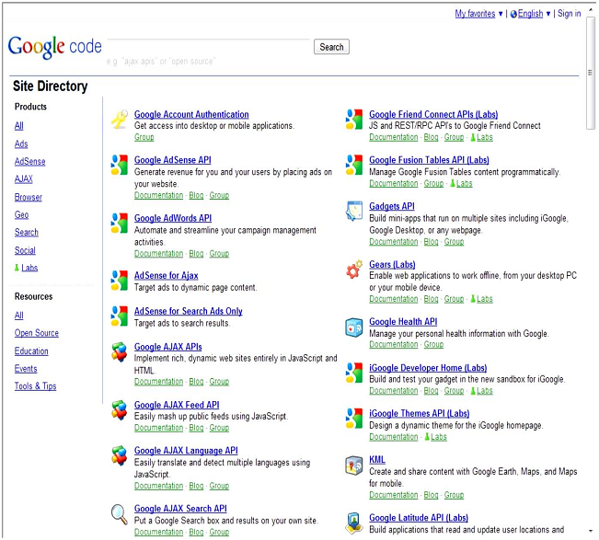

Slide 36
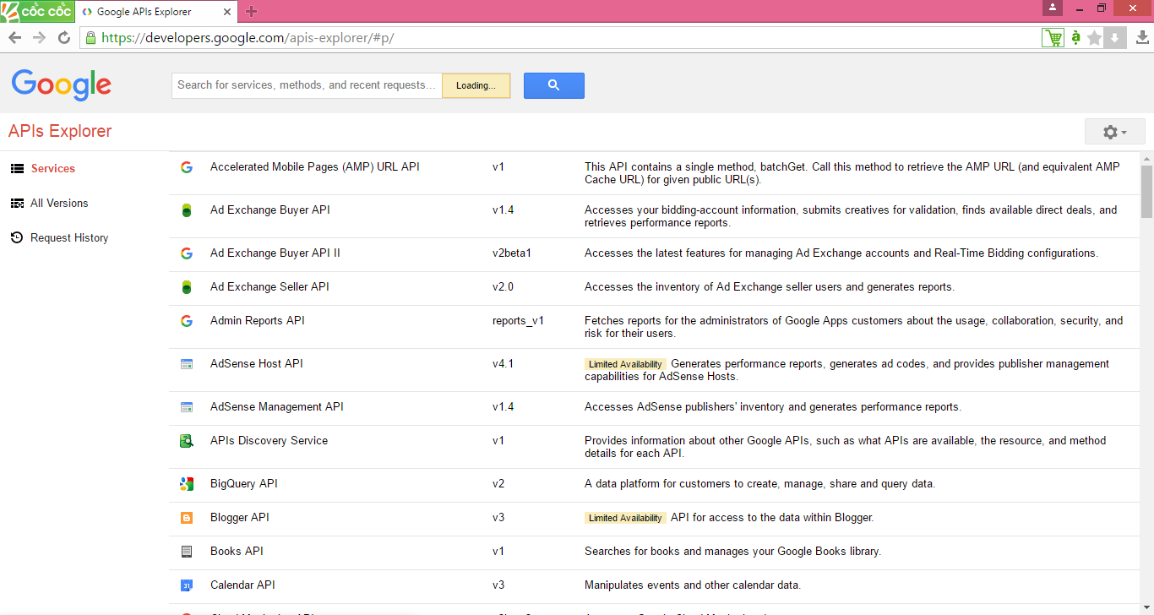
Google APIs
https://developers.google.com/apis-explorer/#p/

Slide 37
Working with the Google App Engine
Google App Engine (GAE) is a Platform as a Service (PaaS) cloud-based Web hosting service on Google's infrastructure.
GAE supports the following major features:
Dynamic Web services based on common standards
Automatic scaling and load balancing
Authentication using Google's Accounts API

Slide 38
Working with the Google App Engine
GAE supports the following major features:
Persistent storage, with query access sorting and transaction management features
Task queues and task scheduling
A client-side development environment for simulating GAE on your local system
One of either two runtime environments: Java or Python

Slide 39
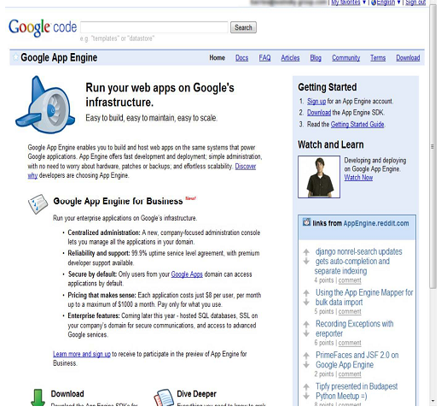

Slide 40
Working with the Google App Engine
Google App Engine currently supports applications written in Java and in Python, although there are plans to extend support to more languages in the future
The service is meant to be language-agnostic. A number of Java Virtual Machine languages are compliant with GAE, as are several Python Web frameworks that support the Web Server Gateway Interface (WSGI) and CGI.
Google has its own Webapp framework designed for use with GAE.

Slide 41
Working with the Google App Engine
Google uses the following pricing scheme:
CPU time measured in CPU hours is $0.10 per hour.
Stored data measured in GBper month is $0.15 per GB/month.
Incoming bandwidth measured in GB is $0.10 per GB.
Outgoing bandwidth measured in GB is $0.12 per GB.
Recipients e-mailed is $0.0001 per recipient.

Slide 42
Summary
Learned about all things Google
The range of applications and services that Google offers is truly impressive; the company is essentially a self-contained ecosystem
Google's empire is built on its highly regarded search engine.
The company monetized search technology by attaching target advertising to searches that its users perform

Slide 43
Summary
The applications and services were listed, as were the APIs that are built on these applications and services.
Google makes nearly all the products accessible through its APIs. That is why you find Google's services on so many of the world's Web sites.
Google App Engine, a Platform as a Service Web-hosting offering that allows you to create Web applications and deploy them on Google's own infrastructure.

