Slide 1
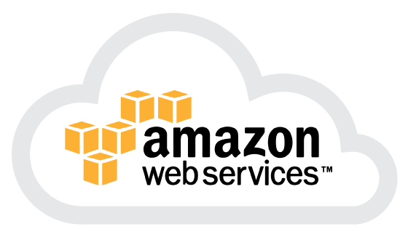
Chapter 9
Using Amazon Web Services

Slide 2
Learning Objectives
Learning about Amazon Web Services
Instantiating Amazon Machine Images
Provisioning storage, databases, and other services
Learning about other AWS offerings
Realizing the potential of Infrastructure as a Service

Slide 3
Understanding Amazon Web Services
Amazon?
Amazon.com
Net sales: over $100 billion
Amazon Web Services? (http://aws.amazon.com/)
The largest pure IAAS
The best examples of using a Service Oriented Architecture (SOA)
Over $10 billion in annual sales

Slide 4
Understanding Amazon Web Services
Amazon Web Services is based on SOA standards, including HTTP, REST, and SOAP transfer protocols, open source and commercial operating systems, application servers, and browser-based access. Virtual private servers can provision virtual private clouds connected through virtual private networks providing for reasonable security and control by the system administrator.
Great value proposition: You pay for what you use.
Low barrier to entry.

Slide 5
Understanding Amazon Web Services
Amazon.com is the world's largest online retailer with net sales in $24.51 billion, according to their 2009 annual report.
While Amazon.com is not the earth's biggest retailer (that spot is reserved for Wal-Mart), Amazon.com offers the largest number of retail product. So, to support this business, Amazon.com has built an enormous network of IT systems to support not only average, but peak customer demands.

Slide 6
Understanding Amazon Web Services
Amazon Web Services (AWS) takes what is essentially unused infrastructure capacity on Amazon.com's network and turns it into a very profitable business.
AWS is having enormous impact in cloud computing. Indeed, Amazon.com's services represent the largest pure Infrastructure as a Service (IAAS) play in the marketplace today. It is also one of the best examples of what is possible using a Service Oriented Architecture (SOA)

Slide 7
Understanding Amazon Web Services
Reliability
Security
Cost benefits
Ease of development
Elasticity
Cohesiveness
Community

Slide 8
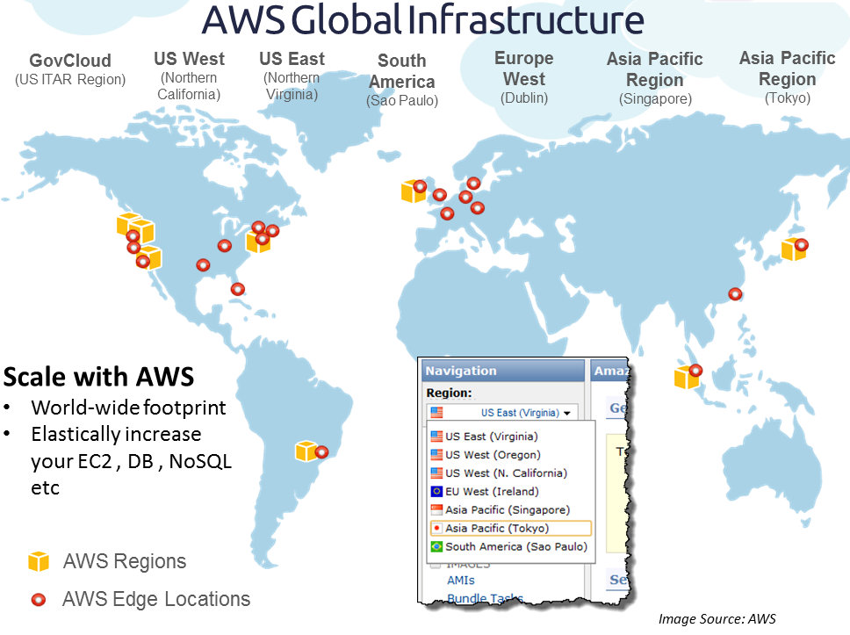

Slide 9
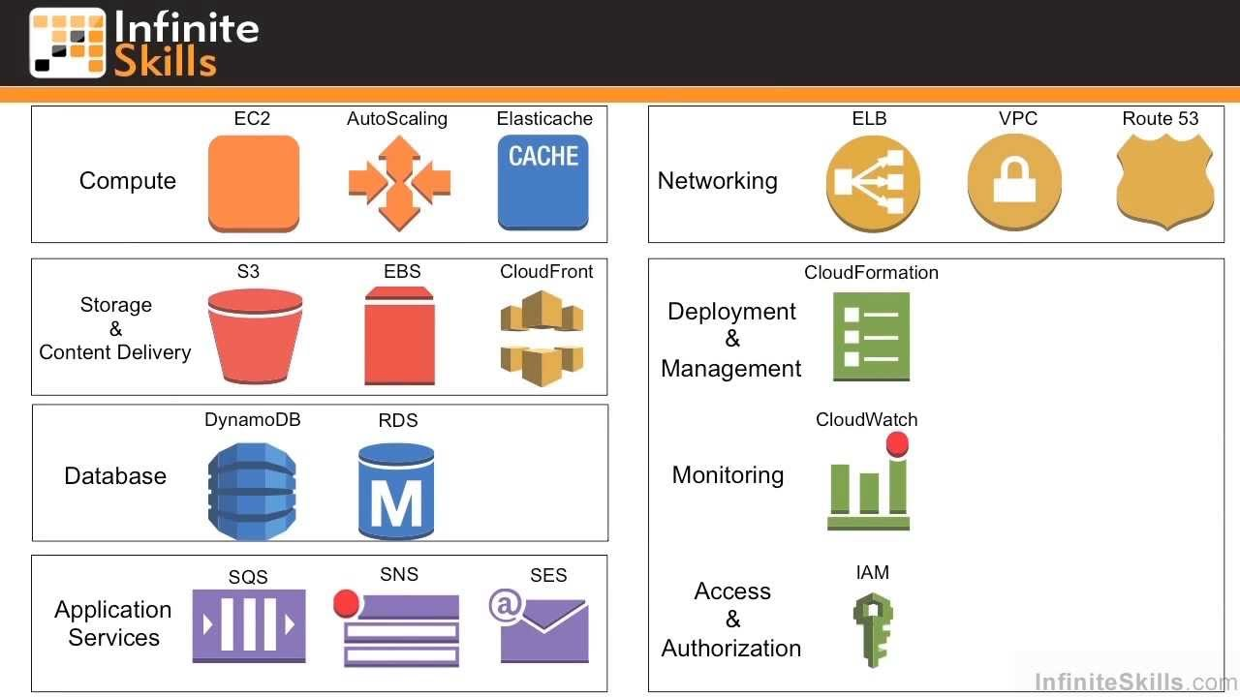
Amazon Web Service Components and Services

Slide 10
AWS Components and Services
Amazon Elastic Compute Cloud (EC2):
It enables the creation, use, and management of virtual private servers running the Linux or Windows operating system.
Spread over data centers worldwide, EC2 applications may be created that are highly scalable, redundant, and fault tolerant.
A number of tools are used to support EC2 services:

Slide 11
EC2 services
Amazon Simple Queue Service (SQS): is a message queue or transaction system for distributed Internet-based applications.
Amazon Simple Notification Service (SNS): is a Web service that can publish messages from an application and deliver them to other applications or to subscribers. SNS provides a method for triggering actions, allowing clients or applications to subscribe to information (like RSS), or polling for new or changed information or perform updates.

Slide 12
EC2 services
Amazon CloudWatch: allow users to monitor EC2 like resource utilization, performance, and operational indicators for factors such as processor demand, disk utilization, and network I/O.
Auto Scaling: a feature that can automatically scale an EC2 site based on a set of rules that you create. It is a part of CloudWatch and available at no additional charge.
Elastic Load Balancing: can detect when an instance is failing and reroute traffic to a healthy instance, even an instance in other AWS zones.

Slide 13
AWS Components and Services
Amazon Simple Storage System (S3): is an online backup and storage system. A high speed data transfer feature called AWS Import/Export can transfer data to and from AWS using Amazon's own internal network to portable storage devices.
Amazon Elastic Block Store (EBS): a system for creating virtual disks (volume) or block level storage devices that can be used for Amazon Machine Instances in EC2.
Amazon SimpleDB: is a structured data store that supports indexing and data queries to both EC2 and S3.

Slide 14
AWS Components and Services
Amazon Relational Database Service (RDS): allows you to create instances of the MySQL database to support your Websites and the many applications that rely on data-driven services. RDS provides features such as automated software patching, database backups, and automated database scaling via an API call.
Amazon Cloudfront: is an edge-storage or content-delivery system that caches data in different physical locations so that user access to data is enhanced through faster data transfer speeds and lower latency. It is set up to work with Amazon Simple Storage System (Amazon S3).

Slide 15
AWS Components and Services
Alexa Web Information Service and Alexa Top Sites are two services that collect and expose information about the structure and traffic patterns of Websites. This information can be used to build or structure Websites, access related sites, analyze historical patterns for growth and relationships, and perform data analysis on site information.
Amazon Virtual Private Cloud (VPC): provides a bridge between a company's existing network and the AWS cloud. VPC connects your network resources to a set of AWS systems over a Virtual Private Network (VPN) connection and extends security systems, firewalls, and management systems to include their provisioned AWS servers.

Slide 16
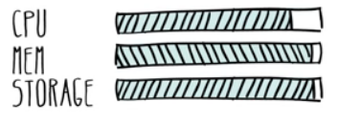

Amazon Machine Images
Standard Instances
High Memory Instances
High CPU Instances
Private
Public
Paid

Slide 17
Amazon Machine Images
AMIs are operating systems running on the Xen virtualization hypervisor. Each virtual private server is accorded a size rating called its EC2 Compute Unit. There are 3 types:
Standard Instances: The standard instances are deemed to be suitable for standard server applications.
High Memory Instances: High memory instances are useful for large data throughput applications such as SQL Server databases and data caching and retrieval.
High CPU Instances: The high CPU instance category is best used for applications that are processor- or compute-intensive. Applications of this type include rendering, encoding, data analysis, and others.

Slide 18
Amazon Machine Image Instance Types
Type | Compute Engine | RAM (GB) | Storage (GB) | Platform | I/O Performance | API Name
Micro instance | Up to 2 EC2 Compute Units (1 virtual core) in short bursts | 0.613 | EBS (Elastic Block Storage) storage only | 32-bit or 64-bit | Low | T1.micro
Standard instance – small (default) | 1 EC2 Compute Unit (1 virtual core) | 1.7 | 160 | 32-bit | Moderate | m1.small
Standard instance – large | 4 EC2 Compute Units (2 virtual cores X 2 EC2 Units) | 7.5 | 850 | 64-bit | High | m1.large
Standard instance – extra large | 8 EC2 Compute Units (4 virtual cores X 2 EC2 Units) | 15 | 1,690 | 64-bit | High | m1.xlarge
High Memory Double Extra Large Instance | 13 EC2 Compute Units (4 virtual cores X 3.25 EC2 Units) | 34.2 | 850 | 64-bit | High | m2.2xlarge
High Memory Quadruple Extra Large Instance | 26 EC2 Compute Units (8 virtual cores X 3.25 EC2 Units) | 68.4 | 1,690 | 64-bit | High | m2.4xlarge
High CPU Medium Instance | 5 EC2 Compute Units (2 virtual cores X 2.5 EC2 Units) | 1.7 | 350 | 32-bit | Moderate | c1.medium
High CPU Extra Large Instance | 20 EC2 Compute Units (8 virtual cores X 2.5 EC2 Units) | 7 | 1,690 | 64-bit | High | c1.xlarge

Slide 19
Pricing models
The pricing of these different AMI types depends on the operating system used, which data center the AMI is located in (you can select its location), and the amount of time that the AMI runs. Rates are quoted based on an hourly rate. Additional charges are applied for:
the amount of data transferred
whether Elastic IP Addresses are assigned
your virtual private server's use of Amazon Elastic Block Storage (EBS)
whether you use Elastic Load Balancing for two or more servers
other features

Slide 20
Pricing models
The three different pricing models for EC2 AMIs are as follows:
On-Demand Instance: This is the hourly rate with no long-term commitment.
Reserved Instances: This is a purchase of a contract for each instance you use with a significantly lower hourly usage charge after you have paid for the reservation.
Spot Instance: This is a method for bidding on unused EC2 capacity based on the current spot price. This feature offers a significantly lower price, but it varies over time or may not be available when there is no excess capacity

Slide 21
System images and software
You can choose to use a template AMI system image with the operating system of your choice or create your own system image that contains your custom applications, code libraries, settings, and data. Security can be set through passwords, Kerberos tickets, or certificates.
These operating systems are offered:
Red Hat Enterprise Linux
OpenSuse Linux
Ubuntu Linux
Sun OpenSolaris
Fedora
Gentoo Linux
Oracle Enterprise Linux
Windows Server 2003/2008/2012/2016 32-bit and 64-bit up to Data Center Edition
Debian

Slide 22
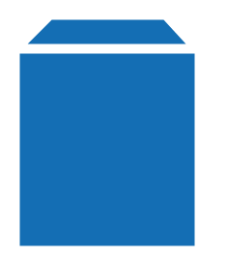
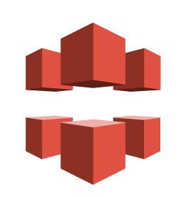
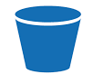
Working with Amazon Storage Systems
Amazon Simple Storage System (S3)
Amazon Elastic Block Store (EBS)
Amazon CloudFront

Slide 23
Amazon S3
Amazon S3 is storage for the Internet. It is designed to make web-scale computing easier for developers.
Amazon S3 provides a simple web services interface that can be used to store and retrieve any amount of data, at any time, from anywhere on the web.
In S3, storage containers are referred to as buckets, and buckets serve the function of a directory
Amazon S3's cloud-based storage system allows you to store data objects ranging in size from 1 byte up to 5GB in a flat namespace
The S3 system allows you to assign a name to a bucket, but that name must be unique in the S3 namespace across all AWS customers

Slide 24
Amazon EBS
The third of Amazon's data storage systems are devoted to Amazon Elastic Block Storage (EBS), which is a persistent storage service with a high operational performance.
Advantages of EBS are that it can store file system information and its performance is higher and much more reliable than Amazon S3.
An EBS volume can be used as an instance boot partition. The advantages of an EBS boot partition are that you can have a volume up to 1TB, retain your boot partition separately from your EC2 instance,
EBS is a service priced on the amount of storage space used, how long you use it, and the number of I/O requests made to the volume.

Slide 25
CloudFront
Amazon CloudFront is referred to as a content delivery network (CDN), and sometimes called edge computing. In edge computing, content is pushed out geographically so the data is more readily available to network clients and has a lower latency when requested.
You can think of a CDN as a distributed caching system. CloudFront servers are located throughout the world—in Europe, Asia, and the United States. As such, CloudFront represents yet another level of Amazon cloud storage.
A user requesting data from a CloudFront site is referred to the nearest geographical location. CloudFront supports “geo-caching” data by performing static data transfers and streaming content from one CloudFront location to another.

Slide 26
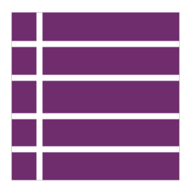

Amazon Database Services
Amazon SimpleDB
Amazon Relational Database Service (RDS)

Slide 27
Amazon SimpleDB
Core database functions of data indexing and querying
No schema, automatic indexing
Eliminates the administrative burden of data modeling, index maintenance and performance tuning
Real-time lookup and simple querying of structured data

Slide 28
Amazon Relational Database Service
Cost-efficient and resizable capacity
Manages time-consuming database administration tasks
Access to the full capabilities of a familiar MySQL, Oracle or SQL Server database
Code, applications and tools you already use today work seamlessly
Automatically patches the database software and backs up your database

Slide 29
Summary
AWS is the most successful example of a Service Oriented Architecture (SOA) that provides an Infrastructure as a Service (IaaS) cloud computing solution
The range of services that AWS supports is wide and includes Content Delivery Networks (CDNs), messaging and notification systems, load balancing and replication, and many other services as well.

