Slide 1
Chapter 10
Using Microsoft Cloud Services

Slide 2
Learning Objectives
Understanding Microsoft's developing cloud computing strategy
Learning about the Windows Azure hosting service
Exploring application development using the Windows Azure Platform
Viewing the applications and services that are part of Windows Live

Slide 3
Microsoft's developing cloud computing strategy
Microsoft is on a multi-year journey to adopt cloud computing throughout the company. This complex and strategic undertaking involves multiple teams, public cloud computing, and private cloud computing.
Understand the strategy, operations considerations, and cultural shifts that are making this journey successful.
Today's reality is a hybrid cloud

Slide 4
Microsoft's developing cloud computing strategy
Since 2011, they have actively pursued cloud adoption to benefit from platform efficiencies, development agility, and rapid deployment capabilities. Their vision has always been "everything runs in the cloud."
At the outset, their goal was to host 80 percent of our services and applications through public cloud services. Since 2011, the strategy has evolved and been refined to pursue a goal of more than 90 percent of IT services and applications in the public cloud.

Slide 5
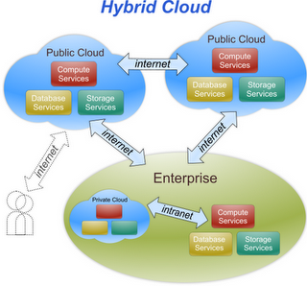
The reality today is a hybrid cloud, using both public and private cloud computing environments.

Slide 6
What does success look like?
A simplified application portfolio.
Enabling IT resources to focus on high-value activities.
Greater focus on delivering customer capability.
Ability to respond more quickly to business changes.

Slide 7
Microsoft's developing cloud computing strategy
Microsoft has a very extensive cloud computing portfolio under active development
Microsoft's approach is to view cloud applications as software plus service
Microsoft calls their cloud operating system the Windows Azure Platform.
The Windows Azure service it self is a hosted environment of virtual machines enabled by a fabric called Windows Azure AppFabric

Slide 8
Microsoft's developing cloud computing strategy
Windows Azure service is an Infrastructure as a Service.
A number of services interoperate with Windows Azure, including SQL Azure (a version of SQL Server), SharePoint Services, Azure Dynamic CRM, and many of Windows Live Services comprising what is the Windows Azure Platform, which is a Platform as a Service cloud computing model.

Slide 9
Microsoft's developing cloud computing strategy
Windows Live Services is a collection of applications and services that run on the Web
Some of these applications called Windows Live Essentials are add-ons to Windows and downloadable as applications.
Other Windows Live Services are standalone Web applications viewable in a browse.

Slide 10
Microsoft Cloud Services
Microsoft Live is only one part of the Microsoft cloud strategy. The second part of the strategy is the extension of the .NET Framework and related development tools to the cloud.
.NET developers to extend their applications into the cloud, or to build .NET style applications that run completely in the cloud, Microsoft has created a set of .NET services, which it now refers to as the Windows Azure Platform.
.NET Services itself had as its origin the work Microsoft did to create its BizTalk products.

Slide 11
Microsoft Cloud Services
Azure is a virtualized infrastructure to which a set of additional enterprise services has been layered on top, including :
A virtualization service called Azure AppFabric that creates an application hosting environment. AppFabric (formerly .NET Services) is a cloud-enabled version of the .NET Framework.
A high capacity non-relational storage facility called Storage.
A set of virtual machine instances called Compute.
A cloud-enabled version of SQL Server called SQL Azure Database.

Slide 12
Microsoft Cloud Services
A database marketplace based on SQL Azure Database code-named “Dallas.”
An xRM (Anything Relations Management) service called Dynamics CRM based on Microsoft Dynamics.
A document and collaboration service based on SharePoint called SharePoint Services.
Windows Live Services, a collection of services that runs on Windows Live, which can be used in applications that run in the Azure cloud.

Slide 13
Defining the Windows Azure Platform
Azure is Microsoft's Infrastructure as a Service (IaaS) Web hosting service. Azure is a deep blue color the color of the clear sky onto which you can paint clouds.
Windows Azure Platform becomes a Platform as a Service (PaaS) offering.
May run into some people calling Azure an infrastructure service and others calling it a platform; in context, both are correct.

Slide 14
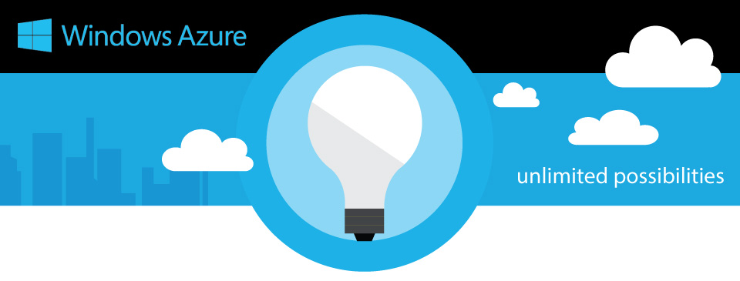
Defining the Windows Azure Platform
Compared to Amazon's and Google's cloud services, Azure (the service) is a competitor to AWS.
Windows Azure Platform is a competitor to Google's App Engine.

Slide 15
Windows Azure Platform
Key components of the Azure Services Platform include the following:
Windows Azure for service hosting and management, low-level scalable storage, computation and networking
Microsoft SQL Services for a wide range of database services and reporting
Microsoft .NET Services which are service-based implementations of familiar .NET Framework concepts such as workflow and access control
Live Services for a consistent way for users to store, share and synchronize documents, photos, files and information across their PCs, phones, PC applications and Web sites
Microsoft SharePoint Services and Microsoft Dynamics CRM Services for business content, collaboration and rapid solution development in the cloud

Slide 16
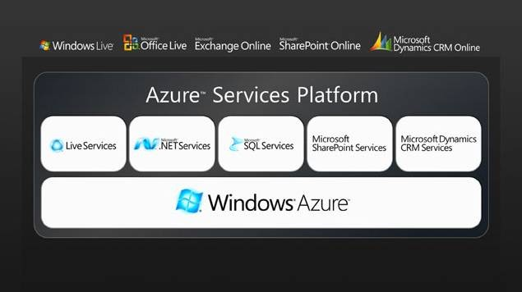
Windows Azure Platform

Slide 17
The software plus services approach
Microsoft has a very different vision for cloud services than either Amazon or Google does.
In Amazon's case, AWS is a pure infrastructure play. AWS essentially rents you a (virtual) computer on which to run your application.
An Amazon Machine Image can be provisioned with an operating system, an enterprise application, or application stack, but that provisioning is not a prerequisite.

Slide 18
The software plus services approach
An AMI is your machine, and you can configure it as you choose. AWS is a deployment enabler.
Google's approach with its Google App Engine (GAE) is to offer a cloud-based development platform on which you can add your program
Google makes it possible to program in a number of languages, but you must write your applications to conform to Google's infrastructure.

Slide 19
The software plus services approach
The Windows Azure Platform allows a developer to modify his application so it can run in the cloud on virtual machines hosted in Microsoft datacenters
Windows Azure serves as a cloud operating system, and the suitably modified application can be hosted on Azure as a runtime application where it can make use of the various Azure Services.

Slide 20
The Azure Platform
The Azure Windows Services Platform API uses the industry standard REST, HTTP, and XML protocols that are part of any Service Oriented Architecture cloud infrastructure to allow applications to talk to Azure.
Developers can install a client-side managed class library that contains functions that can make calls to the Azure Windows Services Platform API as part of their applications.
These API functions have been added to Microsoft Visual Studio as part of Microsoft's Integrated Development Environment (IDE).

Slide 21
The Azure Platform
There are plans to add IPsec connectivity to Azure in the near future. IPsec refers to the Internet Protocol Security protocol suite for creating a secure Internet connection between two endpoints.
IPsec provides for authenticated communication using session-based negotiation and the exchange of cryptographic keys to enable encrypted communication to be sent and decrypted.
IPsec is an IETF standard that is in wide use.

Slide 22
The Azure Platform
The Azure Service Platform hosts runtime versions of.NET Framework applications written in any of the languages in common use, such as Visual Basic, C++, C#, Java, and any application that has been compiled for .NET's Common Language Runtime (CLR).
Azure also can deploy Web-based applications built with ASP.NET, the Windows Communication Foundation (WCF), and PHP, and it supports Microsoft's automated deployment technologies.

Slide 23
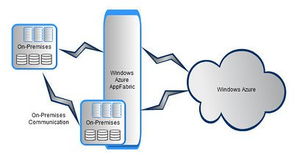
The Azure Platform
Microsoft also has released SDKs for both Java and Ruby to allow applications written in those languages to place calls to the Azure Service.
Platform API to the AppFabric Service.

Slide 24
The Windows Azure service
Windows Azure is a virtualized Windows infrastructure run by Microsoft on a set of datacenters around the world.
Six main elements are part of Windows Azure:
Application
Compute
Storage
Fabric
Config
Virtual machines

Slide 25
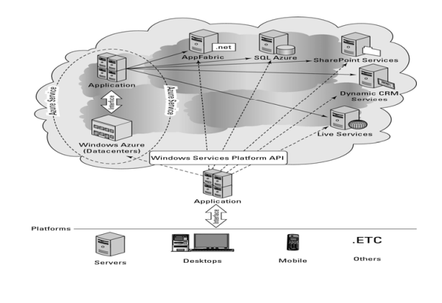

Slide 26
Windows Azure AppFabric
Azure AppFabric is a Service Bus and Access Control facility based on .NET technology for client requests to Web services on Azure.
These services were called Microsoft .NET Services. Azure AppFabric supports the standard Service Oriented Architecture (SOA) protocols such as REST and SOAP and the WS- protocols.

Slide 27
Windows Azure AppFabric
Azure AppFabric manages requests by locating the service, communicating the request, and making the necessary connection possible by performing network address translation, opening appropriate ports in any intervening firewalls.
AppFabric manages the transaction to ensure that it is completed and that a response is sent to the client. A service bus also can serve to negotiate the exchange of information between a client and the service.

Slide 28
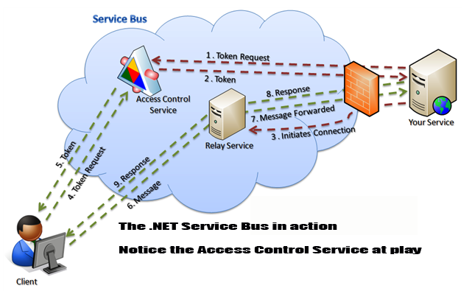
Cross-Ref
The Access Control portion of Azure AppFabric is a claims access control system that provides a token-based trust mechanism for identity management.
Azure AppFabric service pathways :

Slide 29
The steps are associated with Access Control:
The client requests authentication from Access Control.
Access Control creates a token based on the stored rules for server application.
A token is signed and returned to the client application.
The client presents the token to the service application.
The server application verifies the signature and uses the token to decide what the client application is allowed to do.

Slide 30
SQL Azure
SQL Azure is a cloud-based relational database service that is based on Microsoft SQL Server.
Initially, this service was called SQL Server Data Service.
An application that uses SQL Azure Database can run locally on a server, PC, or mobile device, in a datacenter, or on Windows Azure.
Data stored in an SQL Azure database is accessed using the Tabular Data Stream (TDS) protocol, the same protocol used for a local SQL Server database.

Slide 31
SQL Azure
SQL Azure Database supports Transact-SQL statements.
Azure data is replicated three times for data protection and writes are checked for consistency.
SQL Azure eventually will support the Microsoft Sync Framework providing a facility for SQL Azure
Databases to synchronize their data with local databases.

Slide 32
Windows Azure pricing
Prices for working with the Windows Azure Platform are based either on a “consumption” (pay-as-you-go) model or through various contracts for levels of monthly service that Microsoft calls “commitments.”
Current pricing for Windows Azure is as follows: • Compute: $0.12 / hour • Storage: $0.15 / GB stored / month • Storage transactions: $0.01 / 10K • Data transfers (excluding CDN): $0.10 in / $0.15out / GB ($0.30 in / $0.45 out / GB in Asia) • CDN data transfers: $0.15 GB for North America and Europe ($0.20 GB elsewhere) • CDN transactions: $0.01 / 10K

Slide 33
Windows Azure pricing
Windows Azure is a relatively new service and that IaaS likely will become a very competitive market, pricing is sure to change over time
You should definitely check the pricing page for current pricing if you are thinking of deploying on Azure.

Slide 34
Windows Live Services
Windows Live is a collection of cloud-based applications and services, some of which can be used inside applications that run on Windows Azure Platform.
Some Windows Live applications run as standalone applications and are available to users directly through a browser.
Microsoft has rolled out Windows Live in sets of releases they describe as four waves.
The first wave was a rebranding of several Microsoft MSN applications and services in late 2005.

Slide 35
Windows Live Services
More applications including Windows Mail, Windows Photo Gallery, and Windows Movie Maker were unbundled from Vista and rolled into a downloadable software suite called Windows Live Essentials.
Some parts of the Windows Live portfolio are shared applications and services that are accessible to developers, and those services are the Windows Live Services that are one component of the Windows Azure Platform.

Slide 36
Windows Live Services
Developers access the services for Windows Live Services through a collection of APIs and controls called Windows Live Messenger Connect (previously called Live Services and Windows Live Dev).
Using these APIs and controls, developers can add Windows Live Services capabilities and data to their application

Slide 37
Using Windows Live
Windows Live includes several popular cloud-based services.
The two best known and most widely used are Windows Live Hotmail and Windows Live Messenger, with more than 300 million users worldwide
Windows Live is based around five core services: • E-mail • Instant Messaging • Photos • Social Networking • Online Storage
A user or application can consume Windows Live in a number of ways.

Slide 38
Windows Live Essentials
Windows Live Essentials applications are a collection of client-side applications that must be downloaded and installed on a desktop.
Live Essentials rely on cloud-based services for their data storage and retrieval.
Windows Live Essentials currently includes the following: • Family Safety • Windows Live Messenger • Photo Gallery • Mail • Movie Maker

Slide 39
Windows Live Home
Windows Live Home is the central access page or portal for the Windows Live suite.
The page provides navigation, lists activities, provides access to e-mail, shows your RSS feeds, and lists your account name and some related information.
These are the most commonly used features on WLH: • Launching other Windows Live services • Viewing e-mail headers from Hotmail and private messages • Viewing activity of people you follow • Displaying weather information and RSS feed updates • Managing calendars and events • Viewing photos • Modifying profile and relationships

Slide 40
Windows Live for Mobile
Microsoft has a number of Windows Live services that are specifically meant to be run on mobile devices or cell phones that it calls Windows Live for Mobile.
Some of these services run on the Windows Mobile platform, some are Web-based applications that conform to the lightweight Wireless Application Protocol (WAP) or on GPRS (General Packet Radio Service) browser, and some support SMS (Simple Message Service) systems.

Slide 41
Windows Live for Mobile
The current list of these services includes the following: • Live Mesh Mobile • Windows Live Calendar Mobile • Windows Live Contacts Mobile • Windows Live Groups Mobile • Windows Live Home Mobile • Windows Live Messenger Mobile • Windows Live Office Mobile • Windows Live Profile Mobile • Windows Live SkyDrive Mobile • Windows Live Spaces Mobile

Slide 42
Summary
Today's reality is a hybrid cloud
Microsoft's cloud operating system is called Windows Azure
Windows Azure is a hosted environment of virtualized systems tied together in a fabric using a service called AppFabric. This is offered to developers in the form of an Infrastructure as a Service model similar to Amazon Web Services. To Windows Azure is added a cloud-enabled version of the .NET Framework originally called .NET Services, which are now part of Azure AppFabric.

Slide 43
Summary
Microsoft has added a number of additional services and the entire offering is now a Platform as a Service cloud model that Microsoft calls the Windows Azure Platform
The other major component of Microsoft's cloud computing strategy is a collection of user applications and related services called Windows Live
Some Windows Live applications are client-side applications, many others are Web-based applications, some are mobile apps, and an important subset of these services is available to developers through the Windows Live Messenger Connect APIs

