Slide 1
Chapter 11
Managing the Cloud

Slide 2
Learning Objectives
Learning about network management software
Viewing the essential monitoring features
Using lifecycle management techniques
Discovering emerging network management interoperability standards

Slide 3
Administrating the Clouds
The explosive growth in cloud computing services has led many vendors to rename their products and reposition them to get in on the gold rush in the clouds.
The fundamental features are offered by traditional network management systems:
• Administration of resources
• Configuring resources
• Enforcing security
• Monitoring operations
• Optimizing performance
• Policy management
• Performing maintenance
• Provisioning of resources

Slide 4
Administrating the Clouds
Network management systems are often described in terms of the acronym FCAPS, which stands for these features:
Fault
Configuration
Accounting
Performance
Security
Most network management packages have one or more of these characteristics; no single package provides all five elements of FCAPS.

Slide 5
Administrating the Clouds
To get the complete set of all five of these management areas from a single vendor, you would need to adopt a network management framework. These large network management frameworks were industry leaders several years back:
BMC PATROL,
CA Unicenter
IBM Tivoli
HP OpenView
Microsoft System Center.

Slide 6
Management responsibilitis
What separates a network management package from a cloud computing management package is the “cloudly” characteristics that cloud management service must have:
• Billing is on a pay-as-you-go basis.
• The management service is extremely scalable.
• The management service is ubiquitous.
• Communication between the cloud and other systems uses cloud networking standards

Slide 7
Management responsibilitis
To monitor an entire cloud computing deployment stack, you monitor six different categories:
End-user services such as HTTP, TCP, POP3/SMTP…
Browser performance on the client
Application monitoring in the cloud, such as Apache
Cloud infrastructure monitoring of services such as Amazon Web Services, GoGrid, Rackspace, and others
Machine instance monitoring where the service measures processor utilization, memory usage, disk consumption, queue lengths, and other important parameters
Network monitoring and discovery using standard protocols like the Simple Network Management Protocol (SNMP), Configuration Management Database (CMDB), Windows Management Instrumentation (WMI), and the like

Slide 8
Management responsibilities
It's important to note that there are really two aspects to cloud management:
Managing resources in the cloud
Using the cloud to manage resources on-premises

Slide 9
Management responsibilities
Engine cloud service, the Administration Console provides you with the following monitoring capabilities:
Create a new application, and set it up in your domain.
Invite other people to be part of developing your application.
View data and error logs.
Analyze your network traffic.
Browse the application data store, and manage its indexes.
View the application's scheduled tasks.
Test the application, and swap out versions.

Slide 10
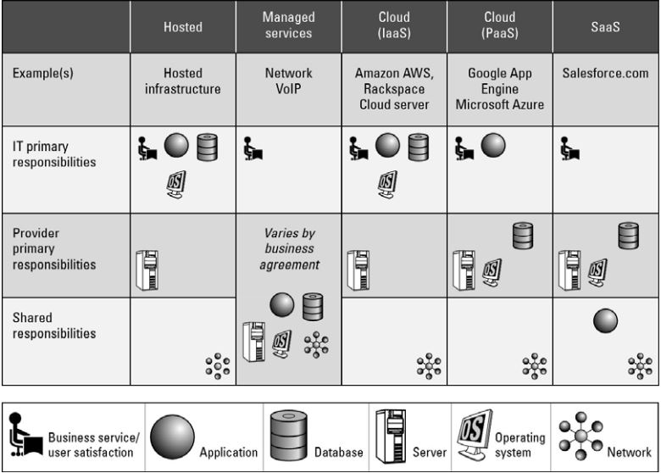
Management responsibilities by service model type

Slide 11
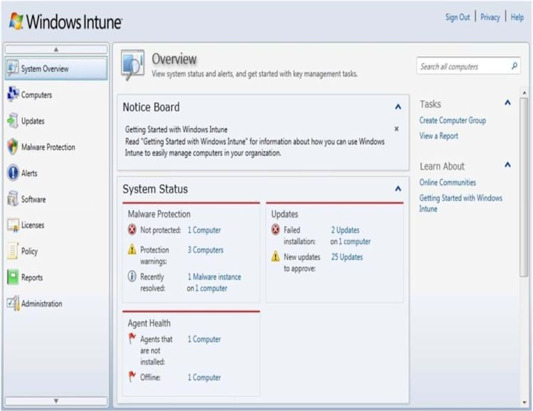
Intune is Microsoft's cloud-based management service

Slide 12
Lifecycle management
A management program has to touch on each of the six different stages in that lifecycle:
The definition of the service as a template for creating instances. Tasks performed in Phase 1 include the creation, updating, and deletion of service templates.
Client interactions with the service, usually through an SLA (Service Level Agreement) contract. This phase manages client relationships and creates and manages service contracts.
The deployment of an instance to the cloud and the runtime management of instances. Tasks performed in Phase 3 include the creation, updating, and deletion of service offerings.

Slide 13
Lifecycle management
The definition of the attributes of the service while in operation and performance of modifications of its properties. The chief task during this management phase is to perform service optimization and customization.
Management of the operation of instances and routine maintenance. During Phase 5, you must monitor resources, track and respond to events, and perform reporting and billing functions.
Retirement of the service. End of life tasks include data protection and system migration, archiving, and service contract termination.

Slide 14
Cloud Management Products
Cloud management software and services is a very young industry, and as such, it has a very large number of companies, some with new products and others with older products competing in this area.
Some of the current players in this market, along with the products they either are offering or are promising in the very near future.
When considering products in cloud management, you should be aware that—as in all new areas of technology—there is considerable churn as companies grow, get acquired, or fail along the way.

Slide 15
Cloud Management Products
The core management features offered by most cloud management service products include the following:
Support of different cloud types
Creation and provisioning of different types of cloud resources, such as machine instances, storage, or staged applications
Performance reporting including availability and uptime, response time, resource quota usage, and other characteristics
The creation of dashboards that can be customized for a particular client's needs

Slide 16
Cloud Management Products
Automated deployment on IaaS systems represents one class of cloud management services. One of the more interesting and successful vendors in this area is Rightscale (http://www.rightscale.com/) whose software allows clients to stage and manage applications on AWS (Amazon Web Service), Eucalyptus, Rackspace, and the Chef Multicloud framework or a combination of these cloud types. Rightscale creates cloud-ready server templates and provides the automation and orchestration necessary to deploy them.

Slide 17
Cloud Management Products
Cloudkick (https://www.cloudkick.com/) is another infrastructure monitoring solution that is well regarded. Its service is noted for being agnostic and working with multiple vendor cloud platforms. The Cloudkick user interface is designed for rapid deployment assessment, and its at-a-glance-monitoring Insight module is particularly easy to use.
All of the service models support monitoring solutions, most often through interaction with the service API. Tapping into a service API allows management software to perform command actions that a user would normally perform

Slide 18
Cloud Management Products
ManageIQ (http://www manageiq.com/) and Service-now.com offer an integrated cloud stack that combines the ManageIQ Enterprise Virtualization Management Suite with Service-Now.com's ITSM SaaS service. The system has offers management, discovery, CMDB synchronization, and automated provisioning services.
Pareto Networks (http://www.paretonetworks.com/) has a cloud computing service that can monitor and manage distributed network services using a physical or virtual appliance. The system can be used to control and provision network services. Pareto Networks plans to add an API to this service.

Slide 19
Emerging Cloud Management Standards
Different cloud service providers use different technologies for creating and managing cloud resources.
Cloud providers are going to be under considerable pressure from large cloud users like the federal government to conform to standards and make their systems interoperable with one another.
No entity is likely to want to make a major investment in a service that is a silo or from which data is difficult to stage or to extract.

Slide 20
DMTF cloud management standards
The Distributed Management Task Force is an industry organization that develops industry system management standards for platform interoperability. Its membership is a “who's who” in computing, and since its founding in 1992, the group has been responsible for several industry standards, most notably the Common Information Model (CIM).
A recent standard called the Virtualization Management Initiative (VMAN) was developed to extend CIM to virtual computer system management. VMAN has resulted in the creation of the Open Virtualization Format (OVF).

Slide 21
DMTF cloud management standards
It was, therefore, a natural extension of the work that DMTF does in virtualization to solve management issues in cloud computing. DMTF has created a working group called the Open Cloud Standards Incubator (OCSI) to help develop interoperability standards for managing interactions between and in public, private, and hybrid cloud systems.

Slide 22
Cloud Commons and SMI
CA Technologies (http://www.ca.com), the company once known as Computer Associates, has taken some of its technologies in measuring distributed network performance metrics and repositioned its products as the following:
CA Cloud Insight, a cloud metrics measurement service
CA Cloud Compose, a deployment service
CA Cloud Optimize, a cloud optimization service
CA Cloud Orchestrate, a workflow control and policy based automation service

Slide 23
Cloud Commons and SMI
CA has lots of experience in this area through its Unicenter management suite and the products that were spawned from it. The company also has invested in cloud vendors such as 3Tera, Oblicore, and Cassatt to create their cloud services.
To demonstrate the potential of cloud-based metrics, the Cloud Commons has built a dashboard called the Cloud Sensor that monitors the performance of the major cloud-based services in real time.

Slide 24
Cloud Commons and SMI
This tool measures the performance of the following:
RackSpace file creation and deletion
E-mail availability (system uptime) based on Google Gmail, Windows Live Hotmail, and Yahoo! Mail
Amazon Web Services server creation/destruction times at four AWS sites
Dashboard Response Times for the consoles of AWS.Amazon, Google App Status, RackSpace Cloud, and Saleforce
Windows Azure storage benchmarks
Windows Azure SQL benchmarks

Slide 25
Cloud Commons and SMI
It is meant to demonstrate the value of cloud performance measurements. These metrics are based on real-time data derived from real transactions.
The Service Measurement Index (SMI) is based on a set of measurement technologies forming the SMI Framework that CA donated to the SMI Consortium. It measures cloud-based services in six areas:
Agility
Capability
Cost
Quality
Risk
Security

Slide 26
Cloud Commons and SMI
These form a set of Key Performance Indicators (KPI) that can be used to compare one service to another.
The CloudSensor
(http://dashboard.atgcloud.info:5001/cloudsensor/cloud-sensor.html) dashboard displays real-time cloud service performance metrics.

Slide 27
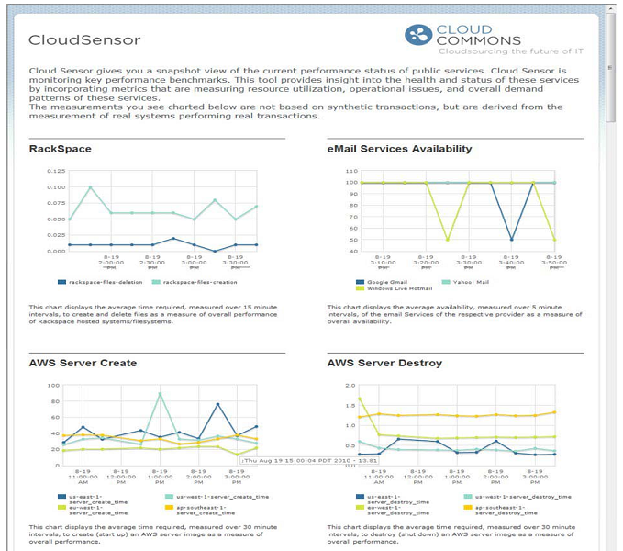

Slide 28
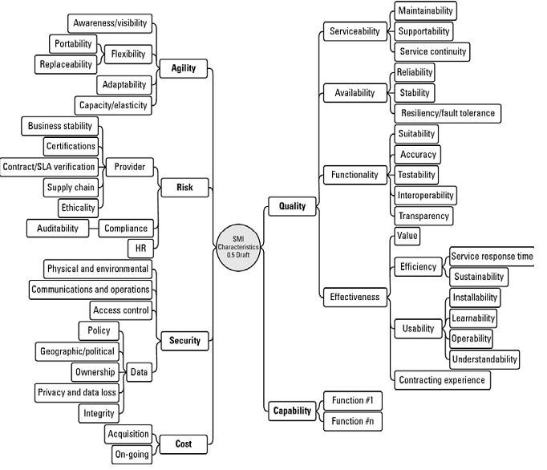

Slide 29
Summary
Cloud management is an important and growing area of technology.
Among the management tasks are deployment, monitoring, configuration, optimization, and often security.
Nearly all network management software vendors are repositioning their products to work with cloud systems.
Some network management is available from within the cloud service providers' platforms.
Many of the software systems utilize the service provider's API to manage, monitor, and control resources. The use of virtualization has spawned many new products in this area.

