Slide 1
Chapter 12
Understanding Cloud Security

Slide 2
Learning Objectives
Reviewing cloud security concerns
Understanding how cloud data can be secured
Planning for security in your system
Learning how identity is used to allow secure cloud access

Slide 3
Securing the Cloud
The Internet was designed primarily to be resilient.
The Internet was not designed to be secure.
Any distributed application has a much greater attack surface than an application that is closely held on a Local Area Network.
Cloud computing has all the vulnerabilities associated with Internet applications, and additional vulnerabilities arise from pooled, virtualized, and outsourced resources.

Slide 4
Securing the Cloud
Areas of cloud computing that were uniquely troublesome:
Auditing
Data integrity
e-Discovery for legal compliance
Privacy
Recovery
Regulatory compliance

Slide 5
Risks analysis
Determine which resources (data, services, or applications) you are planning to move to the cloud.
Determine the sensitivity of the resource to risk.
Determine the risk associated with the particular cloud type for a resource.
Take into account the particular cloud service model that you will be using.
If you have selected a particular cloud service provider, you need to evaluate its system to understand how data is transferred, where it is stored, and how to move data both in and out of the cloud .

Slide 6
Security boundary
Responsibility of the service provider is separate from the responsibility of the customer.
Each service model inherits the capabilities of the model beneath it, as well as all the inherent security concerns and risk factors.
IaaS has the least levels of integrated functionality and the lowest levels of integrated security, and SaaS has the most.

Slide 7
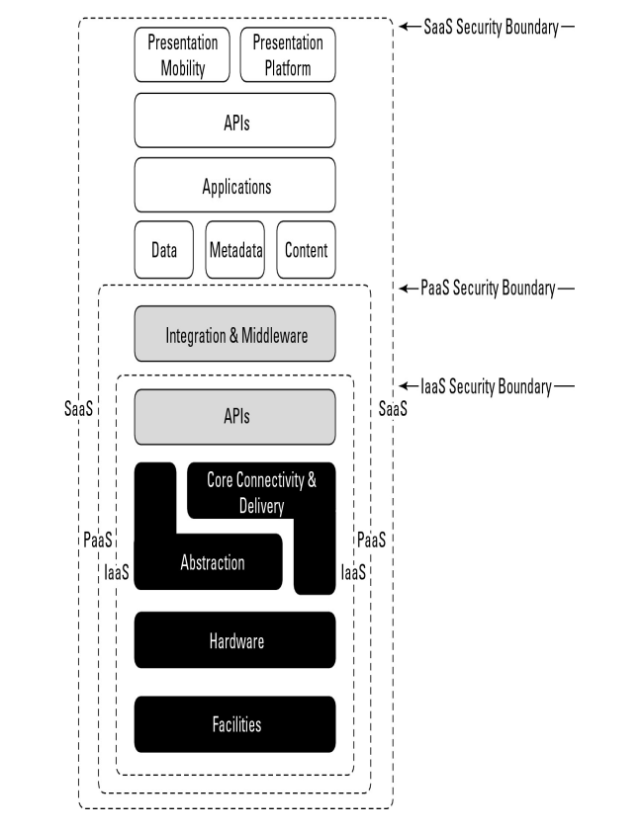
Security boundary

Slide 8
Security boundary
Security Responsibilities by Service Model
Model Type | Infrastructure Security Management | Infrastructure Owner | Infrastructure Location | Trust Condition
Hybrid | Both vendor and customer | Both vendor and customer | Both on- and off-premises | Both trusted and untrusted
Private/Community | Customer | Customer | On- or off-premises | Trusted
Private/Community | Customer | Vendor | Off- or on-premises | Trusted
Private/Community | Vendor | Customer | On- or off-premises | Trusted

Slide 9
Security mapping
Mapping of the particular cloud service model to the particular application you are deploying.
Security control model includes the security that you normally use for your applications, data, management, network, and physical hardware.

Slide 10
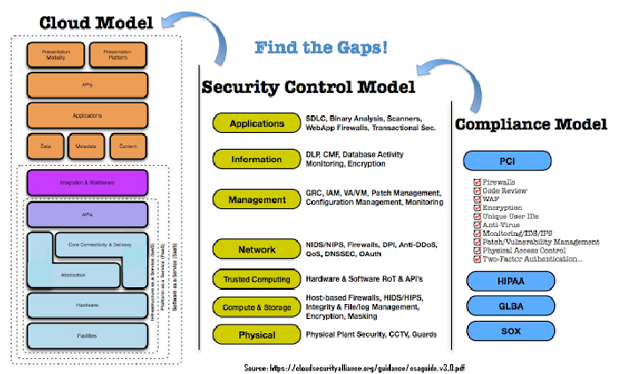
Security mapping

Slide 11
Securing Data
Why?
key mechanisms for protecting data mechanisms:
Access control
Auditing
Authentication
Authorization

Slide 12
Brokered cloud storage
Data can be located anywhere in the cloud service provider's system.
Isolate data from direct client access: create layered access to the data.
In one scheme, two services are created:
a broker with full access to storage but no access to the client.
a proxy with no access to storage but access to both the client and broker.
Relies on the proxy service to impose some rules.

Slide 13
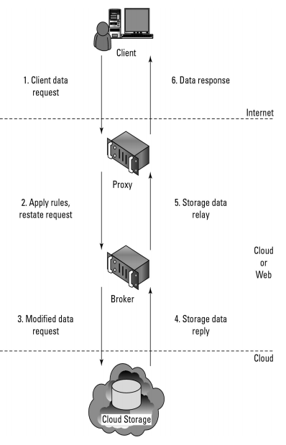
System design

Slide 14
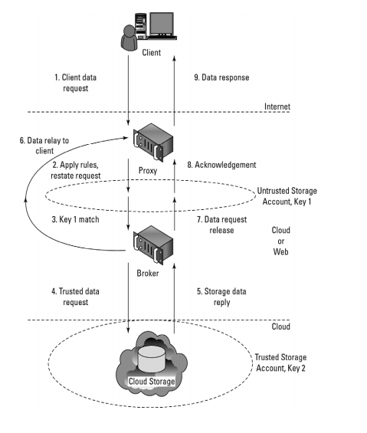
System design

Slide 15
Storage location and tenancy
Contract with cloud service providers.
Specific service provider maintains data segregation.
Who is provided privileged access to storage?
Encrypted data.
Incident response.

Slide 16
Encryption
Maintains confidentiality and data integrity.
Multiple accounts with different keys.
Creation of secure key stores that have restricted role-based access, automated key stores backup, and recovery techniques.
Standards: OASIS Key Management Interoperability Protocol (KMIP), IEEE 1619.3.

Slide 17
Auditing and compliance
Evaluation performance, investigate security and when illegal activity has been perpetrated.
Proprietary log formats from cloud service providers built-in tools.
Logging activity and data co-located, moving across a landscape of different hosts and sites.
Laws and responsible.
Standards: ISO/IEC 27001/27002, SAS70(amazon web service).

Slide 18
Establishing Identity & Presence
Identity management: primary mechanism for controlling access to data in the cloud, preventing unauthorized uses, maintaining user roles, and complying with regulations.
Presence: the mapping of an authenticated identity to a known location; adds context that can modify services and service delivery.
Cloud computing requirements:
That you establish an identity
That the identity be authenticated
That the authentication be portable
That authentication provide access to cloud resources

Slide 19
Identity protocol standards
The protocols that provide identity services have been and are under active development, and several form the basis for efforts to create interoperability among services.
OpenID 2.0
Set of authorization markup languages that create files in the form of being XACML and SAML.
Oauth.
DataPortability Project working group.

Slide 20
OpenIDL
The authentication procedure has the following steps:
The end-user uses a program like a browser that is called a user agent to enter an OpenID identifier, which is in the form of a URL or XRI. An OpenID might take the form of name.openid.provider.org.
The OpenID is presented to a service that provides access to the resource that is desired.
An entity called a relaying party queries the OpenID identity provider to authenticate the veracity of the OpenID credentials.
The authentication is sent back to the relaying party from the identity provider and access is either provided or denied.

Slide 21
Windows Azure identity standards
Uses a claims-based identity based on open authentication and access protocols.
May be used without modification.
Windows Azure security in 3 services:
Active Directory Federation Services 2.0
Windows Azure AppFabric Access Control Service
Windows Identity Foundation (WIF)

Slide 22
Presence
Used on networks to indicate the status of available parties and their location.
Presence services: watchers.
Cloud computing services that rely on presence information: telephony systems such as VoIP, instant messaging services (IM), and geo-location-based systems such as GPS.
Claims-based presence system: WIF.
Standards: Extensible Messaging and Presence Protocol (XMPP). (Jabber XCP platform)
Notion of applying presence services over the standard Service Oriented Architecture (SOA) protocols such as SOAP/REST/HTTP.

Slide 23
Summary
Security may, in fact, be the single most important area of cloud computing that you need to plan for
Depending upon the type of service you use, you may find many security services already built into your system.
An issue you need to consider is how to protect data in transit to and stored in the cloud. Data encryption, access restrictions, and data protection services were described.
Multi-tenancy, system virtualization, and other factors make monitoring, regulatory compliance, and incidence response more challenging than on-premises systems are.
A key concept for controlling access to cloud resources is identity management.

