Slide 1
Chapter 13
Understanding Service Oriented Architecture

Slide 2
Learning Objectives
Using Service Oriented Architecture
Defining message-based transactions
Understanding processes and transactions
Managing SOA distributed applications

Slide 3
Introducing Service Oriented Architecture (SOA)
Service Oriented Architecture (SOA) is a specification and a methodology for providing platform- and language-independent services for use in distributed applications. A service is a repeatable task within a business process, and a business task is a composition of services
Usually service providers and service consumers do not pass messages directly to each other. Implementations of SOA employ Middleware software to play the role of transaction manager (or broker) and translator

Slide 4
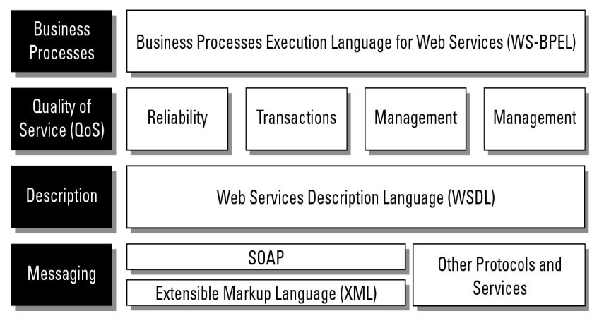
Introducing Service Oriented Architecture (SOA)

Slide 5
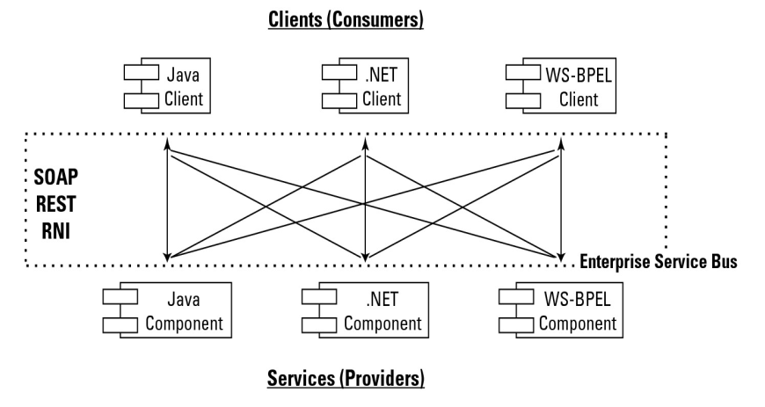
Introducing Service Oriented Architecture (SOA)

Slide 6
Enterprise Service Bus
These typical features are found in ESBs, among others:
Monitoring services aid in managing events.
Process management services manage message transactions.
Data repositories or registries store business logic and aid in governance of business processes.
Data services pass messages between clients and services.
Data abstraction services translate messages from one format to another, as required.
Governance is a service that monitors compliance of your operations with governmental regulation, which can vary from state to state and from country to country.
Security services validate clients and services and allow messages to pass from one to the other

Slide 7
Orchestration
One way of performing orchestration is through the use of an Enterprise Service Bus or ESB.
An ESB provides a middleware software layer for event management with a messaging infrastructure.
An ESB isn't required by SOA, but it is often used to create a compliant and efficient service architecture.

Slide 8
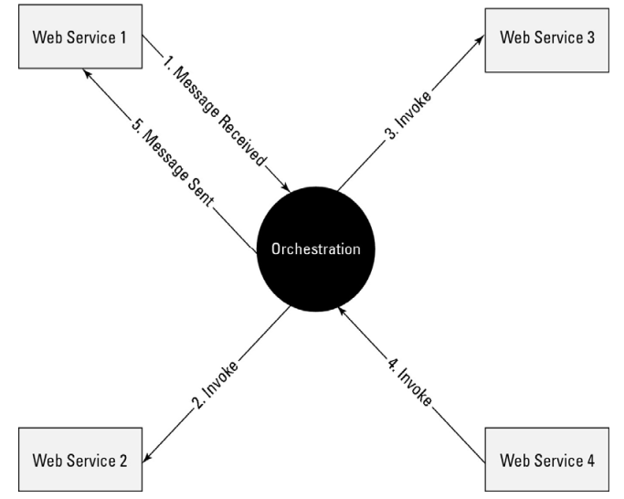
Orchestration

Slide 9
Service Choreography and Service Orchestration
A choreography's role specifies the expected messaging behavior of the participants that will play it in terms of the sequencing and timing of the messages that they can consume and produce
In a sense, service choreography and orchestrations are two flips of the same coin.

Slide 10
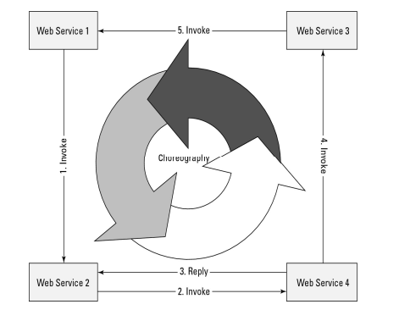
Service Choreography and Service Orchestration

Slide 11
Event-driven SOA or SOA 2.0
Event-driven SOA or SOA 2.0 is an extension of the Service Oriented Architecture to respond to events that occur as a result of business processes or perhaps cause and influence a business process
Thus complex events, in which a pattern of activities—both non-scheduled and scheduled—should trigger a set of services is not accounted for in traditional SOA 1.0 architecture.
To perform these tasks in SOA 2.0, a Causal Vector Engine (CVE) with some built-in artificial intelligence must be added to the SOA design

Slide 12
Service catalogs
To aid in locating services, SOA infrastructure often includes a catalog service.
Catalog servers have these features:
They can be standalone catalog servers serving a single site.
They serve the role of a global catalog service where two or more catalog servers are merged to include several sites. A global service usually requires some sort of synchronization or update to maintain a unified data store across the servers involved.
They can be part of a federated catalog service where two or more global catalog servers have access to one another's information through a trusted query relationship.

Slide 13
Defining SOA Communications
Message passing in SOA requires the use of two different protocol types: the data interchange format and the network protocol that carries the message.
A client (or customer) connected to an ESB communicates over a network protocol such as HTTP, Representational State Transfer (REST), or Java Message Service (JMS) to a component (or service).
Messages are most often in the form of the eXtensible Markup Language (XML) or in a variant such as the Simple Object Access Protocol (SOAP).

Slide 14
Defining SOA Communications
SOAP is a messaging format used in Web services that use XML as the message format while relying on Application layer protocols such as HTTP and Remote Procedure Calls (RPC) for message negotiation and transmission.
The software used to write clients and components can be written in Java, .NET, Web Service Business Process Execution Language (WS-BPEL), or another form of executable code; the services that they message can be written in the same or another language. What is required is the ability to transport and translate a message into a form that both parties can understand.

Slide 15
Defining SOA Communications
Contained within WSDL are essential objects to support message transfer, including these:
The service object
The port or endpoint
The binding
The portType
The operation
The message content
The types

Slide 16
Defining SOA Communications
Messages must have some of the following pieces of information contained inside them:
Header
Service Type
Functional Specification
Transaction attributes

Slide 17
Business Process Execution Language
If a message represents an atomic transaction in a Service Oriented Architecture, the next level of abstraction up is the grouping and managing of sets of transactions to form useful work and to execute a business process.
BPEL is a meta-language comprised of two functions: executable commands for Web services and clients, and internal or abstract code for executing the internal business logic that processes require.
A meta-language is any language whose statements refer to statements in another language referred to as the object language.

Slide 18
Business Process Execution Language
BPEL uses XML with specific support for messaging protocols such as SOAP, WSDL, UDDI, WS-Reliable Messaging, WS-Addressing, WS-Coordination, and WS-Transactions
BPEL was designed to interact with WSDL and define business processes using an XML language. BPEL does not have a graphical component.
One process may interact with other processes, but the goal is to minimize the number of specific extensions added to BPEL to support any particular business process.

Slide 19
Business process modeling
SOA was created by the industry to solve a problem: how to make disparate, diverse, and distributed services talk to disparate and diverse clients.
The final result of an SOA project isn't the access of service , it is the creation of a business process . In a complex business project, the developers juggle many clients and many services.
To address this problem, various modeling tools have been developed to support SOA development and optimization, system and process management, change and life-cycle management.

Slide 20
Business process modeling
Commonly encountered system models include the following:
Unified Modeling Language (UML)
XML Metadata Interchange (XMI)
Systems Modeling Language (SysML)
Business Process Modeling Notation (BPMN)
Service-Oriented Modeling Framework (SOMF)

Slide 21
Business process modeling
The modeling is based on the elements of the service life cycle:
Conceptualization
Discovery
Analysis
Integration
Logical design
Architecture design
System implementation

Slide 22
Business process modeling
Four modeling topologies for message passing are used in SOMF:
Circular topology
Hierarchical topology
Network topology
Star topology

Slide 23
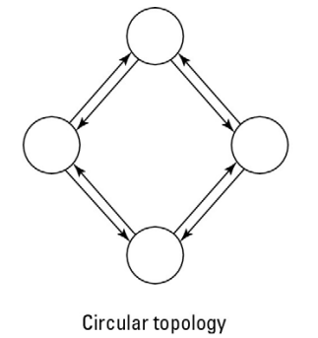
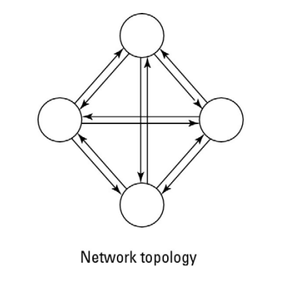
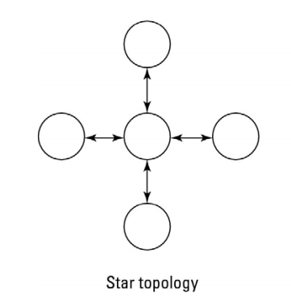
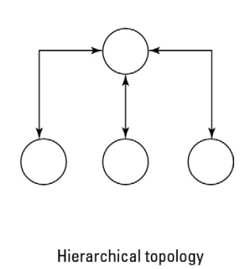
Business process modeling

Slide 24
Managing and Monitoring SOA
Software for monitoring and managing an SOA infrastructure plays an important role in large SOA deployments. While SOA offers a logical design and reusable components, it does not make the task of network management any easier .
If anything, SOA management requires proactive oversight because you can't wait for a particular application to fail before taking corrective action. Therefore, tools for managing SOAs tend to be multifaceted and run constantly.

Slide 25
SOA management tools
There are a number of network management frameworks products:
HP Software and Solutions OpenView SOA Manager
IBM Tivoli Framework Composite Application Manager for SOA
Oracle BPEL Process Manager

Slide 26
SOA security
Any system that sends hundreds or thousands of messages across an internetwork as SOA does is subject to attack in all the traditional ways that network traffic is hijacked, spoofed redirected, or blocked.
Because SOA eliminates the use of application boundaries, the traditional methods where security is at the application level aren't likely to be effective.

Slide 27
SOA security
To address SOA security, a set of OASIS standards was created, which includes the following:
Security Assertion Markup Language (SAML)
WS-Security (WSS)
WS-SecureConversion
WS-SecurityPolicy
WS-Trust

Slide 28
The Open Cloud Consortium
The Open Cloud Consortium of several universities and interested companies that supports the development of standards for cloud computing and for interoperating with the various frameworks.
OCC working groups perform these functions:
They develop benchmarks
They provide testbeds
They support the development
They support the management

Slide 29
Relating SOA and Cloud Computing
SOA is what you do, and cloud computing is how you do it
First, cloud computing won’t work without SOA for most enterprises
They are co-dependent, The relationship between cloud computing and SOA is that cloud computing provides IT resources you can leverage on demand, including resources that host data, services, and processes. Thus you have the ability to extend your SOA outside of the enterprise firewall to cloud computing providers, seeking the benefits of cloud computing

Slide 30
Summary
SOA offers a design methodology for creating distributed applications using diverse clients and components.
SOA defines a message-passing infrastructure from clients or consumers to and from service providers.
Making SOA work correctly requires a certain set of middleware products in your infrastructure.
These servers may aid in transaction management or brokering, message translation, or other services. Taken as a whole, these services are referred to as an Enterprise Service Bus (ESB).

Slide 31
Summary
Most message-passing protocols are based on a version structured XML, although that is not required in SOA. A variety of transport protocols are used, but SOAP and RPC are the most common ones.
The nature of SOA messaging was explored. In a complex system of message passing and services, system management and security is an important consideration. Tools for setting up and running an SOA infrastructure were described.

Slide 32
Summary
You don't need to use SOA to build a massively scaled cloud computing application, but as cloud computing applications become more capable and user configurable, the logic and structure that SOA design imposes on infrastructure will prove to be invaluable to cloud applications. The two areas of technology benefit from their mutual convergence.

