Slide 1
Preliminaries – Knowledge Graph

Slide 2
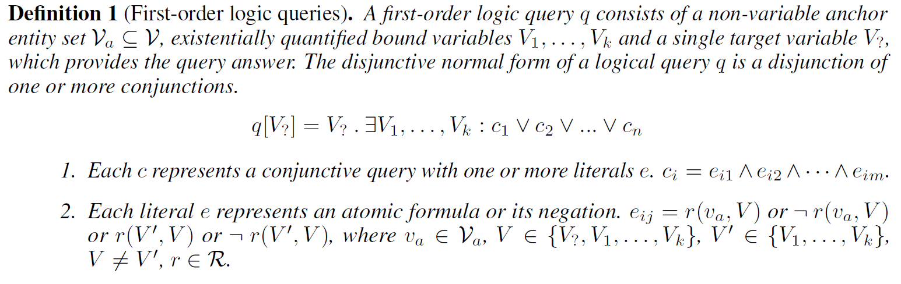
Preliminaries – First-order Logic Query

Slide 3
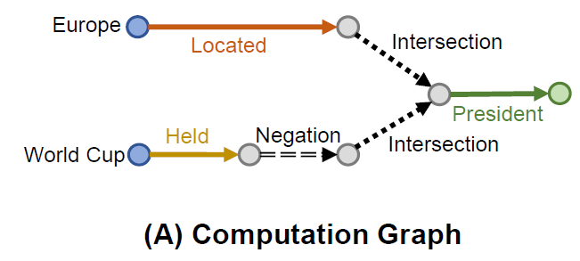
Preliminaries – Computation Graph
A Directed Acyclic Graph (DAG)
Three types of edges: relation projection, intersection, and negation.
Demonstrates the computation process to answer the query.
Start from leaf nodes, and end at root node.

Slide 4
Beta Embeddings for Entities and Queries
In order to model any FOL query, the desirable properties of the embedding include:
Naturally model uncertainty.
We can design logical/set operators (conjunction/intersection, negation/complement that are closed)
Operators can be combined in arbitrary ways
The representation remains at fixed space/time complexity and does not grow exponentially as additional operators are applied.

Slide 5
Beta Embeddings for Entities and Queries
Embed entities and queries into the same space using probabilistic embeddings with bounded support. Especially, they use beta distribution.
Why?
The uncertainty of a Beta distribution can be measured by its differential entropy.
We can design closed logical operators (projection, intersection, negation) for Beta embedding.

Slide 6
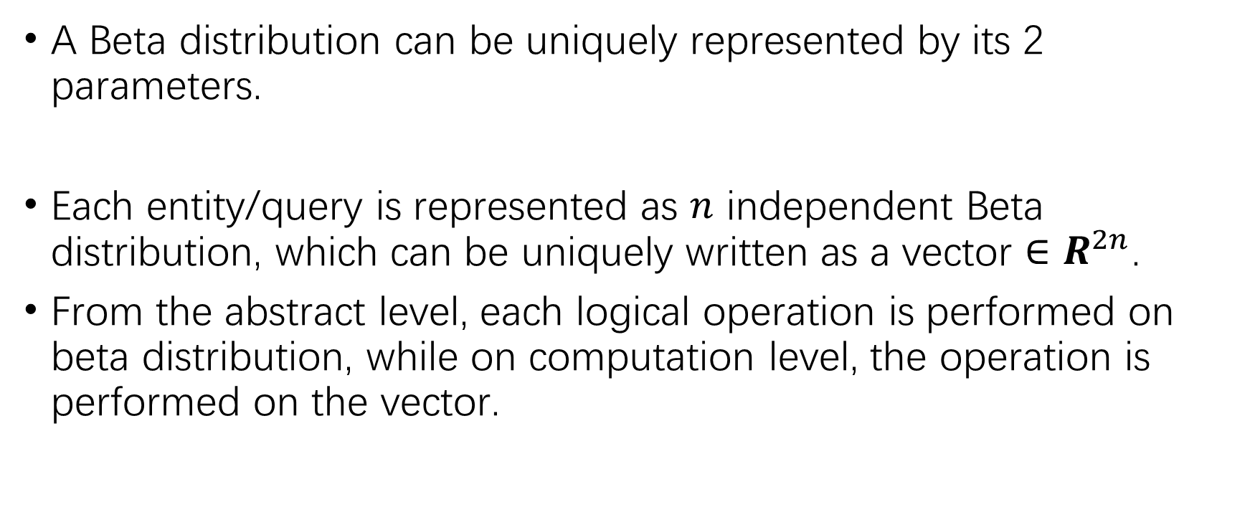
Beta Embeddings for Entities and Queries
A Beta distribution can be uniquely represented by its 2 parameters.
Each entity/query is represented as $n$ independent Beta distribution, which can be uniquely written as a vector $∈R^{2n}$.
From the abstract level, each logical operation is performed on beta distribution, while on computation level, the operation is performed on the vector.

Slide 7

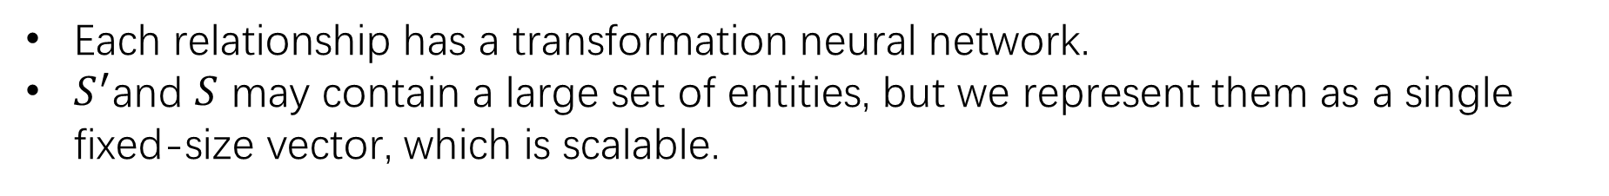
Probabilistic Logical Operators: Projection
Beta distribution for output entity set
Beta distribution for input entity set
Each relationship has a transformation neural network.
$S^{′}$and $S$ may contain a large set of entities, but we represent them as a single fixed-size vector, which is scalable.

Slide 8
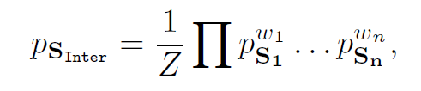
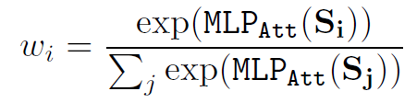
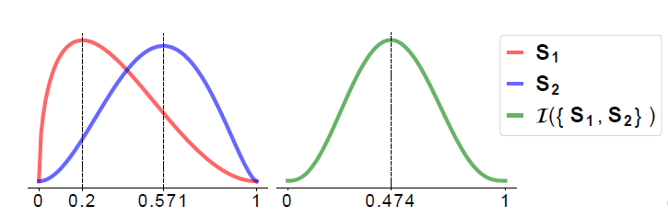
Probabilistic Logical Operators: Intersection

Slide 9
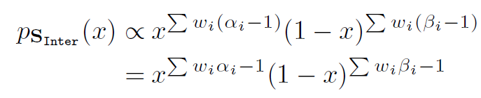
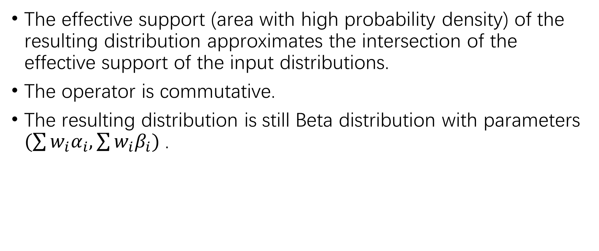
Probabilistic Logical Operators: Intersection
The effective support (area with high probability density) of the resulting distribution approximates the intersection of the effective support of the input distributions.
The operator is commutative.
The resulting distribution is still Beta distribution with parameters $(\sum{w_{i}α_{i}, \sum{w_{i}β_{i}}) }$.

Slide 10

Probabilistic Logical Operators: Intersection
Why weighted?
My explanation is that $w_{i}$ represents the model’s confidence for input $S_{i}$.

Slide 11
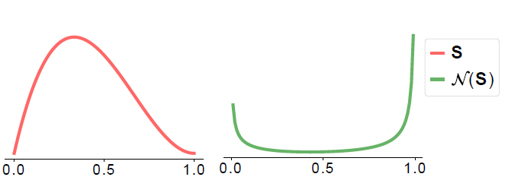
Probabilistic Logical Operators: Negation
We want regions of high density in output distribution to have low density in the input distribution.

Slide 12
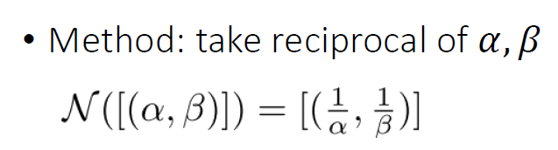
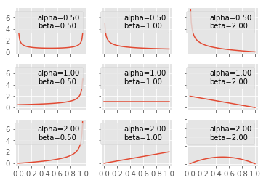

Probabilistic Logical Operators: Negation
Why not
$N\left(\left[\left(α, β\right)\right]\right)=\left[\left(β, α\right)\right]$?

Slide 13
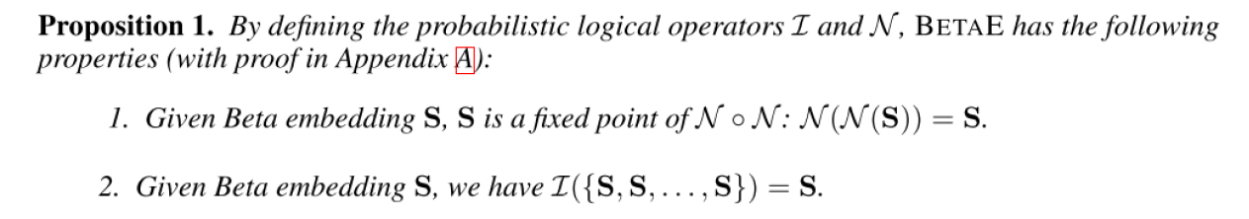
Probabilistic Logical Operators

Slide 14
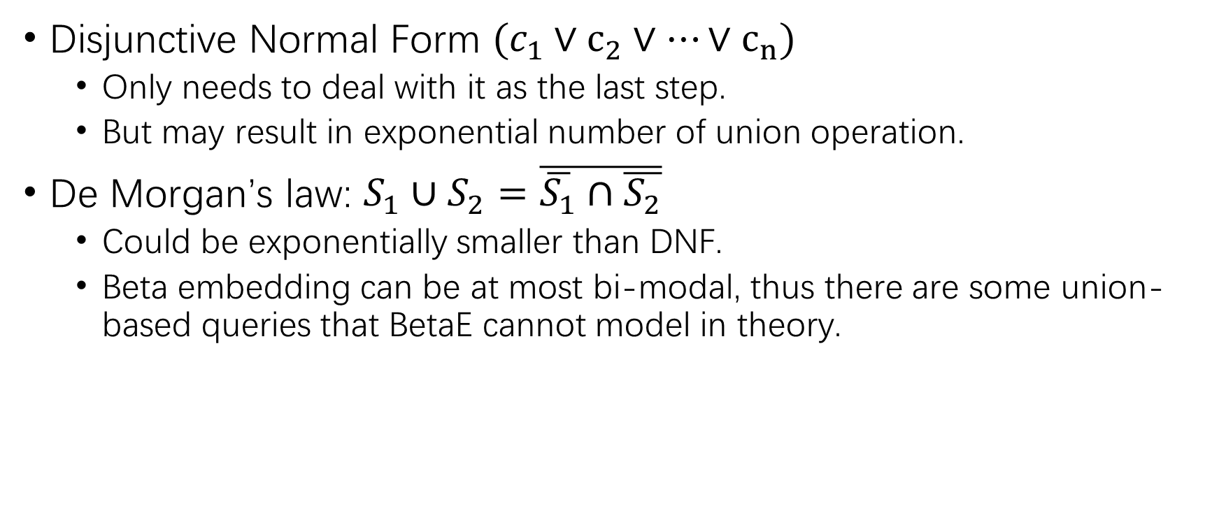
Probabilistic Logical Operators: Union
Disjunctive Normal Form $(c_{1}∨c_{2}∨…∨c_{n})$
Only needs to deal with it as the last step.
But may result in exponential number of union operation.
De Morgan’s law: $S_{1}∪S_{2}=\overline{\overline{S_{1}}∩\overline{S_{2}}}$
Could be exponentially smaller than DNF.
Beta embedding can be at most bi-modal, thus there are some union-based queries that BetaE cannot model in theory.

Slide 15
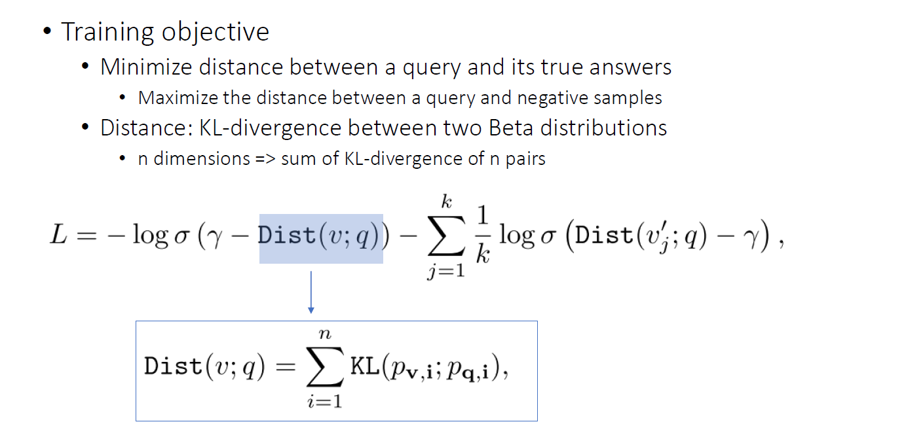
Learning Beta Embedding
This slide is credited to Shirly Chen’s presentation

Slide 16
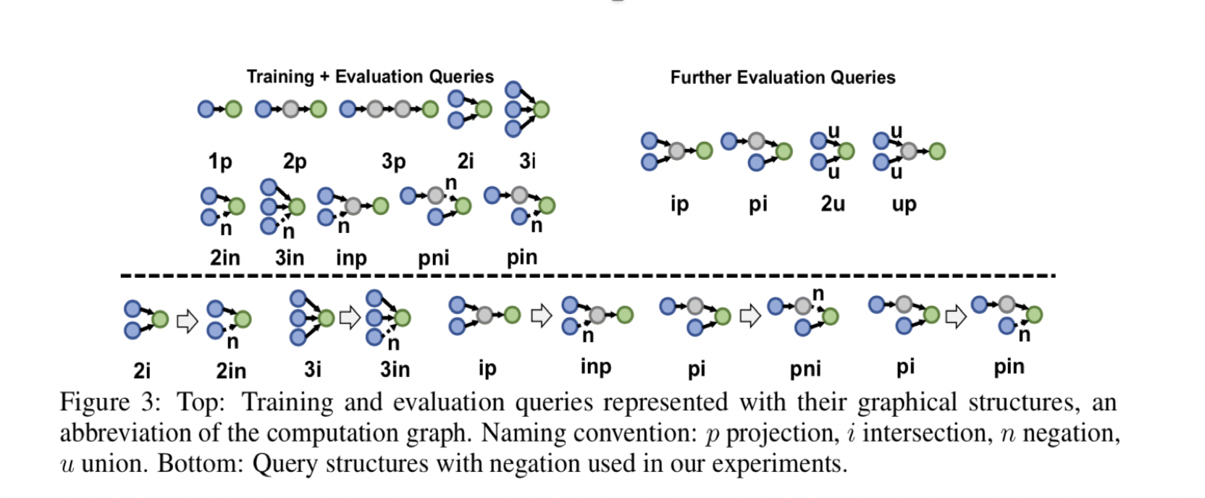
Experiments

Slide 17
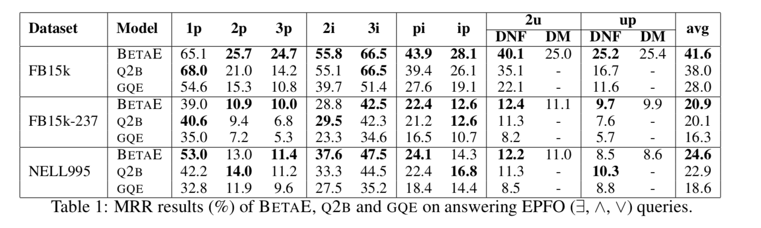
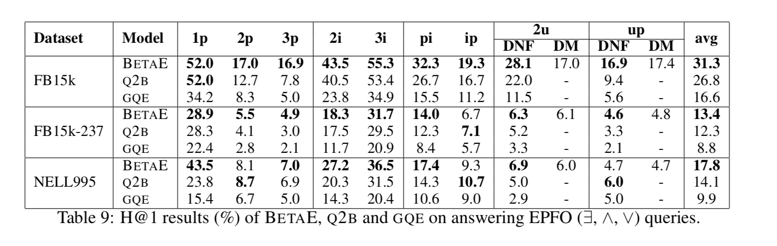
Experiments-EPFO

Slide 18
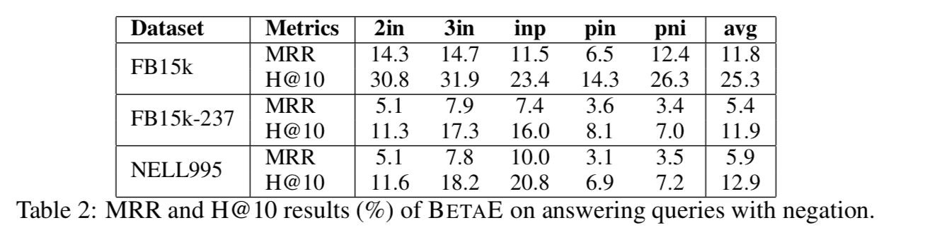
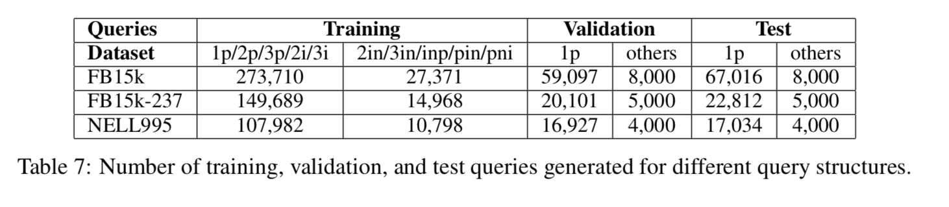
Experiments-Negation

Slide 19
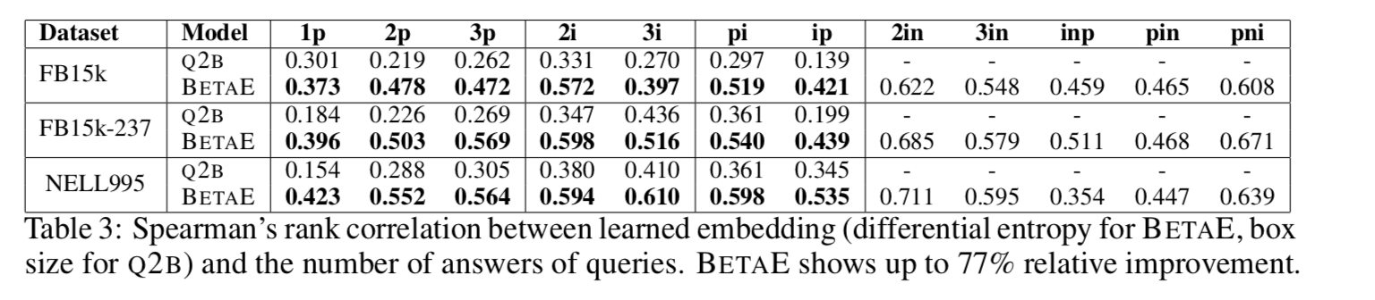
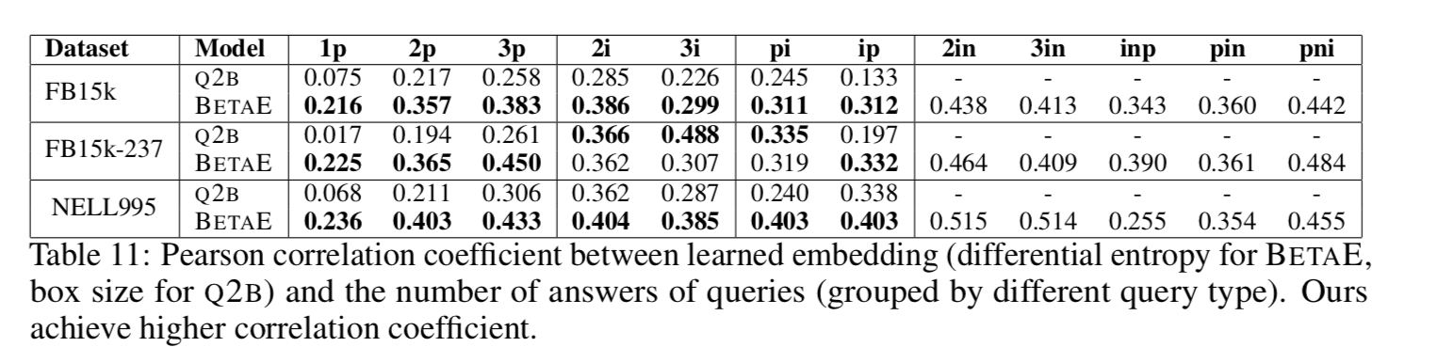
Experiments-Uncertainty Modeling

Slide 20
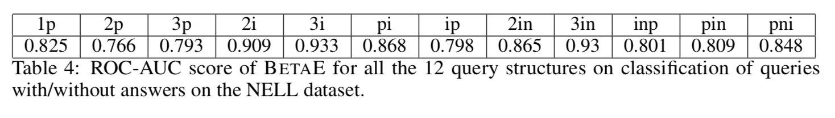
Experiments- Queries Without Answers

