Slide 1
Smart Selling: Data-Driven Strategy for Our Creative Stationery Line
Maximizing Revenue Based on 6-Week Pilot Results
Presenter: Xuan Suo
Date: 2025/11/3
Notes:
Good morning, team. Over the next 15 minutes, I'll share clear insights from our 6-week sales pilot that will help us sell smarter and maximize our results with the new creative stationery line.

Slide 2
Our Mission & Agenda
The Goal: Determine the most effective sales strategy using actual performance data
📊 The Data Foundation: Cleaning & validating our results
💡 Key Findings: What the numbers definitively show us
⚡ The Time Question: Balancing revenue with effort
🎯 Action Plan: Implementing what works
Notes:
We tested three sales methods across 15,000 customer interactions. Today, we'll look at what actually worked, discuss the time implications, and build a strategy that maximizes our results.

Slide 3
Building Trust in Our Data
15,000 customer interactions across 3 methods
✅ Standardized Categories ('email' vs 'Email')
✅ Handled Missing Data (7% missing revenue values corrected)
✅ Removed Errors (impossible tenure records)
✅ Zero Duplicates — 14,998 clean customer records analyzed
Notes:
Before drawing any conclusions, we ensured our data was reliable. We cleaned inconsistencies, handled missing information, and removed clear errors — so every insight today comes from accurate, trustworthy data.

Slide 4
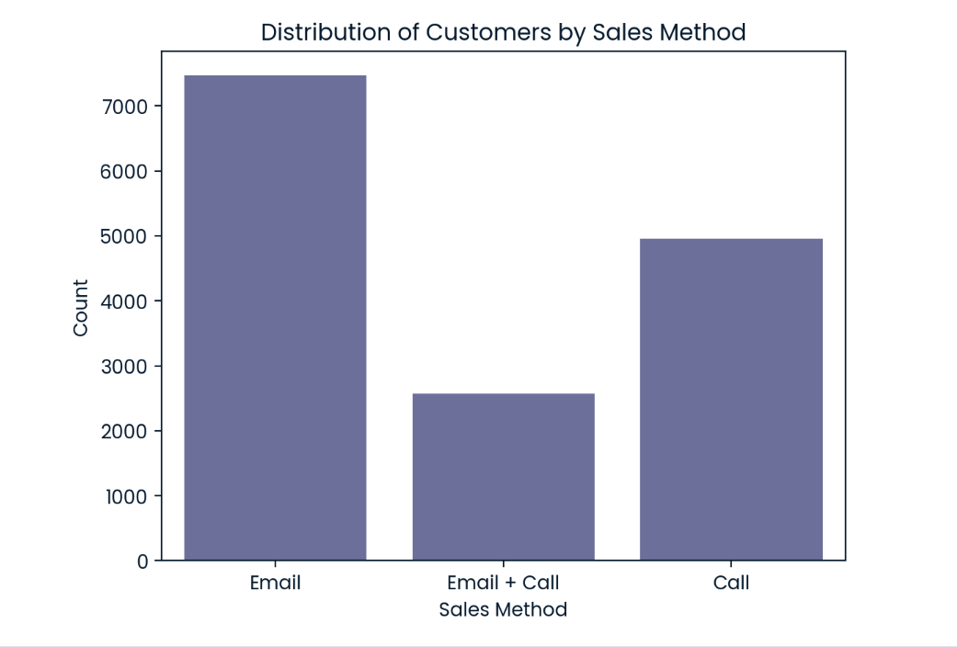
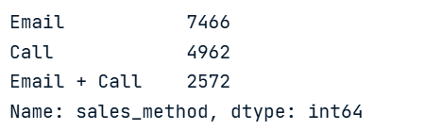
How We Measured Performance
Email: 7,466 customers
Call: 4,962 customers
Email + Call: 2,572 customers
Notes:
We tested three distinct approaches. As you can see, email was our most-used method. Now let’s see if that preference matched our actual results.

Slide 5
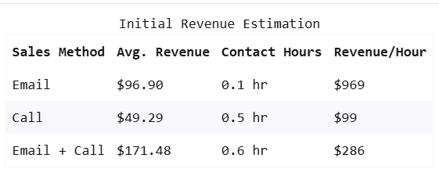
The Undeniable Revenue Champion
Email: $96.90
Call: $49.29
Email + Call: $171.48
→ 77% higher revenue per customer with Email + Call
Notes:
The data speaks for itself. When we combine email with a personal follow-up call, we generate dramatically higher revenue per customer — a 77% improvement over email alone.

Slide 6
The Effort vs. Results Gap
Email used 3× more often than Email+Call
Email+Call delivered 77% more revenue per customer
Notes:
Here’s our opportunity: we’re heavily focused on email, but underutilizing our most effective method. Even though we used email three times more often, the combined approach delivers significantly better results per customer.

Slide 7
The Time Question
Email = $96.90 per customer
Email+Call = $171.48 per customer
Time Estimates — Email: 0.1 hr | Call: 0.5 hr | Email+Call: 0.6 hr
Notes:
Does the 77% revenue increase justify the time investment? Based on your daily experience, are these estimates accurate — and is the combined approach worth it?

Slide 8
The Strategic Choice
Option A – Maximum Efficiency: Email for broad outreach
Option B – Maximum Revenue: Email+Call for qualified leads
The Smart Answer: Use both strategically and stop call-only outreach
Notes:
The data suggests we shouldn’t choose one method over the other, but use both strategically — email for efficiency, Email+Call for maximum value.

Slide 9
Our New Sales Playbook
🛑 Stop call-only outreach to cold leads
📧 Use Email for broad prospecting and qualification
📧📞 Use Email+Call for warm leads and high-value accounts
Track revenue per customer by method
Notes:
Here’s our action plan: stop what’s not working, use email for reach, and deploy the combined approach for conversion. We’ll track results continuously.

Slide 10
Expected Impact & Q&A
💰 Higher earnings from premium conversions
🎯 Clearer daily priorities
📈 Better results with same effort
🤝 Stronger customer relationships
Notes:
By implementing this approach, we expect to significantly increase our average deal size while maintaining efficiency. What questions can I answer about applying this to your accounts?

