Slide 1
CAN MODULE KNOWLEDGE
Thien Tran 29 Apr, 2022

Slide 2
CAN MODULE KNOWLEDGE
Time: 20 Mar 2022

Slide 3
1. Overview Controller Area Network (CAN)
CAN is real-time application serial data transmission system. It is a complex information system with a very high transmission rate and especially the ability to detect failures.

Slide 4
History of CAN
The development of the CAN network was started in 1983 by Robert Bosch GmbH Company. The protocol was then officially announced in 1986 at the Society of Automotive Engineers (SAE) congress in Detroit, Michigan, USA. The first CAN controller chips were manufactured by Intel in 1987, and later by Phillips. The Mercedes-Benz W140 is the first vehicle equipped with CAN.

Slide 5
CAN User Benefits
CAN is low cost
CAN bus has only 2 wires, making it easier to connect control modules together when compared to the traditional way. Accompanied by many benefits of ease of installation and ease of repair and maintenance when there is a problem.
CAN means real-time
Maximum data rate is 1 Mbits/s
Short message length ( <= 8 data bytes/message)
CAN is flexible
CAN allows Multi-Master Operation (every CAN node is able to access the bus individually)
CAN Nodes can easily be connected/disconnected
Number of nodes not limited
CAN is standardized
ISO-11898
ISO-11519-2

Slide 6
Basic Concepts
Message: Data is encapsulated and transmitted in the network under a common convention.
Information Routing: The data message transmitted from any node on the CAN bus does not contain the address of the transmitting node or of any expected receiving node. Instead, the content of the message is labeled with an identifier (ID) that is unique across the network. All other nodes on the network receive the message, and each node performs an acceptance check on the ID to determine if the message is relevant to that node. If the message is relevant, it will be processed; otherwise it is ignored.
Bitrate: The bitrate can be different in different system but must unify in a specific system. Bit rates up to 1 Mbit/s are possible at network lengths below 40 m.
Priorities: The CAN INDENTIFIER defines a static message priority during bus access.

Slide 7
Basic Concepts
Arbitration: if two or more nodes start transmitting message at the same time, the arbitration mechanism is applied to guarantee that one of these message can be sent successfully according the priority.
Connection: CAN nodes can easily be connected/disconnected, and not limited
Bus values: the bus has one of these values:
“dominant bit” is a logical 0
“recessive bit” is a logical 1

Slide 8
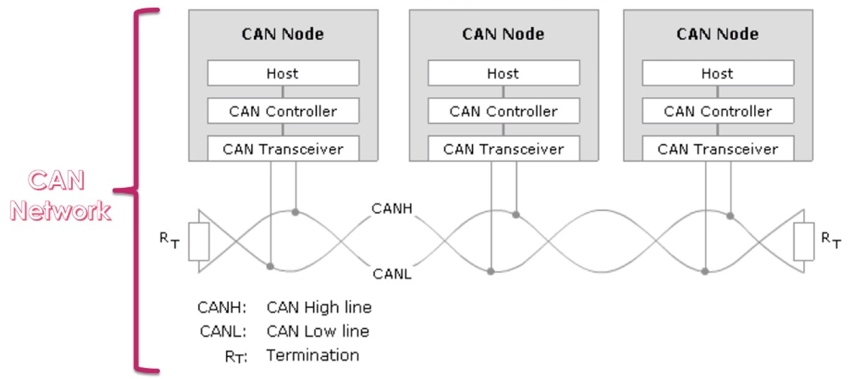
CAN Electrical Characteristics

Slide 9
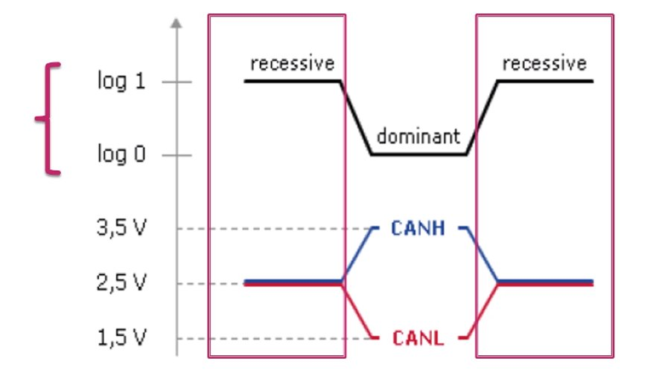
CAN Electrical Characteristics

Slide 10
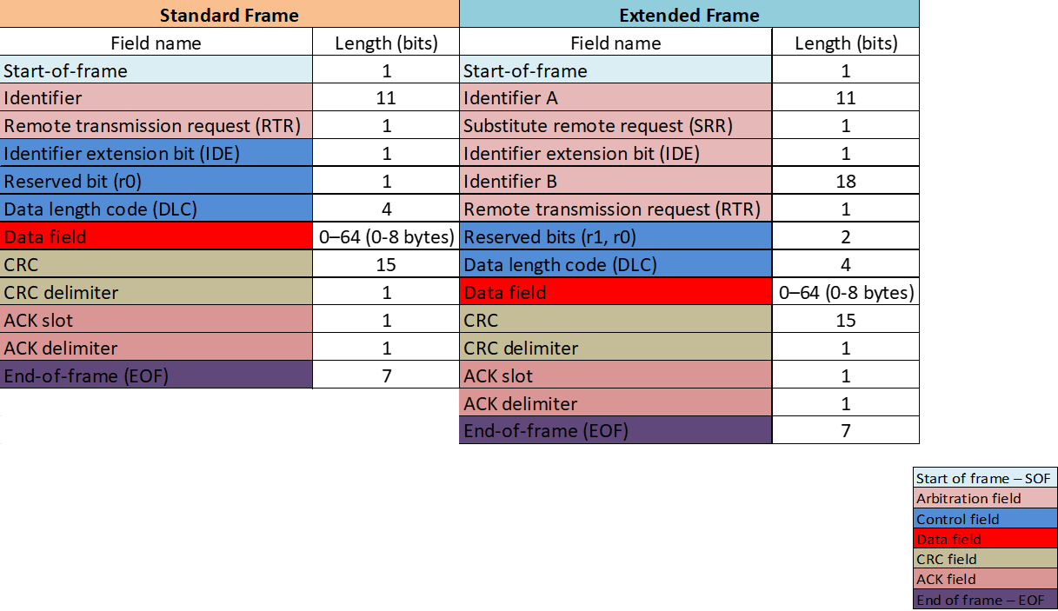
Data-Frame

Slide 11
Data-Frame
Start of frame – SOF
It is a dominate bit, denotes the start of frame transmission.
A CAN node can only transmit when bus is idle state
Arbitration field
IDENTIFIER : The (unique) identifier also represents the priority of the message
RTR : Must be dominant (0) for data frames and recessive (1) for remote request frames (see Remote Frames, below)
SRR : Must be recessive, substitute remote request.
IDE (only Extended Frame): IDE = 0 specifies the standard frame, IDE = 1 specifies the extended frame

Slide 12
Data-Frame
Control field
IDE (only standard frame) : IDE = 0 specifies the standard frame, IDE = 1 specifies the extended frame
Reserved bit r0,r 1 : Must be dominant (0), but accepted as dominant or recessive.
DLC: Specify the length of the data to be transmitted.
Data filed : data to be transmitted (length dictated by DLC field)
CRC field
CRC : a cyclic redundancy check. Receiver will calculate CRC from message, if calculated CRC is different from received CRC, it means error occurred
CRC Delimiter : Must be recessive (1) , separate the CRC field with ACK

Slide 13
Data-Frame
ACK field
ACK slot: Transmitter sends recessive (1) and any receiver can assert a dominant (0)
ACK delimiter : Must be recessive (1) .
EOF : Denotes the end of frame transmission.

Slide 14
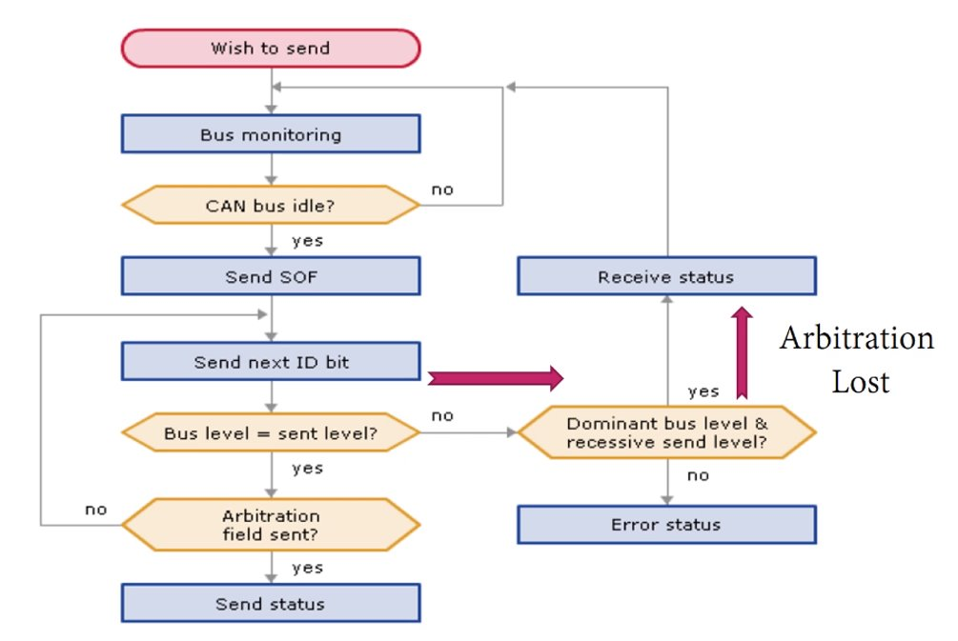
Arbitration mechanism

Slide 15
2. CAN FD – CAN with Flexible Data Rate (V4H)
Because of the bandwidth requirements of the automotive industry, the CAN data link layer protocol needed to be improved. In 2011, Bosch started the CAN FD (flexible data-rate) development in close cooperation with carmakers and other CAN experts. The improved protocol overcomes to CAN limits: You can transmit data faster than with 1 Mbit/s and the payload (data field) is now up to 64 byte long and not limited to 8 byte anymore. In general, the idea is simple: When just one node is transmitting, the bit-rate can be increased, because no nodes need to be synchronized. Of course, before the transmission of the ACK slot bit, the nodes need to be re-synchronized.

Slide 16
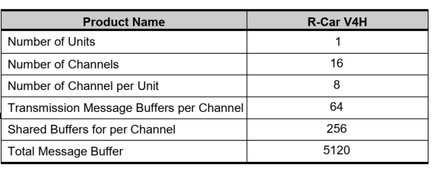
Features of CAN FD
Number of Units and Channedls

Slide 17
Interface Modes
The RS-CANFD has two interface modes.
Classical CAN mode: Handles only classical CAN frames.
CANFD mode: Handles classical CAN frames and CANFD frames.
Interface modes can be switched using the RCMC bit in the RSCFDnCFDGRMCFG register .

Slide 18
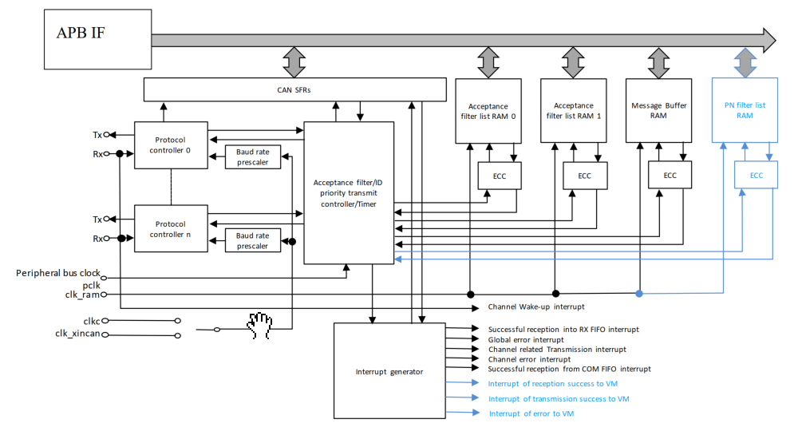
Block Diagram

Slide 19
Block Diagram
Tx/Rx:
Input/Output pins of the CAN module
Protocol controller:
Handles CAN protocol processing such as bus arbitration, bit timing at transmission and reception,
Stuffing, error handling, etc.
Acceptance filter list RAM:
This RAM is used to store the message acceptance filtering entries for all channels. Each acceptance
filter entry has an individual ID, data length code, data field, message pointer for upper layer
application usage and message direction pointer. The AFLRAM is divided in two parts to accelerate the
AFL access process.

Slide 20
Block Diagram
Acceptance filter:
Performs filtering of received messages. The entries in the Acceptance filter list RAM are used for the
filtering process.
Interrupt generator:
Generates several types of global and channel interrupts

Slide 21
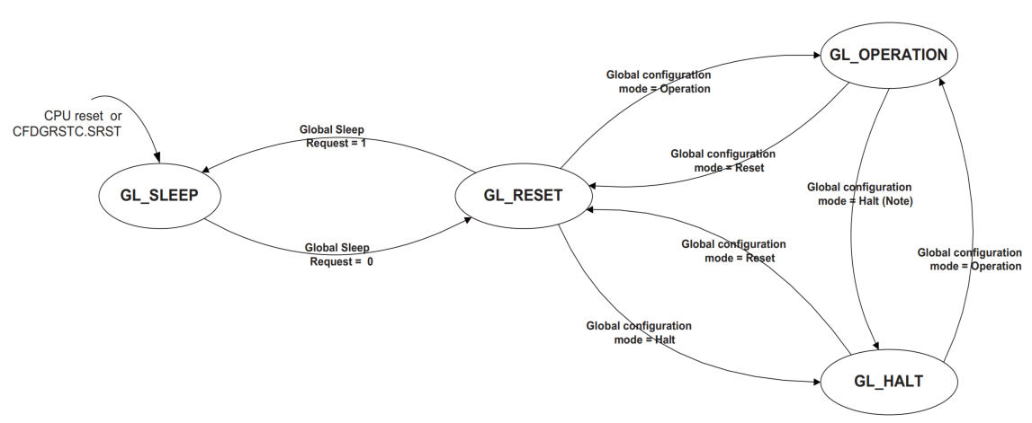
Modes of operation
Global Modes

Slide 22
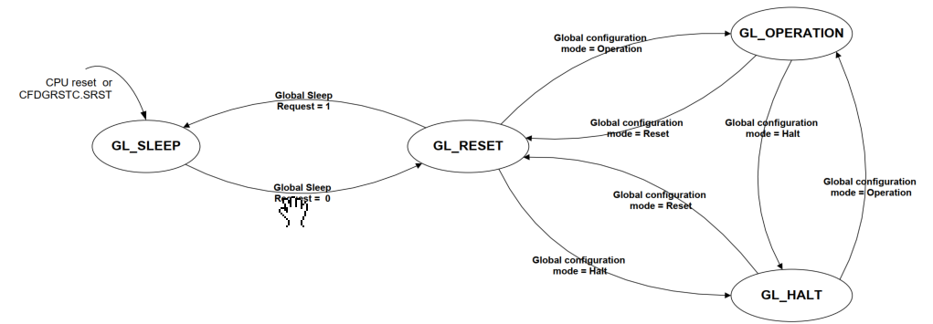
Modes of operation
Global Modes

Slide 23
Initialisation
Before joining CAN communications the following shall be configured:
Clock setting
Bit timing setting (nominal and data rate)
Baud Rate setting (nominal and data rate)
CANFD setting
Acceptance Filter setting (configuration of Global Acceptance Filter List)
Reception-, Transmission- and GW-FIFO setting
CAN Operation Mode setting

Slide 24
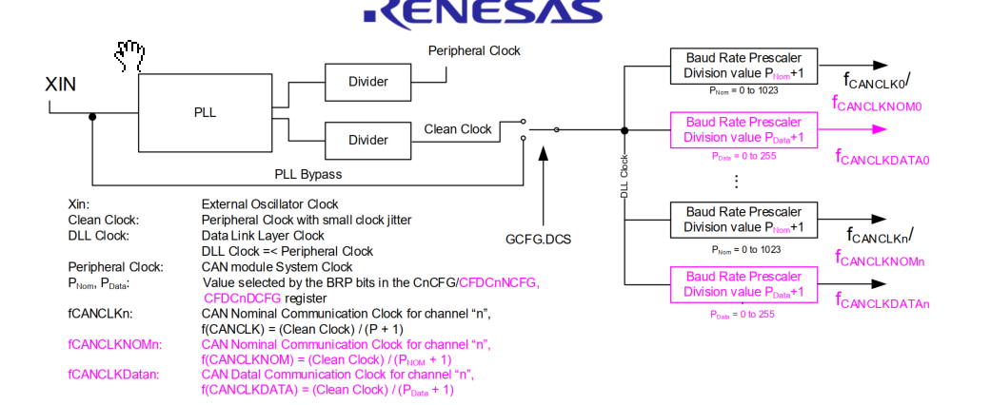
Initialisation -> Clock setting
Clock :

Slide 25
Initialisation -> Clock setting
Time Quanta : It is the basic unit of the bit time and its formula:
Tq = Baud Rate Prescaler/ DLLClock
Baud Rate Prescaler divide-by-N value = P + 1 : value selected by the BRP bits in the Channel Configuration Registers.

Slide 26
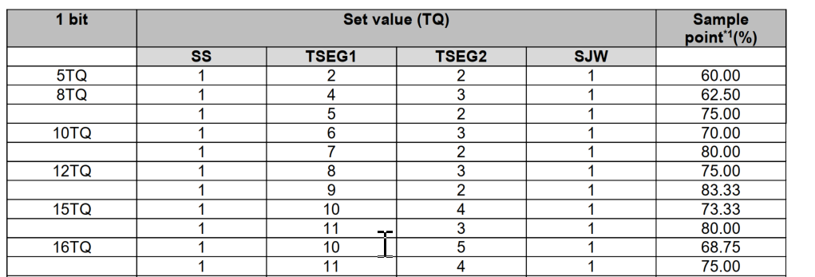
Initialisation -> Clock setting
Bit Timing :

Slide 27
Initialisation -> Clock setting
1. SS: Synchronization Segment This segment is used to synchronize bits by monitoring a recessive-to-dominant edge during the Interframe Space (comprised of Intermission, Suspend Transmission, and Bus Idle; during Bus Idle, all nodes can start transmission) 2. TSEG1: Time Segment 1 This segment absorbs physical delays on the CAN network. A physical delay on the network is two times the total sum of a bus delay, input comparator delay, and output driver delay. It can be lengthened by SJW. 3. TSEG2: Time Segment 2 This segment is used to correct a phase error by performing resynchronization. It can be shortened by SJW (While sending or receiving a message, communication frames between some nodes may get out of sync due to a drift in the oscillator frequency or a delay in the transmission path. This is referred to as a phase error). 4. SJW: Resynchronization Jump Width This is the maximum width by which bits that have become out of sync due to a phase error may be corrected.

Slide 28
Initialisation -> Clock setting
BaudRate :
Baudrate = 1 / (number_of time_quanta_per_bit * Tq)
SS = Fixed to 1 TQ TSEG1 = Refer to (CFDCnNCFG) and (CFDCnDCFG) TSEG2 = Refer to (CFDCnNCFG) and (CFDCnDCFG) SJW = Refer to (CFDCnNCFG) and (CFDCnDCFG)

Slide 29
Initialisation -> AFL setting
The RS-CAN-FD module can handle message acceptance filtering for all channels with a global Acceptance Filter List (called AFL) .
The 8-channel RS-CAN-FD module allows a maximum of 1536 AFL entries across all channels with a maximum of 384 AFL entries per single channel.
Application SW can enter one full entry into the AFL via following registers: Global AFL ID Entry Register:Part 1 of the AFL entry Global AFL Mask Entry Register:Part 2 of the AFL entry Global AFL Pointer 0 Entry Register:Part 3 of the AFL entry Global AFL Pointer 1 Entry Register:Part 4 of the AFL entry

Slide 30
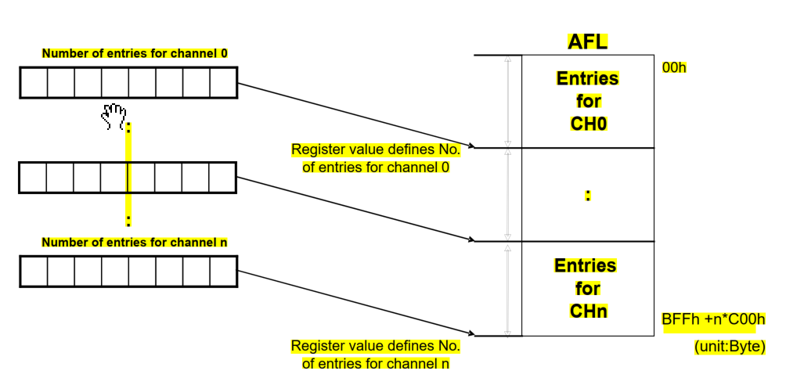
Initialisation -> AFL setting
Allocation of AFL entries to each CAN channel
The number of AFL entries per channel can be configured using the dedicated field in the related Global Acceptance Filter Configuration Registers

Slide 31
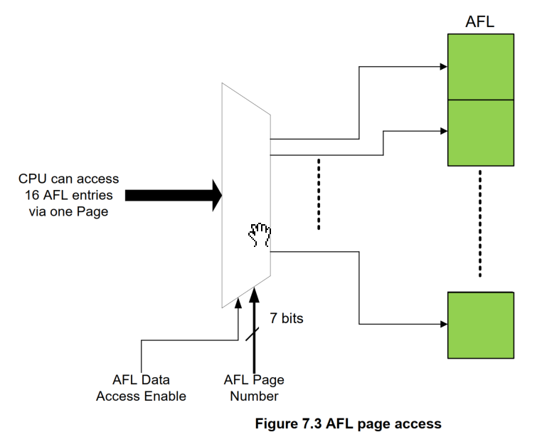
Initialisation -> AFL setting
96 of these pages exist to allow access to the whole AFL range

Slide 32
Initialisation -> AFL setting
AFL entry description Identifier (11 bits for Standard Frame Format, 29 bits for Extended Frame Format): Acceptance filter unit will check Identifier field of received message against Identifier field of each AFL entry (full 29 bit masking of Identifier bits possible, see below). IDE bit: Acceptance filter unit will check IDE bit of received message against this bit and selects the relevant part of the Identifier field for acceptance filtering (masking of IDE bit possible, see below). RTR bit: Acceptance filter unit will only accept Data Frames (RTR = 0) or Remote Frames (RTR = 1) according to the setting of this bit (masking of RTR bit possible, see below).

Slide 33
Initialisation -> AFL setting
AFL entry description Loopback Configuration bit: This bit can enable/disable the AFL entry depending on the Loopback Configuration or Mirror Mode condition. Mask for Identifier bits (29 bits): Each bit in the Identifier Mask can mask the corresponding Identifier bit in the AFL entry during acceptance filtering (Figure 7.2). Mask for IDE bit: If this Mask bit masks the IDE bit of the AFL entry both Standard Identifier and Extended Identifier format messages can be accepted by this AFL entry. The identifier of the received message is compared against the Standard Identifier part of the AFL entry for Standard Identifier format messages and against the Extended Identifier part of the AFL entry for Extended Identifier format messages.

Slide 34
Initialisation -> AFL setting
AFL entry description Mask for RTR bit: If this Mask bit masks the RTR bit of the AFL entry both frame formats ‘Data Frame’ and ‘Remote Frame’ will be accepted by this AFL entry. Pointer information (16 bits): This 16 bit pointer will be attached to a received message accepted by the related AFL entry. The Pointer will be added during message storage in the Message Buffer area and can be used by application as support function. The pointer information could be used for example to support PDU Identifier allocation for the received message in AUTOSAR systems. Information Label (2 bits): This 2bit label will be attached to a received message accepted by the related AFL entry. The label will be added during message storage in the Message Buffer area and can be used by application as support function. DLC value for automatic DLC filtering: If the DLC value of the received message is equal or higher than the configured DLC value the DLC check is passed.

Slide 35
Normal MB and FIFO Buffers Congfiguration
Normal RX Message Buffer configuration :
There are 16 buffers per channel.
In RS-CAN-FD module, the number of normal RX Message Buffers can be configured by writing to the RX Message Buffer Number Register .
The data field size of the RX Message Buffer can be configured via the CFDRMNB.RMPLS.
In case the receiving frame exceeds the data field size then the acceptance depends on the configuration of the CFDGCFG.CMPOC (message rejecting or data payload cut).

Slide 36
Normal MB and FIFO Buffers Congfiguration
FIFO buffers configuration :
Number of reception-only FIFO Buffers is fixed to 8 .
3 common FIFO Buffers per channel can be configured for storing messages for transmission or reception or gateway function .
These FIFO Buffers can be enabled or disabled and the size, Interrupt structure and Message Lost mechanism and Message overwrite mechanism of the FIFO Buffers
In case the receiving frame exceeds the data field size then the acceptance depends on the configuration of the CFDGCFG.CMPOC (message rejecting or data payload cut)

Slide 37
Normal MB and FIFO Buffers Congfiguration
FIFO Mode Configuration of Common FIFO Buffers:
The mode of the common FIFO Buffers can be configured by writing to the CFDCFCCd.CFM[1:0] bits in the Common FIFO Configuration / Control Registers.
Messages can only be read from the common FIFO Buffers configured in GW mode. However, the CPU read access has no impact on the read or write pointers. The pointers can only be incremented when a new message is stored in the FIFO Buffer and decremented when a message is transmitted on the corresponding CAN channel by the RS-CAN-FD module.

Slide 38
Normal MB and FIFO Buffers Congfiguration
FIFO TX-Message Buffer Link configuration:
When the common FIFO is configured as TX or GW FIFO, then the FIFO Buffer must be linked to a normal TX Message Buffer to participate in the transmission scan of a CAN channel.
Users should not write data into a TX Message Buffer that is linked to a Common FIFO buffer.
The TX Message Buffer link of each common FIFO Buffer can be configured by writing to the CFDCFCCd.CFTML[4:0] bits in the Common FIFO Configuration / Control Registers

Slide 39
Reception
Message storage in RX Message
When a message is successfully received and stored in a RX Message Buffer, the corresponding Newdata Flag is set in the RX Message Buffer Newdata Register.
If a new message is stored into a RX Message Buffer before the previous message in this Message Buffer can be read, then the original message is overwritten.
The RX Message Buffer Data Field p registers store the Data Bytes of the received message
Address for RX Message Buffer Data Field p registers = 200Ch + p*0004h + b*0080h + n*800h
n : channel
b : Message Buffer Component Index.
p : data byte to read.

Slide 40
Reception
Message storage in FIFO Buffers
The CFDGAFLP1r.GAFLFDP[31:0] field in the matching AFL entry selects the FIFO Buffers to which the related reception message will be stored.
When the received message is stored in one or more RX FIFO Buffers or Common FIFO Buffers configured in RX Mode or GW Mode, then the Message counter value is incremented in the corresponding RX FIFO Status Registers or Common FIFO Status Registers.
When the value 8’hFF is written to the corresponding FIFO Pointer Control Register, then the Message Count is decremented by 1.
The RX FIFO Access Data Field Registers store the Data Bytes of the received message . Address for RX FIFO Access Data Field Registers = 600Ch + p*0004h + b*0080h.
p : data byte to read.
b : Message Buffer Component Index.

Slide 41
Transmission
A fixed number of transmission Message Buffers (64 TX Message Buffers) are dedicated for each channel.
TX Queue: Up to 32 transmission Message Buffers for one channel can be grouped to form a TX Queue with a common access window.
Common FIFO (TX/GW mode): each Common FIFO in TX or GW mode is linked to a dedicated channel
a Common FIFO configured in TX or GW mode, can be freely linked (assigned) between 32 and 63 transmission Message Buffers (only one FIFO to one transmission Message Buffer). The Common FIFO Buffer then replaces the transmission Message Buffer linked to it.
Common FIFO buffers should not be linked to TX Message Buffers that are already part of a TX Queue.

Slide 42
Transmission
Transmission Priority
If two or more transmission Message Buffers of a channel are configured for transmission, then the transmission priority in the RS-CAN-FD module can be selected from the following two modes: CAN ID priority and Message Buffer number priority.
Message Buffer number priority should not be used if TX Queue is enabled.
All TX Message Buffers can enter the ID priority comparison for Message Buffers configured for transmission. This also includes the TX Message Buffers linked to the Common FIFO Buffers configured in TX mode or GW mode and includes the TX Queue Message Buffers.
For Common FIFO Buffers configured in TX mode or GW mode, only the message currently being pointed to by the FIFO Read Pointer can be included in the transmission arbitration.

Slide 43
Transmission
Normal Transmission
If the Message Buffer is placed in regular transmission mode, the data frame or remote frame set in that Message Buffer can be transmitted. Completion of regular transmission can be checked through the related TX Message Buffer Transmission Result Flag bits (CFDTMSTSj.TMTRF) in the TX Message Buffer Status Registers. When arbitration is lost or an error occurs, message transmission will be attempted further if no transmission abort request is set for this transmission Message Buffer. New internal transmission arbitration for this channel will be performed considering all Message Buffers with transmission request.
One Shot Transmission Mode: When the CFDTMCi.TMOM bit of the TX Message Buffer Control Registers is set for a transmission Message Buffer, then the Message Buffer is placed in one-shot transmission mode and attempts to transmit a message only once.
Set TX Message Buffer Transmission Request then the RS-CAN-FD module logic will try to transmit the message stored in the corresponding Message Buffer.

Slide 44
Transmission
TX FIFO Transmission
When the value 8’hFF is written into the corresponding FIFO Pointer Control Register, then the Message
Count of the related FIFO is incremented by 1.
When a message is successfully transmitted from the TX FIFO, the Message Count value is decremented by 1.
The Common FIFO buffer is considered as disabled after clearing the CFDCFCCd.CFE bit only when the Empty flag is set for the corresponding Common FIFO Buffer.

Slide 45
Transmission
GW FIFO Transmission
When a message is successfully received and stored in a GW FIFO Buffer, then the FIFO Message Count in
the corresponding FIFO Status Register is incremented by 1.
The oldest message in the GW FIFO is included in the scan for transmission by the corresponding RS-CANFD module channel logic.
When a message is successfully transmitted from the GW FIFO, the Message Count value is decremented by 1.

Slide 46
Transmission
Queue Transmission
Each enabled TX Queue for a specific channel consists of 3 to 32 TX Message Buffers, which are accessed via one access window.
As access window TX Message Buffer No.63 (TXQ3) or TXMessage Buffer No.32 (TXQ2) or TX Message Buffer No.31 (TXQ1) or TX Message Buffer No.0 (TXQ0) is used, refer to related access registers TX Message Buffer ID Registers (TMID[m]), TX Message Buffer Pointer Registers (TMPTR[m]), TX Message Buffer Data Field 0 Registers and TX Message Buffer Data Field 1 Registers (TMDF[0:1][m]).
When CFDGAFLP0r.GAFLSRD i (i=0to2) is set and the CFDTXQCCin.TXQGWE (i=0to2, n=0to7) is also set, a receiving frame is stored in the target TXQ as send data by routing.
When CFDTXQCCn.TXQOWE bit is 1’b1, the TX queue is in TX queue overwrite mode. If the message of the same ID is stored in TX Queue when a frame is received and it is stored in TX Queue, an old message will be overwritten by a new message.

Slide 47
Thank You For Your Attendance

