Slide 1
MATLAB R-CarS4 CPU
Mar 2023
Notes:
Created by Hai Phan on Sep 5th 2018. This slide is used to help understand fundamental features and properties of Git ( a distributed version control system).

Slide 2
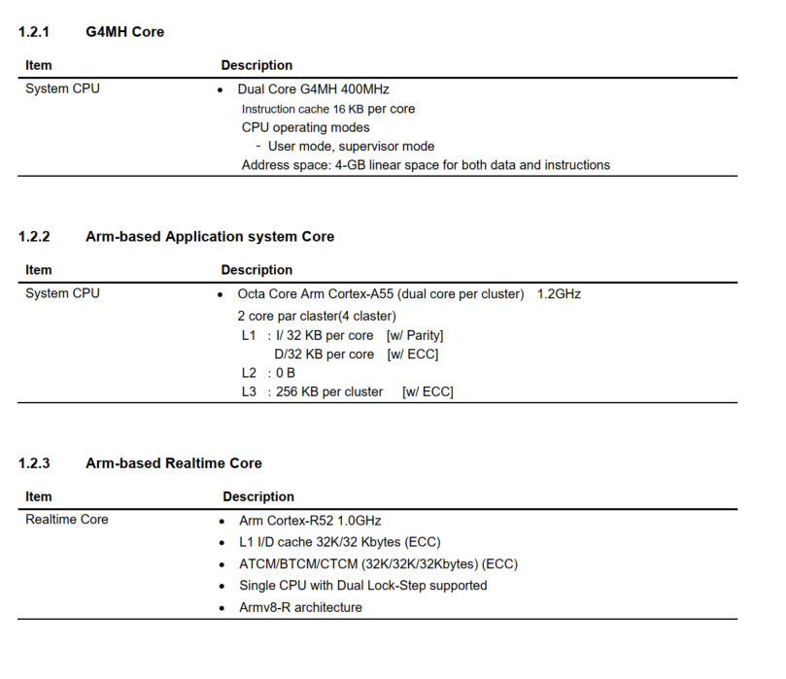
R-CarS4 CPU

Slide 3
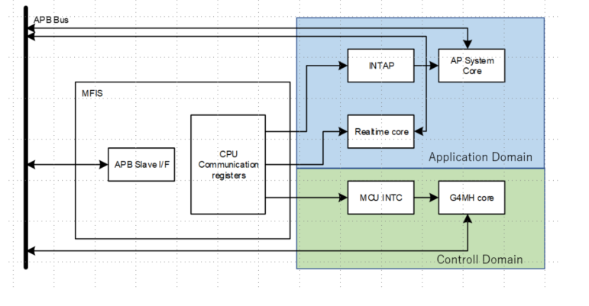
The G4MH core is included as the main CPU. It ensures that the executed instructions on the CPU are executed in the correct order and in the correct time cycle. It also manages resources, including memory and system bandwidth, to ensure that other CPUs operate efficiently. The CPUs also include a checker core for safety assurance (ICUMHB, Local RAM, Cluster RAM, P-Bus and H-Bus and I-Bus, Code-SRAM, INTC1, INTC2, DMA)
Overview

Slide 4
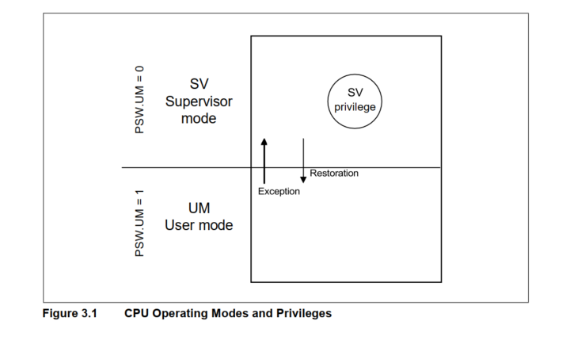
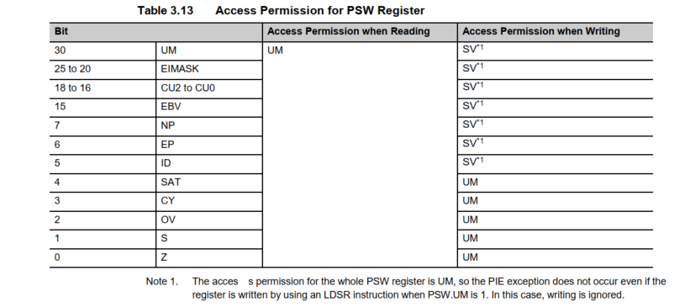
(a) Supervisor Mode (SV): All hardware functions can be managed or used in this mode. The system always starts up in supervisor mode after a reset. (b) User Mode (UM): This operating mode makes up a pair with the supervisor mode. In user mode, address spaces to which access is permitted by the supervisor and the system registers defined as user resources can be used. Supervisor-privileged instructions cannot be executed and result in exceptions.
CPU Operating Modes

Slide 5
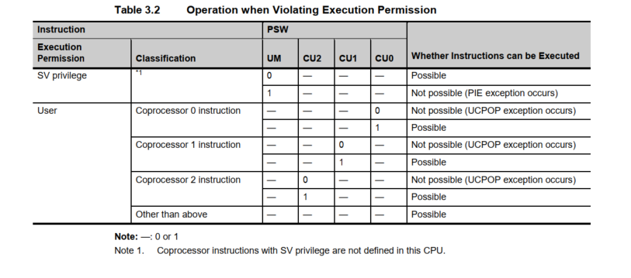
(c) SV privilege: Privilege necessary for important system resources operation, fatal error processing, and user-mode program execution management
CPU Operating Modes

Slide 6
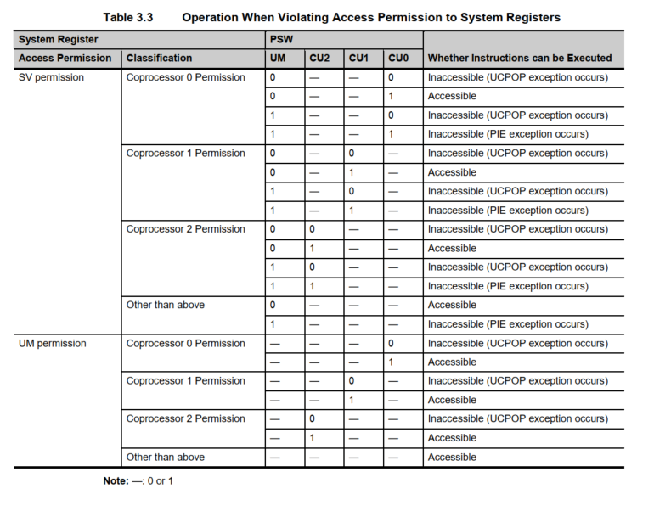
CPU Operating Modes

Slide 7
Exceptions 1.Types of Exceptions The exceptions of this CPU are divided into the following three types according to the purpose of the exceptions: • Terminating exception • Resumable exception • Pending exception 2. Exception Level • EI level exception • FE level exception Note: EI level exceptions are used for processing such as regular user processing, interrupt servicing, and OS processing. FE level exceptions are used to enable interrupts with a high degree of urgency for the system or exceptions from the memory management function that might occur during OS processing to be acknowledged even while an EI level exception is being processed.
CPU Operating Modes

Slide 8
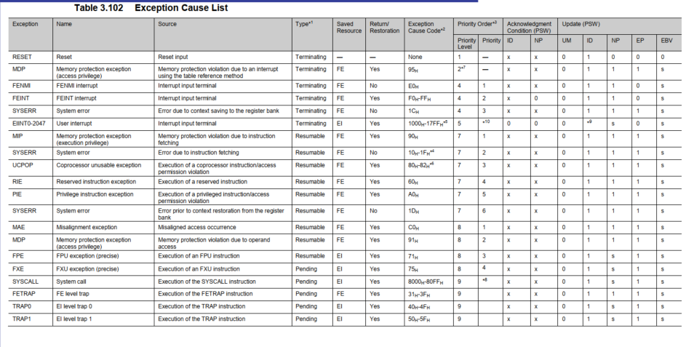
Exceptions
CPU Operating Modes

Slide 9
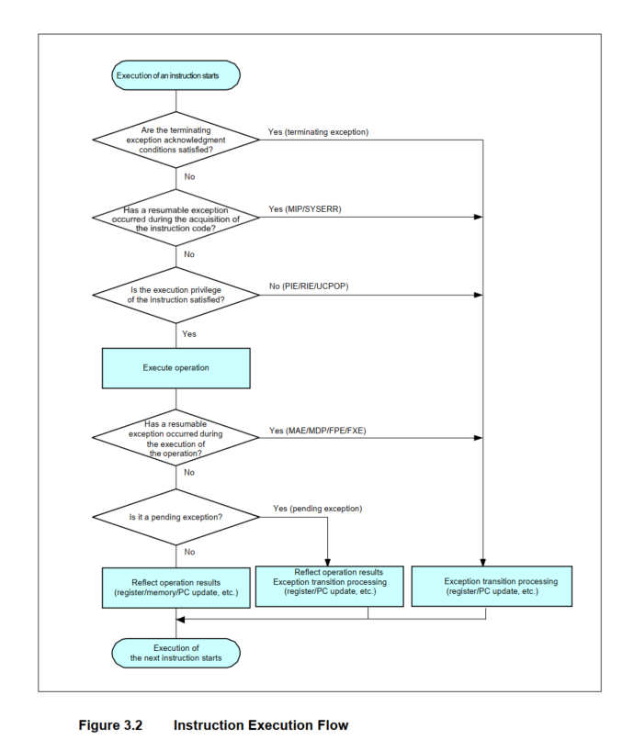
Instruction Execution The instruction execution flow of this CPU is shown below.
CPU Operating Modes

Slide 10
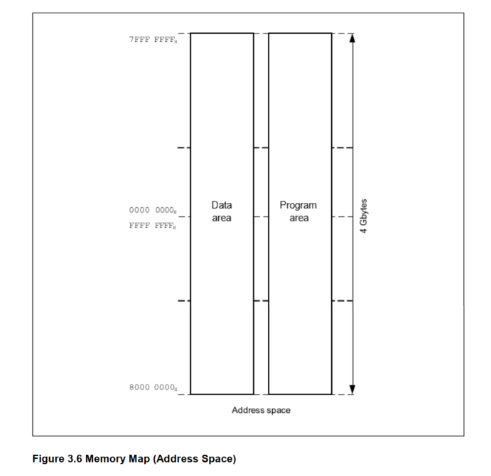
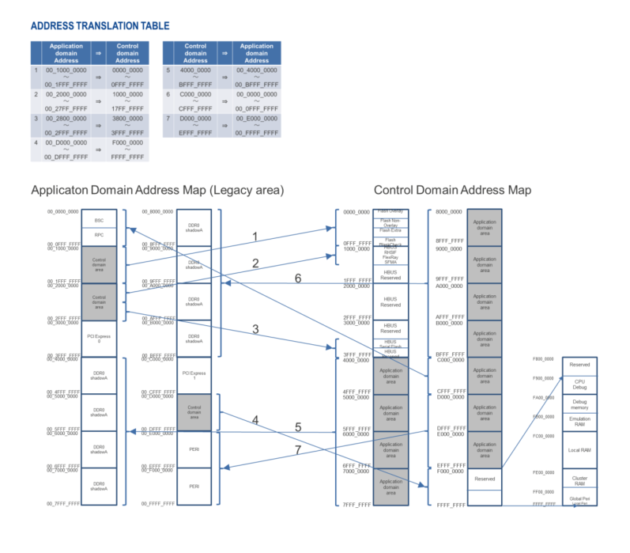
This CPU is 32-bit architecture and supports a linear address space of up to 4 Gbytes. The whole range of this 4-Gbyte address space can be addressed by instruction addressing (instruction fetch access) and data addressing (data access)
Address Space

Slide 11
Instruction Addressing The instruction address is determined based on the contents of the program counter (PC), and is automatically incremented according to the number of bytes in the executed instruction. When a branch instruction is executed, the addressing shown below is used to set the branch destination address to the PC. a. Relative addressing (PC Relative) - Relative addressing is a type of addressing mode used in CPUs. In relative addressing, the address of an operand is calculated as an offset from the current value of the program counter. The offset value is usually specified in the instruction itself. When a CPU executes an instruction using relative addressing, it adds the offset value specified in the instruction to the current value of the program counter to calculate the address of the operand. This allows the CPU to access data that is located at a fixed distance from the current instruction. - The JARL, JR, and Bcond instructions are used with this type of addressing.
Address Space

Slide 12
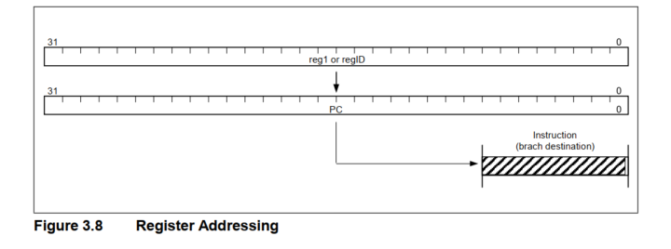
Instruction Addressing b. Register Addressing (Register Indirect) - The memory address of an operand is stored in a register, and the CPU accesses the operand by using the register's value as the memory address. - The JMP, CTRET, EIRET, FERET, and DISPOSE instructions are used with this type of addressing
Address Space

Slide 13
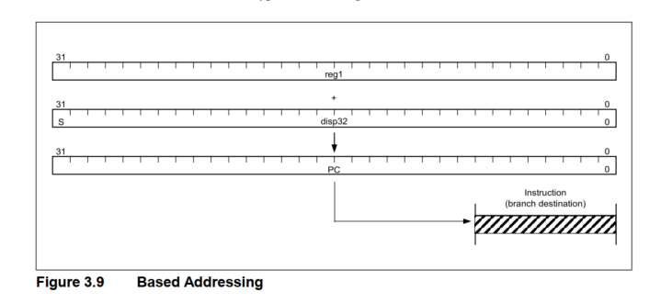
Instruction Addressing c. Based Addressing (Register Indirect) - Uses a pointer register to store the fixed address of the beginning of a data segment or program, called the base address. When the CPU needs to access a data element or instruction, it calculates the relative address of that element by adding the element's offset to the base address. - The JMP instruction is used with this type of addressing.
Address Space

Slide 14
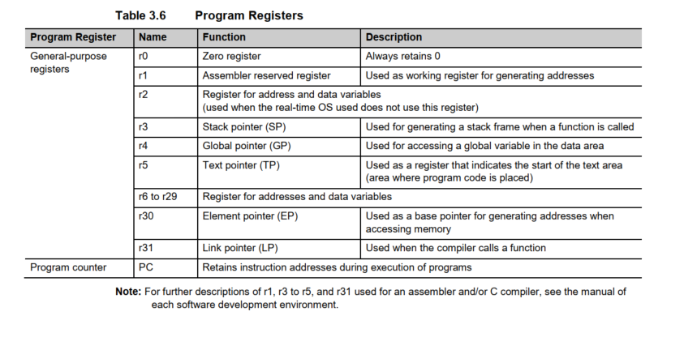
Program Registers Program registers includes general-purpose registers (r0 to r31) and the program counter (PC). r0 always retains 0. The values of the general-purpose registers r1 to r31 after a reset are undefined. The value of the PC after a reset is the value of RBASE register.
Registers

Slide 15
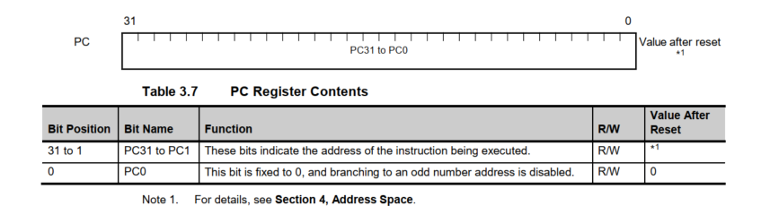
Program Registers Program Counter (PC) retains the address of the instruction being executed.
Registers

Slide 16
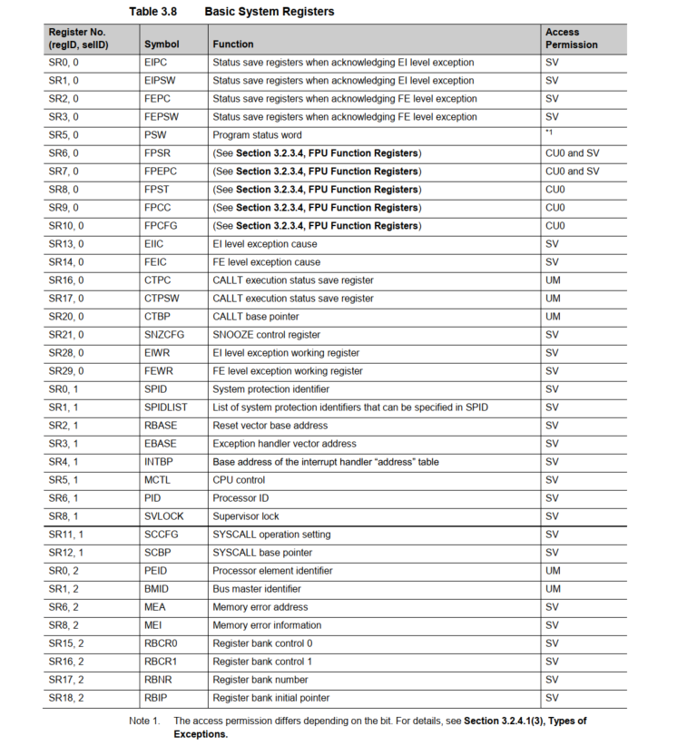
Basic System Registers The basic system registers are used to control CPU status and to retain exception information. The basic system registers are read from or written to by using the LDSR and STSR instructions and specifying the system register number, which is made up of a register number and selection ID.
Registers

Slide 17
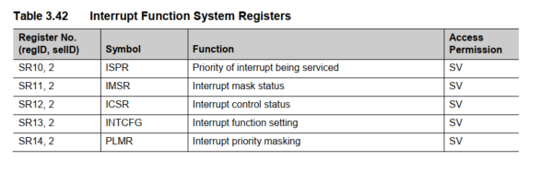
Interrupt Function Registers Interrupt function system registers used to manage interrupt requests from various sources and are read from or written to by using the LDSR and STSR instructions and specifying the system register number, which is made up of a register number and selection ID.
Registers

Slide 18
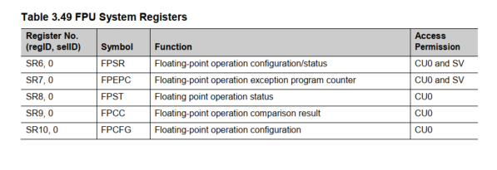
FPU Function Registers FPU Function Registers are a set of registers used by the FPU to perform floating-point arithmetic operations in the CPU. These registers are used to store floating-point values, constants, computation results, and FPU status. The FPU can use the following system registers to control floating-point operations. Floating-point function system registers are read from or written to by using the LDSR and STSR instructions and specifying the system register number, which is made up of a register number and selection ID .
Registers

Slide 19
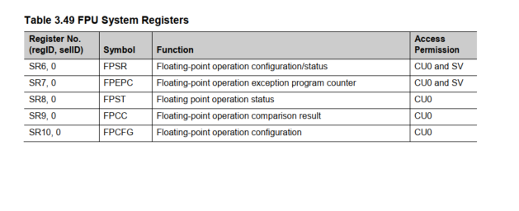
FXU Function Registers The FXU Function Registers are responsible for performing arithmetic operations that do not involve floating-point numbers. Its can use the following system registers to control arithmetic operations. Extended floating point function system registers are read from or written to by using the LDSR and STSR instructions and specifying the system register number, which is made up of a register number and selection ID.
Registers

Slide 20
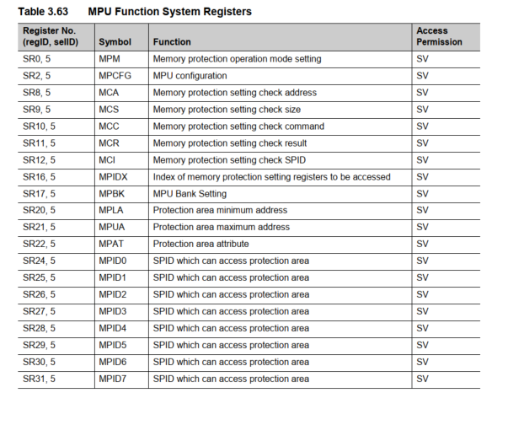
MPU Function Registers The MPU Function Registers provides memory protection by dividing the memory into regions and assigning access permissions to those regions. By configuring these registers, the MPU can be set up to protect specific memory regions from unauthorized access or modification, improving the security and reliability of embedded systems.
Registers

Slide 21
THANK YOU!

