Slide 1
MATLAB R-CarS4 R52
Mar 2023
Notes:
Created by Hai Phan on Sep 5th 2018. This slide is used to help understand fundamental features and properties of Git ( a distributed version control system).

Slide 2
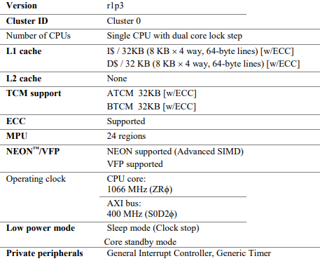
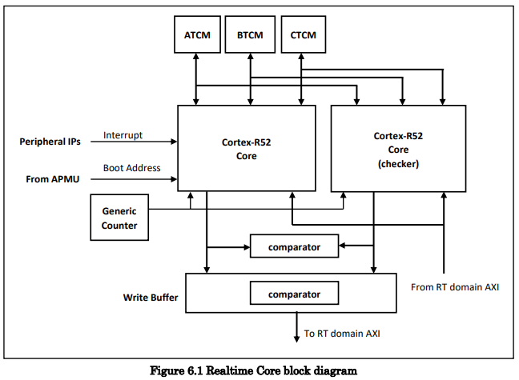
Overview
Cortex R-52 is a Realtime Core used to process real-time tasks and control peripheral devices, responsible for tasks related to monitoring, controlling, and securing important tasks such as protection and secure boot initialization.

Slide 3
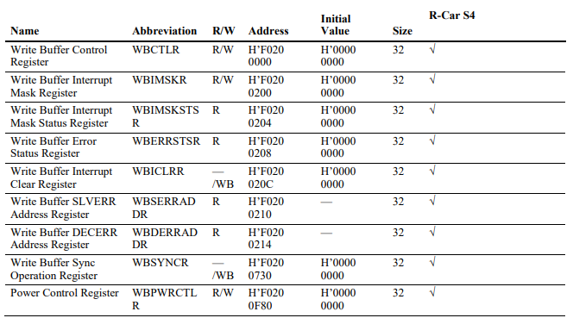
Register Configuration

Slide 4
Register Configuration
-WBCTLR is a register used to activate the write buffer function on the core.
-WBIMSKR is a register that allows enabling interrupt mode when a bus error occurs. When a bus error occurs, the write buffer may not operate correctly, leading to data write transactions not being performed or being performed incorrectly. Enabling interrupt mode when a bus error occurs can help detect this error early and handle it in a timely manner to ensure system stability and reliability.
-WBIMSKSTSR is a register that holds the error status after it has been masked by WBIMSKR. In the event of a bus error, the system will store this error status in the WBIMSKSTSR register to allow for later error handling. When a system developer wants to review a past error, they can access the WBIMSKSTSR register to check and analyze detailed information related to the bus error.
-WBERRSTSR is a register that holds the error status before it is masked by WBIMSKR. When a bus error occurs, the system will store this error status in the WBERRSTSR register to allow for later error handling. After being stored, it will be transferred to WBIMSKSTSR for further processing. Holding the error status before being masked will help system developers analyze and troubleshoot errors more effectively.
-WBICLRR is a register used to clear error status.
-WBDERRADDR is a register that holds the DECERR address, and its value is valid only when the DECERRSTS bit in WBERRSTSR is set to 1.

Slide 5
Register Configuration
-WBSERRADDR is a register that holds the address of the SLVERR error detected, and its value is valid only when the SLVERRSTS bit in WBERRSTSR is set to 1.
+DECERR (Decode Error): An error that occurs when a message on the bus cannot be decoded correctly, usually due to an error in determining the access address or transfer command.
+SLVERR (Slave Error): An error that occurs when a device on the bus cannot access and process commands from the master or cannot transmit data back to the master.
-WBSYNCR is a register used to perform a memory barrier operation combined with flushing the data from the write buffer. This register is used to ensure that all data stored in the write buffer has been flushed before any further operations are performed, to avoid inconsistency between the data in the write buffer and the main memory. When this register is written, the controller performs a memory synchronization operation and flushes all data in the write buffer before any subsequent write operations are performed. After the responses from the target module are returned, this register is automatically cleared by the hardware. Using WBSYNCR ensures the consistency of data in the system, especially when modules access the same memory area managed by the write buffer.
-WBPWRCTLR is a register used to control the function of pausing dynamic modules in processing data stored in the write buffer. It is used to configure the conditions for pausing the dynamic modules before the write buffer overflows. When the write buffer is full, the dynamic modules will be paused to ensure that no data is lost. WBPWRCTLR is used to configure the pause conditions and control the activation or deactivation of the pause function for dynamic modules.

Slide 6
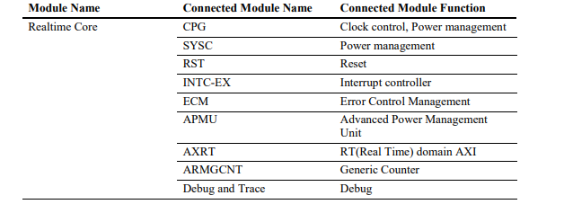
Connected Module

Slide 7
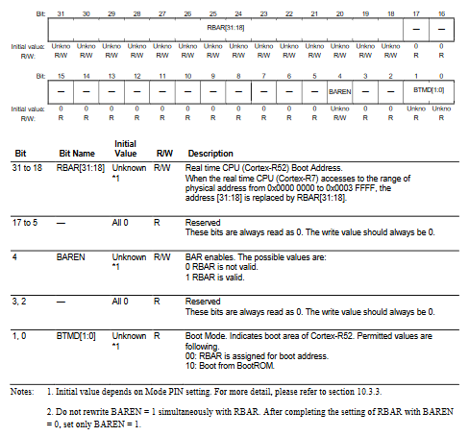
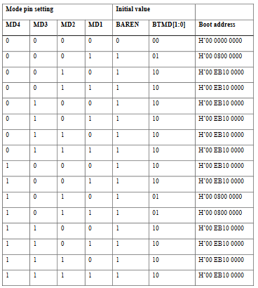
Operation
-Boot Address Setting: The boot address is determined by the value of the Boot Address Register (CR52BAR). Additionally, APMU supports the Reset Vector Base Address Register (CR52RVBAR) to change the boot address. However, in the R-Car S4 product, this register should not be used to avoid conflicts with the CR52BAR register.

Slide 8
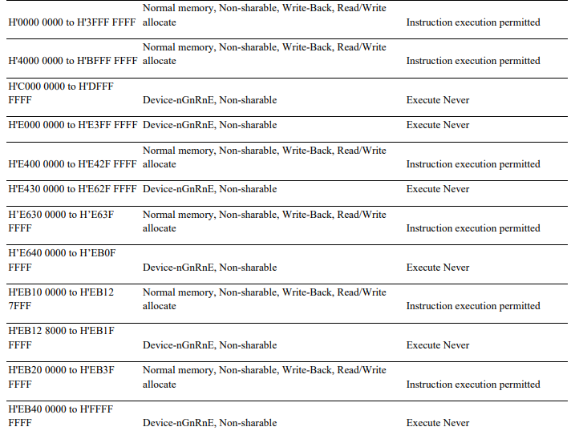
Operation
-MPU(Memory Protection Unit) Setting: In case of boot from R-52, MPU is set by the code in mask ROM

Slide 9
Operation
-Power-Up/Down Mechanism: The power modes supported by the Realtime Core include:
+Core Standby mode: In this mode, the boot address is determined by the Boot Address register (CR52BAR) value and the Realtime Core is in a reset state with no activity occurring during ICUMX boot. The Realtime Core exits this mode when the CPU is activated by ICUMX. However, after exiting this mode, it cannot return to this mode while the chip power mode is in Full Run mode to avoid conflicts with the CR52BAR register.
+Sleep mode (clock stop): This is an energy-saving mode when the CPU executes the WFI instruction. The CPU clock stops to save power until the CPU receives a wake-up request.
+Normal operation mode: This is the normal operating mode of the Realtime Core.
In addition, before the chip power mode switches from Full Run mode to Deep Stop or Cyclic Run mode, the Realtime Core enters the Core Standby mode.

Slide 10
Operation
-Write buffer:
+Core R52 supports the use of a write buffer to optimize read/write operations on the core. When a write request is sent, if the addresses are consecutive, these write requests can be merged into the write buffer instead of sending each write request individually, which helps to increase the data write speed to memory. The write buffer on the R52 core has three merge slots, each merge slot can store up to 128 bytes of data.
+After the data is stored in the write buffer, the write response is returned to the Realtime core master interface before receiving responses from the target modules. When the corresponding responses from the target modules are returned with a bus error attribute (DECERR/SLVERR), the related interrupt for this error can be acknowledged and reported to the ECM.
+To complete write transactions when the write buffer is used, the operation of flushing data from the write buffer is also required.
+The condition for using the write buffer is AWCACHE [1] = B'1 and AWLOCK = B'0.

Slide 11
Operation
-Private Peripheral Modules:
+Peripheral modules that operate in ZRϕ mode are referred to as "private peripheral modules".
+"ZRϕ" is an operation mode of the R52 core. This mode is commonly used when the Realtime Core works with its own peripheral modules. In this mode, the peripheral modules are controlled by a frequency-defined clock and can be configured to operate at different voltage levels. This means that these support modules are not dependent on the system's main clock but are controlled and processed by the Realtime Core itself.
+The base address of private peripheral modules in R-Car S4 products is "H’F000 0000".

Slide 12
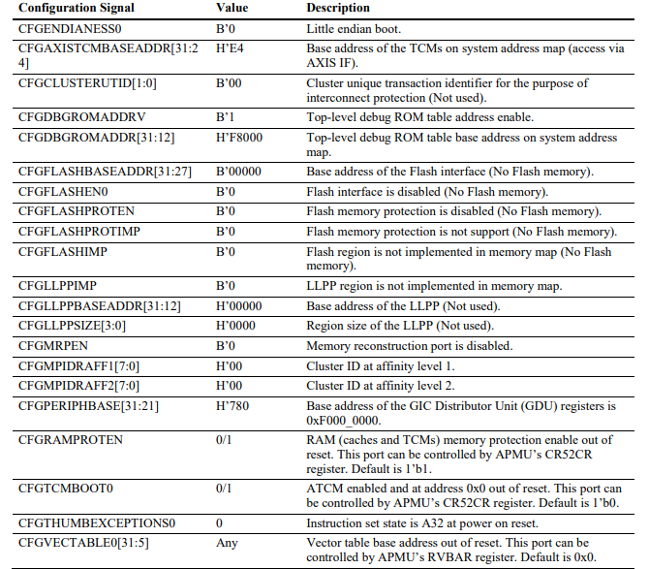
Operation
-Configuration Signals Setting:

Slide 13
THANK YOU!

