Slide 1
MATLAB R-CarS4 R52
GPIO
Mar 2023
Notes:
Created by Hai Phan on Sep 5th 2018. This slide is used to help understand fundamental features and properties of Git ( a distributed version control system).

Slide 2
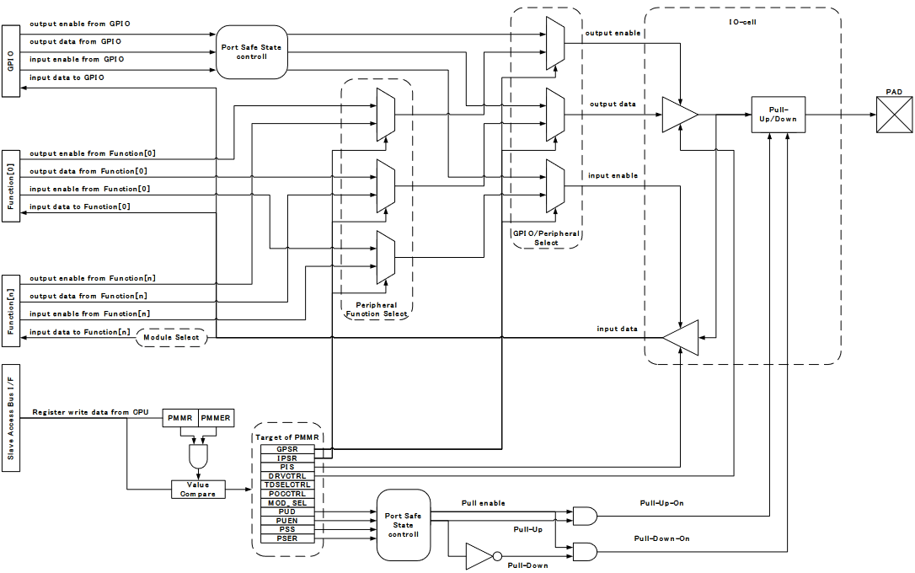
PFC Block Diagram

Slide 3
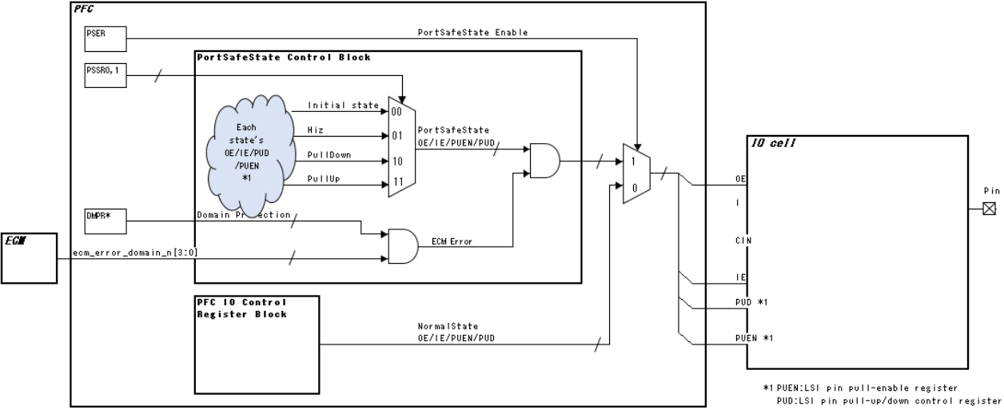
Port Safe State Block

Slide 4
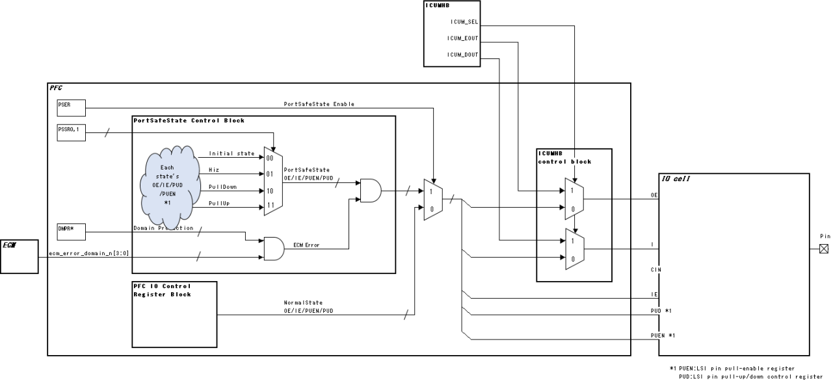
ICUMHB Select Function

Slide 5
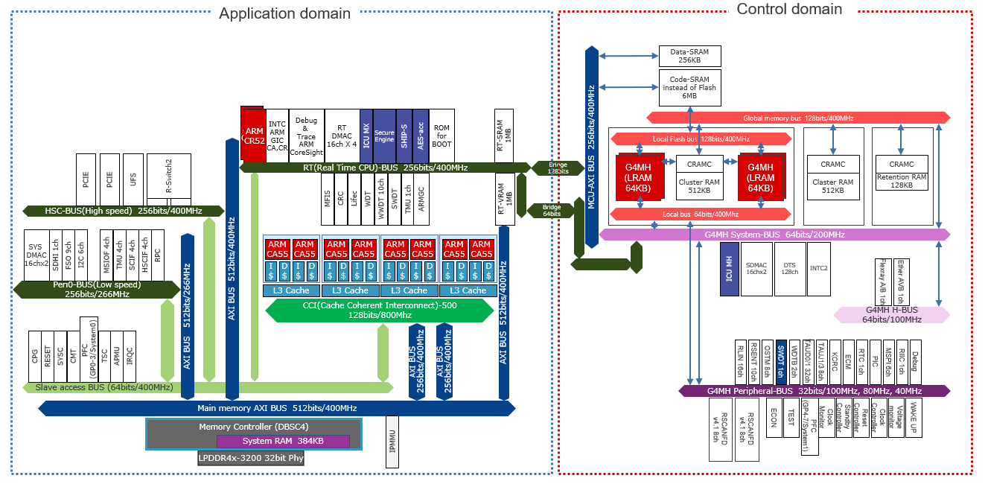
Bus Architecture

Slide 6
Initial value: Register value after a reset - : Undefined value R/W: Readable/writable. The written value can be read. R: Read-only. The write value should always be 0. W: Write-only. Reading this bit is prohibited. When the bit is reserved, the write value should always be 0. n: Number of GPIO Group, it’s value is in the range 0 to 7.
Register Description

Slide 7
Register Description
All the bits are active high unless otherwise specified, and deactivated on reset. All access to registers is made in longword units. The write value to a reserved bit should always be 0. [Register access type and access mode] Register access type is decoded by address offset, and selected by address check. - R/W : Read-Write enabled register. Offset: H’000 - SET : Controled per bit. Write case, applied bit is "1" then "1", or applied bit is "0" then keep value. Read case, return Reg value. (HWM described as WriteOnly) Offset: H’200 - CLR : Controled per bit. Write case, applied bit is "1" then "0", or applied bit is "0" then keep value. Read case, return Reg value. (HWM described WriteOnly) Offset: H’400 - Reserved: Offset: H’600

Slide 8
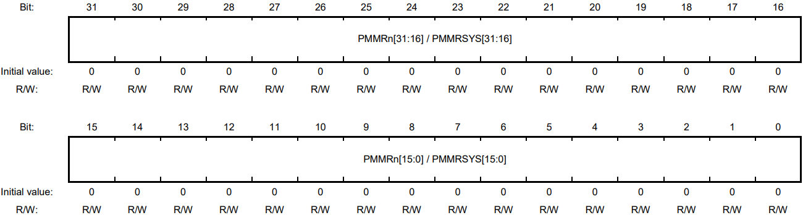
1.LSI Multiplexed Pin Setting Mask Register (PMMRn)

Slide 9
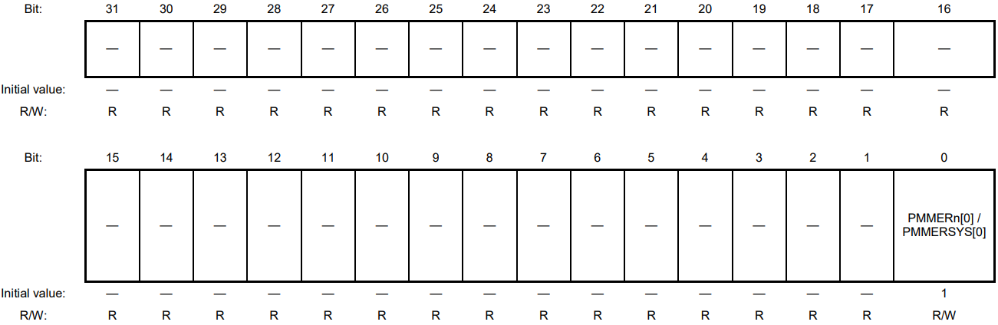
2.LSI Multiplexed Pin Setting Mask Enable Register (PMMERn)

Slide 10
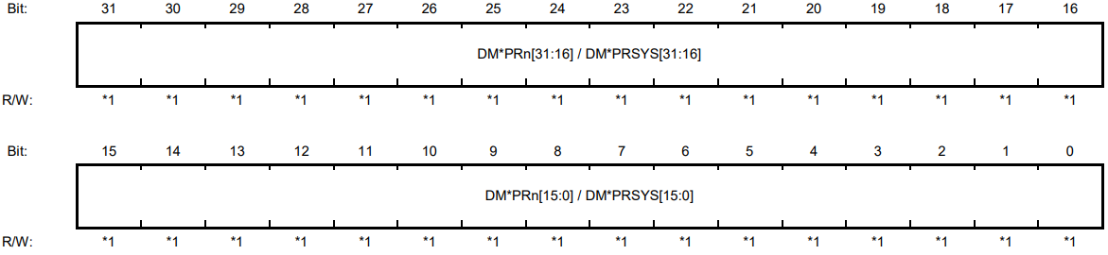
3.Bus Domain Protection Register

Slide 11
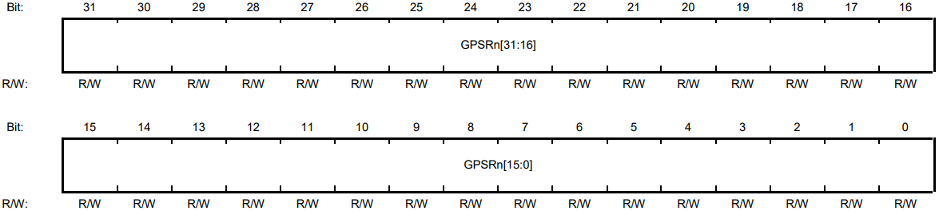
4. GPIO / Peripheral Function Select Register (GPSRn)

Slide 12
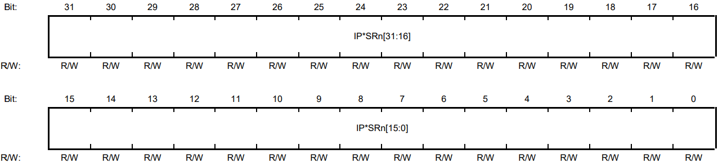
5. Peripheral Function Select Register

Slide 13
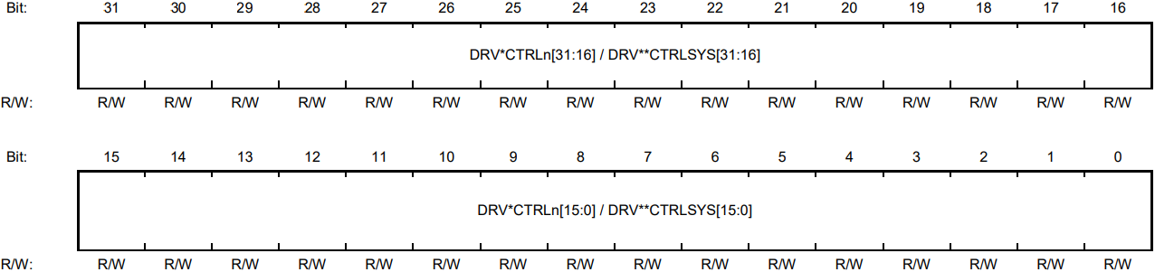
6. DRV Control Register

Slide 14
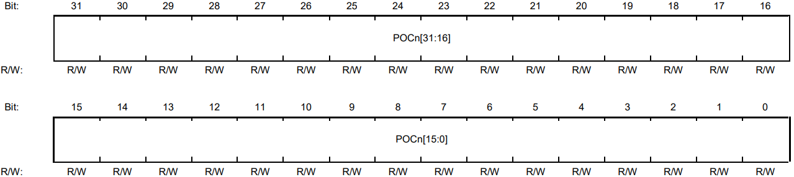
7. POWER Condition Control Register (POCn)

Slide 15
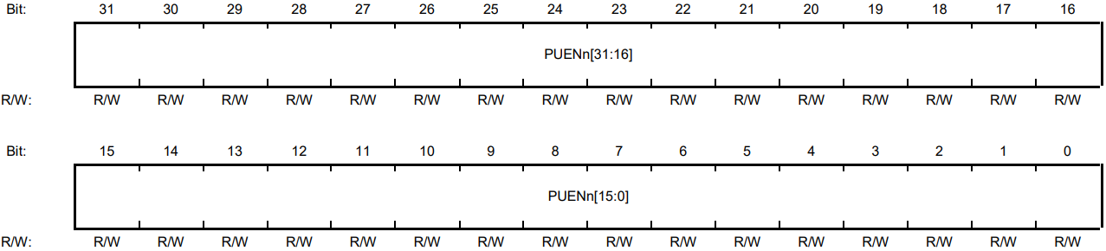
8. LSI pin pull-enable register (PUENn)

Slide 16
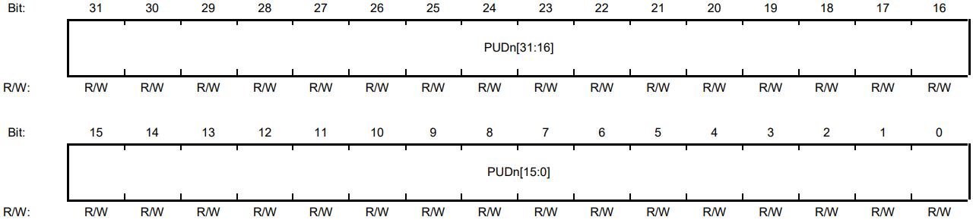
9. LSI pin pull-up/down control Register (PUDn/ PUDSYS)

Slide 17
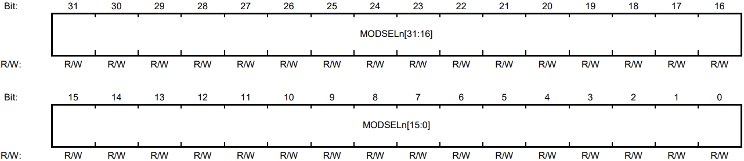
10. Module Select Register (MODSELn)

Slide 18
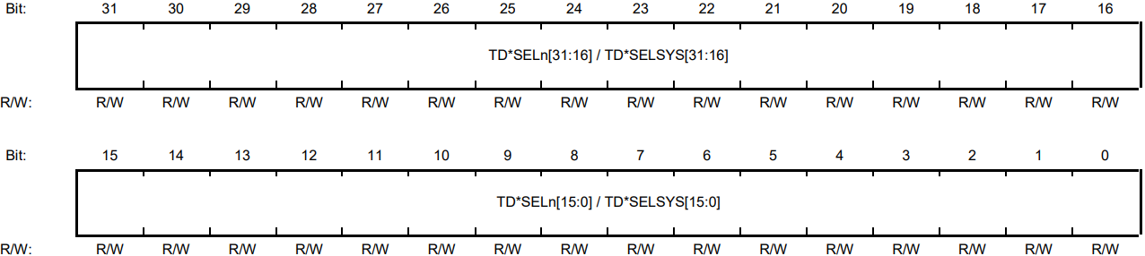
11. TDSEL Control Register 0-1 (TD0SELn , TD1SELn)

Slide 19
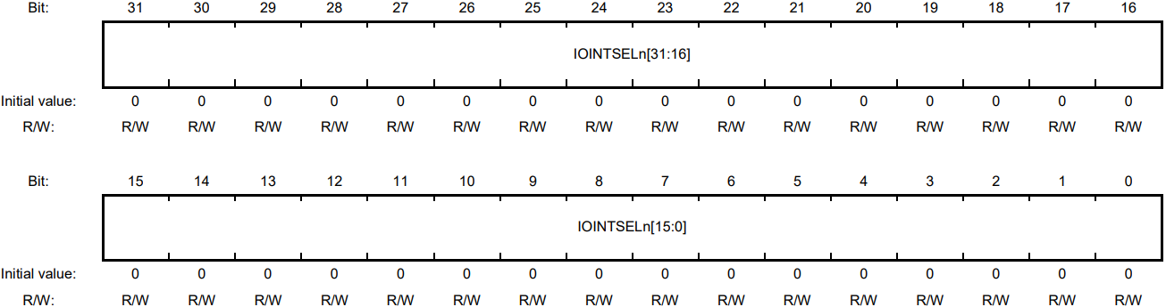
12. General IO / Interrupt Switching Register (IOINTSELn)

Slide 20
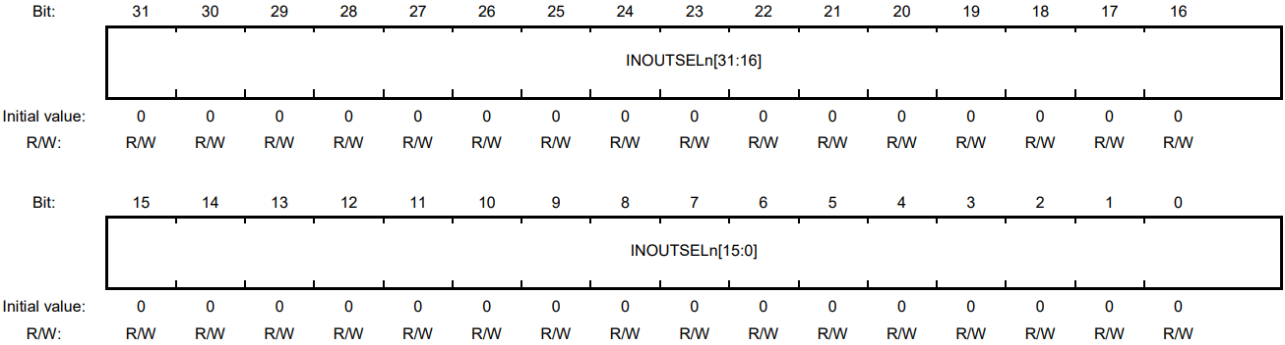
13. General Input/Output Switching Register (INOUTSELn)

Slide 21
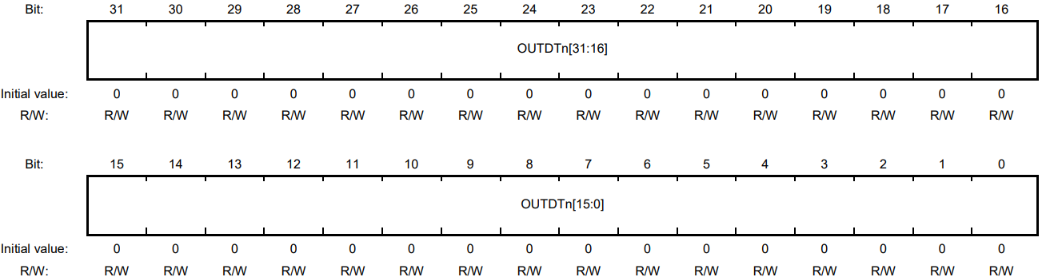
14. General Output Register (OUTDTn)

Slide 22
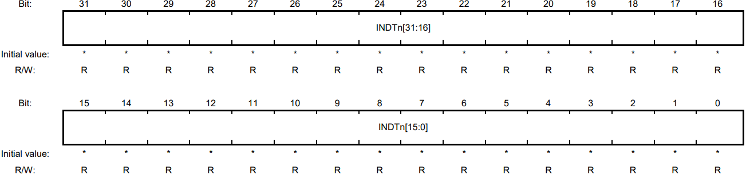
15. General Input Register (INDTn)

Slide 23
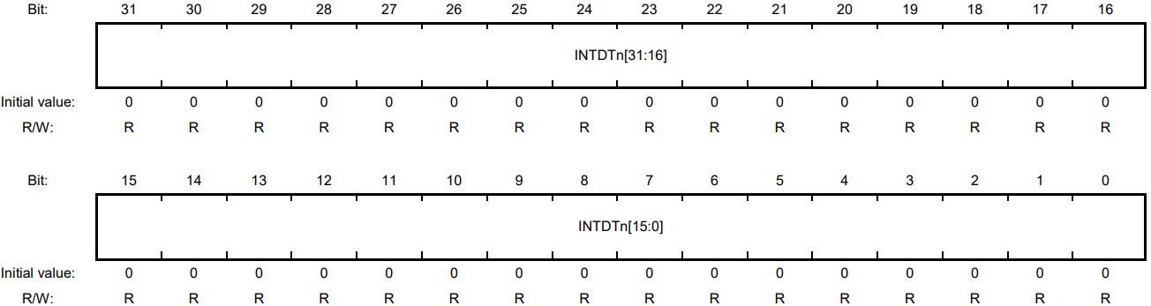
16. Interrupt Display Register (INTDTn)

Slide 24
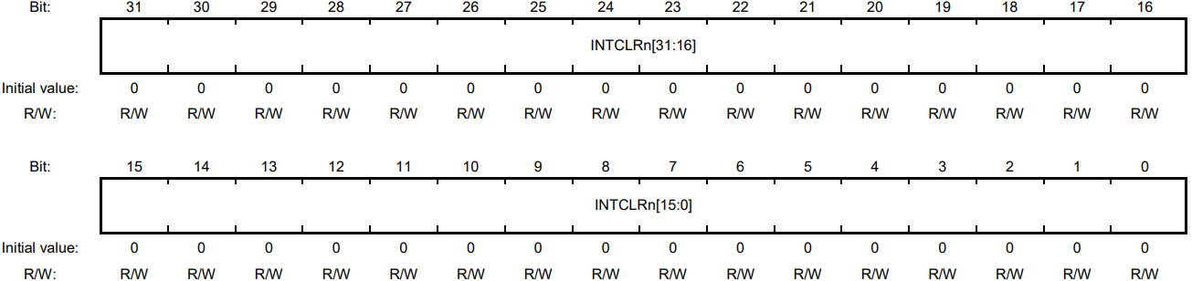
17. Interrupt Clear Register (INTCLRn)

Slide 25
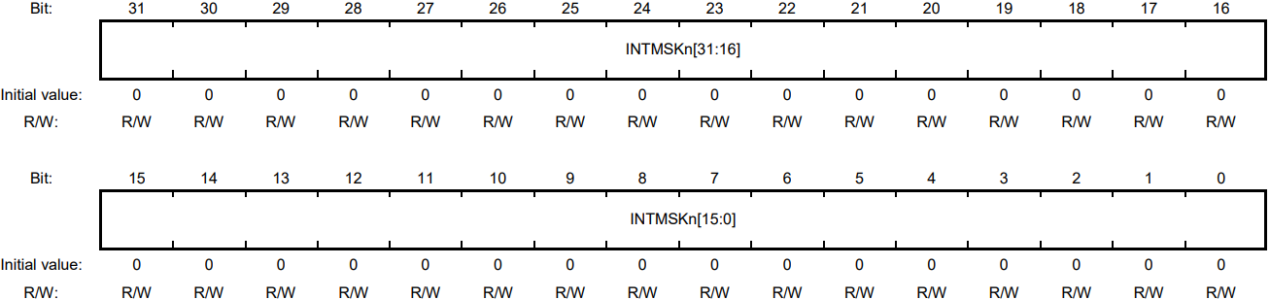
18. Interrupt Mask Register (INTMSKn)

Slide 26
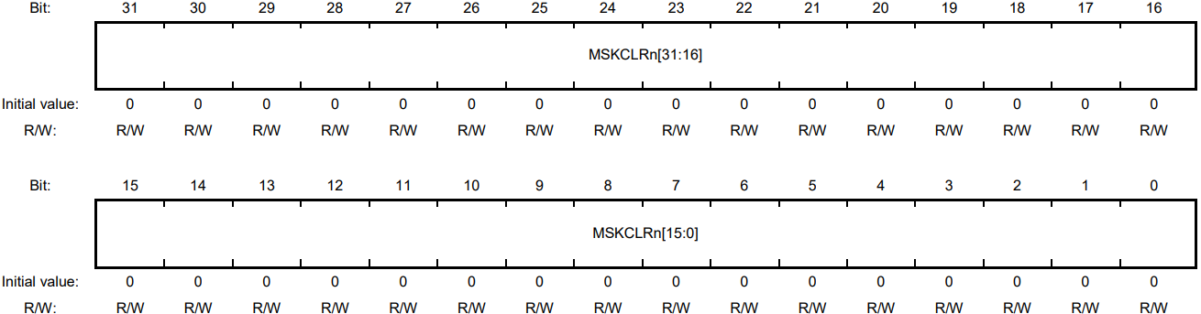
19. Interrupt Mask Clear Register (MSKCLRn)

Slide 27
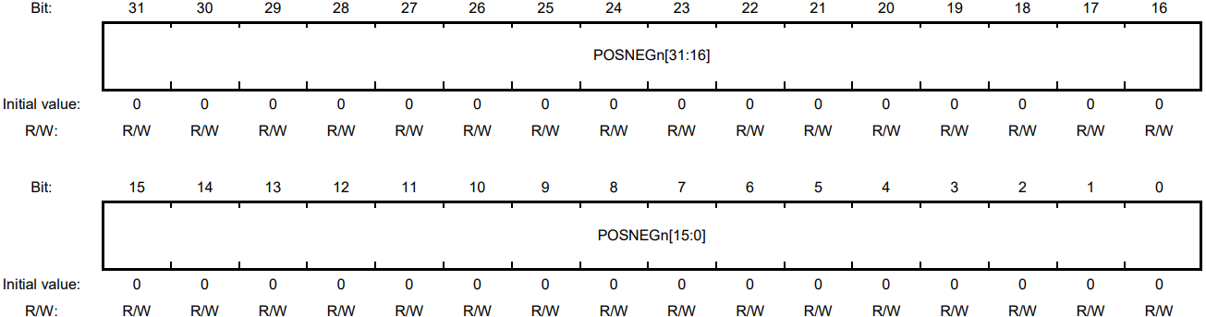
20. Positive/Negative Logic Select Register (POSNEGn)

Slide 28
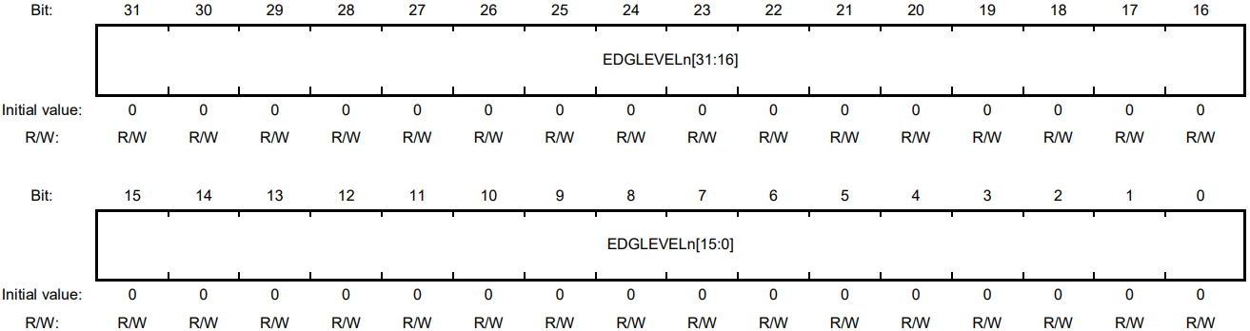
21. Edge / level Select Register (EDGLEVELn)

Slide 29

22. Chattering Prevention On / Off Register (FILONOFFn)

Slide 30
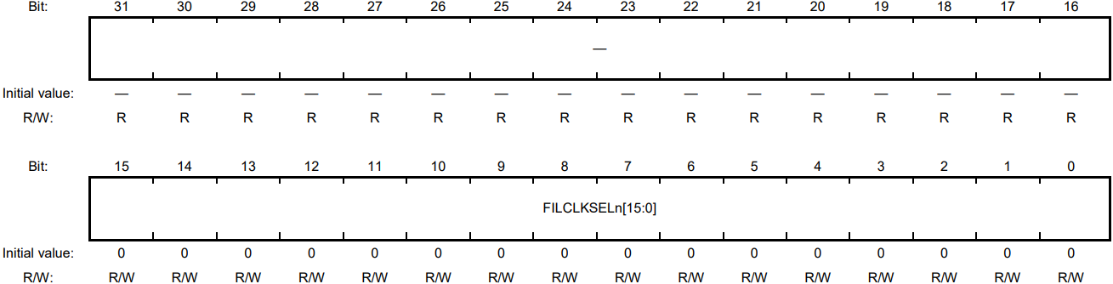
23. Chattering Prevention Clock Select Register

Slide 31
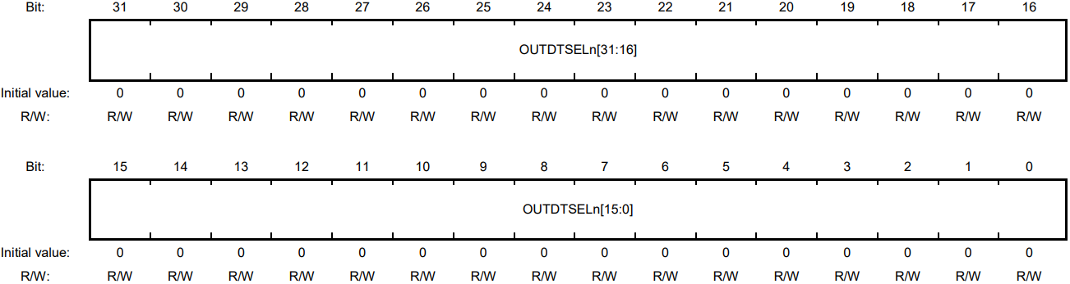
24. Output Data Select Register (OUTDTSELn)

Slide 32

25. Output Data High Register (OUTDTHn)

Slide 33

26. Output Data Low Register (OUTDTLn)

Slide 34
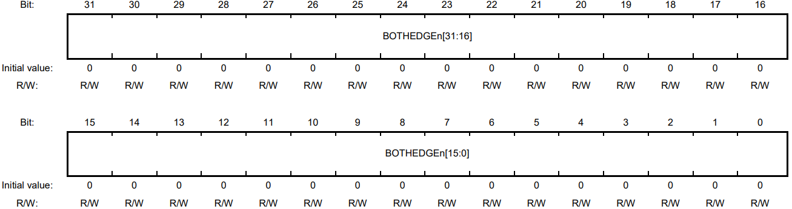
27. One Edge / Both Edge Select Register (BOTHEDGEn)

Slide 35
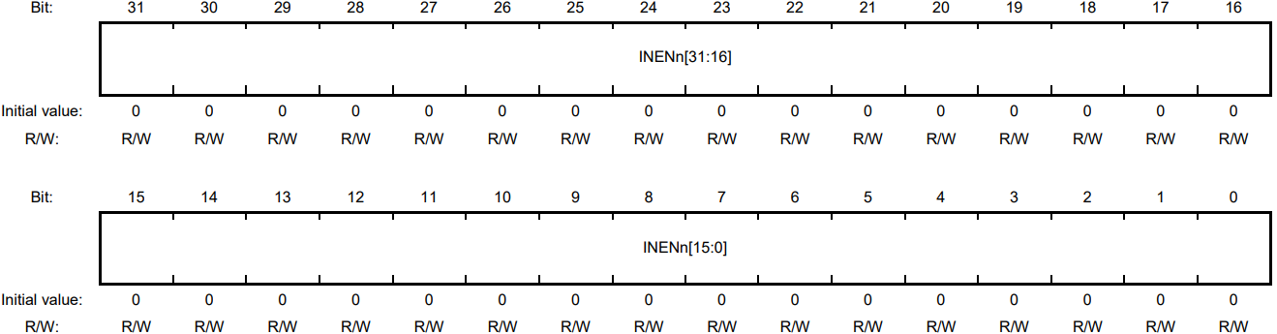
28. General Input Enable register (INENn)

Slide 36
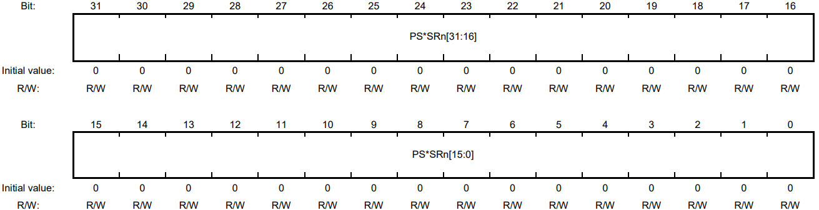
29. Port Safe state Select Register

Slide 37
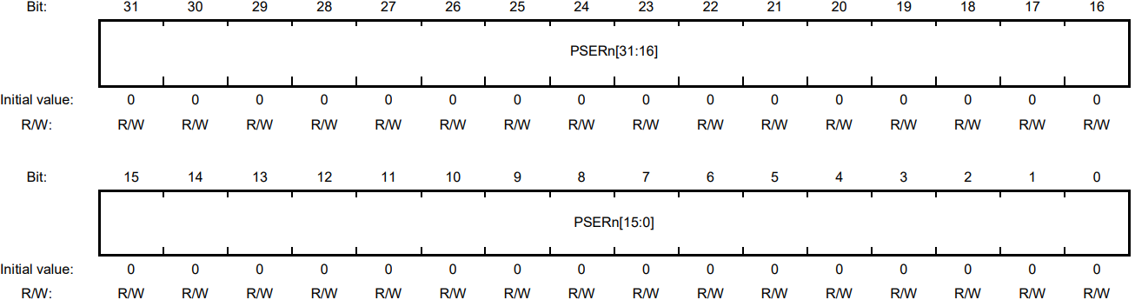
30. Port Safe state Enable Register (PSERn)

Slide 38
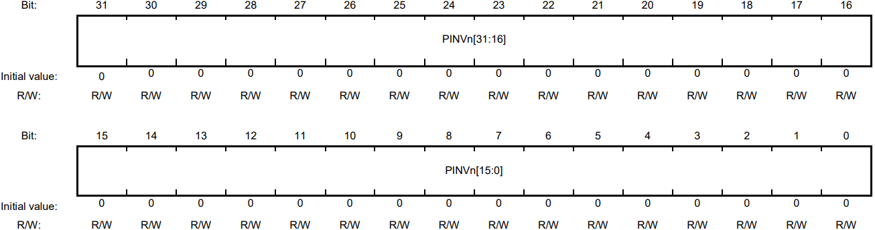
31. Port Output Value Inversion Register (PINVn)

Slide 39

32. Port Input Buffer Selection Register (PISn)

Slide 40
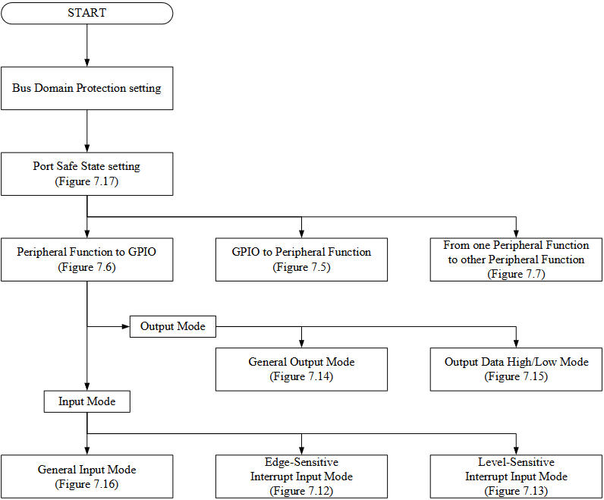
Recomendation of Pin Function setting flow

Slide 41
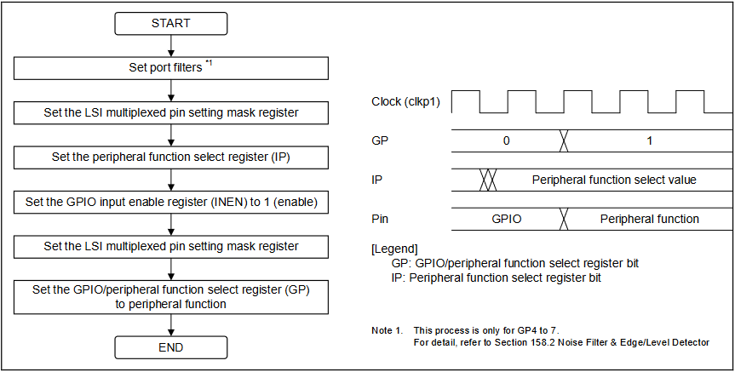
2. Function Setting for Multiplexed Pins

Slide 42
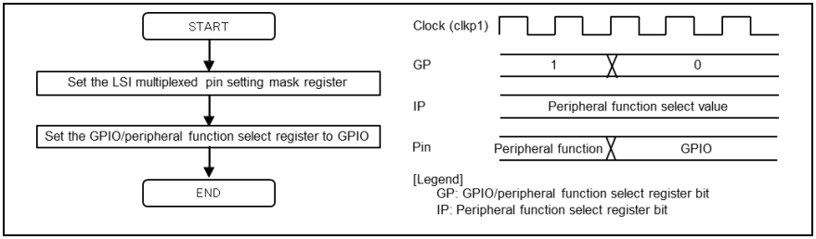
Procedure for changing pin function from peripheral function to GPIO

Slide 43
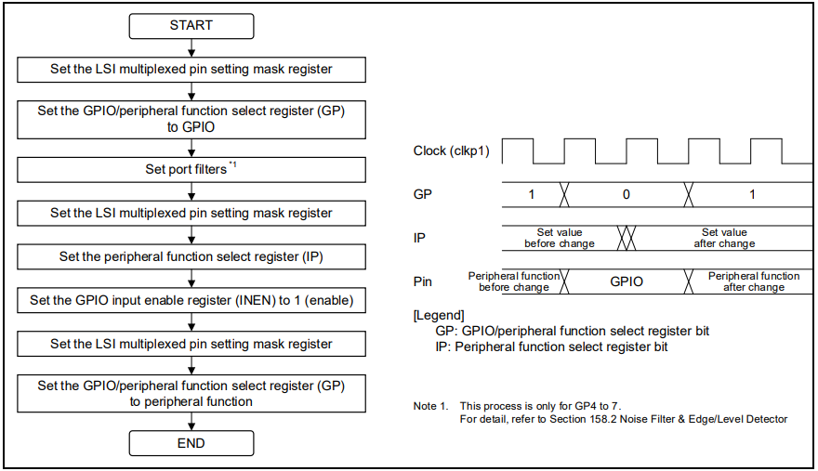
Procedure 1 for changing pin function from one peripheral function to another peripheral function

Slide 44
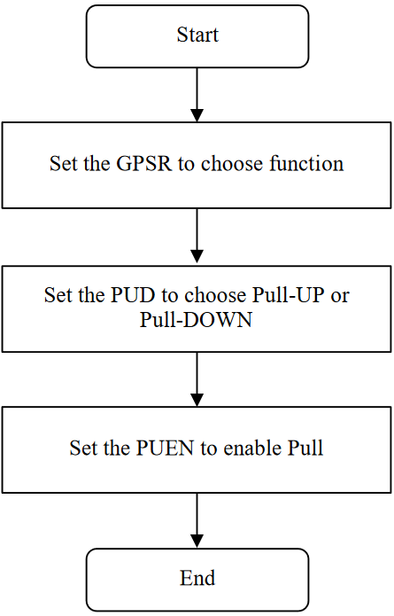
3. Setting Pull-Up / Down Resistors

Slide 45
5. Operations in Each Mode
1. Mode Switching
2. General Input / Output Mode
3. Interrupt Input Mode

Slide 46
6. Handling of Input Signals on Port Pins
2. Input Signal Synchronization
1. Chattering

Slide 47
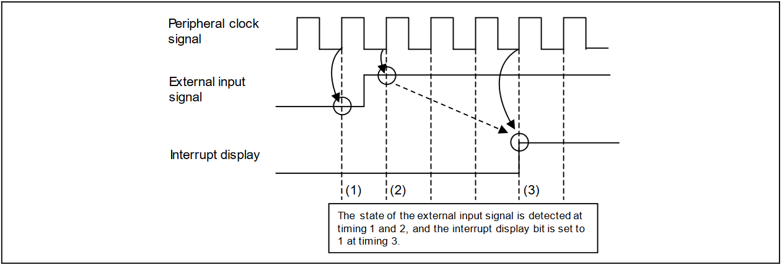
7. Interrupt Display Timing Charts

Slide 48
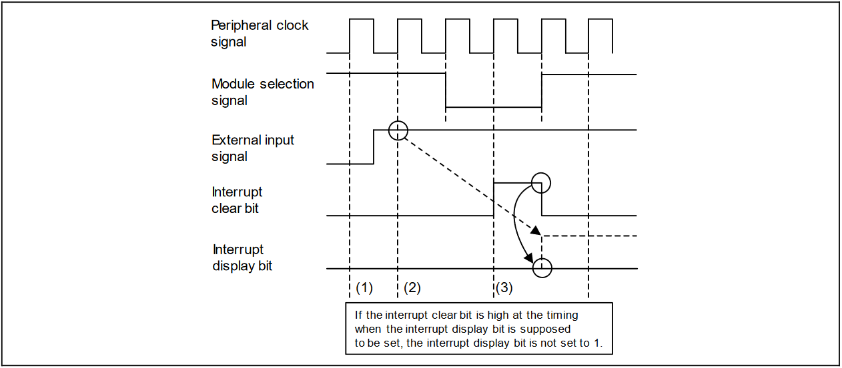
7. Interrupt Display Timing Charts

Slide 49
8. Using GPIO
1. Setting Edge-Sensitive Interrupt Input Mode
4. Setting Output data high / Output data low Mode
2. Setting Level-Sensitive Interrupt Input Mode
3. Setting General Output Mode
5. Setting General Input Mode
6. Setting Port Safe State
7. Switching GPIO to I2C

Slide 50
THANK YOU!

