Slide 1
MATLAB CAN Protocol
Mar 2023
Notes:
Created by Hai Phan on Sep 5th 2018. This slide is used to help understand fundamental features and properties of Git ( a distributed version control system).

Slide 2
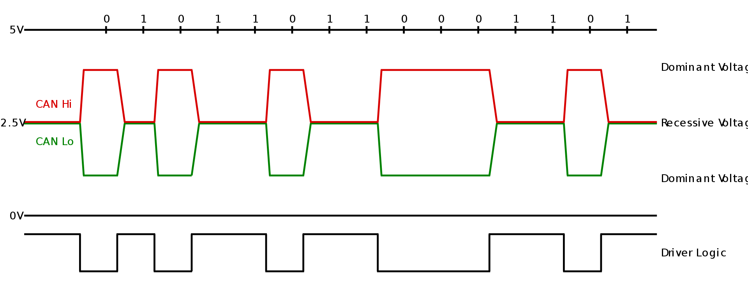
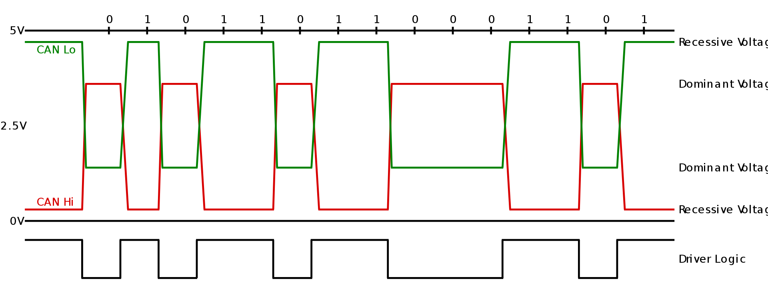
CAN Physical organization - Overview
CAN is a multi-master serial bus standard for connecting electronic control units (ECUs) also known as nodes (automotive electronics is a major application domain). Two or more nodes are required on the CAN network to communicate.
This bus uses differential wired-AND signals. Two signals, CAN high (CANH) and CAN low (CANL) are either driven to a "dominant" state with CANH > CANL, or not driven and pulled by passive resistors to a "recessive" state with CANH ≤ CANL. A 0 data bit encodes a dominant state, while a 1 data bit encodes a recessive state, supporting a wired-AND convention, which gives nodes with lower ID numbers priority on the bus.
High-speed CAN signaling. ISO 11898-2 (Wikipedia)
Low-speed CAN signaling. ISO 11898-3 (Wikipedia)

Slide 3
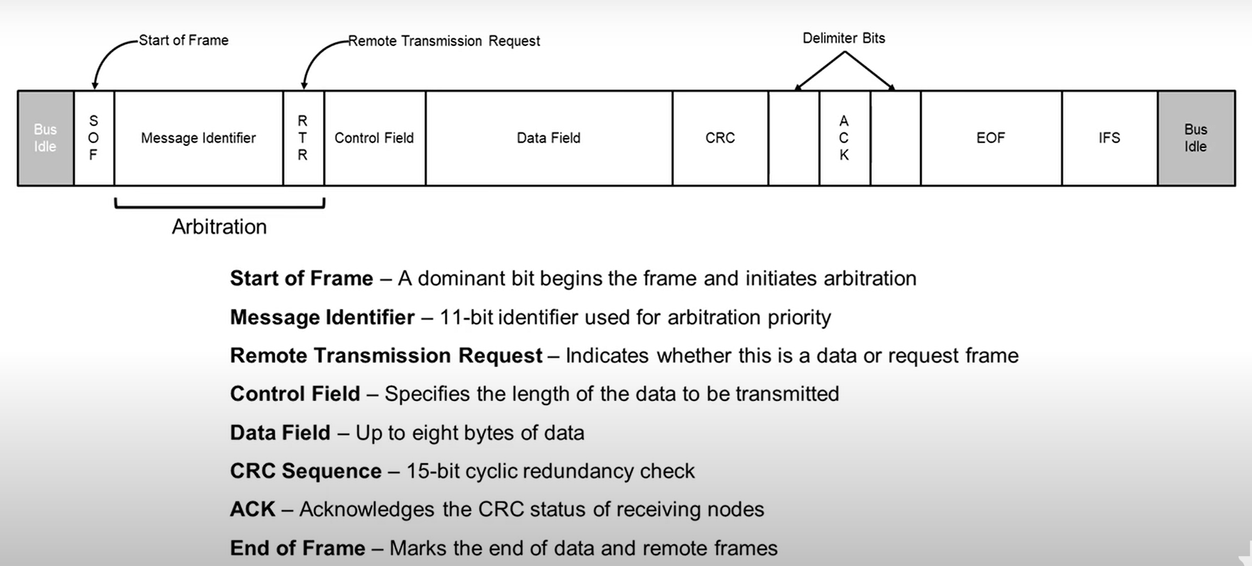
CAN frame - Overview
Note: All entries in CAN frame section are referenced from the Texas Instrument video tutorial

Slide 4
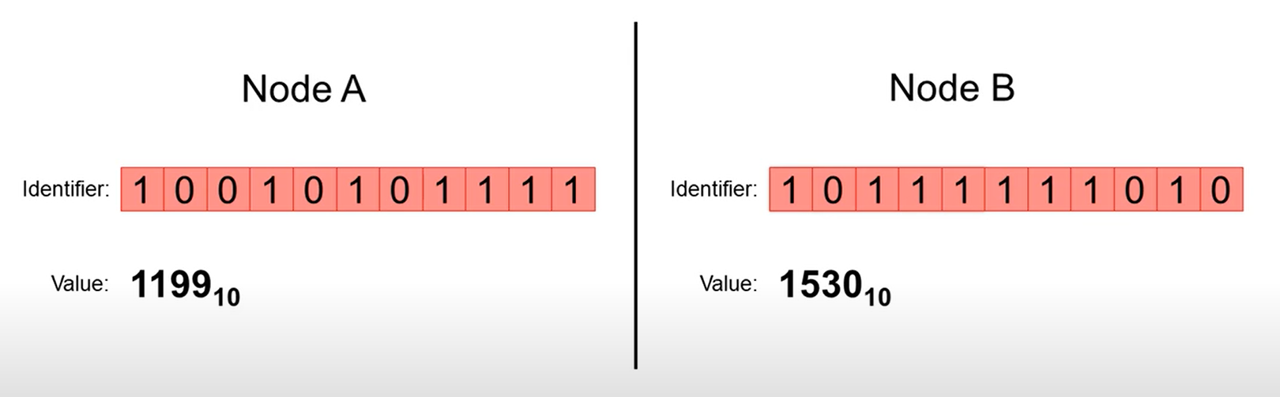
CAN frame - Arbitration
The lower the arbitration value, the higher the priority.
=> Node A has higher priority because of the lower arbitration value.

Slide 5
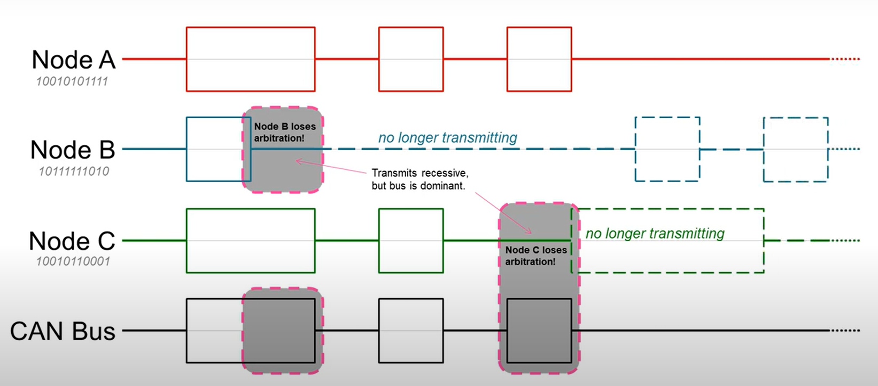
CAN frame - Arbitration
Imagine that we have three nodes that access the same single CAN or CANFD bus and each simultaneously begins to send a message with message identifiers shown here in gray
=> Node A wins arbitration
=> Node B and Node C will reattempt to transmit their lower priority messages after the next interframe spacing, which will be at the end of node A’s transmission
0
0
1

Slide 6
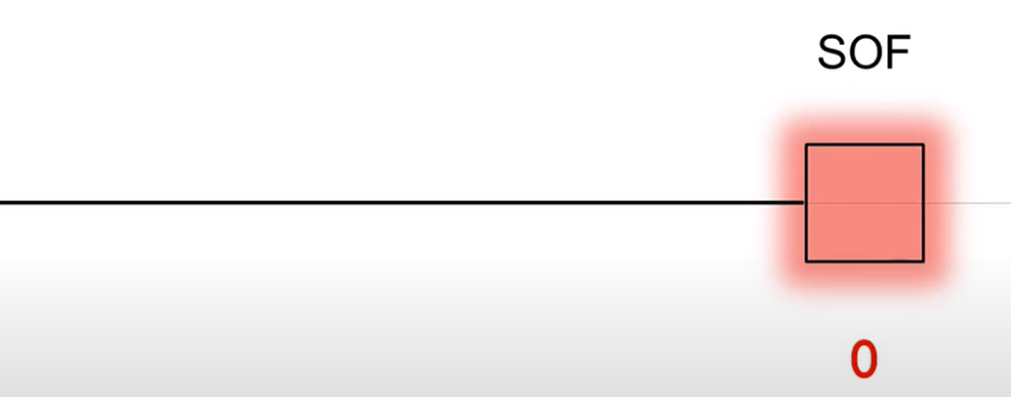
Sample CAN frame - SOF
When no device is transmitting, the bus remains idle. When a device begins transmission, it sends a single dominant bit to indicate it will begin transmitting. This bit is called the start of frame bit or the SOF bit.
SOF is always dominant representing a logic zero. This bit is used to synchronize the nodes on a bus after being idle
idle

Slide 7
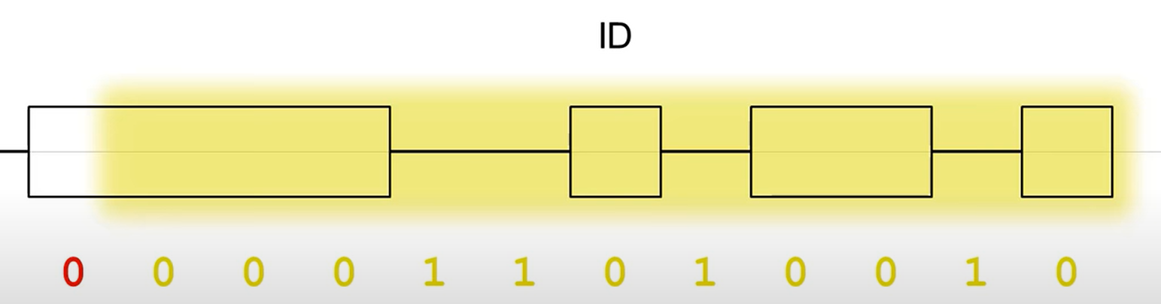
Sample CAN frame - ID
Immediately after the SOF is the message identifier field or ID field The standard 11-bit ID establishes the priority of the message and can indicate the target of the message
This is where arbitration occurs. As we mention earlier, the lower the binary value, the higher the higher the message priority. This message has a binary value of 210

Slide 8
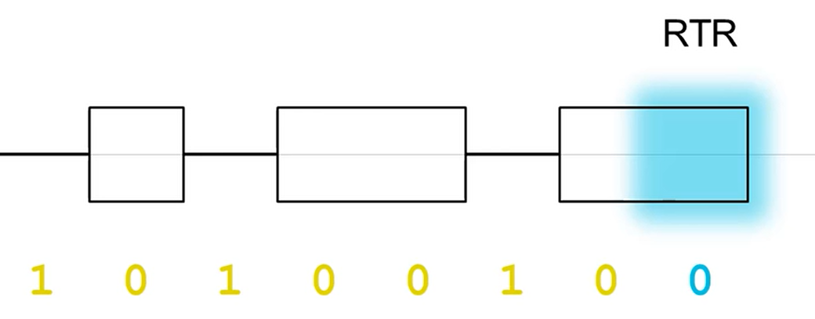
Sample CAN frame - RTR
The remote transmission request (RTR) indicates whether this is transmitting data packets or requesting data from another device:
+ Dominant (0) for data frames
+ Recessive (1) for remote frames

Slide 9
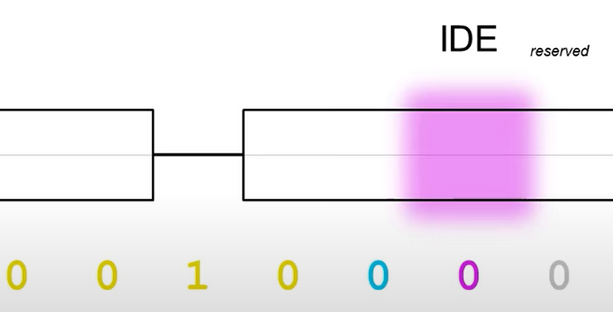
Sample CAN frame – IDE
The control field contains IDE and DLC
The identifier extension bit or IDE, which indicates the length of the identifier being used in the message:
+ Dominant (0) indicates that this message contains an 11-bit identifier
+ Recessive (1) indicates that this message contains a 29-bit extended CAN identifier, which would feature 18 additional identifier bits after the IDE bit.
In this example, the IDE value is 0 so the next bit is a reserved bit saved for possible use in a future CAN standard.

Slide 10
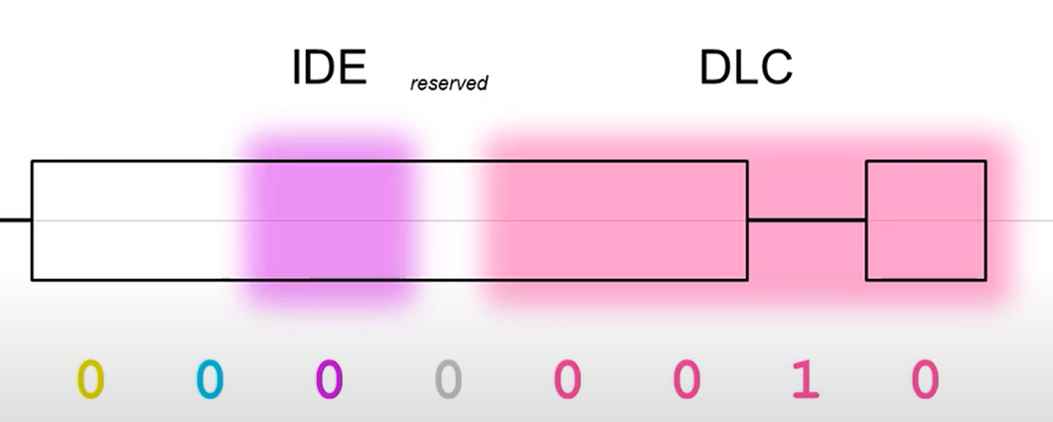
Sample CAN frame – DLC
The last four bits of the control field are the data length code or DLC, which indicate how many bytes of data will be transmitted in this message
The number indicated in the DLC must be between zero and eight for traditional CAN, as the maximum number of bytes that can be transmitted.
In this example, 2 bytes (0010₂) of data will follow this field, which indicates that two bytes of data will be transmitted

Slide 11
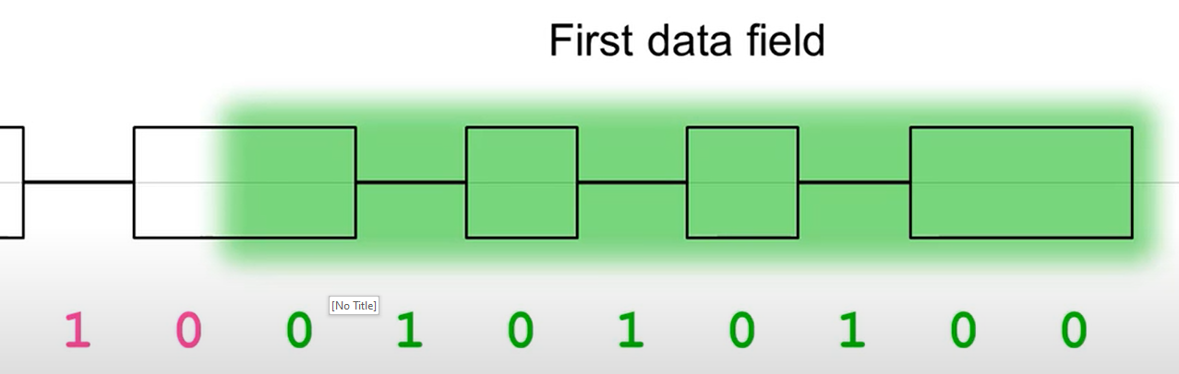
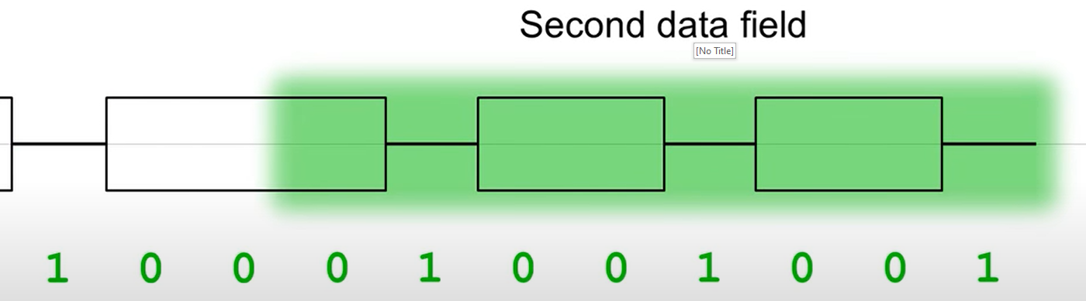
Sample CAN frame – Data field
The first data field byte follows the DLC is transmitted immediately.
Remember that all CAN data transmitted most significant bit (MSB) first (“big-endian form”)
Subsequent data fields are transmitted in series

Slide 12
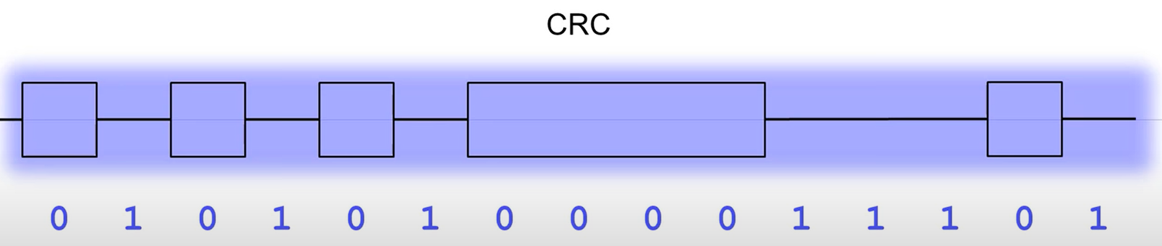
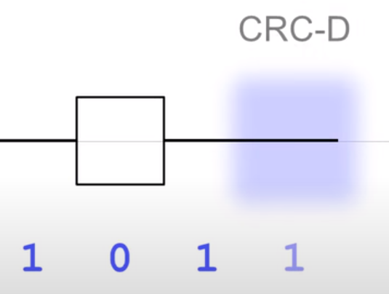
Sample CAN frame – CRC
Once all of our data has been transmitted properly, a 15-bit cyclic redundancy check or CRC is sent, which is used as a means of error detection.
The CRC is calculated using all of the bits transmitted in the message so far. If the receiver receives a CRC that does not match what is has calculated, this indicates an error condition.
The recessive CRC delimiter bit (CRC-D) follows the 15-bit CRC.

Slide 13
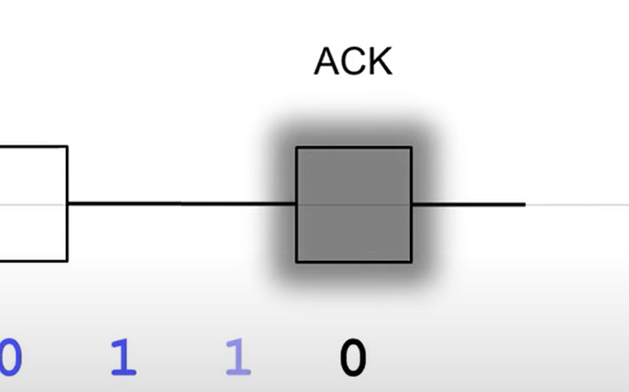
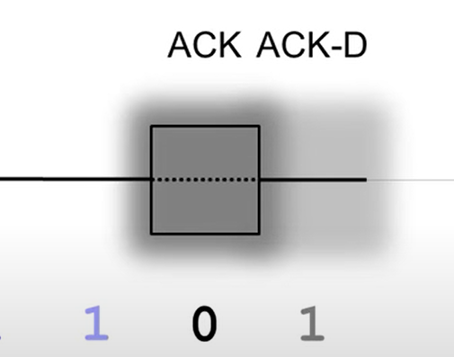
Sample CAN frame – ACK
Once the transmitter has finished sending its data and redundancy check, the receiver must indicate that it has received the transmitter’s message without error. This occur immediately following the CRC-D meaning the acknowledgement slot (ACK).
In this slot, the receiver asserts a dominant (0) signal to confirm acquisition.
Should a receiving node detect an error and the sending node repeats the message after re-arbitration.
This slot is immediately followed by a recessive delimiter (ACK-D)

Slide 14
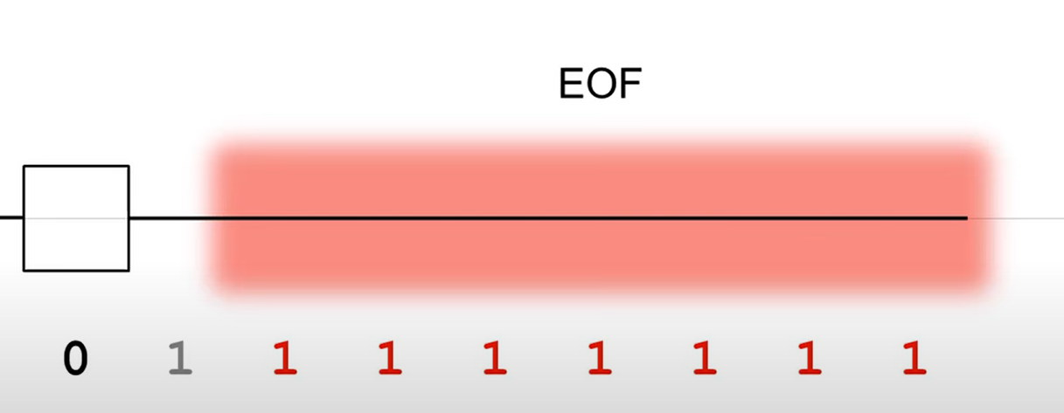
Sample CAN frame – EOF
After acknowledgment, the transmitter sends an end of frame field or EOF field, which marks the end of a CAN message.
This is a field of seven sequential recessive bits. After the EOF, the bus will become free, and another message can be sent over the bus after a seven-bit inter-frame spacing (IFS)

Slide 15
Bit stuffing
A bit of opposite polarity is inserted after five consecutive identical bits:
+ 0111111010 would become 01111101010
+ 1010000011 would become 10100000111
+ 0000011110 would become 000001111100
Stuffed data is destuffed by the receiver:
Original data:
000011010010000001001010100010010010101010000111011011111111
Stuffed data:
0000110100100000101001010100010010010101010000111011011111111
Bit stuffing deactivated after the last bit of the 15-bit CRC, so the ACK slot, its surrounding delimiters and the end of frame field are fixed size and are not subject to bit stuffing.
The stuffed data frame contains the same information as the original data frame. Transmitting six consecutive identical bits in a frame is an error condition

Slide 16
Frame types
The most common frame is a data frame, used to transmit date over the bus.
Remote frames solicit data transmission from other nodes. It contains no data, nodes targeted by the request frames can respond with a data frame.
If there is an error in the transmission or reception of a message or if any other error condition occurs at a node, that node transmits an error frame. The error frame is a special message that violates the formatting rules of a CAN message by deliberately sending at least six consecutive dominant bits which would override all signals on the bus. The original transmitter will then automatically retransmit the original message
The last type of frame is an overload frame. This frame is similar to an error frame, but it is sent between frames or during inter-frame spacing rather than during a frame. This is transmitted by a node that becomes too busy, and it provides extra delay between messages by ensuring that the bus is held up until the overload condition is cleared

Slide 17
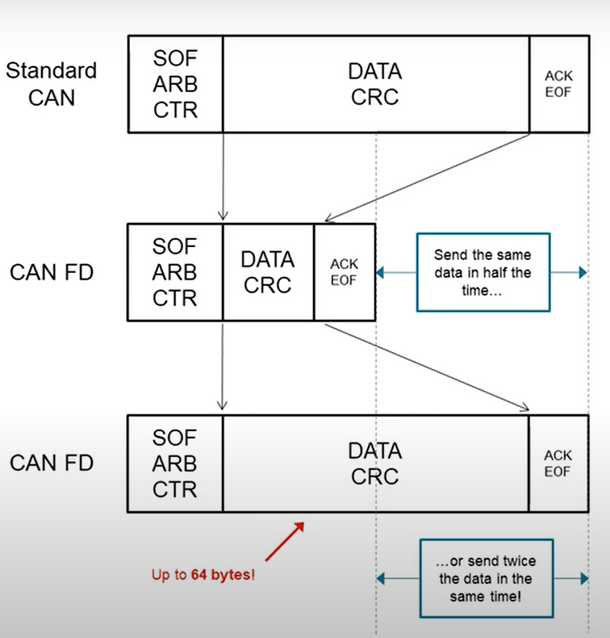
CAN FD
Can with flexible data rate known as CAN FD is an enhancement to the traditional CAN protocol.
CAN FD allows for usable bandwidths of up to 5 megabits per second.
By increasing the bandwidth, CAN FD can transmit more data at the same time compared with traditional CAN protocol.
Moreover, CAN FD can transmit up to 64 bytes of data frame compared with 8 bytes of data frame in traditional CAN protocol.

Slide 18
THANK YOU!

