Slide 1
MATLAB CAN U2B
Mar 2023
Notes:
Created by Hai Phan on Sep 5th 2018. This slide is used to help understand fundamental features and properties of Git ( a distributed version control system).

Slide 2
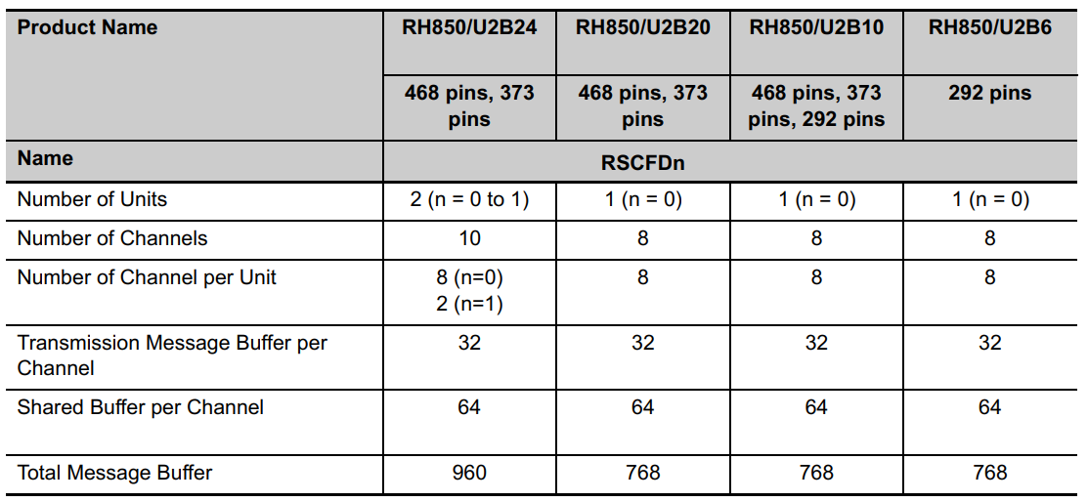
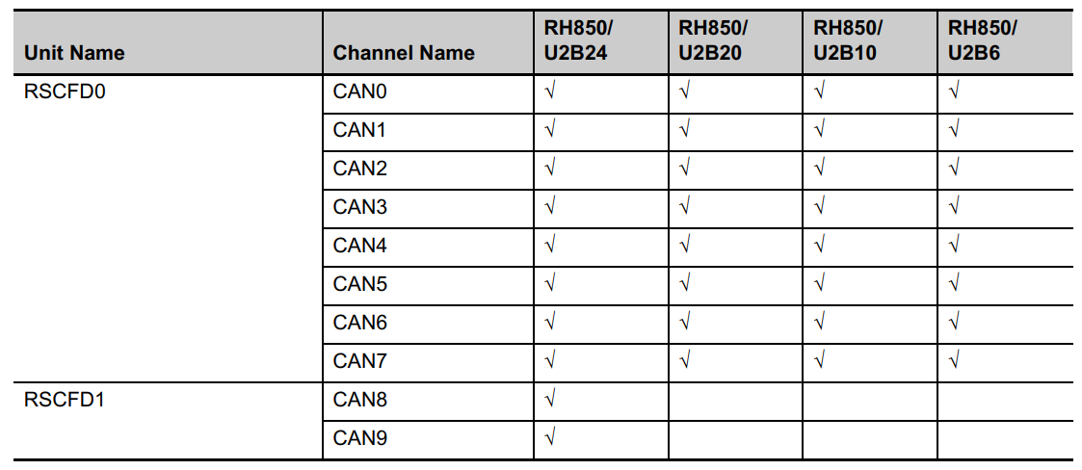
CAN Physical organization - Overview
U2B family devices have up to 10 CAN channels (CAN0 - CAN9), each of them consisting of 2 wires platform (TX - RX) (24.1.1 Number of Units and Channels)
Throughout this section, the individual channels of RS-CANFD units are generically indicated by the index “m” (m = 0 to 7 for n = 0; m = 0 to 1 for n = 1 (U2B24) for example, RSCFDnCFDCmSTS is the channel m status register.

Slide 3
Modes of operation
The modes of the RS-CANFD module can be classified into 2 groups:
+ Global modes
+ Channel modes
Global modes: These modes are applicable for the complete RS-CANFD module and hence are called “global” modes.
The global modes of the RS-CANFD module are:
+ Global Sleep Mode
+ Global Reset Mode
+ Global Halt Mode
+ Global Operation Mode
Channel modes: Each CAN channel can be in one of the following four channel modes:
+ Reset Mode
+ Halt Mode
+ Operation Mode
+ Sleep Mode

Slide 4
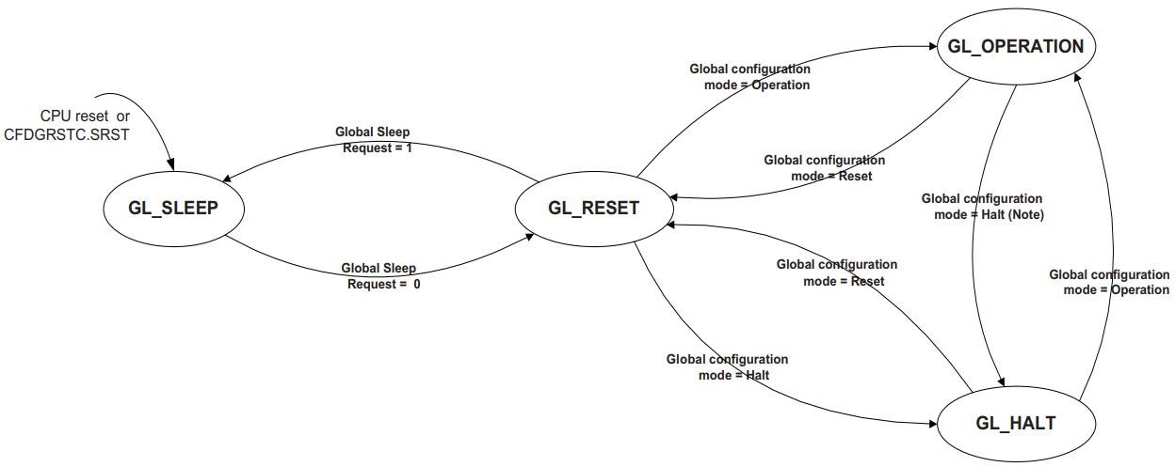
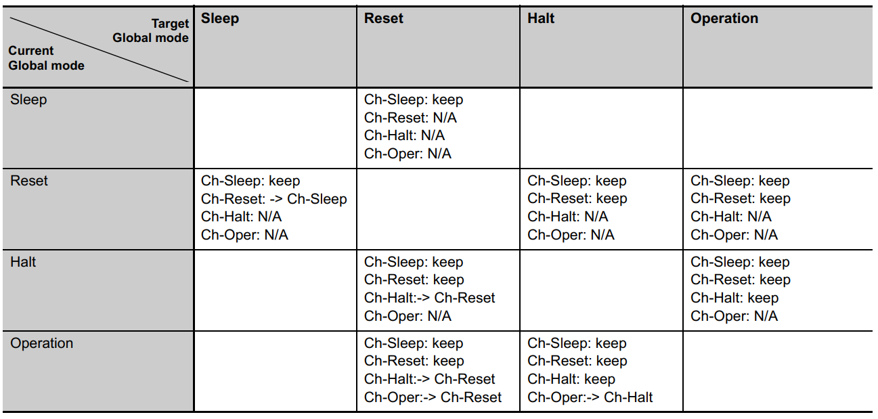
Global modes - Overview
Transition between CAN Global Modes
Possible CAN channel Modes versus Global Module Modes

Slide 5
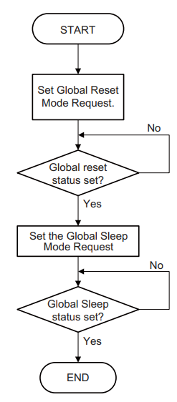
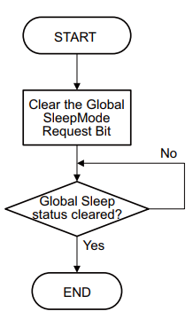
Global mode - Sleep
The ways to enter this mode:
+ Release the hardware reset
+ Setting and clearing a RSCFDnCFDGRSTC.SRST bit
+ The Global Sleep Request bit is set while it is in Global Reset Mode
Setting the Global Sleep Request bit will set all Channel Sleep Request bits and force all channels into the Channel Sleep Mode.
Procedure for exiting global Sleep Mode
Procedure for entering global Sleep Mode

Slide 6
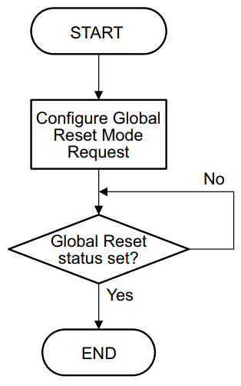
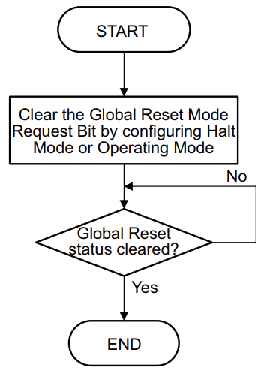
Global mode - Reset
The RS-CANFD module enters this mode in the following ways:
+ Global Mode Control RSCFDnCFDGCTR.GMDC in the Global Control Register is configured for Global Reset Mode while the RS-CANFD module is in Global Halt Mode or Global Operation Mode
+ Global Sleep Mode request bit is cleared while RS-CANFD module is in Global Sleep Mode
Setting the global mode to Reset by setting the Global Mode Control bits RSCFDnCFDGCTR.GMDC in the Global Control Register to 2'b01 will set all Channel Mode Control bits RSCFDnCFDCmCTR.CHMDC in the Channel Control Registers to 2’b01 and force all channels into the Channel Reset Mode.
Procedure for entering global Reset Mode
Procedure for entering global Reset Mode

Slide 7
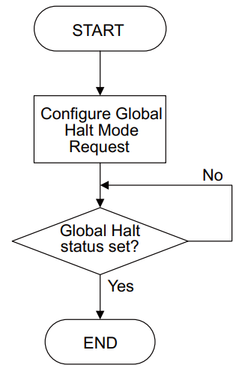
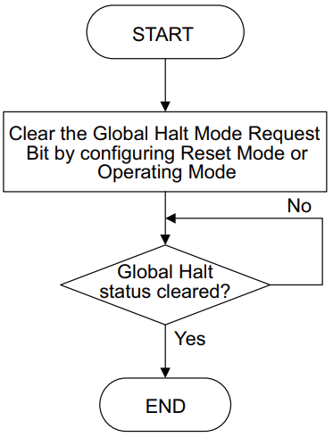
Global mode - Halt
The RS-CANFD module enters this mode in the following ways:
+ Global Mode Control RSCFDnCFDGCTR.GMDC in the Global Control Register is configured for Global Halt Mode while the RS-CANFD module is in Global Reset Mode
+ Global Mode Control RSCFDnCFDGCTR.GMDC in the Global Control Register is configured for Global Halt Mode while the RS-CANFD module is in Global Operation Mode
Setting the global mode to Halt by setting the Global Mode Control bits RSCFDnCFDGCTR.GMDC
in the Global Control Register to 2’b10 will set all Channel Mode Control bits RSCFDnCFDCmCTR.CHMDC in the Channel Control Registers to 2’b10 for the channels that are in Channel Operation Mode and force these channels into the Channel Halt Mode.
Procedure for entering global Sleep Mode
Procedure for entering global Sleep Mode

Slide 8
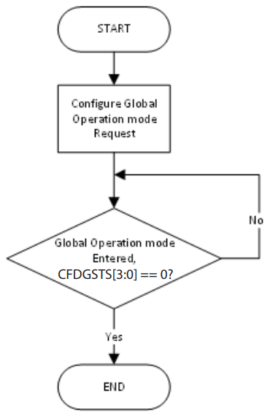
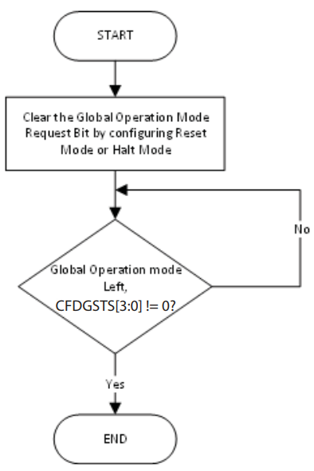
Global mode - Operation
The RS-CANFD module enters this mode when the Global Mode Configuration bits are set to Global
Operation Mode
CAN channels can only be set to Channel Operation Mode and start CAN communication when RSCANFD is in Global Operation Mode.
Procedure for entering global Operation Mode
Procedure for entering global Operation Mode

Slide 9
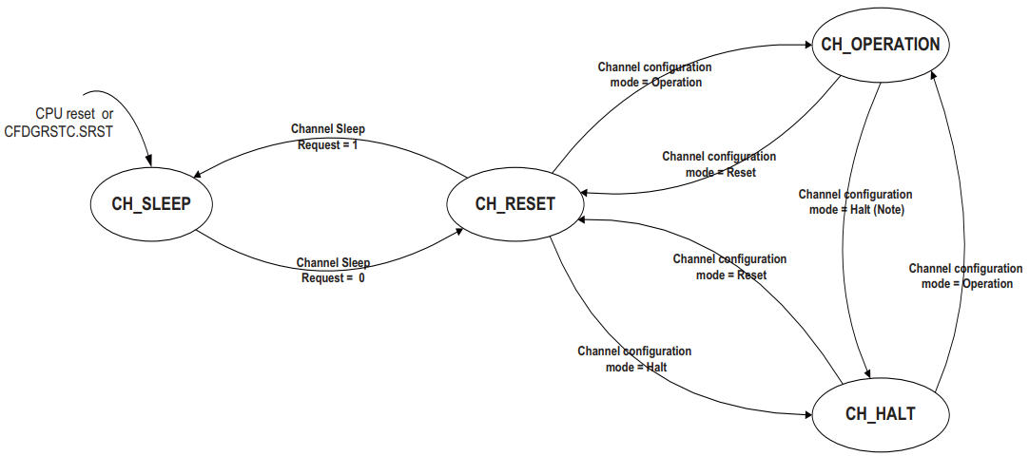
Channel modes - Overview
Transition between CAN channel modes

Slide 10
Channel mode - Sleep
The ways to enter this mode:
+ Release the hardware reset
+ Setting and clearing a RSCFDnCFDGRSTC.SRST bit
+ the related Channel Sleep Mode Request bit is set while the CAN channel is in Channel Reset Mode.
During Channel Sleep Mode, users cannot write to channel related registers. Read operation is still possible.

Slide 11
Channel mode - Reset
The RS-CANFD CAN channel enters this mode in the following ways:
+ Channel Mode Control RSCFDnCFDCmCTR.CHMDC in the Channel Control Registers is configured for Channel Reset Mode while the related CAN channel is in Channel Halt Mode or Channel Operation Mode
+ Channel Sleep Mode request bit is cleared while the related CAN channel is in Channel Sleep Mode
+ Global Mode Control RSCFDnCFDGCTR.GMDC is set to Global Reset Mode and CAN channel is
not in Channel Sleep Mode or Channel Reset Mode
Configuration registers (except the Channel Test Mode registers) are not initialized in this mode and
the RS-CANFD module CAN channel can be configured for communication.

Slide 12
Channel mode - Halt
The RS-CANFD CAN channel enters this mode in the following ways:
+ Channel Mode Control RSCFDnCFDCmCTR.CHMDC in the Channel Control Registers is configured for Channel Halt Mode while the related CAN channel is in Channel Reset Mode or Channel Operation Mode
+ Global Mode Control RSCFDnCFDGCTR.GMDC is set to Global Halt Mode and CAN channel is in Channel Operation Mode
In addition, the channel test mode configuration and control registers are not initialized in this mode.
The Channel Halt Mode should be used to configure channel test modes.

Slide 13
Channel mode - Operation
The Channel Operation Mode is activated by setting the RSCFDnCFDCmCTR.CHMDC bits to 2'b00.
If 11 consecutive recessive bits are detected after entering the CAN Operation Mode, then the
RSCFDnCFDCmSTS.COMSTS bit is set and the CAN channel.
Within the CAN channel Operation Mode, the channel may be in four different sub-modes, depending
on which type of communication functions are performed:
+ Channel idle: The CAN channel is neither receiving nor transmitting.
+ Channel receives: The channel is receiving a CAN message sent by another CAN node.
+ Channel transmits: The channel is transmitting a CAN message.
+ Channel is in Bus-Off state: The CAN channel is cut-off from CAN Bus communication

Slide 14
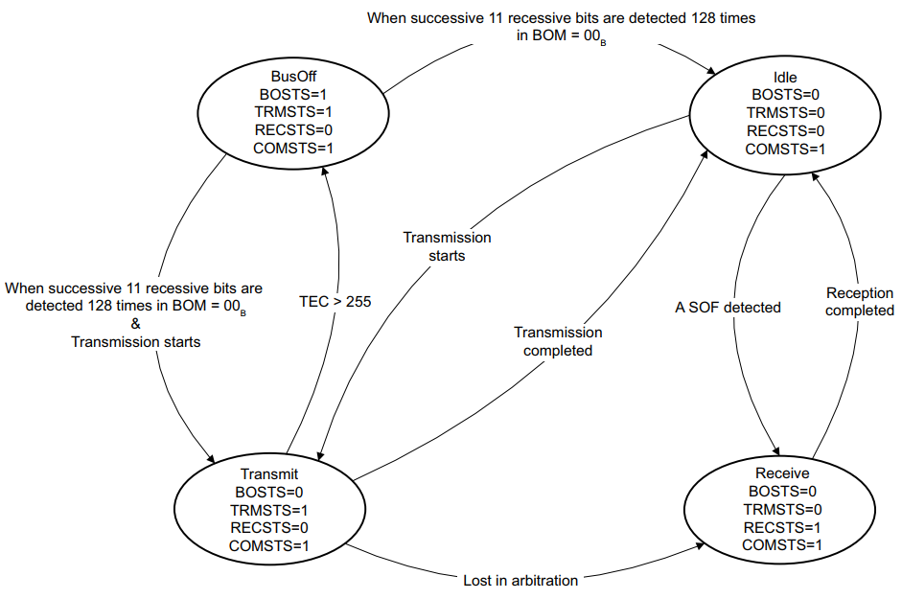
Channel mode - Operation
Sub-Modes of CAN channel Operation Mode (only BOM = 2’b00)

Slide 15
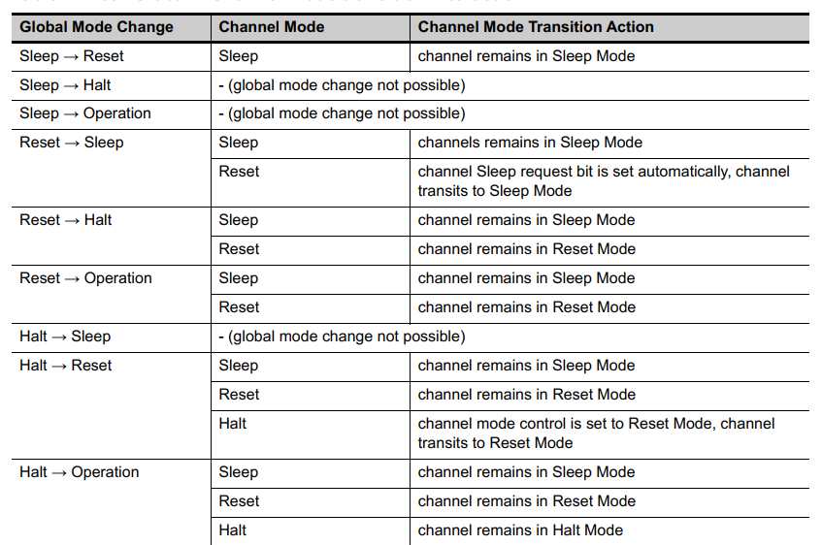
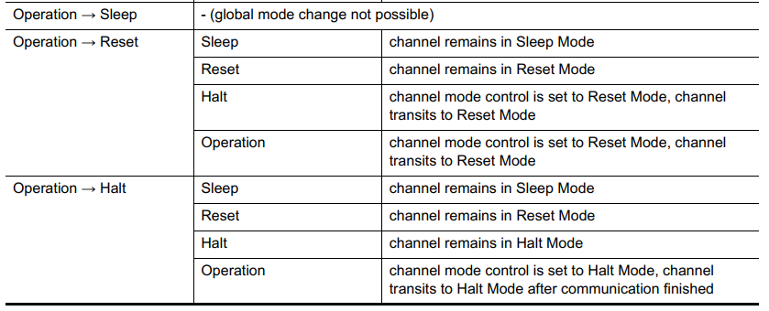
Global - Channel mode interactions summary
Global – Channel mode transition interaction

Slide 16
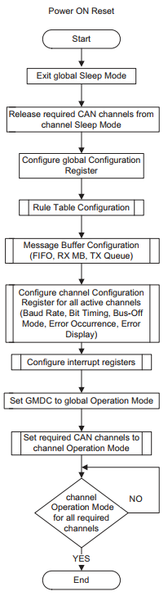
CAN Initialization
Before joining CAN communications the following shall be configured:
Clock setting
+ Bit timing setting (nominal and data rate)
+ Baud Rate setting (nominal and data rate)
+ CANFD setting
+ Acceptance Filter setting (configuration of Global Acceptance Filter List)
+ Reception-, Transmission- and GW-FIFO setting
+ CAN Operation Mode setting
For this all required CAN channels have to be released from channel Sleep Mode and have to be configured for communication in channel Reset Mode (Configuration Mode).
Configuration procedure after H/W Reset

Slide 17
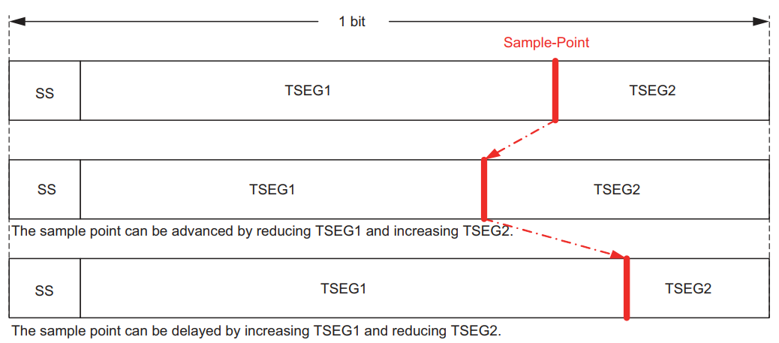
CAN Initialization – Bit timing
CAN bit timing is the time at which each bit on the CAN Bus is sampled
In the CAN protocol, each bit in a communication frame is composed of three segments (SS, TSEG1, TSEG2), which can be configured individually for each channel via the related RSCFDnCFDCmNCFG and
RSCFDnCFDCmDCFG registers.
Segment composition of a bit and the sample point

Slide 18
CAN Initialization – Bit timing
SS = Fixed to 1 TQ
TSEG1 = Refer to (RSCFDnCFDCmNCFG) and (RSCFDnCFDCmDCFG)
TSEG2 = Refer to (RSCFDnCFDCmNCFG) and (RSCFDnCFDCmDCFG)
SJW = Refer to (RSCFDnCFDCmNCFG) and (RSCFDnCFDCmDCFG)
SS + TSEG1 + TSEG2 = 5 to 49 TQs for Data Bit Rate and 8 to 385 for Nominal Bit Rate
Which: (*1)
TQ: Time Quantum - The minimum resolution for the bit timing
SS: Synchronization Segment
TSEG1: Time Segment 1
TSEG2: Time Segment 2
SJW: Resynchronization Jump Width
Limitations:
TSEG1(*2) > TSEG2(*2) ≥ SJW(*2)
TSEG1(*3) ≥ TSEG2(*3) ≥ SJW(*3)
Note1: Section 24.6.1.2 - CAN Bit Timing
Note2: Nominal mode Note3: Data rate mode

Slide 19
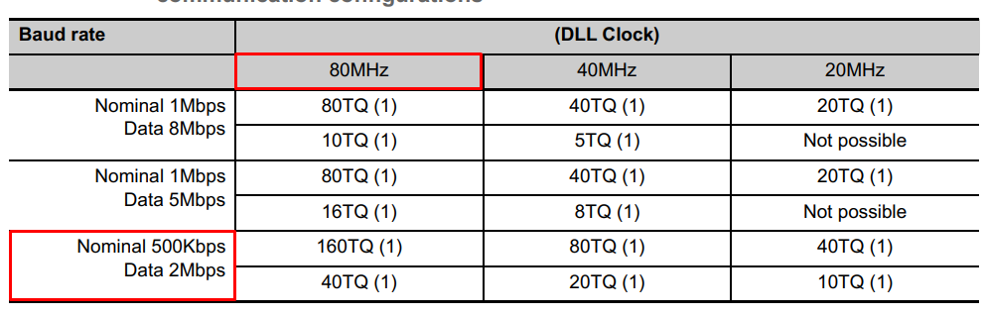
CAN Initialization – Baud rate
Baud Rate calculation example for nominal and data bitrate CAN communication configurations
Example: To reach Nominal baud rate at 500Kbps and Data baud rate at 2Mbps, DLL Clock at 40MHz
+ Nominal: 160 TQs per bit, Baud Rate Prescaler = 1
+ Data: 40 TQs per bit, Baud Rate Presscaler = 1

Slide 20
THANK YOU!

