Slide 1
MCU Modeling – Git
SEP 2018
Hai Phan
Notes:
Created by Hai Phan on Sep 5th 2018. This slide is used to help understand fundamental features and properties of Git ( a distributed version control system).

Slide 2
Agenda
Git
Introduction
Advantage
How it works
Workflow
Daily commands
Powerful commands
Example and Practice

Slide 3

I. a) Introduction
Git is a free and open source distributed version control system designed to handle everything from small to very large projects with speed and efficiency.
Git was created by the Linux creator Linus Torvalds for the management of the Linux kernel source code.

Slide 4
I. b) Advantage
Git has all advantages of a version control system. But there are 3 main points make Git becomes more popular.
Development in parallel.
Easy to synthesis code.
Review before merging branch
It is suitable for:
Large project.
Text file management.

Slide 5
I. c) How it works
Git handles content by snapshots
The info change between 2 snapshots is called change set
A series of snapshots is call a stream or branch
Each snapshot is identified by commit ID (local and global)
A new snapshot(child) is created by applying change set to a previous snapshot(parent)
Term commit, is used both as verb for creating a snapshot and as name for the resulting snapshot
master
feature
develop
3ad024
17ed2c
8b31fd
fe2b18
a7eb21

Slide 6
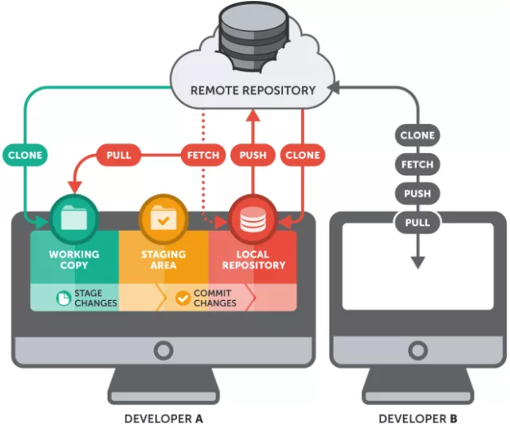
I. d) Workflow

Slide 7
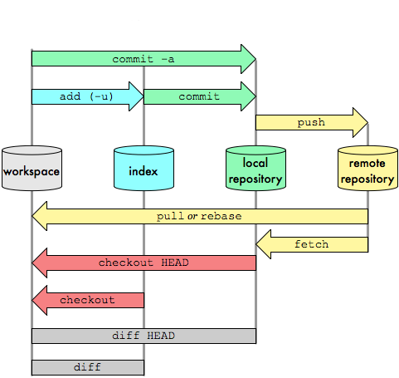
I. e) Daily commands
git pull
git fetch
git checkout
git status
git add
git commit
git push

Slide 8
I. f) Powerful commands
Reset and Revert
Merge, Rebase, and Cherry-pick
Reset
Revert
Merge
Rebase

Slide 9
II. Example and Practice
Create a new git repository
git init
Add remote URL.
git remote add <url_repos>
Create a new branch
git checkout –b <new_branch_name>
Create a readme.txt file
touch readme.txt
Stage the file, then commit file to local repository
git add readme.txt
git commit –m “your_message”
Push (public) your change to remote repository
git push <remote_name> <branch_name>

Slide 10
II. Example and Practice - continue
Edit readme.txt, add 1 arbirary line.
Show the status of the files.
git status
Add and commit the changes.
git add readme.txt
git commit –m “your_message”
Push your change to remote repository.
git push <remote_name> <branch_name>

Slide 11
THANK YOU!!!
SEp 2018
Hai Phan

