Slide 1
MCU Modeling – Makefile
Apr 2020
Notes:
Created by Hai Phan on Sep 5th 2018. This slide is used to help understand fundamental features and properties of Git ( a distributed version control system).

Slide 2
Contents
Define
Make tool
Makefile
Basic Syntax
Make tool
Makefile
A simple Makefile
Rule
Variable
Syntax of Conditionals
Implicit Rules
Phony Target
Including Other Makefiles
Make Tips & Tricks
Refer

Slide 3
Make
Automatically determines which pieces of a large program need to be recompiled.
Give rules how to transform them.
Produce output files from several input files.
Can be used for any kind of “compilation task”.
Preparing LATEX documents.
Transforming images,…
Several variants exist:
GNU Make (covered in this lecture).
Microsoft make.
BSD make.

Slide 4
Makefile
A makefile is a file (by default named "Makefile") containing a set of directives used by a make tool to generate a target/goal.
The makefile also tells make how to compile and link a program.
# This is a very simple makefile
MCU:
echo “Welcome to MCU team”

Slide 5
Make Tool: Syntax Overview
make [options] [target]
Type make --help to see all options make command supports
target is a tag (or name defined) present in makefile
For example:
# This is a very simple makefile
MCU:
echo “Welcome to MCU team”
A file Makefile with this content:
Run the file by typing make, the output will be:
$ make
echo “Welcome to MCU team”
Welcome to MCU team
or
$ make MCU
echo “Welcome to MCU team”
Welcome to MCU team

Slide 6
Basic Syntax of Makefiles
targets : prerequisites
recipe
…
A makefile consists of a set of targets, prerequisites and recipe.
The targets are file names, separated by spaces, to be created/updated.
target depends upon a set of source files or even other targets described in prerequisites.
The recipe of a rule consists of one or more shell command lines to be executed, one at a time, in the order they appear.
Note: Each command in the recipe must be on lines that start with a TAB character. Space issue (****) errors.
targets : prerequisites ; recipe
recipe
…
For example:
# target - prerequisites
KCRC.o: KCRC.cpp KCRC_Func.h
# recipe
gcc –c KCRC.cpp -o KCRC.o

Slide 7
A Simple Makefile
# target - prerequisites
KCRC.o: KCRC.cpp KCRC_Func.h
# recipe
gcc –c KCRC.cpp -o KCRC.o
Suppose we have a small project containing.
Two source file: KCRC.cpp and KCRC_Func.cpp
Header files: KCRC.h, KCRC_Func.h, KCRC_AgentController.h and kcrc_regif.h which included by both .cpp files.
To build: We compile all .cpp files to .o files and then link the .o files together.
When we develop (edit .cpp and .h files).
We need to rebuild the .o files affected by the changes, and finally the binary.
Writing the appropriate compiler invocations by hand all the time is cumbersome.
KCRC_Func.h and KCRC.cpp are prerequisites for KCRC.o
So KCRC.o needs to be rebuilt when one of those are changed.

Slide 8
A Simple Makefile
# target - prerequisites
KCRC: KCRC.o KCRC_Func.o
# recipe
gcc -o KCRC KCRC.o KCRC_Func.o
# target - prerequisites
KCRC.o: KCRC.cpp KCRC_Func.h
# recipe
gcc –c KCRC.cpp -o KCRC.o
# target - prerequisites
KCRC_Func.o: KCRC_Func.cpp KCRC_AgentController.h kcrc_regif.h
# recipe
gcc –c KCRC_Func.cpp -o KCRC_Func.o
Our example:
According to the rules. Make constructs a dependency graph.
This graph needs to be acyclic (DAG).
When processing the Makefile, Make traverses the graph from leaves to root.
If the modification date of a child is newer than the node’s, the node needs to be redone.
Dependencies in our example:
KCRC_Func.h
KCRC.o
KCRC.c
KCRC
kcrc_regif.h
KCRC_Func.o
KCRC_AgentController.h
KCRC_Func.c

Slide 9
Rule – Variables (1/2)
In the above example, most target and prerequisite values are hard-coded, but in real projects, these are replaced with variables and patterns.
The simplest way to define a variable in a makefile is to use the ’=‘ operator.
We can also use: ‘:=‘, ‘+=‘, ‘?=‘, ‘!=‘
Variables defined with ‘=’ are variables recursively expanded.
The value of a variables recursively expanded is installed verbatim; if it contains references to other variables, these references are expanded whenever this variable is substituted.
Variables defined with ‘:=’ or ‘::=’ are simply expanded variables.
The value of a simply expanded variable is scanned once and for all, expanding any references to other variables and functions, when the variable is defined.
Variables defined with ‘+=’ are useful to add more text to the value of a variable already defined.
Variables defined with ‘?=’ are variables to be set to a value only if it’s not already set.
The shell assignment operator ‘!=’ can be used to execute a shell script and set a variable to its output.
KCRC: KCRC.o KCRC_Func.o
gcc -o KCRC KCRC.o KCRC_Func.o
OBJECTS = KCRC.o KCRC_Func.o
=
OBJECTS = KCRC.o
OBJECTS := $(OBJECTS) KCRC_Func.o
=
OBJECTS = KCRC.o
OBJECTS += KCRC_Func.o
KCRC: $(OBJECTS)
gcc -o KCRC $(OBJECTS)

Slide 10
Rule – Variable (2/2)
# Name(overwrite from the top make)
MODEL = KCRC
# Location(overwrite from the top make)
LIBPATH = lib-$(MODEL)
# Linux RedHat7.3 - gcc2.96
CXX = /usr/bin/g++
DEPFLAG = -MM
SOURCES = KCRC.cpp KCRC_Func.cpp kcrc_regif.cpp
OBJECTS = $(LIBPATH)/KCRC.o \
$(LIBPATH)/KCRC_Func.o \
$(LIBPATH)/kcrc_regif.o
TARGET = $(LIBPATH)/$(MODEL).a
Lines starting with # are comments.
Assign the command g++ from /usr/bin to a variable CXX.
Variable DEPFLAG defines flags to be used with gcc in a recipe.
All files with the .cpp extension will be stored in a variable SOURCES.
All files with the .o extension from /lib-KCRC/ will be stored in a variable OBJECTS.
Variable TARGET store /lib-KCRC/KCRC.a

Slide 11
Rule - Syntax of Conditionals
The syntax of a complex conditional is as follows:
conditional-directive
text-if-true
else
text-if-false
endif
if [ expression ]
then
text-if-true
fi
# SystemC location and architecture(overwrite from the top make)
ifeq "$(shell uname -n)" "sdlpc567"
SYSTEMC_HOME = /eda_tools/systemc
else
SYSTEMC_HOME = /home/product/systemc/tools/systemc
endif
ifeq "$(shell uname -s)" "SunOS"
TARGET_ARCH = gccsparcOS5
else
TARGET_ARCH = linux64
endif
SYSTEMC_INCPATH = $(SYSTEMC_HOME)/include
The conditional-directive are ifeq (arg1, arg2) or ifneq (arg1, arg2) or ifdef variable-name
Expand all variable references in arg1 and arg2 and compare them.
The text-if-true and text-if-false may be any lines of text.
To be considered as part of the makefile if the condition is true.
If no condition is true then text-if-false is used

Slide 12
Rule - Pattern-specific Variable Values
In this form, the variable is defined for any target that matches the pattern specified.
pattern ... : variable-assignment
“pattern” is a %-pattern. As with target-specific variable values, multiple pattern values create a pattern-specific variable value for each pattern individually.
The variable-assignment can be any valid form of assignment.
For example:
%.o : CFLAGS = -O
will assign CFLAGS the value of ‘-O’ for all targets matching the pattern %.o.

Slide 13
Rule - Implicit Rules (1/2)
Implicit rules help make knows how to make a file .d from a .o file:
# Implicit rules
%.d: %.cpp
$(CXX) $(DEPFLAG) $(CXXFLAGS) $< | sed 's!$*.o:!$$(LIBPATH)/&!g' > $@
$(LIBPATH)/%.o: %.cpp
$(CXX) -c $(CXXFLAGS) -o $@ $<
Suppose KCRC_Func.cpp is one of the values in $(SOURCES). Then % will match KCRC_Func (% can match any target name). Below is the rule in its expanded form:
KCRC_Func.d: KCRC_Func.cpp $(CXX) $(DEPFLAG) $(CXXFLAGS) KCRC_Func.cpp| sed 's!$*.o:!$$(LIBPATH)/&!g’ > KCRC_Func.d
As shown, % is replaced by KCRC_Func, KCRC and kcrc_regif.
$< (is patterned to match prerequisites) is replaced by %.cpp.
$@ matches the target.

Slide 14
Rule - Implicit Rules (2/2)
Implicit rules help make knows how to make a .o file from a .c file:
# Implicit rules
%.d: %.cpp
$(CXX) $(DEPFLAG) $(CXXFLAGS) $< | sed 's!$*.o:!$$(LIBPATH)/&!g' > $@
$(LIBPATH)/%.o: %.cpp
$(CXX) -c $(CXXFLAGS) -o $@ $<
Every prerequisite in the previous rule is considered a target for this rule. Below is the rule in its expanded form:
# Implicit rules
KCRC_Func.d: KCRC_Func.cpp $(CXX) $(DEPFLAG) $(CXXFLAGS) KCRC_Func.cpp| sed 's!$*.o:!$$(LIBPATH)/&!g’ > KCRC_Func.d
lib-KCRC/KCRC_Fun.o: KCRC_Func.cpp $(CXX) -c $(CXXFLAGS) -o lib-KCRC/KCRC_Fun.o KCRC_Func.cpp

Slide 15
Rule - Phony Target
A phony target (example: clean) is one that is not really the name of a file; rather it is just a name for a recipe to be executed when you make an explicit request.
There are two reasons to use a phony target: to avoid a conflict with a file of the same name, and to improve performance.
If you write a rule whose recipe will not create the target file, the recipe will be executed every time the target comes up for remaking.
# Build rules
.PHONY : all compile clean
all:
if test ! -d $(LIBPATH); then mkdir $(LIBPATH); fi;
$(MAKE) compile
compile: $(TARGET)
$(TARGET): $(OBJECTS)
$(AR) $@ $(OBJECTS) 2>&1 | c++filt
@echo "Done“
$(OBJECTS): $(SOURCES) $(SOURCES:.cpp=.d)
clean:
find . -name "*~" -print -exec rm -f {} \;
-$(RM) $(RM_OPT) $(SOURCES:.cpp=.d) $(OBJECTS) $(TARGET) core
-$(RM) $(RM_OPT) $(LIBPATH)
As example, because the rm command does not create a file named clean, probably no such file will ever exist. Therefore, the rm command will be executed every time you say ‘make clean’.
To avoid this problem you can explicitly declare the target to be phony by making it a prerequisite of the special target .PHONY .

Slide 16
Rule - Including Other Makefiles
The include directive tells make to suspend reading the current makefile and read one or more other makefiles before continuing.
include filenames...
filenames can contain shell file name patterns. If filenames is empty, nothing is included and no error is printed.
If you want make to simply ignore a makefile which does not exist or cannot be remade, with no error message, use the -include directive instead of include, like this:
-include filenames...
For example:
SOURCES = KCRC.cpp KCRC_Func.cpp kcrc_regif.cpp
…
# $(SOURCES:.cpp=.d) = KCRC.d KCRC_Func.d kcrc_regif.d
# Dependencies
-include $(SOURCES:.cpp=.d)

Slide 17
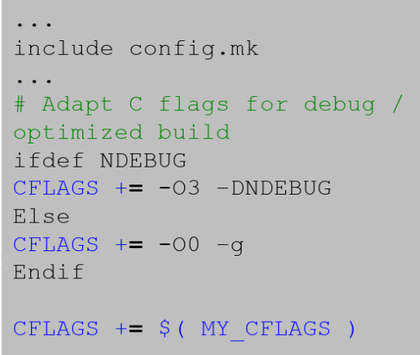
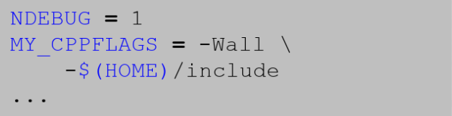
Make Tips & Tricks (1/5)
It is not bad to put configuration settings to be provided by the user into a separate file.
makefile
config.mk

Slide 18
Make Tips & Tricks (2/5)
Put generated files (.o, .d, final binary) into separate directory.
# Name(overwrite from the top make)
MODEL = KCRC
# Location(overwrite from the top make)
LIBPATH = lib-$(MODEL)
…….
# Implicit rules
%.d: %.cpp
$(CXX) $(DEPFLAG) $(CXXFLAGS) $< | sed 's!$*.o:!$$(LIBPATH)/&!g' > $@
$(LIBPATH)/%.o: %.cpp
$(CXX) -c $(CXXFLAGS) -o $@ $<
Note: Generated files do not pollute your source directory.

Slide 19
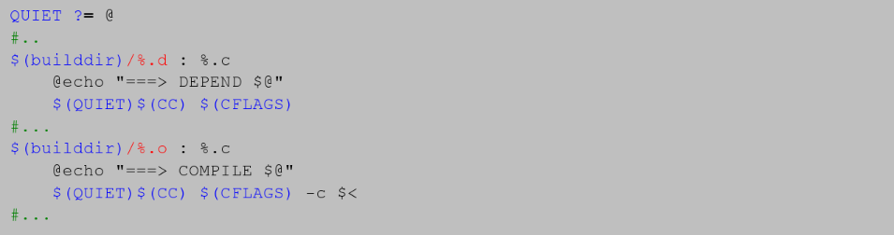




Make Tips & Tricks (3/5)
For nicer output, use Linux kernel style pretty printing.
@ at the beginning of the line does not print the command.
For example:
makefile

Slide 20
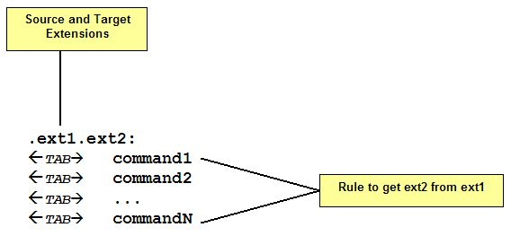
Make Tips & Tricks (4/5)
Suffix rule: Simplifying Makefiles Syntax
For example: Source code file: KCRC.cpp
.c.o:
cc -c $<
KCRC.o: KCRC.cpp
cc -c KCRC.cpp

Slide 21
Make Tips & Tricks (5/5)
More Special Characters
$? | List of dependencies changed more recently than current target.
$@ | The name of current target
$< | The name of current dependency
$* | The name of current dependency without extension
$% | The target member name, when the target is an archive member
$^ | The names of all the prerequisites, with spaces between them
$| | The names of all the order-only prerequisites, with spaces between them
$+ | This is like ‘$^’

Slide 22
Refer
https://www.gnu.org/software/make/manual/make.pdf
https://opensource.com/article/18/8/what-how-makefile

Slide 23
THANK YOU!!!

