Slide 1

Technical Proposal
eShop AI Chatbot Shopping Assistant Integration
Date
June 16, 2026

Slide 2
Table of Contents
Section 1: Strategic Alignment
Section 2: Architecture & Integration
Section 3: MVP Delivery & Quality Assurance
Section 4: Advanced AI Roadmap
Section 5: Project Governance & Appendix

Slide 3
Executive Summary
The Challenge
Our Approach
Rikkeisoft proposes a focused Phase 1 engagement delivering Analytics Foundation MVP — leveraging ABC's existing data infrastructure (API + frontend only, no infrastructure rebuild):
Phase 1 : Chatbot MVP. Includes a Blazor-based UI, semantic product search via Catalog.API, an inline Add-to-Cart button, and local memory fallback for sessions.
Phase 2 : Smart Cards (Identity + Mobile integration), Newsfeed Polls Widget, and Portfolio-level chatbot analytics.
Phase 3 : Advanced AI Insights, Advanced Payment/Rewards Cards, LLM-powered data summarizers.
Each phase delivers independently usable value with modular design — no existing features affected.
Key Outcomes
Phase 1 chatbot live in ~1 weeks — real-time cart addition and semantic search without database rewrite.
Smart Cards, Polls widget, and advanced AI analytics unlocked in Phases 2 & 3.

Slide 4
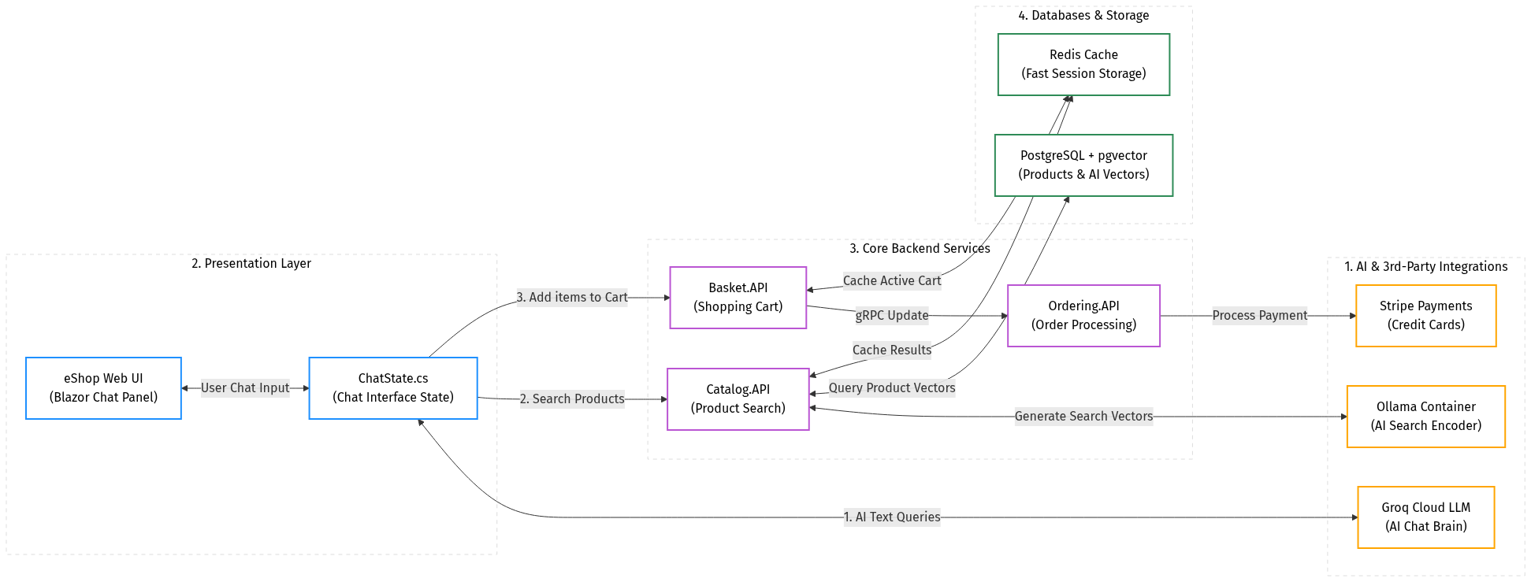
Understanding ABC’s Current Position

Slide 5

Proposed
Solution Approach

Slide 6
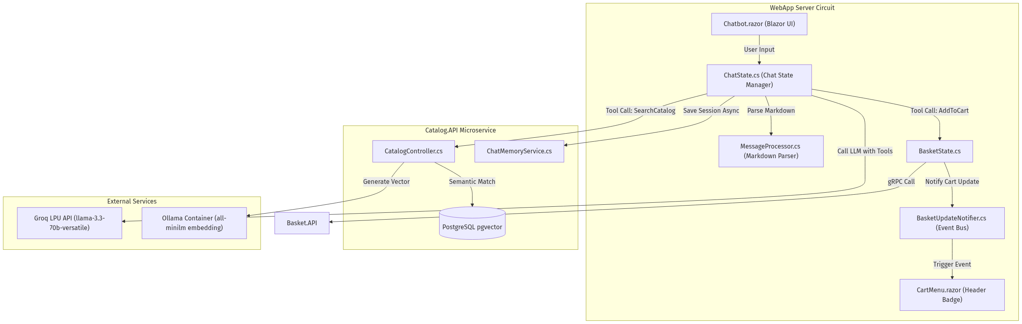
Proposed High-Level Solution Architecture
Existing System
Developed by Boiz

Slide 7
Chatbot Delivery Architecture
Key Assumption: Catalog data already exists in PostgreSQL database. The chatbot runs as an isolated component inside the WebApp and Catalog.API, communicating via gRPC, ensuring no existing services are disrupted.
MVP SCOPE
Stage 1
Codebase Discovery
Stage 2
API & UI Integration
Local LLM Config
Setup & Local Costs
(Developer PCs)
Cloud LLM Config
Setup & Cloud Costs
(Staging/Prod)
Review existing data models in Catalog.API microservice
Map available database tables and existing API patterns
Define API contracts and setup local development Docker containers
Build REST & gRPC API endpoints for chat
Develop Blazor chatbot UI & markdown parser
Run integration & Playwright regression tests
Engine: Ollama (Llama 3.2 3B / Mistral 7B)
Hardware: 8GB-16GB RAM, 4-Core CPU/GPU
Speed: 15-30 t/s | Cost: $0 (run on dev PCs)
Engine: OpenAI GPT-4o-mini / Groq Llama 3.3
Speed: 100-250+ t/s (ultra-low latency)
Cost: ~$0.15-$0.60/1M t. (~$5-$10/mo for 10K q.)

Slide 8
Quality Assurance & Testing Strategy
Key Objective: Deliver a stable, highly performant chatbot assistant with a solid testing strategy — Unit tests, Integration tests, and automated UI Regression tests run before every release.
Testing Pyramid
Test Level | Coverage | Tools
Unit Tests | Business logic, markdown parsing, and state management | xUnit
Integration Tests | REST/gRPC API endpoints, pgvector search, and cart actions | xUnit
UI Regression Tests | Automated checkout flows and UI circuit state verification | Playwright
Per-Feature QA Deliverables
✓ Unit tests: validation of markdown parsing logic in MessageProcessor.cs
✓ Integration tests: gRPC and REST APIs in Catalog.API and Basket.API
✓ Regression tests: automated Playwright tests run against dev server for UI flows

Slide 9
Key Challenges & Mitigation Strategy MVP
# | Category | Challenge / Risk | Impact | Mitigation Plan
1 | Tool Hallucinations | Llama 3.3 outputs conversational text while calling tools, causing ClientResultException. | Prob: High Impact: High | Mitigation: Enforce empty text response constraint in system prompt for tool call turns.
2 | Local Resource Limits | Cosmos DB Emulator requires 3-4 GB RAM, overloading 8GB RAM local dev environments. | Prob: Medium Impact: Medium | Mitigation: Implement ConcurrentDictionary in-memory session backup fallback in local settings.
3 | API Rate Limits | LLM provider limits rpm/tpm, freezing chatbot when multiple users send queries. | Prob: Medium Impact: High | Mitigation: Implement HttpClient retry-after handler and optimize tokens in system prompts.

Slide 10
MVP Delivery Team & Commercials

Slide 11
Roles and Responsibilities
RKTech (Our Team)
ABC (Clients)
Manage project delivery, sprint planning & client communication (PM/BA)
Build chatbot APIs, Postgres pgvector & background memory services (BE Dev)
Implement Blazor chatbot UI, CSS styling & event handlers (FE Dev)
Run xUnit tests, gRPC integration & Playwright UI regression (QA)
Provide codebase access, API docs & staging database credentials (Wk 1-2)
Clarify eShop business logic & product catalog details in 1 business day
Participate in UAT & validate chatbot response accuracy per sprint
Provide prompt sign-off on deliverables to keep timeline on track
⏳ STRICT CLIENT TIME COMMITMENT — We protect ABC leadership's bandwidth. No unnecessary meetings.

Slide 12
AI Advanced features suggestion

Slide 13
Proposed Dashboard & Chatbot Capabilities
Key Objective: Deliver an AI chatbot shopping assistant to automate product discovery, semantic search, and cart actions directly in the chat panel.
Core Chatbot MVP
Expanded AI Roadmap
Platform Analytics
Track overall platform metrics: catalog item popularity trends, user growth, and feature adoption rates.
Portfolio-Level Dashboard
Compare chatbot usage, customer conversion rates, and purchase success across multiple eShop project instances.
Project-Level Dashboard
Track active chat sessions, successful cart additions via AI, average response latency, and frequent product queries.
Advanced AI Insights
Phase 3 expansion: AI-assisted analysis generating natural language summaries of performance metrics for stakeholders.
Advanced AI Insights
Phase 3: LLM-powered checkout recommendations and dynamic UI generation based on customer shopping history.
Key MVP Deliverables (Phase 1):
Chatbot Web UI component in Blazor and gRPC communication layer between WebApp, Catalog.API, and Basket.API.
Semantic search API endpoints using PostgreSQL pgvector and local Ollama embeddings, with in-memory fallback.
Real-time cart updates and badge synchronization using the BasketUpdateNotifier event listener.
Note: All chatbot sessions are tenant-scoped — project managers see only assigned data; customer sessions are strictly isolated via JWT filters.

Slide 14
Proposed AI Scope & Approach
Key Objective: Secure, tenant-scoped data retrieval and real-time interactive UI for the shopping assistant.
Chatbot Data Store
AI Processing Pipeline
Rich Interactive UI
Data Inputs
Product catalog items with pgvector embeddings
Chat session histories saved asynchronously
In-memory cache for local development fallback
Multi-tenant scoped — JWT-enforced per customer & store
Interaction Points
User prompt — "Show red running shoes under $50"
Tool calls — SearchCatalog and AddToCart intents
Real-time events — BasketUpdateNotifier badge trigger
System triggers — checkout reminder on cart abandonment
Step 1 — Semantic Retrieval
Generate query embedding via local Ollama container
Query PostgreSQL catalog database using pgvector cosine distance
Step 2 — Intent Execution
Gateway resolves tool calls (e.g., SearchCatalog, AddToCart)
Execute gRPC cart operations against Basket.API service
Step 3 — UI Rendering
Format LLM output using structured markdown links & buttons
Blazor MessageProcessor parses markdown into interactive HTML
Apply eShop design system styles for seamless circuit integration
Rich Interactive UI
Clickable product links for immediate catalog navigation
Interactive Add-to-Cart buttons embedded in chat bubbles
Real-time updates of header cart badge on item additions
Alerts & Notifications
Friendly error messages on external LLM service timeouts
Local ConcurrentDictionary alerts in development mode
Rate limit warning flags when LLM RPM/TPM bounds are hit
Checkout reminder prompts for abandoned shopping carts
AI Roadmap & Scope
Phase 1 (Chatbot MVP): Chatbot UI, semantic search API, gRPC integration, local session fallback.
Phase 2 (Portfolio & Polls): Event-driven newsfeed polls, Smart Cards, multilingual support.
Phase 3 (AI Expansion): AI-powered checkouts, dynamic charts, personalized product recommendations.

Slide 15
Appendix

Slide 16
Communication Plan
Activity | Description | Participant | Frequency | Channel
Daily Standup | Progress updates, blockers, and impediment resolution | Rikkeisoft dev team only ※3 | Daily | Slack ※3
Weekly Sync | Sprint progress, risks & key decisions — 30 min | Huy (PM), Tech Lead, Delivery Manager | Weekly | Video call ※1
Bi-weekly Demo | Working software demo & feedback — 45 min, recorded | Dung (PM), Boiz (optional), ABC CTO (optional) | Bi-weekly | Video call + recorded ※1
Monthly Report | Progress summary, metrics & next month plan — async, no meeting required | All stakeholders | Monthly | Written report
Quarterly Review | Phase completion review, roadmap & next phase planning — 60 min | ABC CTO, Huy (PM), Rikkeisoft leadership | Quarterly | Video call ※1
※1 Virtual meeting: MS Teams / Google Meet
※2 Escalation path: Level 1 (1 business day) → Level 2 (2 business days) → Level 3 (1 week). See Risk Management slide for full escalation matrix.
※3 Daily Standup: Managed entirely by Rikkeisoft. Interaction with ABC via Huy (PM) on Slack only — C-Level leadership is never required to attend.

Slide 17






Project Management Tool
Activity | Description | Tool/Method
Document management | Control documents send and receive between ABC and RKTech | OneDrive SVN
Source code Management | Facilitate version control, and code tracking for teams, ensuring efficient software development workflows | ADO Bitbucket Github
Question and Answer Management | Manage the questions from ABC and RKTech while doing the project | 365 Sheet
Task (User Story, Task, Bug) Management | Assign and control tasks of members, Bugs/Issues of project | Jira, ADO
Change Requirement Management | Log and control any change requirements of the project | 365 Sheet, Jira, ADO
Commercial licenses are not included in the budget estimation.

Slide 18
Change Management Plan
Requester
(Boiz )
1. Change Request Raised
Boiz submits request via written Q&A doc or weekly sync
Delivery
Manager
2. Impact Assessment
DM evaluates scope, timeline, and effort impact within 2 business days
3. Approved?
DM + Tech Lead review → Boiz signs off
Yes
Tech Lead
/ Outcome
No
Rejected / Deferred
Logged; requester notified with rationale
4. Implementation
Tech Lead executes; documented in sprint backlog with change impact notes
5. Closure & Docs
ADR updated; scope baseline re-confirmed; all stakeholders notified
※ Change requests are assessed within 2 business days. Approved changes are scoped and documented before inclusion in the sprint backlog. Each phase begins only after mutual sign-off — scope changes mid-phase require a formal change request and may adjust the timeline and/or phase gate date.

Slide 19
Risk Management Plan
ABC Project — 7 Key Risks
01
Identification of Risks
# | Category | Prob | Impact | Mitigation Strategy
1 | API Latency Spikes | Med | High | Pre-fetching and caching embeddings; asynchronous loading state
2 | LLM Rate Limiting | High | High | Retry handler; prompt token budget controls; exponential backoff
3 | Database Schema Drift | Low | Med | Automated EF Core migrations; schema validation in staging
4 | Prompt Injection | Low | Crit | Input sanitization; strict system prompt rules; LLM response parsing
5 | Session Data Leakage | Low | Crit | Row-Level Security (RLS) in PostgreSQL; JWT token verification
6 | Local Hardware Limits | High | Med | In-memory backup fallback (ConcurrentDictionary) by default locally
7 | User Adoption Barriers | Med | Med | Clean interactive Blazor HTML elements (links, Add-to-Cart buttons)
02
Risk Assessment
03
Risk Mitigation &
Contingency Plan
04
Implementation &
Monitoring
05
Review & Update
Risk Plan

Slide 20





Rikkeisoft CORPORATION
Headquarters:
21st Floor, Handico Tower, Pham Hung, Me Tri, Nam Tu Liem, Hanoi
Offices:
Da Nang: 11th Floor, VietNam News Agency Building, 81 Quang Trung St., Hai Chau Dist, Danang, VietNam
Ho Chi Minh City: 7th Floor, Maritime Safety South Building, 42 Tu Cuong St., Ward 4, Tan Binh Dist, Ho Chi Minh City, Vietnam
Hue City: 62 To Huu St, Xuan Phu Dist, Hue City, Vietnam
RIKKEI JAPAN
Headquarters:
3rd Floor, Fujishima Building, Tamachi 16 Street, 4-13-4 Shiba, Minato-ku, Tokyo, Japan
Thank you
Offices:
Osaka: 2nd Floor, Office’ Port Osaka, 3-5-10 Nishitenma, Kita-ku, Osaka, Japan
Nagoya: 40th Floor, Nagoya Lucent Tower, 6-1 Ushijima-cho, Nishi-ku, Nagoya, Japan
Fukuoka: Hakata Suncity Building 507, Hakataekiminami 2-chōme−1−5, Hakata-ku, Fukuoka, Japan
RIKKEI THAILAND
Headquarters:
Ramaland building, no. 952 Rama IV Road, Khwaeng Suriyawongse, Khet Bangrak, Bangkok Thailand
POC: truonglpx@rikkeisoft.com
www.rikkeisoft.com
RKTECH CORP.
Headquarters:
Preston Park Towers West, 4975 Preston Park Blvd, Suite 505, Plano, Texas, 75093

