Slide 1


2024
Positioning in the digital twin - a comparison on the fidelity with real data
Xuan Zhang
08 Dec, 2024

Slide 2
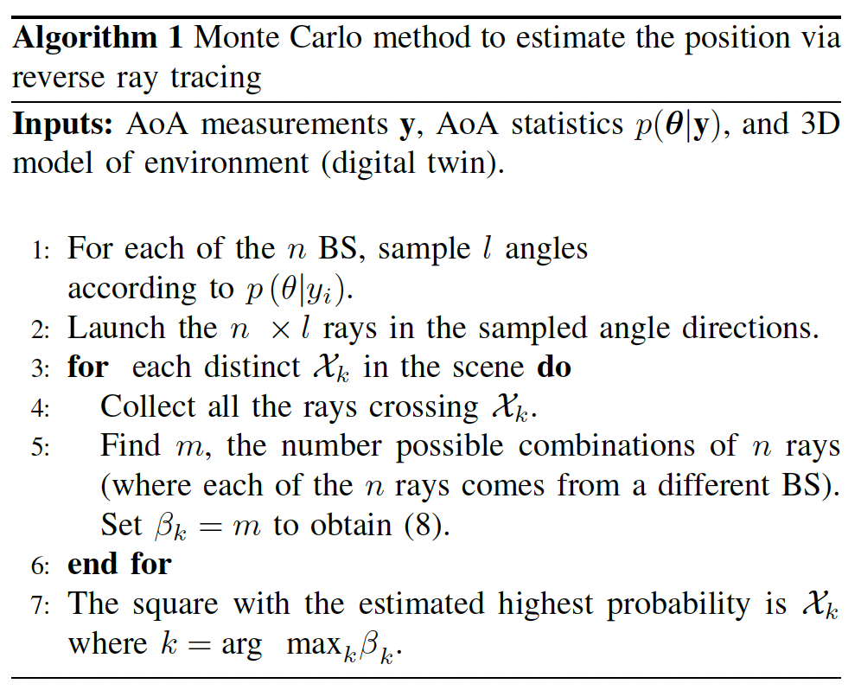
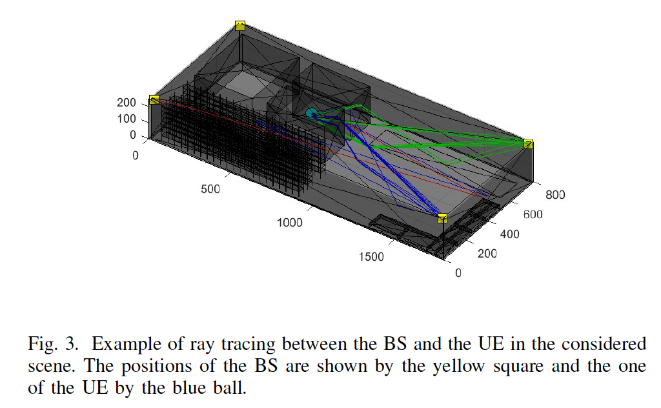
Goal
According to the "Reverse ray tracing" method introduced in the paper [1][2][3], I try to test the first Monte Carlo method of the three algorithms mentioned in Unity to estimate the position via reverse ray tracing as Figure 1, in order to achieve the effect shown in Figure 2. (the original implementation is their own Matlab-implemented ray-launching software)
Figure 1
Figure 2

Slide 3
Reverse ray tracing
A ray in the so-called "Reverse ray tracing" is defined as a path, characterized by a 3D scene, starting from a given location and with an angle of departure (AoD) θ. We use the notation path(θ) to refer to a ray.
Geometric assumption : due to smaller wavelength, the diffraction phenomenon is less important at millimeterwave (mmWave) frequencies compared to centimeter-wave frequencies [4]. Consequently, many channel models consider only specular reflections at the former higher frequencies.
Several models are considered in the article, and the one we try here is the one without noise.

Slide 4
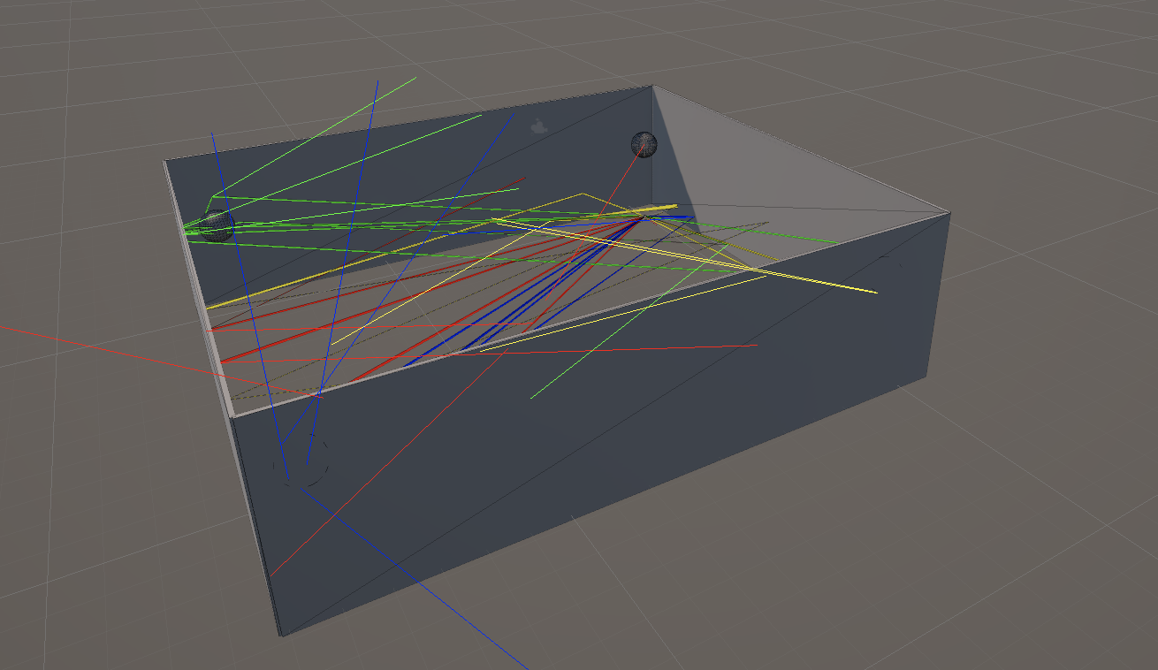
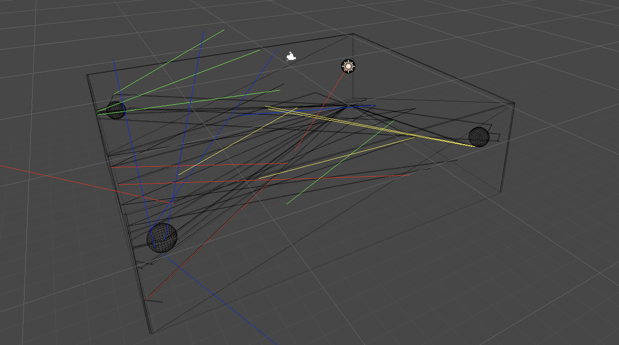
Current progress
According to the AP position in MADE-AGV-TEST-1.mat, four walls are generated. The value of AoA_el data simulates the ray generation between [AoA_el_{min}, AoA_el_{max}], and the maximum number of collisions is 5.

Slide 5
What to do next
1. Analyze AoA statistics p(theta|y)
2. Build a realistic 3D model of environment
3. Collecting the rays crossing

Slide 6
References
V. Nguyen, V. Corlay, and N. Gresset, “Probabilistic ray-tracing aided positioning at mmWave frequencies”, Int. Conf. on Indoor Positioningand Indoor Navigation (IPIN), 2023.
V. Corlay, V. Nguyen, and N. Gresset, “Probabilistic positioning via ray tracing with noisy angle of arrival measurements”, IEEE Communications Letters, vol. 28, no. 10, Oct. 2024.
Fusion of Time and Angle Measurements for Digital-Twin-Aided Probabilistic 3D Positioning Vincent Corlay, Viet-Hoa Nguyen, Nicolas Gresset https://doi.org/10.48550/arXiv.2410.15237、
S. Deng, G. R. MacCartney, and T. S. Rappaport, “Indoor and Outdoor 5G Diffraction Measurements and Models at 10, 20, and 26 GHz,” NYU WIRELESS TR 2016-001, May. 2016.

Slide 7
CONTATTI
xuan3.zhang@polimi.it

