Slide 1
Project Presentation - mean shift part
Qinhan Gao, Tianyang Zhao, Xuan Zhang, Chunrong Shan

Slide 2
Mode Seeking
Baseline (implementation from the original code)
Find the largest value in the 272 × 272 response map.
Obtain its indices/coordinates.
Mean shift
Start from the mode of the last frame (the center of the response map if it’s the first frame).
Calculate the weighted average of the coordinates of all the points in the region of interest.
Round the results to integers, then they are the coordinates of the new center of mass.
If the new center of mass is the same as the old center of mass, it’s the mode we are seeking.
If the new center of mass is different from the old center of mass, continue from step 2 until convergence.

Slide 3
Experiments
Model: the pretrained model provided by the repository
Dataset: VOT2018 (60 different sequences of frames)
Evaluation metrics
Accuracy: weighted Intersection over Union
Robustness: weighted number of tracking failures (the smaller, the more robust)
Speed: average frame per second
Test mode: supervised

Slide 4
Results and Conclusions
GPU | Region of Interest | Accuracy | Robustness | Speed
GeForce RTX 2070 | 50 × 50 | 0.50831 | 58.95793 | 4.18445
GeForce RTX 3090 | 40 × 40 | 0.50256 | 62.17584 | 13.42264
GeForce RTX 3090 | 30 × 30 | 0.51167 | 107.41839 | 25.83890
GeForce RTX 2070 | 20 × 20 | 0.47061 | 593.26042 | 22.00117
GeForce RTX 2070 | 10 × 10 | 0 | 1039.46446 | 59.64209
GeForce RTX 2070 | 5 × 5 | 0 | 1048.24320 | 60.50291
GeForce RTX 2070 | N/A (baseline) | 0.52192 | 63.80731 | 7.40653
With a large enough region of interest, mean shift improves on the robustness at the cost of a small amount of accuracy.
In general, as the region of interest becomes larger, the accuracy improves then becomes relatively stable, the robustness steadily gets better, though the speed gets slower.

Slide 5
Explain Conclusion 1
With a large enough region of interest, mean shift improves on the robustness at the cost of a small amount of accuracy.
The baseline mode seeking approach works due to the assumption that the point with the highest value in the response map is usually the mode.
Mean shift is more robust and versatile.

Slide 6
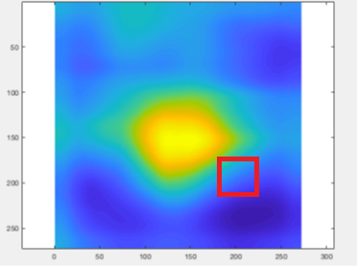
Explain Conclusion 2
In general, as region of interest becomes larger, the accuracy improves then becomes relatively stable, the robustness steadily gets better, though the speed gets slower.
When region of interest is small
Due to the value distribution, if we start at a point where its value is small, the other points in the region of interest are also likely to not provide high values.
Then, the new center of mass is more likely to be very close to the old center of mass and gets rounded to be the same point which leads to early convergence.

