Slide 1
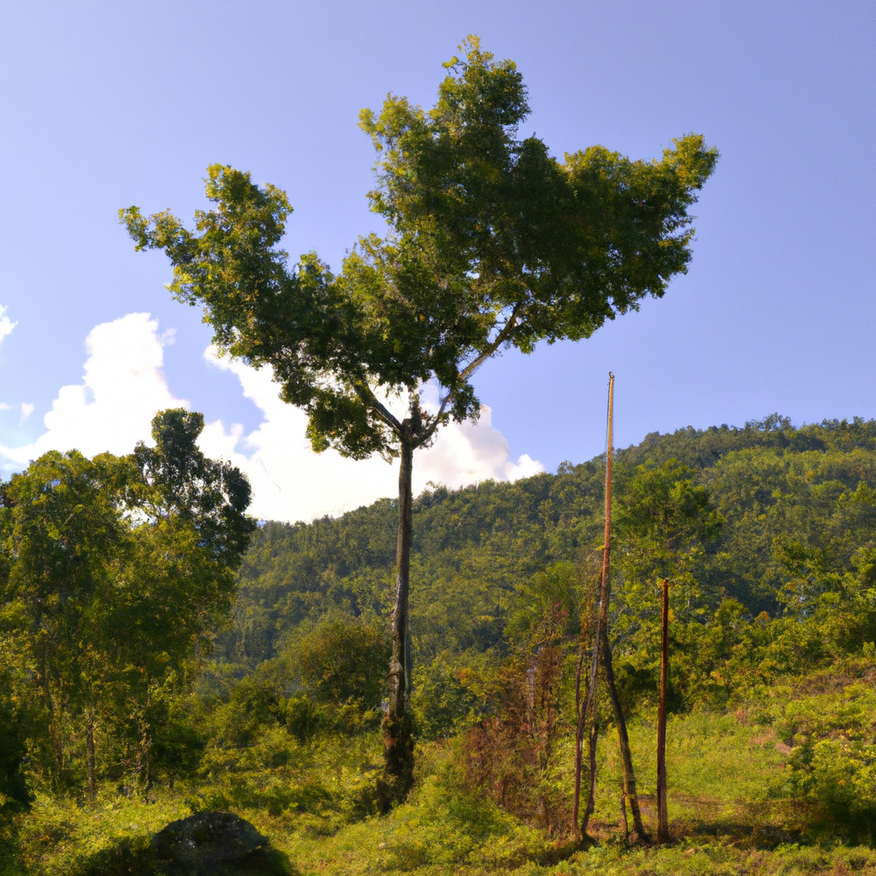
What drives the success of reforestation projects in tropical developing countries? The case of the Philippines

Slide 2
Reforestation projects in tropical developing countries can be successful if they take into account technical/biophysical drivers, socio-economic drivers, institutional, policy and management drivers, and reforestation project characteristics.

Slide 3
Success indicators include forest establishment, forest growth, environmental and socio-economic success indicators.

Slide 4
Policies targeting revegetation methods, socio-economic incentives, forest protection mechanisms, sustainable livelihoods, diversification of funding and partnerships, technical support, and infrastructure development are likely to have a broad systemic and beneficial effect on

