Slide 1
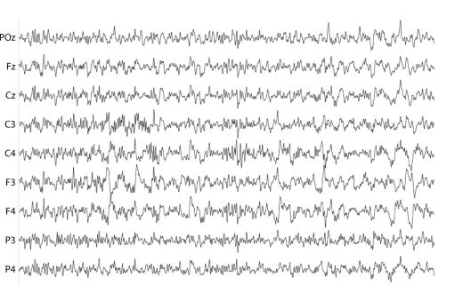
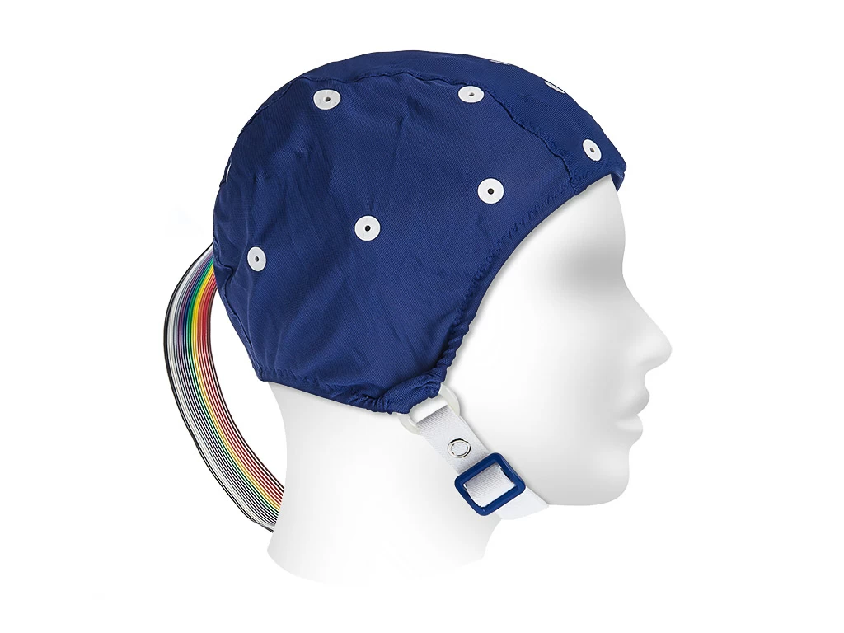
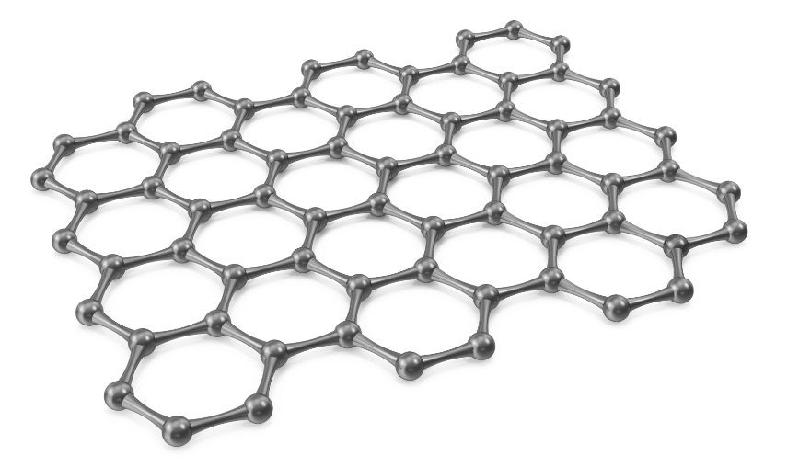
Development of a Wearable EEG Device for Continuous Long-Term Monitoring Using Conductive Polymers as Electrodes
MSc in Biomedical Engineering
Xuanqin Yu
Notes:
Hello, I’m Xuanqin Yu, a master in Biomedical Engineering. Today I’m pleased to introduce our work on the Development of a Wearable EEG Device especially for the long term use. In addition, the performance of a conductive polymer material will be tested

Slide 2
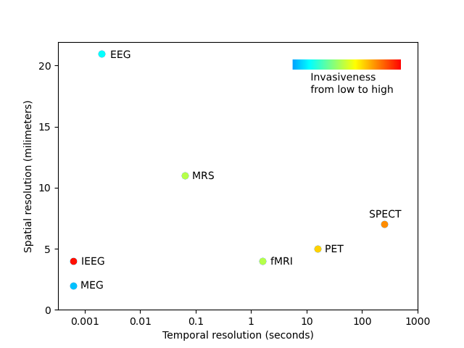
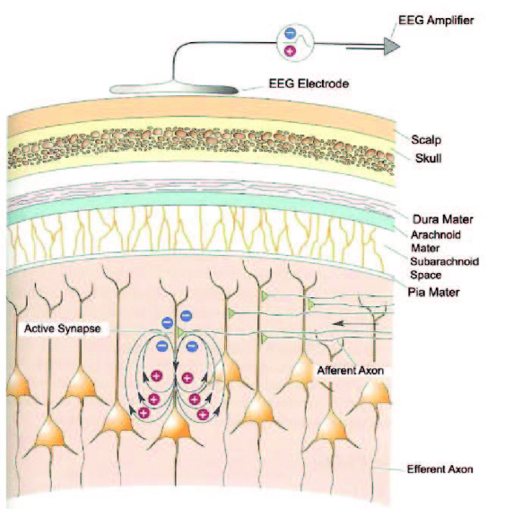
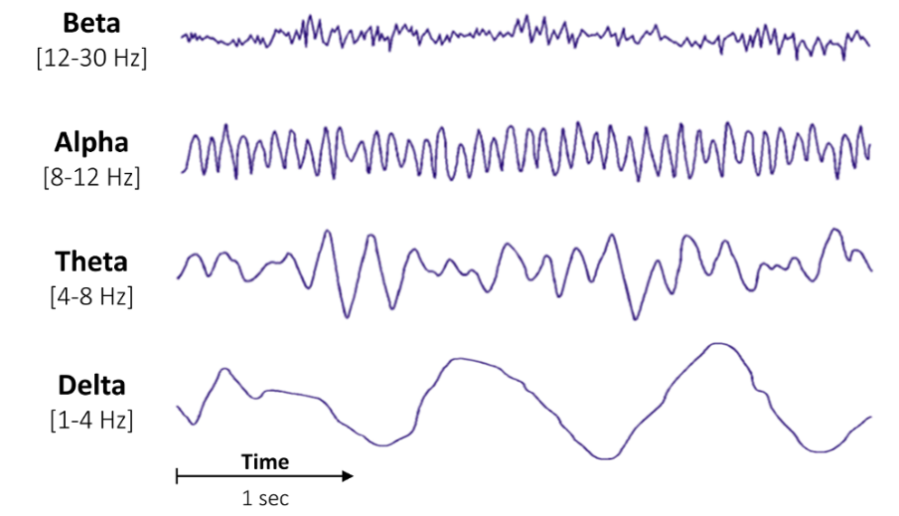
1.1 Background of EEG
EEG generation
Frequency components in EEG
Electroencephalography (EEG) is a method to record an electrogram of the spontaneous electrical activity of the brain.
Advantages: Easy-to-use, Cheap, High temporal resolution, Compatible with other device e.g. fMRI
Compared with other neuroimaging method
Notes:
What is the EEG. EEG is method to recording electrical activity of the brain, the signal first generates from the postsynaptic potential from a group neurons, then it transmits to though the membrain, muscle , bone and finally to the skin and our electrode can detect it. So, it is actually not the action potential of a sinlge neuron but a potential of a group of neurons. Therefore we cannot find a temporal chracteristics such as action potential, but in frequency, EEG has many different components and each represents their own function, such as alpha, beta wave here. Since it is electrical, a good advantage of EEG is their high temporal resolution, and cheap price compared wit other neuroimaing method, and it is non-invasve

Slide 3
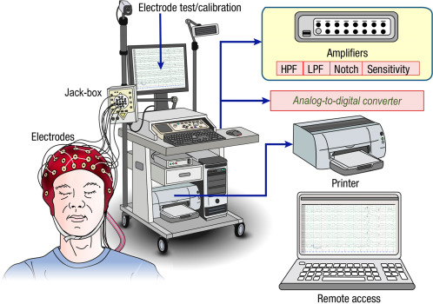
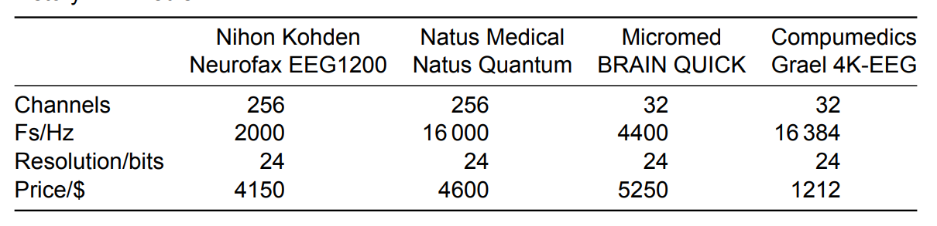




1.2 Limitations: Traditional EEG machine
They are widely used in hospital and research center. But what if the study requires dynamic conditions such as in exercise, driving or homebased monitoring,
Traditional EEG machine in Hospital
Limitation 1: Wearability for different conditions
Notes:
However, there many limitation of the current EEG device. For traditional EEG machine in hospital, as you can see the left figure, is large and bulky has a lot of cables. In the table at right, they usually has many channels from 32 to 256 with great parameter in sample frequency and parameter. But it can only be used on some static condition, for study like the EEG in exercise, in driving or home-based study, the lack of the flexibility or wearability is a limitation for those traditional EEG device

Slide 4
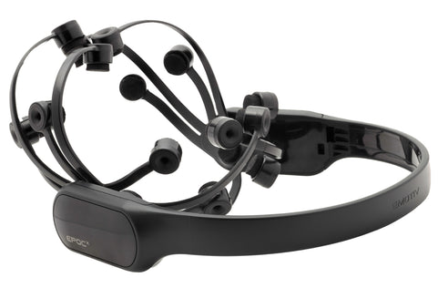
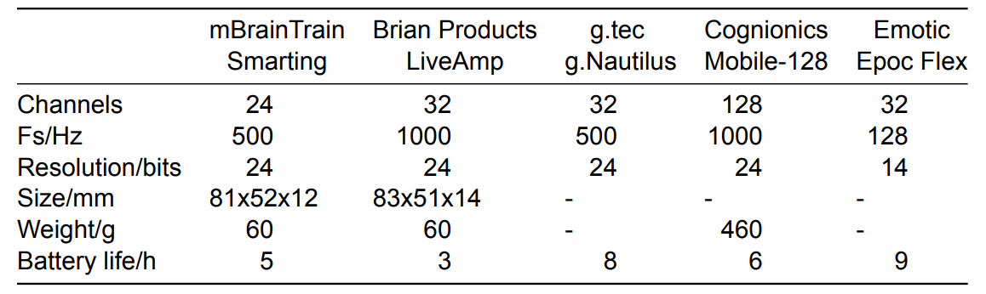
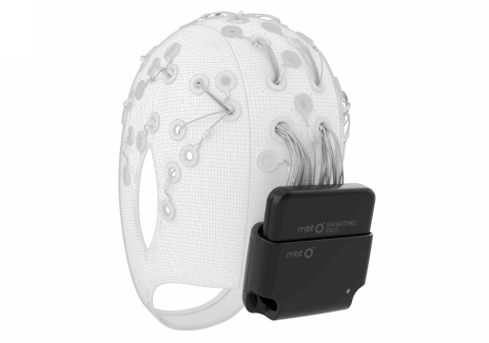
1.2 Limitations: Wearable EEG device
Wearable EEG device on market (Epoc-X (© 2025 EMOTIV))
There are some innovative wearable EEG device on market solving problem mentioned before, but their battery life is only around 5 to 9 hour, which is not suitable for a long-term study such as sleep study
Limitation 2: Short Battery Life
Smarting Pro (© mBrainTrain )
Notes:
Then there are some commercial wearable EEG device, as you can see the they integrate the electrode, signal processing unit and battery to the single device. In the table right, there are the common wearable devices in market, and we found though they provide great flexibility their battery is huge challenge, the can only run for 5 to 9 hour per use, which is not enough for a long term study such sleep research. So the second limitation for current device is their short battery life

Slide 5
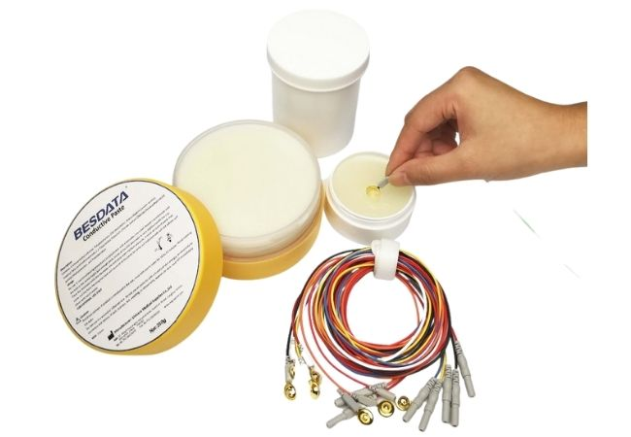
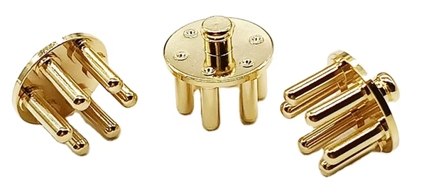
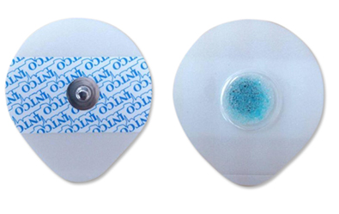
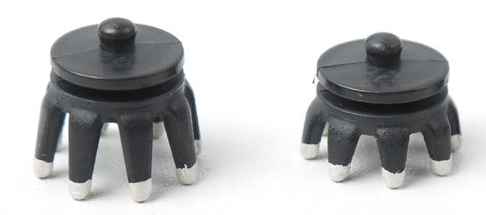
1.2 Limitations: Electrode
Disposable wet electrode
Wet/gel electrode
Dry electrode
Common electrode used in EEG:
Wet/Gel electrode: complex to set up, reapplication required in long using
Dry electrode: large skin-electrode impedance and more noise
Limitation 3: Inconvenient Electrodes
Notes:
Last, electrode also plays an essential role in EEG recording. Here are the common electrode used ,the first two the wet/gel electrode, and third one is the dry electrode. The gel electrode usually provides the best signal quality, but the conductive requires a reapplication every 4 to 5 hour. The dry electrode is easier to used and you can see they have special surface to better contact the skin with hair. But the signal recorded from dry electrode is much weaker than wet electrode, and more noise are detected. Both of them has their own disadvantages, So the electrode is also a limitation for the EEG device

Slide 6
1.3 Motivation and Objective
Development of a Wearable EEG Device for Continuous Long-Term Monitoring Using Conductive Polymers as Electrodes
1. Build a wearable EEG device:
Gain: 10,000 v/v
Frequency*: 0.5 ~ 70 Hz
Powered by single battery
Wireless data transmission
2. Extend the battery life to at least 24 hours
3. Test the performance of the Innovative Conductive Polymer material as EEG electrode
Hardware Design
Software & Low power optimization
Electrode
*EEG Standads from International Federation of Clinical Neurophysiology
Notes:
So conquering the three limitations mentioned before is the main motivation and objective of this project. Let go back to the title, we are going to develop a Wearable EEG Device for Continuous Long-Term Monitoring Using Conductive Polymers as Electrodes. First for the wearability, we have 4 key points, so we will build a EEG machine following the standard EEG requirement from International Federation of Clinical Neurophysiology, that are the amplification level and frequency reserved. Then we will iplment a power management system and wireless data transmission module to make whole design more compact. This part will be solved in hardware design. To the increase the battery life, for example, at least 1day, we’ll make the in depth low power optimization on software and programming to get better result than products before. Finally, we are going to test the performance of a innovative conductive polymer material, whether is can be used in EEG recording.

Slide 7
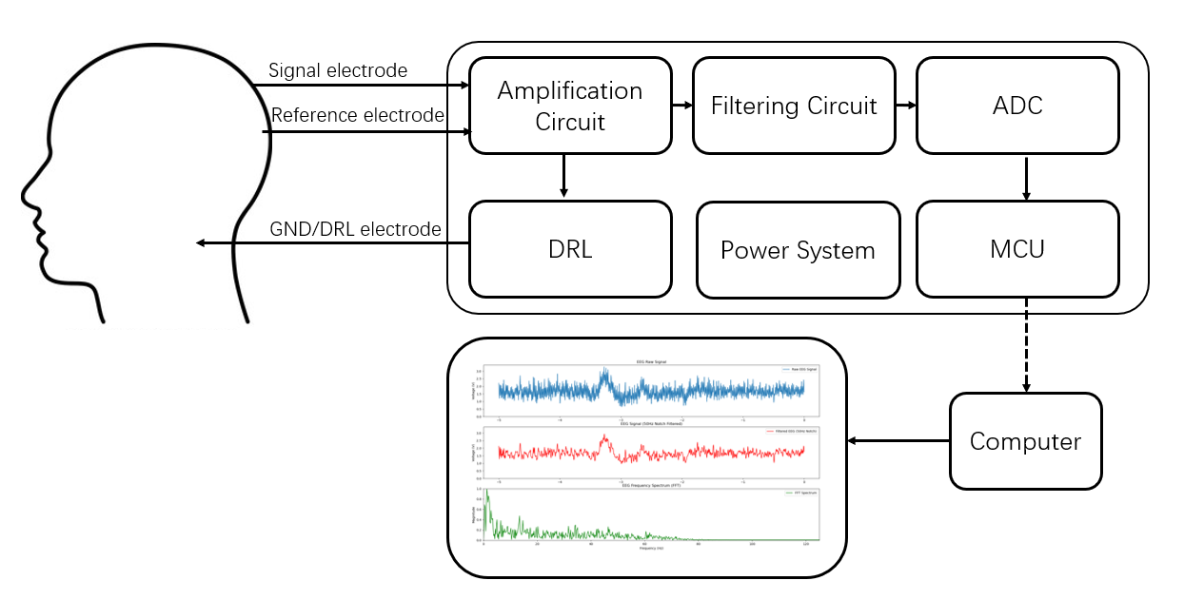
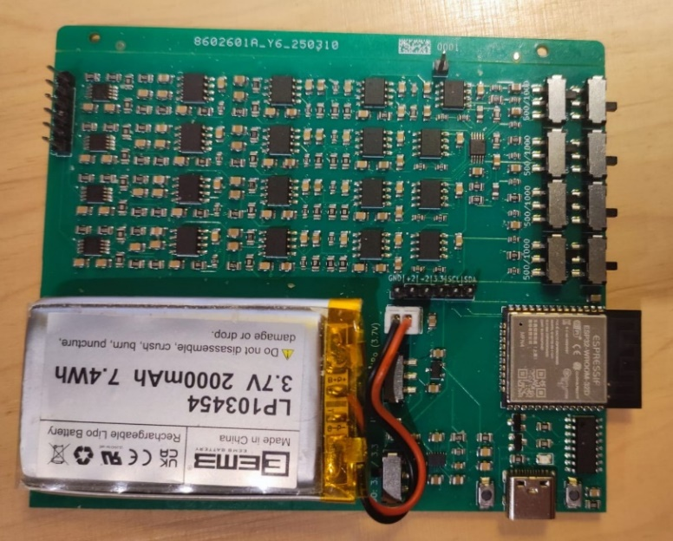
2.1 Hardware: System Overview
x4
Bluetooth
PCB design of the our device
This is a four-channel wearable EEG device design
(1) The signals from each channel are processed with an independent amplification (40+40 dB) and filtering circuit (0.5 ~ 70 Hz)
(2) Then the analog signal is digitalized with a 16-bit ADC in 100 or 250 Hz depending on channels numbers.
(3) Finally the signal is transmitted to computer through Bluetooth
Notes:
First, for the hardware design, the left figure is the device diagram, there are three electrodes connected to the person, that are the signal electrode, reference electrode and the GND electrode.
The differential voltage will amplified in the amplification circuit, then processing with the firltering circuit to resesrve the 0.5 to 70 Hz as refered.
The analog signal is then converted into the digital signal in a 16-bit ADC and sample frequency is 250 Hz in one channel and 100 hz in multipe channel. In this PCB board you can see there four identical circuits and each for one channel.
After the conversion in ADC, the data is stored and send through Bluetooth with the internal MCU here to the computer, the computer will visualize the signal and do some the postprocessing such as FFT for analyzation.
Now we are going to the details for the amplification and filtering circuit

Slide 8
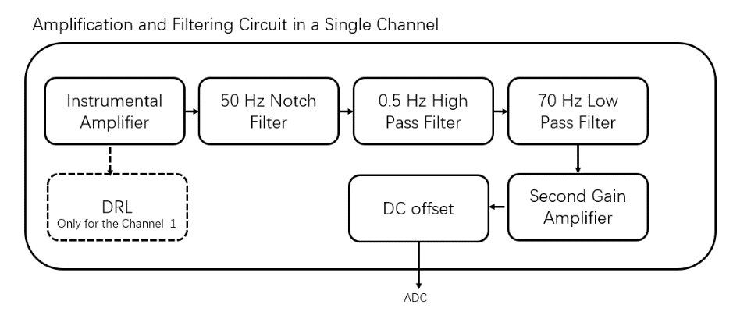
2.1 Hardware: For each channel
Channel
Reference
Notes:
For each channel, we have the same circuit, except the first channel which has an DRL circuit will be introduced later. You can see fitst is the instrumental amplifier, then is the filter in different frequency and a second ampliter. A DC offset circuit is to pull the negative part signal to positive so ADC can record the full information

Slide 9
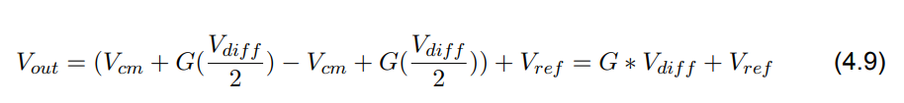
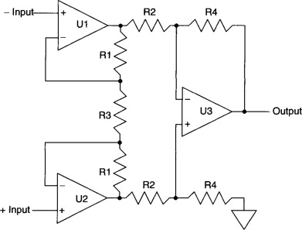
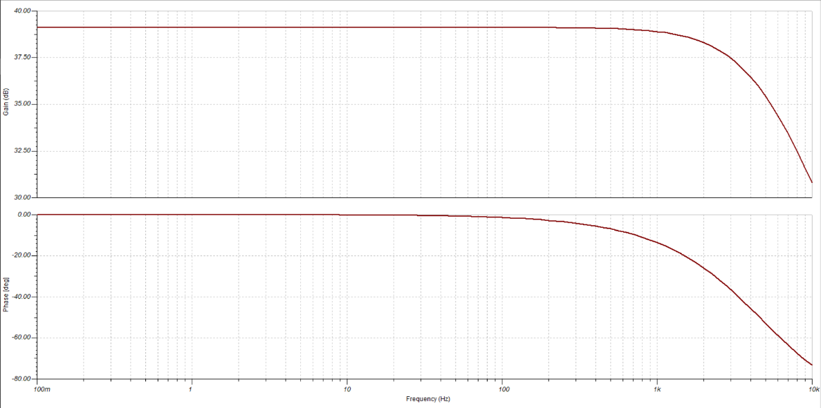
2.1 Instrumental Amplifier (IA)
  Amplify the differential part of the signal to 40 dB
V_{in-} = V_{cm} - V_{diff}/2
Amplitude
Phase
V_{in+} = V_{cm} + V_{diff}/2
Frequency response of INA333 (simulated with Tina-TI)
Notes:
So first is the instrumental amplifier. It is used to amplifier the differential signal to 40 dB, which is around 90 times larger the than before. The design of the IA contains three op amps. The idea is that, we can treat the voltage of two input channels as Common-mode part such as noise and the differential part that is the EEG signal. With a conduction, we can find this circuit cancel the common-mode part of the signal, and only the differential part will be amplifier, the gain depends on the value of the R3 and R1. In our device, we utilized the INA333 from Texus Instrument, and the simulation result at right shows the frequency response of the IA, the components from 0 to 1k part are amplified to around 40 dB

Slide 10
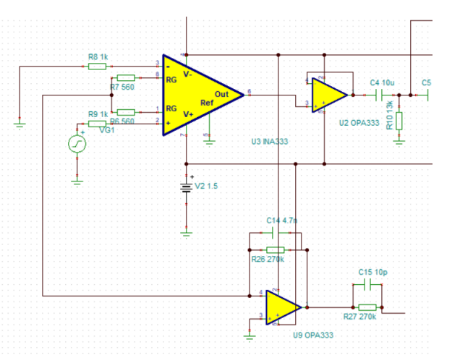
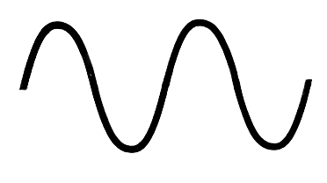

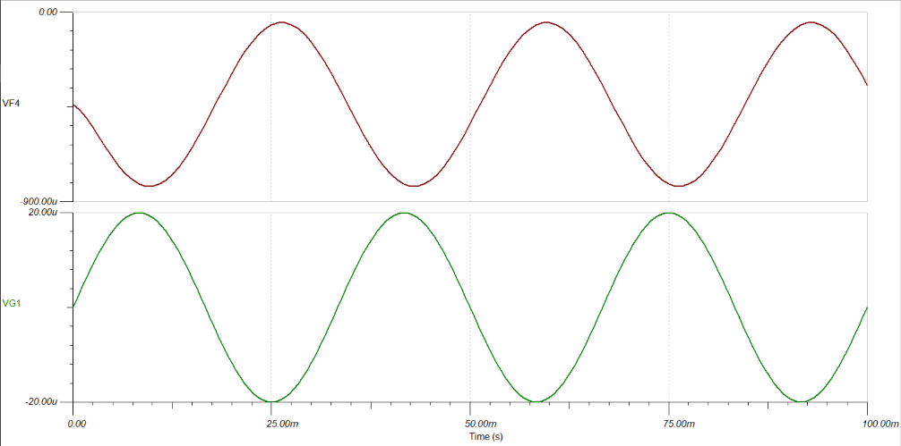


2.2 Driven Right Leg (DRL)
Circuit
The DRL circuit is used to increase the Common-mode Noise Rejection (CMRR)
The common-mode noise is inverted and amplified, then sent back to body to build a negative feedback
V(R3/2) = 0 for Vdiff
V(R3/2) = Vcm for Vcm
DRL output
Original
Notes:
Then for the first channel, we added a dirven right leg circuit to improve the signal quality. The DRL circuit first used in ECG designed to increase the common-mode rejection ratio but it can also be used in EEG. Though in IA we know common-mode noise is canceled, but it is ideal condition, the fact is there is still many common-mode noise. In the circuit you can the large yellow trianle is the IA introduced before, there are three op amps inside, and here is the input and there is R3, but we divided it into two half of R3. Voltage of the their middle point is different depending on the differential of common-mode voltage, for differential voltag it is 0 and for common mode voltage it is actually the voltage of the common mode voltage. The common-mode signal is send to a very simple inverter, you can see the non-inverting input connects to the GND, so he voltage from IA is inverted and amplified.
The key part of DRL circuit is that, the inverted signal is then send back to body, like this. When noise with inverse phase are send back, it actually builds a negative feedback, and the balanced point appears when common-mode noise being zero. So it is actually a smart design. Figure right shows the simulation of the DRL circuit in our device

Slide 11
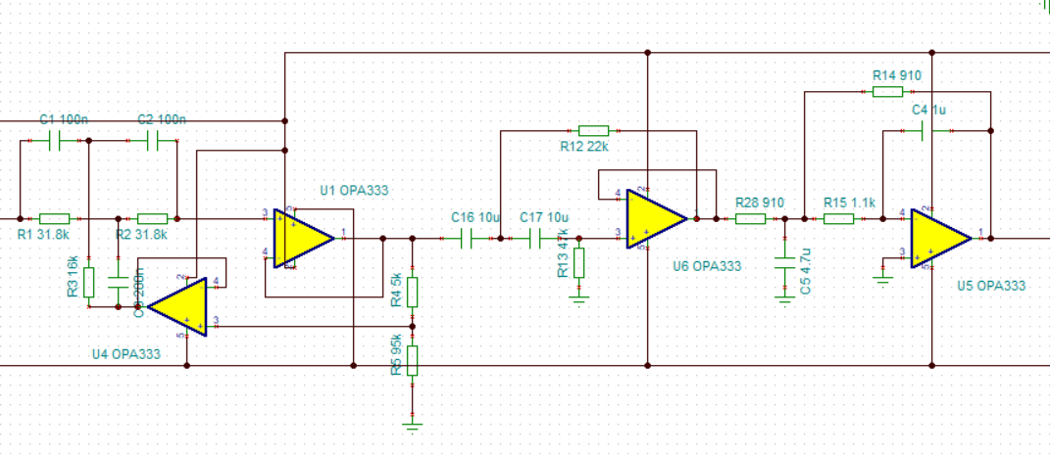
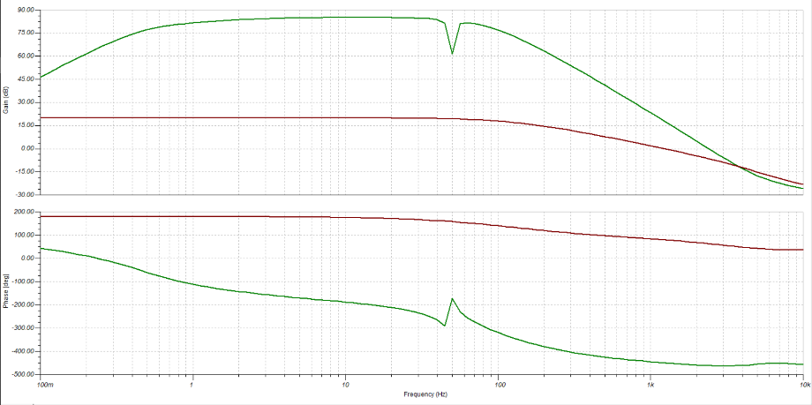
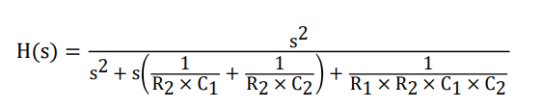
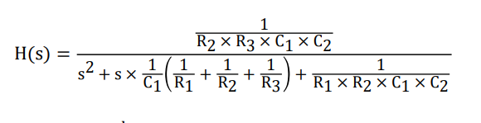
2.3 Filtering circuit
50 Hz Notch Filter
0.5 Hz HPF
70 Hz LPF
R2
R1
R1
R2
Amplitude
R3
C1
C2
R1
C1
Phase
Frequency Response of the whole circuit
Notes:
Here is the filtering circuit in our device, there is a casede of 50 Hz active twin-T notch filter, a 0.5 Hz highpass filter and 70 hz low pass filter. The design of the filter following the regular design topology of Sallen-key and Multiple feedback. Here calculated the transfer function of the high pass and low pass filter. Then choose the suitable value for the resistors and capacitors to meet our need. Finally, in the right figure, we build the exact same circuit and simulated it in the Tina-TI, which a simulation tools developed by the Texus Instrument, ensuring the type of the op amp is the same as the simulation model. Here you can see the component outside the 0.5 to 70 Hz are suppressed, and the 50 Hz is also suppressed, because the 50 hz powerline interference noise is the most common noise in EEG.

Slide 12
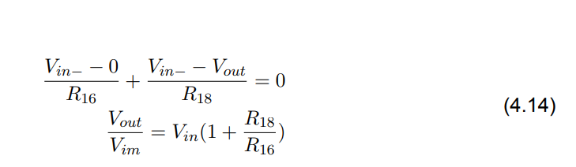
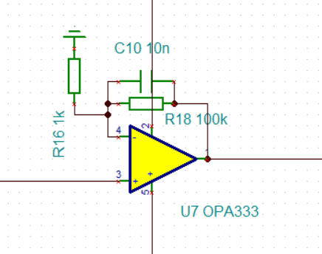
2.4 Second circuit
The amplification circuit contains two stage:
  Instrumental Amplifier: 40dB
  Second Amplifier: 40 dB
The final Gain:
40 dB + 40 dB = 80 dB
EEG: 20~100 μV -> 0.2 ~1 V
*The reason why applied staged amplification comes from properties of INA333
Notes:
After the filtering circuit, we have another amplification circuit, because in IA, the signal is only around 40 dB larger than before, which is not enough for a EEG signal, therefore we uses a very simple amplification circuit, by using KCL at the inverting input, the gain can be changes by editing value of two resistor, in our device , another 40 dB gain is applyied ,therefor the EEG: 20~100 μV -> measurable 0.2 ~1 V. But why don’t we directly amplifer the signal using IA to 80 dB, it is actually limited by the property of IA type we used, that is INA333.
So this the hardware design of our device, the signal is the send to the ADC and ADC will sent it to the MCU

Slide 13
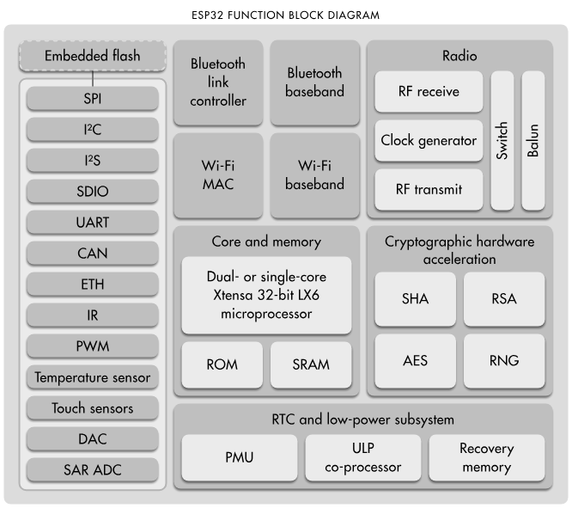
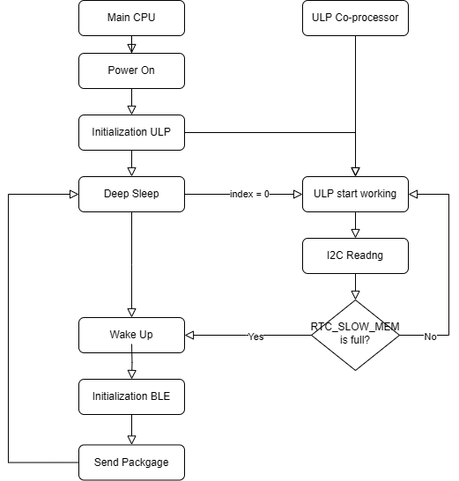
3.1 Low Power Strategy: MCU spends over 90% of the energy
~1000ms
17000ms
10 ms
~3000ms
Available during Deep Sleep with 8 kB RTC_SLOW_MEM reserved
Strategy for the long-term monitoring
Notes:
For the MCU, we did a in depth lower power optimization on programming. So in the left figure, it is the MCU we utilized called ESP32, it is a very powerful chip commonly used in low energy device. There are many module such as WIFI, Bluetooth and RF and even DAC module. An interesting design of the ESP32 is that, except the main CPU, it has an additional independent Ultra low energy ULP processor, and it can work when the main CPU is in deep sleep. The ULP can communicate with the ADC using I2C prototical and store the data in the RTC memory which won’t be cleaned when entering the deep sleep mode.
Based on this property, we developed a special program a strategy for our data collection. In the right figure, you can see, when the main CPU is powered on, it will initialize the ULP, and then goes into the deep sleep mode, it cost around 1 second. The the ULP will continuous read data from the ADC, and decide whether to wake up the main CPU. If the memory in RTC is full, the CPU will be waked up and send the signal through the Bluetooth Low Energy that is BLE to the computer. When sample frequency is 100 Hz, the sleeping time is as long as 17 second, and the BLE sending only spends around 3 seconds.
So let go into the details of the ULP processor

Slide 14
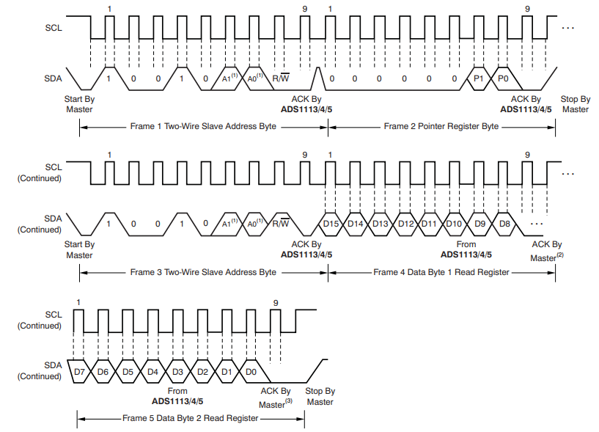
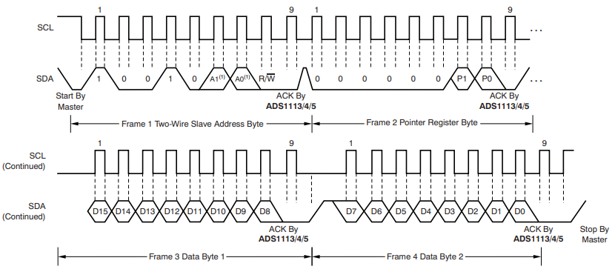
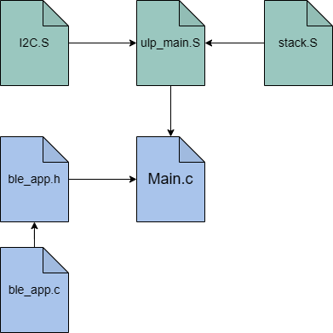
2.2 ULP: I2C protocol in Assembly with ADS1115
I2C writing
I2C.S and stack.S provide essential function for the I2C reading and writing
Ulp_main.S implement communication with ADS1115 (ADC)
Ble_app is configuration of the BLE service.
Main.c contains strategy mentioned before.
I2C reading
The official method provided by ESP-IDF: I2C_READ and I2C_WRITE missing essential part. Therefore we developed our own I2C code in assembly
Script dependency
Notes:
The ULP is powerful, but also has its price. Since it is a very primitive core, we cannot program it in C or C++, however, only assemblier language is allowed. The assemblier language is the lower level machine language by editing the register of the firmware. Here we have to implement the I2C protocol in the ULP code. For the I2C reading data, we have two wires that are SDA for data, SCL for clock. First we send 8 bit for the address and another 8 bit setting the register in read mode. Then we will can read the 16-bit information from the register. For the I2C writing ,we must write a 16-bit commond to the ADC so it can understand when to start work and which channel should be converted.
However, though ESP32 has some method I2C_read and I2C_write, they work in 8 bit but ous in 16 bits. Therefore we built our customed I2C script for ADS1115. that is our ADC.
The blue file is written in C, and the main.C implement the stratagem we mentioned before, and BLE_app.c is the setting for the BLE module such as service and power of advertising. The green file is the ULP code written in assembler, the I2C.S provides the necessary function and ULP .S is used to communicate with ADC.

Slide 15
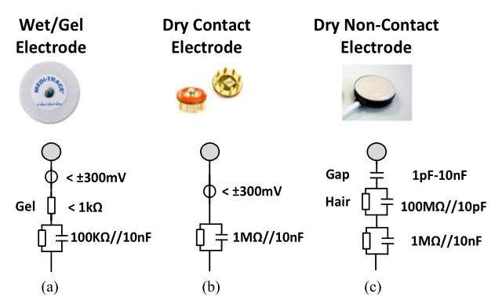
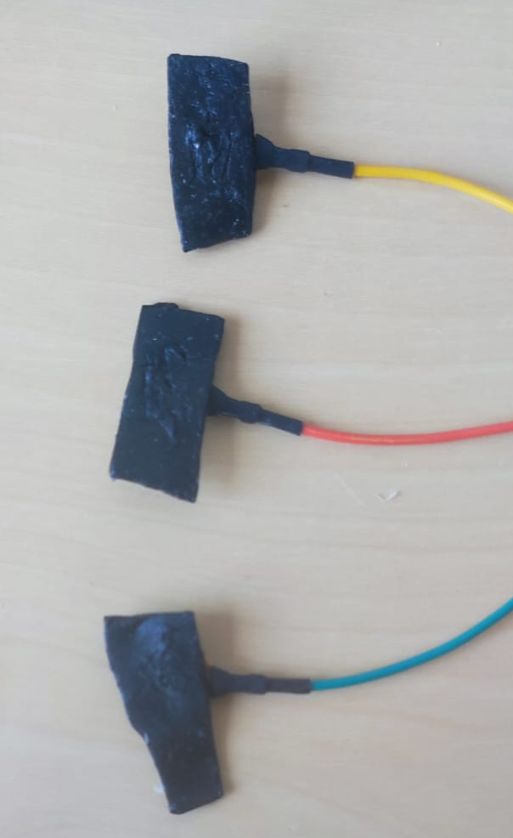
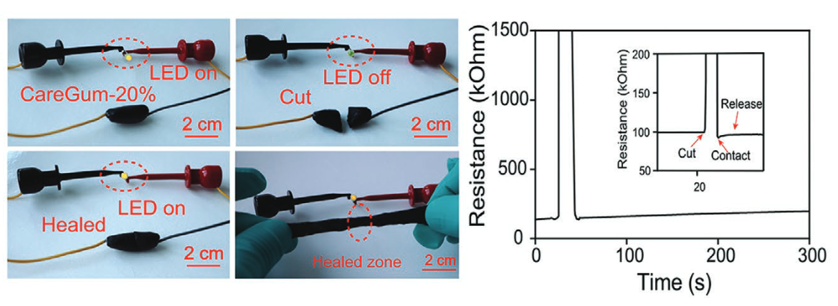
3 Electrode
CareGum(Babu Kadumudi 2021)
In this project, 3 types of electrode are testing:
1. Wet/gel electrode: The gold cup electrode with conductive gel
2. Dry electrode: The gold cup electrode without conductive gel
3. Conductive Polymer Electrode: CareGum
Notes:
Finally is about the electrode, we will test three electrode in out device, ther first one is wet/gel elecdtrode, the impedance with gel is less than 1 kohm. The second one is the dry electode, here we just removed the gel. The impedance is around 1M ohm. The third one is the conductive polymer, in this paper, the impedance is around 100kohm, which is between wet and dry electrode.
Here is the picture of the we fixed the conductive polymer to the electrode.

Slide 16
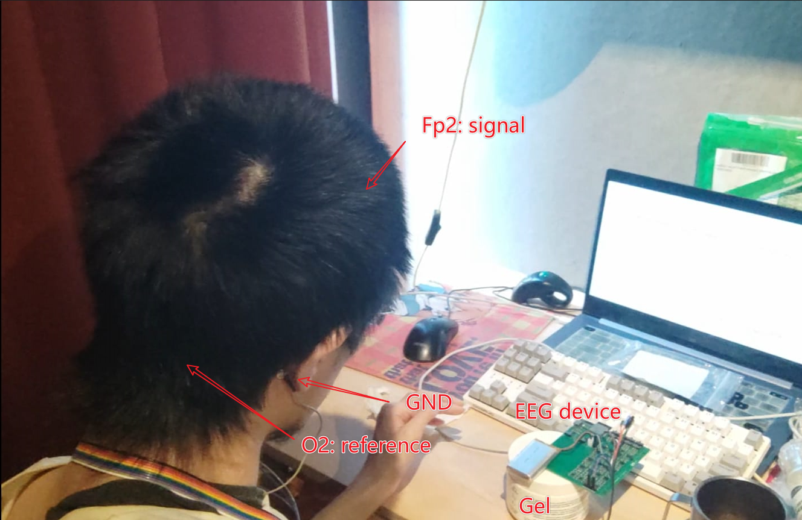
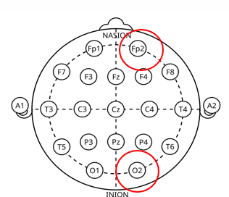
4.1 Performance
Test the performance of :
  1. The device:
  Does it really collect the EEG signal?
  2. The electrode:
  Will the conductive polymer electrode be better than common electrode?
  3. Low power optimization:
  What is the battery life of our device?
Notes:
After building the EEG device, we are eager to know the performance of the our decice. SO there are three expeiremnts each for the performance of device it s
So ,let start!

Slide 17
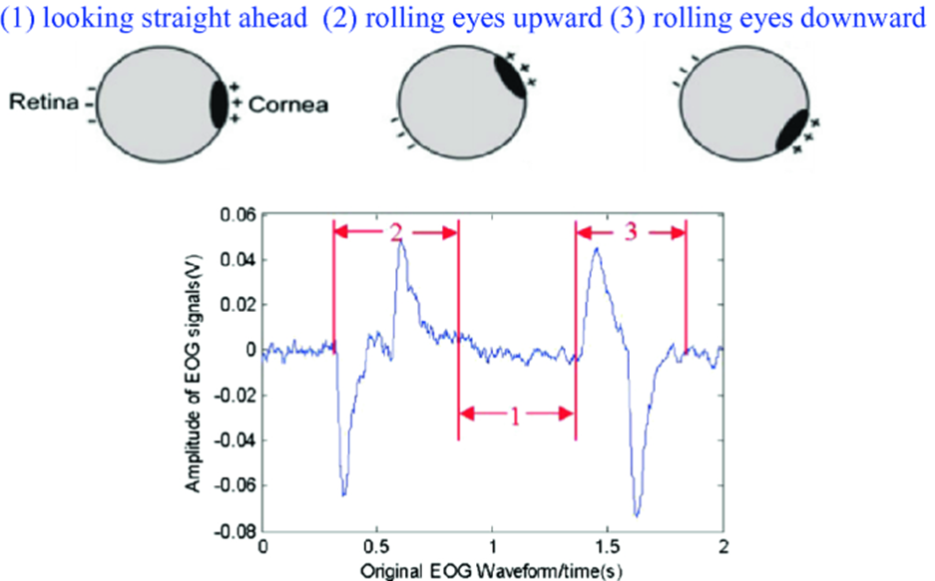
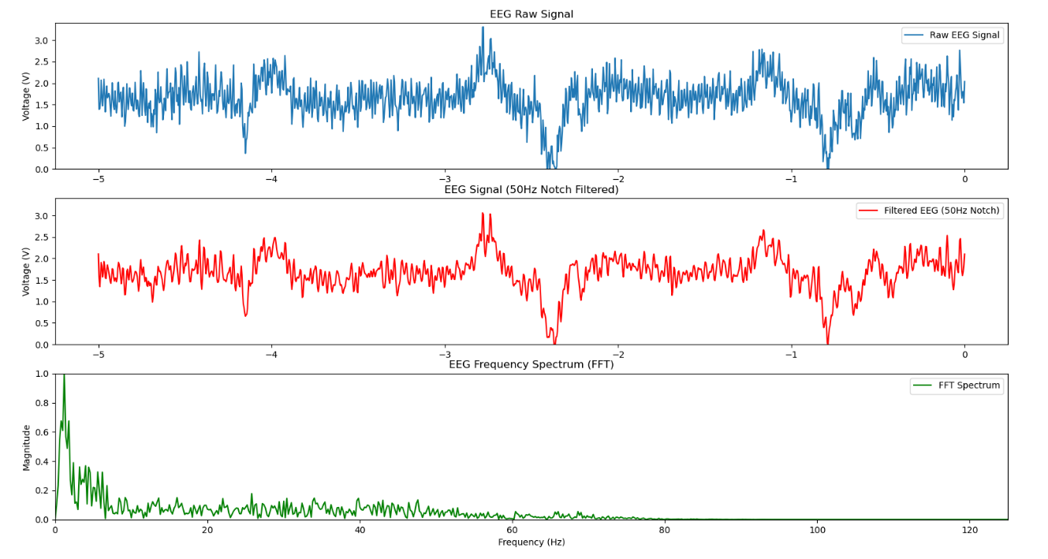
4.1 Experiment 1: Eye movement artifacts catching
Eye movement artifacts is caused by the electron at retina, when it moved up or down, the EEG signal is caught by electrode at FP2 will be influenced.
1. Catching the signal
2. Discriminate it from EMG caused by muscle around front head
Move eye balls up
Move eye balls down
Blinking
Raw signal
Signal after filtering
FFT
Reda, 2020
Notes:
Because the usually EEG signal does not have tempral chra like ECG
The reson why we use two kinds of bahvior, since we wish to Discriminate

Slide 18
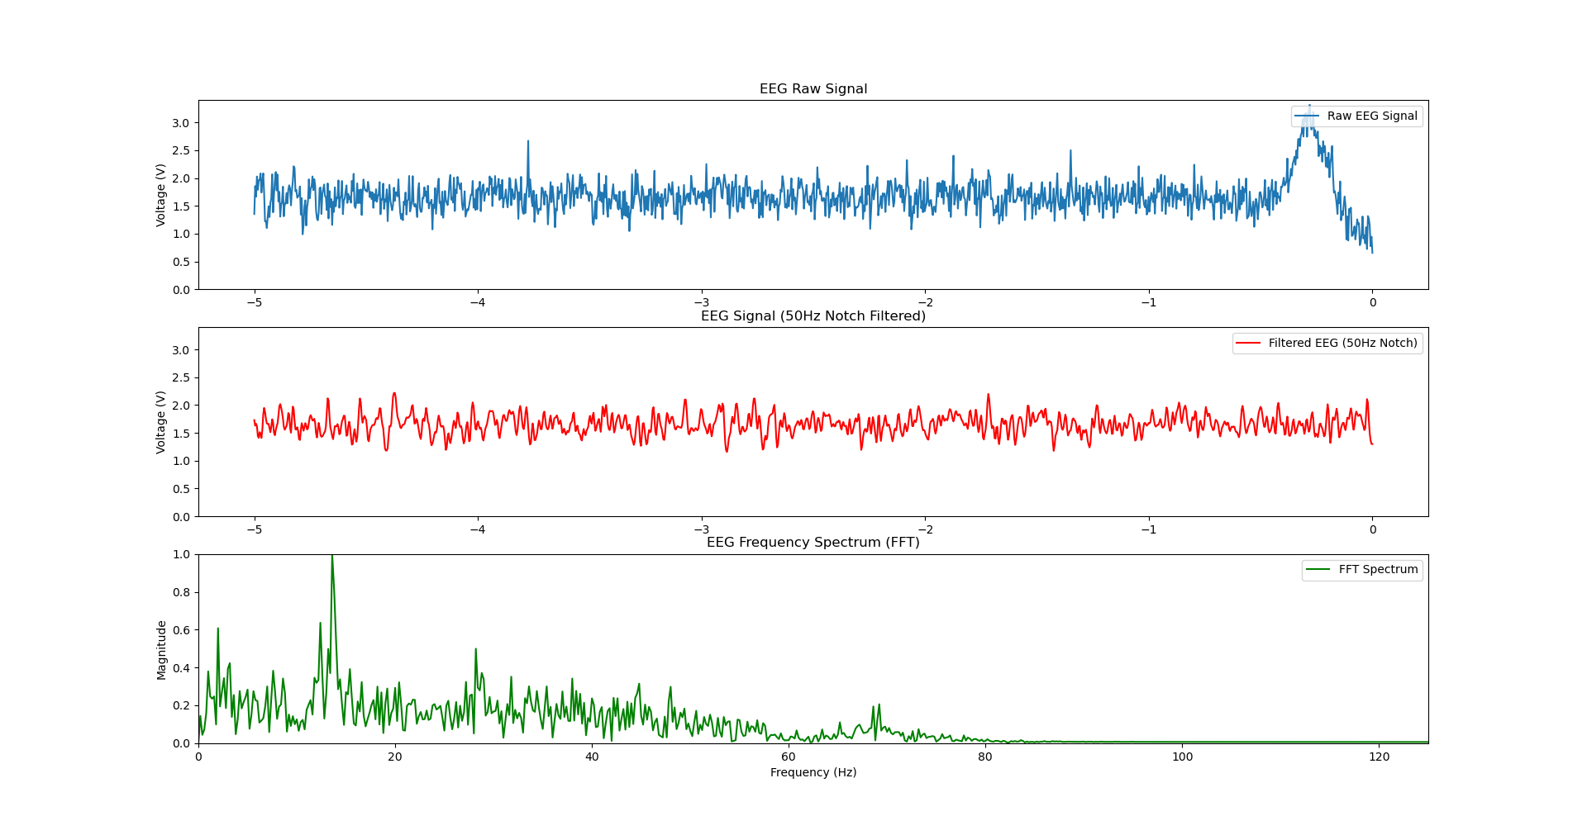
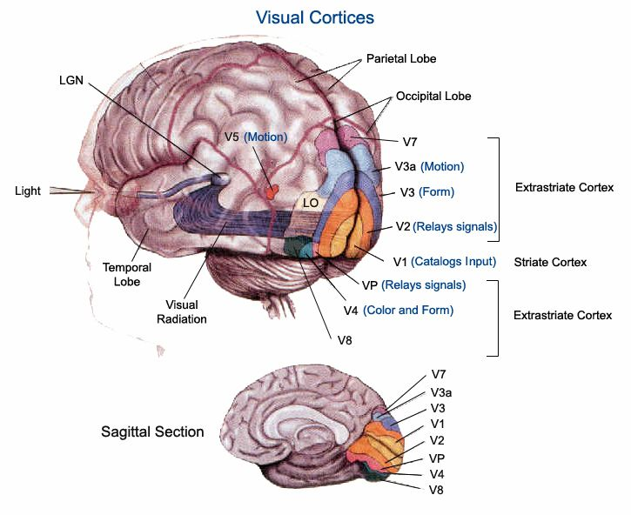
4.2 Experiment 1: Alpha wave acquisition
EEG signal does not have obvious temporal characteristics like QRS wave in ECG
But its frequency components changes can be observed
When the eye is closed, the activity of vision cortex at the occipital lobe is influenced causing higher Alpha wave and caught by electrode at O2
Notes:
The fist one is for temporal artifact
And we are tgoing to see the frequency part. It is based on a pheolomen that when you close you eye, the alpha wave at occipical part of your brian will increased.
This is because the light information in caught by your eyeball are then transport to the visual neurons and to the visual cortex. And .. Is right behind of you headback.

Slide 19
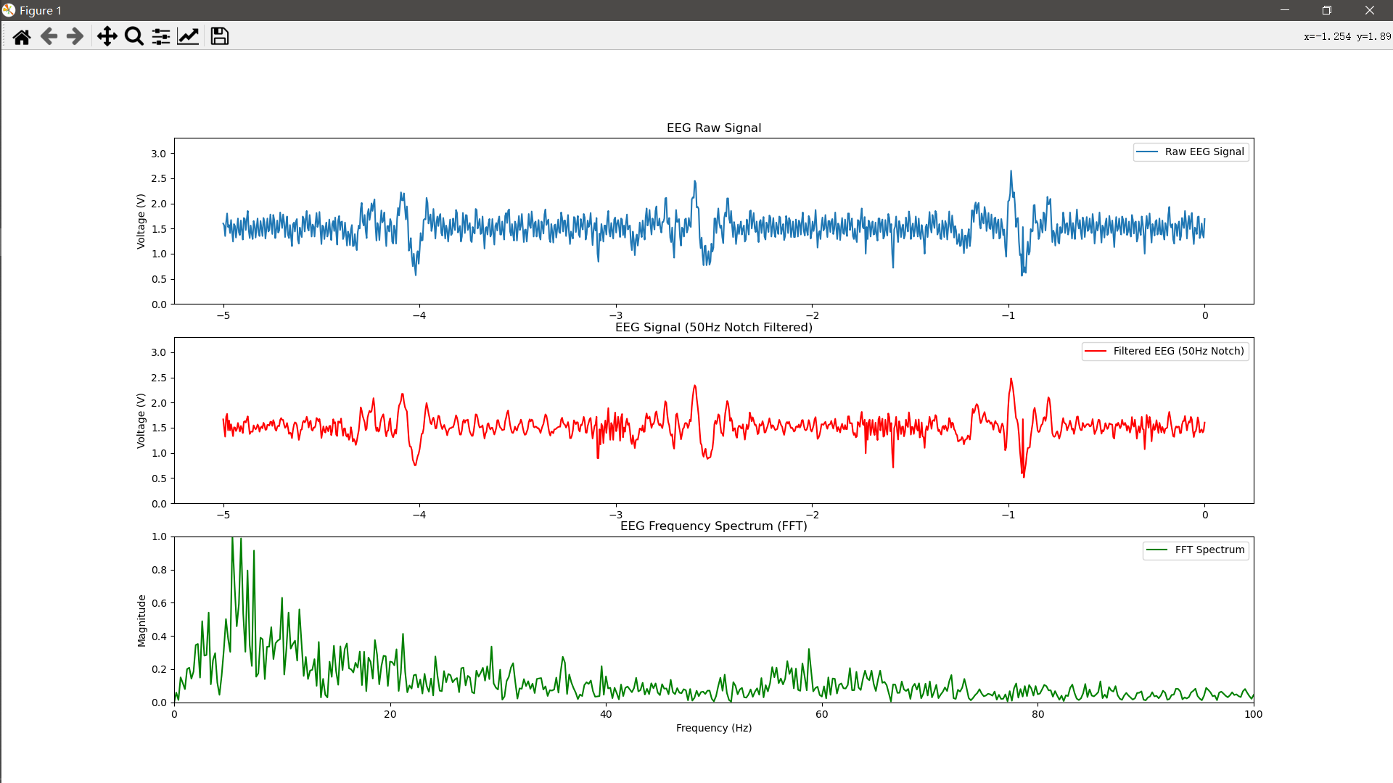
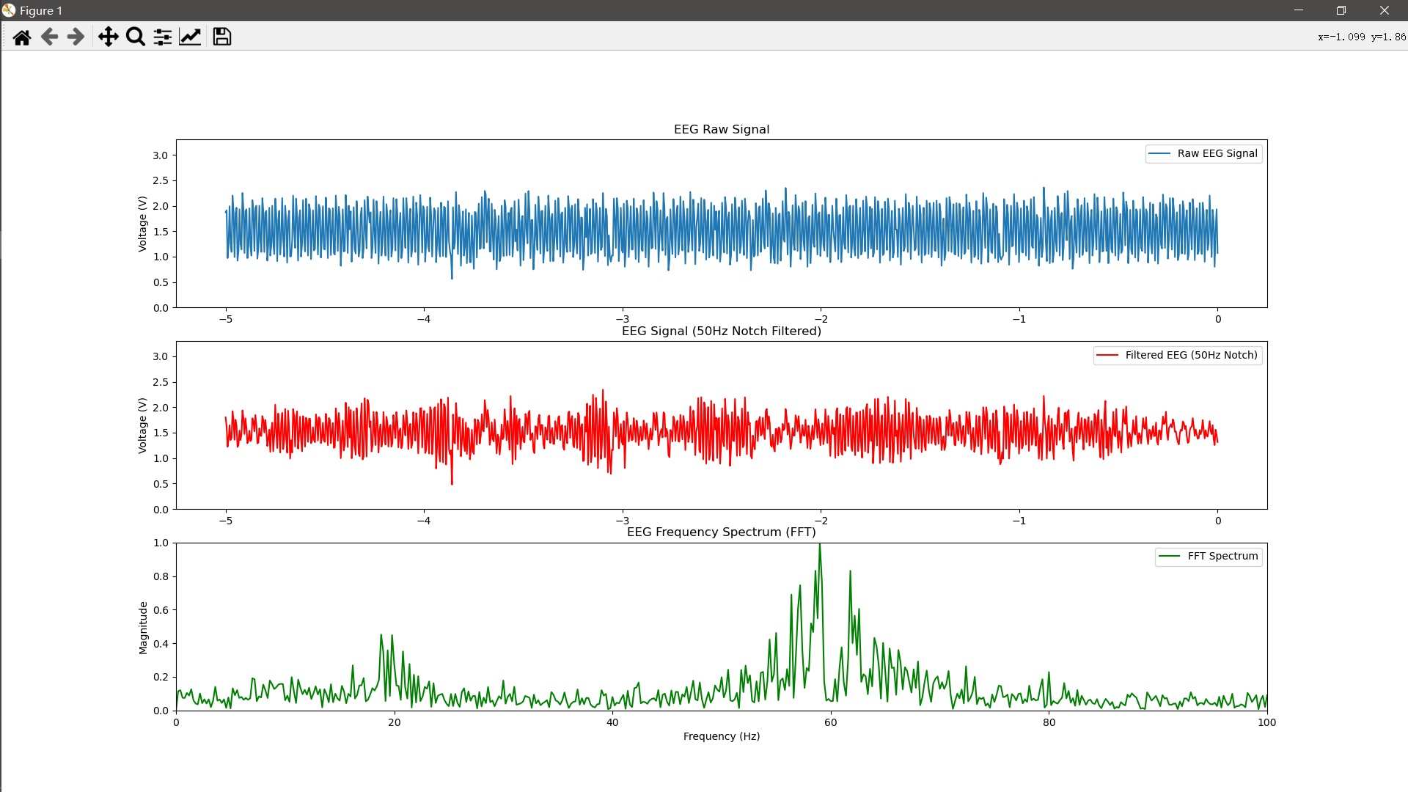
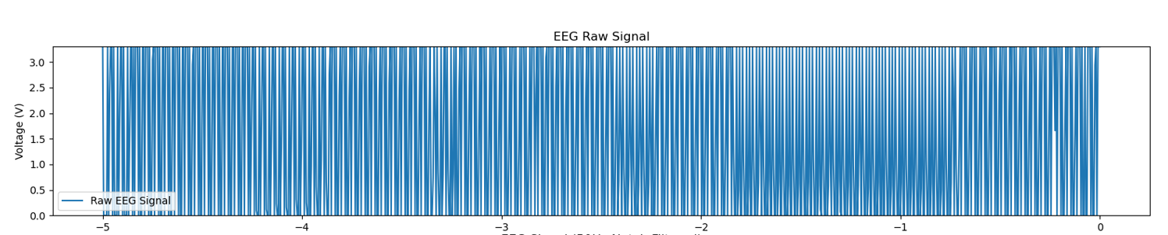
4.2 Experiment 2: Different Electrode
The wet/gel electrode can provide the readable signal
The dry electrode has strong noise components, but can also discriminate eye movement artifacts
The conductive polymer electrode can not provide useful information
Wet/gel
Dry
Conductive Polymer
Notes:
In the next experiment, we recorded some data uisn different types of electrde

Slide 20
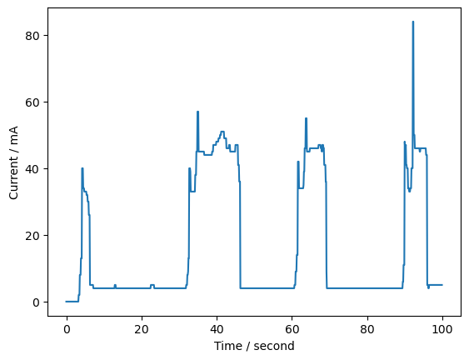
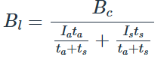
4.4 Experiment 3: Power Consumption
We record the current of our device from power on to send message through BLE in 100s
In most of time the device is in deep sleep,
and the current is around 5 mA, mainly from
power management components and ampli-
fication circuit.
In BLE data transmitting, the current is around
40 mA, and lasts for 3 seconds
The average current is about 10 mA, and the
battery we used is a 2000 mAh Li-Po recharge-
able battery. The battery life is as high as
2000 mAh/ 10 mA = 200 h
In other mode (4 channel) the current is 70 mA
and the battery life is 28 h
Advertizing
Initialization
40 mA
Data transmission
Deep sleep
5 mA
Where:
Bl = Battery lifetime in hours
Bc = Battery capacity in mAh
Il = Load device current draw in mA

Slide 21
5. Conclusion
1. We successfully developed a wearable EEG device with 4 channel in a compact PCB design, and use it to record clear and readable EEG signal. ✔
2. With the in depth low power optimization on MCU and Bluetooth configuration, the battery life is 3 to 10 times better than the current wearable EEG device on market. ✔
3. We compared the performance of the common electrode including wet/gel electrode, dry electrode and innovative conductive polymer electrode. Though the conductive polymer electrode does not provide readable data, it still remains potential as biomedical sensor. ×

Slide 22
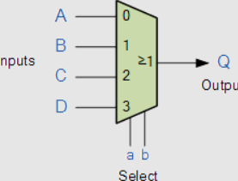

6. Future
For the better wearability:
  the device can be minimized further by integrating four identical amplification circuits of each channel into one, and switched by the NMOS circuit controlled by MCU or a multiplexer, but the sample frequency for ADC will be doubled or more.
For Power consumption:
  The limitation right now is frequency of the BLE communication, and it is limited by the the size of the RTC_SLOW_MEM. A peripheral I2C RAM such as I2C EEPROM or FRAM could tremendously prolong the battery life so it can wake up in few minutes.
The conductive polymer material does not perform well in EEG signal acquisition, further experiment needs to be applied. For example, in Babu Kadumudi 2021, the impedance of the CareGum is measured at around 100 kΩ, which is between wet/gel electrode (1kΩ) and dry electrode (> 100 kΩ). But it is applied in DC current, the EEG signal contains more AC components.
And it requires preparation before applying as electrode, a shorter process should be explored.

Slide 23
Q&A
Thank you!

Slide 24


256 Channels: Neurofax eeg 1200

Slide 25


IA: conduction

Slide 26


HPF

Slide 27

LPF

Slide 28



Twin-T Notch filter

Slide 29

Gain stage: 100*100 vs 1000*10
Pathophysiological condition:
• Gamma waves (30–80 Hz): Associated with sensory perception and cognitive processing.
• Ripples (80–200 Hz): Implicated in memory consolidation and neuronal communication.
• Fast ripples (200–500 Hz): Often linked to epileptic activity and neural hyperexcitability.

Slide 30



Necessity of DC offset
ADC cannot convert the negative part
Therefore, we have a voltage divider (2/VCC) and a op amp to add them together.

Slide 31
ULP RTC_SLOW_MEM distribution
Totally there 8 kB in RTC_SLOW_MEM
Both main CPU and ULP can access this address
Distribution:
1 kB: ulp scrip including ulp_main.S, I2C.S, stack.S
7 kB: data storage:
each sample use 32 bits that is 4 bytes (the data is 16-bit but ULP operates in 32 bit per as unit)
total size: 1700 * 4 = 6.8 kB
The sample rate is 100 Hz in low energy mode, therefore:
The interval of each waking up is 1700/100 = 17 seconds
7kB: Data storage
1kB: Script

Slide 32



CareGum
Babu Kadumudi 2021

Slide 33



ADS1115

