Slide 1
Perceived Stress as a Social and Psychological Outcome: The Role of Socioeconomic Status, Psychosocial Resources, and Adverse Life Experiences
Yuxuan Gou

Slide 2
Why does this topic matter?
Perceived stress is closely related to mental health, physical health, and everyday functioning.
Stress is not only an individual feeling. It is also shaped by social conditions, family environment, health status, and life experiences.
Previous studies have examined demographic factors, psychosocial resources, or adverse experiences, but these factors are often studied separately.
This makes it useful to compare them within one analytical framework.

Slide 3
Research question
Main research question:
Which sociodemographic, psychosocial, and life-course factors matter most for perceived stress?
More specifically:
Do psychological distress variables contribute more strongly to perceived stress than demographic background?
Do psychosocial resources help protect against stress?
Do adverse life experiences remain important across different models?

Slide 4
Data and sample
Data source:
2023 Psychology and Behavior Investigation of Chinese Residents (PBICR)
Sample:
Nationwide survey in China
Collected from June to August 2023
Sample size: 30,054
Why this dataset is useful:
Large sample
Rich measures on stress, health, psychosocial resources, and life experiences
Suitable for comparing multiple groups of predictors in one study

Slide 5
Variables
Outcome: Perceived stress: pss4_total
Predictor groups:
Sociodemographic factors: age, gender, education, income, hukou, marital status, employment, living alone
Health and behavior factors: BMI, self-rated health, sleep quality, chronotype, drinking, smoking, chronic disease
Psychosocial resources: social support, self-efficacy, resilience, family support
Adversity / life-course factors: major life event, debt, adverse childhood experiences

Slide 6
Analytic strategy
Models used in this study
OLS regression: baseline model for direction and statistical significance
LASSO regression: selects a smaller set of important predictors
Random Forest: captures more flexible predictive patterns
SHAP values: improve the interpretation of the Random Forest model
Model evaluation: RMSE, R², MAE
Random Forest setup: 80/20 train-test split; 5-fold cross-validation; 500 trees

Slide 7
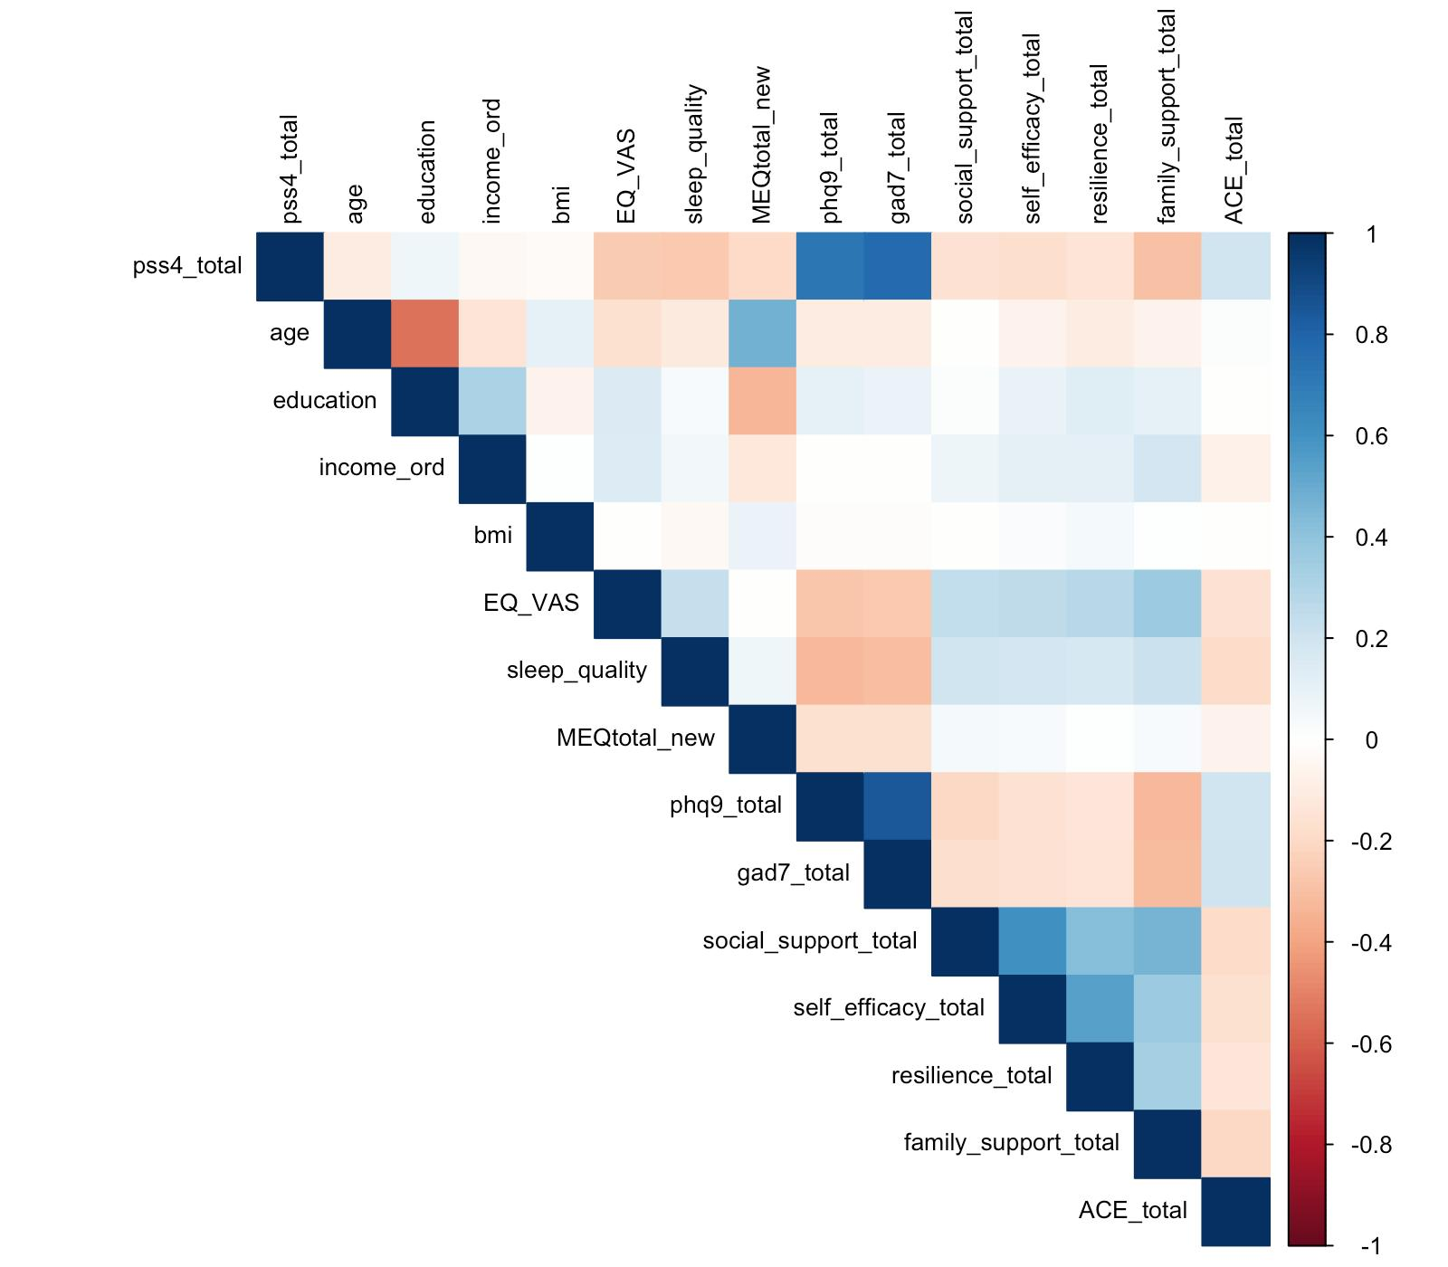
Descriptive and exploratory findings
Descriptive overview
The sample is almost evenly split by gender and fairly balanced by hukou status. Most respondents are married. Most do not live alone and do not report major life events, debt, smoking, or drinking.
Exploratory patterns
Perceived stress is strongly positively correlated with: anxiety symptoms; depressive symptoms; Perceived stress is negatively correlated with:self-rated health, chronotype, self-efficacy, resilience, family support

Slide 8
OLS results
Main OLS findings (HC3 robust standard errors)
Positive associations with perceived stress: anxiety symptoms, depressive symptoms, job employment status, major life event, debt, adverse childhood experiences, drinking
Negative associations with perceived stress: education, income, self-rated health, chronotype, self-efficacy, family support
Most prominent pattern: Anxiety symptoms and depressive symptoms show the strongest positive associations.
Model fit: R² = 0.634

Slide 9
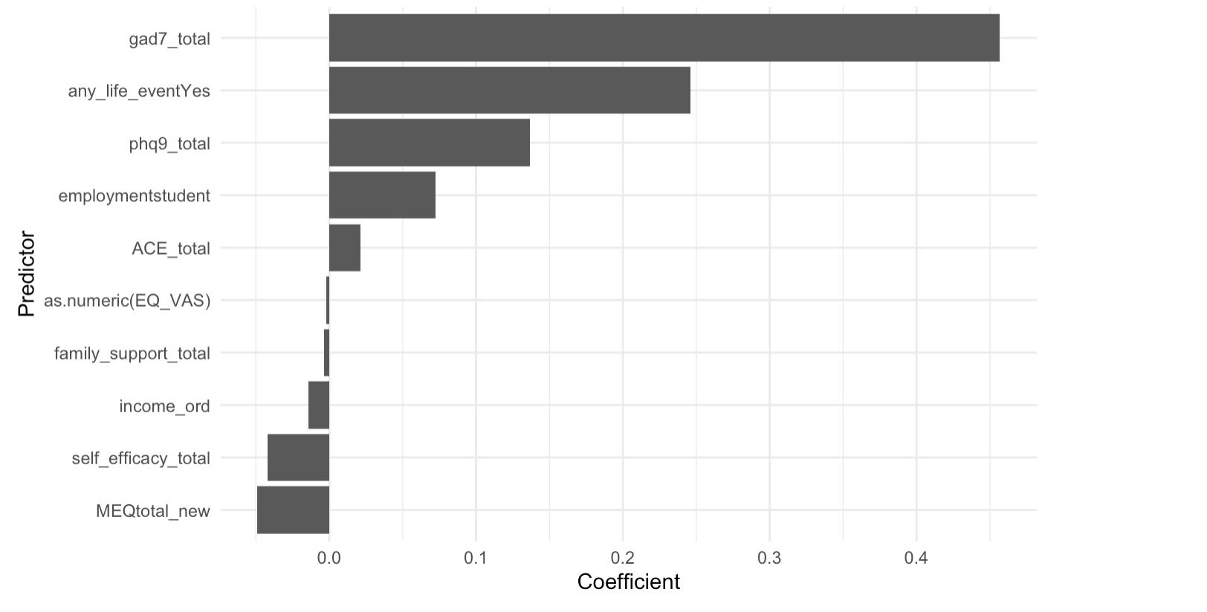
Lasso
Positive predictors retained: anxiety symptoms, major life event, depressive symptoms, student status, and adverse childhood experiences.
Negative predictors retained: chronotype, self-efficacy, income, family support, and self-rated health.
Main takeaway: Anxiety symptoms remain the strongest positive predictor. Even in a more parsimonious model, psychological distress and psychosocial resources still stand out.

Slide 10
Random Forest performance
Model | RMSE | R² | MAE
Full Random Forest | 2.180 | 0.651 | 1.640
LASSO-based Random Forest | 2.172 | 0.654 | 1.653

Slide 11
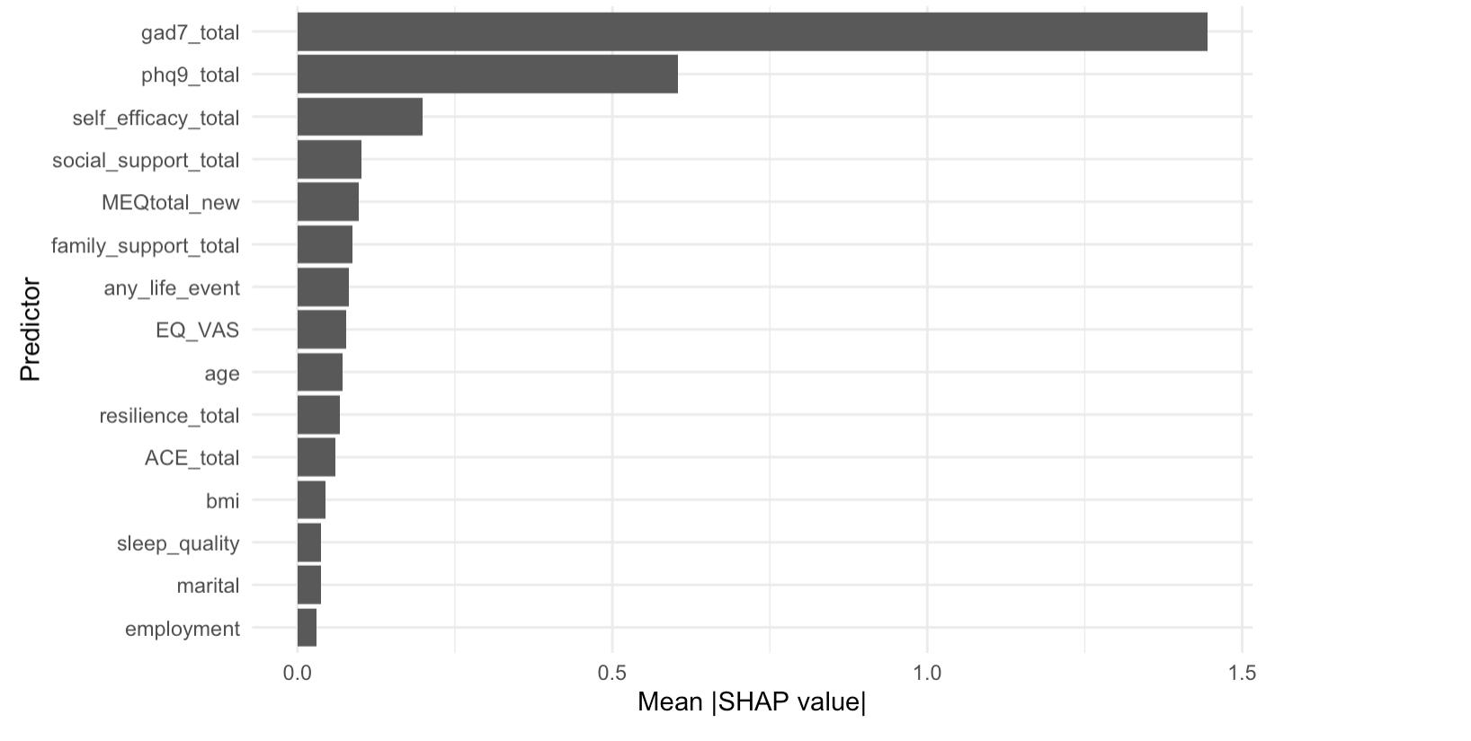
Random Forest performance
Top predictors in the full Random Forest model:
anxiety symptoms, depressive symptoms, self-efficacy, social support, chronotype, family support, major life event, self-rated health, age, and resilience.
Main takeaway:
Anxiety symptoms are the most important predictor by a large margin. Depressive symptoms are the second most important predictor.
Interpretation:
Psychosocial resources also remain highly important. SHAP results support the broader pattern found in OLS and LASSO.

Slide 12
model comparison
Model | Main purpose | Main result | Performance / key output
OLS | Interpretation | Anxiety symptoms and depressive symptoms show the strongest positive associations with perceived stress. Education, income, self-rated health, chronotype, self-efficacy, and family support are negatively associated with perceived stress. | R² = 0.634
LASSO | Variable selection | Positive predictors retained: anxiety symptoms, major life event, depressive symptoms, student status, and adverse childhood experiences. Negative predictors retained: chronotype, self-efficacy, income, family support, and self-rated health. | Most important retained positive predictor: anxiety symptoms
Full Random Forest | Prediction | Flexible model using the full set of predictors. | RMSE = 2.180, R² = 0.651, MAE = 1.640
LASSO-based Random Forest | Prediction with reduced predictors | Performs very similarly to the full RF, suggesting that the reduced predictor set retains most predictive information. | RMSE = 2.172, R² = 0.654, MAE = 1.653
SHAP | Interpretation of RF | Anxiety symptoms are the most important predictor by a large margin, followed by depressive symptoms, self-efficacy, and social support. | Top predictor: anxiety symptoms

Slide 13
Conclusion
Main conclusion
Perceived stress is more strongly associated with psychological distress, psychosocial resources, and adverse life experiences than with demographic background alone.
What is consistent across models
Anxiety symptoms and depressive symptoms remain the most important predictors.
Psychosocial resources, especially self-efficacy and family support, also play a protective role.
Major life events and adverse childhood experiences remain important across models.
Implication
Perceived stress should not be understood only as an individual emotional problem.
It is also shaped by unequal coping resources and accumulated hardship across the life course.
Limitations
cross-sectional data, self-reported measures possible overlap between perceived stress, anxiety, and depression

Slide 14
THANK YOU

