Slide 1
MODERN OPERATING SYSTEMS
Lecture 5
Author: dr. Zvereva olga M.

Slide 2
agenda
Batch files
Definition and structure
Specific commands
Parameters
variables

Slide 3
Batch file
A sequence of commands each in a single line, which is executed as a one program
Must have “.cmd” (or “.bat”) extension
Is developed in editors which do not place specific formatting (i.e. Notepad in windows)

Slide 4
Conditional operation (if-else)
The most common syntax:
IF [NOT] EXIST file_name command
(if file/directory exists [does not exist], the command is executed)
Ex:
if [not] “string1”==“string2” command
(if “string1” is equal [is not equal] to “string2, then the command is executed – mostly used in batch files)
if errorlevel number command
(checks the code being returned by the previous command or program, and if it is less or equal to the “number” the command is executed)

Slide 5

Some other useful commands
Echo off|on (to switch off or switch on echo of the succeeding commands from a command file onto the screen while the command file executing)
Echo message (to display the message in the screen)
REM – (to make a line in a command file to be a comment)
@ - (not to display the command from this line in the screen while the command file executing)
Usually, the first line in a command file is the following:
@echo off
prohibits to display all the succeeding commands (Echo off itself – as well, but all commands output is shown)
Cls – (to clear the command window, to delete all the output information from the window)
PAUSE – STOPS THE EXECUTION UNTIL THE USER PRESS ANY KEY

Slide 6
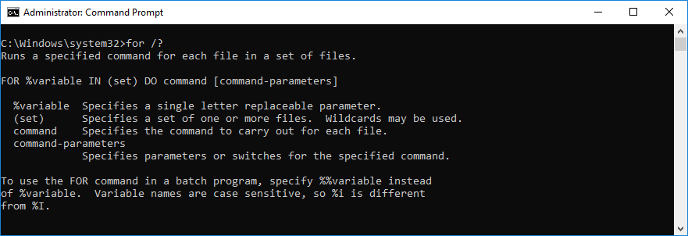
cycle

Slide 7
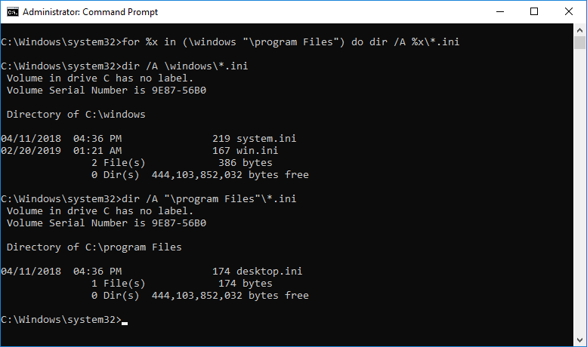
example

Slide 8
Goto
Goto label - (to transfer control to the line labelled by the label, one of the lines must start with -> LABEL:)
Example of code:
Goto m1
cd \
Copy *.txt \1
:M1
echo nothing has been copied

Slide 9
Parameters in a batch file
We could pass some pieces of information to a batch file by means of parameters
One could distinguish two types of parameters:
Those in command line after batch file name – real data (file or directory names, keys, and etc.);
Internal PARAMEtERs’ Names in a batch file (%0, %1, …%9)
If you want to have more parameters, you must use command “shift”
%0 – THE BATCH FILE NAME
Internal names will be replaced by real values from the command line
There is a strict correspondence between data in the command line (batch file call) and internal names in the batch file
(i.e. in the command line: a.cmd C:\users\*.txt “program file.exe”)
In the batch file you could find: %0 (a.cmd), %1 (C:\users\*.txt ), %2 (“program file.exe”)

Slide 10
Example
Task: it is necessary to model the operation of file moving from one directory into another, the source file name and the name of destination directory are necessary to pass as parameters
FILE MUST HAVE 2 PARAMETERS:
SOURCE FILE (TO BE MOVED)
DESTINATION DIRECTORY (WHERE TO MOVE)

Slide 11
Batch file content
@echo off
rem FILES MOVING
if [%1]==[] goto L1
if [%2]==[] goto L1
if not exist %1 goto L1
if not exist %2 mkdir %2
copy %1 %2
echo YOU CAN INTERRUPT OPERATION TYPING CTRL+C OR...
pause > NUL
del %1
goto L2
:L1
echo BAD or LACK OF PARAMETERS
:L2

Slide 12
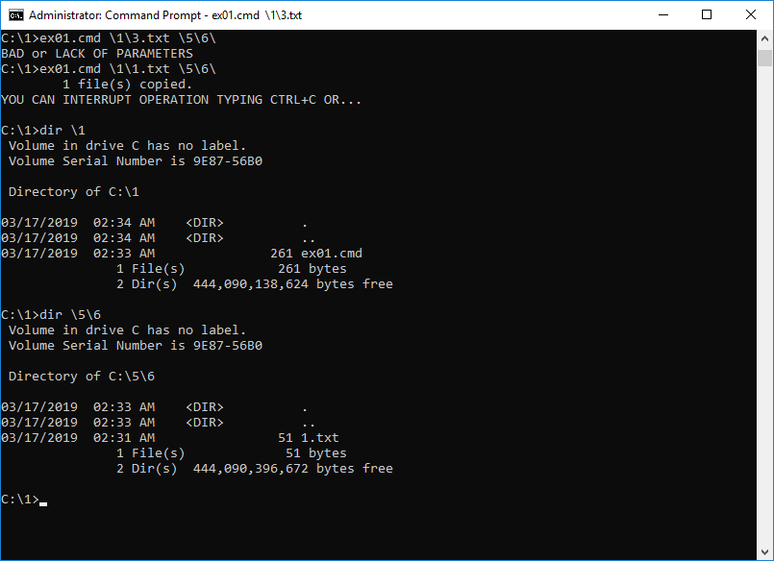
results

Slide 13
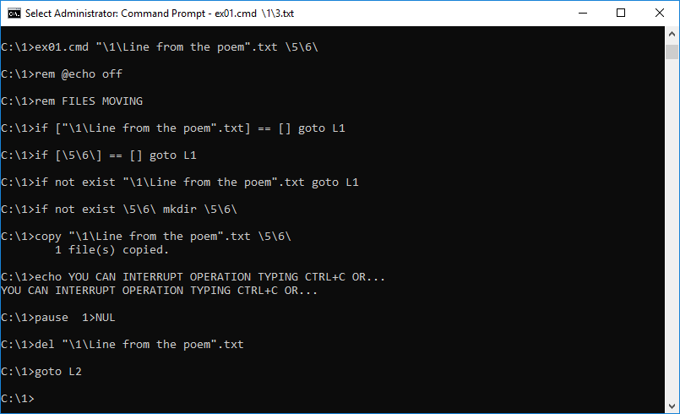

Slide 14
VARIABLES
SYSTEM VARIABLES
(FOR EVERY USER)
USER VARIABLES
(FOR THE USER WHO CREATED IT)

Slide 15
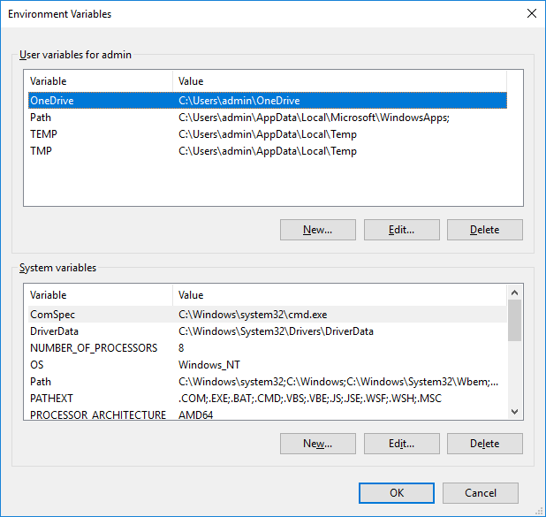
SYSTEM\ADVANCED SYSTEM SETTINGS\ENVIRONMENT VARIABLES

Slide 16
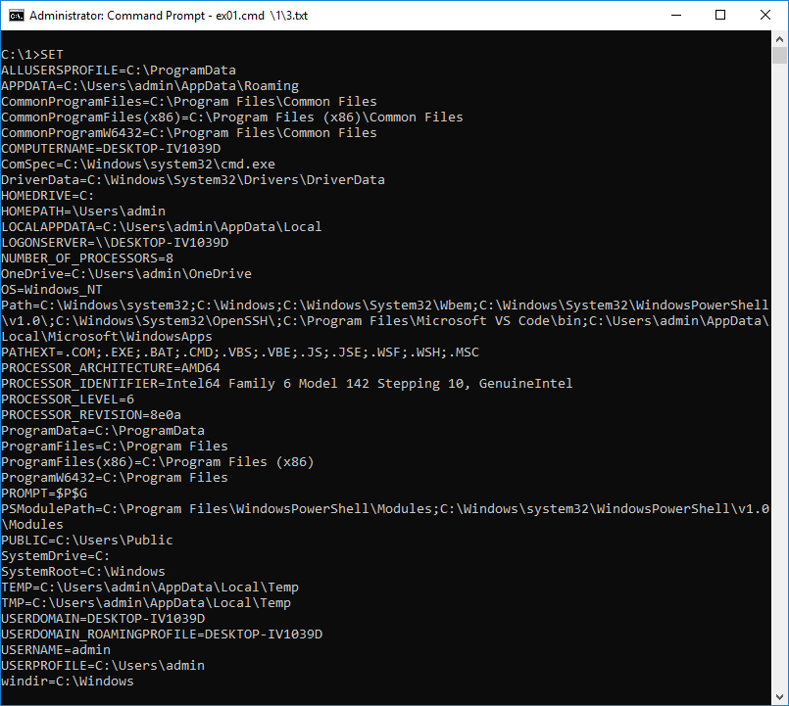
COMMAND “SET”

Slide 17
ENVIRONMENT VARIABLE SET
Variable creation:
Gui (Window shown in the 39 slide)
Command “SET” (Set variable_name=variable_value)
Variable usage:
%Variable_name%

Slide 18
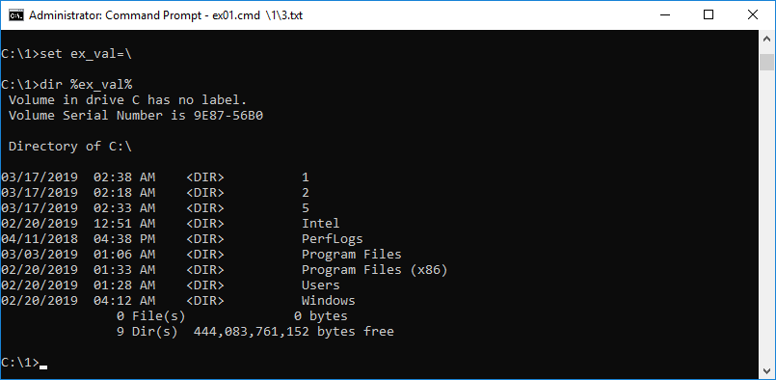
example

Slide 19
Some Environment system variables
VARIABLE NAME | DESCRIPTION
SYSTEMDRIVE | NAME OF THE DRIVE WITH THE SYSTEM DIRECTORY
SYSTEMROOT | PATH TO THE DIRECTORY WHERE SYSTEM FILES ARE STORED
COMPUTERNAME | NAME OF THE COMPUTER YOU ARE WORKING AT THE MOMENT
USERNAME | USER LOGIN YOU ARE USING AT THE MOMENT
OS | OPERATING SYSTEM
PATH | SEQUENCE OF THE PATHES WHER OS ARE LOOKING FOR FILES

Slide 20
HOME task (coding batch files carrying out the following actions)
archive the data stored in various directories (indicated as the batch file parameters) into the specified directory with the preliminary check that this directory exists, if not – create this directory
Look for a file with the indicated as a parameter name in the directory which name is defined by the environment variable “temp”. If file with the specified name exists, compare its content with the content of file with the same name in the home directory of the current user (path to this directory is stored in the “homedir” variable)
receive the Content of the root directories from all existing logical disks of the computer, and write it into the file, which name is the same as the name of the computer

