Slide 1
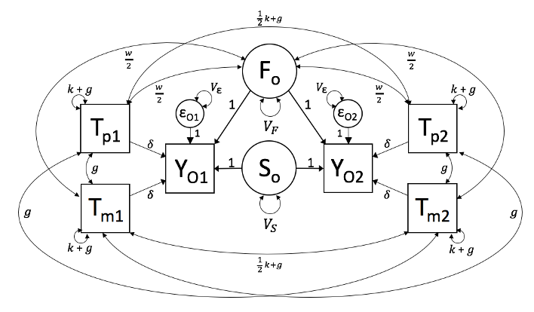
Sibling Model with separated parental haplotypes

Slide 2














$$4(k+g)$$
$$w$$
F_{o}
$$w$$
$$4(k \text{+} g)$$
$$w$$
$$V_{\text{ε}}$$
$$V_{\text{ε}}$$
$$w$$
$$4(k \text{+} g)$$
ε_{O1}
1
1
ε_{O2}
T₁
$$V_{F}$$
T₂
1
2𝛿
1
1
2𝛿
$$4g$$
Y₁
1
S_{o}
1
Y₂
$$4g$$
$$4g$$
NT₁
NT₂
$$4g$$
$$V_{S}$$
$$4(k \text{+} g)$$
$$4(k+g)$$
$$4(k \text{+} g)$$
MZ Model with T/ NT parental haplotypes

Slide 3





$$2k+4g$$
$$w$$
F_{o}
$$w$$
$$4(k \text{+} g)$$
$$w$$
$$V_{\text{ε}}$$
$$V_{\text{ε}}$$
$$w$$
$$4(k \text{+} g)$$
ε_{O1}
1
1
T₁
$$V_{F}$$
T₂
1
2𝛿
1
1
2𝛿
$$4g$$
Y₁
1
S_{o}
1
Y₂
$$4g$$
$$2k+4g$$
NT₁
NT₂
$$2k+4g$$
$$V_{S}$$
$$4(k \text{+} g)$$
$$2k+4g$$
$$4(k \text{+} g)$$
DZ Model with T/ NT parental haplotypes

Slide 4
NT_{p1}
NT_{m1}
Y_{p}
Y_{m}
F_{p}
F_{m}
F_{o}
T_{p1}
Y₁
T_{m1}
T_{p2}
Y₂
T_{m2}
F_{o}
F_{p}
F_{m}
Y_{p}
Y_{m}
NT_{p2}
NT_{m2}

Slide 5





















$$k+g$$
$$V_{\text{ε}}$$
$$V_{\text{ε}}$$
$$k+g$$
NT_{p1}
ε
ε
NT_{m1}
𝛿
$$\frac{w}{2}$$
$$V_{F}$$
Y_{p}
Y_{m}
$$V_{F}$$
$$\frac{w}{2}$$
1
1
F_{p}
F_{m}
$$g$$
$$V_{\text{ε}}$$
$$g$$
ε
$$\frac{w}{2}$$
𝛿
$$f$$
$$f$$
𝛿
$$\frac{w}{2}$$
$$\frac{1}{2}k+g$$
T_{p1}
𝛿
Y₁
𝛿
T_{m1}
$$\frac{1}{2}k+g$$
$$k+g$$
$$k+g$$
$$\frac{1}{2}k+g$$
$$\frac{1}{2}k+g$$
F_{o}
$$\frac{1}{2}k+g$$
$$\frac{1}{2}k+g$$
$$k+g$$
$$k+g$$
T_{p2}
Y₂
T_{m2}
$$\frac{1}{2}k+g$$
𝛿
𝛿
$$\frac{1}{2}k+g$$
$$\frac{w}{2}$$
𝛿
$$f$$
$$f$$
𝛿
$$\frac{w}{2}$$
ε
$$g$$
F_{p}
$$V_{\text{ε}}$$
F_{m}
$$g$$
1
1
$$\frac{w}{2}$$
$$V_{F}$$
Y_{p}
Y_{m}
$$V_{F}$$
$$\frac{w}{2}$$
NT_{p2}
𝛿
NT_{m2}
ε
ε
$$k+g$$
$$V_{\text{ε}}$$
$$V_{\text{ε}}$$
$$k+g$$

Slide 6









$$k+g$$
$$V_{\text{ε}}$$
$$V_{\text{ε}}$$
$$k+g$$
NT_{p1}
ε
ε
NT_{m1}
𝛿
$$\frac{w}{2}$$
$$V_{F}$$
Y_{p}
μ
Y_{m}
$$V_{F}$$
$$\frac{w}{2}$$
1
1
F_{p}
F_{m}
$$g$$
$$f$$
$$f$$
$$g$$
F_{o}
$$\frac{w}{2}$$
𝛿
𝛿
$$\frac{w}{2}$$
$$\frac{1}{2}k+g$$
T_{p1}
𝛿
Y₁
𝛿
T_{m1}
$$\frac{1}{2}k+g$$
$$k+g$$
$$k+g$$
ε
$$V_{\text{ε}}$$
$$\frac{1}{2}k+g$$
$$\frac{1}{2}k+g$$
$$\frac{1}{2}k+g$$
ε
$$\frac{1}{2}k+g$$
$$k+g$$
$$V_{\text{ε}}$$
$$k+g$$
T_{p2}
Y₂
T_{m2}
$$\frac{1}{2}k+g$$
𝛿
𝛿
$$\frac{1}{2}k+g$$
$$\frac{w}{2}$$
𝛿
𝛿
$$\frac{w}{2}$$
F_{o}
$$g$$
F_{p}
$$f$$
$$f$$
F_{m}
$$g$$
1
1
$$\frac{w}{2}$$
$$V_{F}$$
Y_{p}
Y_{m}
$$V_{F}$$
$$\frac{w}{2}$$
μ
NT_{p2}
𝛿
NT_{m2}
ε
ε
$$k+g$$
$$V_{\text{ε}}$$
$$V_{\text{ε}}$$
$$k+g$$

Slide 7
$$k+g$$
$$V_{\text{ε}}$$
$$V_{\text{ε}}$$
$$k+g$$
NT_{p1}
ε
ε
NT_{m1}
𝛿
$$\frac{w}{2}$$
$$V_{F}$$
Y_{p}
μ
Y_{m}
$$V_{F}$$
$$\frac{w}{2}$$
1
1
F_{p}
F_{m}
$$g$$
$$f$$
$$f$$
$$g$$
F_{o}
$$\frac{w}{2}$$
𝛿
𝛿
$$\frac{w}{2}$$
$$\frac{1}{2}k+g$$
T_{p1}
𝛿
Y₁
𝛿
T_{m1}
$$\frac{1}{2}k+g$$
$$k+g$$
$$k+g$$
$$V_{F}$$
ε
$$V_{\text{ε}}$$
$$\frac{1}{2}k+g$$
$$\frac{1}{2}k+g$$
$$\frac{1}{2}k+g$$
ε
$$\frac{1}{2}k+g$$
$$V_{F}$$
$$k+g$$
$$V_{\text{ε}}$$
$$k+g$$
T_{p2}
Y₂
T_{m2}
$$\frac{1}{2}k+g$$
𝛿
𝛿
$$\frac{1}{2}k+g$$
$$\frac{w}{2}$$
𝛿
𝛿
$$\frac{w}{2}$$
F_{o}
$$g$$
F_{p}
$$f$$
$$f$$
F_{m}
$$g$$
1
1
$$\frac{w}{2}$$
$$V_{F}$$
Y_{p}
Y_{m}
$$V_{F}$$
$$\frac{w}{2}$$
μ
NT_{p2}
𝛿
NT_{m2}
ε
ε
$$k+g$$
$$V_{\text{ε}}$$
$$V_{\text{ε}}$$
$$k+g$$

Slide 8




$$k+g$$
$$k+g$$
ε
$$V_{\text{ε}}$$
$$g$$
$$g$$
T_{p1}
T_{m1}
$$\frac{1}{2}k+g$$
𝛿
𝛿
NT_{p1}
Y₁
$$\frac{1}{2}k+g$$
$$k+g$$
NT_{m1}
$$k+g$$
$$V_{\text{ε}}$$
ε
$$\frac{1}{2}k+g$$
F_{o}
$$\frac{1}{2}k+g$$
$$\frac{1}{2}k+g$$
$$\frac{1}{2}k+g$$
NT_{p2}
NT_{m2}
$$k+g$$
Y₂
$$k+g$$
𝛿
𝛿
$$\frac{1}{2}k+g$$
$$\frac{1}{2}k+g$$
T_{p2}
T_{m2}
$$k+g$$
$$g$$
𝛿
$$g$$
𝛿
𝛿
ε
ε
$$k+g$$
$$V_{\text{ε}}$$
$$V_{\text{ε}}$$

