Slide 1

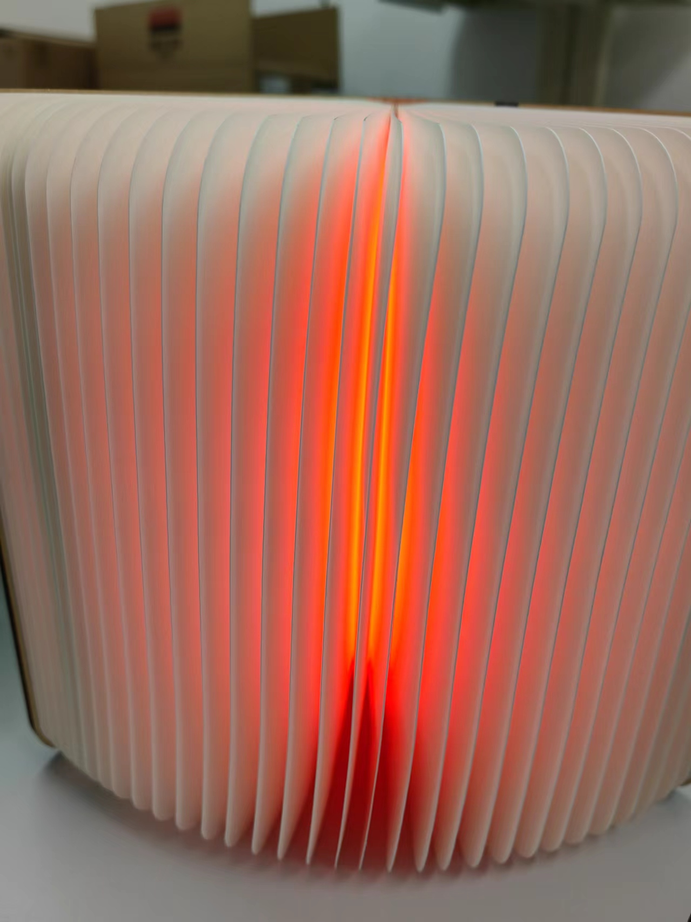
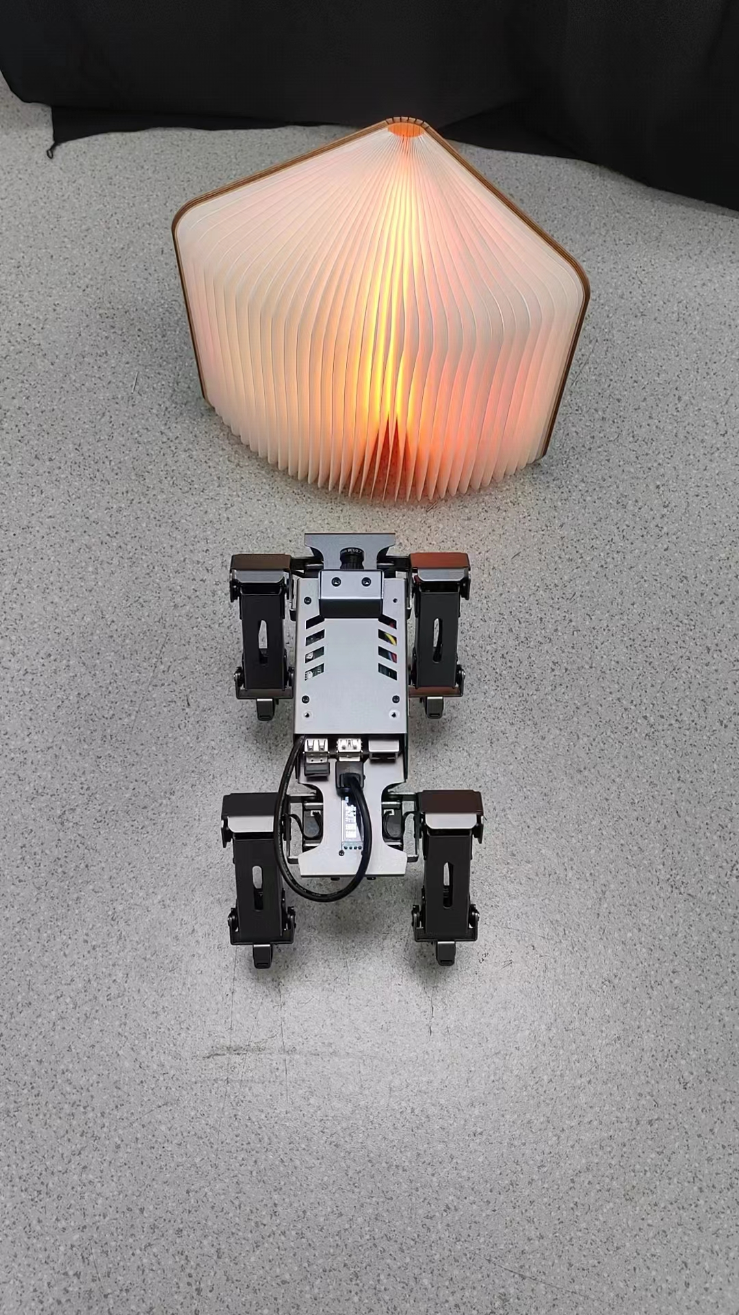
Brain-Robot interaction
SURF Code: SURF-2024-0150
Authors’ name: Xuanzhong Zeng
Supervisor’s name: Nanlin Jin
ABSTRUCT
RESULTS
Brain-robot interaction (BRI) is an emerging field that combines the use of brain-computer interfaces (BCIs) and robotics to enable direct communication and control between the human brain and machines. This research aims to combine brain signals and robots to explore the potential applications of brain-robot interaction. The project involves the use of an EEG headset and a robotic dog. This research will potentially enable direct manipulation of robots by the human brain, thereby facilitating the expansion of the application scope of this technology.
As the result, the response accuracy only has 37%. The line chart display the temporal distribution. It shows most of time the robot running stably only the 6 to 9 seconds and 80 to 84 it change the movements rapidly. And the correct and incorrect running times are more dispersed.
INTRODUCTION
Emotions are important in how people communicate and make decisions in their daily lives [1]. EEG measures the electrical signals resulting from cognitive changes in the brain [2]. Currently, using EEG to study emotion is becoming popular in the field of emotion recognition and classification [1]. BCI works by recording a person's brain activity and then determining their thoughts or intended actions [3]. Same as the BCI, the BRI recording the brain signal but applying in robot controlling field. However, operating robot faced some issues. One-way control limits the full use of a robot's intelligence [4]. Both outer inputs and its own decision is important. This research provide a solution to balance the operation and the decision of robot and try to extend the usage of the robot.
DISCUSSION
There are many reasons why the accuracy rate is so low. The ambient light should not be ignored and it will effect the test. There also exist errors in the robot's camera which may cause it obtaining wrong color. Moreover, the Raspberry Pi 4B responding need time. It may not action in time. Even so many difficulties need to be solve, this study still provide a feasibility of operating the robot with EEG headset.
METHODOLOGY
Using one robot dog equipped with Raspberry Pi 4B and an EEG headset with a book that glows, this study analyze the response accuracy of the robot dog when user wear headset and send signals. User put on the headset and the book’s light will change according to the focus and relaxation. The robot dog will respond to the light with related action. Record the continues time of correct action as 1 and wrong movements as 0.
CONCLUSION
This research combine robot dog with headset equipment to explore the feasibility of interacting the robot with brain signal meanwhile the robot dog do not lose its decision-making ability. Although the experimental data not exactly as expected, its correlation shows that BRI has a lot of room to explore. It may be realizable to interact the robot with brain signal in the future.
REFERENCE
[1] C. Li et al., "Emotion Recognition with the Feature extracted from brain Networks," 2019 IEEE International Conference on Computational Intelligence and Virtual Environments for Measurement Systems and Applications (CIVEMSA), Tianjin, China, 2019, pp. 1-4, doi: 10.1109/CIVEMSA45640.2019.9071616.
[2] H. Park, B. Myung and S. K. Yoo, "Power consumption of wireless EEG device for BCI application: Portable EEG system for BCI," 2013 International Winter Workshop on Brain-Computer Interface (BCI), Gangwon, Korea (South), 2013, pp. 100-102, doi: 10.1109/IWW-BCI.2013.6506645.
[3] D. Wijayasekara and M. Manic, "Human machine interaction via brain activity monitoring," 2013 6th International Conference on Human System Interactions (HSI), Sopot, Poland, 2013, pp. 103-109, doi: 10.1109/HSI.2013.6577809.
[4] X. Mao, W. Li, C. Lei, J. Jin, F. Duan and S. Chen, "A Brain–Robot Interaction System by Fusing Human and Machine Intelligence," in IEEE Transactions on Neural Systems and Rehabilitation Engineering, vol. 27, no. 3, pp. 533-542, March 2019, doi: 10.1109/TNSRE.2019.2897323.

