Slide 1
Individual’s income exploring

Slide 2
What feature related to income
Gender
Work class
Age
Length of work
Education
Race
Occupation
Family

Slide 3
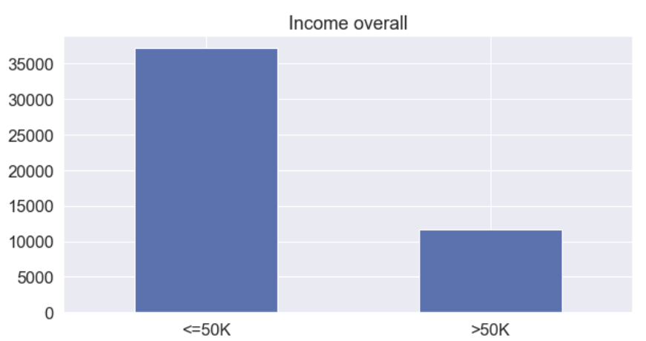
Overall income

Slide 4
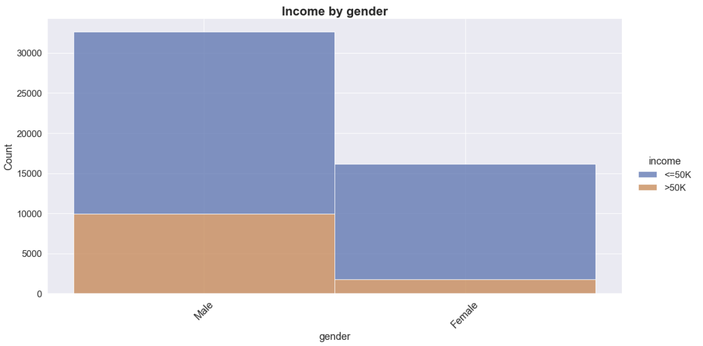
Income by gender
Male:
over 50K : 30%
Female:
over 50K : 10%
Notes:
We can see a significant gap in the earnings between males and females over here

Slide 5
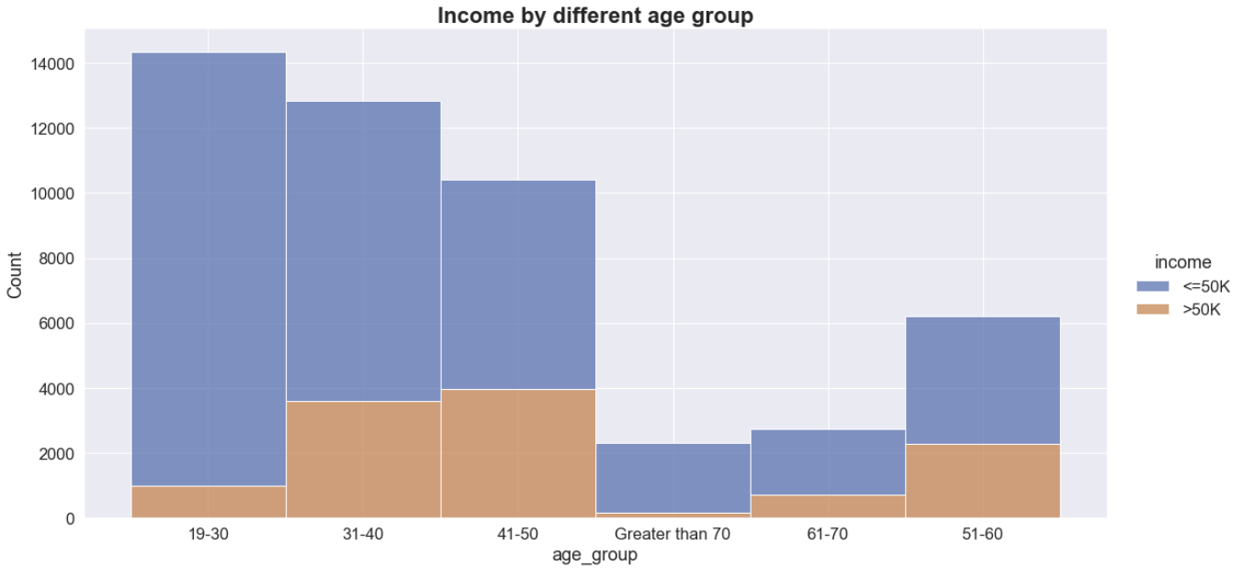
Income by age
By age increase:
Over 50K : ↑
Less than 50K ：↓

Slide 6
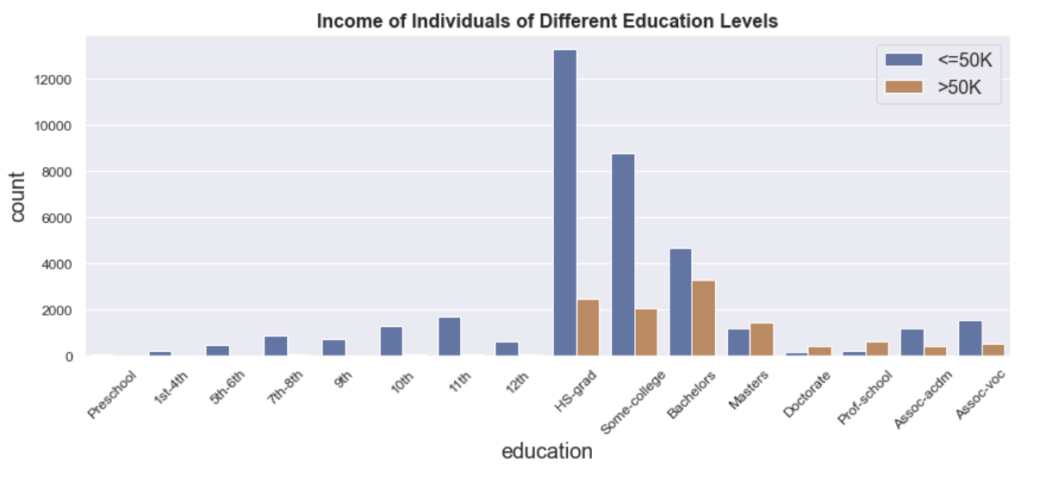
Income by education
before 50K:
Before 12th
Over 50K:
Hs, college,
Master and higher

Slide 7
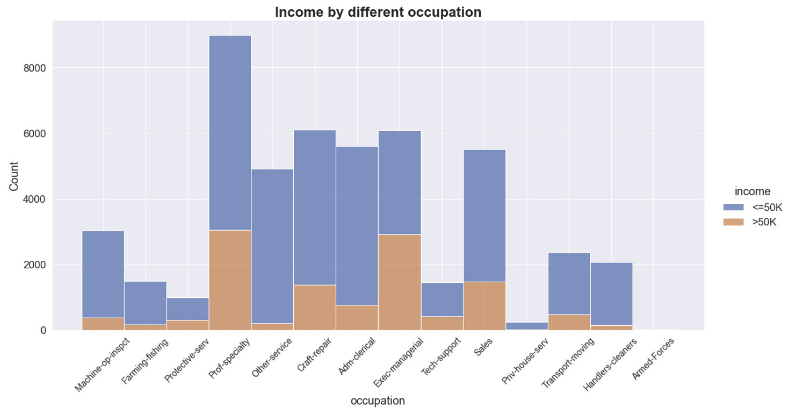
Income by occupation
Over 50K
Exec-managerial : 50%
Prof-specialty : 33%
Less than 50K
Farming-fishing
Machine-op-inspect
Other-service
Adm-clerical
Transport-moving

Slide 8
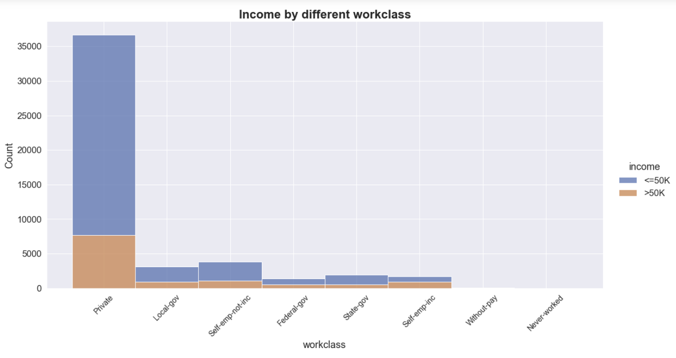
Income by work class
Over 50K
20% of private
80% are not
In self-employed
more than >50K
Less than 50K
Most of them

Slide 9
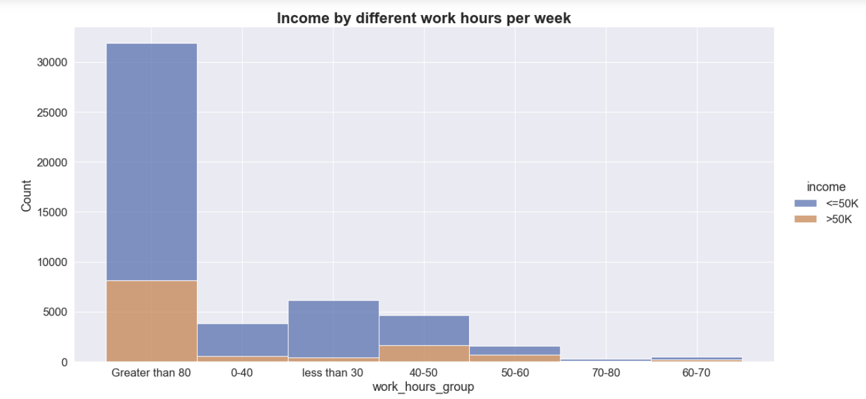
Income by Length of work
Some correlation
More time ≠
More income
Over 50K
50-60 are close to be same as less than 50K

Slide 10
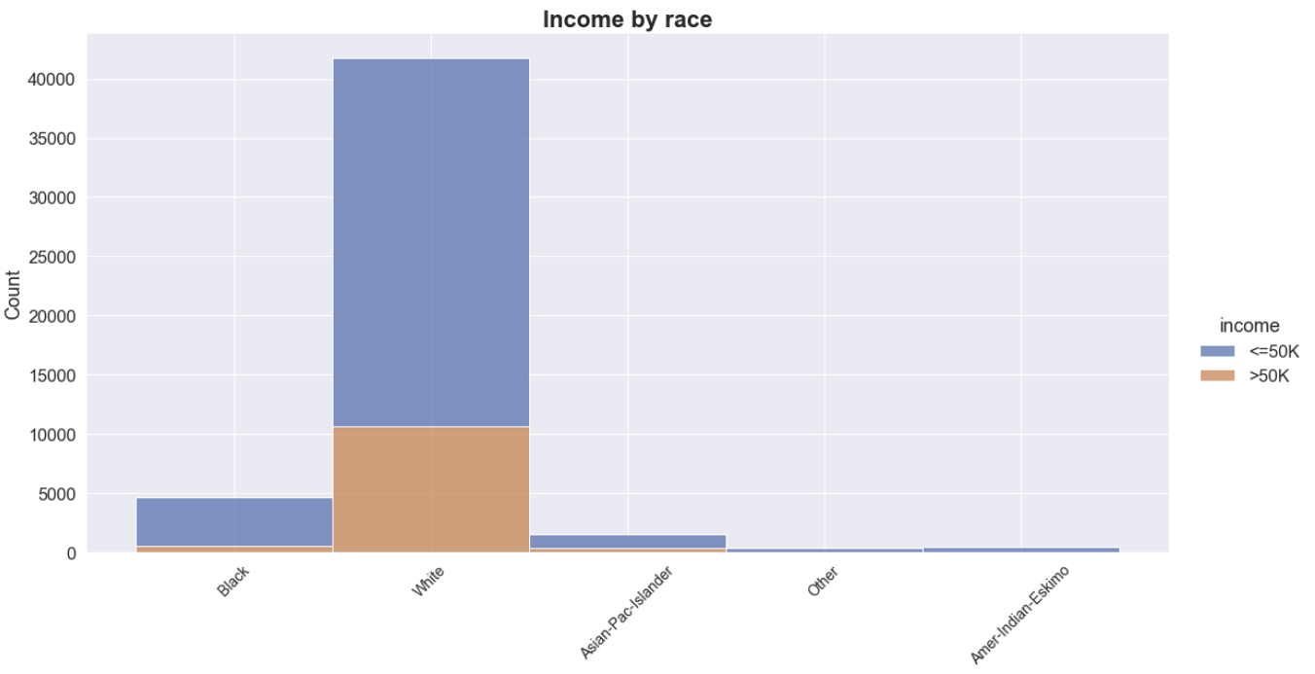
Income by Length of race
Most of people are
White
Doesn’t show relationship between
Race and income

Slide 11
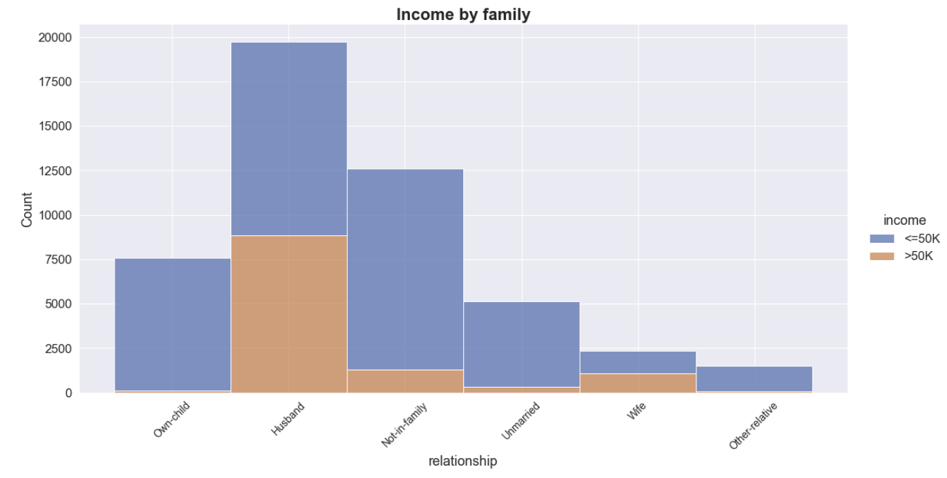
Income by family
Over 50K
Husband and wife both 50%
Less than 50K
Unmarried
Own-child
Not in family

