Slide 1
Forms

Slide 2
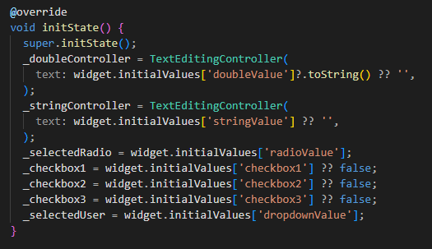
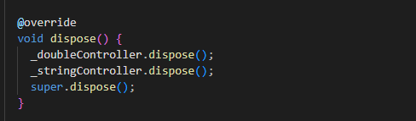
Init and dispose
Notes:
Init:Ensures proper lifecycle and system setup. Dispose: always put it in the end of dispose() or it may cause some errors.

Slide 3
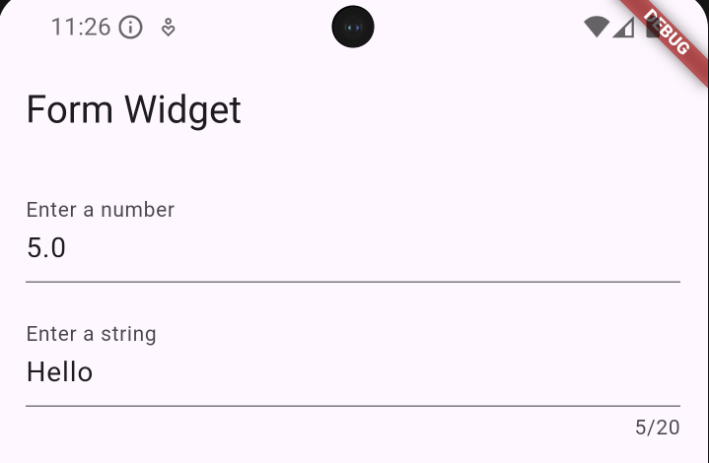

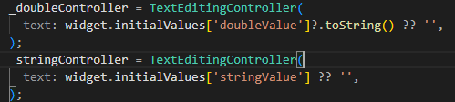
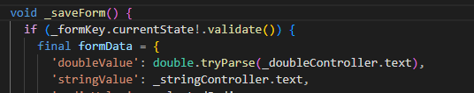
How to validate the textField

Slide 4
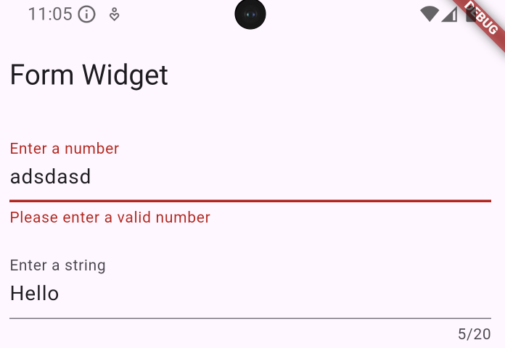

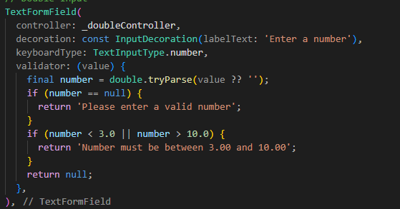

How to retrieve the value of a textfield

