Slide 1
Among Us
-- Xue Liu

Slide 2
3
Task3: Overall Aggregation

Slide 3

3.1. Calculate the total number of events recorded in this collection across all games.
db.Among_Us_data.aggregate([
{ $unwind: "$Game_Feed" }, { $group: { _id: null, totalEvents: { $sum: 1 } } }])
Answer: 5889
Notes:
Use $unwind to deconstructs the Game_Feed in each document and outputs a document for each element.
Use $group to Group all expanded documents together and sum the document counts

Slide 4
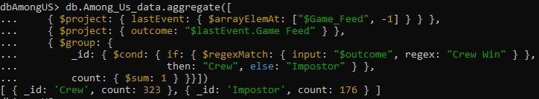
3.2. Compare the crew's wins to the impostors' wins and provide the counts.
db.Among_Us_data.aggregate([
{ $project: { lastEvent: { $arrayElemAt: ["$Game_Feed", -1] } } },
{ $project: { outcome: "$lastEvent.Game Feed" } },
{ $group: { _id: { $cond: { if: { $regexMatch: { input: "$outcome", regex: "Crew Win" } }, then: "Crew", else: "Impostor" } }, count: { $sum: 1 } }}])
Answer: Crew wins 323 times, impostors win 176 times
Notes:
First, Get the last event : Use the $project operator combined with $arrayElemAt to extract the last event in the Game_Feed array of each document.
Then extract the victory type
Finally, group and count

Slide 5
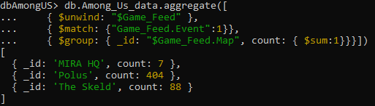
3.3. List the maps played and the total number of games on each map.
db.Among_Us_data.aggregate([
{ $unwind: "$Game_Feed" },
{ $match: {"Game_Feed.Event":1}},
{ $group: { _id: "$Game_Feed.Map", count: { $sum:1}}}])
Answer: "MIRA HQ": 7, "The Skeld": 88, "Polus": 404
Notes:
First expand the Game_Feed array. A new document is created for each array element.
Then use $match to filter those documents whose Event field value is 1. Because the map values of all events in each game are the same.
Finally, use $group to group the documents by the Map field.

Slide 6

3.4. Determine the total instances of crew members skipping a vote across all games.
db.Among_Us_data.aggregate([
{ $unwind: "$Game_Feed" },
{ $match: { "Game_Feed.Votes Off Code": 0,}},
{ $count: "skippedVotes" } ])
Answer: 693
Notes:
First, expand the Game_Feed array:
Then filter the events that skip voting:
The Votes Off Code of crew members skipping votes is 0.
so use $match operator to filter out those events whose Votes Off Code field is 0.
Finally count

Slide 7

3.5. Calculate the total occurrences of crew members voting against imposters across all matches.
db.Among_Us_data.aggregate([
{ $unwind: "$Game_Feed" },
{ $match: { "Game_Feed.Votes Off Code": 2,}},
{ $count: "skippedVotes" } ])
Answer: 639
Notes:
The Votes Off Code of crew members voting against imposters is 2.
so use $match operator to filter out those events whose Votes Off Code field is 2.

Slide 8
4
Task4: Player-level Aggregation

Slide 9
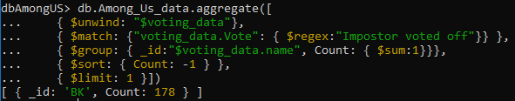
4.2. Identify the player considered the best crew member.
db.Among_Us_data.aggregate([
{ $unwind: "$voting_data"},
{ $match: {"voting_data.Vote": { $regex:"Impostor voted off"}} },
{ $group: { _id:"$voting_data.name", Count: { $sum:1}}},
{ $sort: { Count: -1 } },
{ $limit: 1 }])
Answer: “BK”
Notes:
Analyze specific patterns in the voting data to find the players who were most successful in identifying and voting to expel the Impostor from the game.
Use $unwind to unwind the voting_data array
Use $match to filter documents.The vote field value matches the regular expression "Impostor voted off". This is the event where the Impostor was successfully cast in the Find All Polls.
Use $group to group documents by the voting_data.
Use $sort and $limit to sort the results in descending order. The highest Count value will be ranked first

Slide 10
4.3. Identify the player regarded as the least effective crew member.
db.Among_Us_data.aggregate([
{ $unwind: "$voting_data"},
{ $match: {"voting_data.Vote": { $regex:"Crew voted off"}} },
{ $group: { _id:"$voting_data.name", Count: { $sum:1}}},
{ $sort: { Count: -1 } },
{ $limit: 1 }])
Answer: “Sam”
Notes:
Analyze specific patterns in the voting data to identify players who are most likely to misjudge the game and result in the expulsion of Crew members.
The $match to filter documents. The vote field value matches the regular expression "Crew voted off". Only keep those cases where the vote shows that a Crew member was wrongfully evicted.

Slide 11
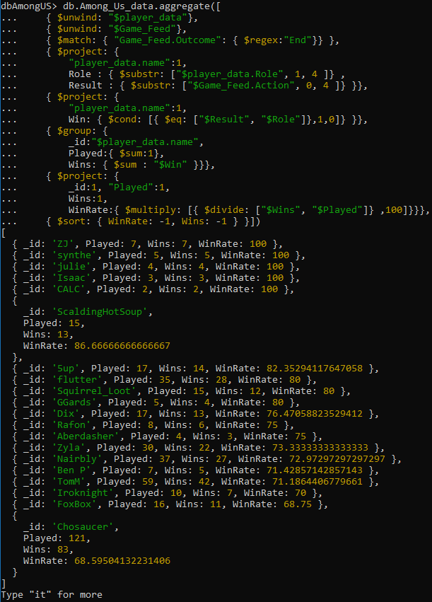
4.4. Compute the win percentage for each player. (Optional)
Notes:
Analyze a player's win rate by counting the number of games and wins for each player
Use $unwind to expand the player_data
Use $match to filter out documents whose Outcome field contains "End".
The first $project: extracts the player_data.name and Role fields. The Role is obtained by intercepting the first 4 characters of the player_data.Role field. Similarly, the Result is obtained by intercepting the first 4 characters of the Action field.
The second $project: calculates the Win field. If Result and Role are equal, the value is assigned to 1 (representing victory), otherwise it is 0.
Use $group to group the documents by player_data.name and calculate the total number of games played and the number of games won by each player.
Project again, this time calculating each player's win rate by dividing the number of games won by the total number of games played and multiplying by 100.
Finally, use $sort to sort in descending order based on winning rate and number of games won.

Slide 12
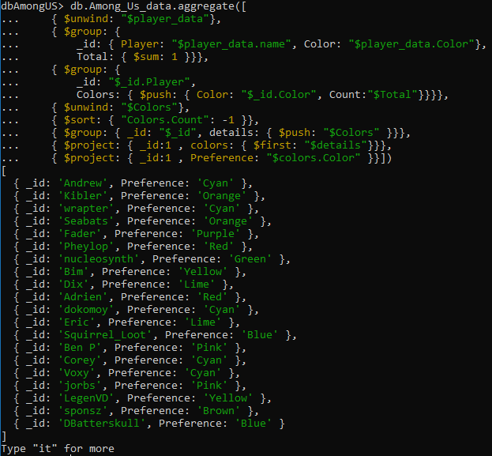
4.5. Determine the color preferences chosen by all players. (Optional)
Notes:
Counting how many times each colour is used by each player, then sort the colours to find the most used ones.
Use $unwind to expand the player_data array
The first $group: Groups the document by player name and colour, counting the number of times each colour is used by each player.
The second $group: groups the document by player name and pushes each color and its count as an object into the Colors array.
Use $unwind to expand the Colors array so that each array element creates a new document.
Use $sort to sort colours in descending order based on the number of times they are used.
The third $group: groups the document by player name and pushes the sorted Colors array into the details field.
The first $project: holds a details field for each player, which contains a list of colours sorted by the number of uses.
The second $project: extracts each player's favourite colour from the details field

Slide 13
5
Task5: Export from MongoDB (Optional)

Slide 14
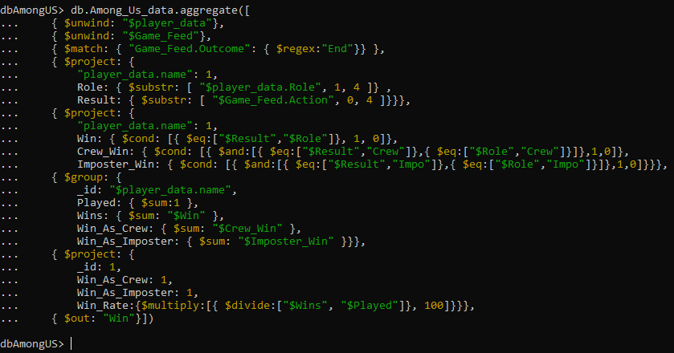
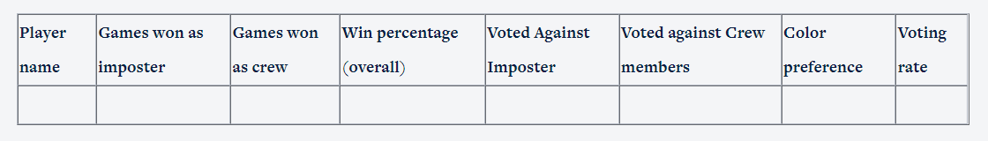
5. Create an export from MongoDB in the form given below
Save the results of "Games won as imposter", "Games won as crew", "Win percentage(overall)" to a collection called ‘Win’. (2nd Column, 3rd Column, 4th Column)
Notes:
Save the results of win, voting and color to collections respectively, then use “_id” as the key value to merge the collections, rename the fields and finally use mongoexport to export the final results as a CSV file

Slide 15
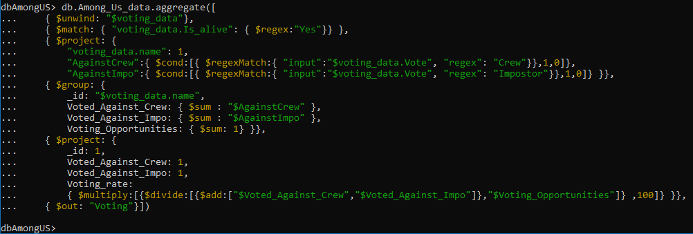
5. Create an export from MongoDB in the form given below
Save the results of "Voted Against Imposter", "Voted against Crew members", “Voting rate" to a collection called ‘Voting’. (5th Column, 6th Column, 8th Column)

Slide 16
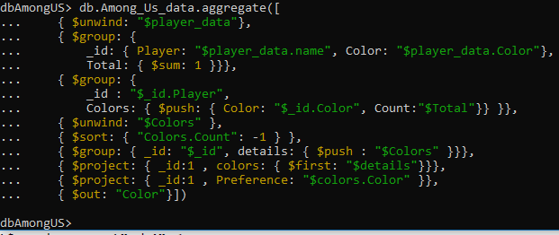
5. Create an export from MongoDB in the form given below
Save the results of "Color preference" to a collection called ‘Color’. (7th Column)

Slide 17
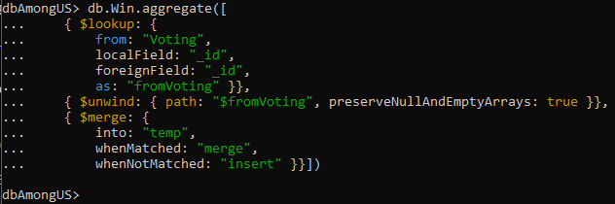
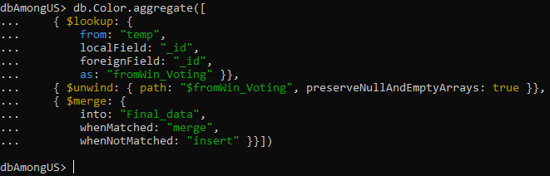
5. Create an export from MongoDB in the form given below
Use “_id” as the key value to merge the collections. Merge the collection ‘Win’ and the collection ‘Voting’ into the temporary collection ‘temp’, and then merge’ temp’ with the collection ‘Color’.

Slide 18
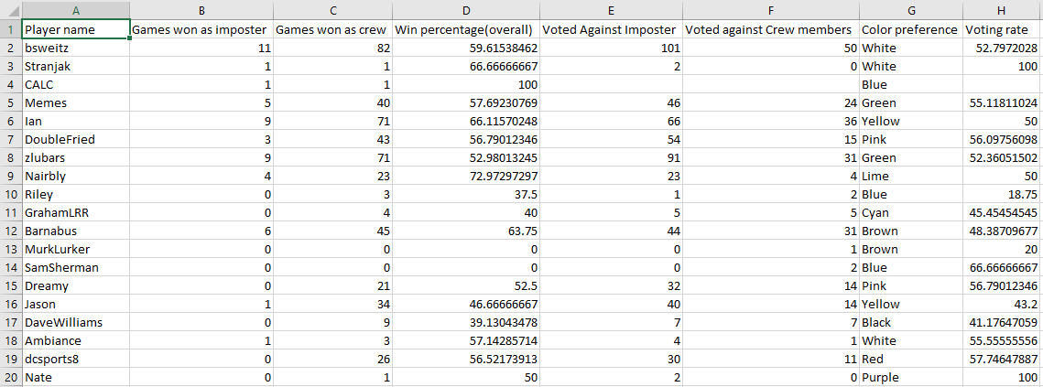
5. Create an export from MongoDB in the form given below
use mongoexport to export the final results as a CSV file

Slide 19
Thank You

