Slide 1
Optimal Controller and Examples- Lecture 7
Instructor: Sanghyuk Lee
Sanghyuk.Lee@xjtlu.edu.cn
Tel: 8816-1415
Department of Electrical and Electronic Engineering
XJTLU

Slide 2
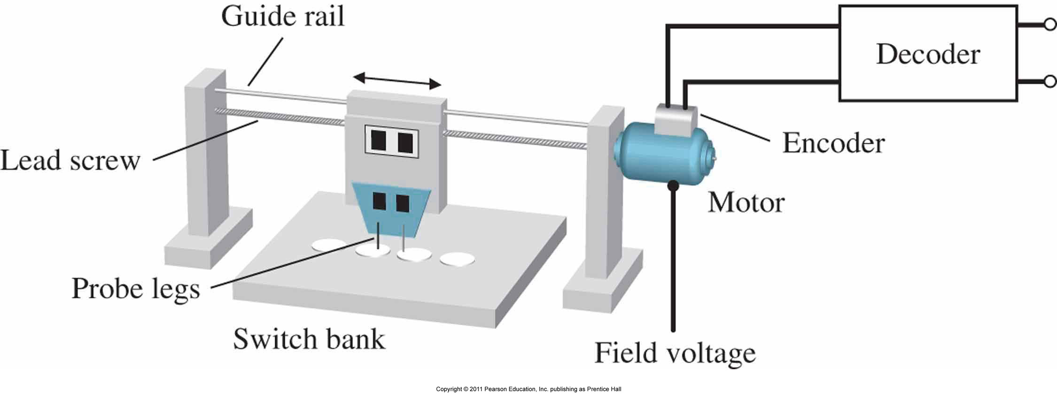
Optimal Controller Design Example
Third order system with full state feedback
DC motor to move a set of test probes
Low through out and high degree of error
Automating require placing a plug across the leads of a part and testing for continuity/resistence/functionality

Slide 3
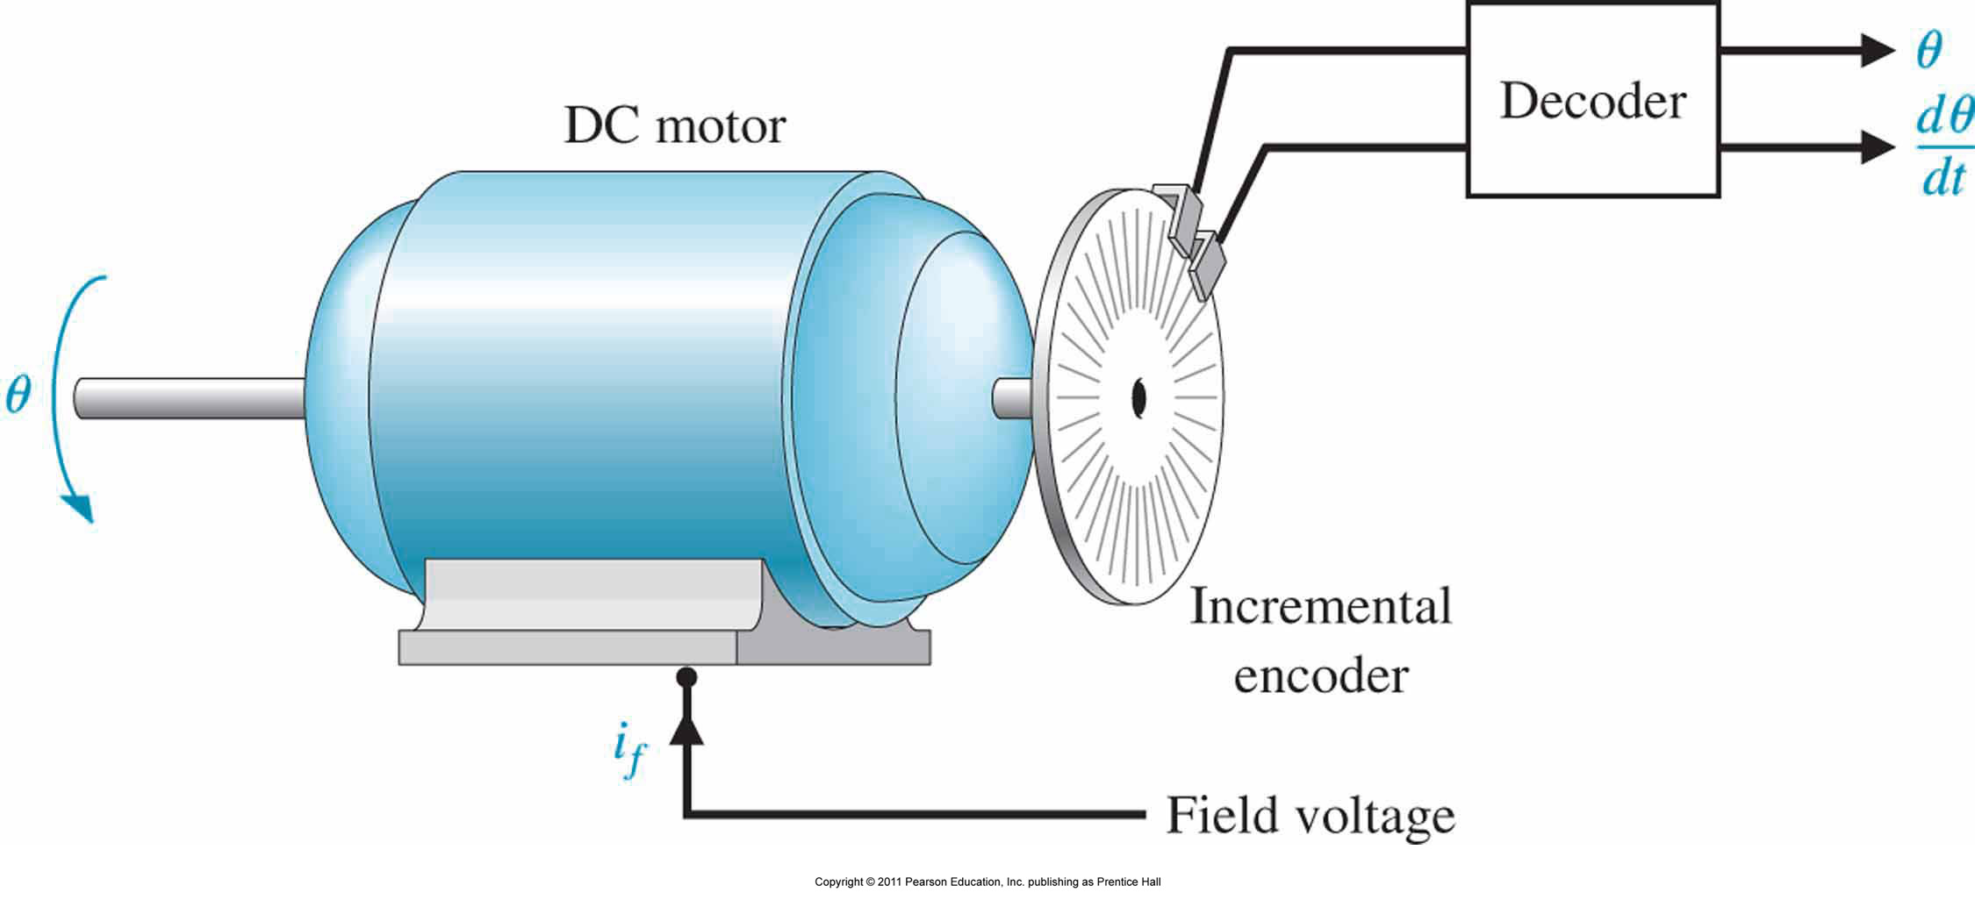
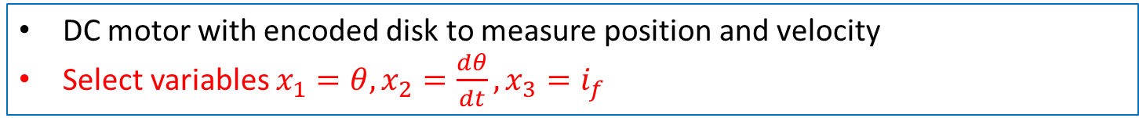
Optimal Controller Design Example
DC motor with encoded disk to measure position and velocity
Select variables $x_{1}=θ, x_{2}=\frac{dθ}{dt}, x_{3}=i_{f}$

Slide 4
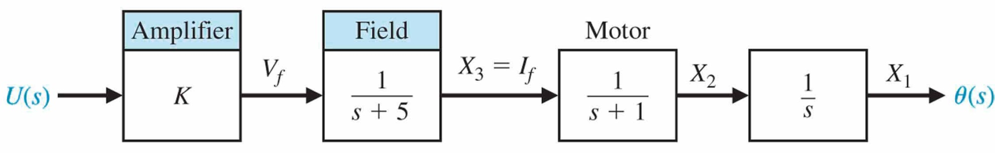
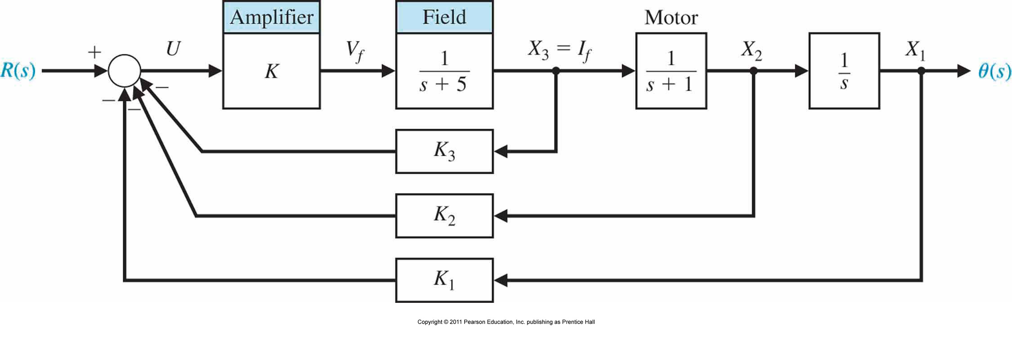
Full state feedback Controller Design Example
State variable feedback is available
$u=\left[\begin{matrix}−K_{1} & −K_{2} & −K_{3}\end{matrix}\right]x+r$ or $u=−K_{1}x_{1}−K_{2}x_{2}−K_{3}x_{3}+r$
Goal is settling time with a 2% criterion and overshoot of less than 4%

Slide 5
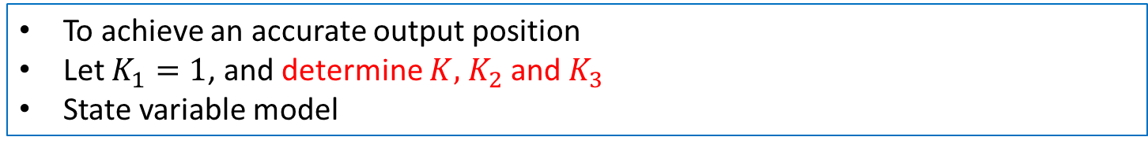
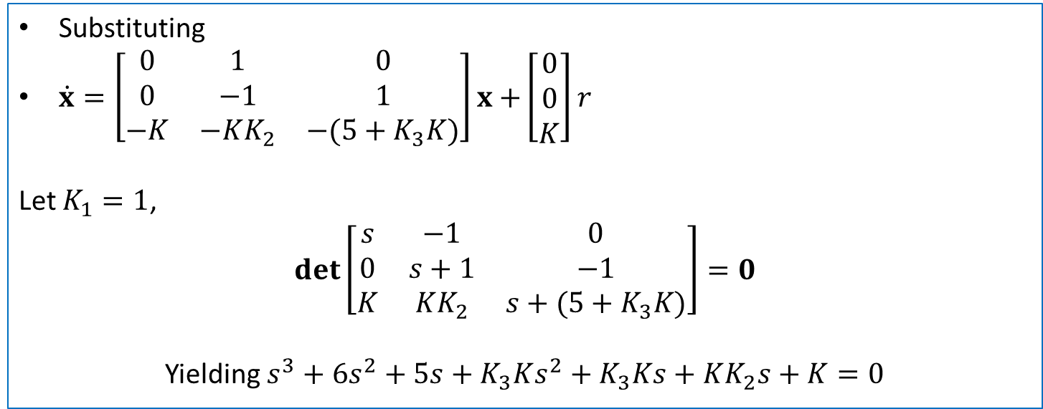
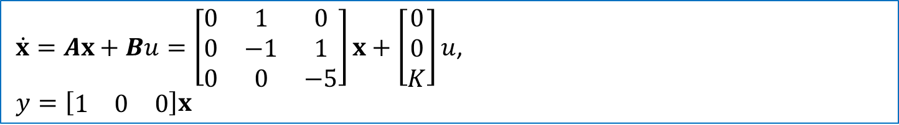
Full state feedback Controller Design Example
To achieve an accurate output position
Let $K_{1}=1$, and determine $K,$ $K_{2}$ and $K_{3}$
State variable model
$\dot{x}=Ax+Bu=\left[\begin{matrix}0 & 1 & 0 \\ 0 & −1 & 1 \\ 0 & 0 & −5\end{matrix}\right]x+\left[\begin{matrix}0 \\ 0 \\ K\end{matrix}\right]u$,
$y=\left[\begin{matrix}1 & 0 & 0\end{matrix}\right]x$
Substituting
$\dot{x}=\left[\begin{matrix}0 & 1 & 0 \\ 0 & −1 & 1 \\ −K & −KK_{2} & −(5+K_{3}K)\end{matrix}\right]x$ $+\left[\begin{matrix}0 \\ 0 \\ K\end{matrix}\right]r$
Let $K_{1}=1$,
$$det\left[\begin{matrix}s & −1 & 0 \\ 0 & s+1 & −1 \\ K & KK_{2} & s+(5+K_{3}K)\end{matrix}\right]=0$$
Yielding $s^{3}+6s^{2}+5s+K_{3}Ks^{2}+K_{3}Ks+KK_{2}s+K=0$

Slide 6
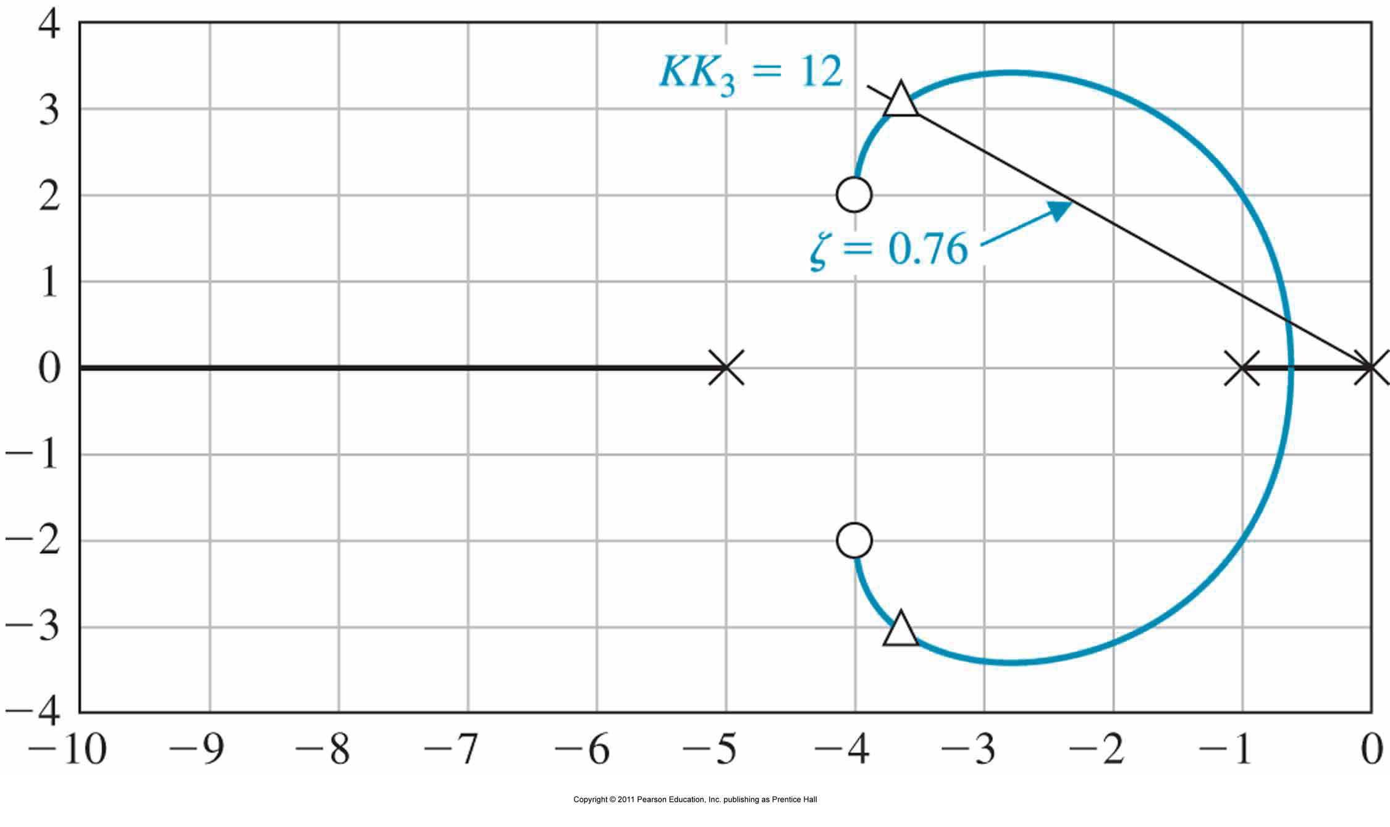
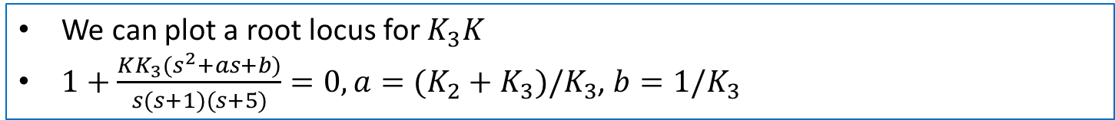
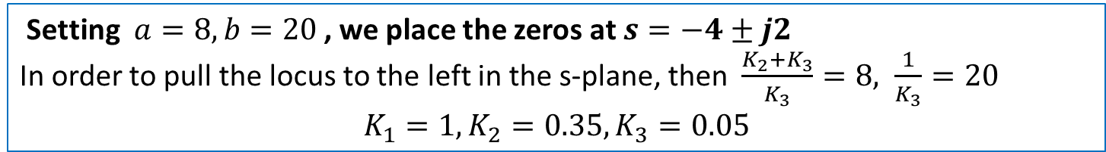
Full state feedback Controller Design Example
We can plot a root locus for $K_{3}K$
$1+\frac{KK_{3}(s^{2}+as+b)}{s(s+1)(s+5)}=0, a=(K_{2}+K_{3})/K_{3}$, $b=1/K_{3}$
Setting $a=8, b=20$ , we place the zeros at $s=−4±j2$
In order to pull the locus to the left in the s-plane, then $\frac{K_{2}+K_{3}}{K_{3}}=8, \frac{1}{K_{3}}=20$
$$K_{1}=1,K_{2}=0.35,K_{3}=0.05$$

Slide 7
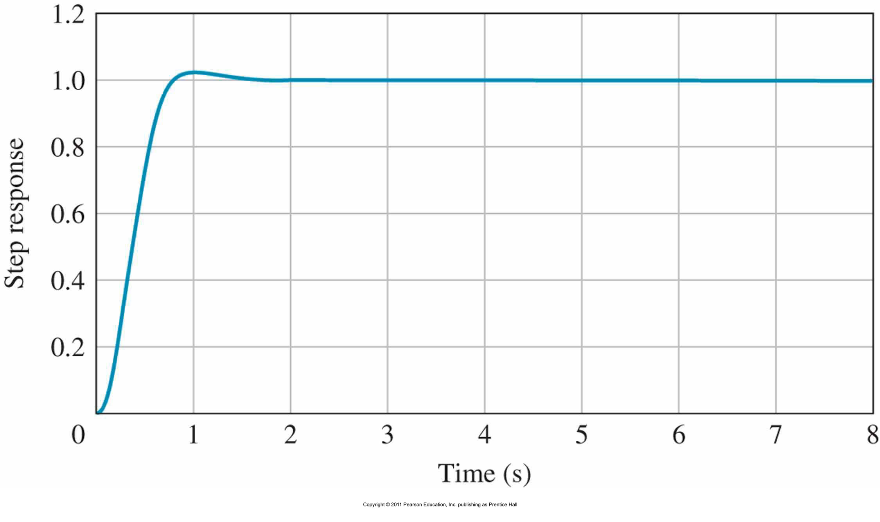
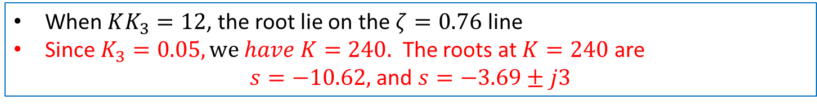
Full state feedback Controller Design Example
When $KK_{3}=12$, the root lie on the $ζ=0.76$ line
Since $K_{3}=0.05, we have K=240.$ The roots at $K=240$ are
$s=−10.62,$ and $s=−3.69±j3$

Slide 8
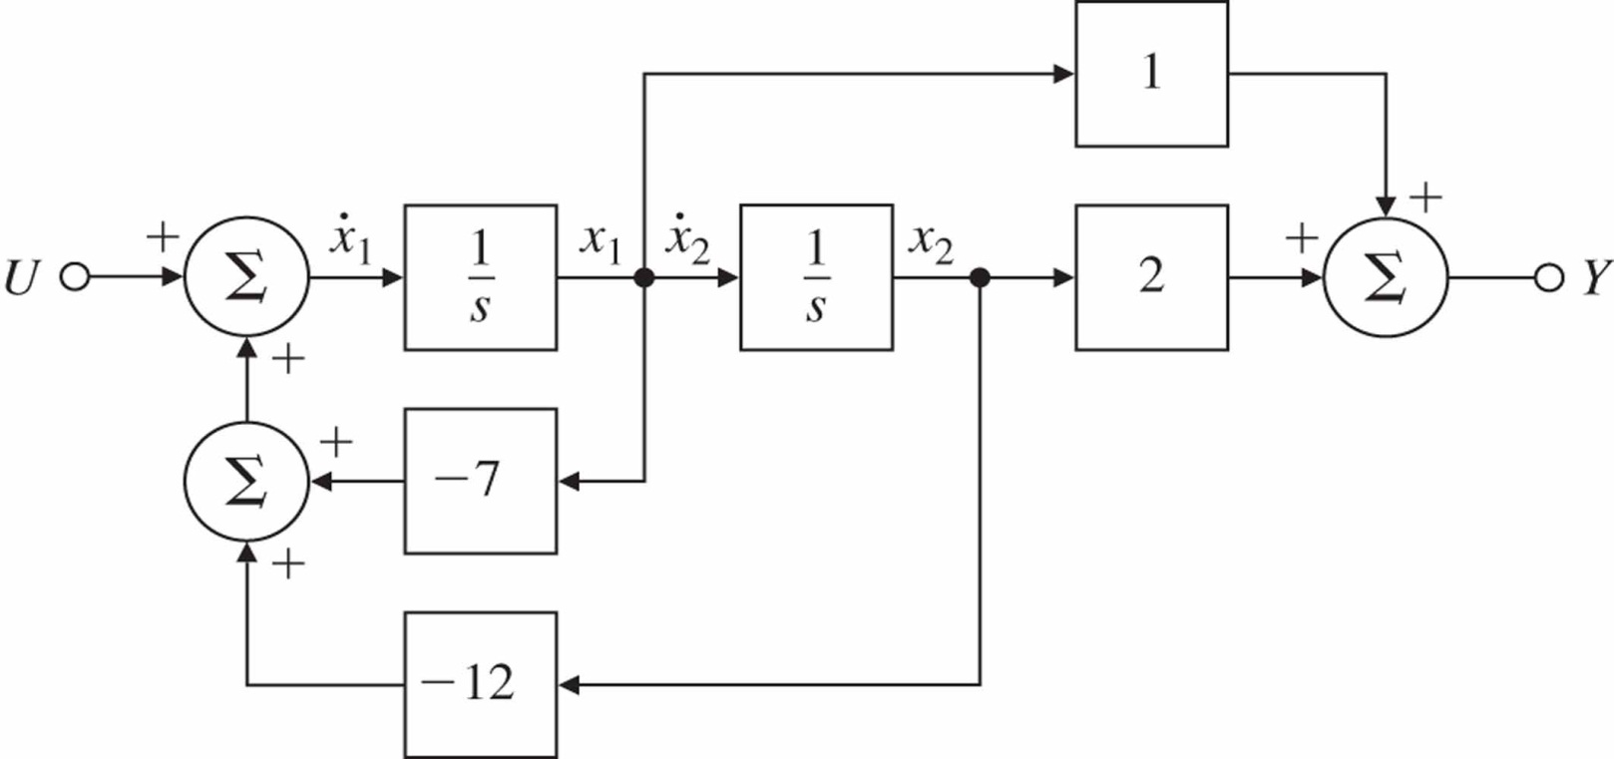
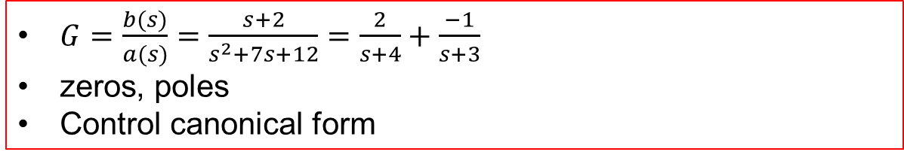
State Space Realization
Study more general models
Idea of geometry into differential equations
Connect internal and external descriptions
$G=\frac{b(s)}{a(s)}=\frac{s+2}{s^{2}+7s+12}=\frac{2}{s+4}+\frac{−1}{s+3}$
zeros, poles
Control canonical form

Slide 9
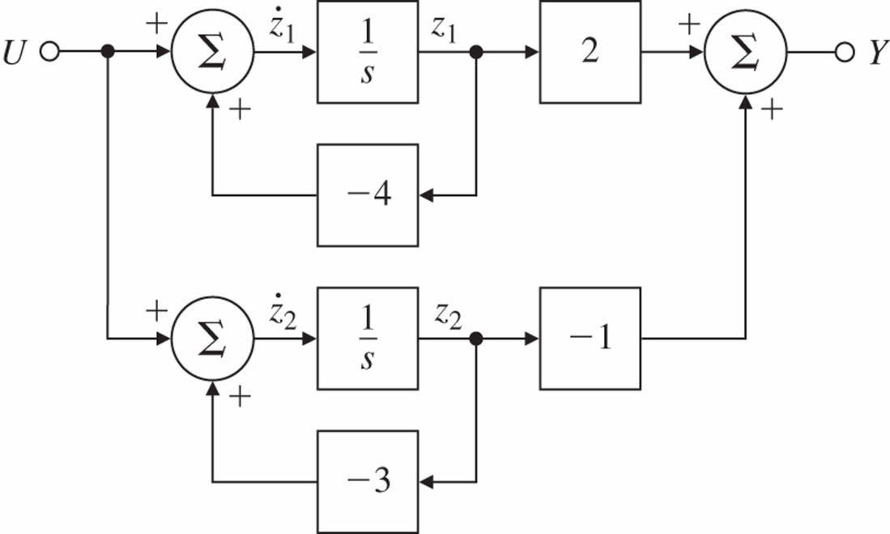
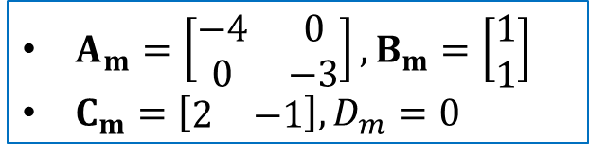
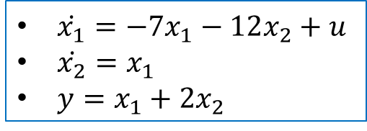
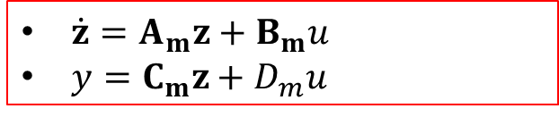

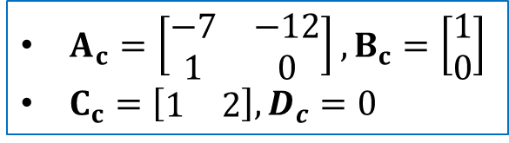

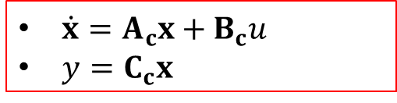
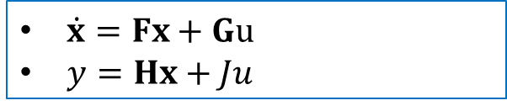
State Space Realization
Controller canonical form
$\dot{x_{1}}=−7x_{1}−12x_{2}+u$
$\dot{x_{2}}=x_{1}$
$y=x_{1}+2x_{2}$
Similarity transform
$\dot{x}=Fx+Gu$
$y=Hx+Ju$
$\dot{x}=A_{c}x+B_{c}u$
$y=C_{c}x$
x$=Tz$, $\dot{z}=Az+Bu$
$A_{c}=\left[\begin{matrix}−7 & −12 \\ 1 & 0\end{matrix}\right], B_{c}=\left[\begin{matrix}1 \\ 0\end{matrix}\right]$
$C_{c}=\left[\begin{matrix}1 & 2\end{matrix}\right], D_{c}=0$
$A=T^{−1}FT$, $B=T^{−1}G$
$\dot{z}=A_{m}z+B_{m}u$
$y=C_{m}z+D_{m}u$
$A_{m}=\left[\begin{matrix}−4 & 0 \\ 0 & −3\end{matrix}\right], B_{m}=\left[\begin{matrix}1 \\ 1\end{matrix}\right]$
$C_{m}=\left[\begin{matrix}2 & −1\end{matrix}\right], D_{m}=0$
Modal canonical form

Slide 10
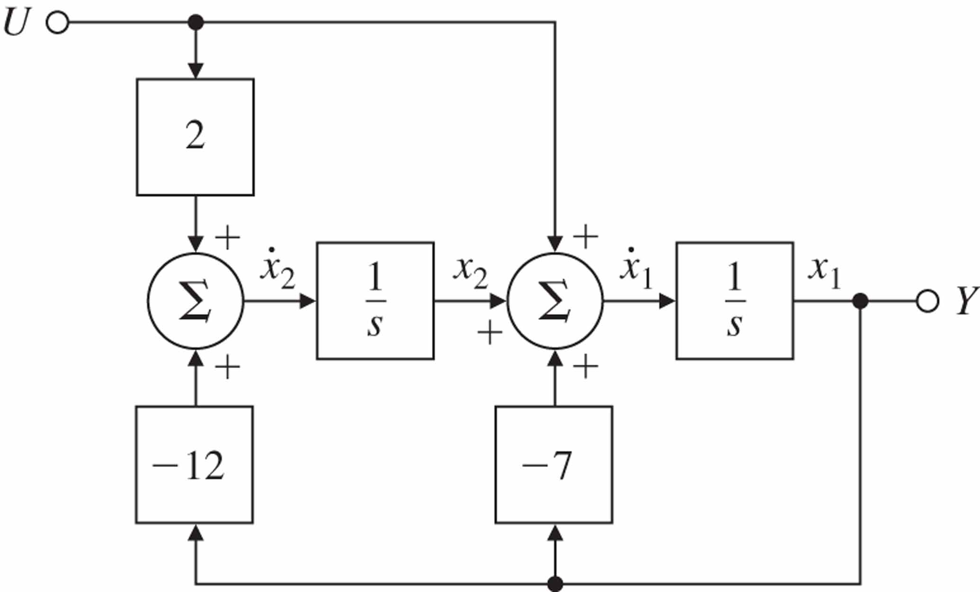
Observer canonical form

Slide 11
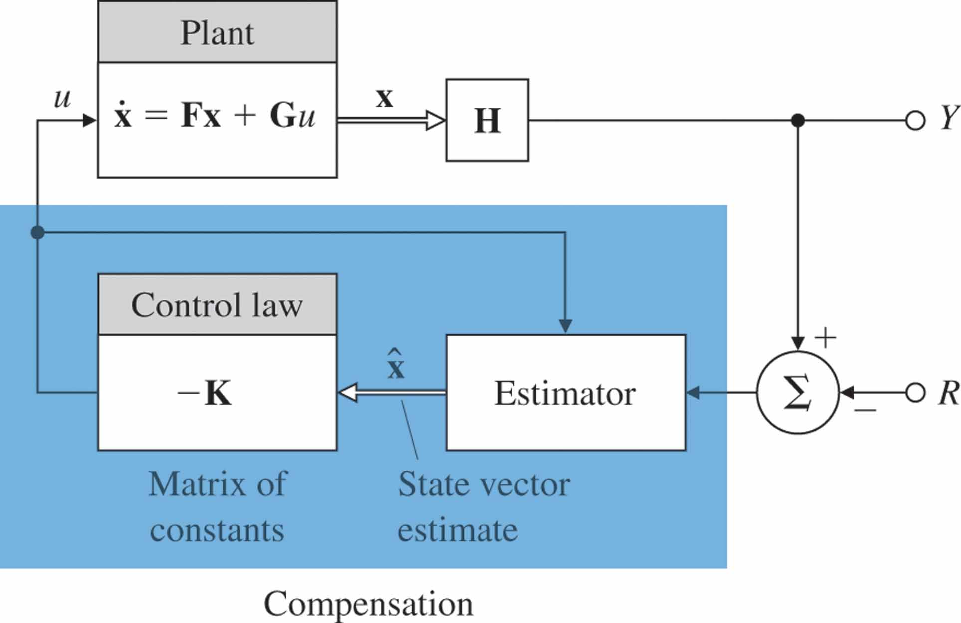
Requirement for state feedback
When the state variables x are not available, how to construct $u=−Kx$ ??

Slide 12
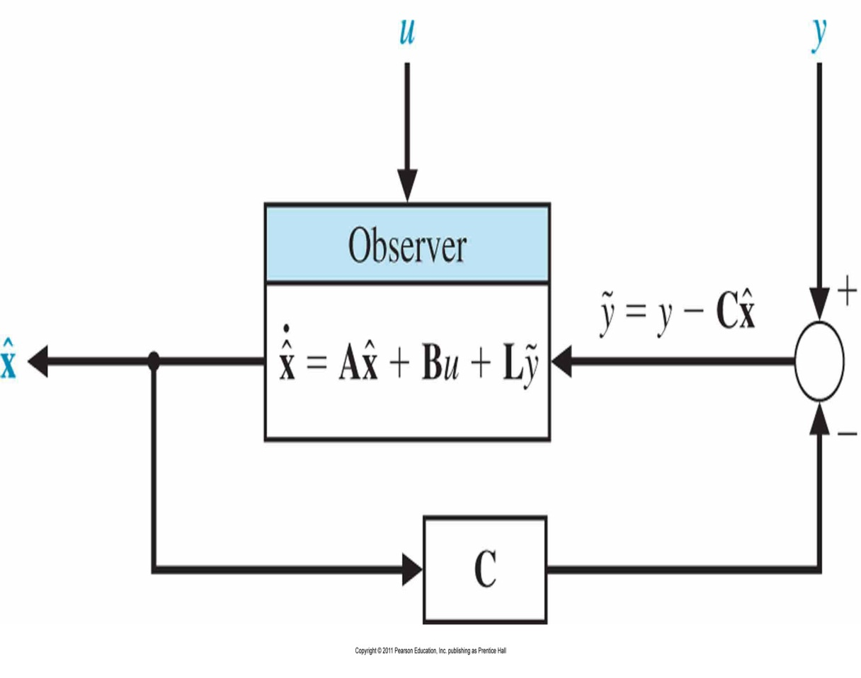
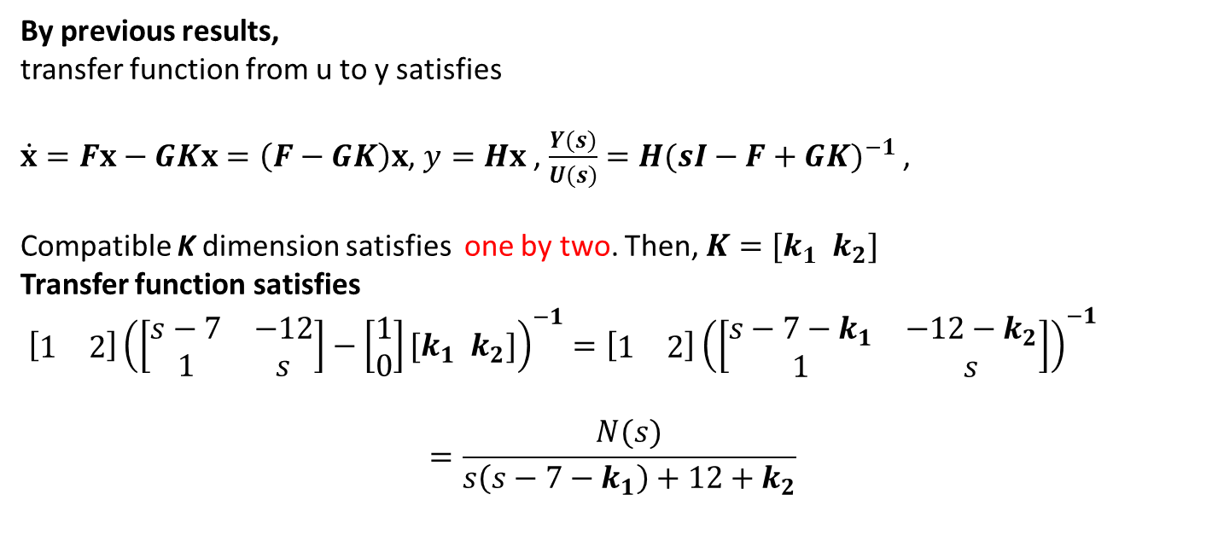
Observer Design
Why do we design observer ?
Goal of observer is to provide $\hat{x}$ so that $\hat{x}→x$ as $t→∞$.
Observer structure(Luenberger)
$$\dot{\hat{x}}=A\hat{x}+Bu+L(y−C\hat{x})$$
Let $e\left(t\right)=x\left(t\right)−\hat{x}(t)$
Taking the time derivative of the estimation error
$$\dot{e}=\dot{x}−\dot{\hat{x}}$$
Then, $\dot{e}=Ax+Bu−A\hat{x}−Bu−L(y−C\hat{x})$ or $\dot{e}(t)=\left(A−LC\right)e(t)$
We guarantee $e\left(t\right)→0$ as $t→∞$ for any initial tracking error $e\left(t_{0}\right)$ if the characteristic equation
$$det\left(λI−\left(A−LC\right)\right)=0$$
All root are in Left Half Plane $↔$ Complete Observable $↔$ Observability matrix $P_{o}$ has full rank

Slide 13
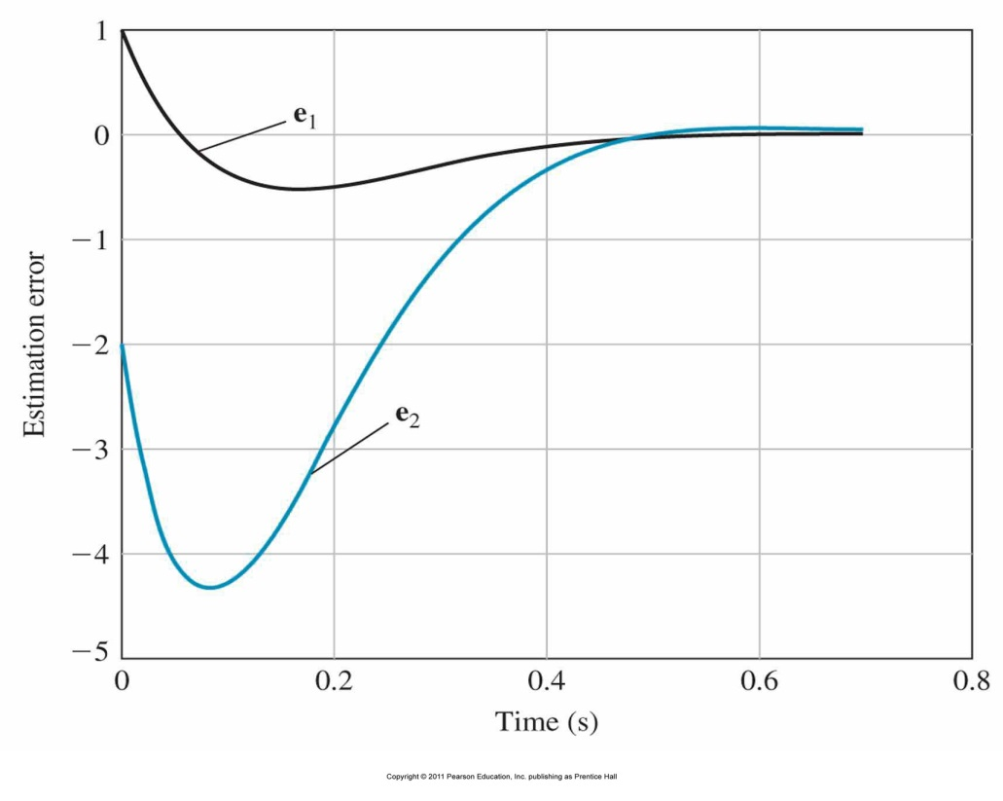
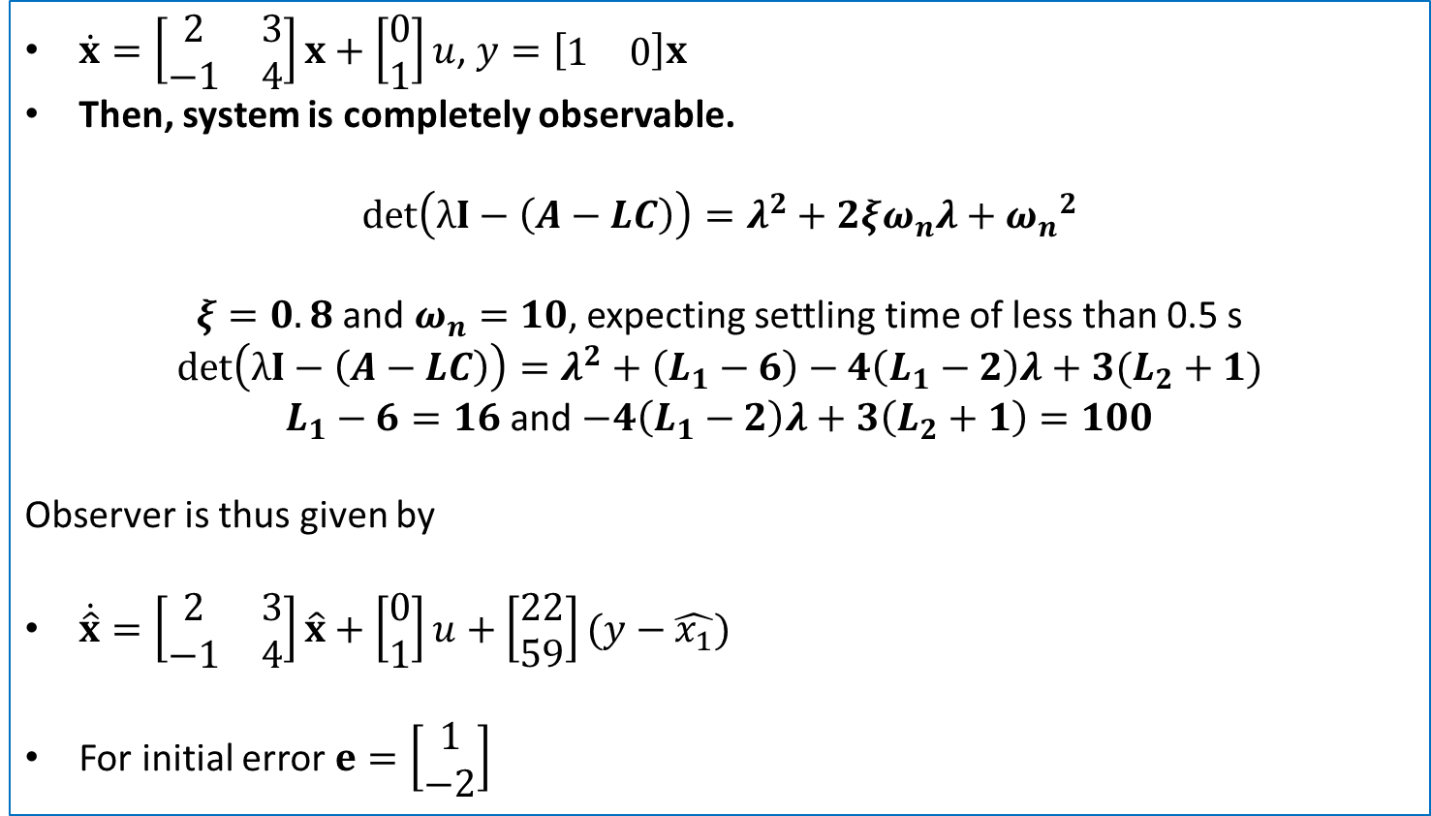
Observer Design Example
$\dot{x}=\left[\begin{matrix}2 & 3 \\ −1 & 4\end{matrix}\right]x+\left[\begin{matrix}0 \\ 1\end{matrix}\right]u$, $y=\left[\begin{matrix}1 & 0\end{matrix}\right]x$
Then, system is completely observable.
$$det\left(λI−\left(A−LC\right)\right)=λ^{2}+2ξω_{n}λ+{ω_{n}}^{2}$$
$ξ=0.8$ and $ω_{n}=10$, expecting settling time of less than 0.5 s
$$det\left(λI−\left(A−LC\right)\right)=λ^{2}+\left(L_{1}−6\right)−4\left(L_{1}−2\right)λ+3(L_{2}+1)$$
$L_{1}−6=16$ and $−4\left(L_{1}−2\right)λ+3\left(L_{2}+1\right)=100$
Observer is thus given by
$\dot{\hat{x}}=\left[\begin{matrix}2 & 3 \\ −1 & 4\end{matrix}\right]\hat{x}+\left[\begin{matrix}0 \\ 1\end{matrix}\right]u+\left[\begin{matrix}22 \\ 59\end{matrix}\right](y−\hat{x_{1}})$
For initial error $e=\left[\begin{matrix}1 \\ −2\end{matrix}\right]$

Slide 14
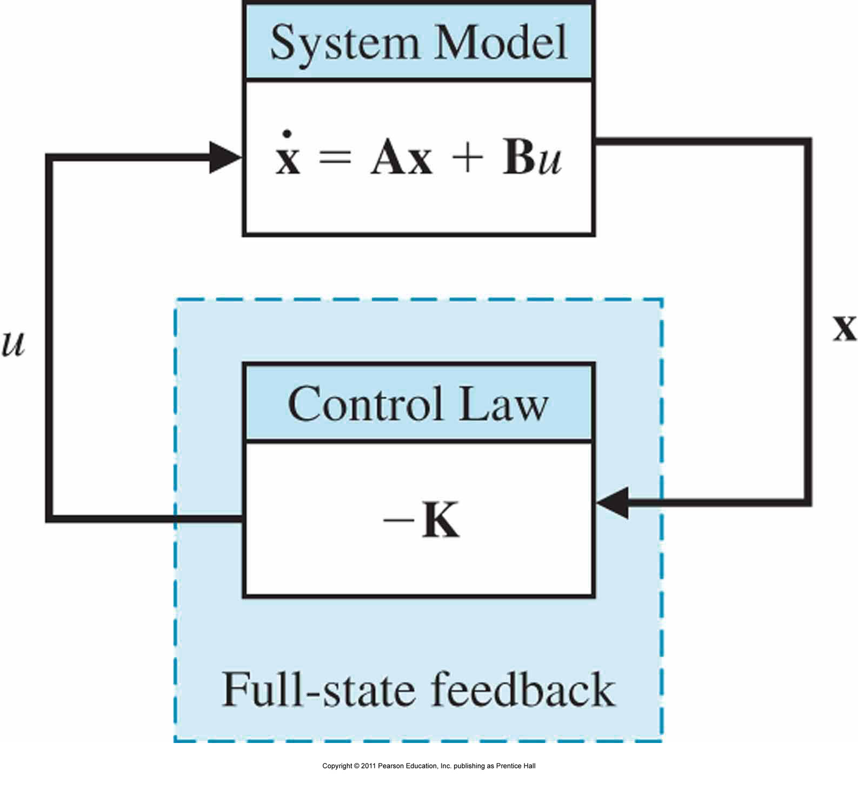
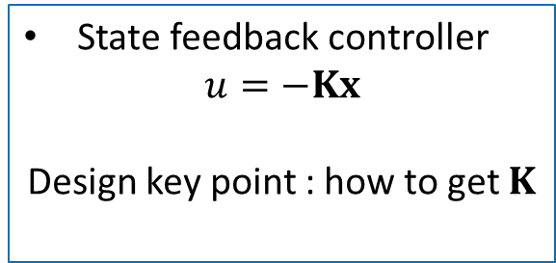
State Feedback Controller Design
State feedback controller
$u=−Kx$
Design key point : how to get $K$
Separation principle
Full state feedback + Observer Design
Two design occur independent, this provides the proof.
Closed loop system
$$\dot{x}=Ax+Bu$$
$=Ax−BKx=\left(A−BK\right)x$
Then $det(λI−\left(A−BK\right))=0$
Satisfy closed loop eigenvalues

Slide 15
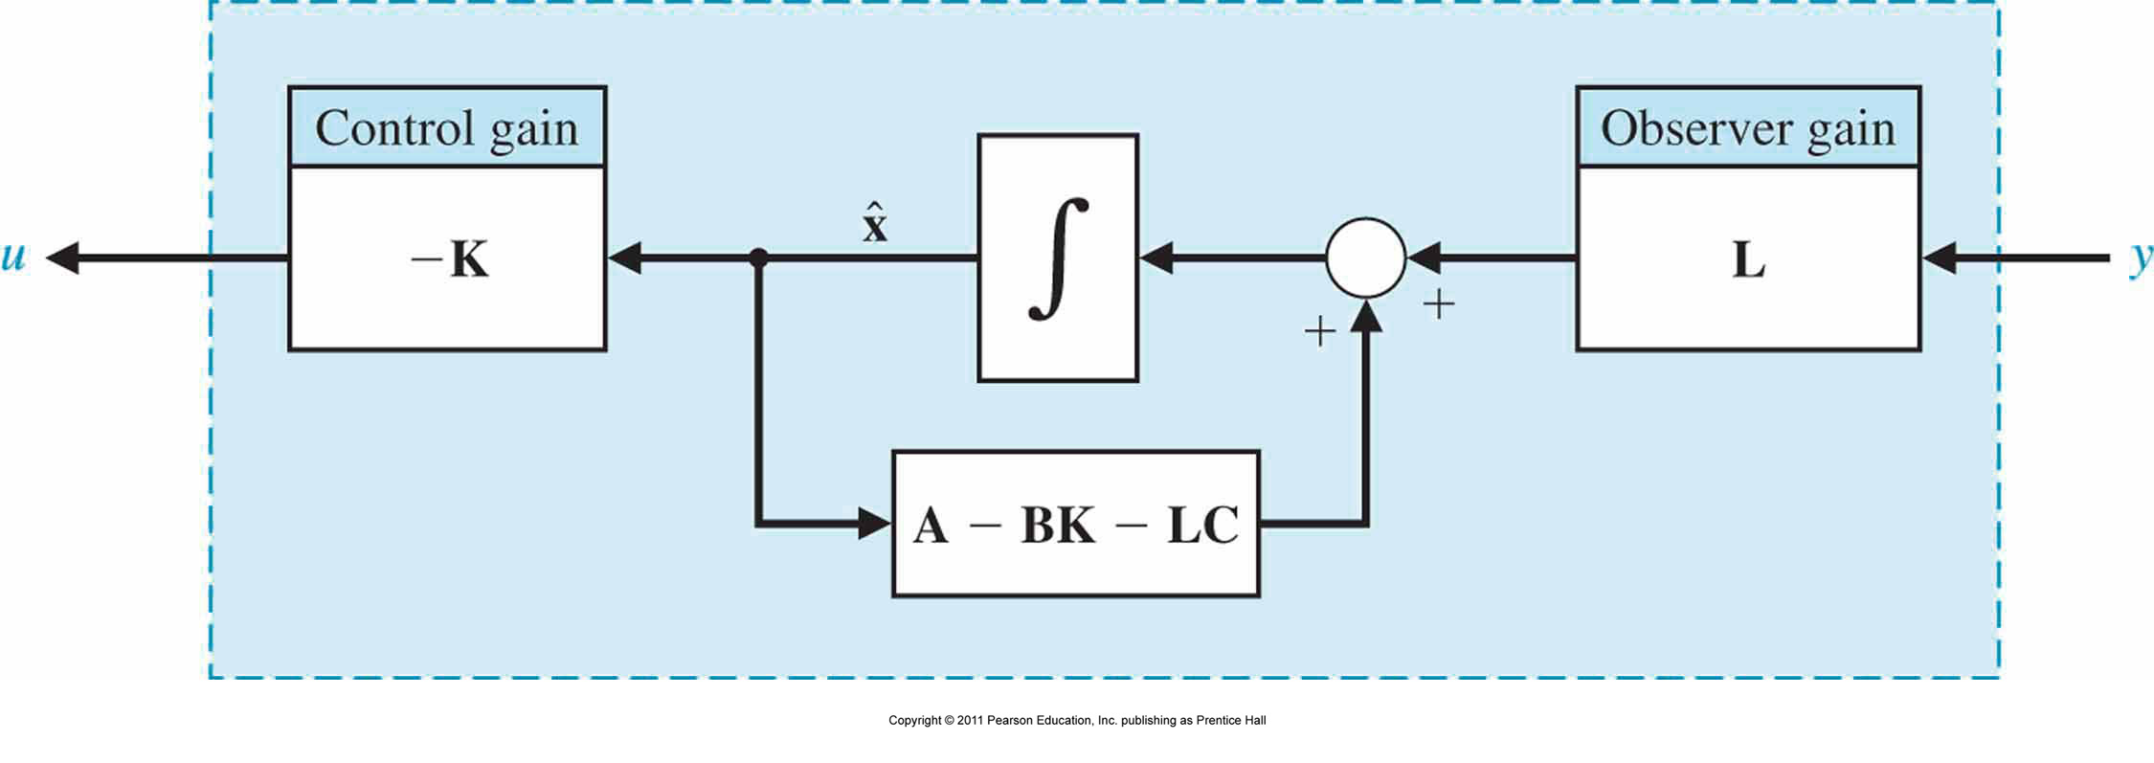
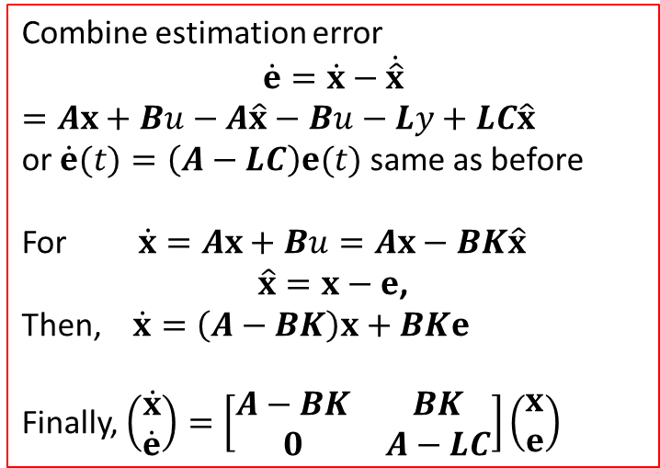
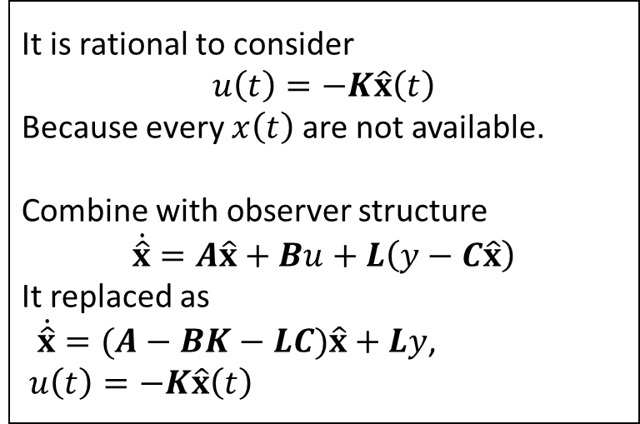
Integration of Estimator and Observer
It is rational to consider
$$u\left(t\right)=−K\hat{x}\left(t\right)$$
Because every $x\left(t\right)$ are not available.
Combine with observer structure
$$\dot{\hat{x}}=A\hat{x}+Bu+L\left(y−C\hat{x}\right)$$
It replaced as
$\dot{\hat{x}}=(A−BK−LC)\hat{x}+Ly$,
$u\left(t\right)=−K\hat{x}\left(t\right)$
Combine estimation error
$$\dot{e}=\dot{x}−\dot{\hat{x}}$$
$=Ax+Bu−A\hat{x}−Bu−Ly+LC\hat{x}$
or $\dot{e}(t)=\left(A−LC\right)e(t)$ same as before
For $\dot{x}=Ax+Bu=Ax−BK\hat{x}$
$\hat{x}=x−e$,
Then, $\dot{x}=\left(A−BK\right)x+BKe$
Finally, $\left(\begin{matrix}\dot{x} \\ \dot{e}\end{matrix}\right)=\left[\begin{matrix}A−BK & BK \\ 0 & A−LC\end{matrix}\right]\left(\begin{matrix}x \\ e\end{matrix}\right)$

Slide 16
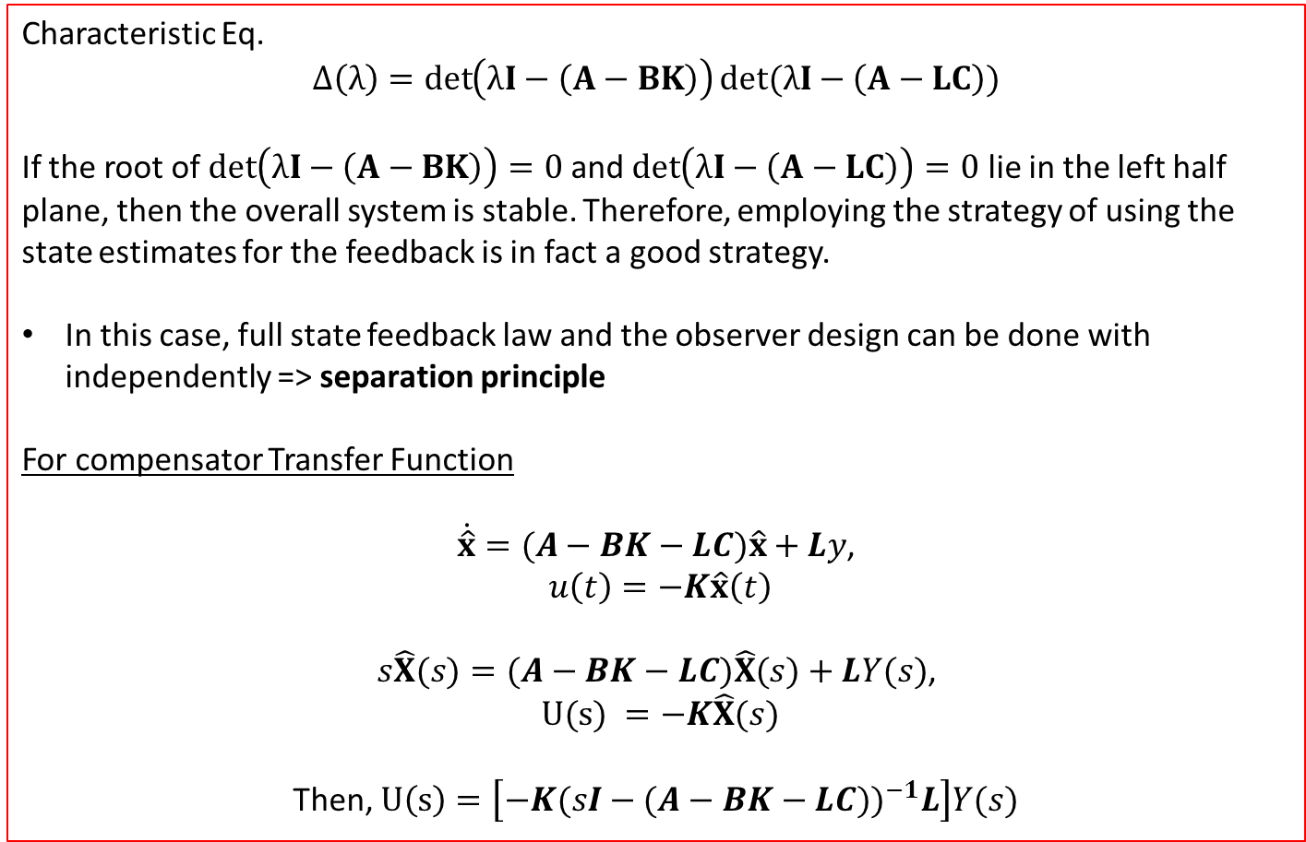
Integration of Estimator and Observer
Characteristic Eq.
$$Δ\left(λ\right)=\det\left(λI−\left(A−BK\right)\right)det⁡(λI−\left(A−LC\right))$$
If the root of $\det\left(λI−\left(A−BK\right)\right)=0$ and $\det\left(λI−\left(A−LC\right)\right)=0$ lie in the left half plane, then the overall system is stable. Therefore, employing the strategy of using the state estimates for the feedback is in fact a good strategy.
In this case, full state feedback law and the observer design can be done with independently => separation principle
For compensator Transfer Function
$\dot{\hat{x}}=(A−BK−LC)\hat{x}+Ly$,
$u\left(t\right)=−K\hat{x}\left(t\right)$
$s\hat{X}(s)=(A−BK−LC)\hat{X}(s)+LY(s)$,
$U(s) =−K\hat{X}(s)$
Then, $U\left(s\right)=\left[−K{(sI−(A−BK−LC\text{))}}^{−1}L\right]Y(s)$

Slide 17
End of Lecture
Optimal Controller and Examples - Lecture 7
Instructor: Sanghyuk Lee
Sanghyuk.Lee@xjtlu.edu.cn
Tel: 8816-1415
Department of Electrical and Electronic Engineering
XJTLU

