Slide 1
Digital Control and Automatic Control Revision
Instructor: Sanghyuk Lee
Sanghyuk.Lee@xjtlu.edu.cn
Tel: 8816-1415
Department of Electrical and Electronic Engineering
XJTLU

Slide 2
Digital Control and Automatic Control EEE327
Contents
Laplace Transform/Z-Transform
Differential and Difference Eq. with System Modelling
State Space Analysis with Transfer Function
- Performance- overshoot, settling time
- PID controller
State Feedback Controller
- Controllability/Observability
- Performance
Stability Analysis
- Rough array
- Root Locus

Slide 3
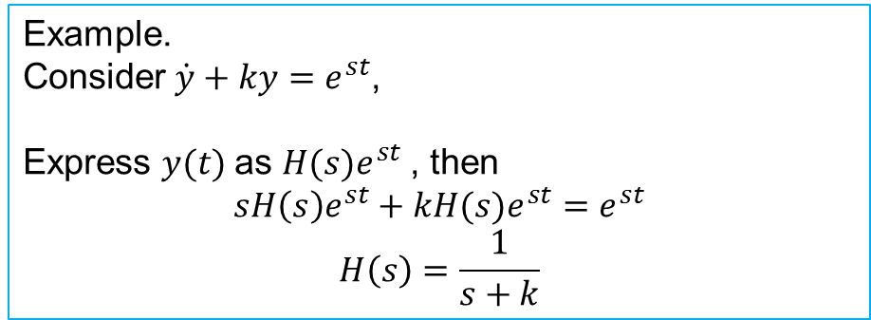
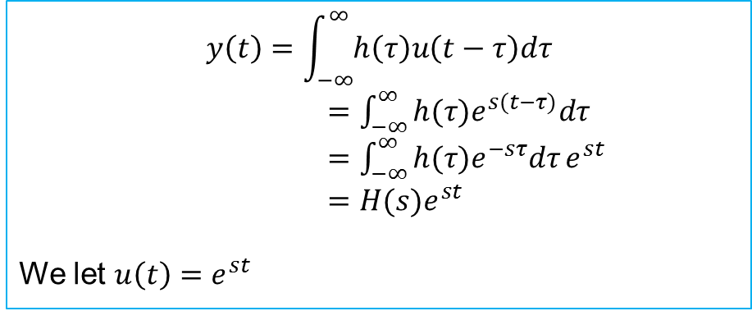
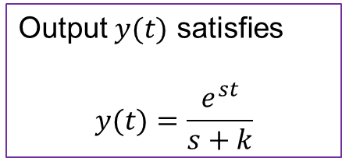
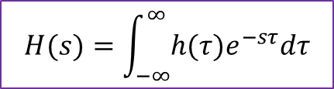
Relation between transfer function and convolution integral
Digital Control and Automatic Control EEE327
Transfer function : description of difference between input and output
$$y\left(t\right)=\int_{−∞}^{∞}{h\left(τ\right)u\left(t−τ\right)dτ}$$
$=\int_{−∞}^{∞}{{h(τ)e}^{s(t−τ)}dτ}$
$=\int_{−∞}^{∞}{{h(τ)e}^{−sτ}dτ}e^{st}$
$=H(s)e^{st}$
We let $u\left(t\right)=e^{st}$
$$H(s)=\int_{−∞}^{∞}{{h(τ)e}^{−sτ}dτ}$$
Output $y(t)$ satisfies
$$y(t)=\frac{e^{st}}{s+k}$$
Example.
Consider $\dot{y}+ky=e^{st}$,
Express $y(t)$as $H(s)e^{st}$, then
$$sH\left(s\right)e^{st}+kH(s)e^{st}=e^{st}$$
$$H\left(s\right)=\frac{1}{s+k}$$

Slide 4
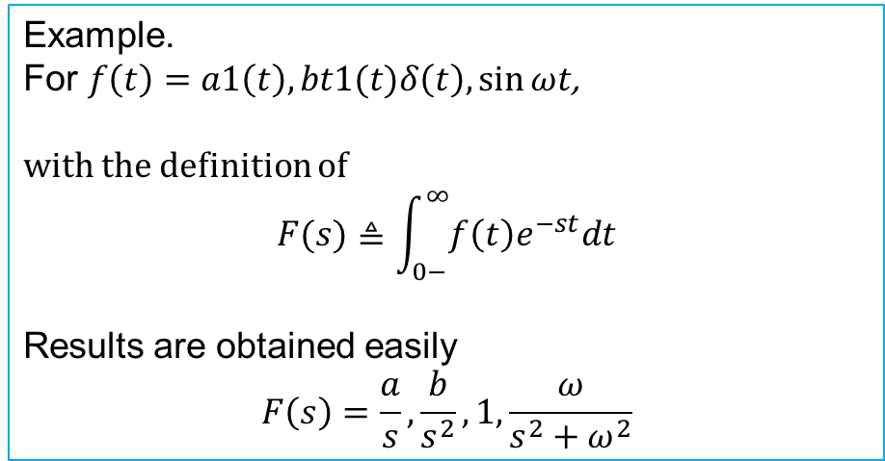
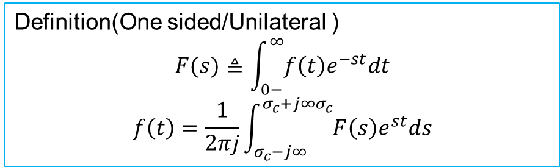
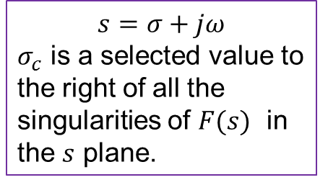
Laplace Transform
Digital Control and Automatic Control EEE327
One method to solve differential equation
Transformation of function from time domain to frequency domain
Only for linear differential equation
Definition(One sided/Unilateral )
$$F(s)≜\int_{0−}^{∞}{f\left(t\right)e^{−st}dt}$$
$$f\left(t\right)=\frac{1}{2πj}\int_{σ_{c}−j∞}^{σ_{c}+j∞σ_{c}}{F\left(s\right)e^{st}ds}$$
$$s=σ+jω$$
$σ_{c}$ is a selected value to the right of all the singularities of $F(s)$ in the $s$ plane.
Example.
For $f\left(t\right)=a1\left(t\right), bt1(t)δ\left(t\right), \sin{ωt}$,
with the definition of
$$F(s)≜\int_{0−}^{∞}{f\left(t\right)e^{−st}dt}$$
Results are obtained easily
$$F\left(s\right)=\frac{a}{s}, \frac{b}{s^{2}}, 1, \frac{ω}{s^{2}+ω^{2}}$$

Slide 5

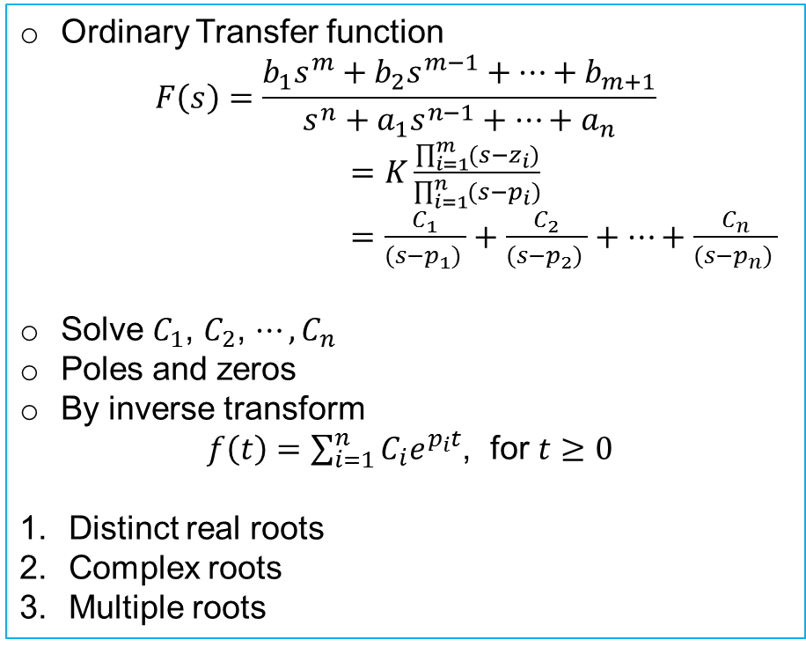
Inverse Laplace transform
Digital Control and Automatic Control EEE327
Using table, compare with those of Laplace transform
With partial fraction expansion
Not easy to apply formula directly
Ordinary Transfer function
$$F\left(s\right)=\frac{b_{1}s^{m}+b_{2}s^{m−1}+⋯+b_{m+1}}{s^{n}+a_{1}s^{n−1}+⋯+a_{n}}$$
$=K\frac{\prod_{i=1}^{m}{(s−z_{i})}}{\prod_{i=1}^{n}{(s−p_{i})}}$
$=\frac{C_{1}}{(s−p_{1}) }+\frac{C_{2}}{(s−p_{2}) }+⋯+\frac{C_{n}}{(s−p_{n}) }$
Solve $C_{1}$, $C_{2}$, $⋯,C_{n}$
Poles and zeros
By inverse transform
$f\left(t\right)=\sum_{i=1}^{n}{C_{i}e^{p_{i}t}}$, for $t≥0$
Distinct real roots
Complex roots
Multiple roots
$F(s)=\frac{1}{s{\left(s+1\right)}^{3}(s+2)}$ ?
$$F\left(s\right)=\frac{1}{2s }+\frac{1}{2\left(s+2\right)}−\frac{1}{\left(s+1\right)}−\frac{1}{{(s+1)}^{3}}$$
$$f(t) =\frac{1}{2 }+\frac{1}{2}e^{−2t}−e^{−t}−\frac{1}{2}t^{2}e^{−t}$$

Slide 6
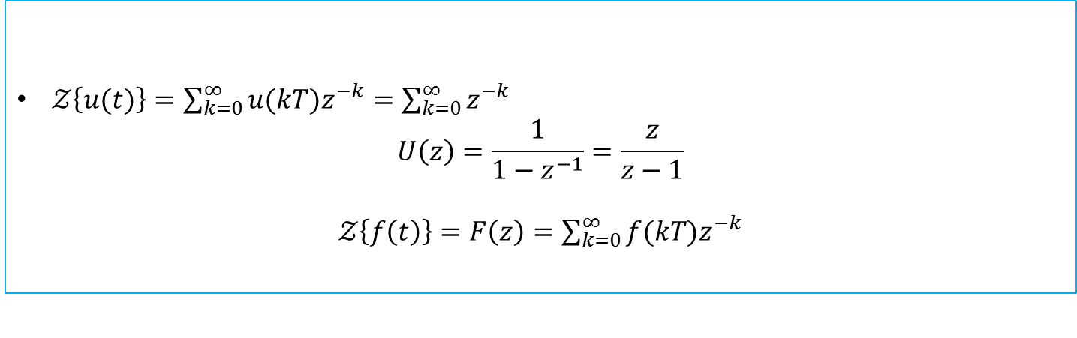
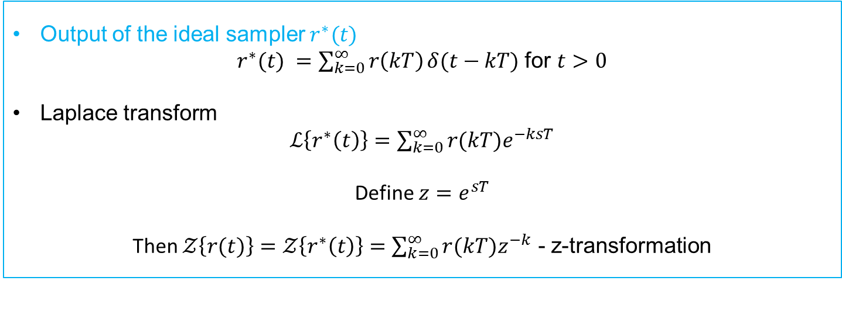
z-Transform
Output of the ideal sampler $r^{∗}(t)$
$r^{∗}(t) =\sum_{k=0}^{∞}{r\left(kT\right)}δ(t−kT)$ for $t>0$
Laplace transform
$ℒ\left\{r^{∗}\left(t\right)\right\}=\sum_{k=0}^{∞}{r(kT)e^{−ksT}}$
Define $z=e^{sT}$
Then $𝒵\left\{r(t)\right\}=𝒵\left\{r^{∗}\left(t\right)\right\}=\sum_{k=0}^{∞}{r(kT)z^{−k}}$ - z-transformation
Examples
$𝒵\left\{u(t)\right\}=\sum_{k=0}^{∞}{u(kT)z^{−k}}=\sum_{k=0}^{∞}{z^{−k}}$
$$U\left(z\right)=\frac{1}{1−z^{−1}}=\frac{z}{z−1}$$
$𝒵\left\{f\left(t\right)\right\}=F\left(z\right)=\sum_{k=0}^{∞}{f(kT)z^{−k}}$

Slide 7
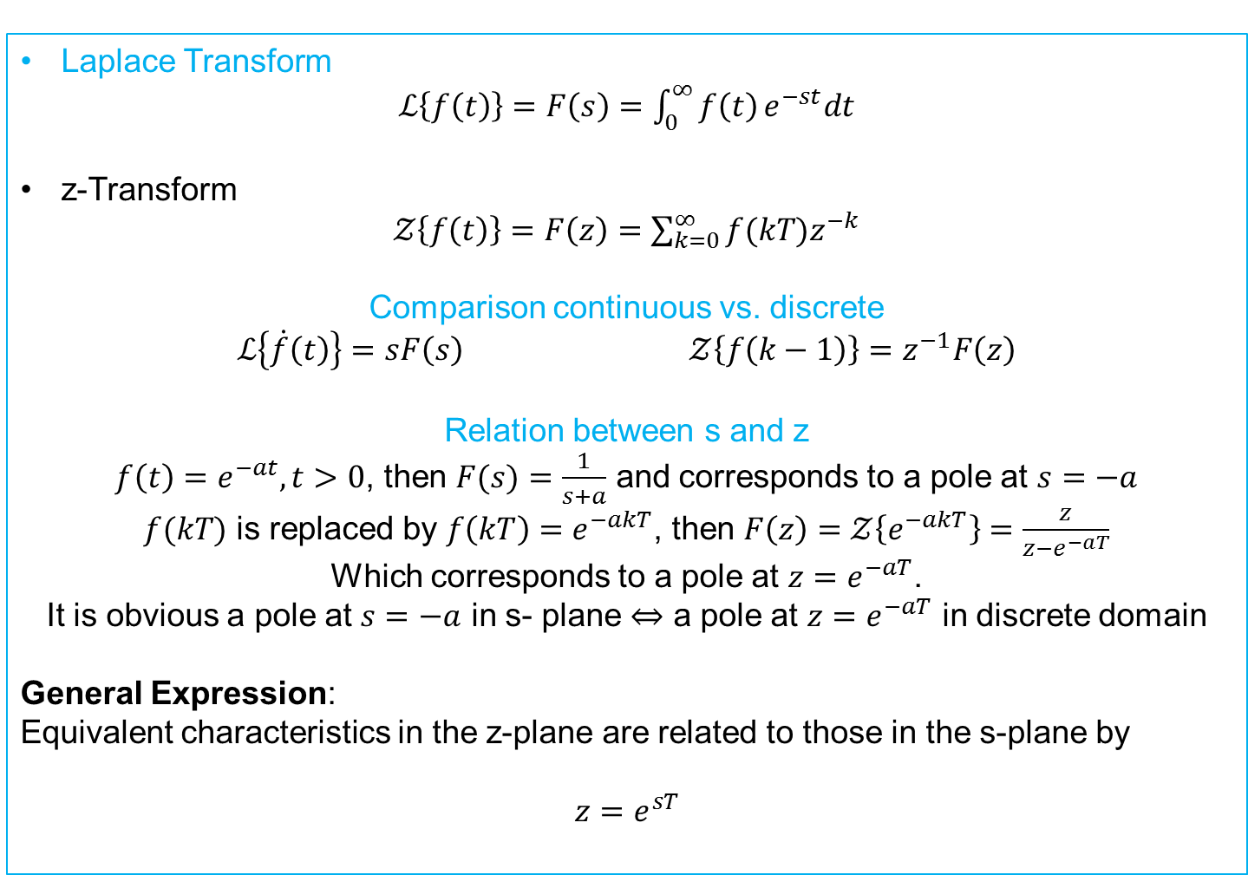
z-Transform
Laplace Transform
$ℒ\left\{f\left(t\right)\right\}=F\left(s\right)=\int_{0}^{∞}{f\left(t\right)}e^{−st}dt$
z-Transform
$𝒵\left\{f\left(t\right)\right\}=F\left(z\right)=\sum_{k=0}^{∞}{f(kT)z^{−k}}$
Comparison continuous vs. discrete
$ℒ\left\{\dot{f}\left(t\right)\right\}=sF\left(s\right)$ $𝒵\left\{f\left(k−1\right)\right\}=z^{−1}F\left(z\right)$
Relation between s and z
$f\left(t\right)=e^{−at}, t>0$, then $F(s)=\frac{1}{s+a}$ and corresponds to a pole at $s=−a$
$f(kT)$ is replaced by $f\left(kT\right)=e^{−akT}$, then $F\left(z\right)=𝒵\left\{e^{−akT}\right\}=\frac{z}{z−e^{−aT}}$
Which corresponds to a pole at $z=e^{−aT}$.
It is obvious a pole at $s=−a$ in s- plane $⇔$ a pole at $z=e^{−aT}$ in discrete domain
General Expression:
Equivalent characteristics in the z-plane are related to those in the s-plane by
$$z=e^{sT}$$

Slide 8
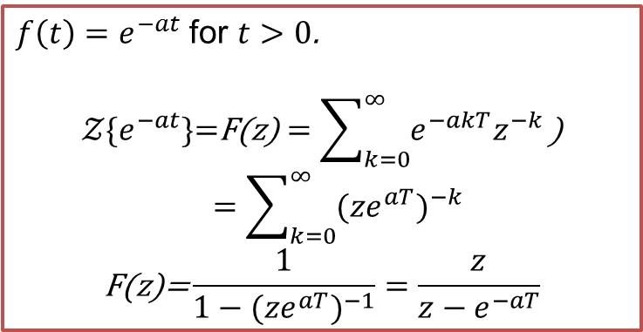
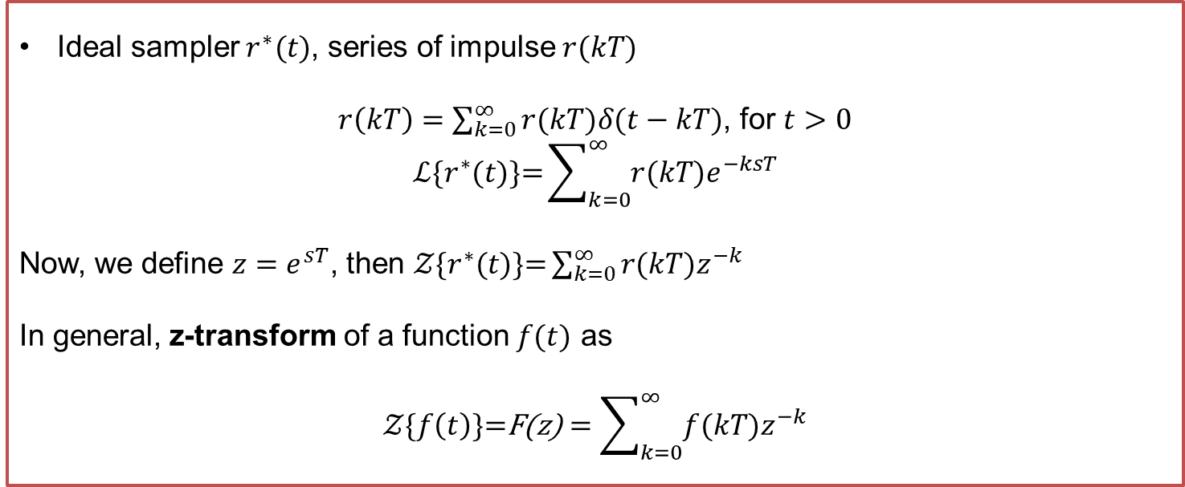

Z-transform
Ideal sampler $r^{∗}(t)$, series of impulse $r(kT)$
$r\left(kT\right)=\sum_{k=0}^{∞}{r(kT)δ(t−kT)}$, for $t>0$
$$ℒ\{r^{∗}(t)\text{\}=}\sum_{k=0}^{∞}{r(kT)e^{−ksT}}$$
Now, we define $z=e^{sT}$, then $𝒵\{r^{∗}(t)\text{\}=}\sum_{k=0}^{∞}{r(kT)z^{−k}}$
In general, z-transform of a function $f(t)$ as
$$𝒵\{f\left(t\right)\text{\}=}\text{F}\text{(}\text{z}\text{)}=\sum_{k=0}^{∞}{f(kT)z^{−k}}$$
$f\left(t\right)=e^{−at}$ for $t>0$.
$$𝒵\{e^{−at}\text{\}=}\text{F}\text{(}\text{z}\text{)}=\sum_{k=0}^{∞}{e^{−akT}z^{−k}}\text{)}=\sum_{k=0}^{∞}{{{(ze}^{aT})}^{−k}}$$
$$\text{F}\text{(}\text{z}\text{)=}\frac{1}{1−{{(ze}^{aT})}^{−1}}=\frac{z}{z−e^{−aT}}$$
$f\left(t\right)=\sin{(ωt)}$ for $t>0$.
$$\sin{(ωt)}=\frac{e^{jωT}−e^{−jωT}}{2j}$$
$$\text{F}\text{(}\text{z})=\frac{1}{2j}\left(\frac{z}{z−e^{jωT}}−\frac{z}{z−e^{−jωT}}\right)$$
$$\text{=}\frac{1}{2j}\left(\frac{z\left(e^{jωT}−e^{−jωT}\right)}{z^{2}−z\left(e^{jωT}+e^{−jωT}\right)+1}\right)$$
=$\frac{z\sin{(ωT)}}{z^{2}−2z\cos{ωT}+1}$

Slide 9
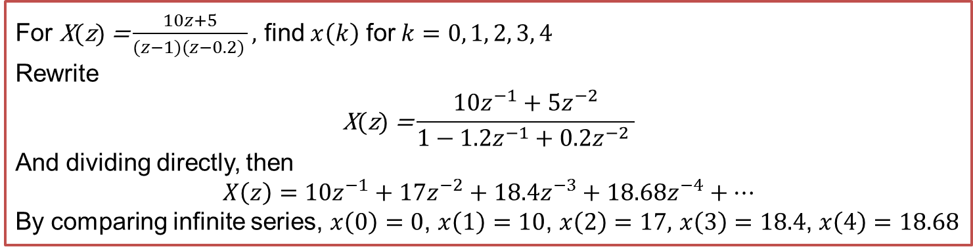
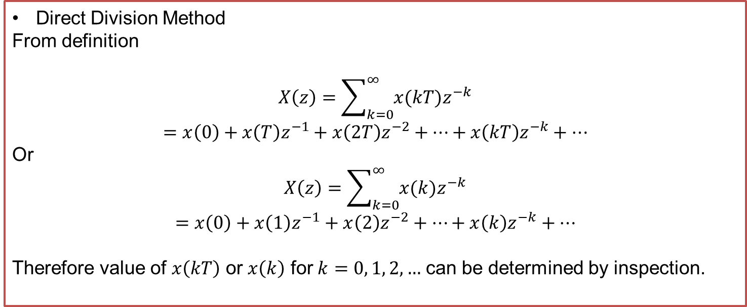
Inverse Z-transform
Direct Division Method
From definition
$$X\left(z\right)=\sum_{k=0}^{∞}{x(kT)z^{−k}}$$
$$=x\left(0\right)+x\left(T\right)z^{−1}+x\left(2T\right)z^{−2}+…+x\left(kT\right)z^{−k}+…$$
Or
$$X\left(z\right)=\sum_{k=0}^{∞}{x(k)z^{−k}}$$
$$=x\left(0\right)+x\left(1\right)z^{−1}+x\left(2\right)z^{−2}+…+x\left(k\right)z^{−k}+…$$
Therefore value of $x\left(kT\right)$ or $x\left(k\right)$ for $k=0, 1, 2, …$ can be determined by inspection.
For $\text{X}\text{(}\text{z}\text{)} \text{=}\frac{10z+5}{(z−1)(z−0.2) },$ find $x\left(k\right)$ for $k=0, 1, 2, 3, 4$
Rewrite
$$\text{X}\text{(}\text{z}\text{)}\text{ =}\frac{10z^{−1}+5z^{−2}}{1−1.2z^{−1}+0.2z^{−2} }$$
And dividing directly, then
$$X\left(z\right)=10z^{−1}+17z^{−2}+18.4z^{−3}+18.68z^{−4}+…$$
By comparing infinite series, $x\left(0\right)=0$, $x\left(1\right)=10$, $x\left(2\right)=17,$ $x\left(3\right)=18.4$, $x\left(4\right)=18.68$

Slide 10
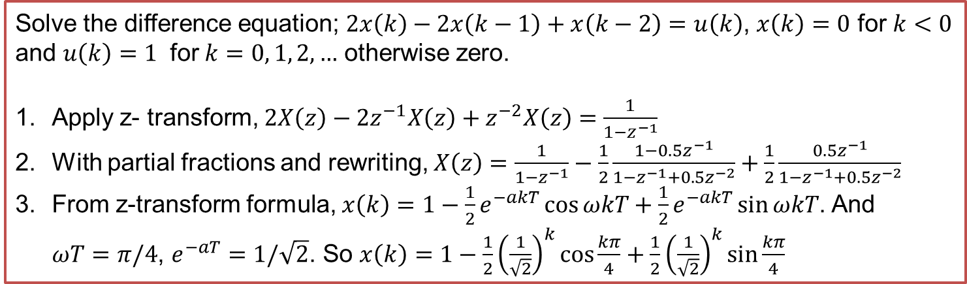
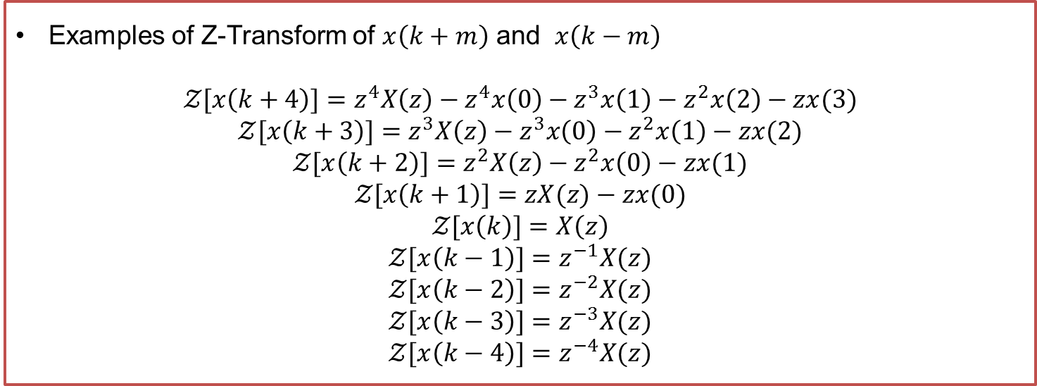
Difference Equation
Examples of Z-Transform of $x\left(k+m\right)$ and $x\left(k−m\right)$
$$𝒵[x\left(k+4\right)]=z^{4}X\left(z\right)−z^{4}x\left(0\right)−z^{3}x\left(1\right)−z^{2}x\left(2\right)−zx(3)$$
$$𝒵[x\left(k+3\right)]=z^{3}X\left(z\right)−z^{3}x\left(0\right)−z^{2}x\left(1\right)−zx(2)$$
$$𝒵[x\left(k+2\right)]=z^{2}X\left(z\right)−z^{2}x\left(0\right)−zx(1)$$
$$𝒵[x\left(k+1\right)]=zX(z)−zx(0)$$
$$𝒵[x\left(k\right)]=X\left(z\right)$$
$$𝒵[x\left(k−1\right)]=z^{−1}X(z)$$
$$𝒵[x\left(k−2\right)]=z^{−2}X(z)$$
$$𝒵[x\left(k−3\right)]=z^{−3}X(z)$$
$$𝒵[x\left(k−4\right)]=z^{−4}X(z)$$
Solve the difference equation; $2x\left(k\right)−2x\left(k−1\right)+x\left(k−2\right)=u\left(k\right)$, $x\left(k\right)=0$ for $k<0$ and $u\left(k\right)=1$ for $k=0, 1, 2, …$ otherwise zero.
Apply z- transform, $2X\left(z\right)−2z^{−1}X\left(z\right)+z^{−2}X\left(z\right)=\frac{1}{1−z^{−1}}$
With partial fractions and rewriting, $X\left(z\right)=\frac{1}{1−z^{−1}}−\frac{1}{2}\frac{1−{0.5z}^{−1}}{1−z^{−1}+0.5z^{−2}}+\frac{1}{2}\frac{{0.5z}^{−1}}{1−z^{−1}+0.5z^{−2}}$
From z-transform formula, $x\left(k\right)=1−\frac{1}{2}e^{−akT}\cos{ωkT}+\frac{1}{2}e^{−akT}\sin{ωkT}$. And $ωT=π/4$, $e^{−aT}=1/\sqrt{2}$. So $x\left(k\right)=1−\frac{1}{2}{\left(\frac{1}{\sqrt{2}}\right)}^{k}\cos{\frac{kπ}{4}}+\frac{1}{2}{\left(\frac{1}{\sqrt{2}}\right)}^{k}\sin{\frac{kπ}{4}}$

Slide 11
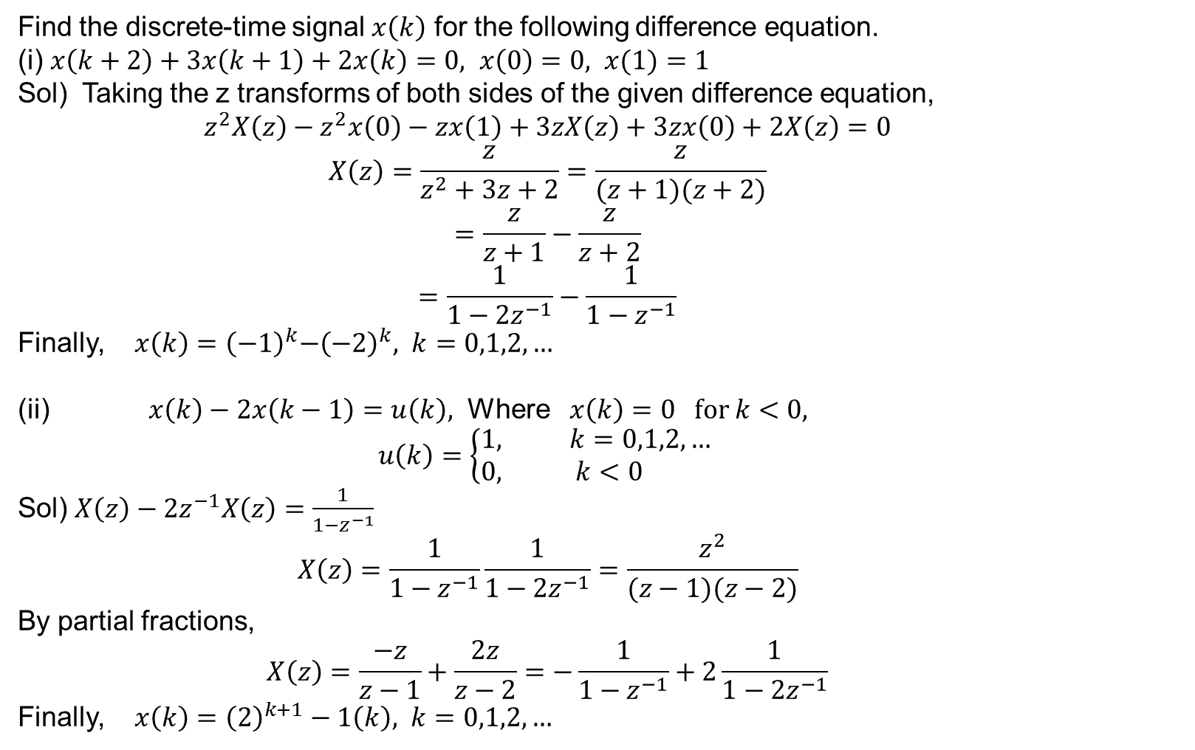
Examples
Find the discrete-time signal $x\left(k\right)$ for the following difference equation.
(i) $x\left(k+2\right)+3x\left(k+1\right)+2x\left(k\right)=0, x\left(0\right)=0, x(1)=1$
Sol) Taking the z transforms of both sides of the given difference equation,
$$z^{2}X\left(z\right)−z^{2}x\left(0\right)−zx\left(1\right)+3zX\left(z\right)+3zx\left(0\right)+2X\left(z\right)=0$$
$$X\left(z\right)=\frac{z}{z^{2}+3z+2}=\frac{z}{(z+1)(z+2)}$$
$$=\frac{z}{z+1}−\frac{z}{z+2}$$
$$=\frac{1}{1−2z^{−1}}−\frac{1}{1−z^{−1}}$$
Finally, $x\left(k\right)={\left(−1\right)}^{k}{−\left(−2\right)}^{k}, k=0,1,2,…$
(ii) $x\left(k\right)−2x\left(k−1\right)=u\left(k\right),$ Where $x\left(k\right)=0 for k<0,$
$$u\left(k\right)=\left\{\begin{matrix}1, k=0,1,2,… \\ 0, k<0 \end{matrix}\right.$$
Sol) $X\left(z\right)−2z^{−1}X\left(z\right)=\frac{1}{1−z^{−1}}$
$$X\left(z\right)=\frac{1}{1−z^{−1}}\frac{1}{1−2z^{−1}}=\frac{z^{2}}{(z−1)(z−2)}$$
By partial fractions,
$$X\left(z\right)=\frac{−z}{z−1}+\frac{2z}{z−2}=−\frac{1}{1−z^{−1}}+2\frac{1}{1−{2z}^{−1}}$$
Finally, $x\left(k\right)={\left(2\right)}^{k+1}−1\left(k\right), k=0,1,2,…$

Slide 12
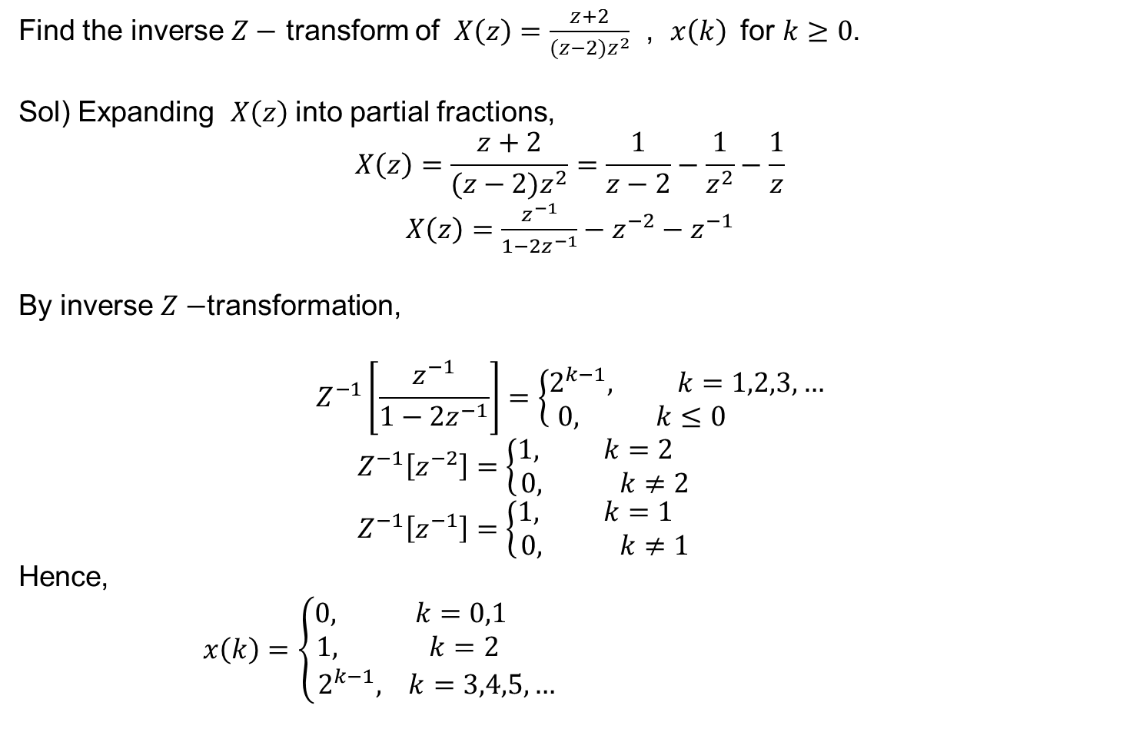
Examples
Find the inverse $Z−$ transform of $X\left(z\right)=\frac{z+2}{(z−2)z^{2}}$ , $x\left(k\right)$ for $k≥0$.
Sol) Expanding $X\left(z\right)$ into partial fractions,
$$X\left(z\right)=\frac{z+2}{(z−2)z^{2}}=\frac{1}{z−2}−\frac{1}{z^{2}}−\frac{1}{z}$$
$X\left(z\right)=\frac{z^{−1}}{1−2z^{−1}}−z^{−2}−z^{−1}$
By inverse $Z−$transformation,
$$Z^{−1}\left[\frac{z^{−1}}{1−2z^{−1}}\right]=\left\{\begin{matrix}2^{k−1}, k=1,2,3,… \\ 0, k≤0 \end{matrix}\right.$$
$$Z^{−1}\left[z^{−2}\right]=\left\{\begin{matrix}1, k=2 \\ 0, k≠2 \end{matrix}\right.$$
$$Z^{−1}\left[z^{−1}\right]=\left\{\begin{matrix}1, k=1 \\ 0, k≠1 \end{matrix}\right.$$
Hence,
$x\left(k\right)=\left\{\begin{matrix}0, k=0,1 \\ 1, k=2 \\ 2^{k−1}, k=3,4,5,…\end{matrix}\right.$

Slide 13


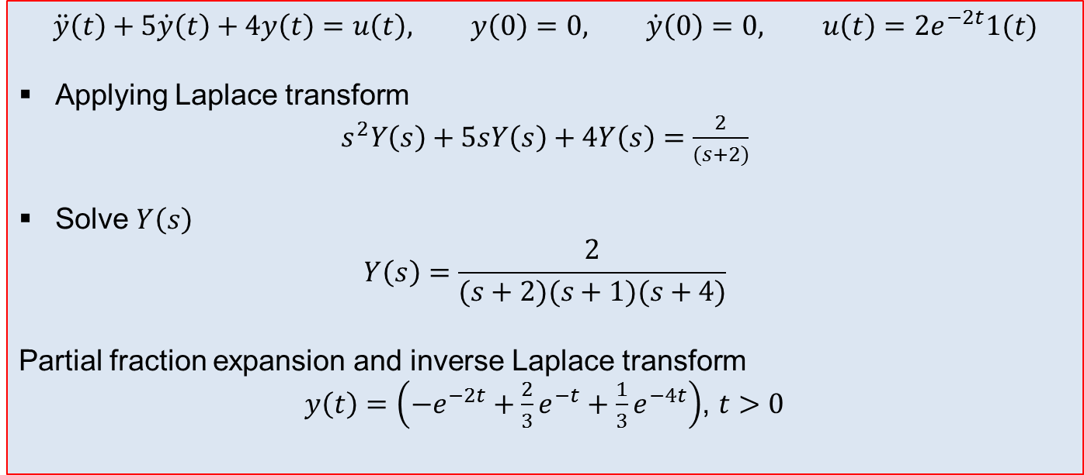
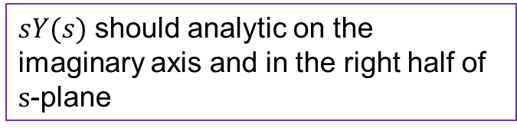
Initial value/Final value theorem
Digital Control and Automatic Control EEE327
$$\lim_{t→0}{y(t)}=\lim_{s→∞}{sY(s)}$$
$$\lim_{t→∞}{y(t)}=\lim_{s→0}{sY(s)}$$
Limit value should exist
$sY(s)$ should analytic on the imaginary axis and in the right half of $s$-plane
Solving Differential Equation via Laplace transform
$$\ddot{y}\left(t\right)+5\dot{y}\left(t\right)+4y\left(t\right)=u\left(t\right), y\left(0\right)=0, \dot{y}\left(0\right)=0, u\left(t\right)=2e^{−2t}1(t)$$
Applying Laplace transform
$s^{2}Y\left(s\right)+5sY\left(s\right)+4Y\left(s\right)=\frac{2}{(s+2)}$
Solve $Y\left(s\right)$
$$Y\left(s\right)=\frac{2}{(s+2)(s+1)(s+4)}$$
Partial fraction expansion and inverse Laplace transform
$y\left(t\right)=\left(−e^{−2t}+\frac{2}{3}e^{−t}+\frac{1}{3}e^{−4t}\right)$, $t>0$

Slide 14
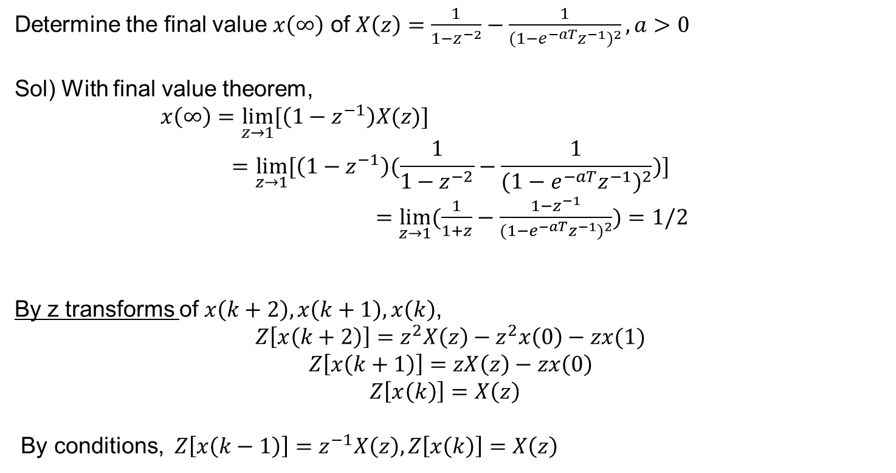
Examples
Determine the final value $x\left(∞\right)$ of $X\left(z\right)=\frac{1}{1−z^{−2}}−\frac{1}{{(1−e^{−aT}z^{−1})}^{2}}, a>0$
Sol) With final value theorem,
$x\left(∞\right)=\lim_{z→1}{[\left(1−z^{−1}\right)X(z)]}$
$$=\lim_{z→1}{[\left(1−z^{−1}\right)(\frac{1}{1−z^{−2}}−\frac{1}{{(1−e^{−aT}z^{−1})}^{2}})]}$$
$=\lim_{z→1}{(\frac{1}{1+z}−\frac{1−z^{−1}}{{(1−e^{−aT}z^{−1})}^{2}})}=1/2$
By z transforms of $x\left(k+2\right), x\left(k+1\right), x\left(k\right)$,
$$Z\left[x\left(k+2\right)\right]=z^{2}X\left(z\right)−z^{2}x\left(0\right)−zx(1)$$
$$Z\left[x\left(k+1\right)\right]=zX\left(z\right)−zx\left(0\right)$$
$Z\left[x\left(k\right)\right]=X\left(z\right)$
By conditions, $Z\left[x\left(k−1\right)\right]=z^{−1}X\left(z\right),Z\left[x\left(k\right)\right]=X\left(z\right)$

Slide 15
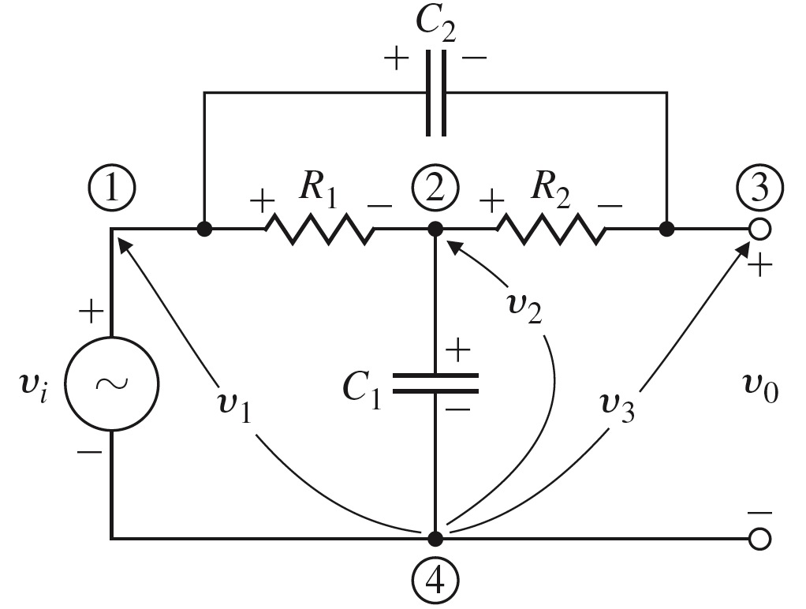
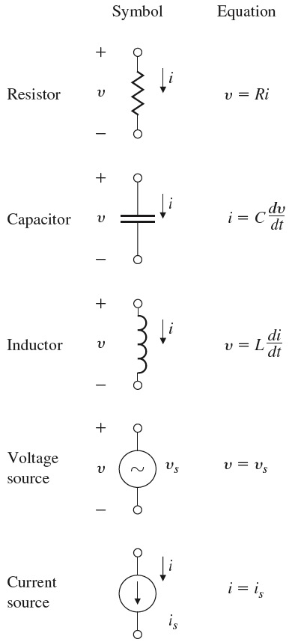



Elements of electric circuits
Digital Control and Automatic Control EEE327

Slide 16



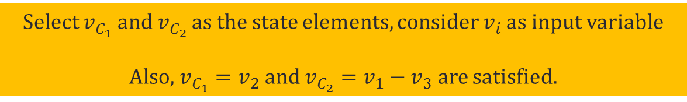
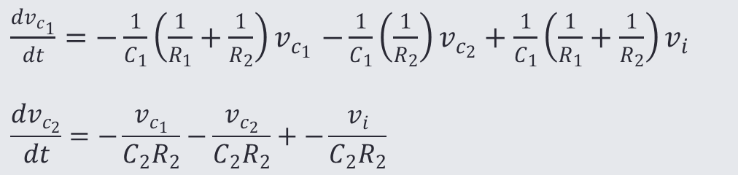
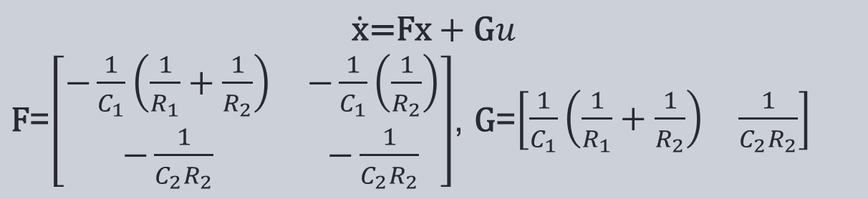
Elements of electric circuits
Digital Control and Automatic Control EEE327

Slide 17
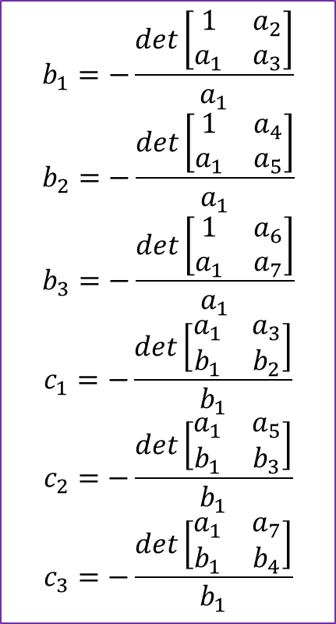
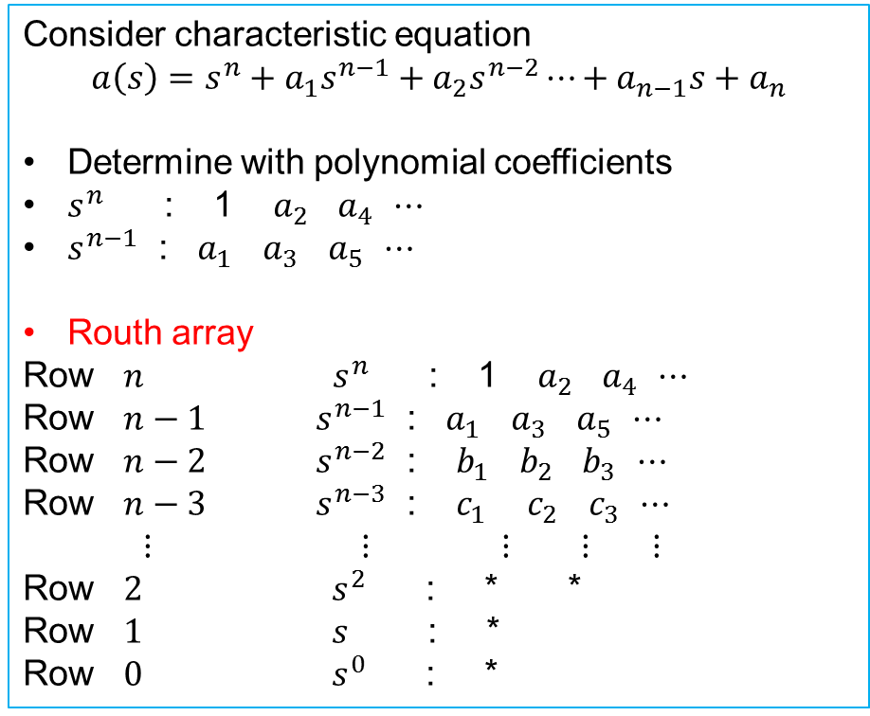
Stability
One of the most important consideration to design controller
Stability determination is verified by pole location
Routh’s Criterion
Consider characteristic equation
$$a\left(s\right)=s^{n}+a_{1}s^{n−1}+a_{2}s^{n−2}⋯+a_{n−1}s+a_{n}$$
Determine with polynomial coefficients
$s^{n}$ : 1 $a_{2}$ $a_{4}$ $⋯$
$s^{n−1}$ : $a_{1}$ $a_{3}$ $a_{5}$ $⋯$
Routh array
Row $n$ $s^{n}$ : 1 $a_{2}$ $a_{4}$ $⋯$
Row $n−1$ $s^{n−1}$ : $a_{1}$ $a_{3}$ $a_{5}$ $⋯$
Row $n−2$ $s^{n−2}$ : $b_{1}$ $b_{2}$ $b_{3}$ $⋯$
Row $n−3$ $s^{n−3}$ : $c_{1}$ $c_{2}$ $c_{3}$ $⋯$
$⋮$ $⋮$ $⋮$ $⋮$ $⋮$
Row $2$ $s^{2}$ : * *
Row $1$ $s$ : *
Row $0$ $s^{0}$ : *
$$b_{1}=−\frac{det\left[\begin{matrix}1 & a_{2} \\ a_{1} & a_{3}\end{matrix}\right]}{a_{1}}$$
$$b_{2}=−\frac{det\left[\begin{matrix}1 & a_{4} \\ a_{1} & a_{5}\end{matrix}\right]}{a_{1}}$$
$$b_{3}=−\frac{det\left[\begin{matrix}1 & a_{6} \\ a_{1} & a_{7}\end{matrix}\right]}{a_{1}}$$
$$c_{1}=−\frac{det\left[\begin{matrix}a_{1} & a_{3} \\ b_{1} & b_{2}\end{matrix}\right]}{b_{1}}$$
$$c_{2}=−\frac{det\left[\begin{matrix}a_{1} & a_{5} \\ b_{1} & b_{3}\end{matrix}\right]}{b_{1}}$$
$$c_{3}=−\frac{det\left[\begin{matrix}a_{1} & a_{7} \\ b_{1} & b_{4}\end{matrix}\right]}{b_{1}}$$
Number of sign change in first column represent number of roots in RHP. All 1st col. positive ➔ All roots in LHP

Slide 18
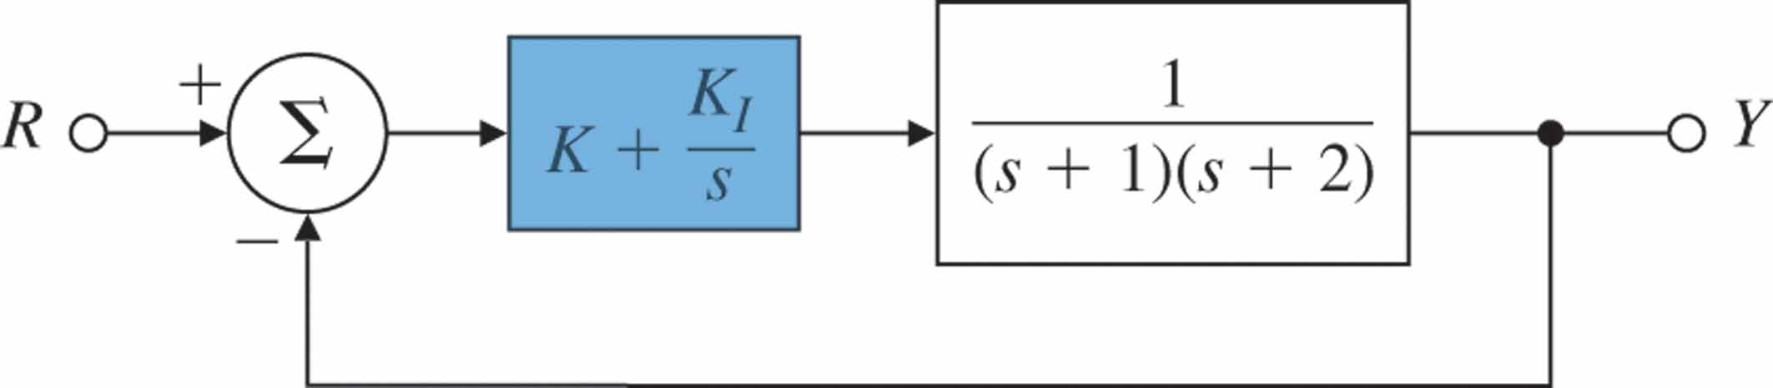
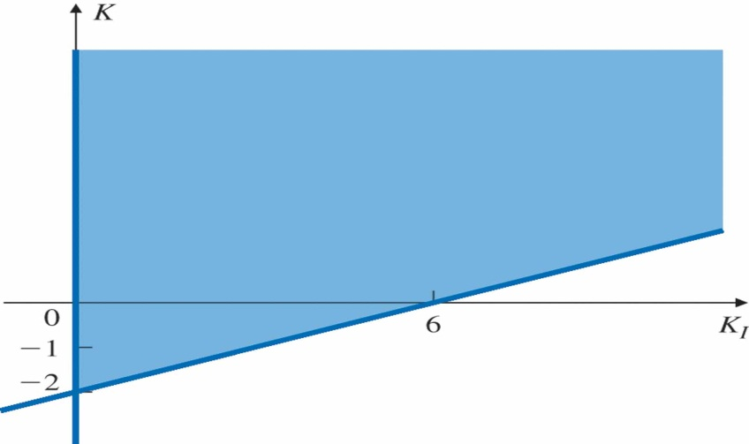
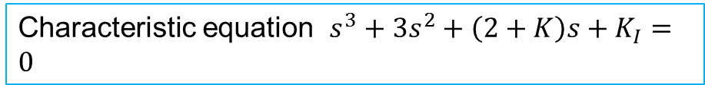

Examples
Digital Control and Automatic Control EEE327
Find range of the controller (${K, K}_{I}$) so that feedback system is stable
Critical cases
Characteristic equation $s^{3}+3s^{2}+\left(2+K\right)s+K_{I}=0$
$K_{I}>0$, $K>\frac{1}{3}K_{I}−2$
Allowable region for stability

Slide 19
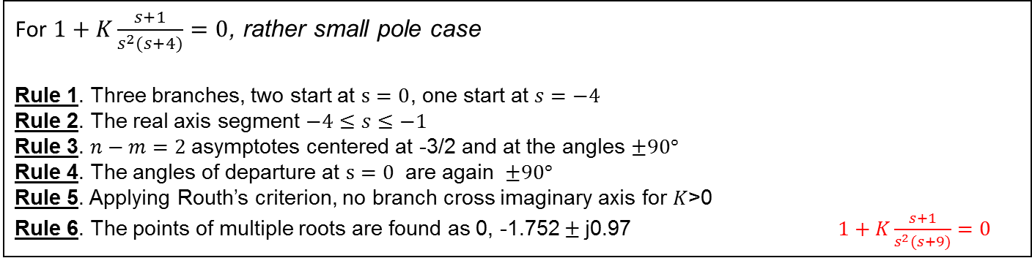
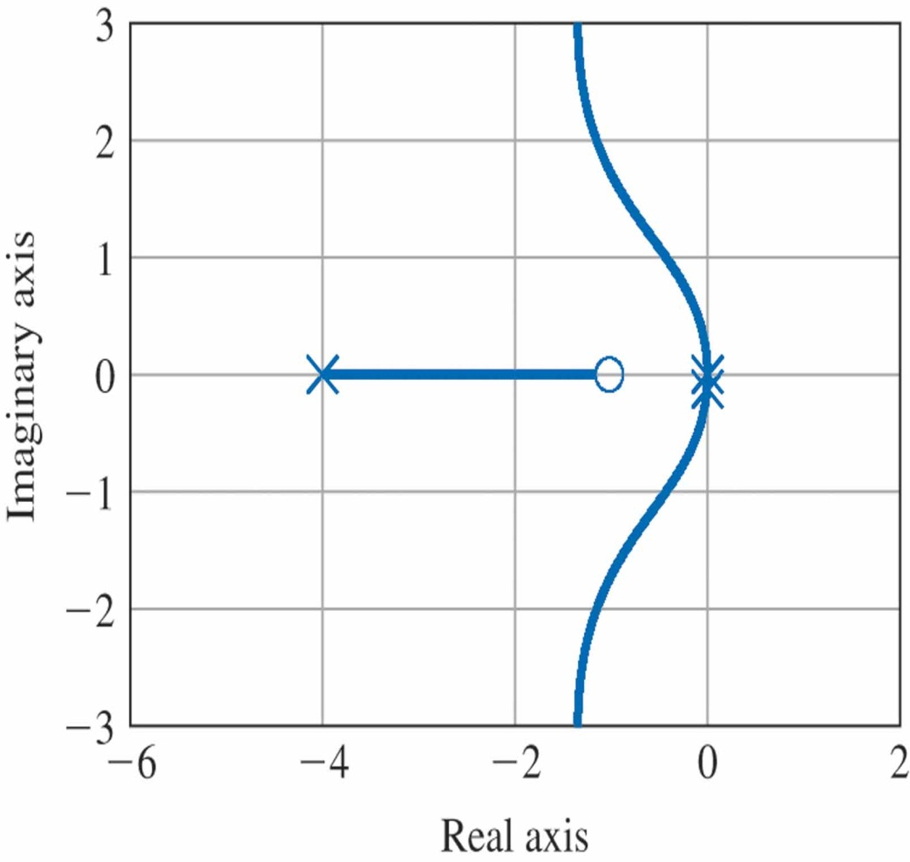
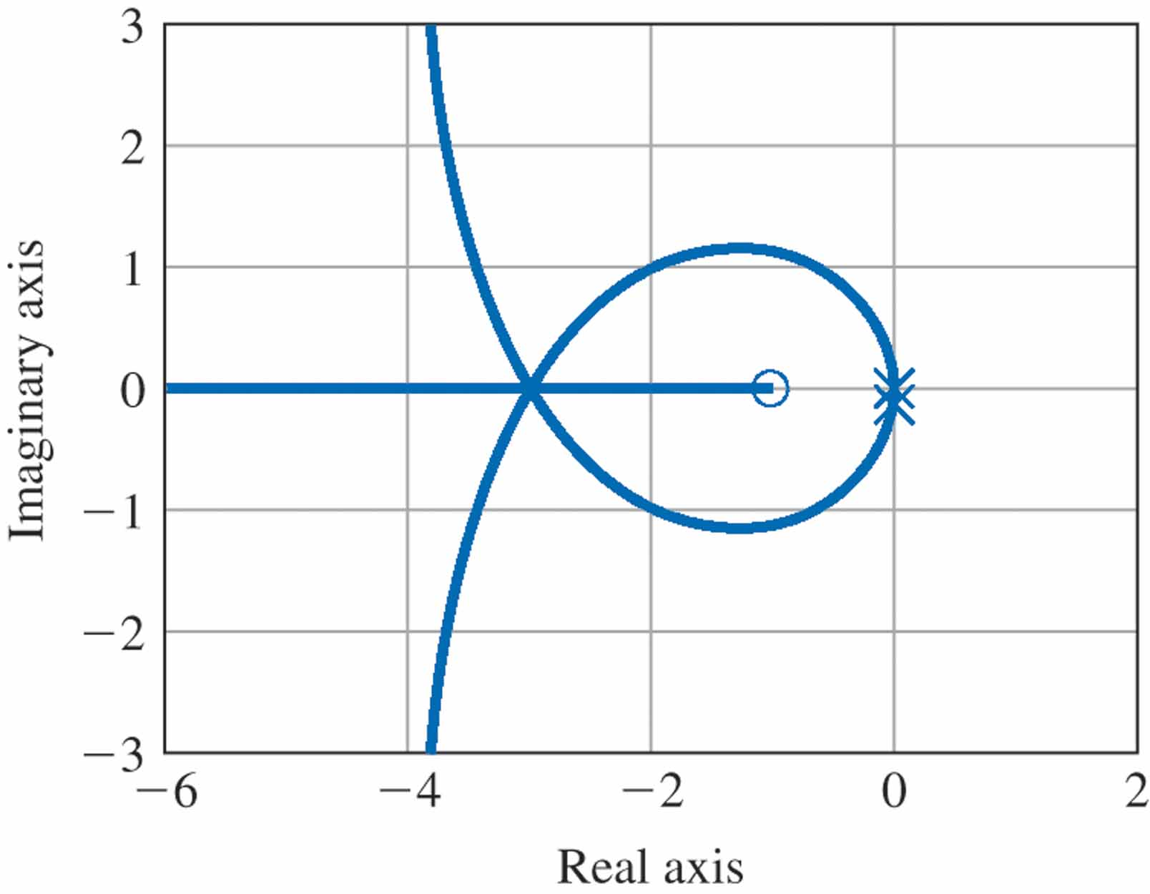

Slide 20
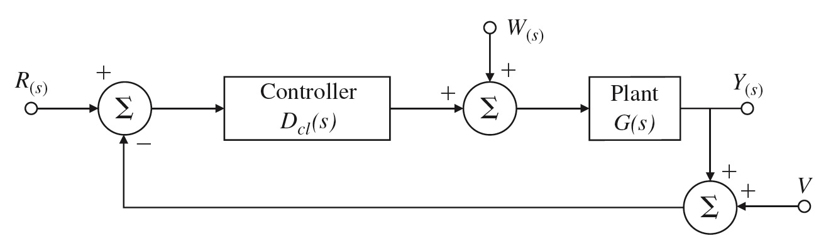
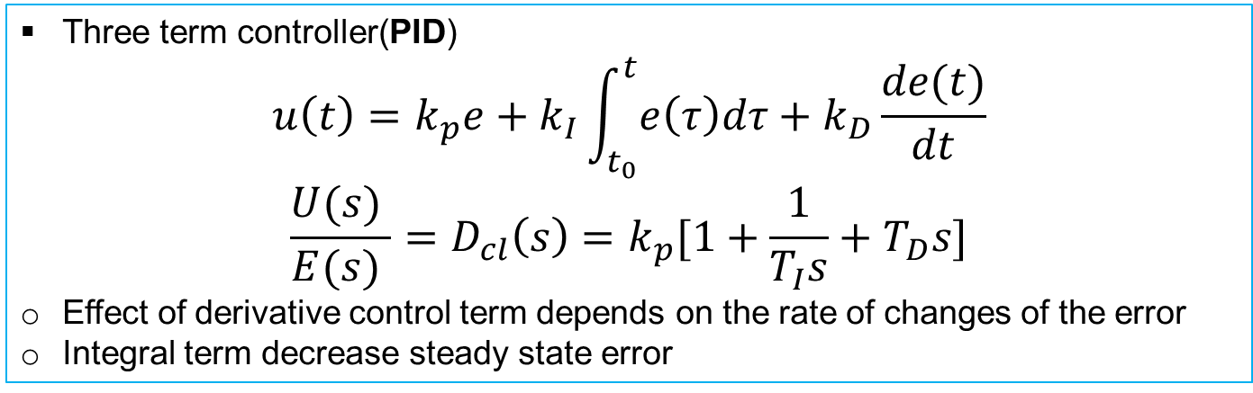
PID Controller Design
Three term controller(PID)
$$u\left(t\right)=k_{p}e+k_{I}\int_{t_{0}}^{t}{e\left(τ\right)dτ}+k_{D}\frac{de(t)}{dt}$$
$$\frac{U(s) }{E(s) }=D_{cl}\left(s\right)=k_{p}[1+\frac{1}{T_{I}s}+T_{D}s]$$
Effect of derivative control term depends on the rate of changes of the error
Integral term decrease steady state error
(P) and (I), additionally Derivative(D) with respect to error
Typical output structure : only measured output y(t) or Y(s) are used for feedback.

Slide 21
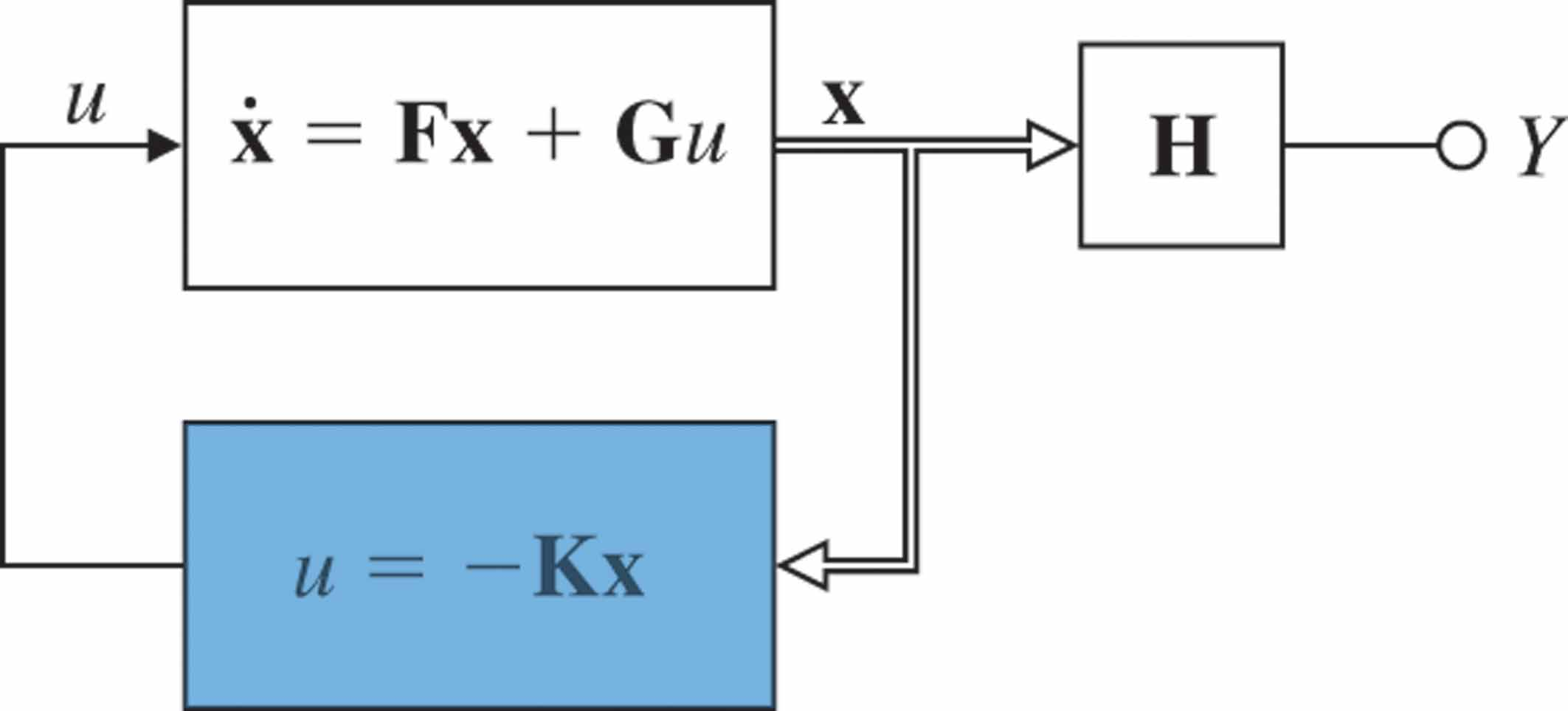
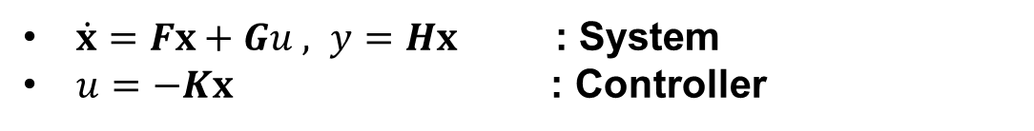
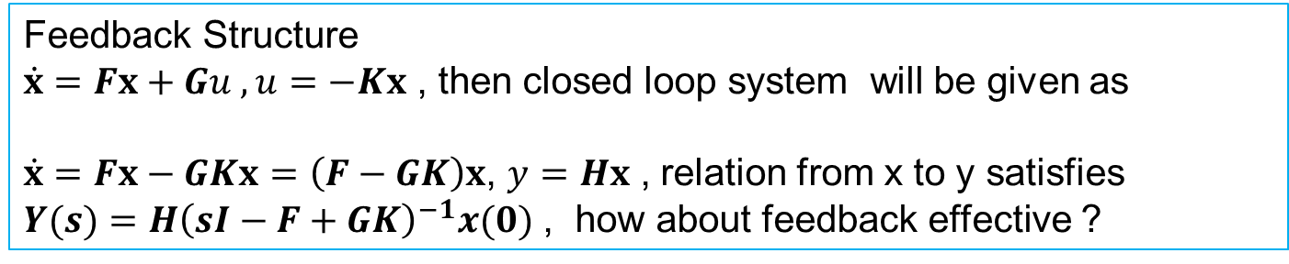
State Feedback
Consider block diagram
$\dot{x}=Fx+Gu , y=Hx$ : System
$u=−Kx$ : Controller
Feedback Structure
$\dot{x}=Fx+Gu , u=−Kx$, then closed loop system will be given as
$\dot{x}=Fx−GKx=\left(F−GK\right)x$, $y=Hx$ , relation from x to y satisfies
$Y(s)=H{\left(sI−F+GK\right)}^{−1}x(0)$ , how about feedback effective ?

Slide 22
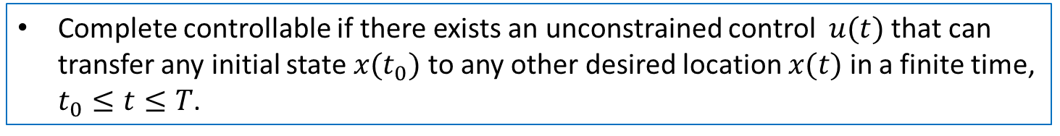
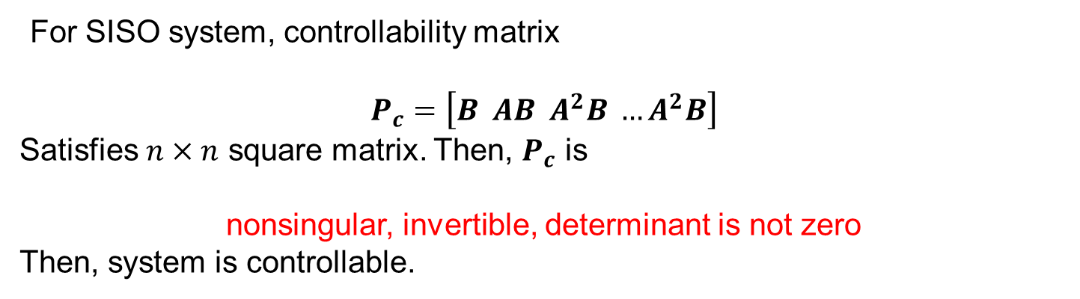
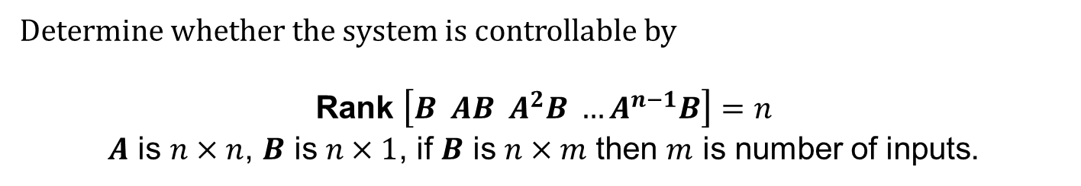

Controllability
Complete controllable if there exists an unconstrained control $u(t)$ that can transfer any initial state ${x(t}_{0})$ to any other desired location $x(t)$ in a finite time, $t_{0}≤t≤T$.
For the system
$$\dot{x}=Ax+Bu$$
Determine whether the system is controllable by
Rank $\left[B AB A^{2}B …A^{n−1}B\right]=n$
$A$ is $n×n$, $B$ is $n×1$, if $B$ is $n×m$ then $m$ is number of inputs.
For SISO system, controllability matrix
$$P_{c}=\left[B AB A^{2}B …A^{2}B\right]$$
Satisfies $n×n$ square matrix. Then, $P_{c}$ is
nonsingular, invertible, determinant is not zero
Then, system is controllable.

Slide 23
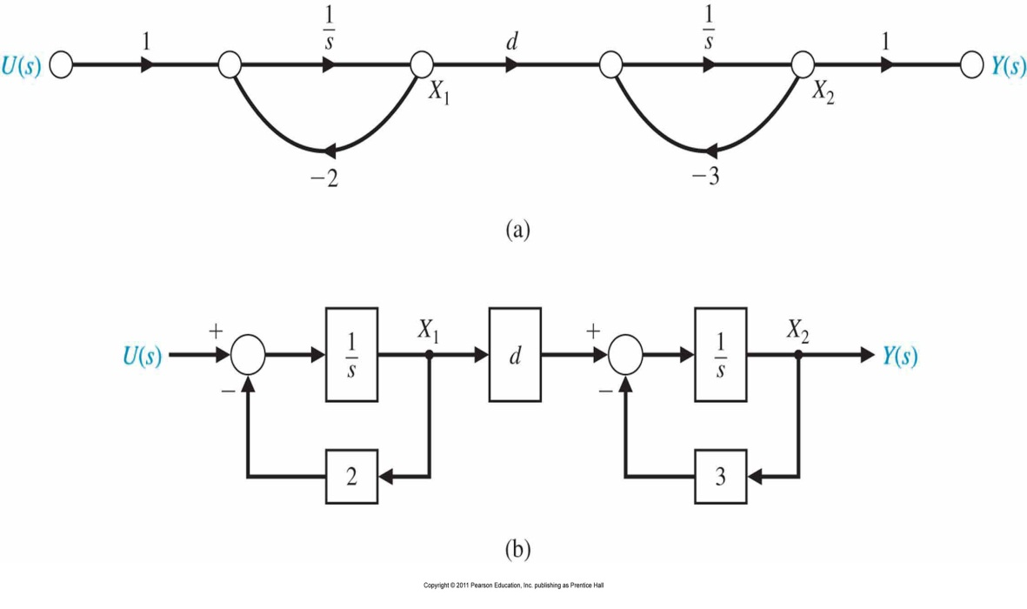
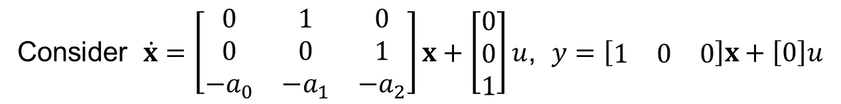
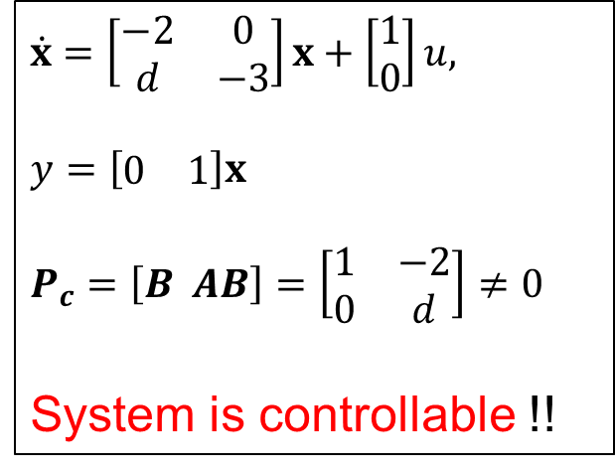
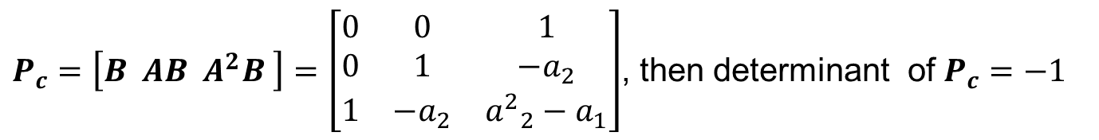
Controllability
Example
Consider $\dot{x}=\left[\begin{matrix}0 & 1 & 0 \\ 0 & 0 & 1 \\ −a_{0} & −a_{1} & −a_{2}\end{matrix}\right]x+\left[\begin{matrix}0 \\ 0 \\ 1\end{matrix}\right]u$, $y=\left[\begin{matrix}1 & 0 & 0\end{matrix}\right]x+\left[0\right]u$
$P_{c}=\left[B AB A^{2}B \right]=\left[\begin{matrix}0 & 0 & 1 \\ 0 & 1 & −a_{2} \\ 1 & −a_{2} & {a^{2}}_{2}^{}−a_{1}\end{matrix}\right]$, then determinant of $P_{c}=−1$
$$\dot{x}=\left[\begin{matrix}−2 & 0 \\ d & −3\end{matrix}\right]x+\left[\begin{matrix}1 \\ 0\end{matrix}\right]u,$$
$$y=\left[\begin{matrix}0 & 1\end{matrix}\right]x$$
$$P_{c}=\left[B AB\right]=\left[\begin{matrix}1 & −2 \\ 0 & d\end{matrix}\right]≠0$$
System is controllable !!

Slide 24
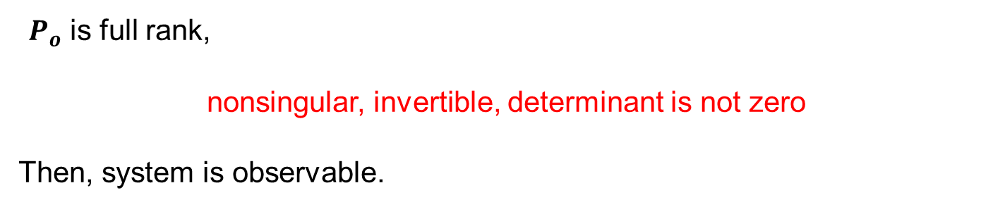
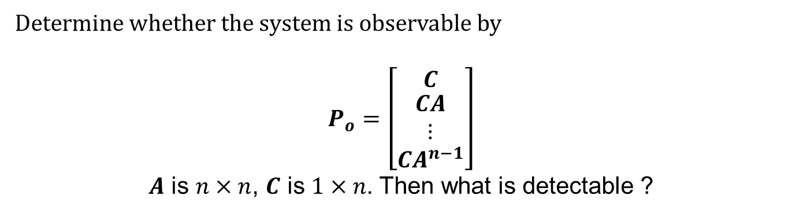

Observability
Complete observable if and only if there exists a finite time $T$such that the initial state ${x(t}_{0})$can be determined from the observation history $y(t)$ given the control $u(t)$, $0≤t≤T$.
For the system
$\dot{x}=Ax+Bu$, $y=Cx$
Determine whether the system is observable by
$$P_{o}=\left[\begin{matrix}C \\ \begin{matrix}CA \\ ⋮\end{matrix} \\ CA^{n−1}\end{matrix}\right]$$
$A$ is $n×n$, $C$ is $1×n$. Then what is detectable ?
$P_{o}$ is full rank,
nonsingular, invertible, determinant is not zero
Then, system is observable.

Slide 25
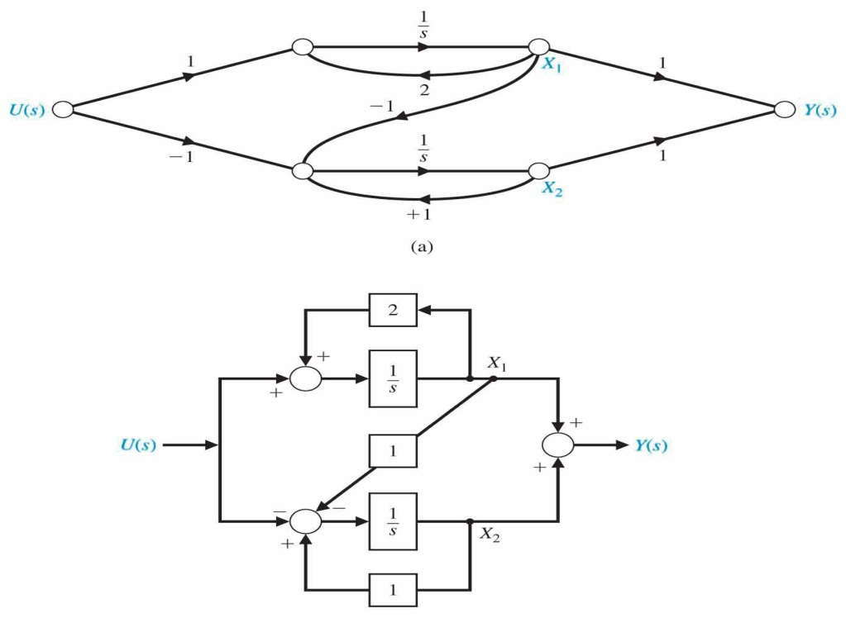


Observability
Example
Consider $\dot{x}=\left[\begin{matrix}0 & 1 & 0 \\ 0 & 0 & 1 \\ −a_{0} & −a_{1} & −a_{2}\end{matrix}\right]x+\left[\begin{matrix}0 \\ 0 \\ 1\end{matrix}\right]u$, $y=\left[\begin{matrix}1 & 0 & 0\end{matrix}\right]x+\left[0\right]u$
$P_{o}=\left[\begin{matrix}C \\ \begin{matrix}CA \\ ⋮\end{matrix} \\ CA^{n−1}\end{matrix}\right]=\left[\begin{matrix}1 & 0 & 0 \\ 0 & 1 & 0 \\ 0 & 0 & 1\end{matrix}\right]$, then determinant of $P_{o}=1$
$$\dot{x}=\left[\begin{matrix}2 & 0 \\ −1 & 1\end{matrix}\right]x+\left[\begin{matrix}1 \\ −1\end{matrix}\right]u,$$
$$y=\left[\begin{matrix}1 & 1\end{matrix}\right]x$$
$$P_{c}=\left[B AB\right]=\left[\begin{matrix}1 & 2 \\ −1 & −2\end{matrix}\right], detP_{c}=0$$
$$P_{o}=\left[\begin{matrix}C \\ CA\end{matrix}\right]=\left[\begin{matrix}1 & 1 \\ 1 & 1\end{matrix}\right],detP_{o}=0$$
Hence, System is not controllable and observable

Slide 26


Optimal/State feedback Controller Design Example
State variable feedback is available
$u=\left[\begin{matrix}−K_{1} & −K_{2} & −K_{3}\end{matrix}\right]x+r$ or $u=−K_{1}x_{1}−K_{2}x_{2}−K_{3}x_{3}+r$
Goal is settling time with a 2% criterion and overshoot of less than 4%

Slide 27



Performance of Second Order Systems
$$Y\left(s\right)=\frac{G\left(s\right)}{1+G\left(s\right)}R\left(s\right)$$
$$=\frac{{ω_{n}}_{}^{2}}{s^{2}+2ζω_{n}+{ω_{n}}_{}^{2}}R\left(s\right)$$
$$=\frac{{ω_{n}}_{}^{2}}{s(s^{2}+2ζω_{n}+{ω_{n}}_{}^{2})}$$
$y\left(t\right)=1−\frac{1}{\sqrt{1−ζ^{2}}}e^{−ζω_{n}t}\sin{(ω_{n}\sqrt{1−ζ^{2}}t+θ)}$, $θ={\cos{ζ}}^{−1}$, $0<ζ<1$

Slide 28


Performance of Second Order Systems; impulse response
$$Y\left(s\right)=\frac{G\left(s\right)}{1+G\left(s\right)}R\left(s\right)$$
$$=\frac{{ω_{n}}_{}^{2}}{s^{2}+2ζω_{n}+{ω_{n}}_{}^{2}}R\left(s\right)$$
$$=\frac{{ω_{n}}_{}^{2}}{s^{2}+2ζω_{n}+{ω_{n}}_{}^{2}}$$
$y\left(t\right)=\frac{ω_{n}}{\sqrt{1−ζ^{2}}}e^{−ζω_{n}t}\sin{(ω_{n}\sqrt{1−ζ^{2}}t)}$, $0<ζ<1$

Slide 29



Performance of Second Order Systems
Settling Time $T_{s}=4τ=\frac{4}{ζω_{n}}$
Peak Time $T_{p}=\frac{π}{ω_{n}\sqrt{1−ζ^{2}}}$
Percent Overshoot = $100e^{−ζπ/\sqrt{1−ζ^{2}}}$

Slide 30


Performance of Second Order Systems
The step response for ζ = 0.2 for ω_{n} = 1 and ω_{n} = 10
The step response for ω_{n} = 5 with ζ = 0.7 and ζ = 1.

Slide 31



Optimal Controller Design Example
To achieve an accurate output position
Let $K_{1}=1$, and determine $K,$ $K_{2}$ and $K_{3}$
State variable model
$\dot{x}=Ax+Bu=\left[\begin{matrix}0 & 1 & 0 \\ 0 & −1 & 1 \\ 0 & 0 & −5\end{matrix}\right]x+\left[\begin{matrix}0 \\ 0 \\ K\end{matrix}\right]u$,
$y=\left[\begin{matrix}1 & 0 & 0\end{matrix}\right]x$
Substituting
$\dot{x}=\left[\begin{matrix}0 & 1 & 0 \\ 0 & −1 & 1 \\ −K & −KK_{2} & −(5+K_{3}K)\end{matrix}\right]x$ $+\left[\begin{matrix}0 \\ 0 \\ K\end{matrix}\right]r$
Let $K_{1}=1$,
$$det\left[\begin{matrix}s & −1 & 0 \\ 0 & s+1 & −1 \\ K & KK_{2} & s+(5+K_{3}K)\end{matrix}\right]=0$$
Yielding $s^{3}+6s^{2}+5s+K_{3}Ks^{2}+K_{3}Ks+KK_{2}s+K=0$

Slide 32


Optimal Controller Design Example
When $KK_{3}=12$, the root lie on the $ζ=0.76$ line
Since $K_{3}=0.05, we have K=240.$ The roots at $K=240$ are
$s=−10.62,$ and $s=−3.69±j3$

Slide 33
Digital Control and Automatic Control
End of Revision Class

