Slide 1
Electronic Circuits and Systems EEE211
How Diodes Work - Review
Dept. of Electrical & Electronic Engineering
XJTLU

Slide 2
Part 1: Diode

Slide 3
Electronic Circuits and Systems EEE211
How Diodes and Transistors work (review)
To understand how semiconductor devices work it is first necessary to be familiar with the electrical behaviour of semiconductor materials.
Silicon is by far the most common semiconductor material used to make transistors. There are some other semiconductor materials used, but only for very special purposes (e.g. for use at microwave frequencies).
Silicon has gained this lead because its basic properties are well suited for most transistor applications and because of the large amount of research and development work undertaken on this material over the years – in particular it is possible to grow a very good quality oxide on its surface (which is an excellent insulator), and the silicon itself can be made with very high quality – i.e. free of defects and unintended impurities.

Slide 4
Electronic Circuits and Systems EEE211
Free electrons can be created thermally by liberating an electron from the crystal covalent bonding scheme
‘Intrinsic’ semiconductors
This also creates a hole that is able to move and, like the electron, conduct electricity
Free hole
+
Si
Si
Si
Free electrons move in the conduction band and represent a negative charge
Electron energy
Si
Si
Si
-
Conduction band
-
Free electron
Si
Si
Si
In an intrinsic semiconductor, the electrons and holes will exist in equal numbers.
+
Valence band
Free holes move in the valence band and represent a positive charge
Distance

Slide 5
Electronic Circuits and Systems EEE211
‘Extrinsic’ semiconductors
An N-type extrinsic semiconductor is made by adding donor impurities (i.e. valence 5 atoms) in controlled numbers into the pure (intrinsic) silicon. These take the place of a silicon atom in the crystal and are therefore known as ‘substitutional’ impurities.
For example, if a known quantity of phosphorous atoms (valence 5) are introduced into the silicon lattice, each phosphorous atom can take the place of one silicon atom.
Si
Si
Si
Only four of the five valence electrons from each phosphorous atom are needed to satisfy the covalent bonding of the crystal.
Si
P+
Si
-
The remaining electron is free to move in the semiconductor, leaving a positive charge on the fixed phosphorous atom.
Si
Si
Si

Slide 6
Electronic Circuits and Systems EEE211
Relatively little energy is required to separate the spare electron from its parent phosphorous atom (0.045eV compared with the average thermal energy of 0.025eV). At normal operating temperatures, almost all the phosphorous atoms will have been separated from their spare electron.
Note that the free electron has been introduced without a corresponding hole in the valence band – so the density of electrons will now be higher than the density of holes.
Electron energy
-
-
-
-
-
Conduction band
+
+
+
+
However, note that the material is still electrically neutral because n = p + N_{D}
+
Valence band
This is n-type material.
Distance

Slide 7
Electronic Circuits and Systems EEE211
Alternatively, a P-type extrinsic semiconductor is made by adding acceptor impurities (i.e. valence 3 atoms) in controlled numbers into the pure (intrinsic) silicon. These also become ‘substitutional’ impurities.
e.g. boron
This time, there are only three valence electrons available to satisfy the covalent bonding of the crystal. This effectively introduces a ‘hole’ (i.e. an empty valence state) into the semiconductor
Si
Si
Si
Si
B-
Si
The hole is free to move (in the same way as a hole was able to move in an intrinsic semiconductor), leaving a negative charge on the fixed boron atom.
Si
Si
Si

Slide 8
Electronic Circuits and Systems EEE211
A small amount of energy will be required to move a valence electron from a neighbouring silicon atom into the vicinity of the boron atom. The energy is small however and is easily available thermally (0.045eV compared with the average thermal energy of 0.025eV). When this happens, the boron atom may be considered to have released its previously bound hole into the valence band.
At room temperature, almost all the boron atoms will have accepted an electron from the valence band and therefore their previously bound hole is free to move in the valence band.
This time, the density of holes will be higher than the density of electrons.
Electron energy
-
Conduction band
The material is still electrically neutral because p = n + N_{A}
-
-
-
-
-
This is p-type material.
+
+
+
+
+
+
Valence band
Distance

Slide 9
Electronic Circuits and Systems EEE211
The Table below shows the activation energies (in eV) of common dopant impurities.
 | Impurity | Silicon | Germanium
P-type | Boron | 0.045 | 0.010
 | Aluminium | 0.057 | 0.010
 | Gallium | 0.065 | 0.011
 | Indium | 0.16 | 0.011
N-type | Phosphorous | 0.045 | 0.012
 | Arsenic | 0.049 | 0.013
 | Antimonide | 0.039 | 0.010

Slide 10
Electronic Circuits and Systems EEE211
The semiconductor pn junction diode
Diodes are often made by starting with n-type silicon and adding boron in well defined regions – hence creating a pn junction.
Thin wafer of n-type silicon with polished top surface
Thin (μm) oxide grown on top surface
Hole etched through oxide
N-type
N-type
N-type
Boron diffusion
Aluminium metallisation
Electrical contacts added top and bottom
P-type
P-type
P-type
N-type
N-type
N-type

Slide 11
Electronic Circuits and Systems EEE211
What happens when n and p type semiconductors are brought into electrical contact?
Electron energy
-
When in electrical contact, the large number of electrons in the n-type material are able to flow into the p-type region
-
-
-
-
-
-
-
-
-
CB
+
+
+
+
+
-
-
-
-
-
VB
Likewise the large number of holes in the p-type flow into the n-type region
+
+
+
+
+
+
+
+
+
P-type
N-type
This transfer of electrons and holes causes the n-type to become positive with respect to the p-type material – a contact potential is created

Slide 12
Electronic Circuits and Systems EEE211
This flow of charge ends when the contact potential becomes just sufficient to prevent any further flow of electrons and holes.
Electron energy
Note:
The n-type side is positive with respect to the p-type side. It appears lower down on this diagram because electron energy is qV where q is the electronic charge, which is negative.
(-1.609x10⁻¹⁹ coulombs)
-
CB
-
-
-
-
-
-
-
-
+
+
+
+
+
-
-
-
-
-
VB
+
+
+
+
+
+
+
+
+
P-type
N-type

Slide 13
Electronic Circuits and Systems EEE211
Note that the contact potential cannot be measured directly because there are equal and opposite contact potentials created at the contacts.
contact potential at contact to n-type
contact potential at contact to p-type
pn junction contact potential
V = 0
UNLESS – the temperature of the contacts becomes different from that of the junction – this changes one of the local contact potentials and a voltage is then measured - thermoelectric effect

Slide 14
Electronic Circuits and Systems EEE211
The pn junction under forward bias
What happens at the pn interface when a forward voltage is applied - i.e. when the p-type side is made positive relative to the n-type side?
Electron energy
The applied voltage reduces the barrier height and electrons in the n-type material are able to flow into the p-type region
-
-
-
-
-
-
-
-
-
CB
-
-
-
-
-
-
+
+
+
+
+
+
-
-
-
-
-
-
VB
+
Likewise holes in the p-type flow into the n-type region
+
+
+
+
+
+
+
+
+
+
+
+
Because of the energy distribution of the electrons and holes, the current increases exponentially with the applied bias
P-type
N-type
+

Slide 15
Electronic Circuits and Systems EEE211
The pn junction under reverse bias
If the polarity of the applied voltage is reversed, the barrier is made larger
The increased barrier height prevents electrons and holes crossing the junction except for a small number of electrons in the p-type material and holes in the n-type region. These are called minority carriers
Electron energy
-
CB
-
-
-
-
-
-
-
-
-
-
-
-
-
-
-
-
-
-
-
VB
+
+
+
+
+
+
+
+
+
+
+
+
+
+
+
+
+
+
The flow of minority carriers causes a small temperature dependant ‘leakage’ current to flow in reverse bias
P-type
N-type
+

Slide 16
Electronic Circuits and Systems EEE211
The electrical characteristics for the diode are therefore:
Diode current (mA) (linear scale)
Rapid increase in current when V_{D} = Vγ
Very small ‘leakage’ current (typ ~nA)
Vγ
Applied diode voltage, V_{D} (linear scale)

Slide 17
Electronic Circuits and Systems EEE211
A detailed analysis of the electron and hole currents that flow in the diode support the experimentally verified diode equation:
Diode current (logarithmic scale)
n = 2
Exponential increase in current
n = 1
n = 2
REMEMBER THIS EQUATION
Vγ
Applied diode voltage, V_{D} (linear scale)
The diode has a very non-linear characteristic
– not like a resistor.
So how do we analyse circuits that have diodes in them?

Slide 18
Electronic Circuits and Systems EEE211
In most electronic circuits, it is sufficiently accurate to replace the diode with an equivalent circuit made up from linear components, that reproduces the actual electrical characteristic of the diode.
NB we may need to be careful not to use the equivalent circuit model if high accuracy is required or the circuit is conducting either very low or very high currents. In these cases a computer analysis using (for example) Pspice will be needed.
Compare the real diode characteristic with an approximate ‘straight line’ characteristic
Typical values for Vγ
(N.B. varies with diode size and temp):
Material turn-on voltage
Ge 0.3
Si 0.7
GaAs 1.1
GaAsP 2.1
I_{D}
Approximate with a straight line, slope 1/R_{d}
Neglect leakage
R_{d} is usually a few ohms (often neglected)
Vγ
V_{D}
‘Turn-on’ voltage

Slide 19
Electronic Circuits and Systems EEE211
To create the equivalent circuit, we represent the real diode as a perfect diode but with added circuit components that take into account the differences between the characteristics of the real diode and a perfect diode. This is known as a ‘piece-wise linear’ equivalent circuit model of the diode.
I_{D}
Approximate with a straight line, slope 1/R_{d}
R_{d}
P
Neglect leakage
=
=
N
(ideal)
V_{D}
(real)
Vγ
Vγ
‘Turn-on’ voltage
Actual diode characteristic
Equivalent circuit diode characteristic
Ideal diode characteristic

Slide 20
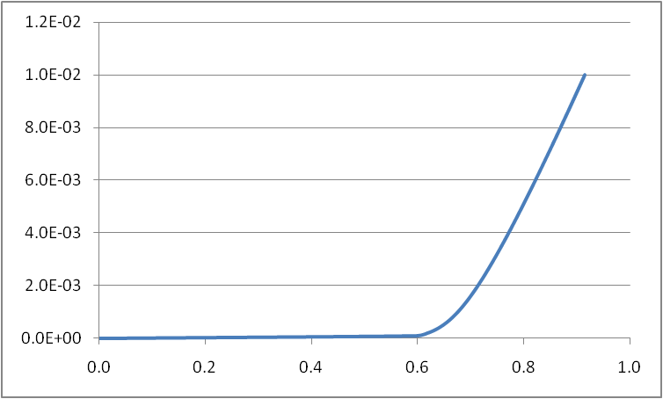
Electronic Circuits and Systems EEE211
Example
We will analyse a diode circuit using a piece-wise linear approximation to the true diode characteristic.
Suppose the diode characteristic is given by:
where I_{s} = 1e-14 amps and R_{S} = a ‘parasitic’ series resistance = 20 ohms
Plotting this characteristic gives:
R_{D} = 1/slope = 25ohms
(note R_{D} is slightly more than R_{S} because of the finite slope of the exponential diode characteristic)
V_{γ} = 0.67 volts
Fitting a straight line to the characteristic gives Vγ = 0.67 volts and R_{D} = 25 ohms

Slide 21
Electronic Circuits and Systems EEE211
Now consider the following diode circuit and solve it using a piecewise linear approximation for the diode.
Real diode
Sum the voltages around the circuit :
1k
First approximation assuming R_{D} ~ 0 and Vγ ~ 0.7 volts
5 – I x 1000 – 0.7 = 0
I = 4.3 mA
R_{D}
5v
(ideal diode)
Now compare with more accurate answer using the previous piece wise linear model with R_{D} = 25 ohms and Vγ = 0.67 volts
Vγ
I = 4.224 mA
Finally compare with accurate (computer) solution:
I = 4.223 mA
Conclusion – the accuracy of the piecewise model is often good enough for most applications and allows quick estimates to be made in simple circuits.
Use PSpice if greater accuracy is necessary or if the circuit is complex.

Slide 22
Part 2: Exercise on Diodes

Slide 23
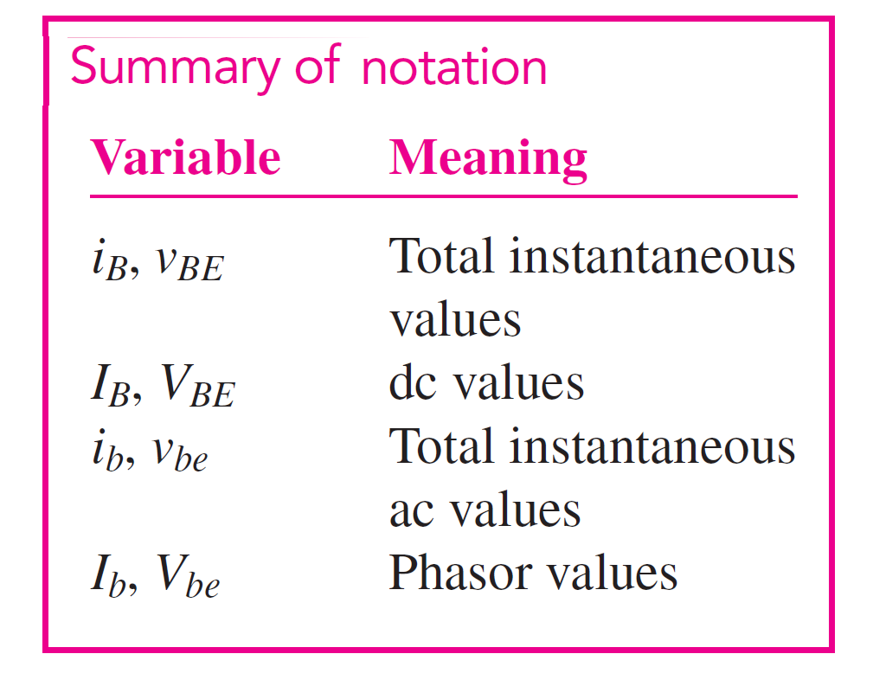

Slide 24
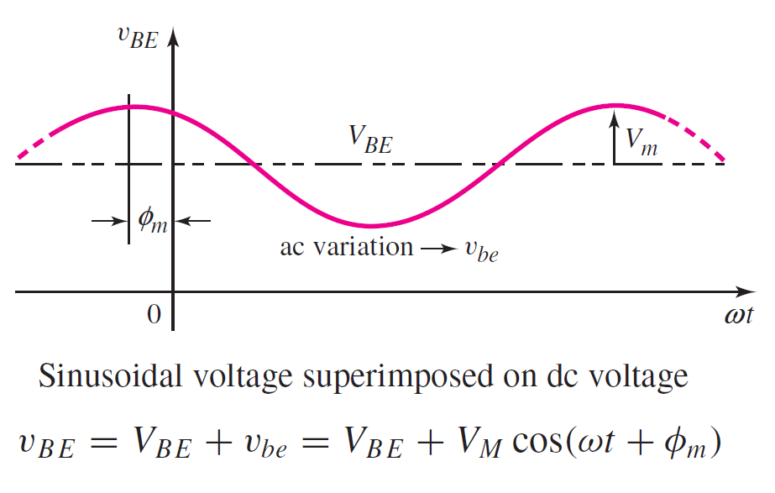

Slide 25
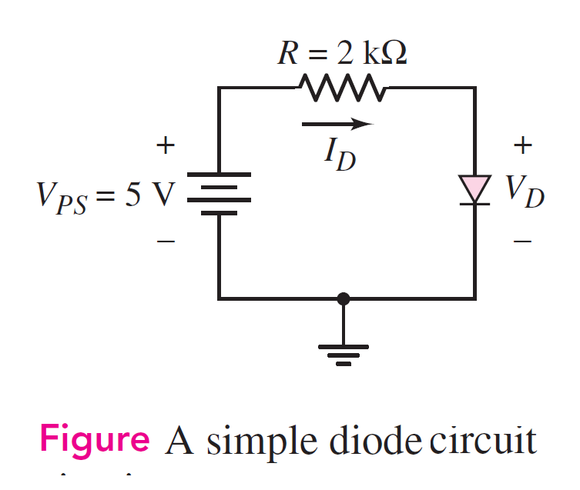
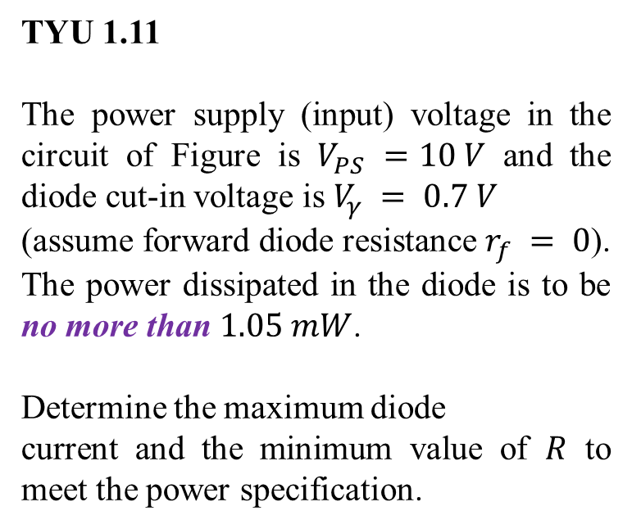
DC Analysis
TYU 1.11
The power supply (input) voltage in the circuit of Figure is $V_{PS} =10 V$ and the diode cut-in voltage is $V_{γ} = 0.7 V$
(assume forward diode resistance $r_{f} = 0$). The power dissipated in the diode is to be no more than $1.05 mW$.
Determine the maximum diode
current and the minimum value of $R$ to meet the power specification.

Slide 26
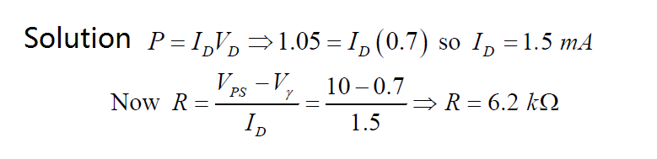
Electronic Circuits and Systems EEE211

Slide 27
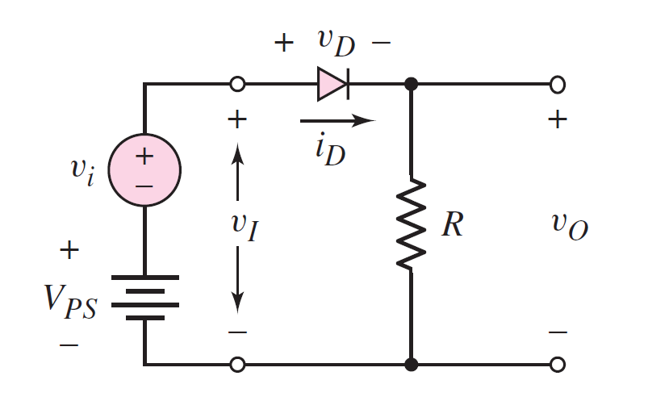
AC Analysis
Figure: Diode circuit with combined DC and sinusoidal input voltages

Slide 28
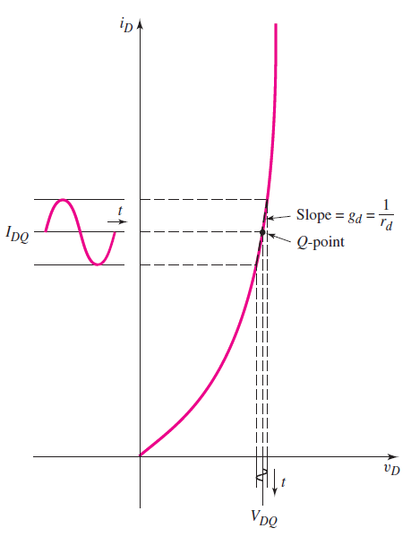
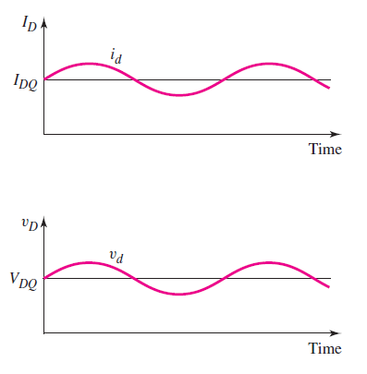
AC Analysis

Slide 29
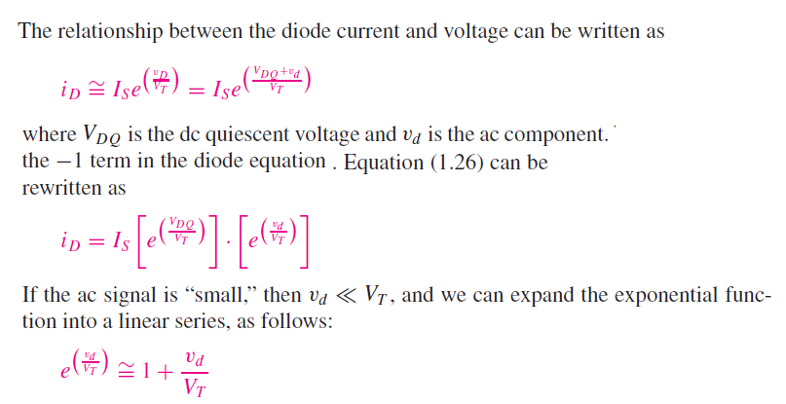
AC Analysis

Slide 30
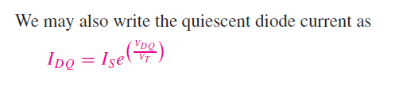
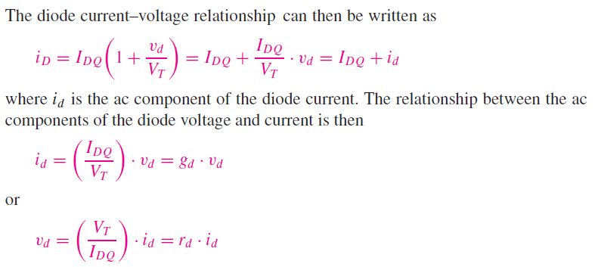
AC Analysis

Slide 31

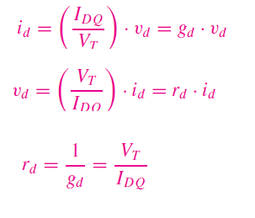
AC Analysis

Slide 32
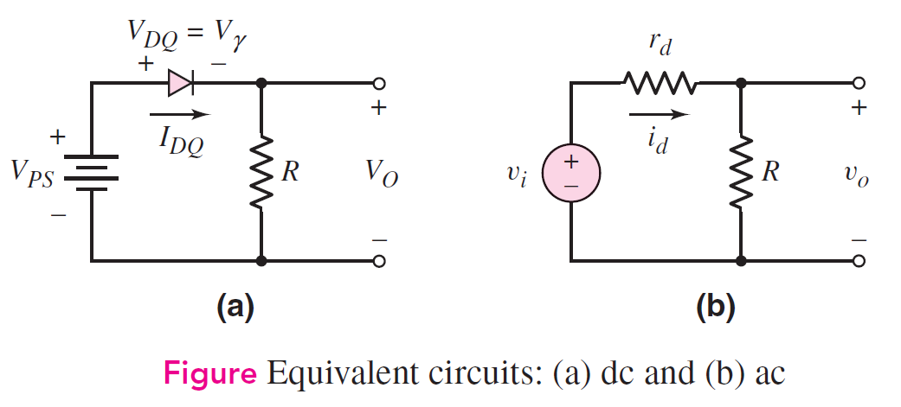
AC Analysis

Slide 33
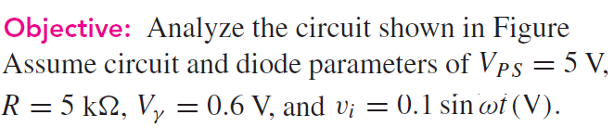
AC Analysis

Slide 34
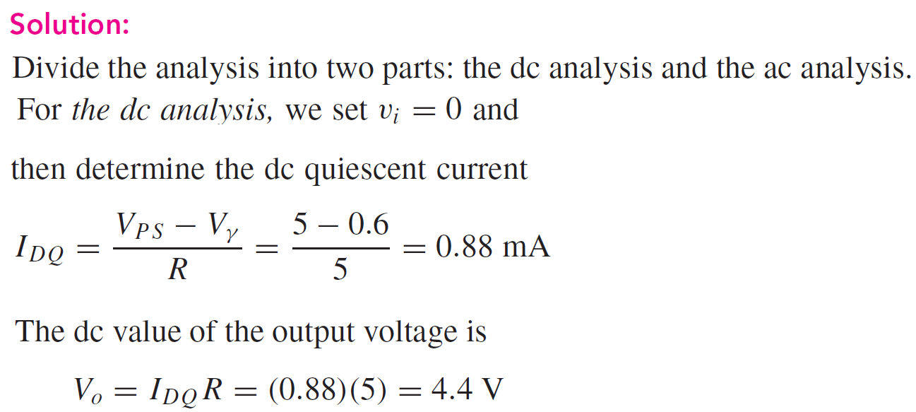
AC Analysis

Slide 35
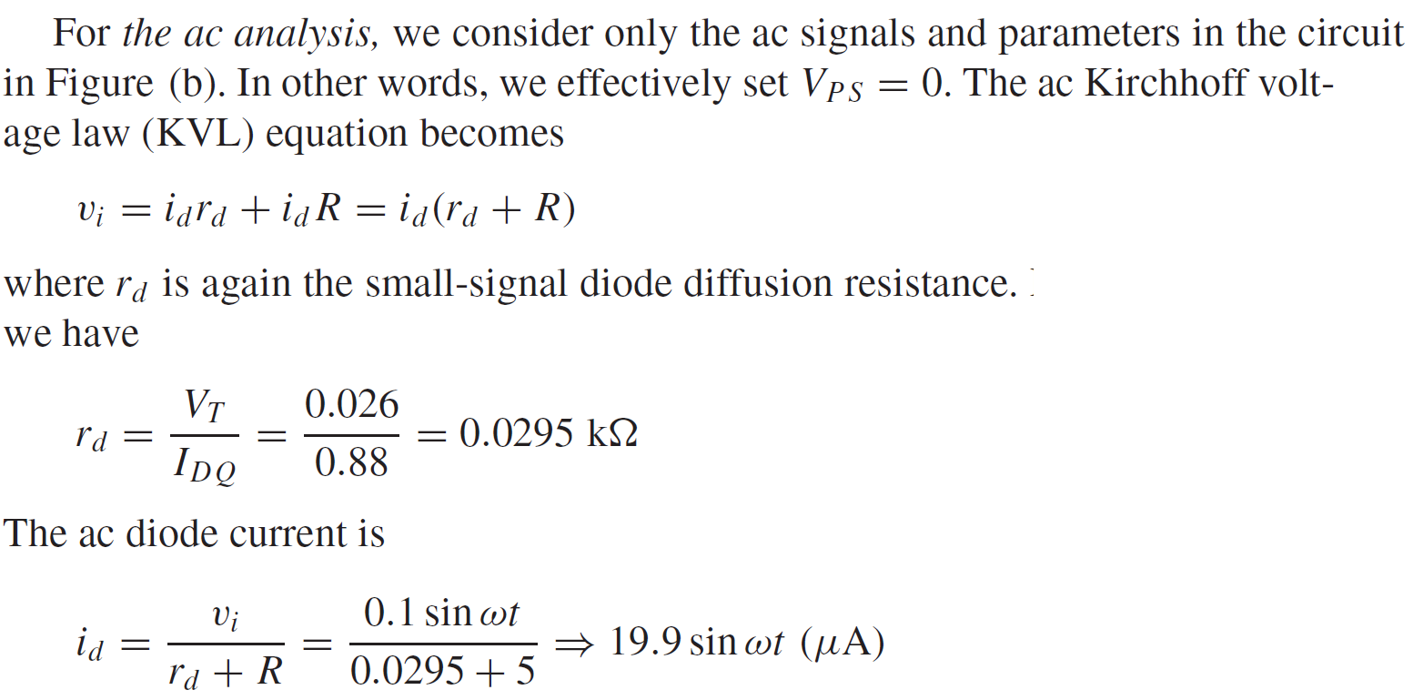
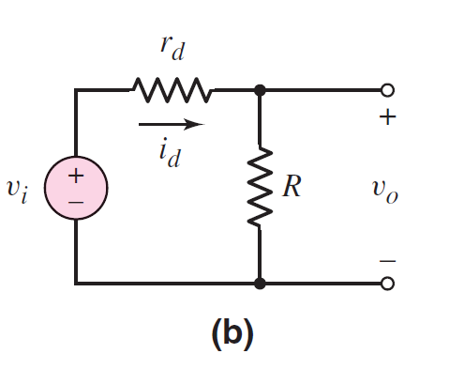
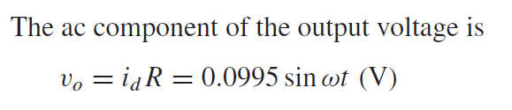
AC Analysis

Slide 36
Electronic Circuits and Systems EEE211
See Page 57 in Neamen’s textbook (4th edition) for more exercise.

