Slide 1
Electronic Circuits and Systems EEE211
High Frequency Transistor Circuits
Dept. of Electrical & Electronic Engineering
XJTLU

Slide 2
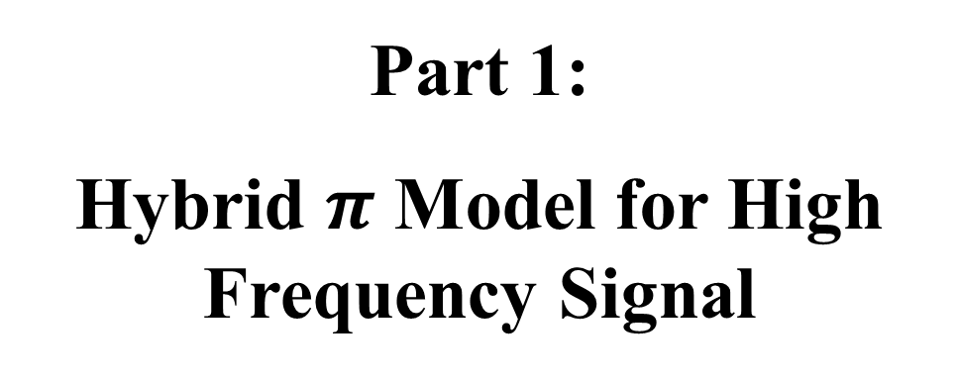
Electronic Circuits and Systems EEE211
Part 1:
Hybrid $π$ Model for High Frequency Signal

Slide 3
High Frequency Transistor circuits
High frequency hybrid-π model for the bipolar transistor
The equivalent circuit model presented so far is suitable only for low frequency use.
r_{b}
b
c
v_{π}
r_{π}
g_{m}v_{π}
r_{o}
e
e
We now seek to develop this further to produce a model suitable for high frequency analysis

Slide 4
Electronic Circuits and Systems EEE211
Feedback resistance, r_{μ}
r_{μ}
b
c
v_{π}
r_{π}
g_{m}v_{π}
r_{o}
e
e
This component takes account of feedback between the output and input of the transistor, which arises due (partly) to leakage currents within the device.
It is normally a very large value resistor (MΩ) and is usually neglected.

Slide 5
Electronic Circuits and Systems EE211
‘Leakage’ current in the base-collector junction
I_{E}
-
-
-
-
-
-
-
-
-
-
-
-
-
CB
-
-
-
-
-
-
VB
+
+
+
+
I_{C}
+
+
+
+
+
+
+
+
-
+
-
-
-
-
-
-
-
-
-
CB
+
+
+
+
+
+
+
VB
+

Slide 6
Electronic Circuits and Systems EEE211
Base- emitter capacitance, C_{π}
r_{b}
b’
r_{μ}
b
c
C_{diff}
C_{dep}
v_{be}
v_{π}
r_{π}
g_{m}v_{π}
r_{o}
e
e
C_{π} = C_{diff} + C_{dep}
This component represents the capacitance of the forward biased emitter-base junction. This is made up of two components: a diffusion capacitance C_{diff} and a space charge region capacitance C_{dep}. The diffusion capacitance usually dominates and occurs because a change of the density of mobile charge passing through the base region is required whenever the emitter-base junction voltage is changed, hence C_{π} ~ ∆Q_{B}/ ∆V_{BE}
Note that C_{π} must be charged and discharged through r_{b} – hence r_{b} becomes very important at high frequencies. Transistors designed for HF applications are specially designed to reduce this resistance to a minimum..

Slide 7
Electronic Circuits and Systems EEE211
I_{E}
Q_{B}
-
-
-
-
-
This charge Q_{B} is in transit through the base region and gives rise to both C_{diff} and I_{C}. If the average transit time = τ_{B}, then I_{C} = Q_{B}/τ_{B}
-
-
-
-
-
-
-
-
CB
-
-
-
-
-
-
VB
+
+
+
+
I_{C}
+
+
+
+
+
+
+
+
+
-
-
-
-
-
-
-
-
-
-
CB
+
+
+
+
+
+
+
VB
+
Remembering that g_{m} = 40I_{C} (at room temperature) then it will be clear that C_{diff} increases with the collector current. This has a significant effect on the high frequency performance of the transistor.

Slide 8

Electronic Circuits and Systems EEE211
C_{μ}
r_{b}
r_{μ}
b
b’
c
v_{be}
v_{π}
C_{π}
r_{π}
g_{m}v_{π}
r_{o}
e
e
This component represents the capacitance of the reverse biased collector-base junction. It is small but cannot always be neglected because its effect is magnified by the ‘Miller effect’ (more on this later)

Slide 9
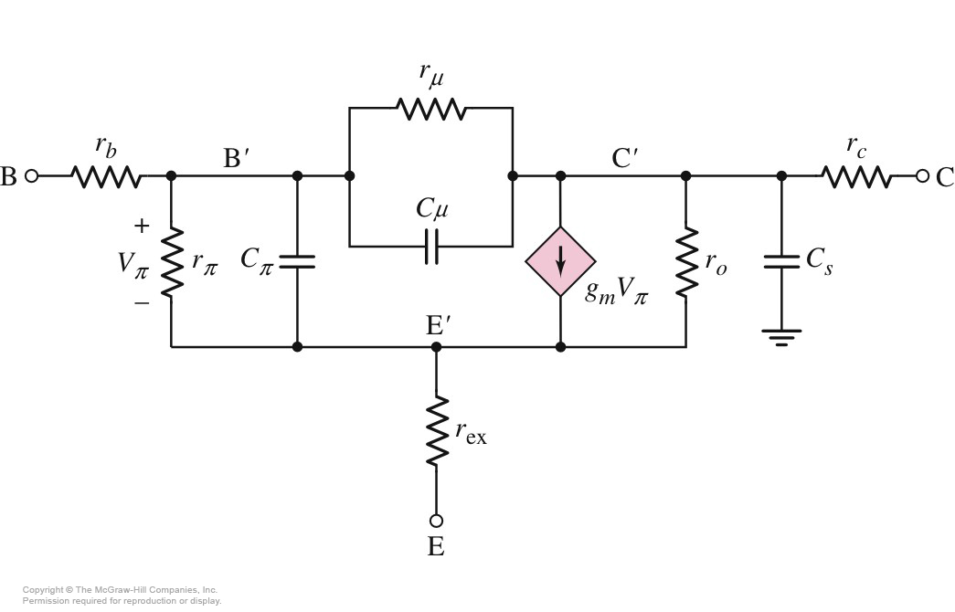
Electronic Circuits and Systems EEE211
There are other components that can be added – especially if the transistor is part of an integrated circuit – to represent the capacitances with the substrate or the package etc. Thankfully, we will not get involved with these in this course, but they can be important, especially at high frequencies.
Most transistors have computer models provided by the manufacturer for use in Pspice etc.

Slide 10
Electronic Circuits and Systems EEE211
Summary
PARAMETER | PHYSICAL DEFINITION
r_{b} | ohmic resistance of the semiconductor bulk from external base contact to the intrinsic transistor region. Also written as r_{bb’}
r_{π} | dynamic resistance of the emitter-base junction (ΔV_{BE}/ ΔI_{B} = v_{be}/i_{b}). Also written as r_{b’e}
r_{o} | dynamic resistance of the transistor output characteristic due to Early effect (ΔV_{CE}/ ΔI_{C} = v_{ce}/i_{c}). Also written as r_{ce}
r_{μ} | Takes care of feedback. Will always be assumed very large and hence ignored. Also written as r_{b’c}
C_{π} | differential capacitance of the forward biased emitter-base junction comprising the sum of the depletion and diffusion capacitances. Also written as C_{b’e}
C_{μ} | differential capacitance of the reverse biased collector-base junction (capacitance of the depletion region). Also written as C_{ce}
g_{m} | transistor transconductance (ΔI_{C}/ΔV_{BE} = 40 I_{C})

Slide 11
Electronic Circuits and Systems EEE211
Part 2:
Miller Effect and Miller’s Theorem

Slide 12
Electronic Circuits and Systems EEE211
The Miller Effect
This effect is particularly important in amplifiers that have high voltage gain.
In the inverting amplifier circuit shown below, the voltage gain is A_{V} where
v_{i}
Z
- A_{V}v_{i}
i_{i}
i_{Z}
i_{Z}
If a small voltage change +v_{i} occurs on the input, a magnified voltage change - A_{V}v_{i} occurs on the output.
-A_{V}
v_{i}
v_{o} = - A_{V}v_{i}
Now consider the current drawn by an impedance Z connected between the input and output terminals of the amplifier. Assuming an inverting amplifier, the current i_{Z} through Z will be [v_{i} – (– A_{V}v_{i})]/Z = v_{i} (1+ A_{V})]/Z and is much more than just v_{i}/Z when -A_{V} is large. So because the current drawn by Z is larger, the ‘loading effect’ of Z on the input is magnified and it ‘looks’ like (to the source) a much smaller impedance than it really is. This is known as the ‘Miller Effect’
Question: what would the magnitude of Z ‘look like’ to the source if the amplifier were a non-inverting unity gain amplifier (A_{V} = +1) ?

Slide 13
Electronic Circuits and Systems EEE211
Miller’s Theorem
Z
Miller’s theorem states that we may replace the impedance Z with two equivalent impedances, one connected across the input Z₁ and another across the output Z₂.
i_{Z}
i_{Z}
A_{V}
This is useful, because it keeps the input and output circuits separate and simplifies the analysis of the amplifier circuit
v_{i}
v_{O}
i_{Z1}
A_{V}
i_{Z2}
v_{i}
Z₁
Z₂
v_{O}

Slide 14
Electronic Circuits and Systems EEE211
First consider the input side of the two amplifiers
If Z_{in} is to correctly represent the effect of Z on the input, then i_{Z} = i_{Z1}
and
hence
[ Note that for an inverting amplifier, A_{V} = -A_{V} ]
Now consider the output side of the two amplifiers
and
Note that for a non-inverting unity gain amplifier (i.e. an ideal buffer), A_{v} = +1 so both Z₁ and Z₂ are infinite
hence
We shall see later that Millers theorem allows us to simplify the high frequency transistor equivalent circuit considerably.

Slide 15
Electronic Circuits and Systems EEE211
Z₁
Z₂
Z
Z
Av
0
1
Av
0
1

Slide 16
Electronic Circuits and Systems EEE211
High frequency model for the bipolar transistor
A transistor equivalent circuit for use at high frequencies has already been developed.
Note the presence of ‘feedback’ components C_{μ} and r_{μ} that link the input and output
r_{μ}. Is usually negligible, but the same cannot be said for C_{μ}
C_{μ}
r_{b}
r_{μ}
b
b’
c
v_{be}
v_{π}
C_{π}
r_{π}
g_{m}v_{π}
r_{o}
e
e

Slide 17
Electronic Circuits and Systems EEE211
The capacitor C_{μ} can be replaced using Miller’s Theorem:
and
to give:
r_{b}
r_{μ}
b
b’
c
v_{be}
C_{π}
v_{π}
r_{π}
g_{m}v_{π}
r_{o}
e
e
Note that for an inverting amplifier with high voltage gain, C₁ is significantly increased [ C₁ → C_{μ} (1+A_{V})]. In contrast, C₂ → (1+A_{V})/A_{V}. ≈ C_{μ} and is usually of less concern.
Also, because the effective values of capacitance for C₁ and C₂ contain A_{V}, the transistor will be dependent on the frequency behaviour of the circuit in which the transistor is used.

Slide 18
Electronic Circuits and Systems EEE211
Part 3:
Transition Frequency f_{T}

Slide 19
Electronic Circuits and Systems EEE211
Measurement of Transition frequency f_{T}
Because of the voltage gain dependence of C₁ and C₂, measurements of the high frequency performance of a transistor need to be performed in a circuit with known voltage gain. For convenience, a condition of zero voltage gain has been adopted and the resulting current gain is measured. Zero gain is easily achieved using a large capacitance across collector to emitter to short the output signal to ground.
The transistor equivalent circuit for such a measurement would become:
R_{S}
b
r_{b}
c
b’
v_{S}
v_{be}
r_{π}
C_{μ}
C_{π}
v_{π}
g_{m}v_{π}
e
e
Note that the short circuit on the output effectively eliminates all components in the collector circuit except the current generator and that the input capacitor C₁ becomes simply C_{μ} because A_{V} = 0.

Slide 20
Electronic Circuits and Systems EEE211
R_{S}
i_{S}
b
r_{b}
c
b’
v_{S}
v_{be}
r_{π}
C_{μ}
C_{π}
v_{π}
g_{m}v_{π}
i_{O}
e
e
b
r_{π} // (r_{b}+R_{S})
c
b’
C_{μ}+C_{π}
v_{π}
g_{m}v_{π}
i_{O}
e
e
The frequency dependence of the transistor is now seen to be due to a first order CR circuit formed by a combined source resistance R = r_{π} // (r_{b}+R_{S}) and a capacitance C = C _{μ} + C _{π}.
Remember that C_{π} = C_{diff} + C_{dep} (i.e. the diffusion capacitance of minority carriers in transit across the base region plus the emitter-base space charge capacitance). C_{μ} represents the capacitance of the collector-base space charge region.

Slide 21
Electronic Circuits and Systems EEE211
R_{S}
i_{S}
b
r_{b}
c
b’
v_{S}
v_{be}
r_{π}
C_{μ}
C_{π}
v_{π}
g_{m}v_{π}
i_{O}
e
e
where
Note that because f_{β} is defined in terms of the circuit current gain, it is not dependent on R_{S} or r_{b}

Slide 22
Electronic Circuits and Systems EEE211
Frequency response of the current gain measurement
20log₁₀ (A_{i})
( dB )
β
where
-20dB/decade
The frequency response is therefore a standard single lag response starting at 180° instead of the usual 0°
0
f_{β}
f_{T}
A common practice is to show the response on Bode plots.
f_{β}/10
10f_{β}
180°
The phase (in radians) is given by:
135°
-45°/decade
90°

Slide 23
Electronic Circuits and Systems EEE211
The definition of the ‘Transition frequency’, f_{T}
20log₁₀ (A_{i})
The frequency f_{T} is defined to be the frequency at which the current gain falls to 1 (=0dB)
( dB )
β
Assuming a reasonable transistor so that β >> 1, then f_{T} >> f_{β} and the equation for A_{i} becomes approximately
-20dB/decade
0
f_{β}
f_{T}
f_{β}/10
10f_{β}
Note the 90° phase shift implied by ‘1/ j’, so f_{T} >10f_{β} is being assumed.
180°
135°
-45°/decade
90°

Slide 24
Electronic Circuits and Systems EEE211
When A_{i} = 1, then f = f_{T} and
20log₁₀ (A_{i})
( dB )
β
For this reason, f_{T} is known as the ‘current gain-bandwidth product’ or sometimes the ‘Transition frequency’. It is important to remember that it applies only to the circuit conditions described.
-20dB/decade
0
f_{β}
f_{T}
Note that provided the measurement is taken at a frequency that places it on the -20dB/decade slope, it does not matter exactly where it is measured. The product of current gain and frequency is always the same. For convenience, a frequency of 35MHz is usually taken.
f_{β}/10
10f_{β}
180°
135°
-45°/decade
90°

Slide 25
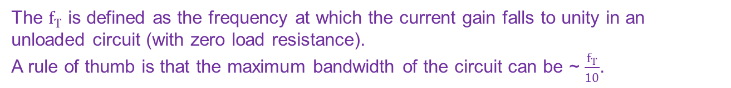
Electronic Circuits and Systems EEE211
The maximum possible value for f_{T}
Suppose a transistor was made such that the space charge region capacitances were small compared to the base diffusion capacitance, C_{diff}. Then: negligible.
But
Hence
where τ_{B} is the base transit time
So the high frequency performance is ultimately determined by the base transit time (more accurately, the total time for charges to move through the transistor). So for a high frequency transistor, make the base width small.
The $f_{T}$ is defined as the frequency at which the current gain falls to unity in an unloaded circuit (with zero load resistance).
A rule of thumb is that the maximum bandwidth of the circuit can be ~ $\frac{f_{T}}{10}$.

Slide 26
Electronic Circuits and Systems EEE211
Part 3:
Frequency Dependence of CE

Slide 27
Electronic Circuits and Systems EEE211
The frequency dependence of the common emitter amplifier voltage gain
We will now consider the voltage gain of a standard CE amplifier
Adding typical external circuit components to the transistor high frequency equivalent circuit gives:
R_{S}
b
r_{b}
c
b’
v_{S}
v_{be}
r_{π}
C₁
C_{π}
v_{π}
g_{m}v_{π}
r_{o}
C₂
C_{S}
R_{C}
R_{L}
e
e
Which may be reduced to:
Possible ‘stray capacitance’
R
c
b’
v_{S}’
C
v_{π}
g_{m}v_{π}
C’
R_{t}
v_{O}
where
e

Slide 28
Electronic Circuits and Systems EEE211
R
b’
c
v_{S}’
C
v_{π}
g_{m}v_{π}
C’
R_{t}
v_{O}
e
Both input and output sections of the amplifier are simple, first order circuits that give rise to two corner frequencies f₁ and f₂..

Slide 29
Electronic Circuits and Systems EEE211
We now consider the relative magnitudes of f₁ and f₂ for the case A’_{V} =v_{O}/v_{π} is large and negative – as expected for a CE amplifier.
where
and
where
Because C_{μ} is multiplied by A’_{V} (=v_{O}/v_{π}) in the equation for f₁ but not in f₂, and often C_{π} > C_{S} it is generally the case that f₁ << f₂. The high frequency fall in voltage gain occurs first at f₁. and f₂ can be ignored.
Note than in any problem, it is important to justify the use of this approximation by checking the relative values for f₁ and f₂

Slide 30
Electronic Circuits and Systems EEE211
Using this approximation, it is the input time constant that will set the response of the amplifier and therefore:
where
is the voltage gain bandwidth.
Note that
whilst

Slide 31
Electronic Circuits and Systems EEE211
Frequency response of the CE amplifier
20log₁₀ (v_{o}/v_{i})
( dB )
The frequency response therefore can be assumed to be that of a standard single lag response (assuming f₁ << f₂)
A_{V}(0)
-20dB/decade
0
f₁
Since the CE is an inverting amplifier, then the phase (in radians) is given by:
f₁/10
10f₁
180°
135°
-45°/decade
i.e. a 90º phase lag starting from 180º
90°

Slide 32
Electronic Circuits and Systems EEE211
So far, we have:
1) Developed the transistor equivalent circuit to include additional components that take account of internal capacitances due to charge storage in the base of the transistor and the capacitance of the base-emitter and base-collector junctions .
2) Reviewed the Miller Effect
3) Analysed the common emitter amplifier circuit and shown that its high frequency performance of the circuit is often dominated by the existence of the internal capacitances.
4) Shown how the Miller Effect can significantly affect the high frequency performance of high voltage gain transistor circuits.

Slide 33
Electronic Circuits and Systems EEE211
Notes:
1. The low frequency voltage gain (f << f_{C}) is
Notice that, if r_{b} = 0 and R_{S} = 0, then the voltage gain is a maximum A_{V} = -g_{m}R_{t} Therefore use a low source resistance to achieve a high voltage gain.
2. We have seen that the high frequency performance is often dominated by f₁ due to the Miller effect which causes a considerable reduction in bandwidth as it ‘amplifies’ the capacitor C_{μ} by the voltage gain of the amplifier. R_{S} also reduces the bandwidth.
3. Note that the voltage gain that ‘magnifies’ the value of C_{μ} due to the Miller effect
is not the overall voltage gain
We now consider some circuits which avoid or reduce the Miller effect and so have greatly increased bandwidth:

Slide 34
Electronic Circuits and Systems EEE211
Part 4:
Frequency Dependence of CB

Slide 35
Electronic Circuits and Systems EEE211
The frequency dependence of the voltage gain of the common base circuit
Consider the common base circuit. In this circuit, the base is grounded and the input is connected to the emitter and the output is taken from the collector to base (ground).
+V_{CC}
c
R₁
R_{C}
g_{m}v_{π}
r_{o}
R_{S}
e
r_{μ}
C_{μ}
i_{o}
R_{C}
R_{L}
i_{i}
C_{π}
r_{π}
v_{π}
v_{o}
v_{S}
R_{E}
b’
C_{S}
R_{s}
R_{L}
v_{o}
C_{B}
R₂
R_{E}
v_{i}
r_{b’}
v_{s}
b
b
0V
Typical CB circuit
ac Equivalent circuit
Note that R₁ and R₂ are shorted to ground by the capacitor C and so do not appear in the ac equivalent circuit

Slide 36
Electronic Circuits and Systems EEE211
The circuit can be simplified considerably if we ignore the small base resistance r_{b}’ and the large resistors r_{o} and r_{μ} , so that the circuit becomes:
c
R_{S}
r_{e}
g_{m}v_{π}
e
C_{μ}
R_{C}
R_{L}
v_{o}
v_{S}
R_{E}
C_{π}
r_{π}
v_{π}
C_{S}
b
b
Note:
1) the feedback capacitance C_{μ} appears connected across the output and does not link the input and output as it does in the CE circuit. So in the CB circuit, C_{μ} does not appear across r_{π} ! Therefore the CB circuit does not suffer from the ‘Miller effect’
2) we have seen (see earlier lecture on CB circuit configuration) that the input resistance ‘looking into’ the emitter of the CB circuit is very much smaller than r_{π}:
See Week 3. Material, p. 25
So the input time constant will be very much smaller than was the case for the CE amplifier

Slide 37
Electronic Circuits and Systems EEE211
To analyse the circuit, combine capacitors and resistors as we did for the CE amplifier:
c
r_{e}
g_{m}v_{π}
R_{S}
e
C_{μ}
R_{C}
R_{L}
v_{o}
v_{S}
R_{E}
r_{π}
v_{π}
C_{S}
C_{π}
b
b
R
e
c
v’_{π}
C_{π}
v_{π}
g_{m}v_{π}
C’
R_{t}
v_{O}
where
b
Noting that we have used r_{e} (and not r_{π}) as the true resistance ‘looking into’ the emitter.

Slide 38
Electronic Circuits and Systems EEE211
R
e
c
v’_{π}
C_{π}
v_{π}
g_{m}v_{π}
C’
R_{t}
v_{O}
b

Slide 39
Electronic Circuits and Systems EEE211
R
e
c
v’_{π}
C_{π}
v_{π}
g_{m}v_{π}
C’
R_{t}
v_{O}
b
where
Note that f₁ will be high because there is no Miller effect capacitance to add to C_{π} and also r_{e}=1/g_{m} is small. In practice, for the CB amplifier, f₁ may be similar to f₂.
This means the CB amplifier has a much higher bandwidth than the CE amplifier for the same transistor parameters – but keep the stray capacitance C_{S} small !

Slide 40
Electronic Circuits and Systems EEE211
Other high frequency circuits
(i) Long-tailed pair differential amplifier with one input grounded
Used in this way, the differential amplifier can be considered a two-stage, d.c. coupled amplifier: that is made up of a CC followed by CB.
The CC stage is inherently immune to Miller Effect because the collector is connected directly to ac ground and therefore the collector to base capacitance C_{μ} is not magnified. Therefore the CC circuit has good high frequency performance.
0v
The CC represents a low impedance source to the CB stage, which also inherently has good high frequency performance
So this amplifier overall has a very good high frequency performance.
CC
2
CB

Slide 41
Electronic Circuits and Systems EEE211
(ii) The ‘cascode’ amplifier
Another example is the ‘cascode’ configuration which combines a CE stage with a CB stage as its collector load, (ideally using two identical transistors). The CE stage ‘sees’ the small input resistance of the CB stage (r_{e2} ≈ 1/g_{m2}) as its effective load. The voltage gain of the CE stage is therefore equal to -1.
A_{VCE} ≈ -g_{m1}R_{t} = -g_{m1}r_{e2} = -g_{m1} / g_{m2} ≈ -1
(g_{m1} = g_{m2} because the same current flows in the CE and CB transistors, so the g_{m} values will be the same for identical transistors = 40I_{C}).
The collector to base capacitor of the CE transistor C_{μ} is therefore only increased by a factor of 2 due to the Miller effect.
The current then passes through to the CB transistor and the output voltage is developed across R_{C} giving a high voltage gain overall. As before, the CB does not suffer from the Miller Effect so the circuit overall produces good voltage gain with good high frequency performance.
The CE provides the current gain and the CB provides the voltage gain
Overall gain is A_{V} = A_{VCE} x A_{VCB} = -1 x g_{m} R_{t} ≈ −g_{m}R_{C}

Slide 42
Electronic Circuits and Systems EEE211
Part 5:
Exercise

Slide 43
Electronic Circuits and Systems EEE211
Example
The voltage gain bandwidth of a single common-emitter amplifier stage is required to be 1.5 MHz with a quiescent collector current of 5 mA and a total load of 1 kΩ. The transistor parameters are β = 100, r_{b} = 20 Ω, C_{μ} = 2 pF and f_{T} = 200 MHz.
a) Deduce the values of g_{m}, r_{π}, C_{π} and f_{β}.
Find the value of the source resistance to give the required bandwidth
c) Calculate the mid-frequency voltage gain v_{o}/v_{s}.
Ans: a) 200 mA/V, 500 Ω, 157 pF, 2MHz b) 286 Ω c) 124

Slide 44
Electronic Circuits and Systems EEE211
Example
The voltage gain bandwidth of a single common-emitter amplifier stage is required to be 1.5 MHz with a quiescent collector current of 5 mA and a total load of R_{t} =1 kΩ. The transistor parameters are β = 100, r_{b} = 20 Ω, C_{μ} = 2 pF and f_{T} = 200 MHz.
Solution
a) Deduce the values of g_{m}, r_{π}, C_{π} and f_{β}.

Slide 45
Electronic Circuits and Systems EEE211
b) Find the value of the source resistance to give the required bandwidth
The required voltage gain bandwidth,
where
and
(Note that C is dominated by A_{’v}C_{μ})
which gives the required source resistance to be:

Slide 46
Electronic Circuits and Systems EEE211
c) Calculate the low-frequency voltage gain v_{o}/v_{s}.
R_{S}
b
r_{b}
b’
c
v_{S}
C₁
C_{π}
C₂
C_{S}
R_{C}
R_{L}
v_{O}
v_{be}
r_{π}
v_{π}
g_{m}v_{π}
r_{o}
e
e

Slide 47
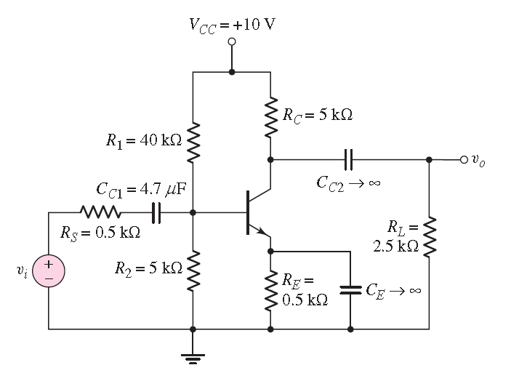
Electronic Circuits and Systems EEE211
Frequency Domain Analysis
Common Emitter Amplifier Configuration

Slide 48
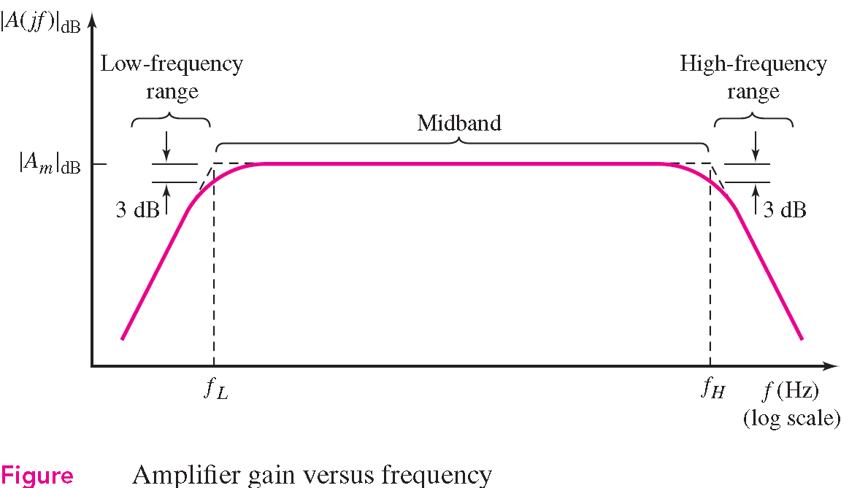
Electronic Circuits and Systems EEE211
Frequency Domain Analysis

Slide 49
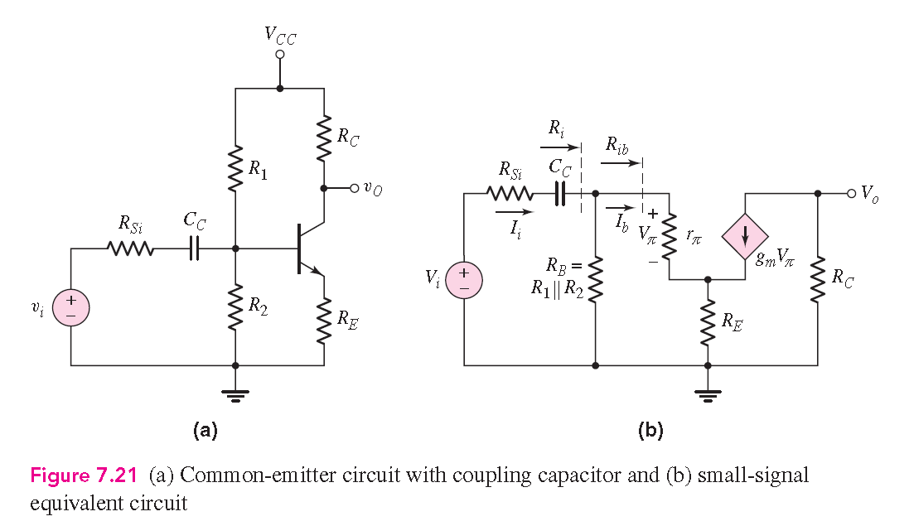
Electronic Circuits and Systems EEE211
Low Frequency Range:
Coupling and bypass capacitors must be included in the equivalent circuit and in the
amplification factor equations. The stray and transistor capacitances are treated as
open circuits.

Slide 50
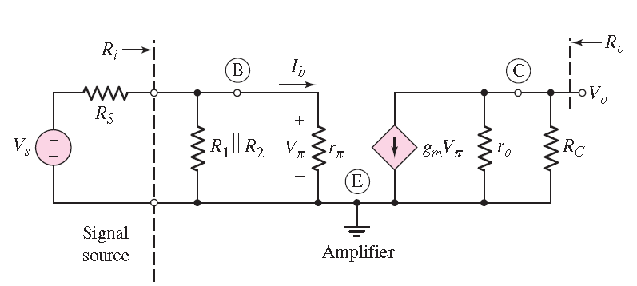
Electronic Circuits and Systems EEE211
Mid-band Range:
The coupling and bypass capacitors in this region are treated as short circuits. The stray and transistor capacitances are treated as open circuits. In this frequency range, there are no capacitances in the equivalent circuit.

Slide 51
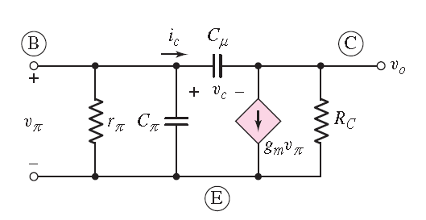
Electronic Circuits and Systems EEE211
High-Frequency Range:
We use a high-frequency equivalent circuit. In this region, coupling and bypass capacitors are treated as short circuits. The transistor and any parasitic or load capacitances must be taken into account in this equivalent
circuit.

Slide 52
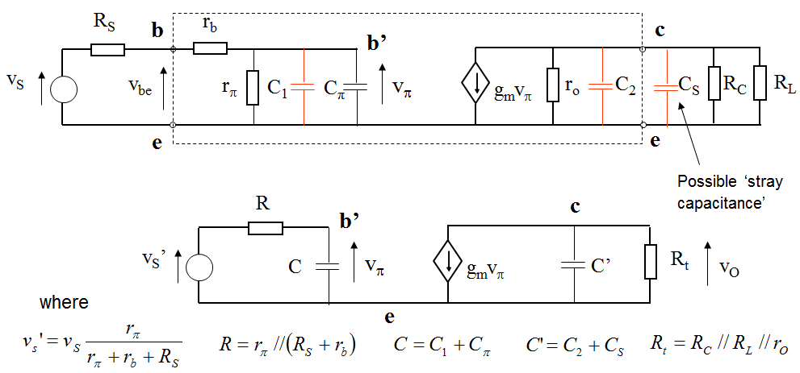
Electronic Circuits and Systems EEE211

Slide 53
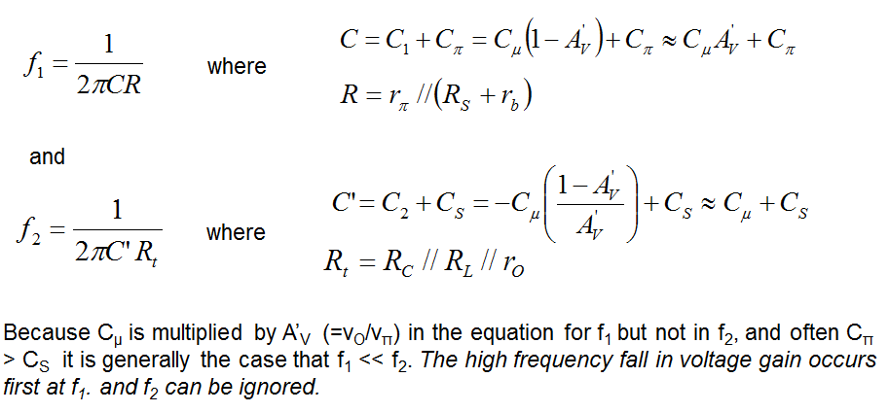
Electronic Circuits and Systems EEE211

Slide 54
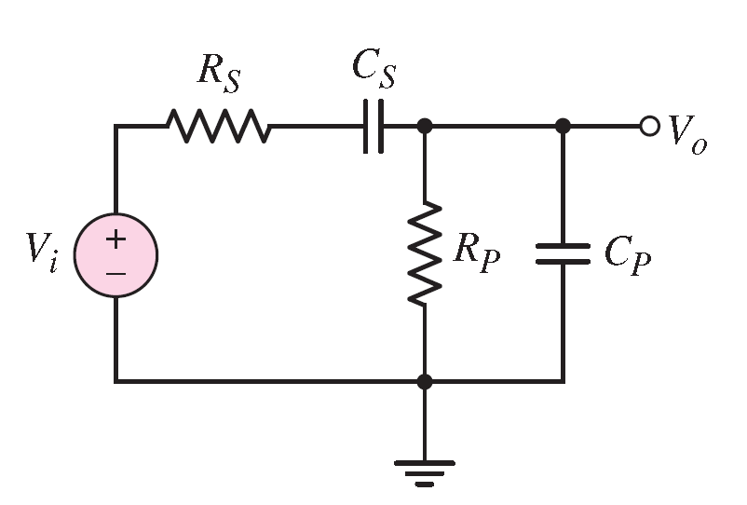
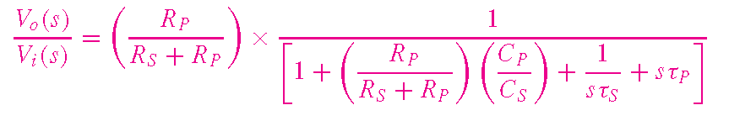

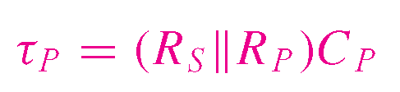
Electronic Circuits and Systems EEE211
Figure: Circuit with both a series coupling and a parallel load capacitor

Slide 55
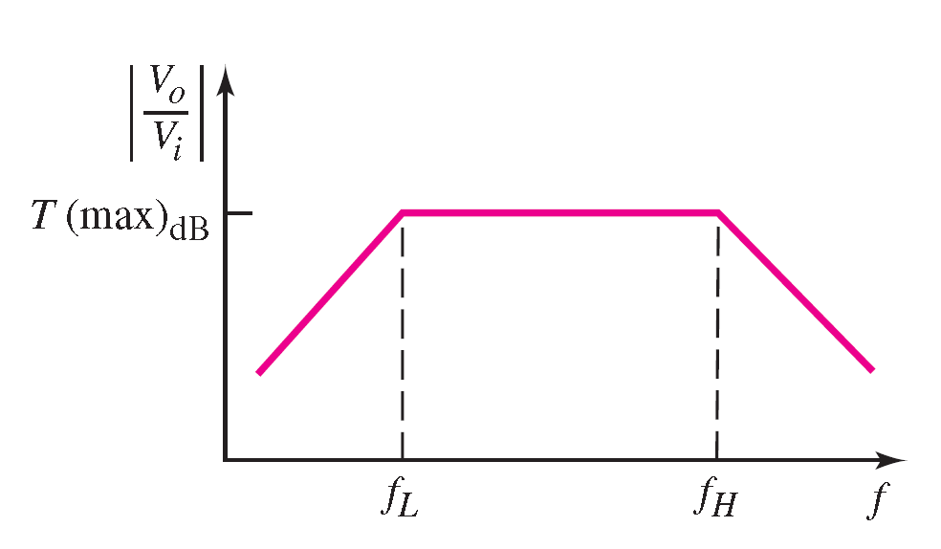
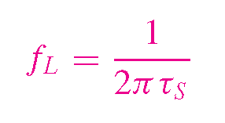
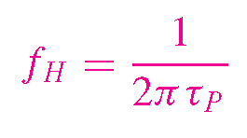
Electronic Circuits and Systems EEE211

Slide 56
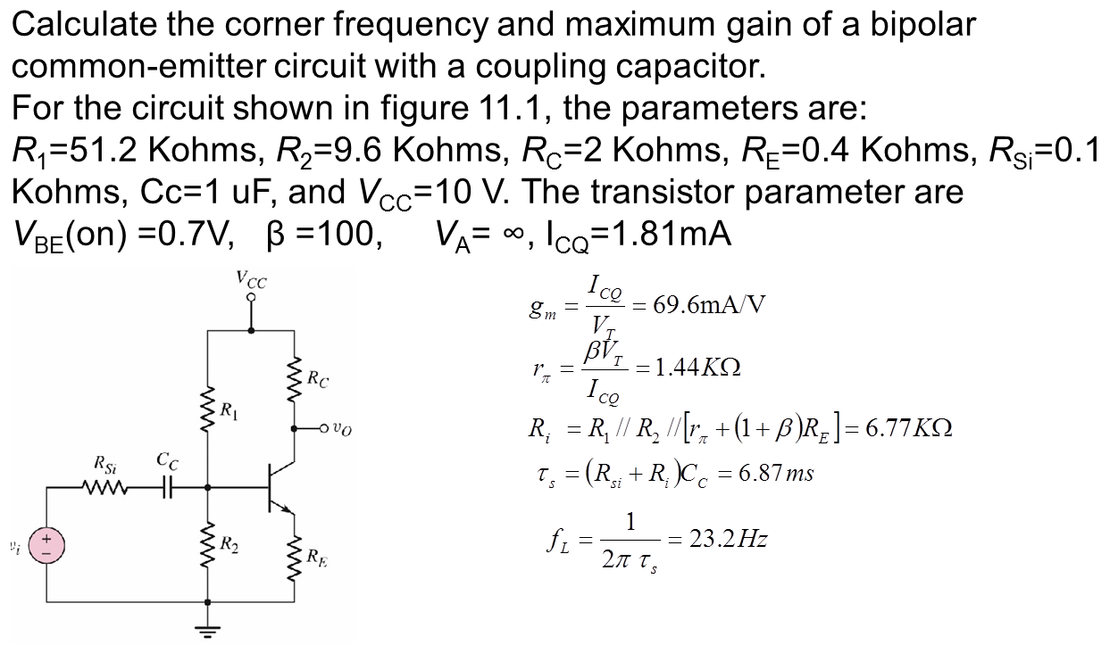
Electronic Circuits and Systems EEE211

Slide 57
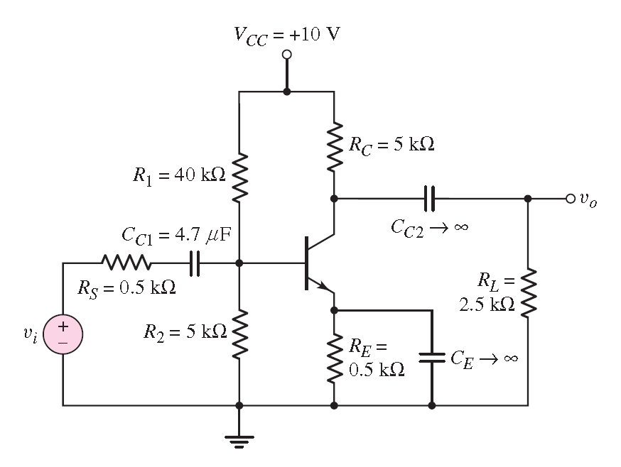
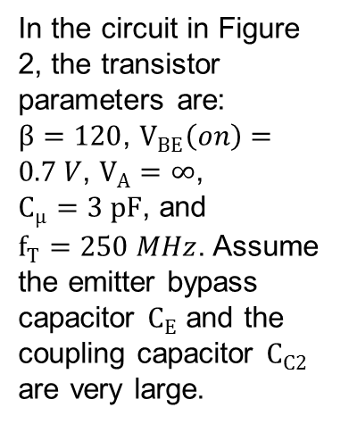
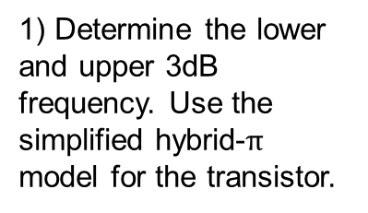
Electronic Circuits and Systems EEE211
In the circuit in Figure 2, the transistor parameters are: $β=120$, $V_{BE}\left(on\right)=0.7 V$, $V_{A}=∞$, $C_{μ}=3 pF$, and $f_{T}=250 MHz$. Assume the emitter bypass capacitor $C_{E}$ and the coupling capacitor $C_{C2}$ are very large.
1) Determine the lower and upper 3dB frequency. Use the simplified hybrid-$π$ model for the transistor.

Slide 58
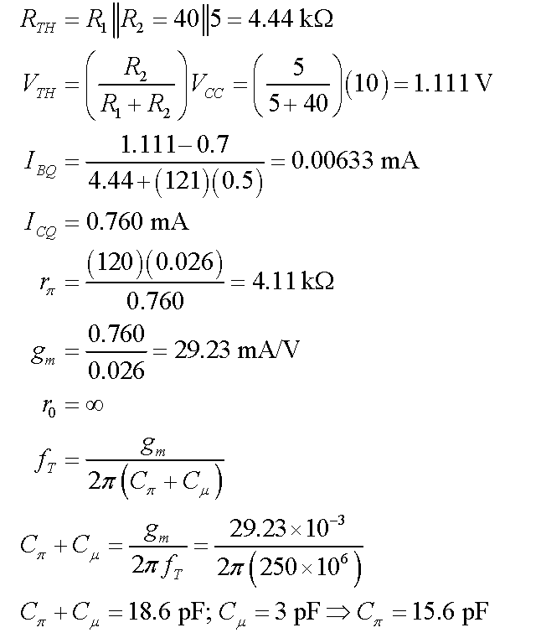
Electronic Circuits and Systems EEE211
Solution:

Slide 59

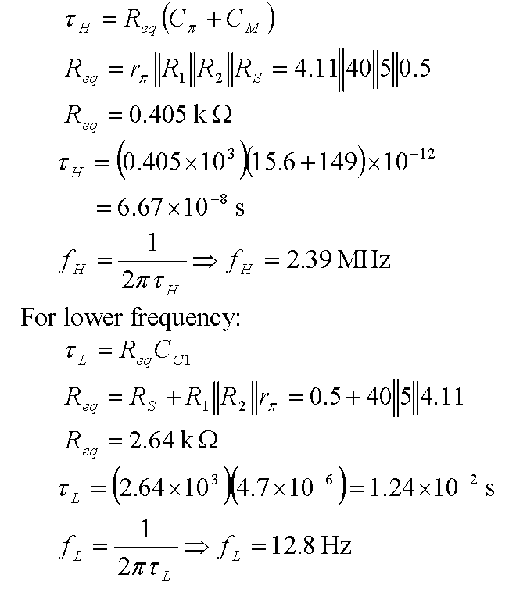
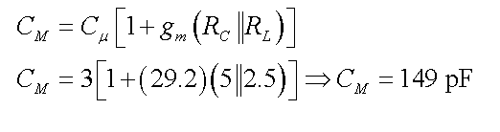
Electronic Circuits and Systems EEE211
Solution:
=== Miller Effect ===

Slide 60
Electronic Circuits and Systems EEE211
In the circuit in Figure 2, the transistor parameters are: $β=120$, $V_{BE}\left(on\right)=0.7 V$, $V_{A}=∞$, $C_{μ}=3 pF$, and $f_{T}=250 MHz$. Assume the emitter bypass capacitor $C_{E}$ and the coupling capacitor $C_{C2}$ are very large.
2) Sketch the Bode plot of the voltage gain magnitude

Slide 61
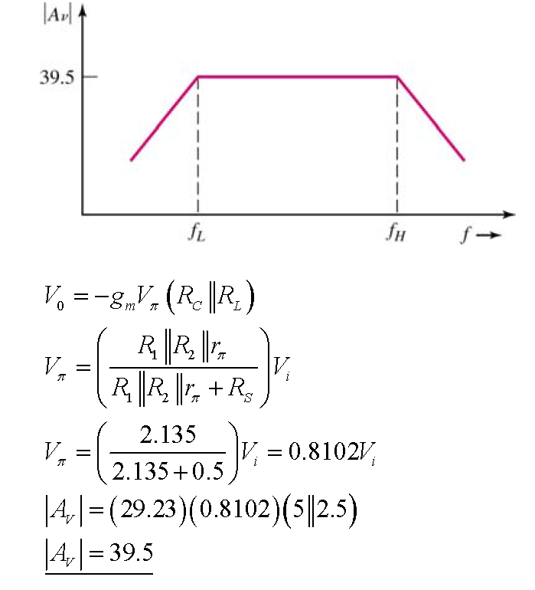
Electronic Circuits and Systems EEE211
Solution:

Slide 62
Electronic Circuits and Systems EEE211
In this lecture we have:
1) shown that the common base circuit is not affected by the Miller Effect and therefore has good high frequency performance
2) reviewed some special circuits that incorporate the common base configuration to combine high voltage gain with good high frequency performance
3) Noted that the common collector circuit also has good high frequency performance

Slide 63
Electronic Circuits and Systems EEE211
In next lecture, we will study another two transistor circuits – differential amplifier and current mirror, which could be used to build operational amplifier

