Slide 1
Electronic Circuits and Systems EEE211
Current Mirror Circuits
Dept. of Electrical & Electronic Engineering
XJTLU

Slide 2
Electronic Circuits and Systems EEE211
Part 1:
Current Repeater Circuit

Slide 3
Electronic Circuits and Systems EEE211
The current mirror circuit
This is a very useful circuit to create a temperature compensated current source. It is widely used in integrated circuit designs, because all the transistors are produced at the same time in the same piece of silicon – hence it easy to produce matched transistors that also share the same thermal environment. These are key requirements for the circuit to operate effectively.
Notice that the V_{BE1} = V_{BE2} (= V_{BE}) and so provided the transistors are identical, the collector currents will be the same also (I_{C1} = I_{C2} = I_{O}) .
Hence
V
cc
I
ref
R
I
o
I_{B}
I_{B}
T2
I
o
V
BE2
V
T1
BE1
if β is large

Slide 4
Electronic Circuits and Systems EEE211
Thus I_{ref} is set by choosing R and this current is then ‘mirrored’ in T₂ to provide I_{O}.
Note that if the temperature of the transistors were to change, the V_{BE} of both transistors will change slightly. However, this makes very little change to the total voltage across R_{ref} and so I_{ref} stays almost constant. T₁ adopts whatever V_{BE} is needed at the new temperature to keep I_{ref} constant. Since the V_{BE} of T₁ is also the V_{BE} of T₂, the ‘mirrored’ current I_{O} will also hardly change.
A development of this circuit is the current repeater circuit in which a number of identical current sources can be produced to provide bias currents to different parts of the circuit, as required.

Slide 5
Electronic Circuits and Systems EEE211
The current repeater circuit
The reference transistor is placed alongside a series of transistors with their base-emitter junctions connected in parallel.
V
cc
R
output 1
output 2
output N
In this circuit, the reference current also feeds all the transistor base currents, so
I
ref
I
o
I
o
I
o
V_{BE}
-v_{EE}
A limitation of this circuit is that the same current is produced in each load, but usually different bias currents will be required. It is possible to scale the currents - within limits - by scaling up the area of the (otherwise identical) transistors:
so
or

Slide 6
Electronic Circuits and Systems EEE211
Part 2:
Widlar Current Mirror

Slide 7
Electronic Circuits and Systems EEE211
The Widlar current mirror
A variation of the basic current mirror circuit can be used if larger current ratios are needed.
V
cc
It is particularly useful in internal integrated circuit biasing arrangements because:
R
o
R
a range of currents can be produced by changing the value of R_{E} rather than the size of the output transistor,
the resistance values required are much smaller.
I
ref
I
c1
I
o
= I
c2
V
T2
BE2
T1
V
BE1
R
E
Both of these features leads to a much more compact design.

Slide 8
Electronic Circuits and Systems EEE211
Analysis
Ignoring base currents so that I_{E} ≈ I_{C} = I_{o} and assuming the transistors are of equal size, then:
V
cc
R
o
R
hence
I
ref
and
I
c1
I
o
= I
c2
V
T2
BE2
T1
V
BE1
R
E
but
This equation allows the required value for R_{E} to be calculated given I_{ref} and the required output current I_{o}.

Slide 9
Electronic Circuits and Systems EEE211
a.c. Analysis continued – output resistance, R_{o}
The output resistance R_{o} ‘seen looking into’ the collector of T2 will depend on the impedance in its base circuit. It is therefore necessary to first determine the resistance represented by the reference circuit (R_{o}’).
collector connected to base
B
C
R
R’_{o}
R’_{o}
v_{π}
r_{π}
r_{O}
R
g
m1
v_{π}
E
Evidently, the output resistance is R // r_{o} // r_{π} // (the impedance of the current source)
However, unlike previous analyses, the current source in this case is dependent on the voltage across it through v_{π} and so its resistance is not infinite as would be expected for a normal current source.

Slide 10
Electronic Circuits and Systems EEE211
To determine its effective resistance, imagine injecting a small current i as shown. The resulting small change in v gives the circuit’s effective resistance as v / i.
B
i
R_{og}
i_{rπ1}
v_{π1}
r_{π1}
v
g
m1
v_{π1}
E
This is the equation for two resistors in parallel: r_{π1} and the effective resistance of the current source, r_{e1}
So the total resistance represented by the reference current circuit is

Slide 11
Electronic Circuits and Systems EEE211
Incorporating this into the second part of the circuit gives:
B
C
I_{O}
T1
g_{m2}v_{π}
v_{π}
r_{π2}
r_{o2}
E
i₁
R_{o}’ ≈ r_{e1}
R_{E}
We have already analysed this circuit in the last lecture (output resistance of a constant current source with base bias resistors, lecture 4 pp. 24, CE-ED output Resistance)).
In the present circuit, the equivalent base resistance R ≈ 1/g_{m1} = r_{e1} so the equation becomes:
Eqn (1)
Finally, if we make r_{π2} >> r_{e1} + R_{E} then

Slide 12
Electronic Circuits and Systems EEE211
So the output resistance of the Widlar circuit is a factor of 1+g_{m}R_{E} times higher than that of the simple two transistor current source.
Note that
where R_{E} I_{o} is the voltage drop across R_{E}. But V_{T} = 0.025V so only a small voltage is required across R_{E} to ‘multiply up’ the transistor output resistance r_{o2} and give a large R_{o} for the current source.
Finally, recall the assumption r_{π2} >> r_{e1} + R_{E} has been made in this analysis.
This implies that r_{π2} >> r_{e1} i.e.
or
In practice, matched transistors of equal area are used in this circuit, so I_{C2} will be less than I_{C1} because of the presence of R_{E}. Hence this approximation will be valid for any pair of matched transistors with a reasonable gain.

Slide 13
Electronic Circuits and Systems EEE211
Example
For the circuit shown, find values for R and R_{E} to give a bias current of I_{o} = 0.1 mA if I_{ref} = 5mA.
Estimate the output resistance, given that both transistors have current gain β = 200 and V_{A} = -110 V. The transistors are of equal size.
V_{CC} = 5v
Solution
R_{out}
From KVL applied to the reference transistor:
R
I_{ref} = (V_{CC}-V_{EE} -V_{BE})/R
I_{ref}
5x10⁻³ = (5-(-5) -0.6)/R gives R = 1880 Ω
I_{o}
For matched transistors of equal size, the output current I_{o} is related to I_{ref} through:
T₁
T₂
R_{E}
V_{EE} = -5v
So with I_{o} = 0.1mA, and I_{ref} = 5mA, then R_{E} = 978Ω ~ 1k Ω

Slide 14
Electronic Circuits and Systems EEE211
Assuming that the average collector voltage of T2 will be ≈ 0 volts (so V_{CE} ≈ 5v), the output resistance r_{o} of the transistor is:
V_{CC} = 5v
R_{out}
R
I_{ref}
I_{o}
The output resistance of the Widlar circuit is therefore:
T₁
T₂
if r_{π2} >> r_{e1}+R_{E}
[ Check:-
R_{E}
V_{EE} = -5v
Note that a larger R_{E} would be needed if a higher output resistance was required – but check the inequality remains valid and if not, use the full equation for R_{O} (eqn1).
and R_{E} = 1kΩ
Hence the approximation r_{π2} >> r_{e1}+R_{E} is valid ]
For I_{o} = 0.1mA, g_{m2} = 40 x 10⁻⁴ = 4mA/V
Hence for R_{E} = 1kΩ ,

Slide 15
Electronic Circuits and Systems EEE211
Part 3:
Differential Amplifier with Active Loads

Slide 16
Electronic Circuits and Systems EEE211
Differential amplifier with active loads
+V_{CC}
We have seen that
R
C
(1) For low common mode voltage gain, we need R_{E} large
Q1
Q2
0V
(2) For high common mode input impedance we need R_{E} large and β large
v
I
v
v
o
i1
S
i2
0V
R
0V
0V
E
-V_{EE}
(3) For high differential mode voltage gain we need R_{C}I_{CQ} large (but limited by V_{CC})
We have seen that replacing R_{E} with the high output impedance of a current mirror allows requirements (1) and (2) to be met with reasonable voltage supplies.
(4) For high differential mode input impedance we need I_{CQ} small and β large
Can we do the same with R_{C} to meet (3) and (4)?

Slide 17
Electronic Circuits and Systems EEE211
The direct approach would be to replace the collector resistor R_{C} by a current mirror in the manner shown in the figure. (note the use of pnp transistors)
+V_{CC}
T3
T4
I_{C4}
I_{ref}
I_{C1}
I_{C2}
Unfortunately this would be very difficult to get to work because the current through T₂ is being set by two independent current sources that are in series with each other, i.e. I_{S} and the current mirror T₃/T₄.
T1
T2
v_{i1}
v_{i2}
v_{o}
R
I
S
-V_{EE}
If I_{ref} is not exactly equal to I_{S}/2 then transistor T₂ will be driven either hard on or hard off trying to match the two currents.
This can be solved if any difference in current was allowed to flow as an output current ( I_{O} ). But if I_{C4} is not equal to I_{C2} then there will be a DC output current.

Slide 18
Electronic Circuits and Systems EEE211
The solution is to connect the reference transistor T₃ into the collector circuit of T₁.
This has a number of advantages:
+V_{CC}
1) The reference current I_{ref} through T₃ is now I_{C1} which, with no input signal applied, will be equal to I_{C2} (because I_{S} shares equally between the two matched transistors T1 and T2). Hence there is no need to match the two separate current sources (I_{C4} and I_{C2} ) – it happens automatically and the DC output current of the balanced circuit is zero.
T3
T4
I_{C4}
I_{out} = I_{C4} – I_{C2}
I_{C1}
I_{C2}
T1
T2
v_{o}
v_{i1}
v_{i2}
I
S
-V_{EE}
2) It doubles the gain of the circuit. If a differential signal voltage is applied so that v_{i1} increases and v_{i2} decreases, then I_{C1} increases and I_{C2} decreases and the circuit becomes unbalanced. But the increase in I_{C1} causes the same increase in I_{C4} due to the action of the current mirror and an output current I_{out} = I_{C4} – I_{C2} is created which is twice that produced by the previous circuit in which I_{C4} remained constant.

Slide 19
Electronic Circuits and Systems EEE211
The combined action of T3 and T4 is described as an ‘active load’ (as opposed to a ‘passive load’ R_{C})
.[Note that this amplifier produces a current output in response to a differential voltage input – i.e. it is a transconductance amplifier.]
Voltage gain
The configuration is a transconductance amplifier with gain
To create an output voltage, the output current must flow though a load resistance R_{L}. In practice this could be the effective input resistance of the next stage. With R_{L} connected, the differential voltage gain from this circuit becomes:

Slide 20
Electronic Circuits and Systems EEE211
Note:
With the differential input voltage defined as v_{i1} – v_{i2}, there is no signal inversion – i.e. a positive value for v_{i1} – v_{i2} results in a positive output current (and output voltage).
The use of an active load reduces the available voltage swing on the output by the V_{CE}(sat) of T₄ but this is not major concern unless the design requires use of very low supply voltages.
In practice, the transistors T₂ and T₄ will each have a finite output resistance r_{o} so the voltage gain will be:
A_{V(DM)} = g_{m} (r_{o2} // r_{o4} // R_{L} ) so to achieve a high gain, R_{L} should be large.
The input impedance of the circuit connected to the output will have a significant effect on the voltage gain of this differential amplifier.
The design of a differential amplifier with active loads is the subject of the second piece of experimental work for this module in week 13.

Slide 21
Electronic Circuits and Systems EEE211
Part 4:
Exercises on Current Mirror

Slide 22
Electronic Circuits and Systems EEE211
Exercise 1
It is proposed instead to use the circuit in the figure below, in which the transistors are identical.
Show that:
where V_{T} is the ‘thermal voltage’. Assume negligible base currents.
If I_{r} = 1 mA select values for R, R₁ and R₂ to achieve I_{o} = 10 μA. Resistor values should be less than 50 kΩ. Assume V_{T} = 25 mV.

Slide 23
Electronic Circuits and Systems EEE211
Exercise 1 solution
To show that:
Assume negligible base currents.
T2
T1

Slide 24
Electronic Circuits and Systems EEE211
Exercise 1 solution (continued)
=10V
If I_{r} = 1 mA select values for R, R₁ and R₂ to achieve I_{o} = 10 μA. Resistor values should be less than 50 kΩ. Assume V_{T} = 25 mV.
T2
T1
This is the difference in the volt drops across R1 and R2, with that across R1 being larger than that across R2
Choose the volt drop across R1 to be approx twice this value, i.e. 0.25V say.
This gives R1 = 0.25/10⁻³ = 250Ω and R2 = (0.25 - 0.115)/10⁻⁵ = 13.5k
R = (10 – 0.25 – 0.7)/10⁻³ = 9kΩ

Slide 25
Electronic Circuits and Systems EEE211
Exercise 2: Differential amplifier with active load
Show that without R_{L} connected, A_{V(DM)} can be expressed in terms of the Early voltages for T2 and T4 (V_{An}, V_{Ap} respectively ) as:
and state the assumptions made.
Solution
The output resistance of T2 = -V_{An}/I_{C}.
The output resistance of T4 = -V_{Ap}/I_{C}.
Without R_{L},
A_{V(DM)} = g_{m} (r_{o2} // r_{o4} ) = g_{m} (V_{An}/I_{C} // V_{Ap}/I_{C})
Assumptions made: 300ºK, V_{CE}<<V_{A}

Slide 26
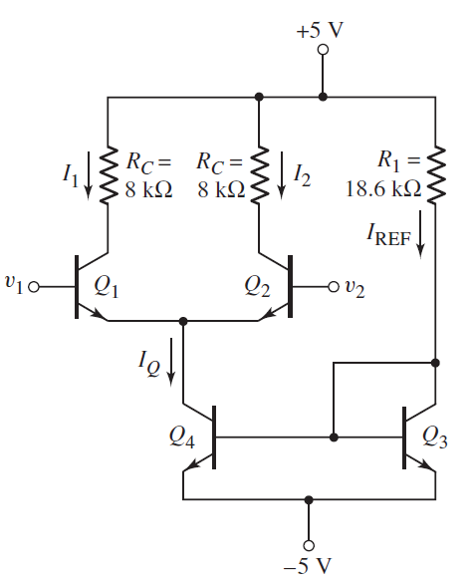
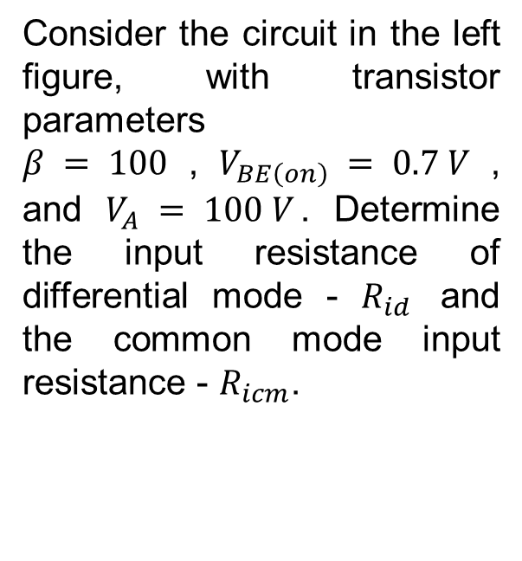
Consider the circuit in the left figure, with transistor parameters $β = 100$,$V_{BE\left(on\right)} = 0.7 V$, and $V_{A} = 100 V$. Determine the input resistance of differential mode - $R_{id}$ and the common mode input resistance - $R_{icm}$.

Slide 27
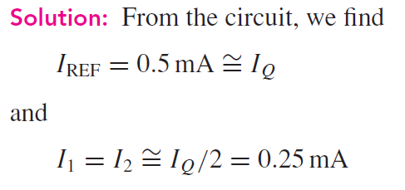
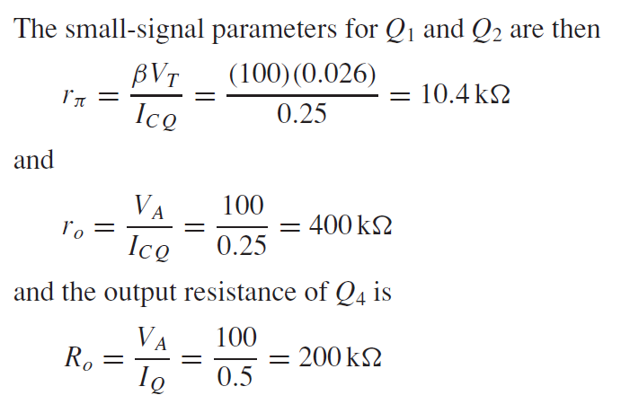

Slide 28
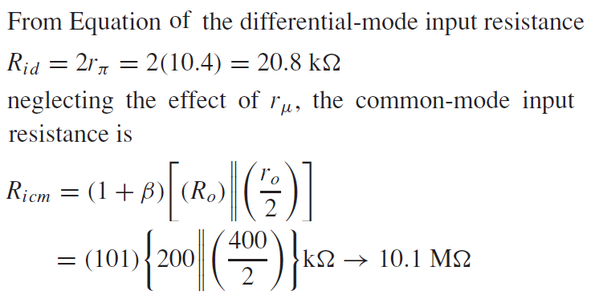

Slide 29
Electronic Circuits and Systems EEE211
Generally, there are two basic amplifier design technologies: the bipolar technology, which uses npn and pnp bipolar junction transistors; and the MOS
technology, which uses NMOS and PMOS field-effect transistors. We showed that
bipolar transistors have a larger transconductance than MOSFETs biased at the same current levels, and that, in general, bipolar amplifiers have larger voltage gains. We also showed that MOSFET circuits have an essentially infinite input impedance at low frequencies, which implies a zero input bias current.
These advantages of the two technologies can be exploited by combining bipolar and MOS transistors in the same integrated circuit. The technology is called BiCMOS.
BiCMOS technology is especially useful in digital circuit design, but also
has applications in analog circuits.

Slide 30
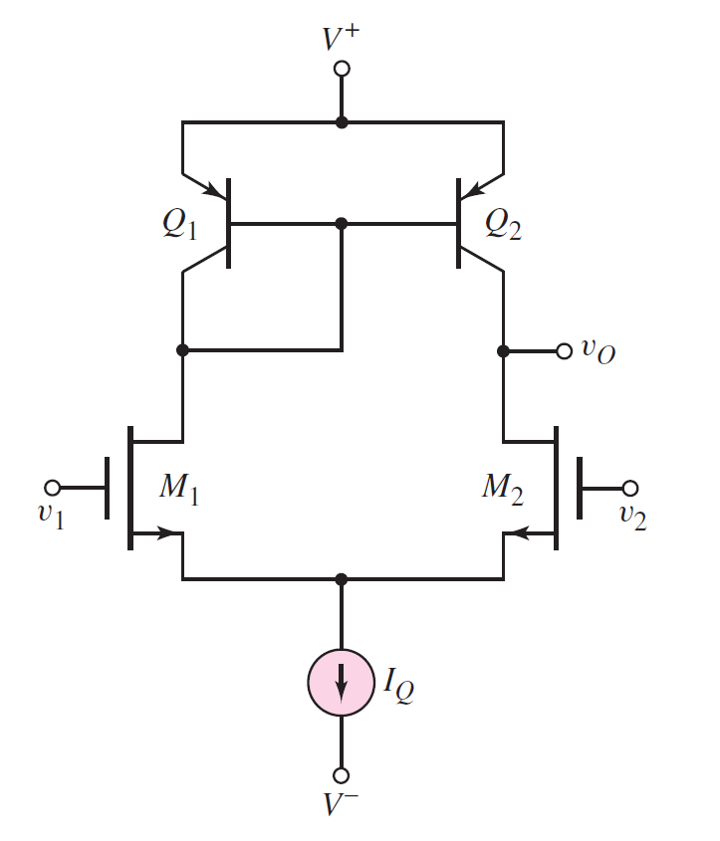
Electronic Circuits and Systems EEE211
A basic BiCMOS differential amplifier, with a constant-current source bias and a bipolar active load, is shown in the figure left. Again, the primary advantages are the infinite input resistance and the zero input bias current.
One disadvantage of a MOSFET input stage is a relatively high offset voltage compared to that of a bipolar input circuit. Offset voltages occur when the differential-pair input transistors are
mismatched. (be discussed later)

Slide 31
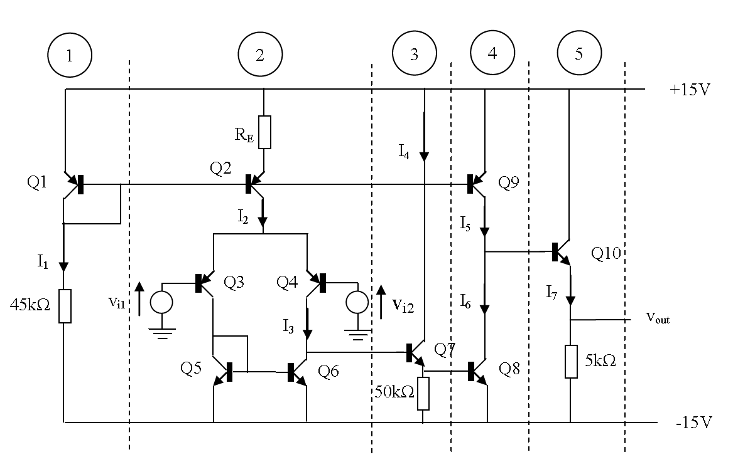
Electronic Circuits and Systems EEE211
Multi-Stage Circuit Analysis & Design
Stage 1 is the bias reference section of a current mirror formed with Q2 and Q9
Stage 2 is a differential amplifier with active load that provides voltage gain.
Stage 3 is an emitter-follower circuit forming an impedance matching buffer between stages 2 and 4
Stage 4 is a common emitter amplifier with current mirror load that contributes significantly to the overall
voltage gain..
Stage 5 is a common collector amplifier forming a low/medium impedance output.

Slide 32
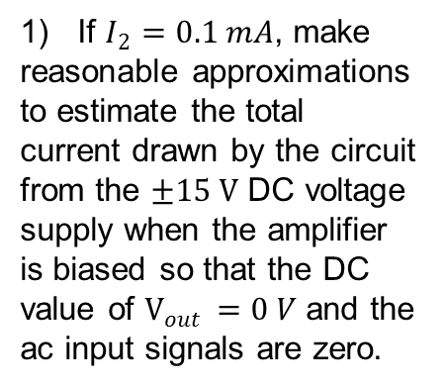
Electronic Circuits and Systems EEE211
Multi-Stage Circuit Analysis & Design – Q1
1) If $I_{2}=0.1 mA$, make reasonable approximations to estimate the total current drawn by the circuit from the $±15 V$ DC voltage supply when the amplifier is biased so that the DC value of $V_{out }=0 V$ and the ac input signals are zero.

Slide 33
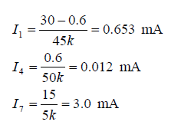
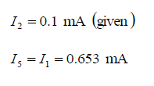
Electronic Circuits and Systems EEE211
Multi-Stage Circuit Analysis & Design – Q1

Slide 34
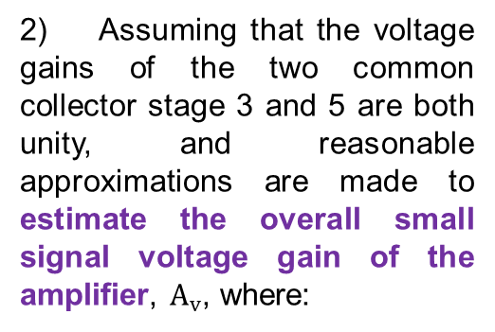
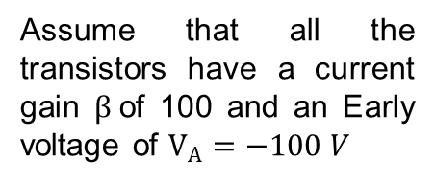
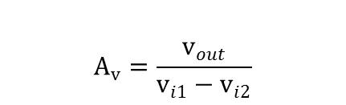
Electronic Circuits and Systems EEE211
2) Assuming that the voltage gains of the two common collector stage 3 and 5 are both unity, and reasonable approximations are made to estimate the overall small signal voltage gain of the amplifier, $A_{v}$, where:
$$A_{v}=\frac{v_{out}}{v_{i1}−v_{i2}}$$
Assume that all the transistors have a current gain $β$of 100 and an Early voltage of $V_{A}=−100 V$

Slide 35
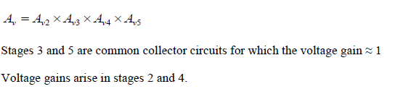
Electronic Circuits and Systems EEE211

Slide 36
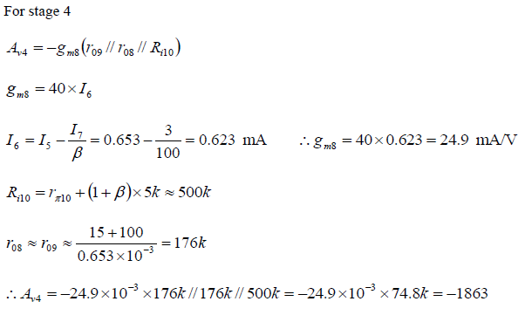
Electronic Circuits and Systems EEE211

Slide 37
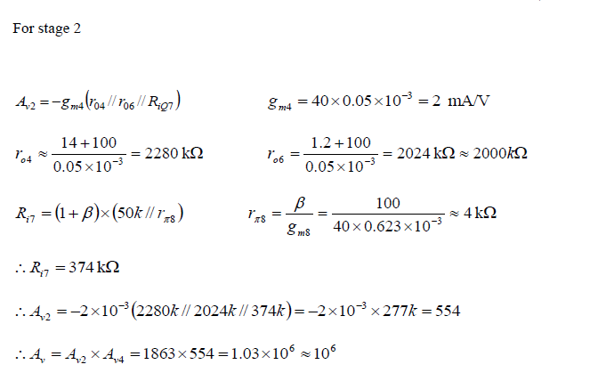
Electronic Circuits and Systems EEE211

Slide 38
Electronic Circuits and Systems EEE211
In this lecture we have seen:
How the current mirror circuit is able to create a temperature compensated current source and how the basic circuit can be easily adapted to provide a number of separate sources with a range of output currents.
How the range of currents produced by the basic current repeater circuit can be extended with the Widlar circuit without the need for large value resistors, making it particularly suitable for use in integrated circuits.
How the performance of the basic long-tailed pair differential amplifier circuit can be improved by replacing the emitter resistor (the ‘tail’) with a current mirror.
How an active load can be used to produce a high gain differential transconductance amplifier.

